Slide 1
How much Water does it take to Run a Business?
David M.. Boje
Western Carolina University Climate Panel

Slide 2
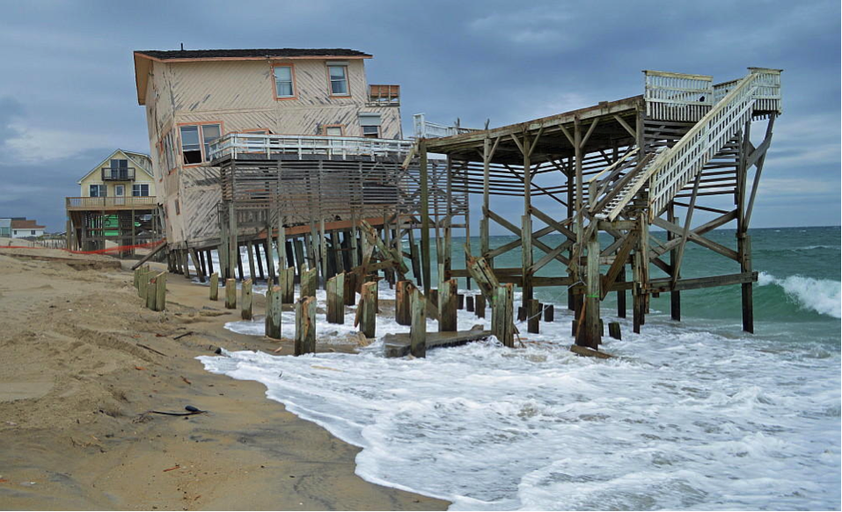
What does Climate Change Look Like?

Slide 3
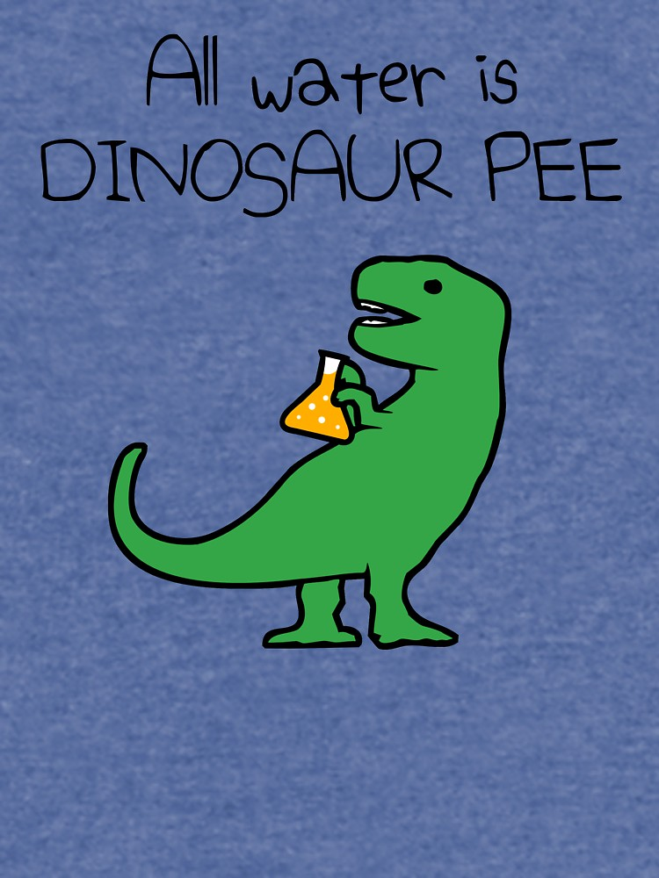
Notes:
Question: Why is all Water Dinosaur Pee?
By 2025 UN predicts 66% of world’s people will live in countries with high water stress & about 25% of people will be living in countries or regions with absolute water scarcity
• Unsafe water kills 200 children every hour
• Water intensified industry, including some large bottled water companies, paid for a study showing demand for water will outstrip supply in the world by 40%
• More than 60,000 chemicals are used in the US, but only 91 contaminants are currently being regulated by the Safe Drinking Water Act; no chemicals have been added to that list since 2000
• National Resource Defense Council did 4-year test of 103 bottled water, & found that 1/3rd contained bacteria & other chemicals exceeding industry standards
• 1/3 what the world spends on bottled water in one year could pay for projects providing water to everyone in need
• There is an estimated 326 million trillion gallons of water on earth, but less than 1% of water can be used as drinking water
• Water covers 70.9% of Earth’s surface of which 97% is saltwater, but only 0.03% is freshwater
• 68.7% of the freshwater on Earth is trapped in glaciers, and inaccessible
• 30% of freshwater is in the ground, but much of it too deep to pump to surface
• Agriculture accounts for about 70% of global freshwater withdrawals (up to 90% in some fast-growing economies).
• About 6,800 gallons of water is required to grow a day's food for a family of four
• Water makes up about 66% of the human body; 70% of the human brain

Slide 4
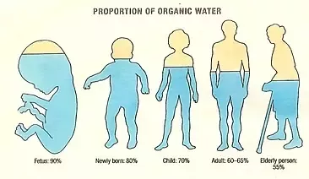
Notes:
By 2025 UN predicts 66% of world’s people will live in countries with high water stress & about 25% of people will be living in countries or regions with absolute water scarcity
• Unsafe water kills 200 children every hour
• Water intensified industry, including some large bottled water companies, paid for a study showing demand for water will outstrip supply in the world by 40%
• More than 60,000 chemicals are used in the US, but only 91 contaminants are currently being regulated by the Safe Drinking Water Act; no chemicals have been added to that list since 2000
• National Resource Defense Council did 4-year test of 103 bottled water, & found that 1/3rd contained bacteria & other chemicals exceeding industry standards
• 1/3 what the world spends on bottled water in one year could pay for projects providing water to everyone in need
• There is an estimated 326 million trillion gallons of water on earth, but less than 1% of water can be used as drinking water
• Water covers 70.9% of Earth’s surface of which 97% is saltwater, but only 0.03% is freshwater
• 68.7% of the freshwater on Earth is trapped in glaciers, and inaccessible
• 30% of freshwater is in the ground, but much of it too deep to pump to surface
• Agriculture accounts for about 70% of global freshwater withdrawals (up to 90% in some fast-growing economies).
• About 6,800 gallons of water is required to grow a day's food for a family of four
• Water makes up about 66% of the human body; 70% of the human brain

Slide 5
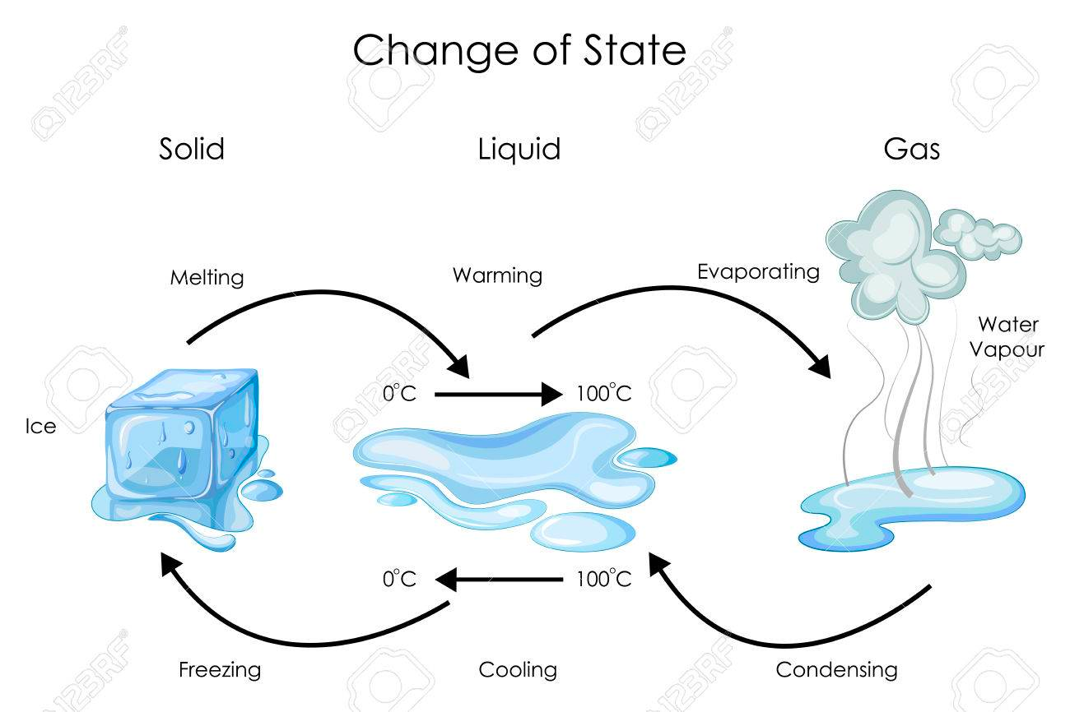

Slide 6
Duke Energy to hand out bottled water in North Carolina after wells polluted
US is largest consumer of bottled water in the entire world
50 Billion water bottles/year US
Notes:
FACT: US is largest consumer of bottled water in the entire world: 50 billion single-use plastic water bottles,
GETS WORSE: 250 Billion beverage bottles made of plastic sold in USA, 69% go to landfill
USA=> 8.6 billion gallons a year in 2017; Average US consumer 21 gallons a year
Bottled water costs consumers 3 to 7 times more water in production than tap water & costs 1,000 times more
50 billion bottles of water in plastic sold in US each year.
They say 23% recycled, most of other 38 billion single use bottles make their way to the ocean
In 1999 Charles Moore found 6 times more plastic than plankton, by 2008 it was 46 times more, a huge increase
rPET is the new storytelling of how to make plastic beverage drinks healthy for people & planet
But the the plastic fiber in rPET breaks down, putting microplastics, and then nanoplastic particles into the water
PepsiCo says its consumers are INDIFFERENT to plastic effect on health and ecology, so it refuses to put post-consumer content on its labels
This goes back to Water=Desire is being manipulated by advertising
Poland Springs water does not come from Poland Springs, Maine, not much of it, less than 30%, and its mostly well water that is being mislabeled as spring water.
Looking at the places Nestle (owner of Poland Springs, Arrowhead Mountain, etc) sinks their wells, much of it is in draught areas
In Texas, so far, its in areas not hit by drought.

Slide 7
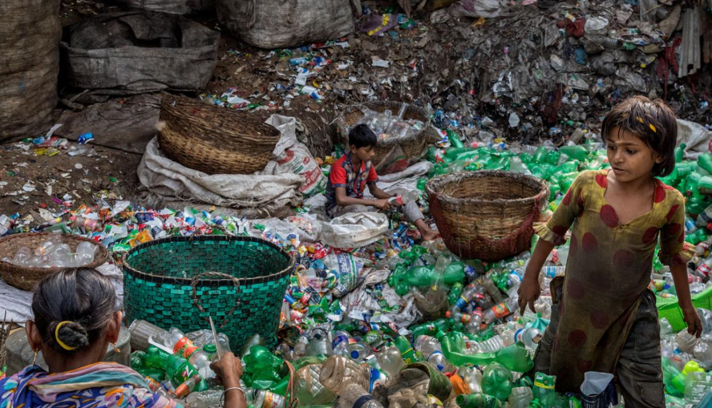
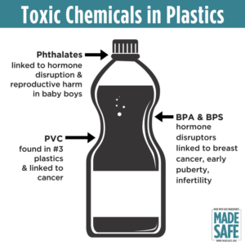
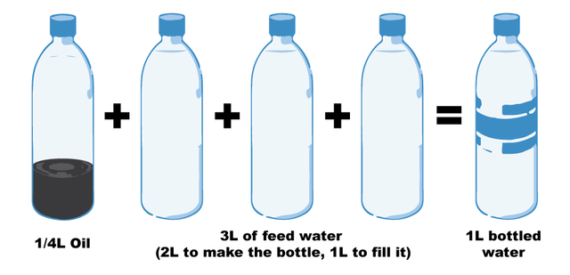
Notes:
Fill a plastic water bottle 25% with OIL to illustrate how much oil it take. https://www.portlandoregon.gov/sustainabilityatwork/article/535746
USA consumes 50 billion plastic water bottles a year, 23% head to recycling, but 38 billion don’t go to recycling, and then only about 9% actually gets recycled, because China is no long taking them, and because it costs $$$ to sort the bottles, shred them, wash them, heat them to sanitize, then melt into pellets and sell to beverage companies
Billions of gallons of water are used to make the Billions of gallons of water in water bottles ( feed waters 3 to 1 final bottle of water)
50 billion USA plastic water bottles is 17 million gallons of oil. It takes 6,000 megajoules of electricity for each barrel of oil, and with all the oil for 40 billion bottles that is 106 billion megajoules of electricity, which is how the 25% oil calculation is based on.
OUR PROBLEM TO BE SOLVED GETS WORSE: 50 billion USA plastic water bottles, is small part of the 250 billion BEVERAGE bottles with juices, sodas, etc. in them
WORLDWIDE: USA is 50 billion plastic water bottles, but world total is 500 Billion, and that means five times that in Total World Beverage plastic bottles
PROBLEM GETS WORSE AGAIN: Most are made of PET –Polyethylene Terephthalate and that has BPA in it.
https://www.madesafe.org/avoid-toxic-chemicals-plastics/
BPA stands for Bisphenol-A and it is a carcinogen, cause low sperm count in boys, and early puberty in girls. PBA is endocrine disruptor.
BPA has been a resin to make plastics clear and strong since the 1960s. https://www.mayoclinic.org/healthy-lifestyle/nutrition-and-healthy-eating/expert-answers/bpa/faq-20058331
It is not just making plastic bottles, but coats the insides of beverage cans, and used to make epoxy.
The FDA does not regulate it, saying low levels of BPA are SAFE to use in foods, and of no harm to human body. But Mayo Clinic says cut back on plastic bottles, and on metal cans (coated in BPA), for your good health life.
PROBLEM GETS WORSE: BPA has phthalates, and FDA refuses to regulate them either. Phthalates are industrial chemicals are binding agents, and to soften plastic, make it clearer and more durable.Also used in cosmetic consumer products. https://www.fda.gov/cosmetics/productsingredients/ingredients/ucm128250.htm Phthalates however do cause reproductive, liver, kidney, and lung problems in human beings. See Canada https://noharm-uscanada.org/issues/us-canada/phthalates-and-dehp Guardian https://www.theguardian.com/lifeandstyle/2015/feb/10/phthalates-plastics-chemicals-research-analysis
CDC recommends further study, FDA says its safe to consume, but others say health hazard https://www.theguardian.com/lifeandstyle/2015/feb/10/phthalates-plastics-chemicals-research-analysis. 2008 Henry Waxman bill did ban phthalates in some baby products
BUT the science says phthalates linked to asthmas, attention-deficit disorder, breast cancer, Type II diabetes, autism, and male fertility disorders. Watch the milk because a lot of plastic tubes are used in milking machines, and the phthalates make their way into even glass bottles of milk.
rPET is recycled PET https://earthhero.com/whats-the-deal-with-rpet/ Good news it uses 75% less energy to make rPET, less resource extraction, less CO2,
BUT ITS NOT A PERFECT SOLUTION TO NANOPLASTIC POLLUTION
The rPET, has microfibers, and with each washing, or swallow, it goes into the water, and these break down into microplastics, then into nanoplastic particles, which circulate in the water cycle with the PET nanoplastic particles, and it take 500 years to degrade, and that means all the plastic every made (except some incinerated) is still here, and worse problem, that are a lot of other plastics, and they break down to nanoparticles and head into food chain, so the water cycle gets more and more contaminated.
BOTTOM LINE
Our desire for plastic has change our Self. Other contaminants stick to the plastic and circulate in the water cycle, and the food chain, and that means plastic water and beverage bottles is a huge contributors to the human activities changing the global water cycle, and changing the Self of Water=Desire, Water=Life, Water=Memory, Water=Spirit, and Water=Matter but also means we are in Water-Denial, so Water=$$$
Plastic is a waste byproduct of petrochemical manufacturing. The oil industry had to get rid of the waste, so making it into plastic was how to do that, now we are past peak oil, and past three water peaks, and Water=Desire (our Ego manipulated by marketing hype) is causing an evolutionary change in the Self, so instead of an authentic Self, we have the Self as Desired by DuPont (inventor of plastic), and by Nestle, Coke, and PepsiCo (and their imitators). This is why Boje says in his books we are in a culture of denial, as marketing sells us a new self, and corporate lobbies corrupt agencies like FDA, or defang the EPA, and fund the campaigns of political leaders with PAC meney, as the corporation became a legal person, then its PAC money declared free speech act in political elections, while a human citizen ahs a limit in USA of $2,500.
All this boils down to Water=Desire is a corruption of Water=Spirit (Radah, mistranslated from the Hebrew in King James bible 1611, and used to by Francis Bacon soon after to make scientific method about subduing and domination of nature as an improper translation of ‘dominion’ and this became a political ideology in the 1970s e.g. James Watt, Secretary of the Interior to Reagan, said “After the last tree is felled, Christ will come back”
In sum bad bible translations of Radah are now being corrected so that it means ‘caring for creation’ and ‘stewardship, but the damage will take generations to undo, and by then the science says the water cycle will be destroyed. I.E. By 2030 global water demand will be 40% greater than it is today (McKinsey Report). By 2030 40% of world’s population will lack access to safe, sanitary water, in 2030 there will need 60% more fresh water to support demand than we have today in the water cycle. The developing nations are increasing water withdrawals by 50% and 18% in developing nations. In short, the fresh water system, if it were a bank, has more withdrawals than deposits, and is bankrupt!
https://www.waterlogic.com/en-us/resources-blog/world-oceans-day-plastic-pandemic/ for ocean impact
WATER sourced in a State, is NOT subject to FDA jurisdiction. And see Documentary Tapped – only one person works in FD WITH JOB OF OVERSEEING BOTTLED WATER INDUSTRY.
https://www.isitbadforyou.com/questions/is-ozarka-water-bad-for-you
Nestle says ‘Water is NOT a Human Right!’ https://www.nestle-watersna.com/en/bottled-water-brands/ozarka/ozarka-water-quality-report
Bottled Water Leaches dangerous chemicals into what you drink.
Most plastic bottles end up in the land fill
USA consumes 50 billion plastic single use bottles a year, and 77% are not recycled, much of the ones that are, are down-cycled to making polyester shirts, or rugs.
Since plastic invented, and took off in 1950s, then in bottled water in 1970s, we have 9.2 billion tons of it, and more each year than the prior year, and ALL OF IT STILL HERE. Of the 9.2 billion tons, 6.2 billion tons of plastic never reaches the recycling bin, and that which does, most of that is not actually being recycled.
Oil companies had waste gas, ethylene to get rid of, so plastic

Slide 8
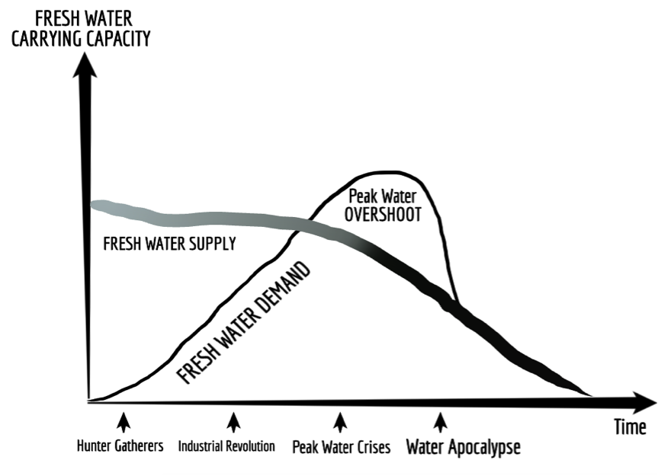

Slide 9
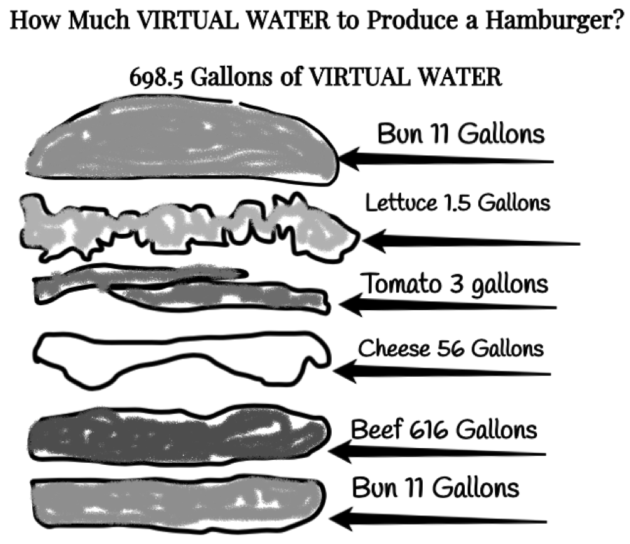

Slide 10
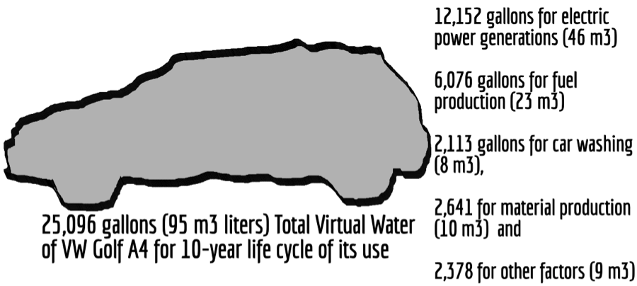
How Much Virtual Water to Produce a Car?
Notes:
Business Product Virtual Water Footprint[1]
Car 13,737 – 21,926 gallons
Leather Shoes 3,626 gallons
Smart phone (mobile) 3,190 gallons
Bed Sheet (cotton) 2,839 gallons
Jeans (cotton) 2,108 gallons
T-shirt (cotton) 659 gallons
One litre of bio-diesel fuel from soybeans uses 14,000 gallons of water
· One litre of bio-ethanol from maize uses 2,600 gallons of water
· One litre of bio-ethanol from sugar beet uses 1,400 gallons of water
· One litre of bio-ethanol from sugar cane uses 2,500 gallons of water
· One car uses 39,090 gallons of water in the entire business supply chain
· One ton of steel uses 62,000 gallons of water to produce it
· One ton of cement uses 1,360 gallons of water to produce it
· One cell phone uses 240 gallons of water to produce it
· One pound of plastic uses 24 gallons of water to produce it
· One single use plastic for water or soda uses 1.85 gallons for the plastic, and the water in has a virtual footprint that is
· One pound of synthetic rubber uses 55 gallons of water to produce it
· One cotton T-shirt uses 650 gallons of water to produce and transport it
· One pair of blue jeans uses 2000 gallons of water to produce and transport it

Slide 11
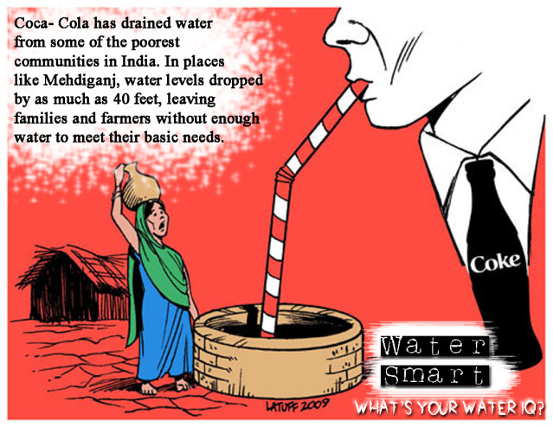

Slide 12
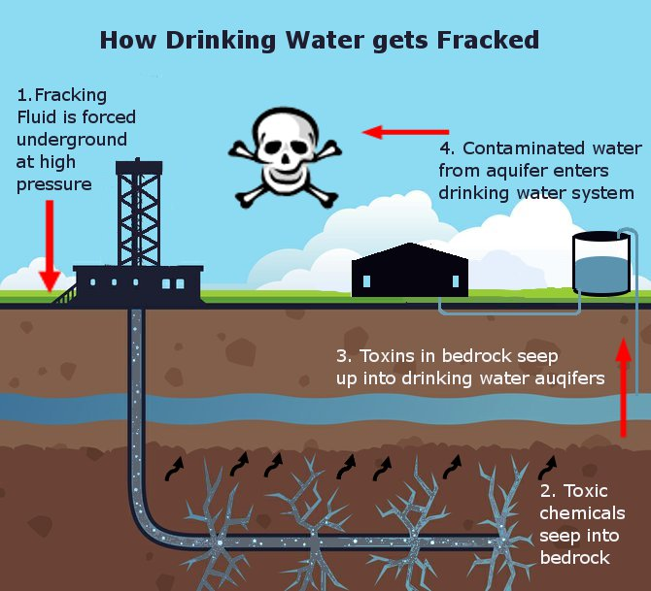
Notes:
https://s3-us-west-1.amazonaws.com/lifeionizers.com/media/blog-images/Fracked.jpg
http://frackingfact.com/fracking_refs.html#contaminated
The fracking industry storytelling is it does not affect aquifers, but the counternarrative is to drill to frack means drilling through aquifers, the well can crack, the deep storage wells can crack and split, crumble and leak.
The problem in the water cycle is major because, the evaporation enters the water cycle, the leaked ground water enter the water cycle, the recycled wastewater sprayed on roads enters the water cycle, the leaking fracking-water into neighboring ground wells, enters the water cycle. Once the water cycle is contaminated, the water enters tap and bottled water. Some fracking wastewater is sued in agriculture, and that also enters the water cycle through drainage, evaporation, and transpiration processes
The industry sponsored sciences, says not a concern
The non-industry sponsored sciences, say yes a big concern
From a creation care standpoint, what do you think?

Slide 13
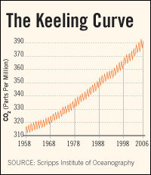
Empirical evidence:
Collapsing aquifers,
60% die-off of marine life in last few decades,
Deforestation,
Desertification,
Bioaccumulation of carcinogenic toxins, and
Keeling’s Curve of CO2 Climate Change summarily ignored by those in Water=Denial
Notes:
The quantum tunneling of water occurs when water molecules in nanochannels exhibit quantum tunneling behavior that smears out the positions of the hydrogen atoms into a pair of corrugated rings. In that state, the water molecules become delocalized around a ring and assume an unusual double top-like shape.
The bottled water part is a joke sort of being played by https://www.quantumpcr.com/ https://www.terrawellnessok.com/12_pk_quantum_cbd_h20
It is water, it is for sale, but not really quantum in the scientific sense of the term
“QUANTUM PCR H2O uses a broad spectrum, hemp derived formula to provide CBD along with additional active cannabinoids and terpenoids providing maximum efficacy with a unique and familiar flavor profile”
See Roberto Car from Princeton University, “Quantum Physics in a Glass of Water” https://www.youtube.com/watch?v=SXqDhu4AEF8
https://www.livescience.com/62708-water-two-kinds.html
Second company -- http://www.quantumagua.com/quantum_en.html Quantum Water --- Quantum is derived from the springs deep within the mountains of the Juan Castro Blanco Water National Park of Costa Rica. The sedimentary rocks act as a natural filtration system, controlling the levels of acidity and minerals creating an ideal PH7.+. Quantum is not chemically processed in any way. We at Quantum know that what you drink is just as important as what you eat. This clean, crisp water will keep you hydrated and refreshed. Premium water created by nature and brought to you by Quantum.”
See Youtube “Water and Quantum Physics; The Perfect Couple” https://www.youtube.com/watch?v=sVIX3fnTCg0 by Marta from

Slide 14
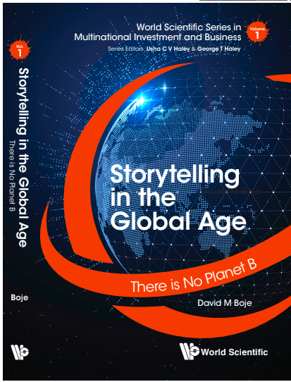
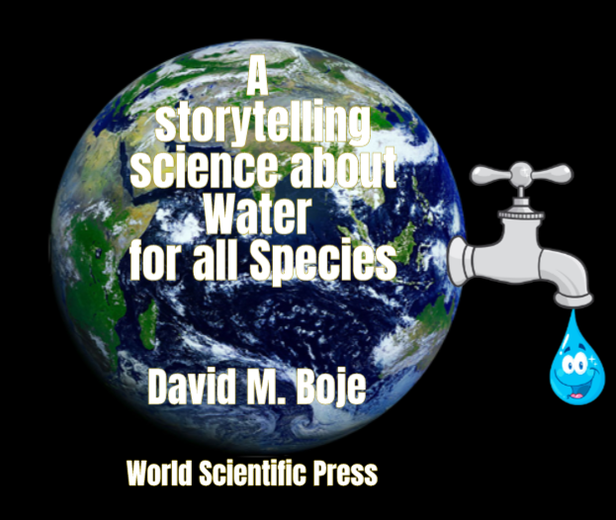
Thank You: Any Questions?
Download Conversational Storytelling book and slides for this presentation at
https://davidboje.com/wcu
Notes:
If you have and comments or questions contact me at davidboje@gmail.com
Thank you

