Slide 1
TRUE STORYTELLING™
Train-the‑Trainers
Level II — Session 7
TRUE STORYTELLING INSTITUTE TSI ®

Slide 2
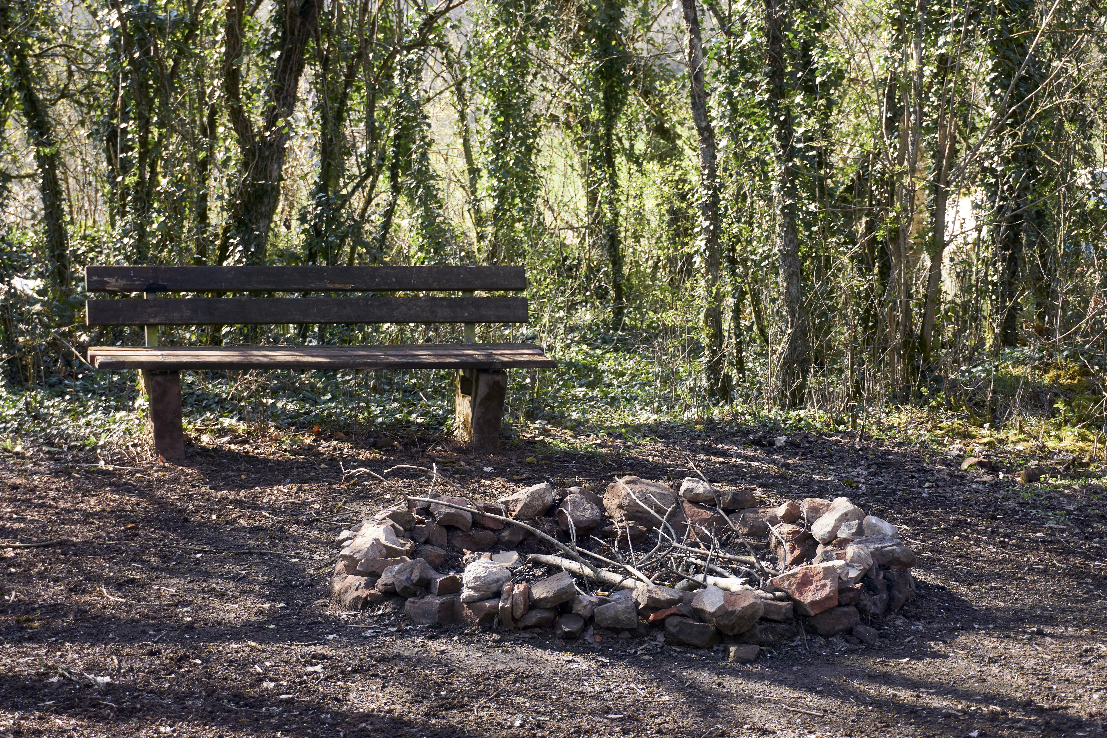
PRE-
SESSION
“COFFEE
in the LOBBY”
Notes:
ROADMAP: Lena
Last Week:
Principle 1 True
This week:
Principle 2 Making Room
and
Nuts and Bolts

Slide 3
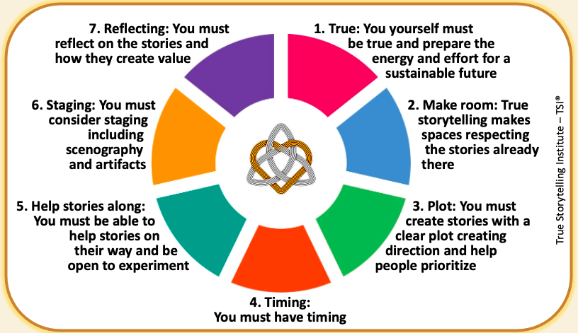
ROADMAP
Last Week:
Principle 6 –
Staging &
Between
Hearts
This week:
Principle 7 –
Reflection & BEYOND
Nuts and Bolts Training
Notes:
ROADMAP: Lena
Last Week:
Principle 1 True
This week:
Principle 2 Making Room
and
Nuts and Bolts

Slide 4
Groundrules
Please bring a notebook and pen/pencil to each session.
Use the “Gallery View” so you can see each other while viewing PowerPoint.
Please do not give advice to others or use ‘should’ statements for self or others.
Speak more from the heart than from the head.
Laser in, be concise, and share only one story
instead of several.
CONFIDENTIALITY:
Do not tell someone else’s story. Please DO NOT record any session of the presenters or the participants.
Please use Chat
ONLY when asked to do so. Avoid “side talk.”
Please attend all sessions. If you must miss one, contact us so we can help you to catch up before you return.

Slide 5
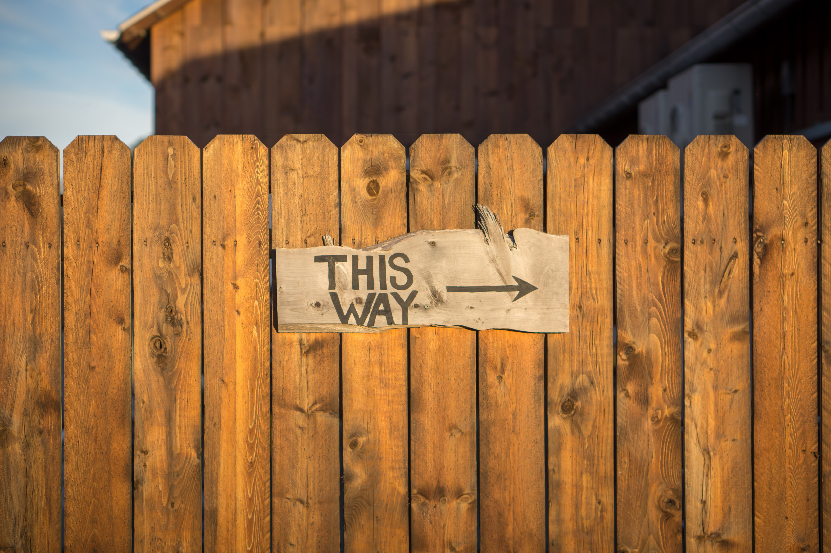
Agenda for Today
PART I Check-In of Group & ROADMAP
PART II NUTS & BOLTS – ‘’Reflection”
PART III Introduce Principle 7
Reflection & Guiding
PART IV Pre-Reflective BEYOND-♥
PART V Your 3-minute films
(carrying over into “Lobby”)
PART VII GRADUATION! & Next Steps
Notes:
PART I Check-in of Group Members; Roadmap: Lena
PART II Homework from Session 4: Lena
Part III Nuts & Bolts: Demonstrating for Breakouts: Grace Ann
PART IV Introduce Principle 5 Helping & Guiding: Jens
PART V ReStorying: David
PART VI ReStorying: Karin
PART VII Breakout&Debrief: Lena
PART VIII Homework & Masters Class: David
PART IX Post-Discussion “Lobby,” Q&A: Jim

Slide 6
PART III — NUTS & BOLTS
LAST WEEK: STAGING and Memory Aids
– 6X6 role; 18 points font
– Material Objects, Nature, Music, Art
– Use Physical Objects, Quasi-Objects, Action
Holmberg’s error; Traffic Stop Story
THIS WEEK: Reflection - WHICH Mirror?
– Introspection/Self-Reflection
* Internal/External Attribution
– Others: Johari Window
* Public, Hidden, Blind, Unknown
– Let a Horse Be Your Mirror
– Actual Mirror / Film

Slide 7
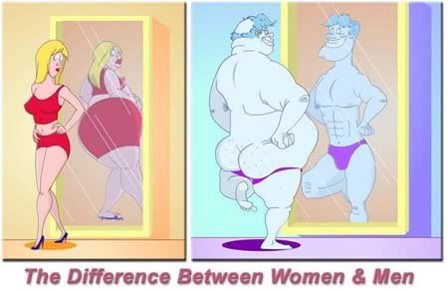
REFLECTION
Notes:
With IWOK, PLACE is more important than TIME

Slide 8


Principle 7: Reflect
You must reflect on the stories & how they create value
8
Notes:
Helping stories along, be open to experiment – local community, future audience, on the road nationally exhibitions, network internationally exhibition
You must consider STAGING including SCENOGRAPHY and ARTIFACTS

Slide 9

The BEYOND process of fore-grasping
Study Guide for BEYOND-heart Fore-grasping
Notes:
Story: I have been dong muscle-testing daily since I met Grace Ann Rosile. We use it with horses, and to get pre-reflective embodiment answers to yes/no questions. It is how I attune to space, the subject of the 2nd Masters Class.
QUESTION: What is Space?
“Space is not the setting (real or logical) in which things are arranged, but the means whereby the position of things becomes possible. This means that instead of imagining it as a sort of ether in which all things float, or conceiving it abstractly as a characteristic that they have in common, we must think of it as the universal power enabling them to be connected” (Merleau-Ponty, 2012: 284). https://voidnetwork.gr/wp-content/uploads/2016/09/Phenomenology-of-Perception-by-Maurice-Merleau-Ponty.pdf
We trace out our spatial relations to understand sustainability. A reflection on “space as the indivisible system governing the acts of unification performed by a constituting mind” (Merleau-Ponty, 2004: 284).
In True Storytelling, space-attunement is very practical. “What counts for the orientation of the spectacle is not my body as it in fact is, as a thing in objective space, but as a system of possible actions, a virtual body with its phenomenal ‘place’ defined by its task and situation. My body is wherever there is something to be done” (Merleau-Ponty, 2004: 291). We inhabit the virtual-spectacle that the Nature of things in their visual, auditory, tactile fields (spaces) already pre-constituted. Welcome to antenarrative processes.
The body is an ensemble of entanglements and relationships to our environment, already-there, constituted, shifting, unfolding, and changing, in-action, in circuits of existence of our habits of Being-in-the-world of place already-there.
Nature be always already (forestructuring BETWEEN) implicated in human projects (in spacetimemattering), and of human projects as already implicated/entangled in nature (BEYOND in our attunements). Nature is therefore already part of True Storyteling. We are already embedded in-Nature, entwined in ontology of Nature. We are already embedded in attunement-Nature. That is the very definition of quantum storytelling, to attune to vibrant energy mattering.
Unlike the 5 senses of sensemaking of the rational/empirical/intellectual/cognitive BENEATH-Heart, we are entangled already in the BEYOND-Heart of Nature. This is why IWOK is a very different attunement than WWOK.
Background: Merleau-Ponty argues for a Phenomenology of Perception book draws on biophysical responses are pre-reflective
Word attunement (aka Mood) comes from Martin Heidegger’s Being and Time book
Merleau-Ponty has a pre-reflective embodied reflection, whereas Heidegger’s 10 attunements are to our entanglements and uncoverings of Being-in-the-world
Attunement to the quantum field energies of our existence is through the body, our embodiment Nature
Muscle-testing energy work is a good example
Muscle testing is a holistic technique derived from the field of Kinesiology
For more see → https://discoverhealing.com/muscle-testing-energy-healing/
e.g. Straight Arm Muscle-Test
Hold your arm straight out in front of your body and ask yourself a question like “should I drink this cup of coffee?” or “would this supplement be advantageous to my body?” If your arm feels a bit weaker when you ask a question like this, the answer is ‘no’, whereas a strong, stable arm represents a positive, ‘yes’ answer.
e.g. Whole Body Stress Muscle-Test
Before you pour your third cup of coffee or bite into that apple, hold the cup or fruit in your hand. Be hyper aware of how your body responds; if you subtly sway forward, this indicates a ‘yes’ or strong response. If your body subtly sways backward, however, this indicates a ‘no’ or negative response and signals that your particular item won’t benefit you.
Take a deep breath, let it out, and try to relax your body completely. Then ask yourself a yes or no question, and see how embodiment answers.
10 Tips for Self-test Muscle Testing https://www.youtube.com/watch?v=fw3rd6PEpFQ
We attune constantly and never have complete attunement spatially. “The primordial level is on the horizon of all our perceptions, but it is a horizon which cannot in principle ever be reached and thematized in our express perception” (Merleau-Ponty, 2004: 295).
The 4 Hearts of True Storytelling is spatialzing, as well as temporalizing. You can discern it in this quote:
“There is, therefore, another subject beneath me, for whom a world exists before I am here, and who marks out my place in it. This captive or natural spirit is my body, not that momentary body which is the instrument of my personal choices and which fastens upon this or that world, but the system of anonymous ‘functions’ which draw every particular focus into a general project. Nor does this blind adherence to the world, this prejudice in favour of being, occur only at the beginning of my life. It endows every subsequent perception, of space with its meaning, and it is resumed at every instant” (IBID. p. 296).

Slide 10
Examples of Pre-Reflective Embodiment
When REFLECTION is pre-reflective embodied performance
E.G. Steering a car into a parking place without reflection, movements are habitual in ‘Embodied Intelligence’
E.G. Learning to swing a golf club without hooking or slicing
E.G. Abduction – the Beyond of intuition that has no empiric or intellectual mooring
Experiment 1:
Duality of Object & Subject in Embodiment
Hold pen in right hand, then extend forefinger of left hand to touch the hand holding the pen.
Point: overcome duality of object (hand) and subject (hand) in embodiment
Experiment 2:
Reflexivity of touching
Press hands together at fingertips, left touching right,
then right touching left (repeat)
Notes:
Be practiced repetition of embodied actions, we perfect performance-in-action habits
In the experiments, see Russon (1993: 293) “Just as between two spatial areas the boundary is at one and the same time the end of one area and the beginning of the next, the point of bodily contact is no more subject than object… All there is is the body, and it is the living process of self-differentiation in which indeterminate horizons of expectation are projected, along which paths determinateness emerges.”
“The body is thus the point where I touch the world, where I intervene, and, equally, where the world touches me” (Reynolds, 2004: 295). We are each bodies already involved in touching nature and being touched by the world (its primordial elements: air, water, fire, earth). All we have to do is overcome the dualism of body-nature separation, and see it’s illusion by embodying situatedness. We are already making contact with the living story webs of life we indwell. Living things have embodied situated agency (Reynolds, 2004). We can be aware of our embodied nature relations and move from ego-centric to we-centric care and understanding attunements. This is a radical shift in our sensemaking (Weick, 1995) to an antenarrative process embeddedness that is pre-reflective embodiment. Body-Nature cannot continue to be a dualism if we hope to achieve sustainability.
The experiments from Merleau-Ponty’s writings are described in Reynolds (2004). I summarize them here.
What is Embodied-Nature-Reflecting
?
it's about attunements. Attunements is an existential approach to ‘care’ and ‘understanding’ and making (true storytelling) assertions). The word attunement is used by Heidegger, and developed into Embodied Nature-Reflection by French philosopher Merleau-Ponty in his final three lectures
A multispecies storytelling (Haraway, 2018) dissolves our egos. The radical desires a ’True Storytelling’ one deeper than mainstream offers, one with less self-deception, more ecospiritual wisdom, and “overcoming the forgetfulness of our death-bound nature” (Fisher, 2012: 81).
It gets back to IWOK and WWOK Reflecting-Nature. WWOK perpetuates a nature-estranged way of storytelling that deanimates nature, what Carolyn Merchant (1980) says signals the ‘death of nature.’
In Living Storytelling (Kaylynn TwoTress) ‘all things have place, time, and mind or a mind-like quality’ (p. 87) and to WOOK that is just animism — attributing spirit/soul to animals, plants, rocks, mountains, rivers, and so on). But to Cajete animism is part of Native Science (2000). Maurice Merleau-Ponty is an exception, as a non-dualistic philosopher. In IWOK Gregory Cajete (2000) has an animistic reading of the world that is without apology.
In IWOK plants are spirit-filled.
Contrast it with TS Eliot’s poem Little Gidding.
“Plants ‘know; what their place in Nature is, but do we?” (Gagliano, 2013: 2). In her book she has experiments how seeds are cared for by trees, through microbial/fungi strands passing carbon, water, and nutrients from not just mother treet, but other trees in the canopy to the seedling, and actually monitoring if the seedling needs more or less, in carious conditions.
There is a parallel to Merleau-Ponty (Phenomenology of Perception): p, 72: "the body, by withdrawing from the objective world, will carry with it the intentional threads linking it to its surrounding and finally reveal to us the perceiving subject as the perceived world."
REFERENCES
Merleau-Ponty, M. (1964). Signs. Transl. ed R. C. McCleary. Evanston, IL: Northwestern University Press.
Merleau-Ponty, M. (1969). The Visible and the Invisible, trans. Alphonso Lingis (Evanston: Northwestern University Press. https://monoskop.org/images/8/80/Merleau_Ponty_Maurice_The_Visible_and_the_Invisible_1968.pdf
Merleau-Ponty, M. (2012). The Phenomenology of Perception. Transl. ed D. A. Landes. London; New York: Routledge. https://voidnetwork.gr/wp-content/uploads/2016/09/Phenomenology-of-Perception-by-Maurice-Merleau-Ponty.pdf
Reynolds, J. (2004). Merleau-Ponty and Derrida: intertwining embodiment and alterity (No. 32). Ohio University Press.
Russon, J. (1994). Embodiment and responsibility: Merleau-Ponty and the ontology of nature. Man and World, 27(3), 291-308.

Slide 11
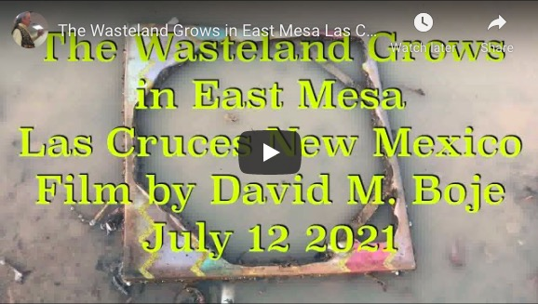
https://youtu.be/aNIbVcJY00s

Slide 12
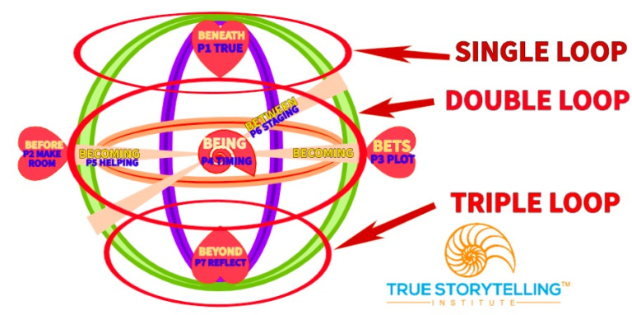
BIG PICTURE: Pre-Reflective Embodiment→ BEYOND
Notes:
QUESTION: What is the bodily grounding of True Storytelling?
Embodied Attunement comes from existential philosophy of Merleau-Ponty, who late in life worked on the problem of Nature and our Embodied Reflection getting beyond representation, into what we call grounding, in the vibrant matter (Jane Bennett, 2008), how our body quantum vibrations have what Merleau-Ponty calls CONNEXION, what quantum storytelling calls vibrant mattering energy waves, and that is what we do in attunement.
“---- Chiasm, instead of the For the Other: that means that there is not only a me-other rivalry, but a co-functioning. We function as one unique body” (Merleau-Ponty, 1969: 160).
In True Storytelling we move from the ego-centric, to the we-centric (& eco-centric), from the egoistic-BENEATH-Heart to the BEYOND-Heart of embodiment, as we are uncovering all around BEING-there, we dwell in-BETWEEN.
“…self-reflective egos capable of self-conscious rationality and moral existence is only understandable in terms of the unreflective and intersubjective habits of cultural behavior and communication which are situated in this dynamic of embodied emergence” (Reynolds, 2004: p. 295).
The Self is first and foremost, body, therefore not a mind-body separation of duality (Reynolds, 2004). True Storytelling brings embodied reflection and pre-reflective entanglement to our conscious awareness so we make good, just, true, and beautiful decisions.
See article by Boje and Rosile on intersubjectivity of humans and dogs.
Boje, D. M., & Rosile, G. A. (2019). Conversational storytelling research methods: cats, dogs, and humans in pet capitalism. Communication Research and Practice, 5(4), 309-326. Also in the conversational storytelling book (2020) and in chapter 7 of True Storytelling book

Slide 13
The 7 Principles

Slide 14
Share Feedback the videos
Content
  clear
  useful
Presentation
  Interesting
  involving

Slide 15
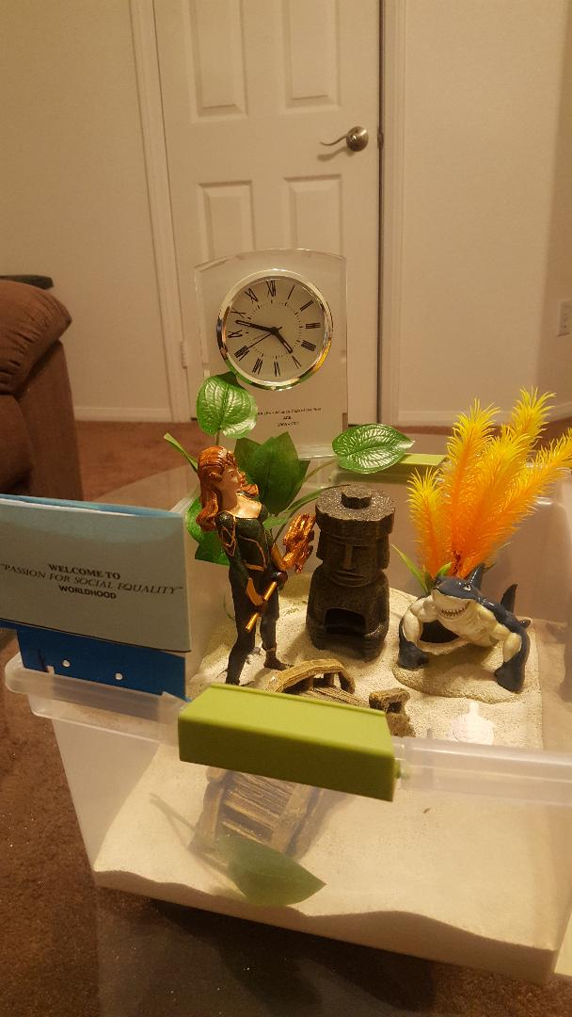
Embodied Performances 3-min presentations
BARBARA Click Here
ERNEST Click Here
RICO Click Here
OSCAR Click Here
Feedback in the Chat
REFLECT on presentation

Slide 16
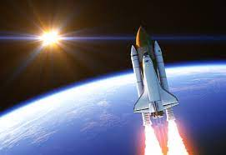
CONGRATULATIONS!
Sure a long way to go, but look how far you have come!
  Mention 1-3 ‘things’ about how space’ ready are they now.
Trainer & BEYOND
  What’s next for Oscar’s Team?
We’d love to build a spaceship with YOU
https://www.youtube.com/watch?v=Kw-_Ew5bVxs

Slide 17
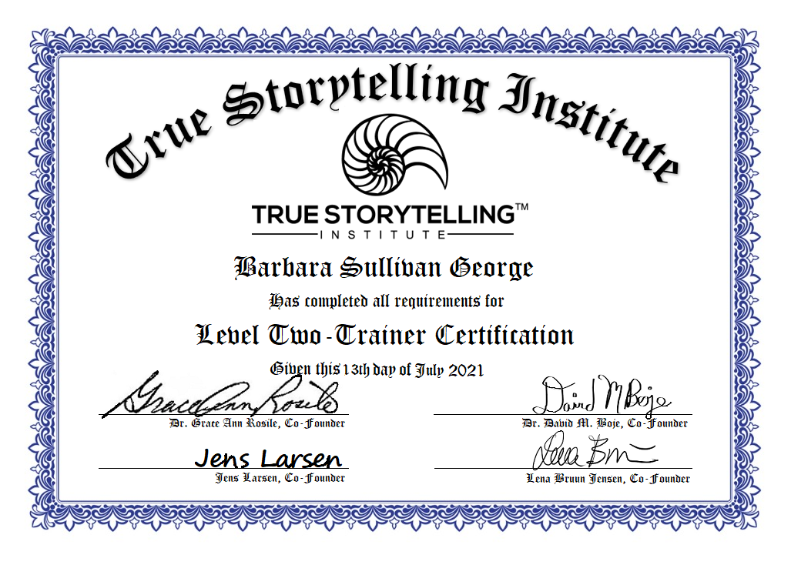

Slide 18
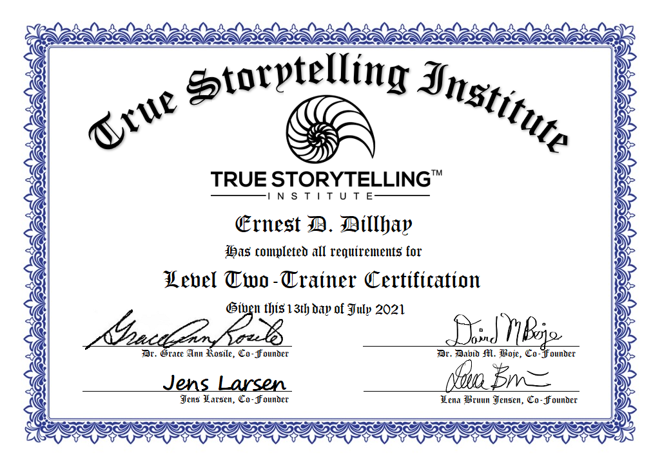

Slide 19


Slide 20


Slide 21
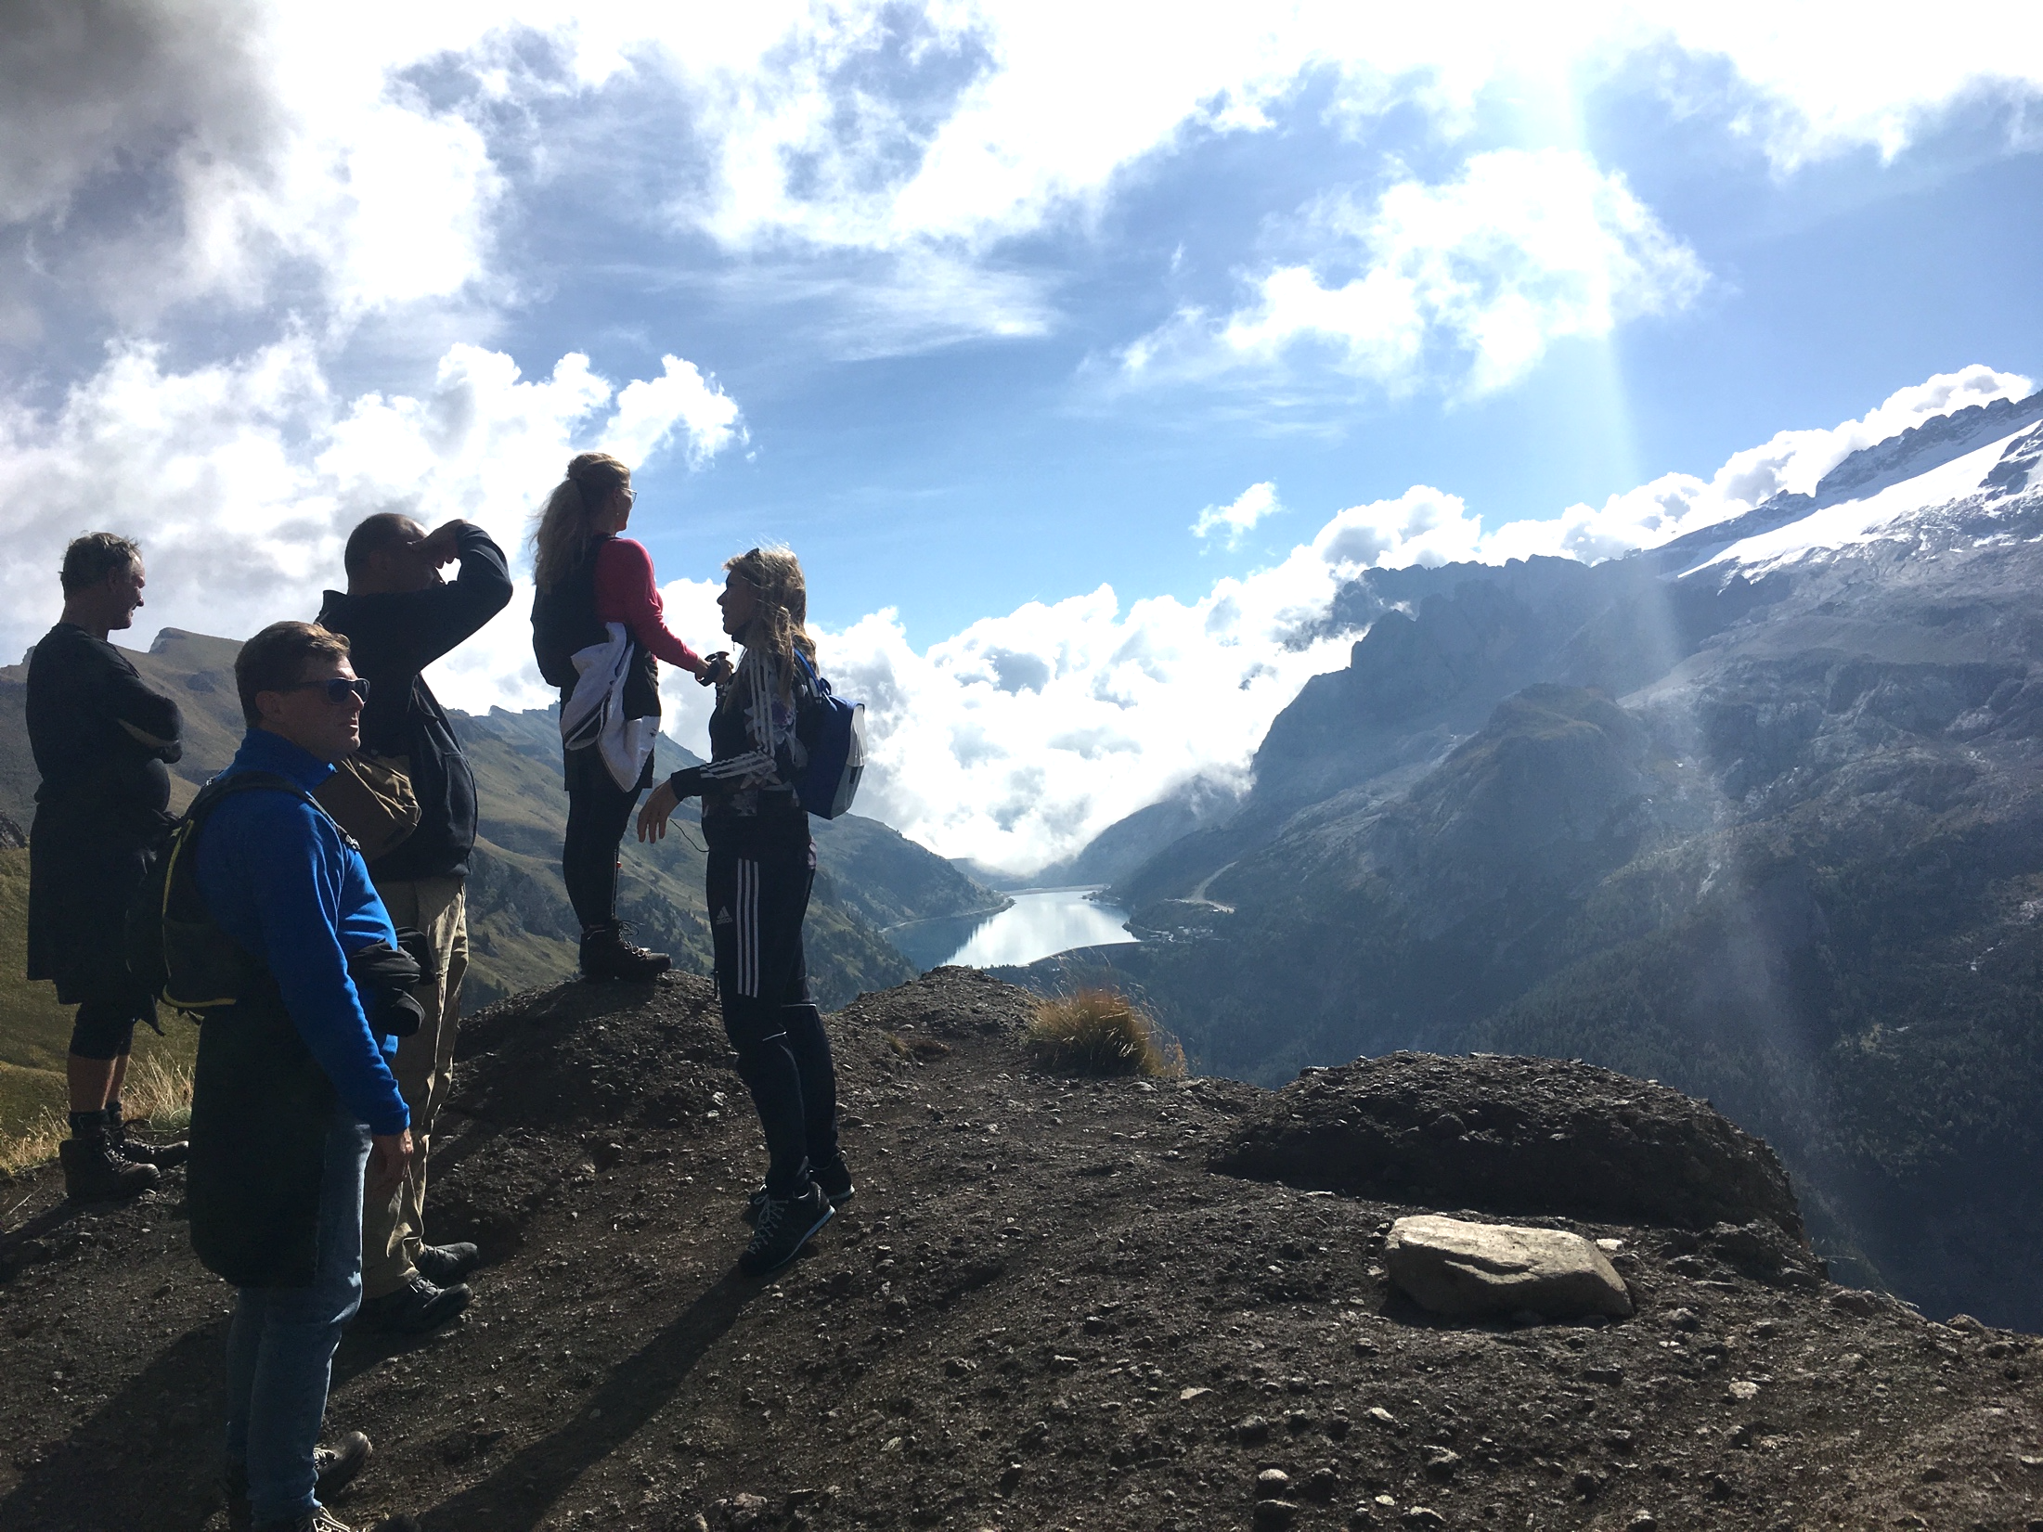
What is Next
21

Slide 22
CASCADING True Storytelling Large Group/Corporate Proposal
CSI = Conversational Storytelling Interviewing
SC = Story Circles are how the organization
Story Circles are self-directed storytelling circles
each person tells a brief (3 min) story, followed by 20
45min-1 hour per session
ReSt = Restorying follows the principles of True Storytelling
The problem is addressed with 7 steps
Fd = Foundations & Ethics module, Cohort #, Session
OD = Organization Development and Change (ODC)
Le = Leadership module, Ensemble Leadership.
Su = Sustainability module,
DEI = Diversity, Equity, Inclusion module

Slide 23
CASCADING True Storytelling Large Group/Corporate Proposal
CSI = Conversational Storytelling Interviews, used for co-exploration of problem areas as well as assessment of progress.
SC = Story Circles are how the organization maintains an ongoing approach to addressing issues through storytelling.
Story Circles are self-directed storytelling circles where participants have chosen a topic then
each person tells a brief (3 min) story, followed by 20 seconds of silence before the next person tells their story.
45min-1 hour per session
ReSt = Restorying follows the principles of True Storytelling with a more specific focus on a particular problem.
The problem is addressed with 7 steps of the Restorying process. Custom designed for specific problem issues.
Fd = Foundations & Ethics module, Cohort #, Session #, (so FD1.2 is Foundations cohort 1, session 2) 4 90 min sessions
OD = Organization Development and Change (ODC)
Le = Leadership module, Ensemble Leadership. 4 90-min sessions
Su = Sustainability module, 4 90-min sessions
DEI = Diversity, Equity, Inclusion module, 4 90 min sessions

Slide 24
Pair #, Partner# | Co | Wk 1 | Wk 2 | Wk 3 | Wk 4 | Road Map
1 1,2 | 1 | Fd1.1 | Fd1.2 | Fd1.3 | Fd1.4 | CSI
2 3,4 | 1 | Fd1.1 | Fd1.2 | Fd1.3 | Fd1.4 | CSI
3 5,6 | 1 | Fd1.1 | Fd1.2 | Fd1.3 | Fd1.4 | CSI
4 7,8 | 1 | Fd1.1 | Fd1.2 | Fd1.3 | Fd1.4 | CSI
5 9,10 | 1 | Fd1.1 | Fd1.2 | Fd1.3 | Fd1.4 | CSI
6 11,12 | 1 | Fd1.1 | Fd1.2 | Fd1.3 | Fd1.4 | CSI
7 13,14 | 1 | Fd1.1 | Fd1.2 | Fd1.3 | Fd1.4 | CSI
8 15,16 | 1 | Fd1.1 | Fd1.2 | Fd1.3 | Fd1.4 | CSI
9 17,18 | 1 | Fd1.1 | Fd1.2 | Fd1.3 | Fd1.4 | CSI
10 19,20 | 1 | Fd1.1 | Fd1.2 | Fd1.3 | Fd1.4 | CSI
11 21,22 | 1 | Fd1.1 | Fd1.2 | Fd1.3 | Fd1.4 | CSI
12 23,24 | 1 | Fd1.1 | Fd1.2 | Fd1.3 | Fd1.4 | CSI

Slide 25
Pair #, Partner# | Co | Wk 1 | Wk 2 | Wk 3 | Wk 4 | Road Map | Wk6 | Wk7 | Wk8 | Wk9 | Road Map | 11 | 12 | 13 | 14
1 1,2 | 1 | Fd1.1 | Fd1.2 | Fd1.3 | Fd1.4 | CSI | SC | SC | SC | SC |  | OD | OD | OD | OD
2 3,4 | 1 | Fd1.1 | Fd1.2 | Fd1.3 | Fd1.4 | CSI | ReSt | ReSt | ReSt | ReSt | CSI | DEI | DEI | DEI | DEI
3 5,6 | 1 | Fd1.1 | Fd1.2 | Fd1.3 | Fd1.4 | CSI | Lead | Lead | Lead | Lead |  | SC | SC | SC | SC
4 7,8 | 1 | Fd1.1 | Fd1.2 | Fd1.3 | Fd1.4 | CSI | SC | SC | SC | SC | CSI | OD | OD | OD | OD
5 9,10 | 1 | Fd1.1 | Fd1.2 | Fd1.3 | Fd1.4 | CSI | ReSt | ReSt | ReSt | ReSt |  | Su | Su | Su | Su
6 11,12 | 1 | Fd1.1 | Fd1.2 | Fd1.3 | Fd1.4 | CSI | Lead | Lead | Lead | Lead |  | SC | SC | SC | SC
7 13,14 | 1 | Fd1.1 | Fd1.2 | Fd1.3 | Fd1.4 | CSI | SC | SC | SC | SC |  | OD | OD | OD | OD
8 15,16 | 1 | Fd1.1 | Fd1.2 | Fd1.3 | Fd1.4 | CSI | ReSt | ReSt | ReSt | ReSt |  | SC | SC | SC | SC
9 17,18 | 1 | Fd1.1 | Fd1.2 | Fd1.3 | Fd1.4 | CSI | Lead | Lead | Lead | Lead | CSI | DEI | DEI | DEI | DEI
10 19,20 | 1 | Fd1.1 | Fd1.2 | Fd1.3 | Fd1.4 | CSI | Lead | Lead | Lead | Lead |  | SC | SC | SC | SC
11 21,22 | 1 | Fd1.1 | Fd1.2 | Fd1.3 | Fd1.4 | CSI | StCir | StCir | StCir | StCir | CSI | Su | Su | Su | Su
12 23,24 | 1 | Fd1.1 | Fd1.2 | Fd1.3 | Fd1.4 | CSI | ReSt | ReSt | ReSt | ReSt |  | Su | Su | Su | Su
13 25,26 | 2 |  |  |  |  | CSI | Fd2.1 | Fd2.2 | Fd2.3 | Fd2.4 | CSI | SC | SC | SC | SC
14 27,28 | 2 |  |  |  |  |  | Fd2.1 | Fd2.2 | Fd2.3 | Fd2.4 | CSI | OD | OD | OD | OD
15 29,30 | 2 |  |  |  |  |  | Fd2.1 | Fd2.2 | Fd2.3 | Fd2.4 | CSI | DEI | DEI | DEI | DEI
16 31,32 | 2 |  |  |  |  |  | Fd2.1 | Fd2.2 | Fd2.3 | Fd2.4 | CSI | SC | SC | SC | SC
17 33,34 | 2 |  |  |  |  | CSI | Fd2.1 | Fd2.2 | Fd2.3 | Fd2.4 | CSI | DEI | DEI | DEI | DEI
18 35,36 | 2 |  |  |  |  |  | Fd2.1 | Fd2.2 | Fd2.3 | Fd2.4 | CSI | OD | OD | OD | OD
19 37,38 | 2 |  |  |  |  | CSI | Fd2.1 | Fd2.2 | Fd2.3 | Fd2.4 |  | Su | Su | Su | Su
20 39,40 | 2 |  |  |  |  |  | Fd2.1 | Fd2.2 | Fd2.3 | Fd2.4 | CSI | OD | OD | OD | OD
21 41,42 | 2 |  |  |  |  | CSI | Fd2.1 | Fd2.2 | Fd2.3 | Fd2.4 |  | Su | Su | Su | Su
22 43,44 | 2 |  |  |  |  |  | Fd2.1 | Fd2.2 | Fd2.3 | Fd2.4 | CSI | SC | SC | SC | SC
23 45,46 | 2 |  |  |  |  | CSI | Fd2.1 | Fd2.2 | Fd2.3 | Fd2.4 |  | DEI | DEI | DEI | DEI
24 47,48 | 2 |  |  |  |  |  | Fd2.1 | Fd2.2 | Fd2.3 | Fd2.4 | CSI | DEI | DEI | DEI | DEI

Slide 26
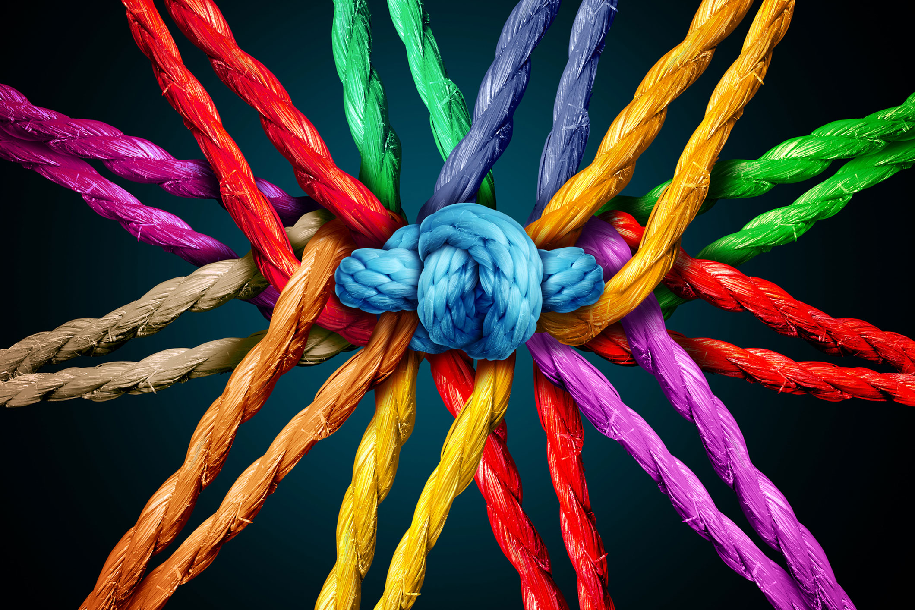
SCHEDULE for Session 7
SCHEDULE for Session 7
8:45-9:00 Pre-session ”coffee:” Lena
9-9:05 Welcome; Check-in and Agenda for the session Lena
9:05-9:10 Groundrules; (homework at the end); GraceAnn
9:10-9:20 Nuts&Bolts of Embodied Reflection: GA
9:20-9:35 Principle 7 Embodied Reflection : Jens
9:35-9:50 Principle 7 Embodied Reflection: David
9:50-9:55 Set Up for Videos and Feedback Instructions:
3 min each video
+ 1 min feedback via CHAT and live
+ 1 min transition to next speaker
9:55-10:00 Transition to VIDEOS
10:00-10:30 VIDEOS plus feedback (6 5-min rounds)
10:30-10:45 GRADUATION! And NEXT STEPS

