Slide 1
Storyboard Homework for Sept 14 session 3 of True Storytelling End Racism
David M. Boje &
Oscar Edwards
Co-hosts

Slide 2
Thank you for Storyboard Homework Received
Karin Strzeletz Ivertsen
Joyce Anastasia
Olivia Parr-Rud
Bob Skinner
Sabine Trafimow
Asma Manshalin
Rico Smith
Ernest Dillihay
Ken Long
Jens Larsen
Ben Wesson
Jim Sibel
David Boje
If Not received, Please mail to
davidboje@gmail.com

Slide 3
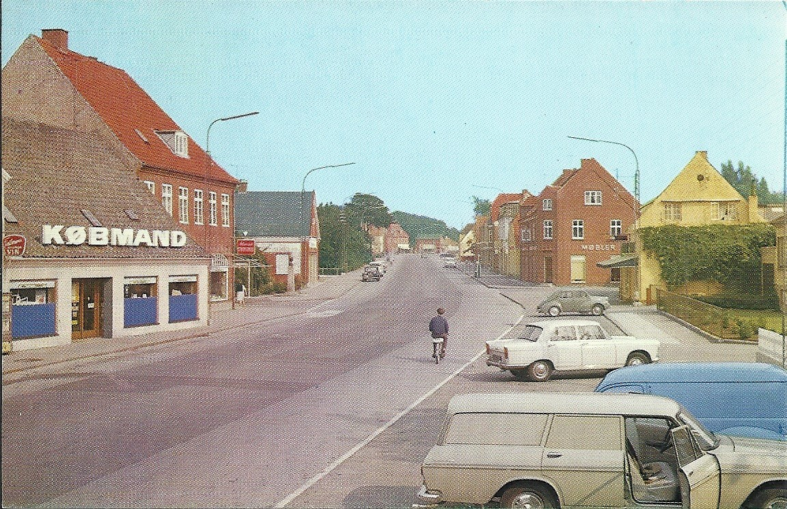
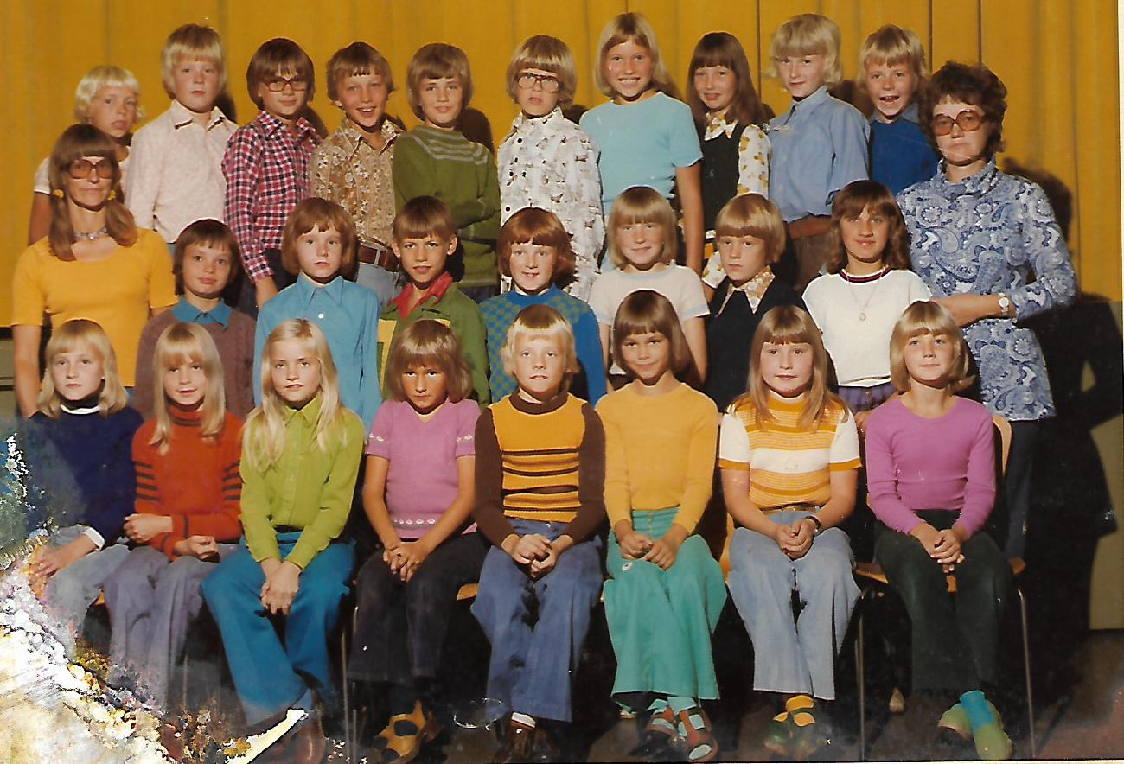
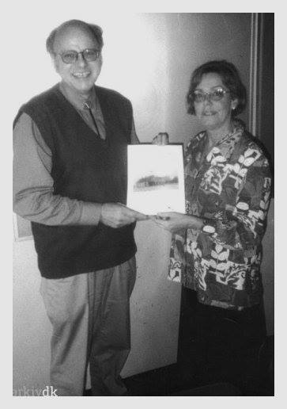
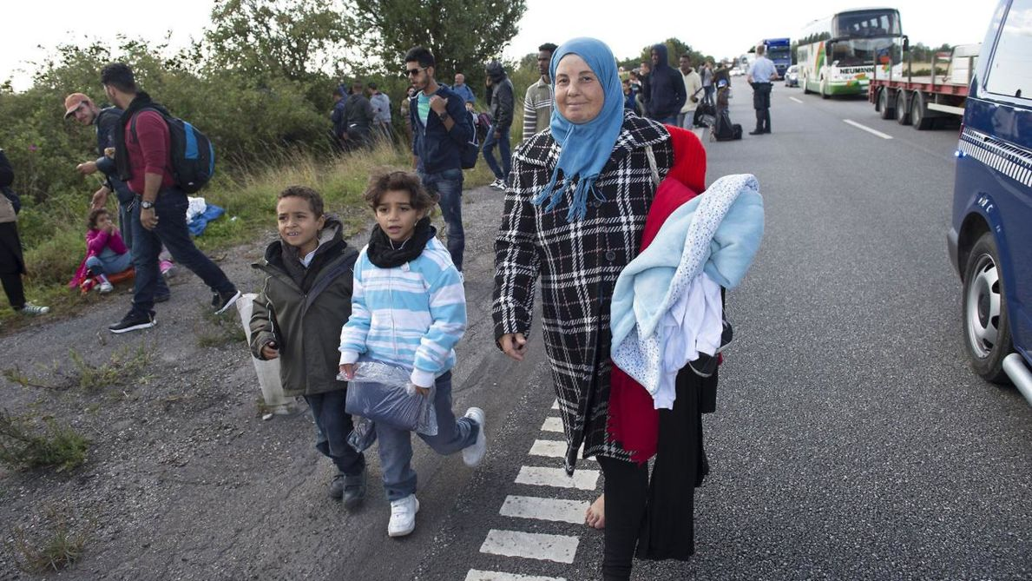
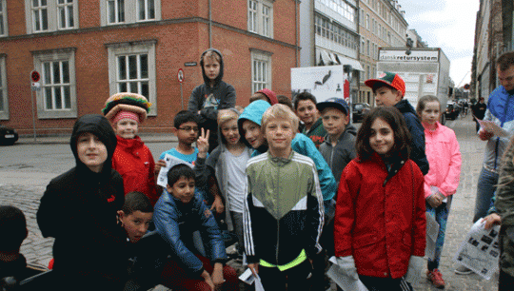
Jens Larsen
EXTERNALIZE
I call the animal
”DISTANCE”
My class
My hometown street
Storyteller
My teacher
Refugees, Syria
On a Danish Freeway
My kids school

Slide 4
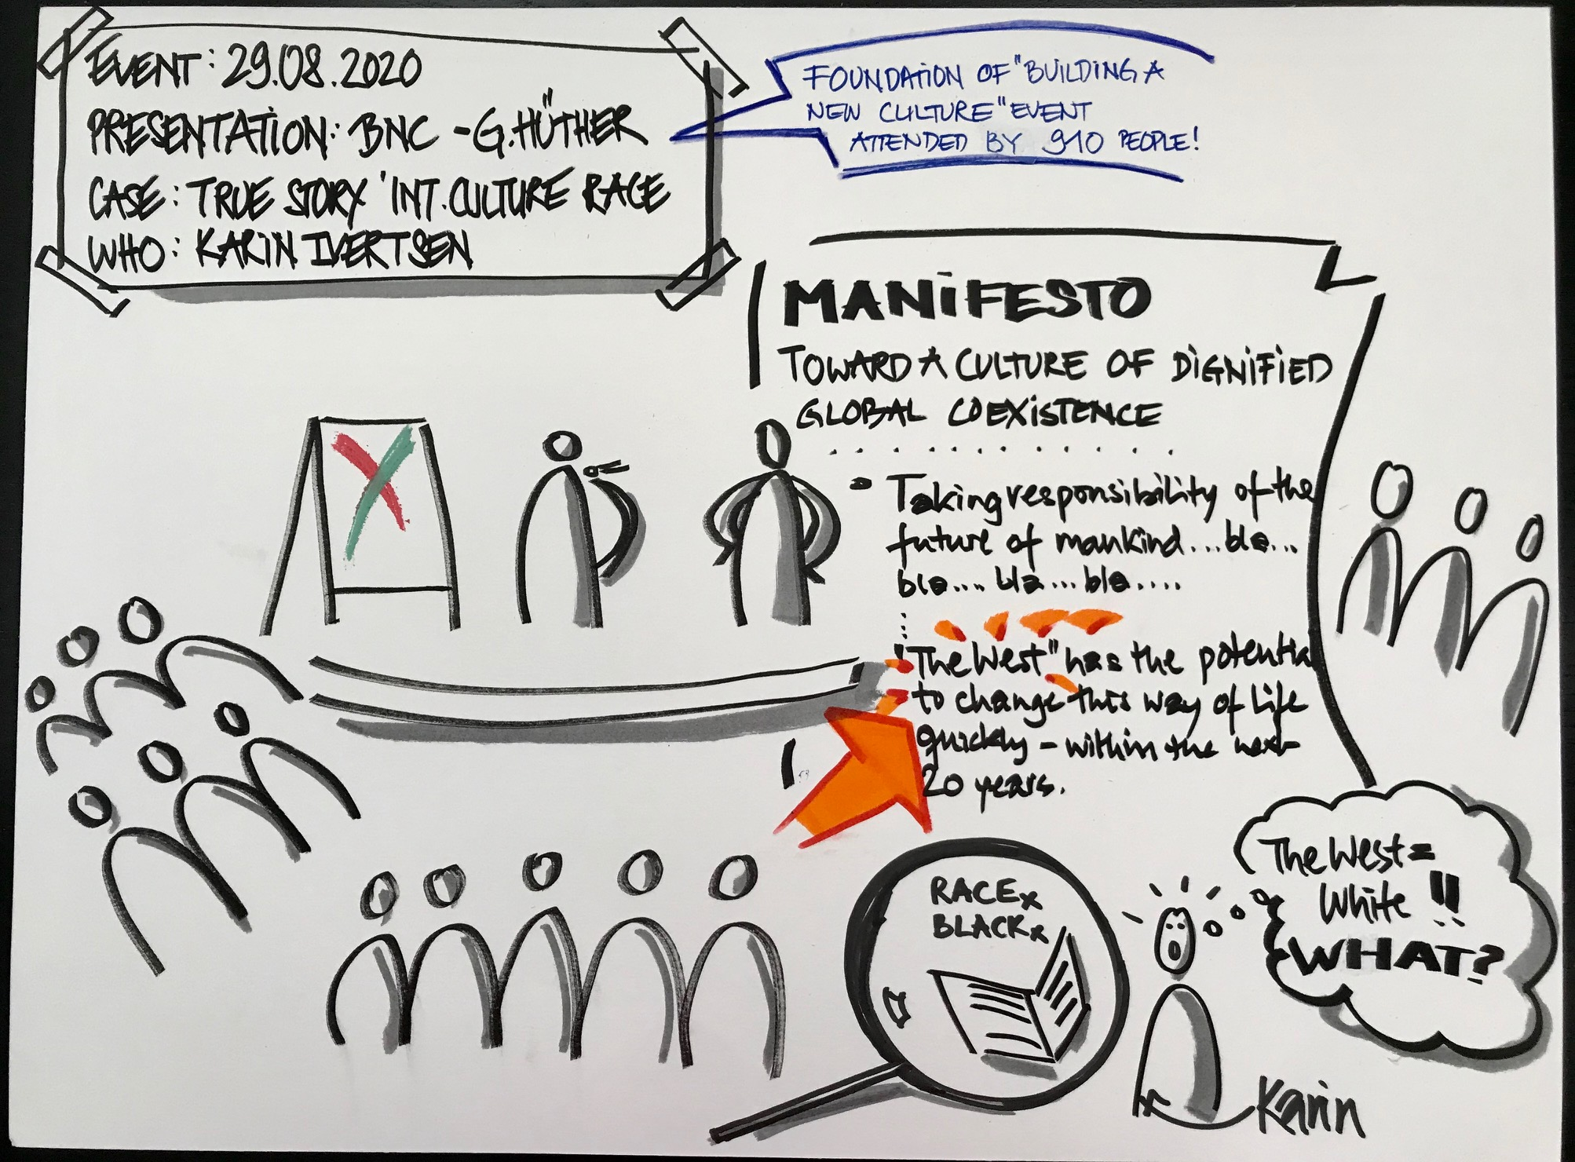
Karin Strzeletz
Ivertsen

Slide 5
Karin Strzeletz
Ivertsen

Slide 6
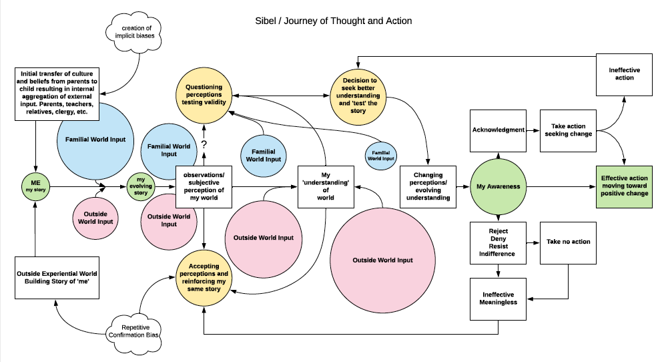
Jim Sibel

Slide 7
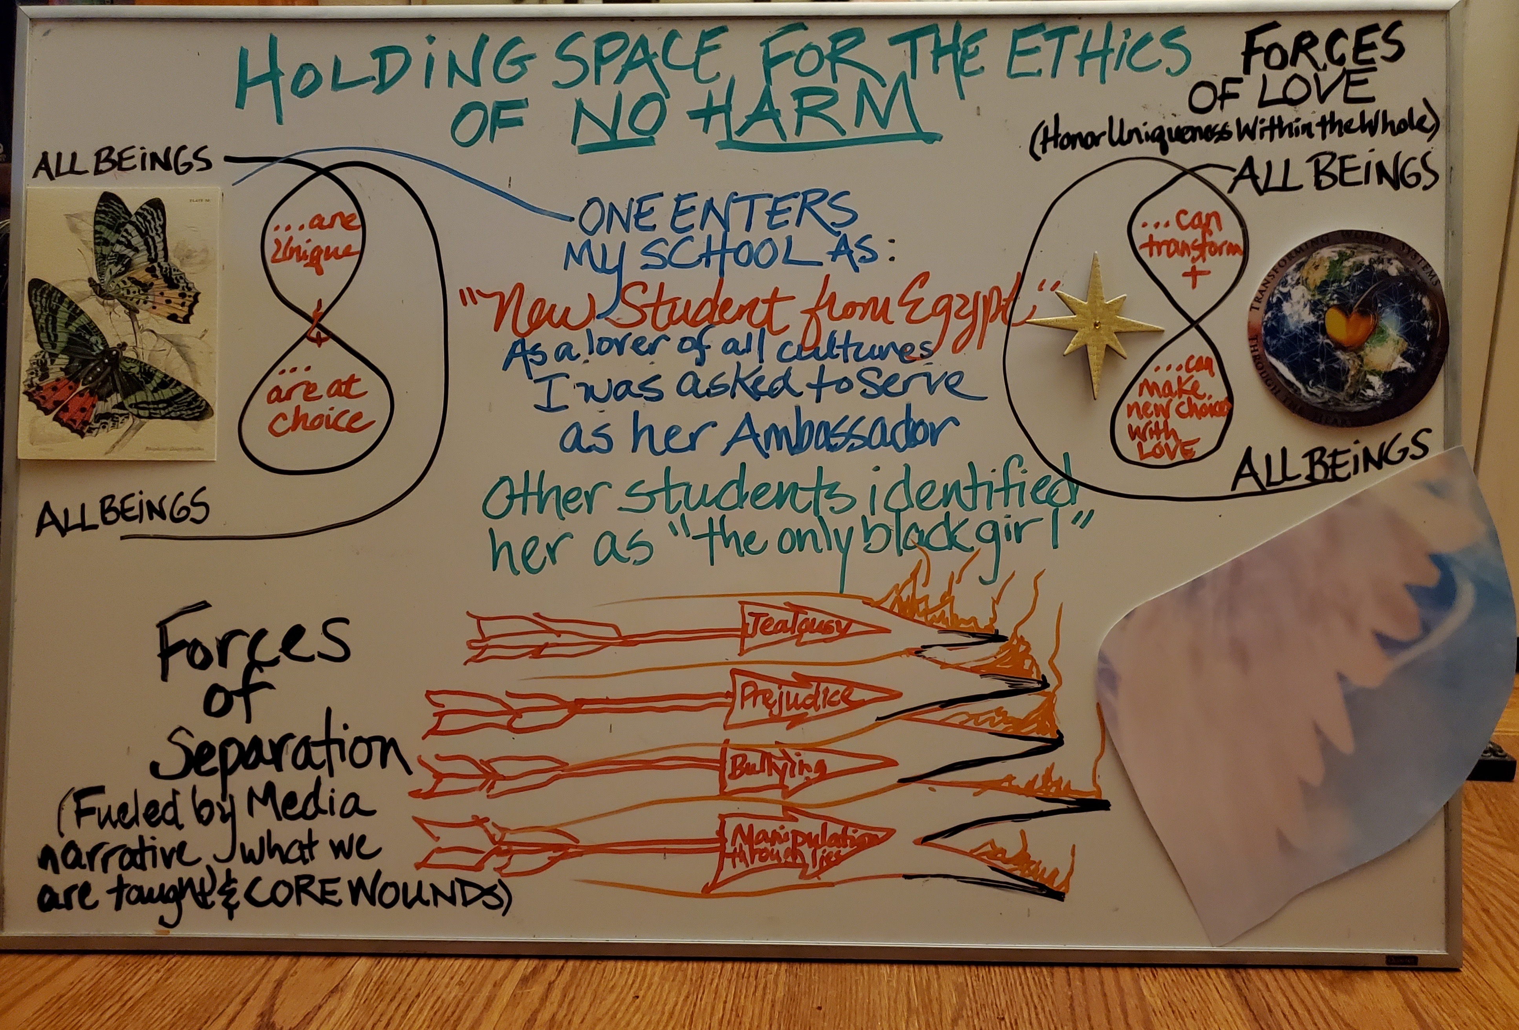
Joyce Anestasia

Slide 8
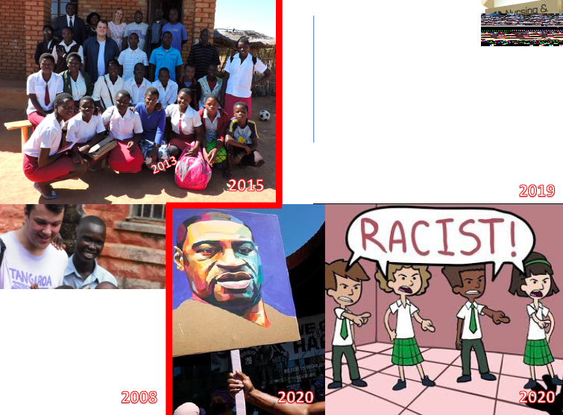
Ben Wesson

Slide 9
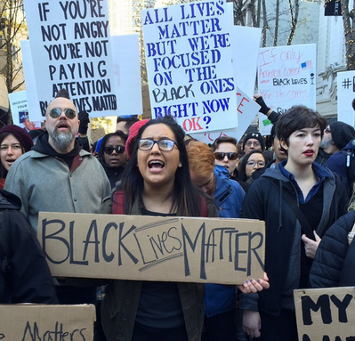
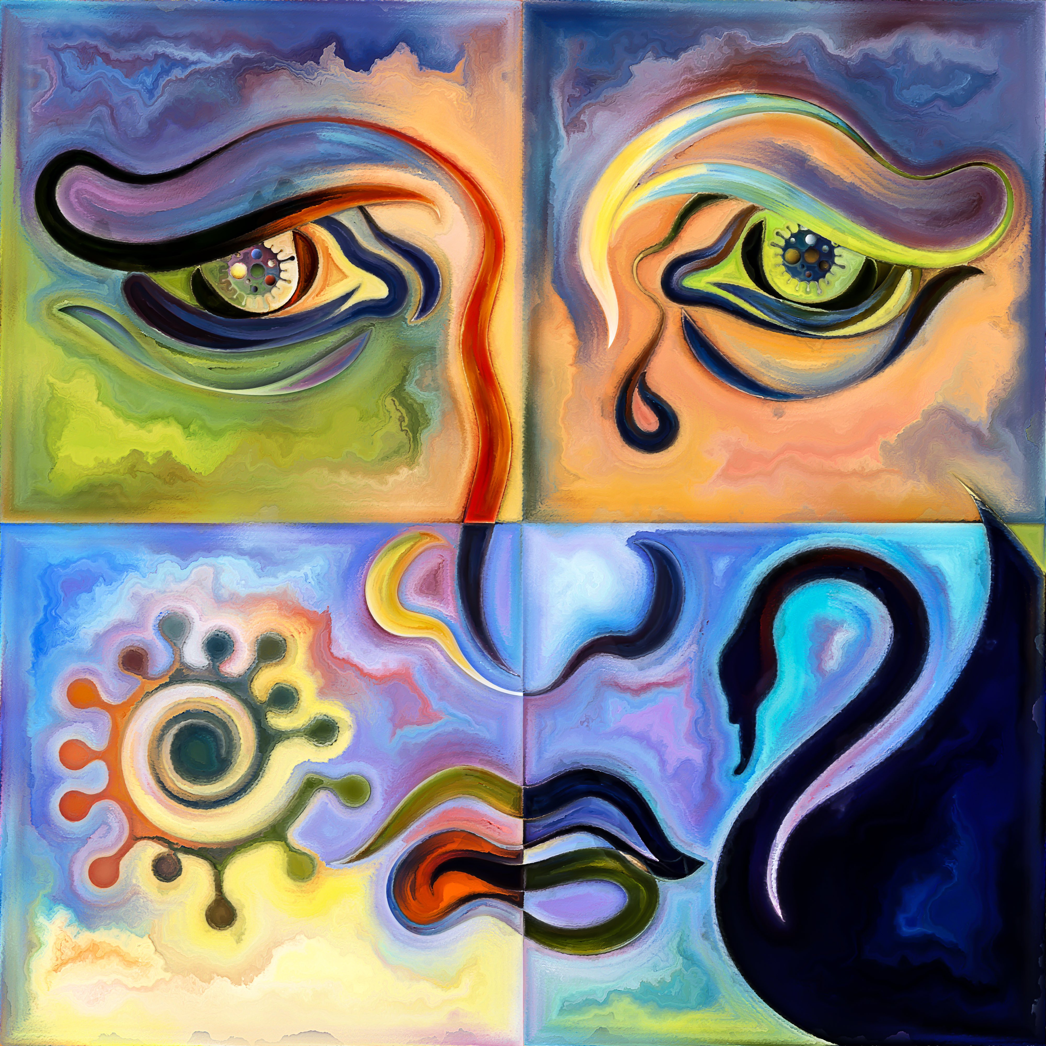
Olivia Parr-Rud
_
Roommates
BLM Protests
George Floyd
Murder
Me
Research
New budding friendship and understanding.
Modeling tolerance and appreciation in challenging times.

Slide 10
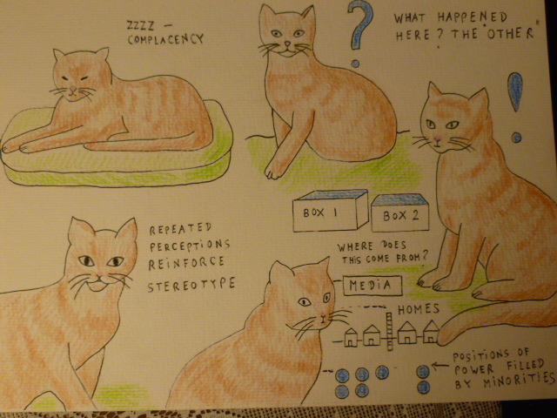
Sabine Trafimow

Slide 11
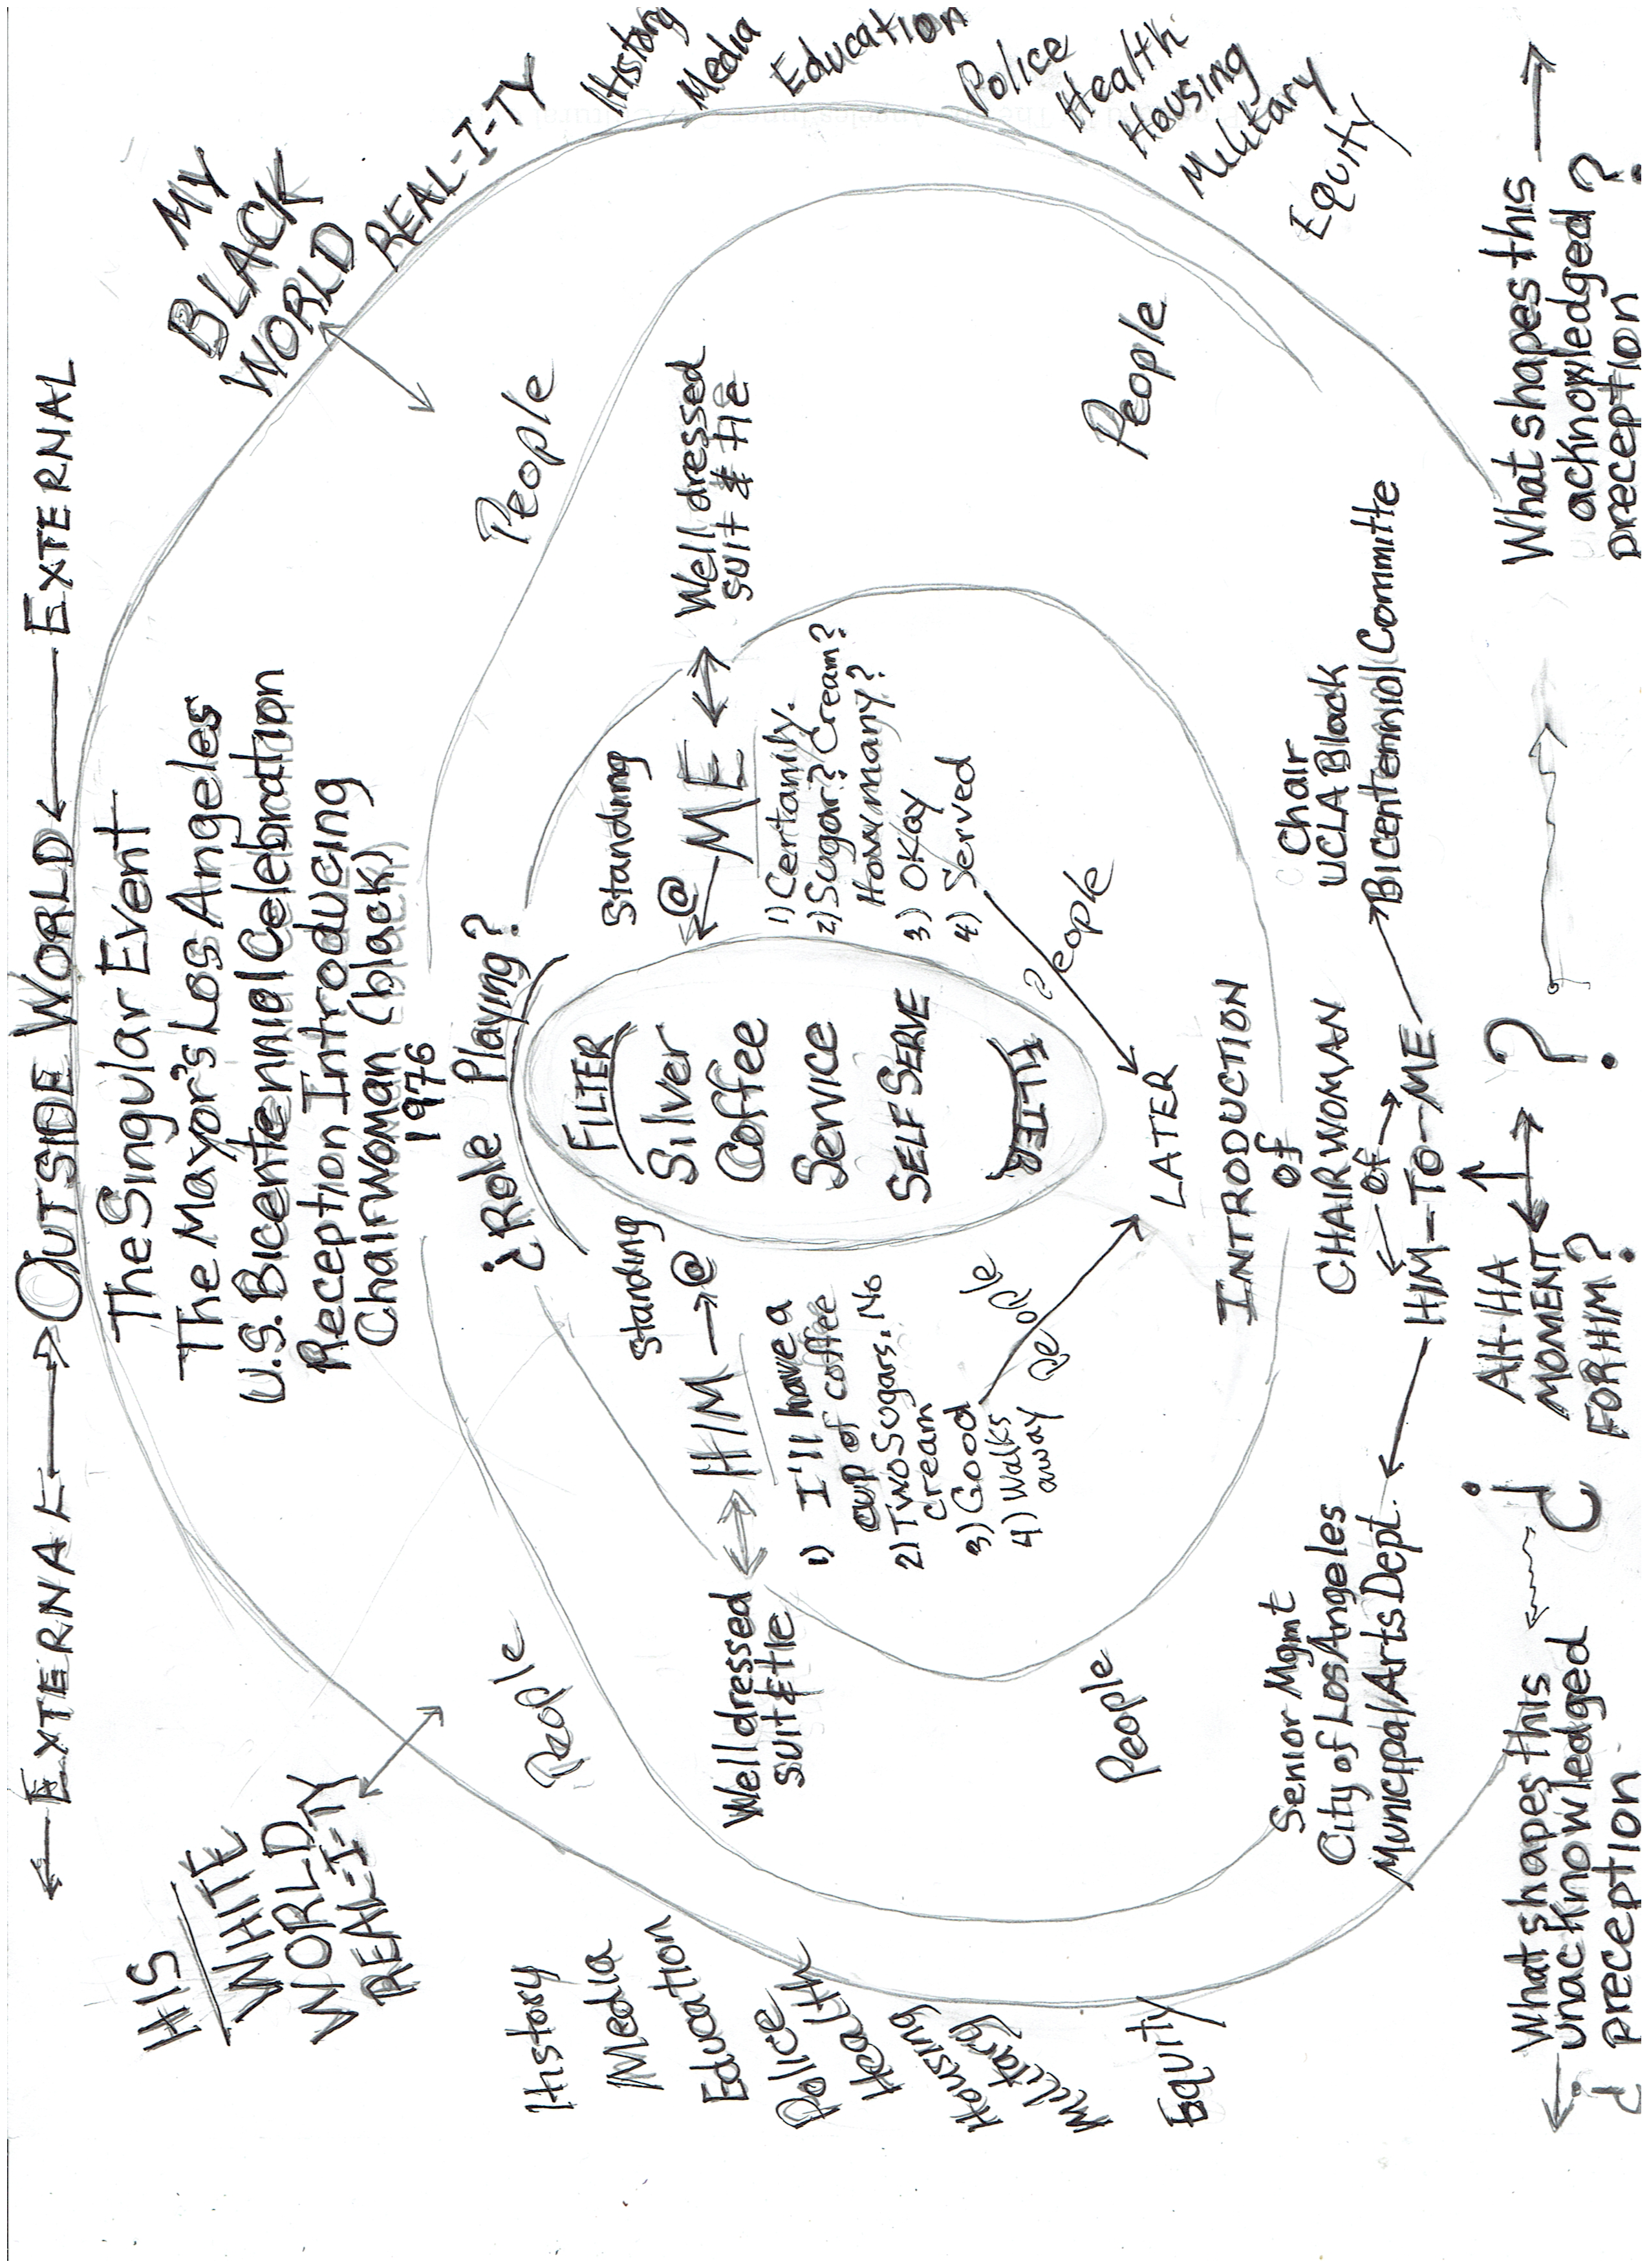
Ernest Dillihay

Slide 12
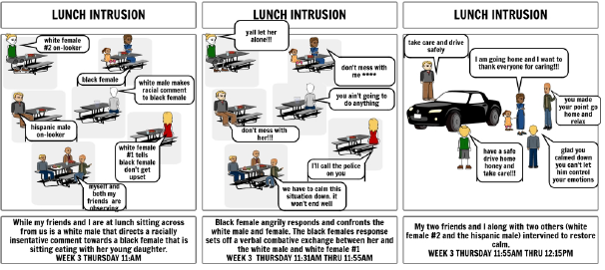
Rico Smith

Slide 13
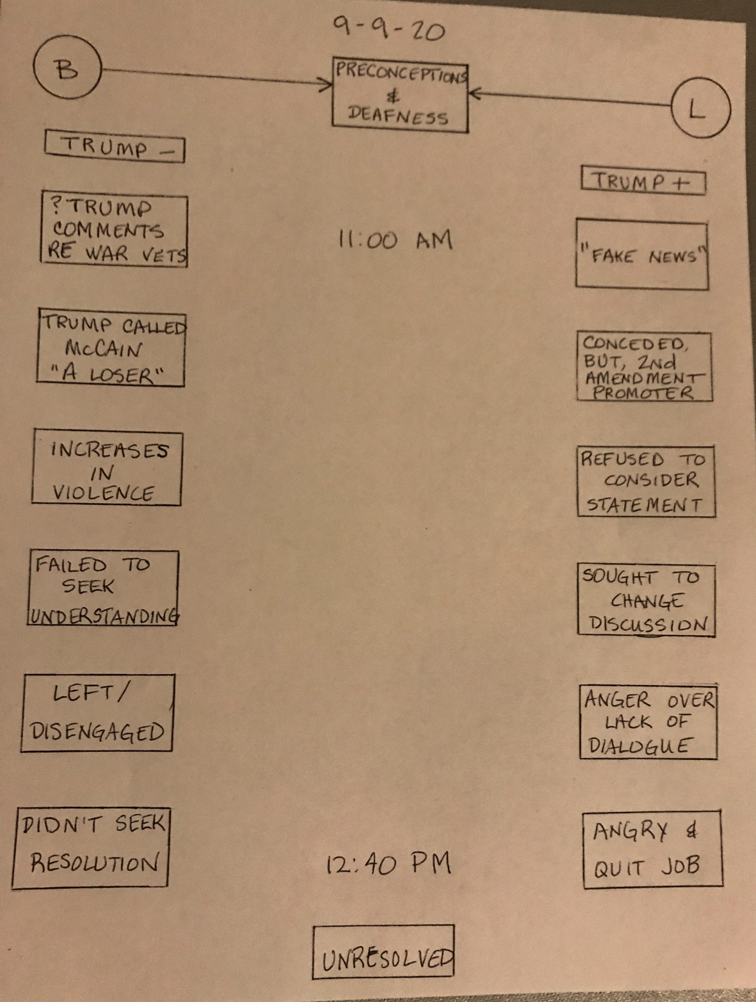
Bob Skinner

Slide 14
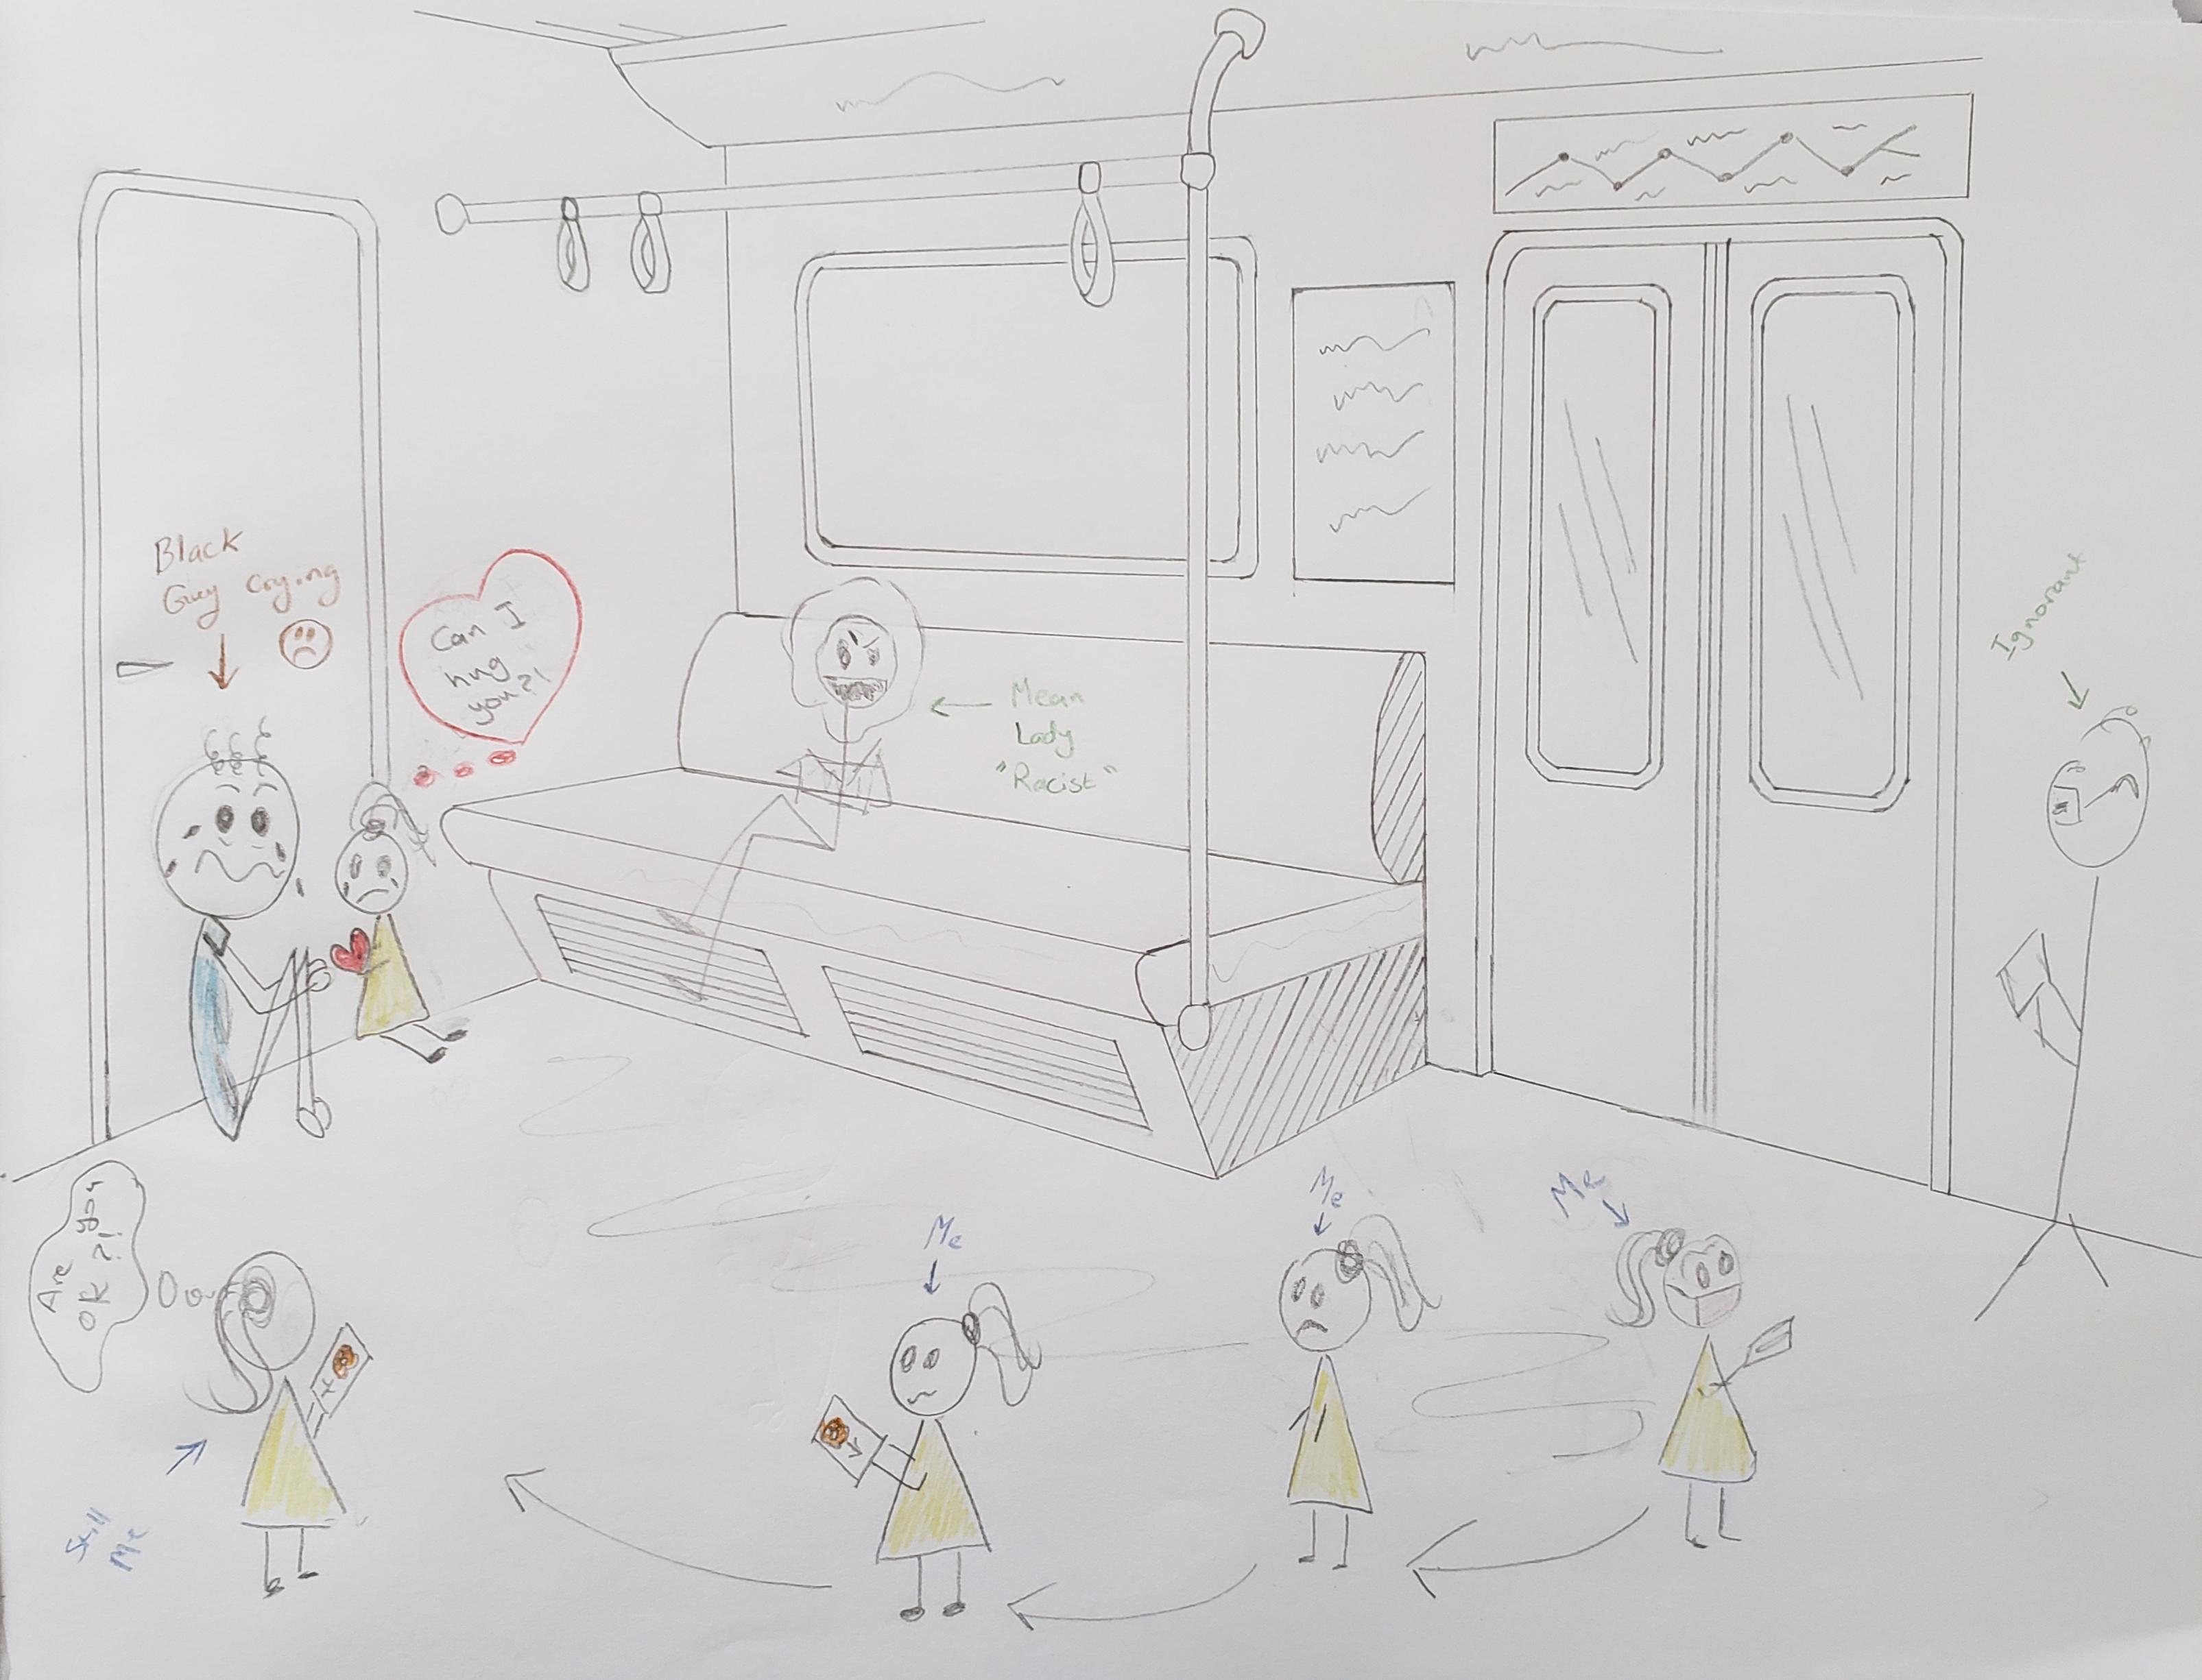
Asma Mashalim

Slide 15
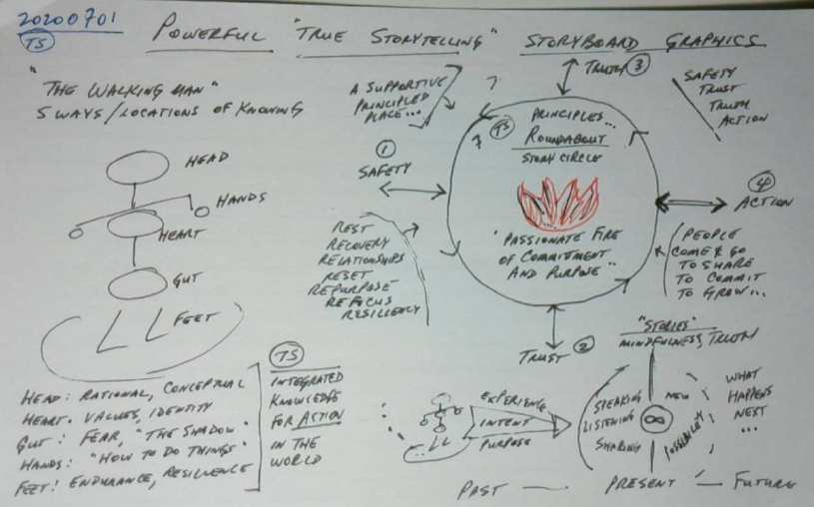
Ken Long

