Slide 1
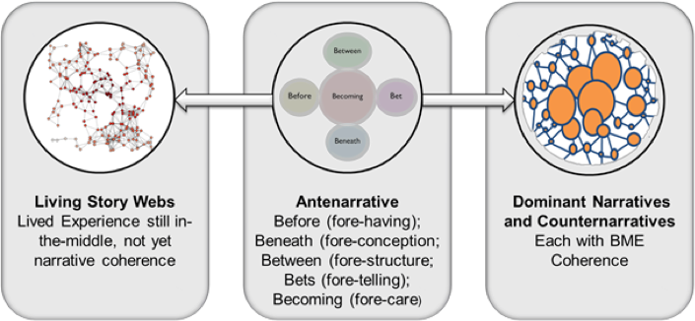
Principle 5 Help stories along
You must be able to help stories on their way and be open to experiment
Marita Svane & David Boje

Slide 2
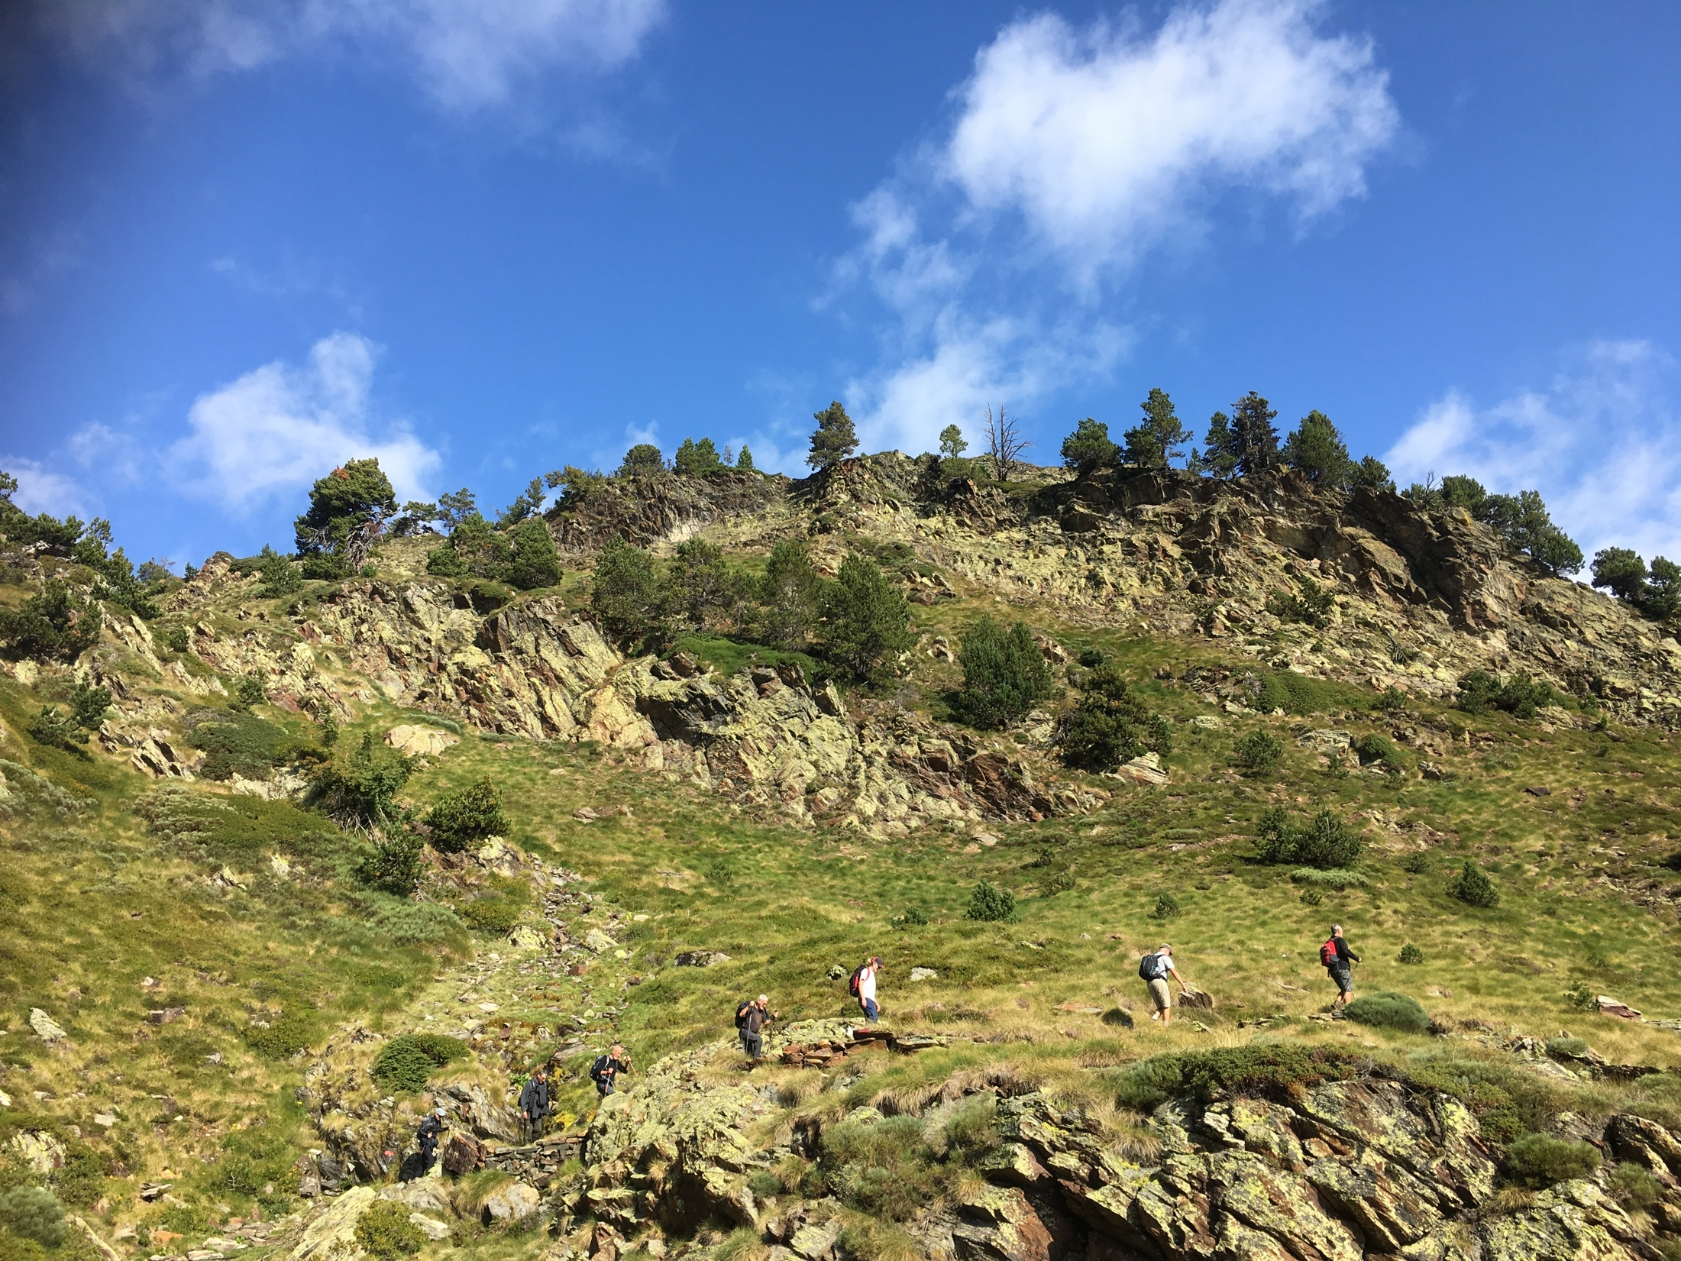
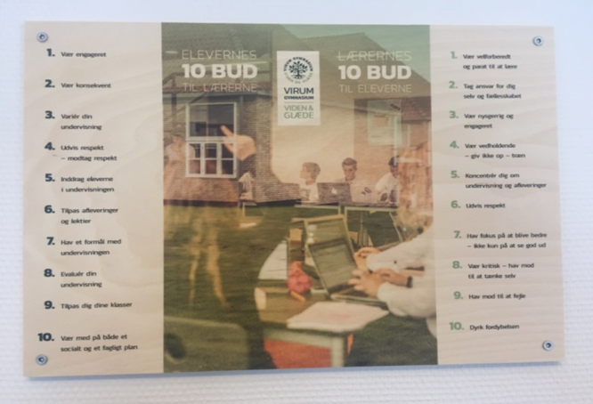
Principle 6: You must consider staging including scenography and artifacts
How are material & social agents part of the staging & artifact of RESTORYING?
Niels Bohr, 1885-
1962

Slide 3
Principle 5
Share a story about a your best conversation ever –
which created a change
How can it inspire the challenge you are working with?
Principle 6
Share a story about the object you brought.
How can it support the way you
stage your challenge and true story?

