Slide 1
Agenda for 1st June 22 Principles 1&2
5 Min. Demo Talking Stick in Welcome by Lena, Grace Ann, Jens: Introduce yourself in a few lines, cover: What is certificate Program; what to expect from the Foundation Session (ethical coaching): etc. Keep it short.
15 Min. Presentation of the participants: 30 seconds Name, home and what is an ethical life (if larger group just name)
15 Min. Grace Ann: Inner and Outer Dialogues (see figure)
15 Min. 1st Breakout (groups of 3) – passing talking stick, theme is lying (3 questions are sent in by host):
10 Mims- Plenary sharing - David: What is True Storytelling ‘ethical life, How it fits with other ethics approaches (instrumental, virtue, etc.)
10 Min. – Principle 2 – Make Room for stories already there
15 Min – 2nd Breakout Room (groups of 3) – topic – when treated unfairly (take 3 questions to the breakout)
5 min. Debrief, Check in, and homework

Slide 2
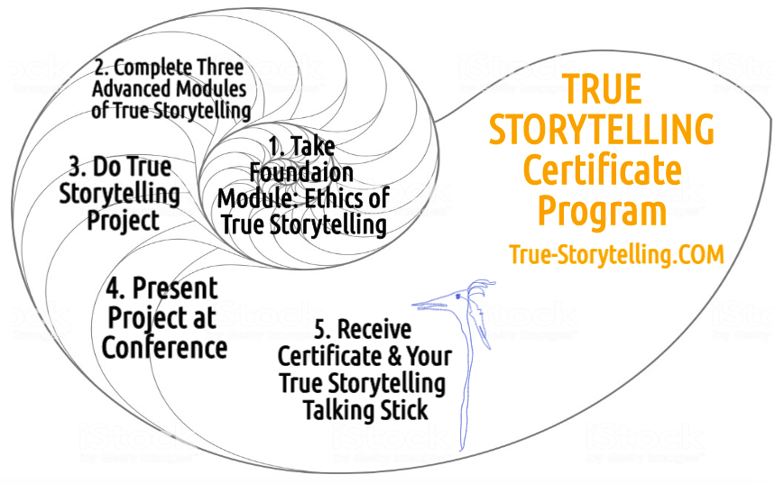
Become a True Storyteller
“Its’ not about living a good life, but a true life
[an ethical life]” – Kierkegaard
Hosts:
Jens Larsen oldfriendsindustries@gmail.com ,
David M. Boje davidboje@gmail.com ,
Grace Ann Rosile garosile@nmsu.edu ,
Lena Bruun lenabruunjensen@gmail.com
True-storytelling.com Truestorytelling.blog

Slide 3
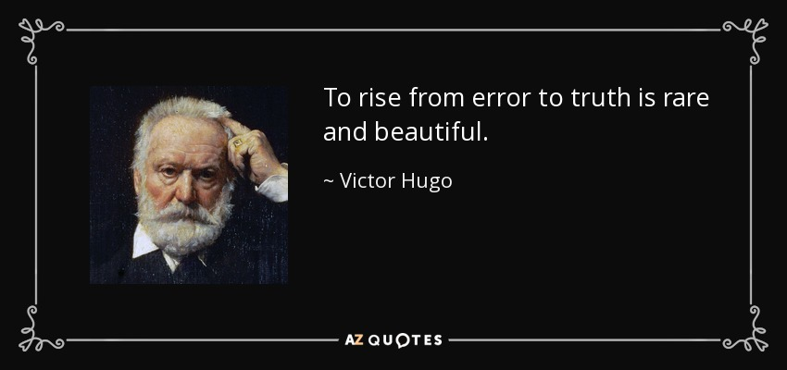
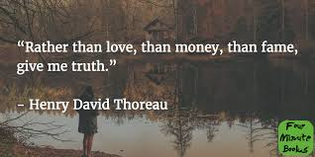
Some inspiration for your introductions
“Its’ not about living a good life, but a true life [an ethical life]”
– Kierkegaard
Introductions (your name, location & One sentence what is an ethical life & favorite Animal – for your talking stick gift in completing the program)

Slide 4
Over these 4 sessions, you Can Expect to learn how to:
Use several ethics approaches relevant to becoming a True Storytelling facilitator/coach;
Align the inner dialogue of the mind with the inner dialogue of the heart;
Align the head/heart dialogues with your embodied outer dialogues with others (your verbal storytelling, and walking the talk);
Apply Tribal Wisdom ‘storytelling ethics’ to family, community, & business or governmental organizations;
Consider both Doing and Being (do-be-do-be-do) for an ethical life in your own living story;
Become a coach instead of an inquisitor (interrogator) or fault-finder,
Replace persuasive storytelling with respect for the uniqueness & autonomy of the other person’s story;
Coach people using talking stick story circles;
Do advanced ‘process coaching’ using conversational storytelling by the 4th session;
Acquire skills in process consultation using story circles that are open dialogue conversations by the 4th session.
Deepen the practice of embodied reflection on our relationships by the 4th session;

Slide 5
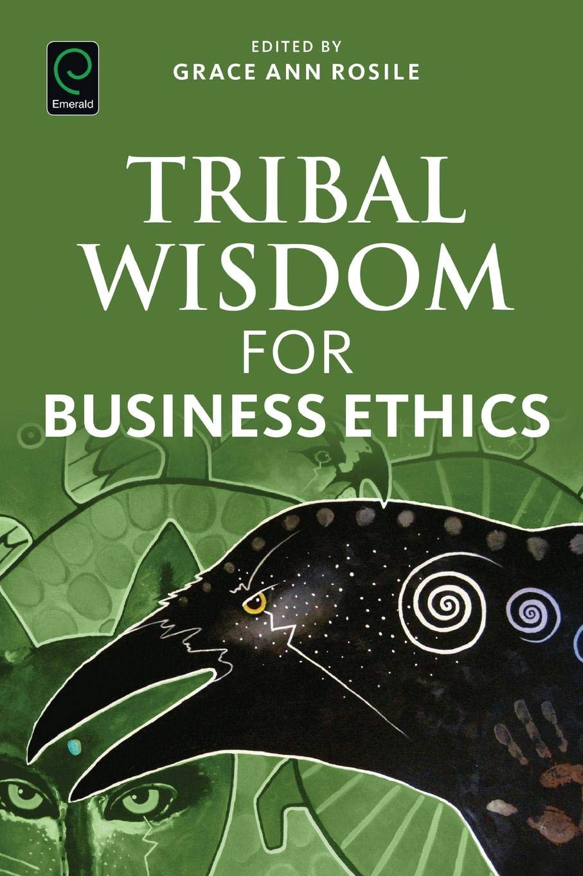
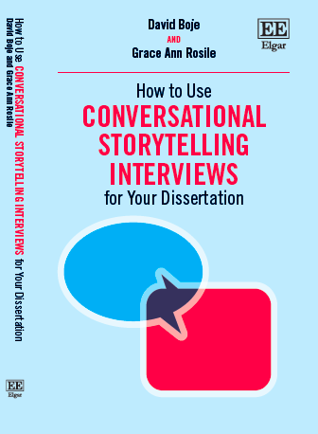
BUILD YOUR LIBRARY
Tribal wisdom book is available now
True Storytelling book by Larsen, Boje & Bruun is available in October 2020
Conversational Storytelling book available in September 2020- we will send some chapters to seminar participants

Slide 6
Ground rules
Please bring a notebook and pen/pencil to each session, and colored markers may be required for some sessions.
Please do not give advice to others or use ‘should’ statements for self or others.
Speak more from the heart than from the head
Laser in, be concise, and share only one story instead of several.
CONFIDENTIALITY: Do not tell someone else’s story.
Please attend all four sessions. If you must miss one, contact us so we can schedule a session to catch you up before you return.

Slide 7
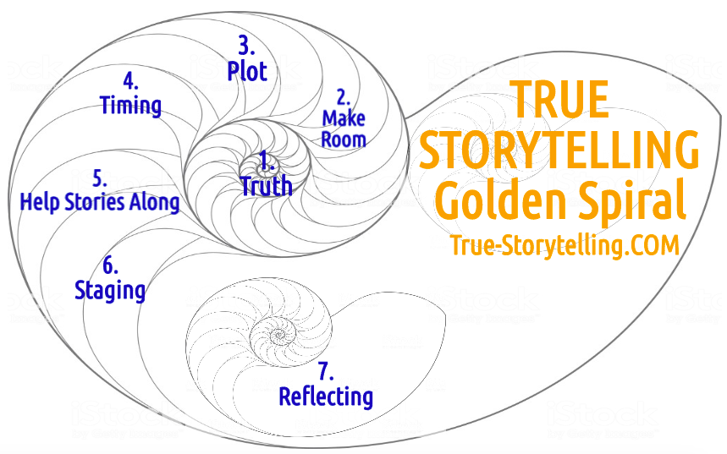
True Storytelling – 7 Principles for Ethical Life

Slide 8
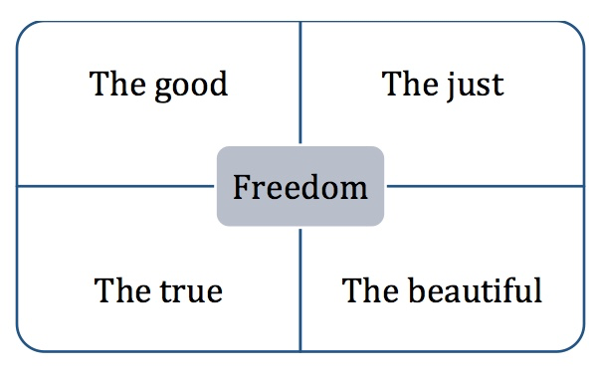
True Storytelling Ethics & Greek Square

Slide 9
1st True Storytelling Principle: You yourself must be true and prepare the energy and effort for a sustainable future.
3 Questions:
Did you check it out?
Do you believe in it?
Can you sustain (get energized & not burn out) in long future?
Notes:
Example: Living Stories with a Place, A Time, and a Truth of lived experience
Happening Here and Now
In the middle, unfolding, emerging, happening
Goes from strategic level of power, to what is best for the world in Council of Elrond
Tell LESS is MORE
BE AUTHENTIC - Create an emotional component that resonates with the audience YouTube Peter Guber of Mandalay Group, so they retell it forward owning; See article 4 truths of the storyteller HBR

Slide 10
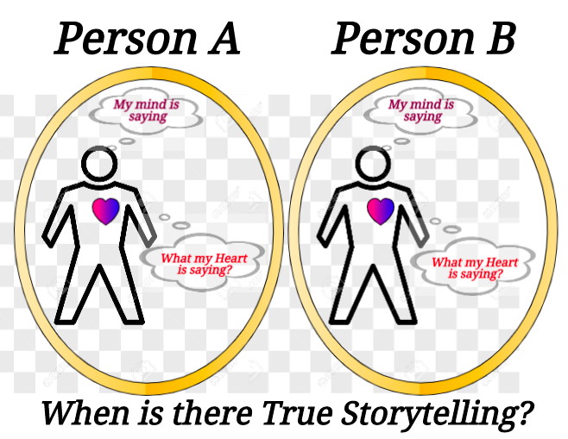

Slide 11
“Annie Hall” video clip 0:44 up to 1:30 https://www.youtube.com/watch?v=3tcH2zSqVCc

Slide 12
True Storytelling has WHOLENESS of head and heart INTEGRITY: from Integral = whole means CONGRUENCE of head and heart

Slide 13
True Storytelling Breakout #1: Lying 3 rounds, 1 question per round, each round 2-3 minutes INSTRUCTIONS: Your group Will receive a Question to answer, every few minutes. Start answering the question when it arrives TOTAL time: 10 minutes for EVERYONE to answer all 3 questions NO Q&A, NO discussion, just a quick 10-15 second answer Research says that in general, we are not good at telling when someone is lying to us---yet most of us have experienced knowing when someone else was lying, especially when we know that person well.

Slide 14
Before Breakout: Think of someone you know well, AND make it someone that you can tell when they are LYING. (a boss, a spouse, a little brother whose ears always got red, etc.)

Slide 15
Question Sent to Breakout by Host Question #1: What do you observe that lets you know when this person is LYING?

Slide 16
Question Sent to Breakout by Host QUESTION #2: What do YOU do when YOU are LYING?

Slide 17
Question Sent to Breakout by Host QUESTION #3: Do you think people who know you well, know when you are LYING?

Slide 18
Back from Breakout PLENARY DEBRIEF Reasons/times lies work: Bad results from lying, whether successful or not:

Slide 19
Now we go deeper into what it means to facilitate and coach, for an ethical life

Slide 20
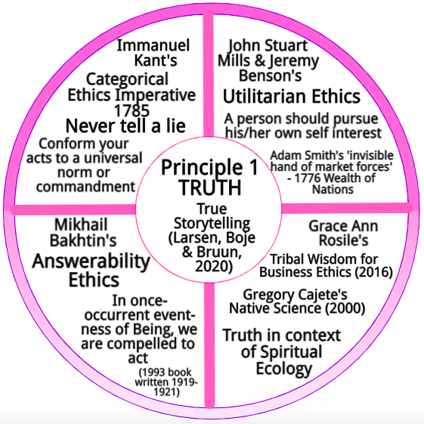
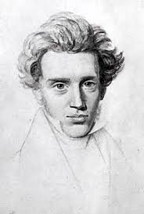
“Its’ not about living a good life, but a true life [an ethical life]”
Danish Philosopher
Søren Kierkegaard

Slide 21
Principle 2: Make Room True storytelling makes spaces respecting the stories already there
Notes:
Diane Dredge suggested Bus Tour with all the stakeholders on board on Tues May 8 2018 at Aalborg, at conference held there on storytelling
How to tell a motivating & inspiring story? MOST ENGAGING STORY WAITING TO BE TOLD IS YOURS! I was so shocked, surprised, stupid, suspicious (HOW DID YOU FEEL?)
What is ENGAGING & EMOTIVE-language? – when audience is ENERGIZED (look to body language) – START WITH CONTEXT (PAINT THE VIVID SCENE) e.g. in my driving through woods, icy roads, snowing, on mountain road ADD DIALOGUE
A PROBLEM, an OBSTACLE to OVERCOME: E.g. When I was first person in family ever to go to college? SET UP FOR THE TIMING POINT (THE ARC is SET) THEN SURPRISING TURNING POINT seeYouTube: Jim Carey
A proud moment when MORAL OF STORY →YOU inspired others? THE RESOLUTION E.g. When Bo Kimble died, the team used my motto to move forward

Slide 22
Breakout exercise Story Circle for Principle 2
Breakout room - 10 minutes –
Practice Principle 2: Make Room for the stories already there
AGAIN: 3 questions, 3 rounds, VERY brief answers (15 seconds),
TOTAL for all 3 rounds = 10 minutes
Use Talking Stick method:
Pick someone to share their story first, they will tell it and pick next person
As listeners - Use deep listening, Do not ask questions of the storyteller, do not give advice, and please hold a space for silence because silence speaks
When it is your turn, you hold the stick and you have the authority to speak, to share one and only one story, & when done say ‘Ho’ or ‘Complete’ or ‘I’m Done’ so people know you are done, & then YOU choose who to pass the stick to next
It is OK to ‘pass’ and wait for another opportunity;
Continue to Story Circle until all have shared once, and if time remains do another round until you receive the next question for the next round.

Slide 23
3 QUESTIONS for Breakout
#1. When were you UNFAIRLY TREATED?
(Example: I should have been promoted, but the boss’ relative got the job instead of me.
#2. Why was it UNFAIR?
(Example: My sales numbers were better.)
#3. What was valued instead of your side of the
story? Can you name the value?
(Examples: nepotism, family, “kissing up”, etc)

Slide 24
Principle 2: Make Room True storytelling makes spaces respecting the stories already there
PLENARY DEBRIEF
Notes:
Diane Dredge suggested Bus Tour with all the stakeholders on board on Tues May 8 2018 at Aalborg, at conference held there on storytelling
How to tell a motivating & inspiring story? MOST ENGAGING STORY WAITING TO BE TOLD IS YOURS! I was so shocked, surprised, stupid, suspicious (HOW DID YOU FEEL?)
What is ENGAGING & EMOTIVE-language? – when audience is ENERGIZED (look to body language) – START WITH CONTEXT (PAINT THE VIVID SCENE) e.g. in my driving through woods, icy roads, snowing, on mountain road ADD DIALOGUE
A PROBLEM, an OBSTACLE to OVERCOME: E.g. When I was first person in family ever to go to college? SET UP FOR THE TIMING POINT (THE ARC is SET) THEN SURPRISING TURNING POINT seeYouTube: Jim Carey
A proud moment when MORAL OF STORY →YOU inspired others? THE RESOLUTION E.g. When Bo Kimble died, the team used my motto to move forward

Slide 25
Next session
Homework: Practice Principles 1 and 2: In your notebook, write about noticing two (2) times during the week when you saw one or both of these principles in action (Principle 1 True Storytelling and Principle 2 Making Room).
FUTURE SESSIONS:
Session #2 Principle 3 Plotting and Principle 4 Timing (Identifying patterns and exceptions and choosing your timing).
Session #3: Principle 5 Helping Stories Along (Conversational Storytelling) and Principle 6 Staging (Conveying your plot to your audience).
Session #4: Principle 7 Reflection (Aligning the head/heart dialogues with your embodied outer dialogues with others).

Slide 26
Thank you More information on True Storytelling
https://true-storytelling.com
https://truestorytelling.blog
Thank you

