Slide 1
Homework Storyboards from Session 3 of End Racism True Storytelling Module
David Boje
Oscar Edwards (co-facilitators)
With Grace Ann Rosile (co-author of this module)
© TSI True Storytelling Institute

Slide 2
Mary Katungu and Wanda Cousar – interview with Superintendent of School District
As the Superintendent of XYZ, it is my moral and ethical obligation to not only ensure high quality educational experiences for our students, but also support their emotional wellbeing. We are proud of the rich diversity within our learning community and I want to assure everyone that ALL are welcomed in District XYZ. We have considerable work before us to eradicate the inequitable outcomes within our district often experienced by students of color, those living in conditions of poverty, students receiving special education support or acquiring English as a second language

Slide 3
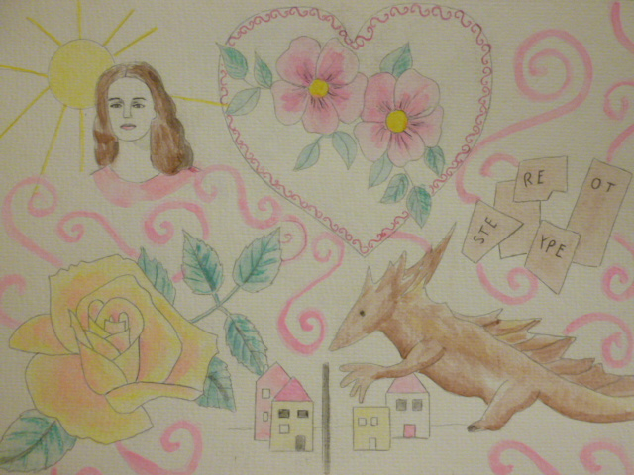
Sabine Trafimow Homework

Slide 4
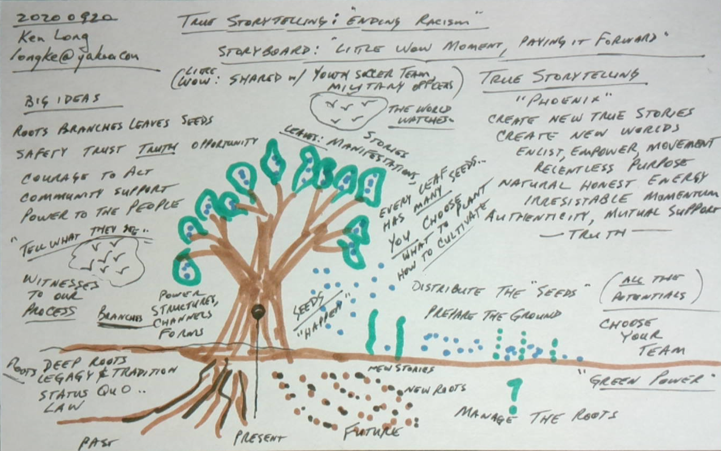
Ken Long homework

Slide 5
Rico Smith Storyboard from session 3

Slide 6
Liz Bryant homework

Slide 7
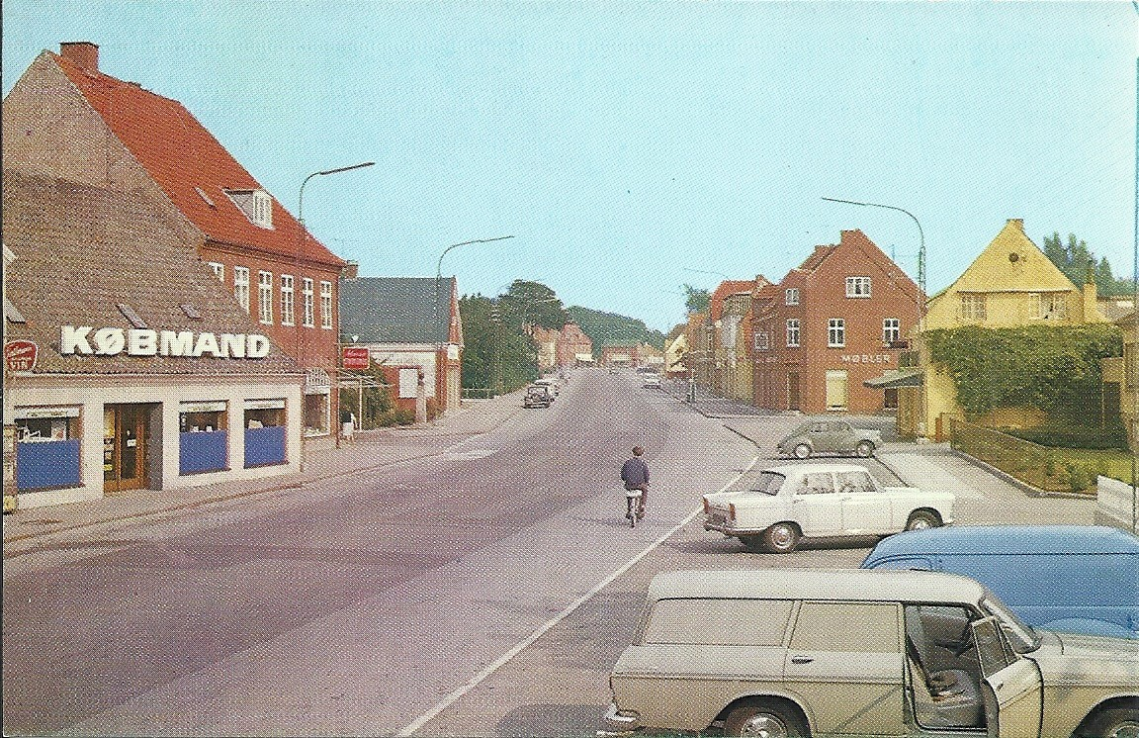
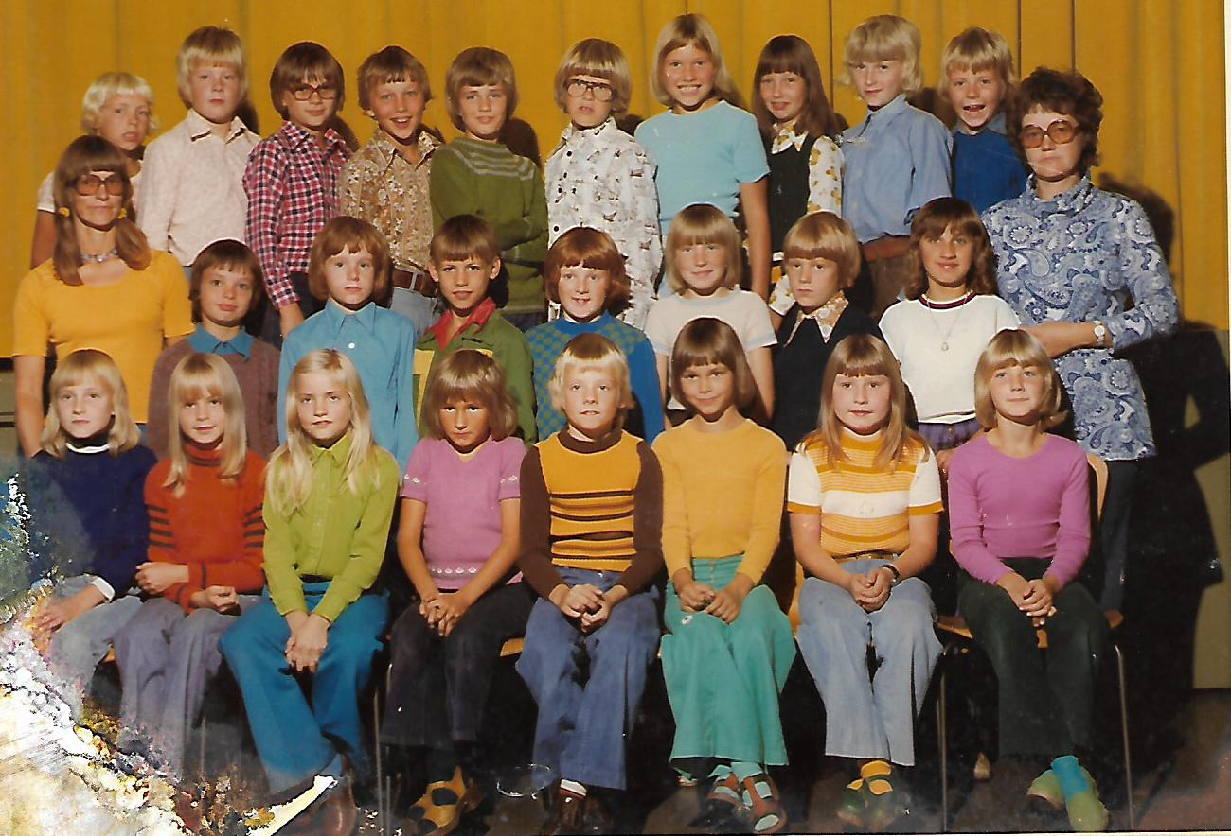
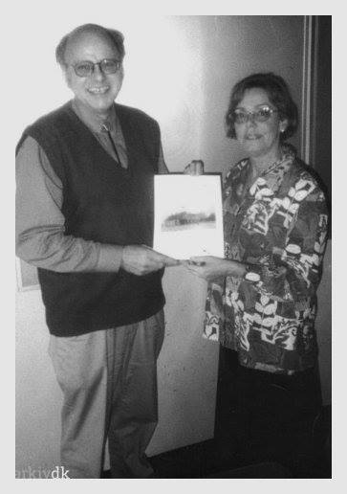
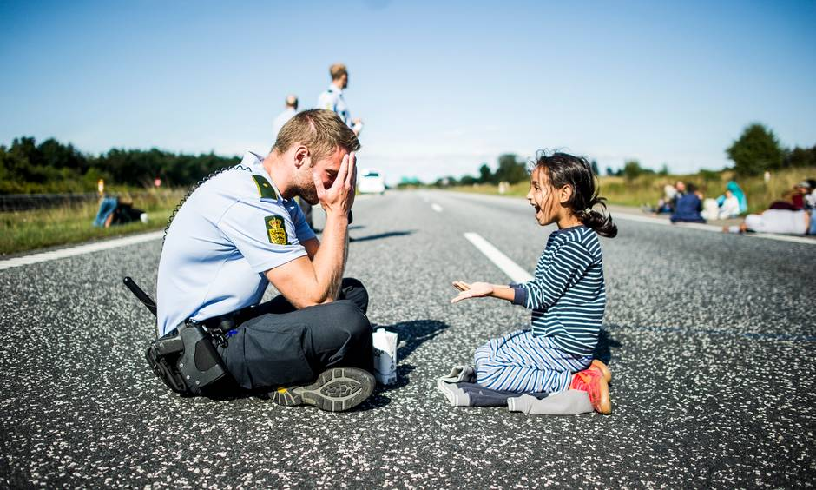
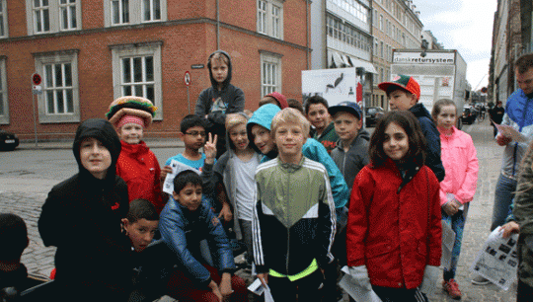
Jens Larsen
Little wow
moments
My class
My hometown street
Storyteller
My teacher
Little wow moments
Danish policeman playing with
refugee child from Syria
on a Danish Freeway
My kids school, little wow moment

Slide 8
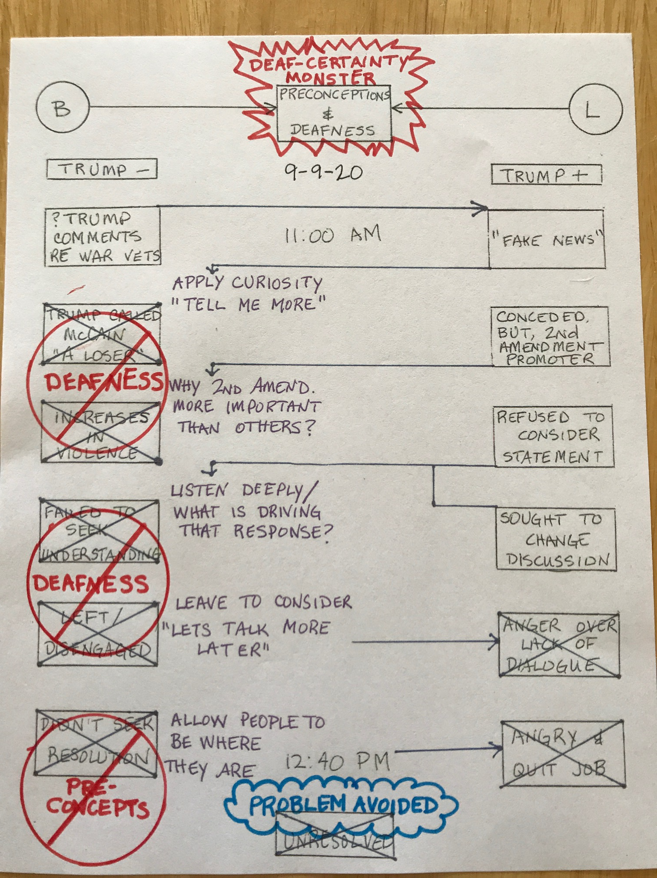
Bob Skinner Homework

Slide 9
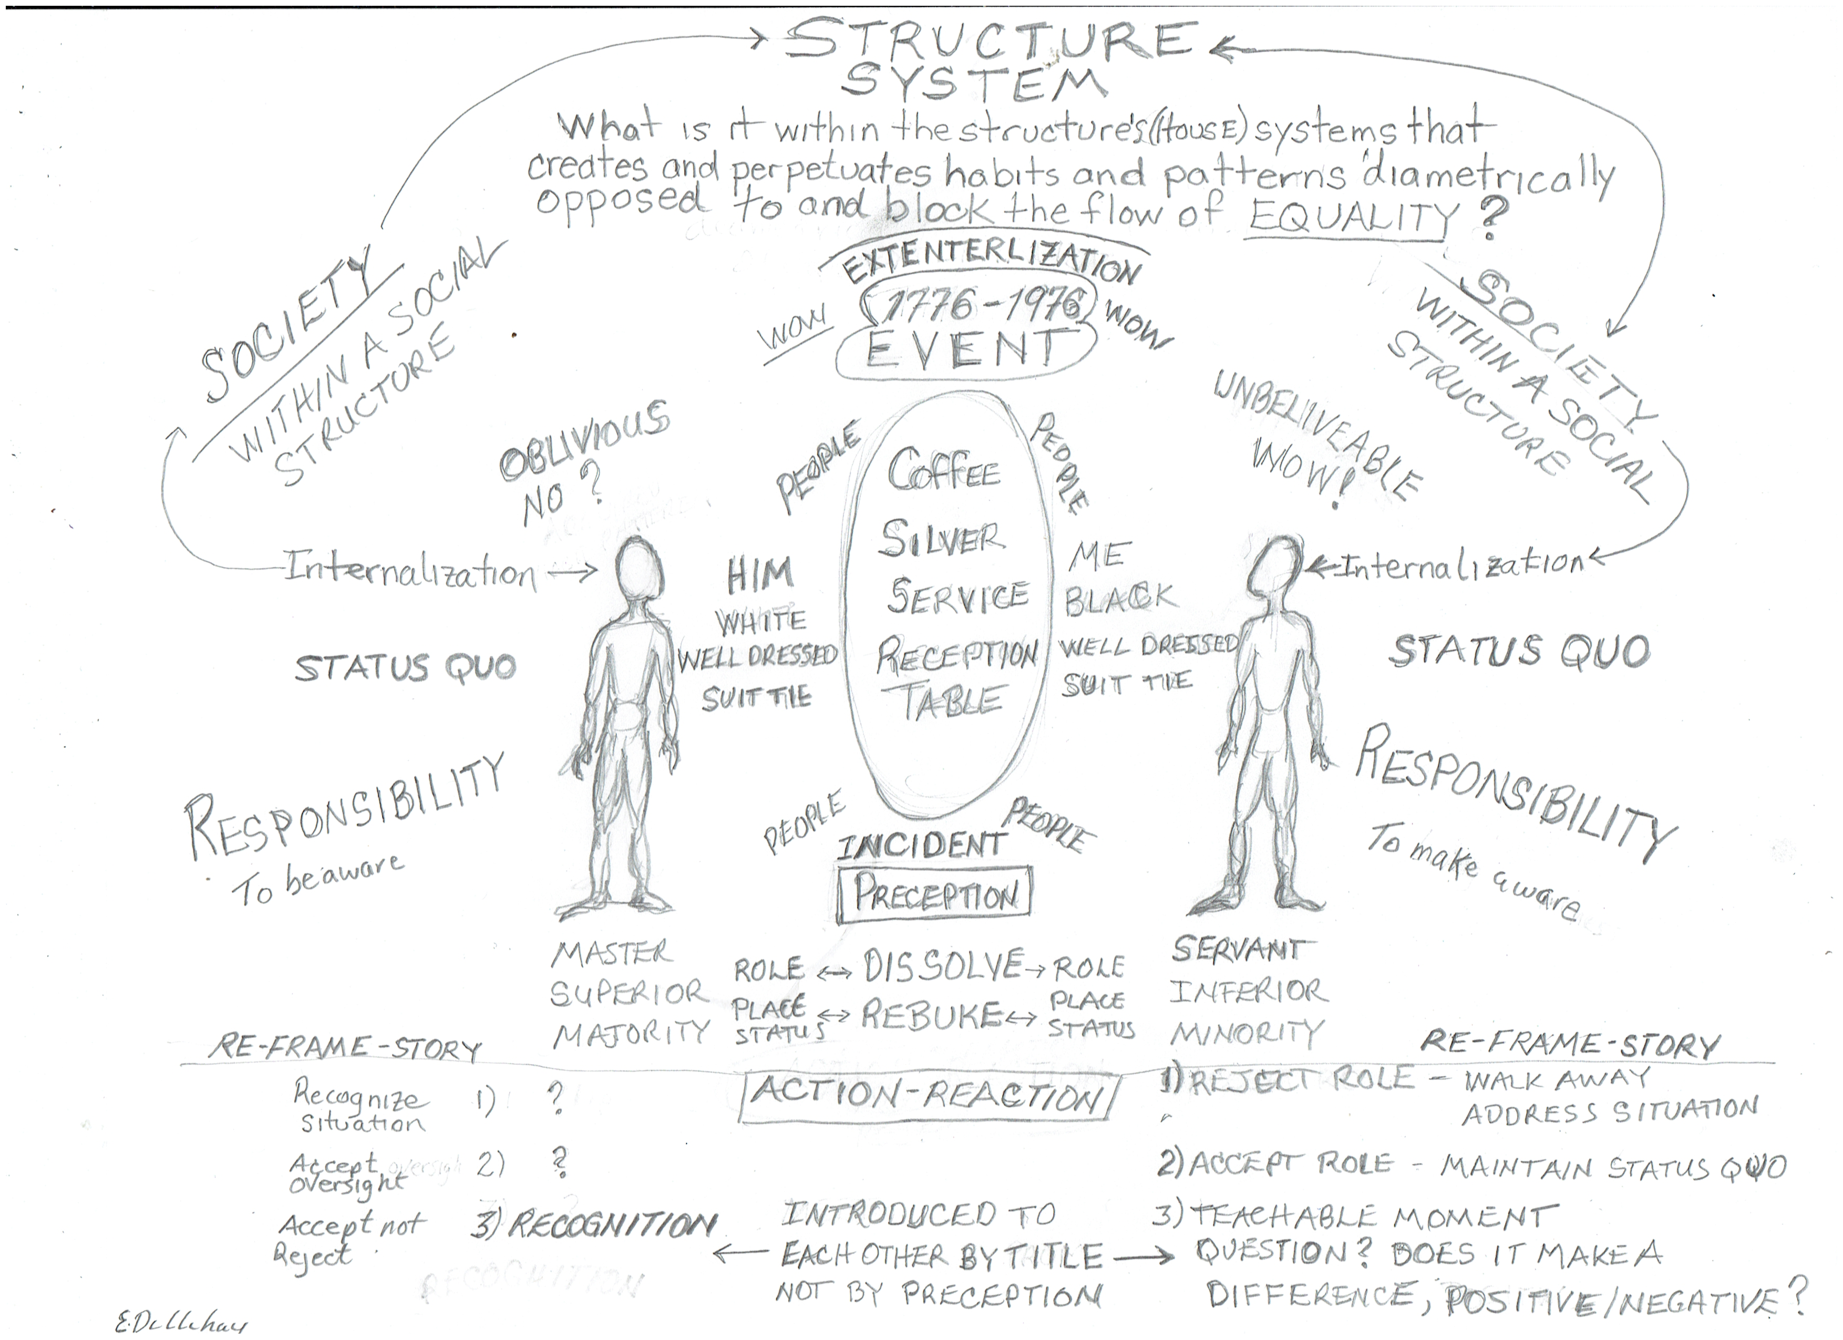
Ernest Dillihay Homework

Slide 10
Asma Manshalin Homework

Slide 11
Asma

Slide 12
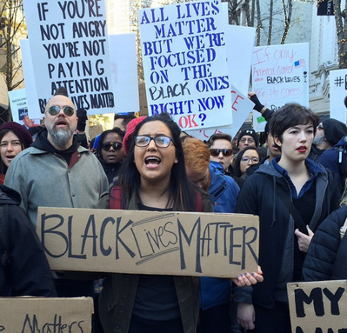
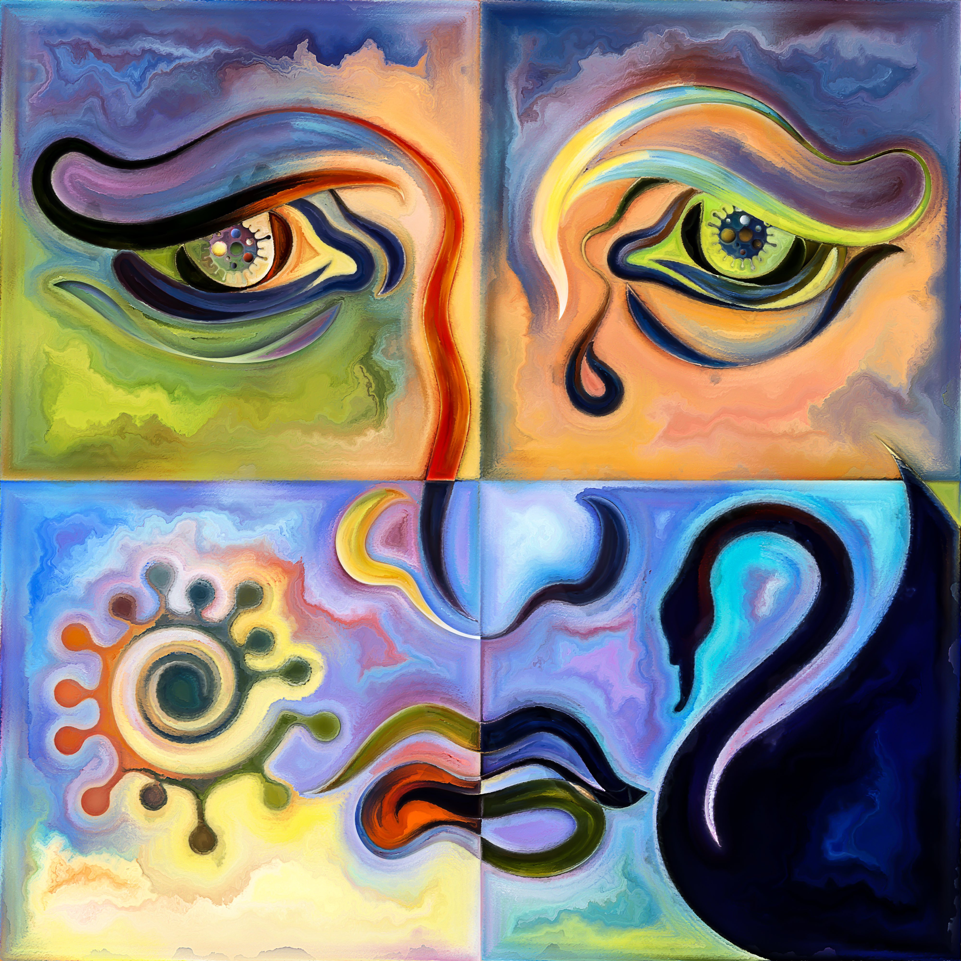
_
Roommates
BLM Protests
George Floyd
Murder
Me
Research
New budding friendship and understanding.
Modeling tolerance and appreciation in challenging times.
Olivia Parr-Rud, MS
Homework

Slide 13
_
Roommates
BLM Protests
George Floyd
Murder
Me
Research
Community gatherings to discuss racial harmony.

Slide 14
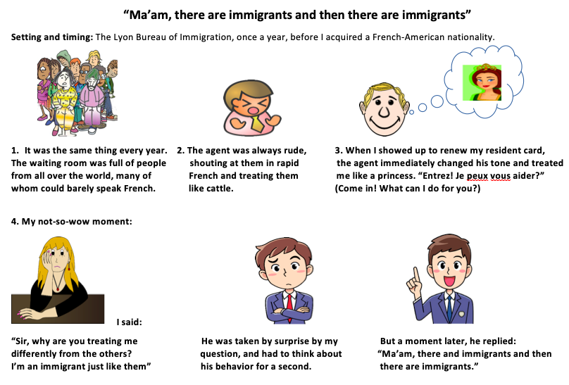
BETTY

Slide 15
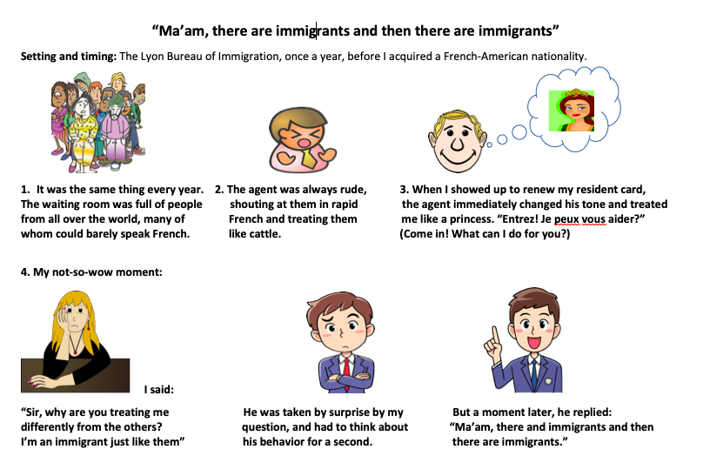
RICK HERDER

