Slide 1
Agenda for Session 1Principles 1&2
15 Min. Demo Talking Stick in Welcome by Oscar & David, cover; what to expect from the Module (ending intercultural racism): etc. Keep it short. Oscar (seek to centering all communities through TST ---building trust –truth-collaborations
10 Min. 1st Breakout (groups of 3) – passing talking stick, theme is When you experienced the Headcuts of Racism (3 questions are sent in by host):
10 Min- Plenary sharing - David: What is True Storytelling ‘ethical life, How it fits with other ethics approaches (instrumental, virtue, etc.)
David: Inner and Outer Dialogues (see figures)
10 Min. – Principle 2 – Make Room for stories already there
5 Min – 2nd Breakout Room (groups of 3) – topic – when treated unfairly (take 3 questions to the breakout)
10 min. Plenary Debrief, Check in, and homework & : What is certificate Program
Notes:
How can True Storytelling Gain Legitimacy in our lives?
A Heart-of-Care is defined as ethical Truth of ‘True Storytelling’s’ potential-for-Being-in-the-world, revealing itself as care (see Heidegger #228).
http://pdf-objects.com/files/Heidegger-Martin-Being-and-Time-trans.-Macquarrie-Robinson-Blackwell-1962.pdf
These 4 sessions are rooted in Ole Fogh Kirkeby’s The New Protreptic, what we are calling becoming a True Storytelling Guide. We don’t use the word Protreptic at this introductory level, but later a module just on this can be developed. See
The Foundations Seminar is required to earn a True Storytelling Certificate and your very own Talking Stick with animal of your choice carved on it. You may supply your own stick if you choose.

Slide 2
Intercultural Conversations to Impact Racism
True
Storytelling
Facilitated by
David M. Boje and Oscar Edwards
Notes:
Image is from free downloads https://www.pexels.com/photo/hands-heart-love-305530/
True Storytelling Intercultural Racism conversations module
10AM Mountain Time Zone on 24, 31st Aug, 7 and 14th Sept
Join Zoom Meeting
https://us02web.zoom.us/j/89397616259
Meeting ID: 893 9761 6259
Passcode: endracism

Slide 3
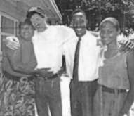
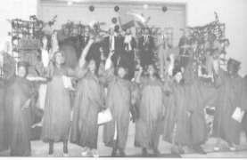
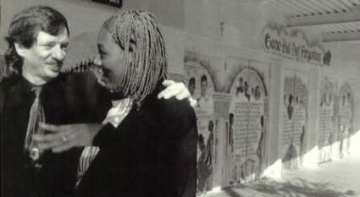
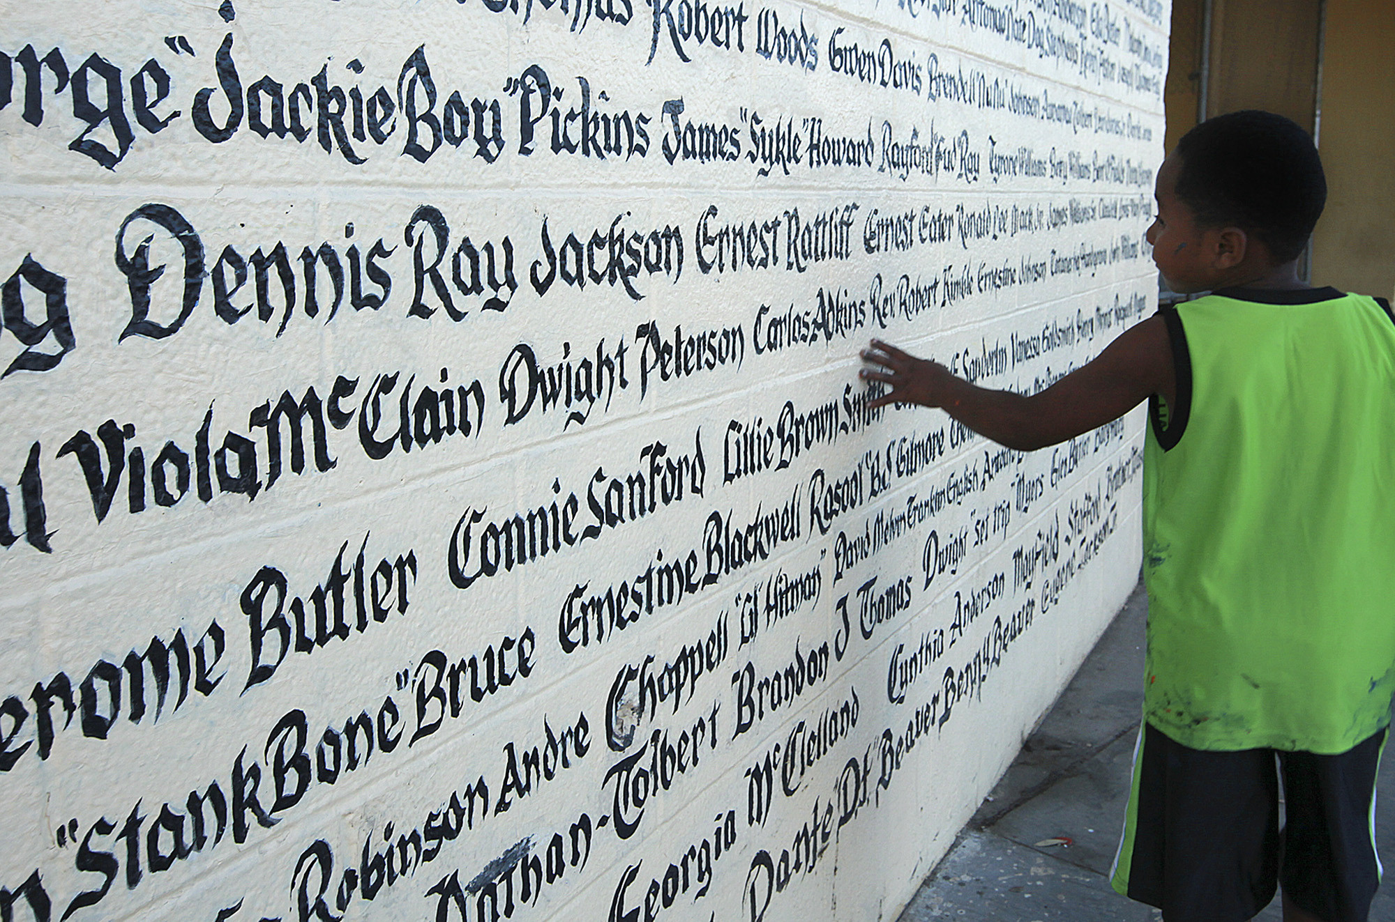
DEMO OF TALKING STICK
Oscar’s Story & David on Why are we doing this seminar
TIME LINE
Notes:
https://us-sabc.org/team/oscar-edwards/
Photo LEFT – Nora King, David Boje, Vincent Woods (Operations Director), and Lisa Sprinkles (Administrative Program Analyst for the Transportation Company of NGRMC)
Photo RIGH – graduates of 2nd training of Dual Management jobs in city bureaucracies program
Bottom photo – Boje and Pam Griffin
David → Race is a socially constructed fiction used commodify group differences, blaming the victim of the stereotype while failing to examine how the SYSTEM is the PROBLEM pitting one group against another group in a divide-and-conquer practice.
Fake Storytelling is a tool of Global Racial Capitalism used to commodify racial and gender identities in organizational storytelling systems, while hiding its hidden costs to humanity and the commons (water, land, trees, biodiversity, & climate emergency).
Racial Capitalism is defined here as a socially constructed character narrative, anchoring a systematic phenomenon of daily practices in which predominantly white institutions (media, corporations, big box stores, government, universities, & non-profits) derive socioeconomic value from fictitious narrative identities of nonwhitenes that are socially constructed in material practices of fake storytelling masking untold stories of the tragedy of the commons (land & water appropriated).
True Storytelling deconstructs the root causes of racial capitalism’s identity constructions, disclosing how commodifying whiteness and nonwhiteness is being used systemically to create symbolic value for one group while devaluing another group. Deconstructing’ blaming the victim’, ‘there is no alternative’ (TINA narratives), and ‘racialized stereotype narratives’ in True Storytelling Conversations can create ethical institutional practices and improve racial relations.
Bhattacharyya, G. (2018). Rethinking racial capitalism: Questions of reproduction and survival. London: Rowman & Littlefield.
Leong, Nancy. (2012). Racial capitalism. Harvard Law Review, Vol.126 (8): 2151-2226. (More)
Pulido, L. (2016). Flint, environmental racism, and racial capitalism. (More)
Ranganathan, M. (2016). Thinking with Flint: Racial liberalism and the roots of an American water tragedy. Capitalism Nature Socialism, 27(3), 17-33. (More)
Robinson, Cedric J. (2019). On Racial Capitalism, Black Internationalism and Cultures of Resistance. Edited by H.L.T. Quan, foreword by Ruth Wilson Gilmore. London: Pluto Press
When Me Too started it was about the personal stories. We are doing the same thing now about Racism – the personal stories, people can relate to them

Slide 4
Ground rules for ‘Safe Space’
CONFIDENTIALITY: Do not tell someone else’s story. No recording of any session by us or you.
Please do not give advice to others or use ‘should’ statements for self or others.
Speak more from the heart than from the head.
Laser in, be concise, and share only one story instead of several.
Please bring a notebook and pen/pencil to each session.
Please attend all four sessions. If you must miss one, contact us so we can schedule a session to catch you up before you return.

Slide 5
1st True Storytelling Principle: TRUTH You yourself must be true and prepare the energy and effort Impacting storytelling conversations.
3 Questions:
Are you willing to explore your own beliefs?
Will you share your beliefs with others in this workshop?
Will you commit for 4 sessions?
Notes:
Can you sustain (get energized & not burn out) in long future?
How much of you are you willing to risk? Do you have skin in the game?
Example: Living Stories with a Place, A Time, and a Truth of lived experience
Happening Here and Now
In the middle, unfolding, emerging, happening
Goes from strategic level of power, to what is best for the world in Council of Elrond
Tell LESS is MORE
BE AUTHENTIC - Create an emotional component that resonates with the audience YouTube Peter Guber of Mandalay Group, so they retell it forward owning; See article 4 truths of the storyteller HBR

Slide 6
True Storytelling Breakout #1 P1: TRUTH INSTRUCTIONS: Click the LINK to go to the breakout room. Your group will receive a question to answer. Choose a time keeper, choose the first person to answer, then start the first round of answering the question. Please use the Talking Stick method. The person with the stick has the authority to speak, & everyone else listens. TOTAL time: 10 minutes for EVERYONE NO Q&A, NO discussion, just a quick 1-2 min. or less per answer Laser in: 2 minutes per story

Slide 7
Question Sent to Breakout by Host QUESTION: Tell 1 story, a time when you let someone slide who was unaware of unconscious or implicit bias practice. HOLD your solutions(“Little Wow Moments”) for later when we “RESTORY”

Slide 8
Back from Breakout PLENARY DEBRIEF What PATTERNS do you see among the stories?

Slide 9
TOPICS over 4 sessions
P1: TRUTH Help find Truth common values, common ground, in ‘Acts of Community’ with awareness of our own implicit biases
P2: MAKING ROOM Make Safe Space to discuss systemic racism
P3: PLOT Get everyone to the table); we’ve flat lined 40 years now (not translated into practice); who are actors of community body (Nora King) and actors not of the community
P4: TIMING What is happening systemically, lessons not learned; one of the positive super powers of community is that members can give testimony about the truthfulness of the systemic issues
P5: Helping (New) Stories How to restory with little wow moments, into ‘new’ story of future?
P6: STAGING Ways to bring ‘new’ story to the table (storyboarding a new future)
P7: REFLECTION Deepen the practice of ‘embodied reflection and valuing community to impact ‘new story’ in creating web of trust relationships by the 4th session
Notes:
Nora King Link https://web.nmsu.edu/~dboje/rmcstory.html picture only https://web.nmsu.edu/~dboje/dm1.html
What stories (+/-) are already in the community, nation, & world about systemic racism
P1
Coach people about Racism using talking stick story circles
P6: Align the inner dialogue of the mind with the inner dialogue of the heart;
Align the head/heart dialogues with your embodied outer dialogues with others (your verbal storytelling, and walking the talk);
Apply ‘True Storytelling’ conversational tools to
Racism in family, community, business, government, & education;
Consider both Doing and Being (do-be-do-be-do) for an ethical life in your own living story
P7:
Do advanced ‘process coaching’ using conversational storytelling by the 4th session
Acquire skills in process consultation using story circles that are open dialogue conversations by the 4th session.

Slide 10
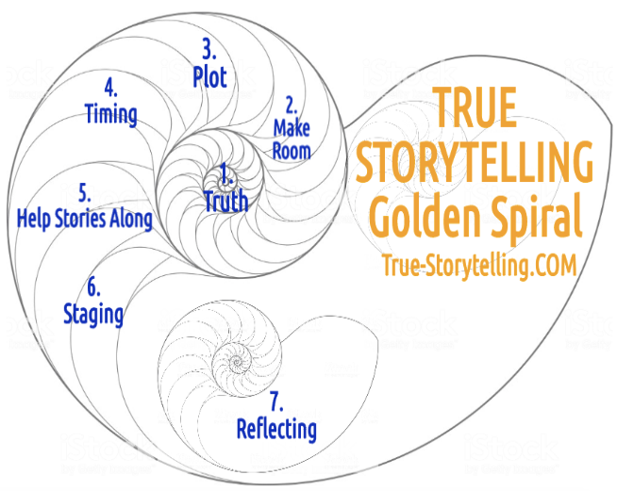
True Storytelling – 7 Principles for Impacting Racism
Session #1 P1: What is Truth? &
P2:
Make Room
Notes:
What is ‘Truth’? – It is the ancient Greek dialogues that bring True Storytelling out of hiding.
A ancient indigenous Guide before Aristotle and Plato would help people find a way of Being-in-the-world of Being-true
In today’s corporations, media, government, and our daily lives, The Being-true of ‘Truth’ has been diminished.
As Walter Benjamin (1968, in 1930s essay The Storyteller) put it, ‘True’ “Storytelling is coming to an end”.
See p. 4 and read his story of the ‘True Storyteller’ https://arl.human.cornell.edu/linked%20docs/Walter%20Benjamin%20Storyteller.pdf
“From this story it may be seen what the nature of true storytelling is” (p. 4).
TRUTH in True Storytelling is what Parmenides called “The Goddess of Truth”… “both in truth and in untruth: (Heidegger, Being and Time, 1962: section #223).
As True Storytelling Guides, you encounter the Truth and Untruth of your own inner and outer dialogues.
We live in societies that cover up what is Truth and Untruth, and what a True Storytelling guide does is uncover the Truth (#226).

Slide 11
Learning Objectives for Principle #1: True Storytelling
Identify 7 elements of True Storytelling.
Commit to building a True Storytelling community in this group.
Distinguish between head and heart storytelling.
Practice congruence and wholeness of integrated head and heart communications
Explore examples of implicit and unconscious bias to identify the underlying structural and systemic conditions which promote these behaviors.

Slide 12
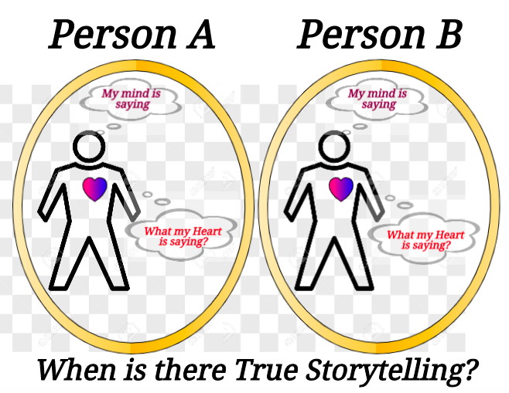
What gets
Said?
What gets
Said?
Notes:
True Storytelling has WHOLENESS of head and heart INTEGRITY: from Integral = whole means CONGRUENCE of head and heart with What Gets Said

Slide 13
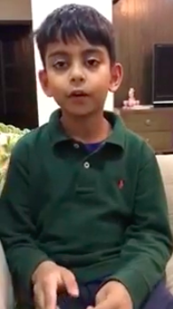
TRUTH in Acts of Community https://www.youtube.com/watch?v=zcLnsnJ-ZsY
What is Your TRUTH Practice? Worry, Joy, Complaining, Peace?
If we practice worry, we get so good at it that we see worry everywhere.
Let us practice
LISTENING to stories and NOTICING,
without judging or anger, and
without blaming or ‘fixing’.
Notes:
How would you feel if your child saw this behavior -

Slide 14
Learning Objectives for Principle #2: Making Room for other Stories
Practice “listening” to others’ stories.
Practice “noticing” the untold stories.
Identify the untold and less-visible stories of systemic and structural causes of implicit and unconscious bias in both our own and others’ stories.
Identify broader networks of stories related to systemic and structural sources of bias.
Notes:
Relate listening and noticing to stories from Oscar and David, and to Breakout #1 stories.
Not moving with nice talk, time to get serious and go deeper into the true storytelling conversations, and make room for breakthrough possibilities
Bystander theory, and answerability ethics of bystander vs. the answerability to intervene because you are the one person in the eventness of Being that is there with the skill to intervene.
Commit to the common value rudder

Slide 15
BREAK OUT “Talking Stick” PROCESS
SPEAKERS: Pick someone to share their story first. The person who speaks holds the Talking Stick, and only they have the authority to speak. They will share one (and only one) story. When done, the speaker says ‘I’m done’ or ‘Ho’ or ’I’m complete’ so people know when they are done. The current speaker chooses who will speak next and passes the Talking Stick to that person.
LISTENERS: Use deep listening; do not ask questions of the storyteller, do not give advice, and please hold a space for silence because silence speaks.
PASS OPTION: It is OK to ‘pass’ and wait for another opportunity;
TIME: Continue to Story Circle until all have shared once, and if time remains you may do another round.

Slide 16
QUESTION for Breakout 2
Building on what we have discussed so far, take
2 min. to think and write down some answers to the following question:
Q#1. Tell a story of an experience you have had, when you noticed systemic and structural conditions that
promote and allow unconscious and implicit bias to happen again and again, year after year?
Then…
CLICK on the link to enter your break-out group,
CHOOSE a timekeeper, CHOOSE who will go first, and
BEGIN, with each person telling their story in less than 2 min.
(Note: Stay hopeful! We will learn how to change these stories in Session #3!)
Notes:
#1. When were you UNFAIRLY TREATED?
(Example: I should have been promoted, but…) – pass the stick
#2. What was valued instead of your side of the story? Can you name the value?

Slide 17
Debrief
Systemic and Structural Sources of
Implicit Bias and Unconscious Racism:
Economic
Political
Historical
Sociological
Place-based
???

Slide 18
Next session HOMEWORK
A. Practice Principle1: In your notebook, write about listening and noticing a story of unconscious and/or implicit bias this week;
B. Practice Principle 2 Making Room: Look for and write down some possible systemic and/or structural factors fostering the bias observed in your story from Part A (above).
Notes:
As Walter Benjamin (1968, in 1930s essay The Storyteller) put it, ‘True’ “Storytelling is coming to an end”.
See p. 4 and read his story of the ‘True Storyteller’ https://arl.human.cornell.edu/linked%20docs/Walter%20Benjamin%20Storyteller.pdf
“From this story it may be seen what the nature of true storytelling is” (p. 4).

Slide 19
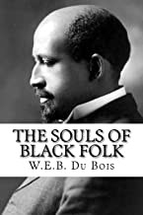
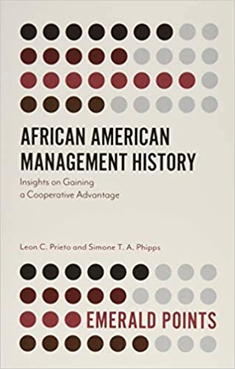
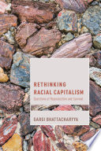
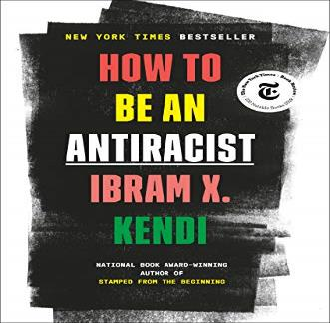
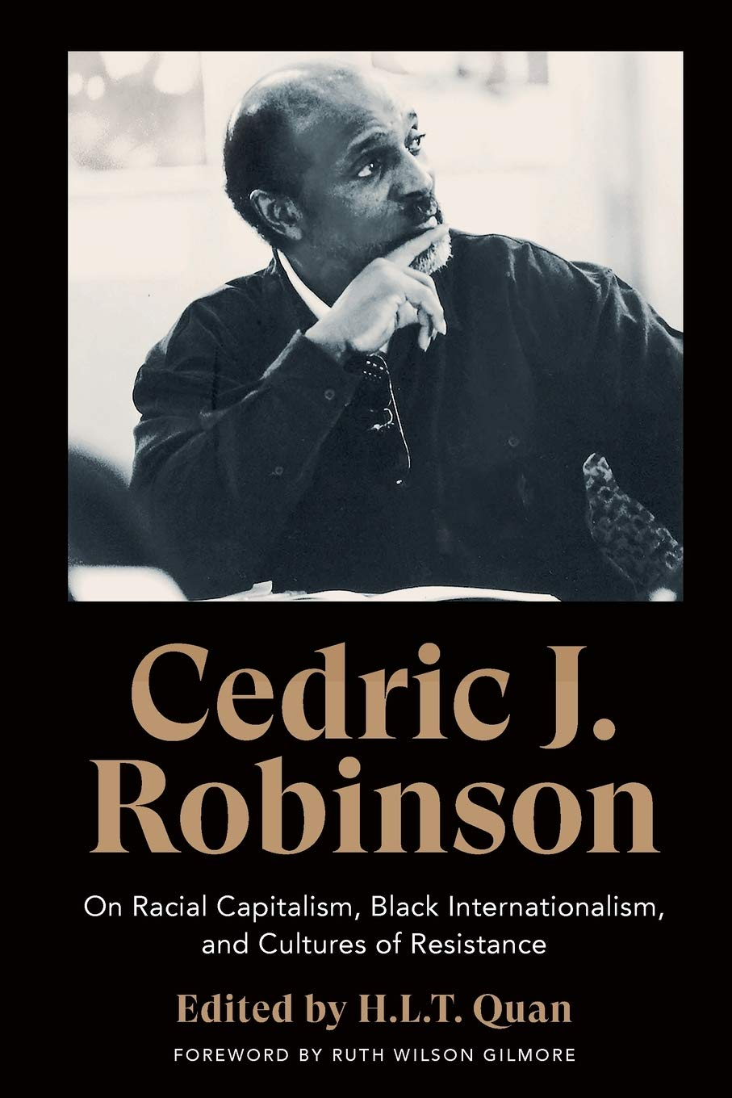
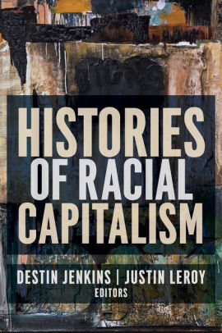
BUILD YOUR LIBRARY
Notes:
Bhattacharyya, G. (2018). Rethinking racial capitalism: Questions of reproduction and survival. London: Rowman & Littlefield.
“Race does not do things in the world, but racism does” (Bhattacharyya (2018: 103).
Robinson, Cedric J. (2019). On Racial Capitalism, Black Internationalism and Cultures of Resistance. Edited by H.L.T. Quan, foreword by Ruth Wilson Gilmore. London: Pluto Press.

Slide 20
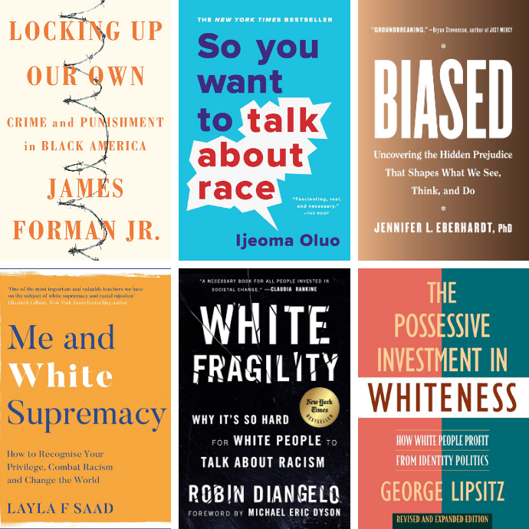
BUILD YOUR LIBRARY
Notes:
This is something we have to deal with, to find the Truth in it, and not talk around it anymore

Slide 21
Homework Videos Principle 3: What is the Plot? What is Racial Capitalism and Why Does it Matter by Robin D. G. Kelley Geographies of Racial Capitalism by Ruth Gilmore How Capitalism Needed Racism to Operate by Boots Riley Racial Capitalism Power and Resistance by Barbara Ransby The Black Outdoors: Fred Moten & Saidiya Hartman

Slide 22
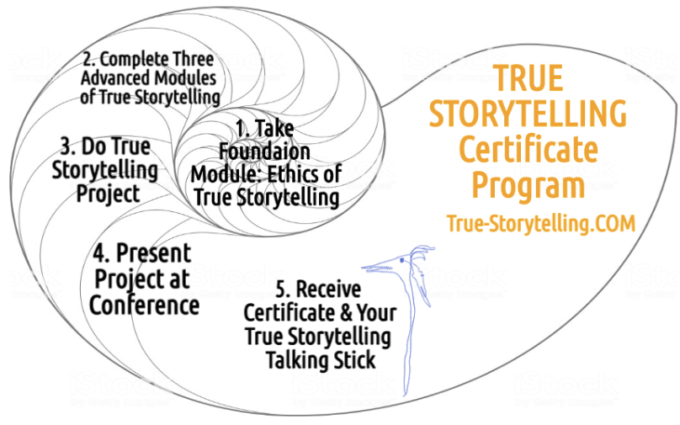
Become a True Storyteller
“It’s not about living a good life, but a true life
[an ethical life]” – Kierkegaard
Jens Larsen oldfriendsindustries@gmail.com ,
David M. Boje davidboje@gmail.com ,
Grace Ann Rosile garosile@nmsu.edu ,
Lena Bruun lenabruunjensen@gmail.com
True-storytelling.com Truestorytelling.blog

Slide 23
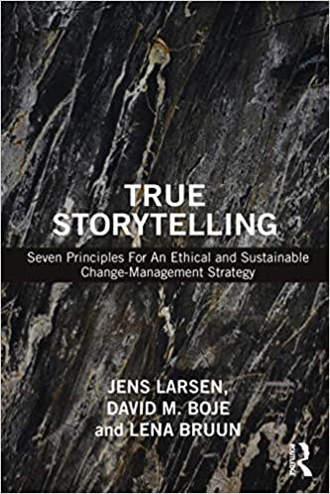
Thank you More information on True Storytelling
https://true-storytelling.com
https://truestorytelling.blog
David Boje davidboje@gmail.com
Oscar Edwards oscar@hgs-solutions.com

