Slide 1

How to Live the True Storytelling® Life

Slide 2
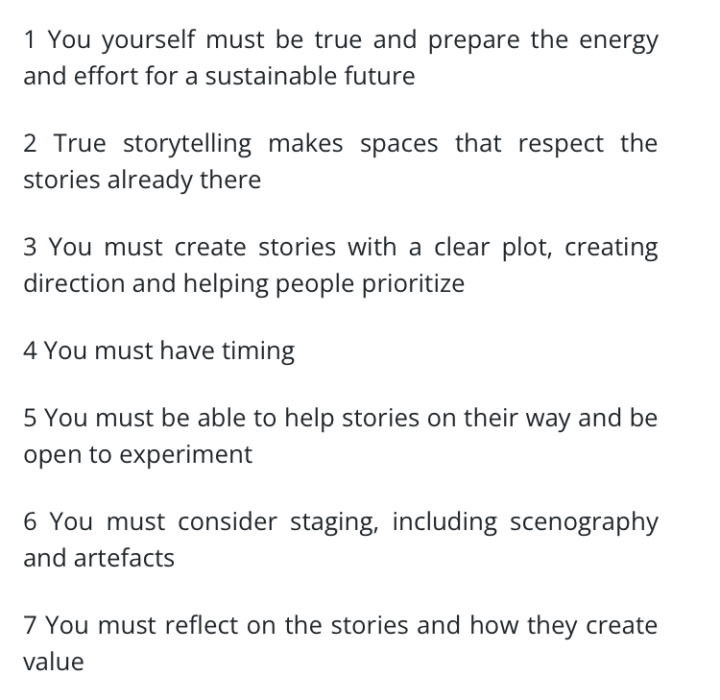
These are 7 Principles of True Storytelling: Basis of 3 Levels of Certificate Programs

Slide 3

Begin as Truth-Teller, then do 2, 3
Certificate programs are offered at 5 levels
1. Truth-Tellers
2. Truth-Listeners
3. Truth-Seekers

Slide 4
Prerequisite – Complete 1, 2, & 3
Most Advanced
Certificate program Levels
4. True Storytelling® Trainer
5. True Storytelling® Process Consultant

Slide 5

Truth-Tellers are Living the Ethical Life
How to live an ethical life?
How to be truthful in organizations that too often are not?
How to overcome estrangement from our own self, from nature, from one another and from the meaning of life.
This is captured in the words of Danish philosopher, Søren Aabye Kierkegaard:
"The truth is what ennobles" - Søren Kierkegaard
"The more consciousness, the more self, the more consciousness, the more will; the more will, the more self" (Kierkegaard 1849: 29).

Slide 6
What is Truth-Teller Certificate?
Certifies you know and can apply the True Storytelling Principles
Certifies you completed 'Foundation Ethics Module', and 3 Advanced Modules
Entitles you to practices module exercises with Alumni of TSI modules
Does not allow you to become a TSI trainer (takes higher level certificates)

Slide 7
Level 1 (Truth-Tellers) Complete 4 of these 5 Recommended Course Modules
'True Storytelling® Foundation Ethics' Certificate ©TSI
True Storytelling® Innovation and Entrepreneurship ©TSI (
True Storytelling® for Ethical Administration ©TSI
True Storytelling® for an Ecological Future ©TSI
True Storytelling Innovation and Entrepreneurship ©TSI

Slide 8
1-8 of 19 Modules to choose from
True Storytelling Ethics Foundations ©TSI (Mandatory before any other module, all levels)
©TSI* True Storytelling® Leadership and Success (Manual by Jens Larson & Lena Bruun) Prerequisite None
True Storytelling Innovation and Entrepreneurship ©TSI (Manual by Jens Larson & Lena Bruun) Prerequisite None
True Storytelling® for Ethical Administration ©TSI* (Manual by Jens Larson & Lena Bruun) Prerequisite None
True Storytelling for an Ecological Future ©TSI (Manual by Jens Larson & Lena Bruun) Prerequisite None
Ensemble Leadership Module ©TSI (Manual by Rosile & Boje, see Reference) Prerequisite Level 1
Worker Driven Corporate Social Responsibility ©TSI (Manual by Rosile & Boje) Prerequisite Level 1
Organizational Change & Development ©TSI Prerequisite Level 1, 2, 3, & 4

Slide 9
Module Options 9 to 13
9. True Sustainability Beyond Sustainability Theater ©TSI (Manual by Boje & Larsen) Prerequisite Level 1
10. Diversity Equity Inclusion ©TSI Prerequisite Level 1, 2, 3
11. Conversational Storytelling Interviewing ©TSI* (proposed12. Process Consulting Module ©TSI* (Manual by Boje) Prerequisite Level 1, 2
13. True Storytelling Coaching Module ©TSI* (Proposed Manual by Larsen) Prerequisite Level 1, 2, 3, 4
14. Startup Module ©TSI* (Manual by Bruun) Prerequisite Level 1, 2
15. Quantum Storytelling Consulting ©TSI* (Manual by Boje, see reference) Prerequisite Level 1, 2, 3, 4
16. Attunement to Quantum Energy Fields ©TSI* (Manual by Boje) Prerequisite Level 1
17. Self-Correcting Research & Intervention Methods ©TSI (Manual by Boje, Rosile, & Sibel, see reference) Prerequisite Level 1, 2
18. Antenarrative Module ©TSI* (Book by Boje) Prerequisite Level 1, 2, 3
19. Multifractal Consultation ©TSI* (2 books by Manual by Boje & Henderson) Prerequisite Level 1, 2, 3, 4

Slide 10
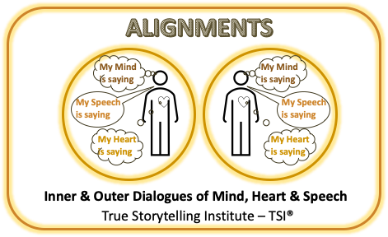
Truth-Teller Tool

Slide 11
Tool for Truth-Tellers
HANDOUT How to Make a Storyboard & Restory by Grace Ann Rosile

Slide 12
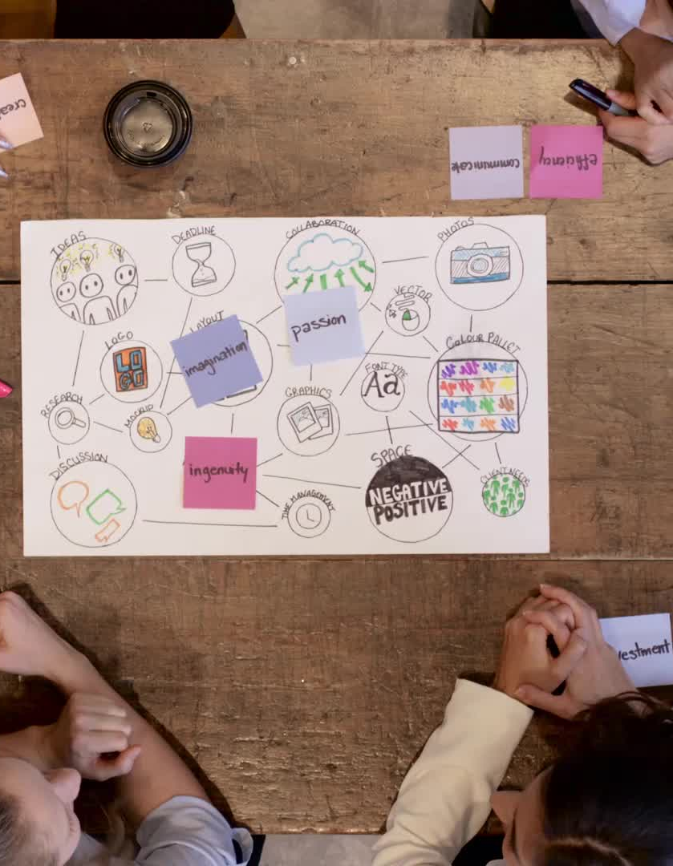
What to do as a Truth-Teller
Practice being at True-Storyteller
You can repeat modules or take new ones.
You can also join an alumni meeting of TSI
Get some more practice in the tools.
Join a “Storytelling Circle” Alumni Zoom group.
A great place to check-in & stay in tune with True Storytelling® Principles

Slide 13

Live the Truth-Listener Life (Level 2)
Listening is more important than telling because:
Together-telling requires Together-Listening to one another
Excellent Leaders, don’t just tell, they listen to the storytelling of workers, managers, technicians, suppliers, customers, supply chain members).
Truth-Listeners listen to other humans and can interpret material artifacts (principle 6)
Truth-Listeners learn to be reflective (principle 7) to listen to their heart.

Slide 14
Truth-Teller Tool
Talking Stick Method
First speaker has the stick, shares their story,
then picks the next speaker
Listeners - DEEP listening, NO questions,
NO advice, ALLOW silence
Stick holders: you speak; share ONE story;
when done say ‘Ho’ or ‘Complete’ or ‘I’m Done’
OK to ‘pass’ and wait for another opportunity
If time remains after all have shared once,
do another round.
Notes:
Nuts-and-Bolts CHECKLIST
Part 2 / Session #2:
5. Using “active” methods for conveying theory/lecture
6. Giving instructions for break-out groups
7. Modeling a break-out group process
8. Sitting in on break-out groups
9. Debriefing a break-out group and moderating discussions
10. Asking for and Responding to questions/comments

Slide 15

What is Level 2 “Truth-Listener” Program?
Includes modules around together-listening.
Includes apprenticing with one of the TSI founding members or certified TSI trainers.
Learning and Practicing Level 2 TSI tools
What’s it for? Graduates can be licensed to do completed True Storytelling® modules with your own clients
(school systems, military, government departments, corporations, small businesses, or non-profits, and other entitiesO.
There is a requirement to stay current with ©TSI practices, new modules, and new tools (one module a year).

Slide 16
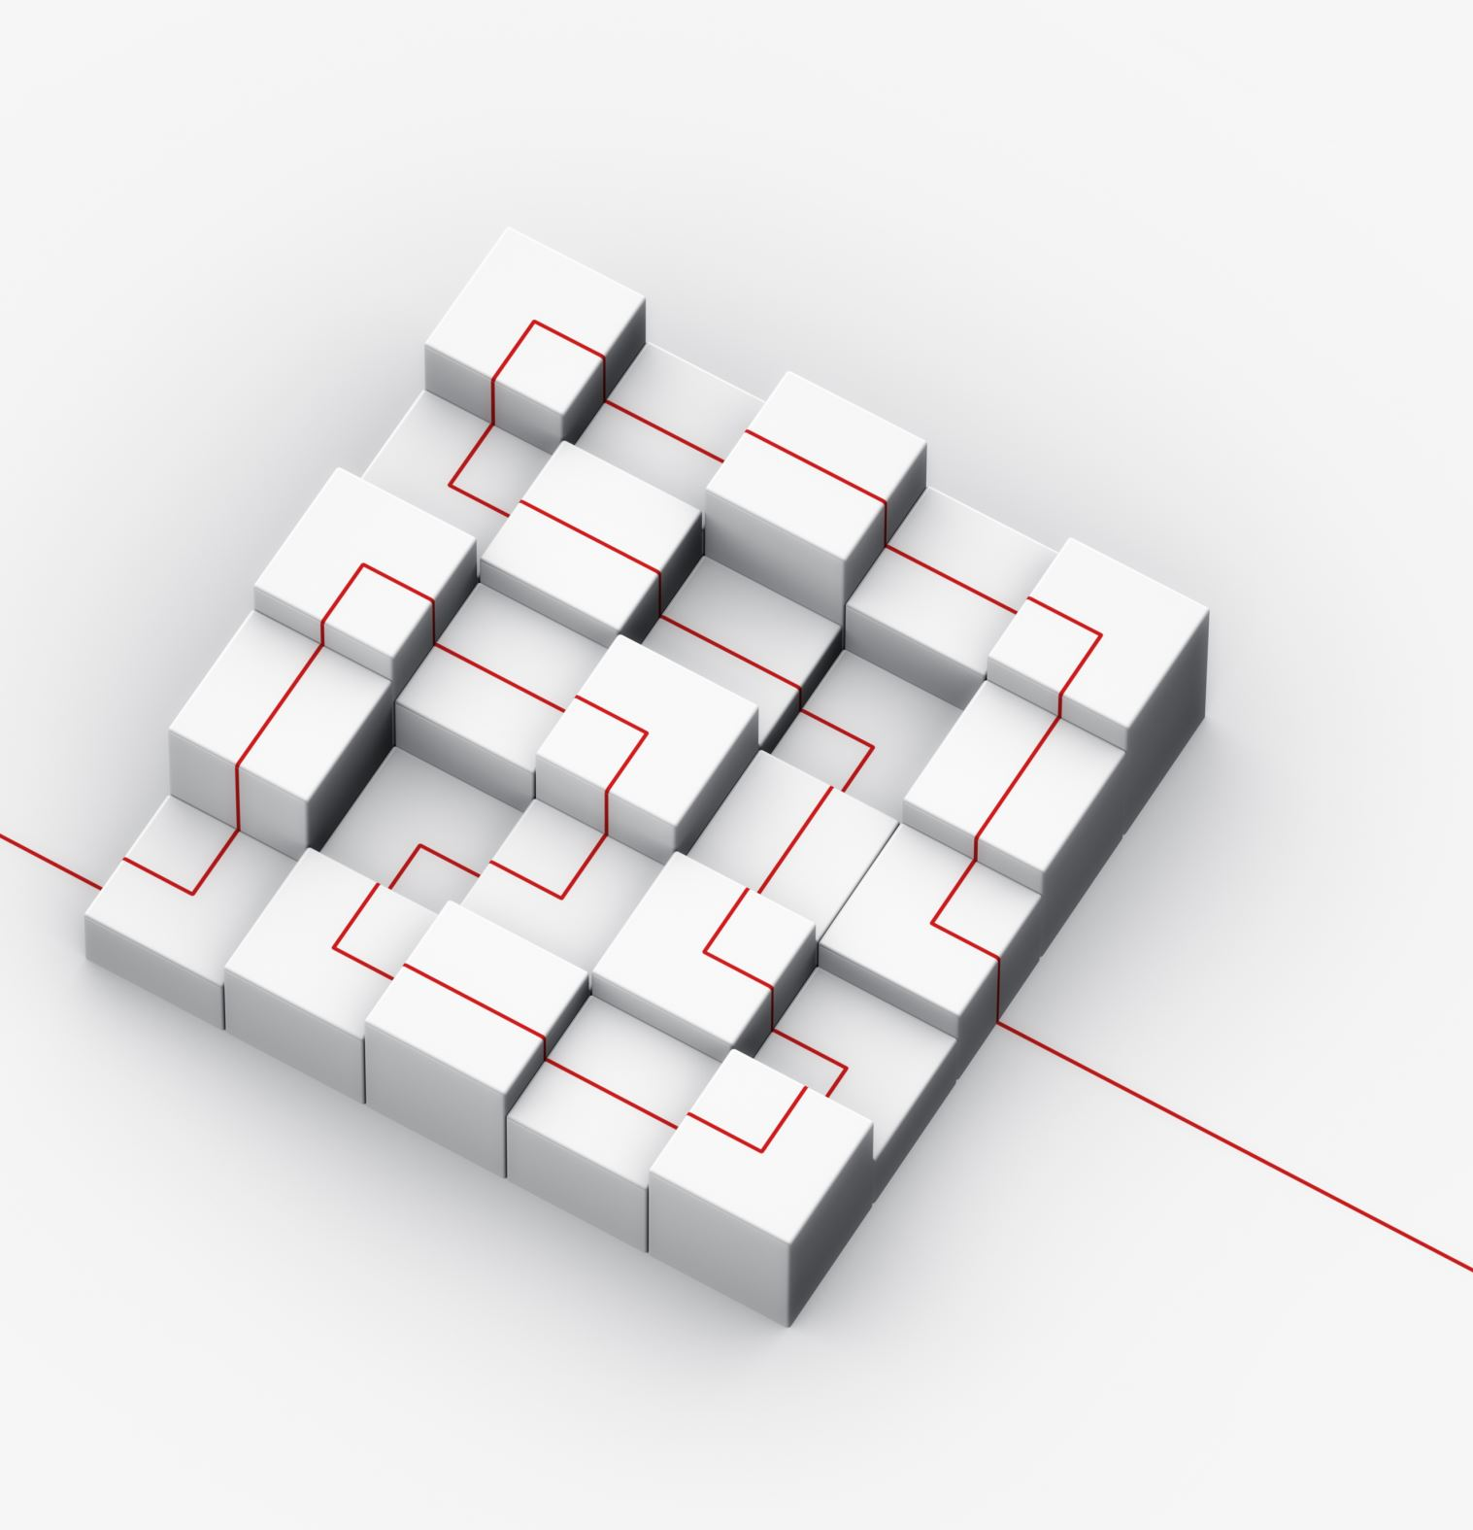
4 Recommended
Truth-Listeners Modules plus project
Ensemble Leadership Module ©TSI* (proposed Manual by Rosile & Boje, see Reference) – Leaders listen to others
Worker Driven Corporate Social Responsibility ©TSI* (Manual by Rosile & Boje) – Listening to workers
Worker Driven Corporate Social Responsibility ©TSI (Manual by Rosile & Boje) Prerequisite Level 1
Attunement to Quantum Energy Fields ©TSI* (Manual by Boje) Prerequisite Level 1
PROJECT: Do Restorying by Listening for Little Wow Moments that make a new story for your future

Slide 17
RESTORYING Tool
1. Recharacterize (received Organization identity) from how other organizations are telling it.
2. Externalize (re-label) Make the Problem the Problem, not the Person as the problem.
3. Sympathize (benefits) – of old story of or your organization has its payoffs
4. Revise (consequences) – What are the negative consequences, including the stereotypes of received organization identities being applied to you?
5. Strategize (Little Wow Moments of exception to Others' dominant master narratives); Reclaim Little Wow Moments
6. Restory (rehistoricizes the old dominant narratives by collecting Little Wow Moments into A 'New Story' of you several possibility futures), to not be stuck in the past, reliving one event
7. Publicize (support networking) e.g. letter writing, social media, celebratory events with supporters of your ‘New Story’ of future and potentiality, to stay in the ‘new world.’

Slide 18
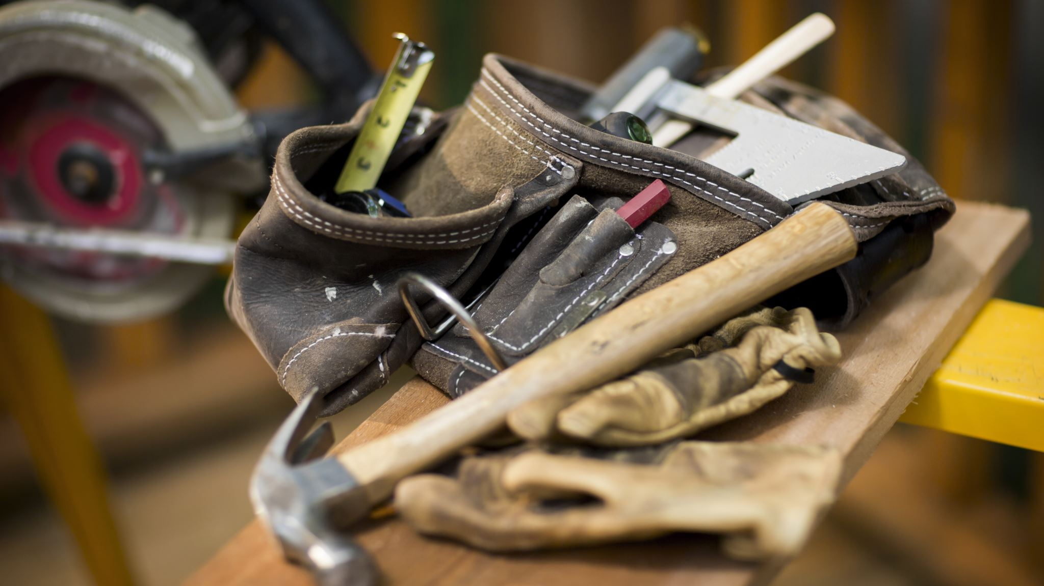
Tool for Attunement

Slide 19
What A Truth-Listener Learns to Do
Learn skills in facilitating client and participant restorying. This goes way beyond just doing storyboarding.
Learn Embodied Restorying, P4 (Respecting Stories already There by listening.
P5 (Helping Stories Along) by learning to guide by listening.
Guiding from BEFORE to BEING with BETWEEN, BEYOND and making new BETS on your Future that does not just roll out a leader-telling the way without taking input.
Helping to listen so people get Unstuck from a Rut in their Past.
Making Bets on the Future (P3 Plot) by together-listening to many plots possible.

Slide 20
What Can A Truth-Listener Do With their Certificate?
Certifies you know and understand the True Storytelling ®Principles
Certifies you completed Foundation Ethics Module and earned this Level 2 Advanced Module Certificate.
Entitles you to host practices module exercises with Alumni of TSI modules
Does allow you to become a ©TSI trainer, consultant, or coach(takes years of training) with your own clients.
Does not allow training outside your work organization.. You can not teach others to be trainers.

Slide 21

Live the Truth-Seeker Life
This involves learning advanced methodologies
Requires apprenticing with TSI founder and/or certified coaches
Requires a Truth-Seeker personal inventiory

Slide 22

Level 3 Truth-Seeker Prerequisites
Must have completed Truth-Teller (Level 1) and Truth-Listener (Level 2) certificate programs
Must submit brief resume.
Must do interview with True Storytelling® founder(s)
Submit your letter of intention (Why this is for you) to be admitted to level three certificate programs.

Slide 23
Truth-Seeker (Level 3) Recommended 4 Modules
Conversational Storytelling Interviewing ©TSI* (proposed Manual by Boje & Rosile)
Self-Correcting Research & Intervention Methods ©TSI* (Proposed Manual by Boje, Rosile, & Sibel, see reference)
Attunement to Quantum Energy Fields ©TSI* (Manual by Boje) Prerequisite Level 1
Startup Module ©TSI* (Manual by Bruun) Prerequisite Level 1, 2

Slide 24
What Truth-Seeker Learns
Advanced methodologies in True Storytelling® practices
How to use conversational storytelling interviewing
New Tools for True Storytelling® unavailable to Truth-Teller & Truth-Listener levels

Slide 25
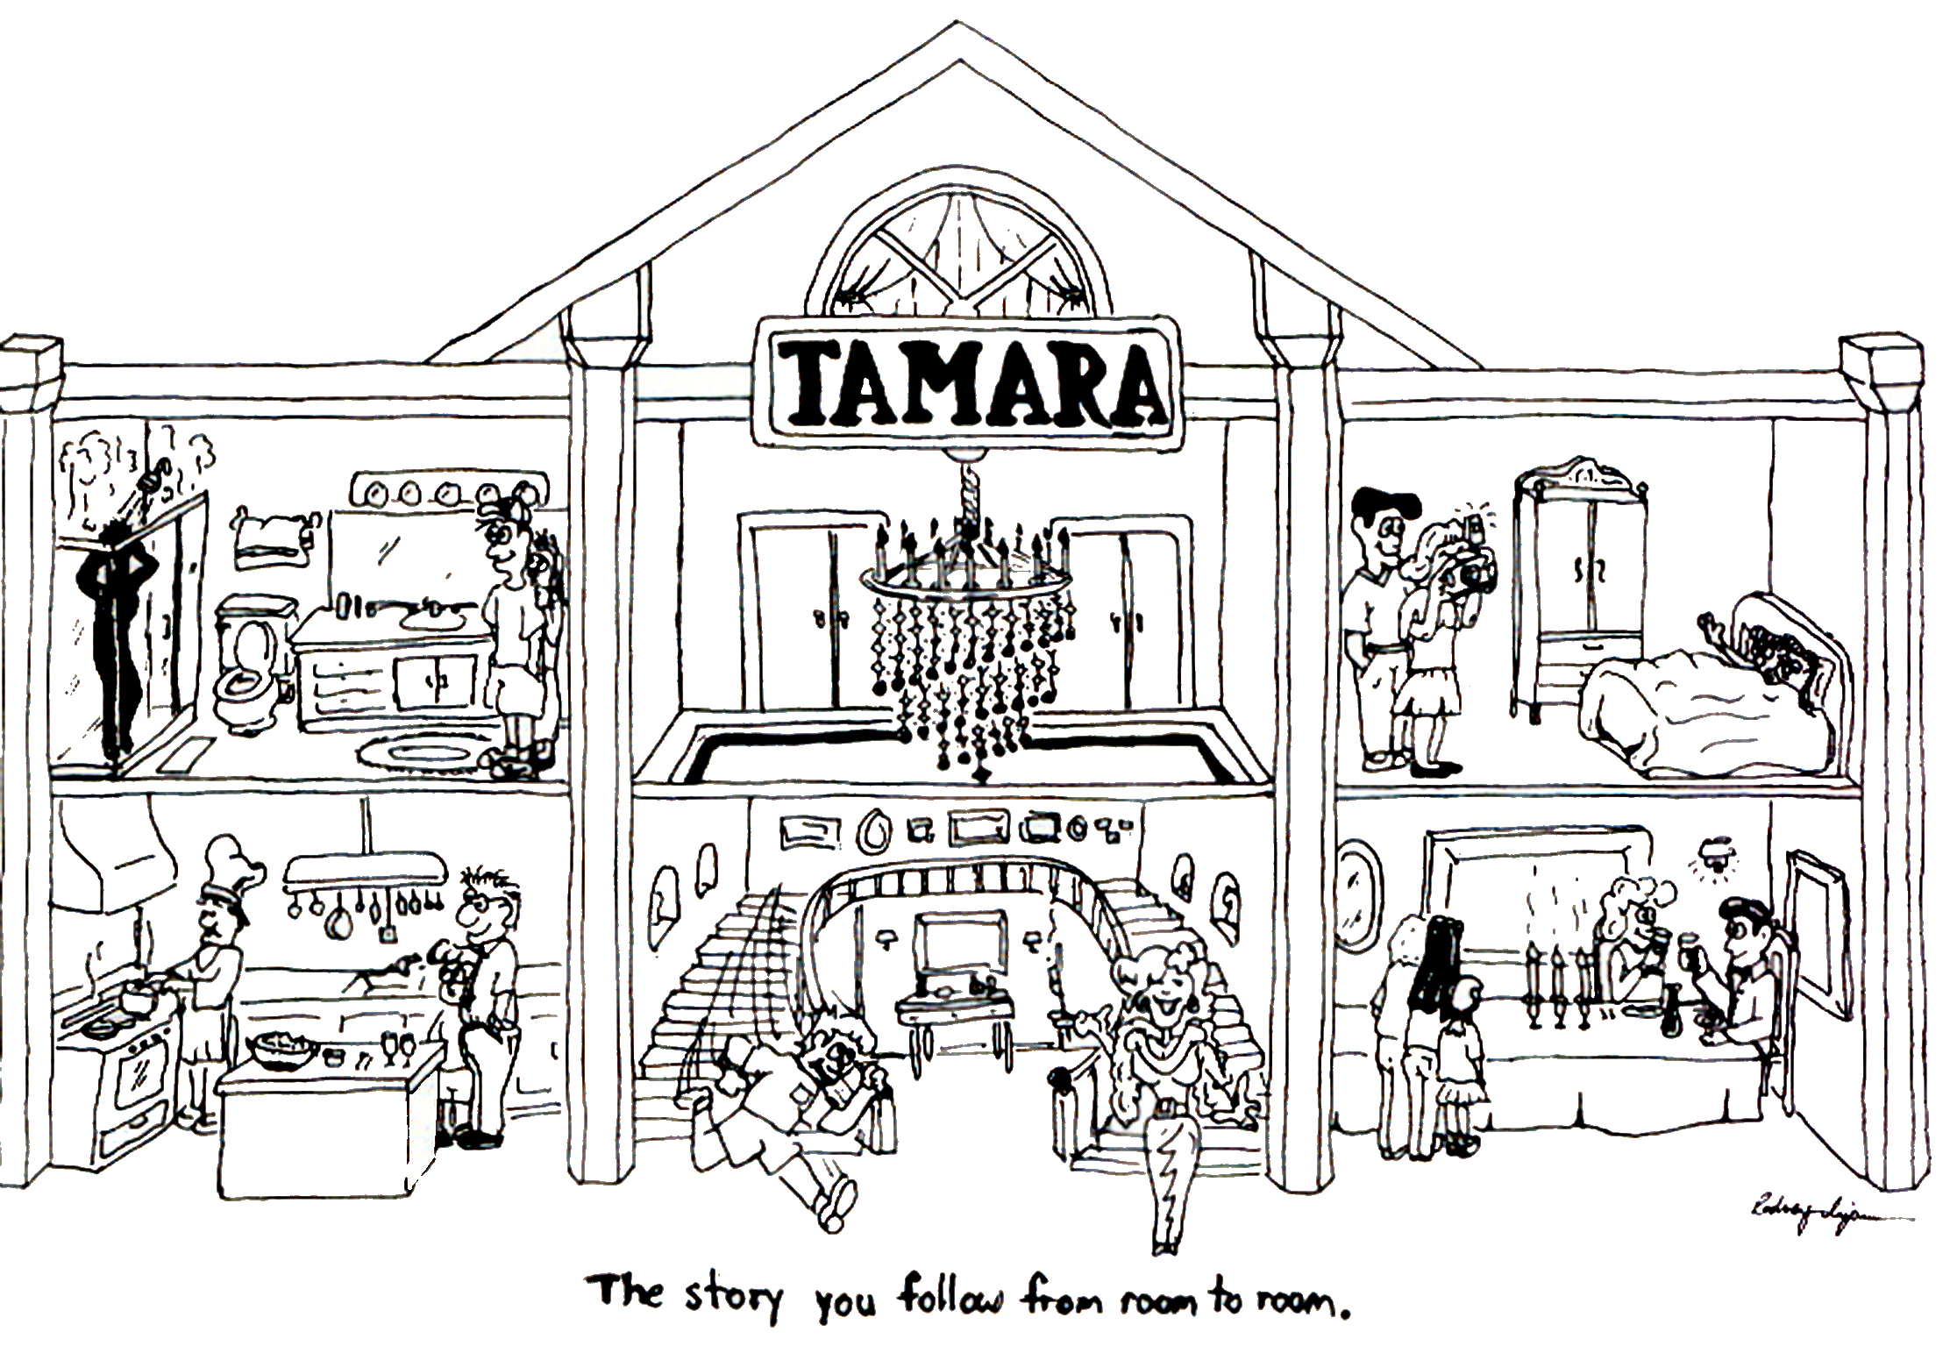
Truth-Seeker Tool: TAMARA-LAND
TAMARA-Land
True Storytelling Institute – TSI®
“You cannot be in every room at once. So the Meaning of the storytelling conversation in the room you are in depends on the history or rooms you have been in.”
The factorial of 6 rooms in TAMARA-LAND Is exactly 720
Notes:
The factorial of 6 rooms in TAMARA-LAND Is exactly 720
The factorial of 12 rooms is exactly 479,001,600
So the calculation is to be tested with Jim: 6 room

Slide 26
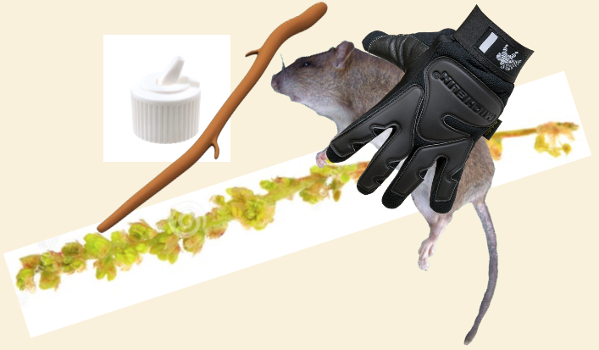
Onto-Story Tool for Principle 5 - Staging
“On a sunny Tuesday morning on 4 June in the grate over the storm drain to the Chesapeake Bay in front of Sam’s Bagels on Cold Spring Lane in Baltimore, there was”…
EXERCISE Tell the onto-story of things
– large men’s black plastic work glove
– dense mat of oak pollen
– unblemished dead rat
– white plastic bottle cap
– smooth stick of wood
Notes:
What is onto-story. A term invented by Jane Bennett (2010). Vibrant matter: A political ecology of things. Duke University Press.
The vibrant mattering of ontological story (Onto-Story).
Bennett gives this example (2010: p 4. Thing-power):
On a sunny Tuesday morning on 4 June in the grate over the storm drain to the Chesapeake Bay in front of Sam’s Bagels on Cold Spring Lane in Baltimore, there was:
one large men’s black plastic work glove
one dense mat of oak pollen
one unblemished dead rat
one white plastic bottle cap
one smooth stick of wood
Glove. pollen. rat. cap. stick. As I encountered these items. they shimmied back and forth between debris and thing-between. on the one hand. stuff to ignore. except insofar as it betokened human activity (the workman’s efforts. the litterer’s toss. the rat-poisoner’s success). and, on the other hand, stuff that commanded attention in its own right, as existents in excess of their association with human meanings, habits, or projects. https://davidboje.wordpress.com/true-storytelling-of-spacetime-and-worldhood-of-being/
About Rats, Disney movides vilify rats, but rats have many jobs. E.g. “Just think of the rat that almost killed the baby in Disney's "Lady and the Tramp" or evil Professor Ratigan, the murderous villain in the Sherlock Holmes-inspired "The Great Mouse Detective." The dichotomy used to be pretty clear: mice are good guys and rats are bad.” …
“The African giant pouched rats trained by the Belgian nonprofit Apopo don't have to die to do their jobs: They sniff out landmines. Apopo trains the cat-sized rodents, who have an excellent sense of smell and are light enough not to set off the mines, to find explosives in Tanzania, Mozambique, Angola and Cambodia.” Source: https://www.dw.com/en/rats-dangerous-vermin-or-useful-members-of-society/a-19161314

Slide 27
Preparing for Productive Interactions
Basic SOS Model
Self
Others
Success
Situation
Self
Do I know myself well?
What is my intention for this situation?
How do I feel today?
Am I in tune with my emotions?
What am I projecting (voice, body language,
word choice)?
Have I set appropriate boundaries?
Others
Who are these people around me?
What are their limitations?
What do they need?
What do they expect of me?
Are they truly present and focused on the task at hand?
What can we accomplish together?
Situation
What’s the context (business, social, family)?
What’s going on around us?
Are things changing or is the situation stable?
Is this a healthy environment? If not, what are my choices?
tlhenderson@tonya.today
719-440-7067
Copyright Tonya Lynn Henderson 2012

Slide 28

Become True Storytelling® Trainer (Level 4)
In our Train-the-Trainer certificate program you learn how to conduct Level 1 (Truth-Teller) & Level 2 (Truth-Listener) events
This includes conducting storytelling circles
We provide any referrals that suit you interests and experience
You can become a True Storytelling® trainer for your own organization.
Learn to train in restorying process
Learn to train and lead a True Storytelling® Circle
Learn to train DEI sessions

Slide 29

Trainer (Level 4) Recommended 4 Modules
True Sustainability Beyond Sustainability Theater ©TSI** (proposed Manual by Boje & Larsen)
Diversity Equity Inclusion ©TSI**
Conversational Storytelling Interviewing ©TSI* (Manual by Boje & Rosile)
Startup Module ©TSI* (Manual by Bruun)

Slide 30
Become True Storytelling® Process Consultant
Being an excellent trainer in a particular skill (listening, Foundation Ethics, DEI) is nto same as being a ‘Process Consultant.
Process Consulting involves diagnosis of organizational processes, diagnosis of process problems, developing collaborative process solutions with the client, and doing interventions that are timely, cost-effective, and get results.

Slide 31
True Storytelling® Process Consultant (Level 5) Prerequisites
Must have completed Truth-Teller (Level 1), Truth-Listener (Level 2), Truth Seeker (Level 3), Trainer (Level 4) certificate programs
Must submit brief resume
Must do interview with True Storytelling® founder(s)
Submit your letter of intention (Why this is for you) to be admitted to level three certificate programs.

Slide 32
True Storytelling® Process Consultant (Level 5) Required 5 Modules
Process Consulting Module ©TSI* (Manual by Boje)
True Storytelling® Coaching Module ©TSI* (Manual by Jens Larsen)
Quantum Storytelling Consulting ©TSI* (Manual by Boje, see reference)
Self-Correcting Research & Intervention Methods ©TSI* (Proposed Manual by Boje, Rosile, & Sibel, see reference)
Multifractal Consultation ©TSI* (Books by Boje & Henderson)

Slide 33

Coaching Tool
Protreptic Dialogue Process
Focuses on the life of the story; not the storyteller
Focuses the context of the story:
timing
ability to inspire and motivate
embeddedness in other stories, told & untold.
The "Protreptic Guide" :
avoids blaming the people
makes the problem is its own character
allows the problem/character to be acted
upon by the people in the story.

Slide 34
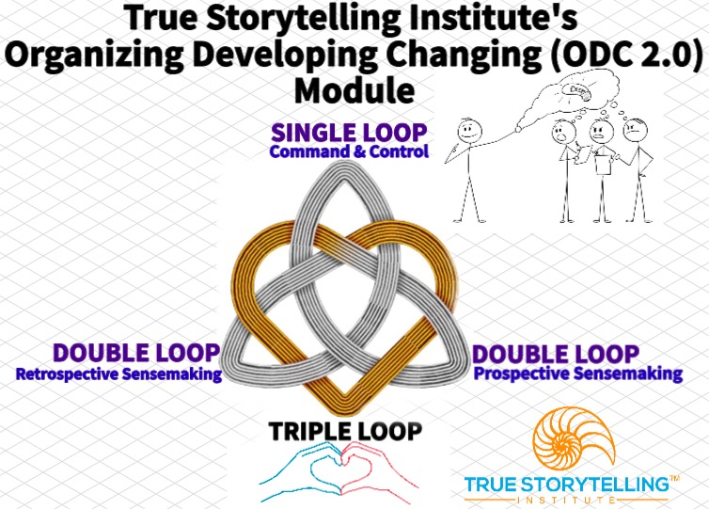

Slide 35
TOOL Storyboard
SPIRAL-FRACTAL Trash Compactor Invention

Slide 36
Advanced Tool for Process Consulting: Attune
Antenarrative
Processes

