Slide 1
TRUE STORYTELLING
Train-the-Trainers
Level II session 5
<number>
Notes:
Just go over this slide
<number>

Slide 2
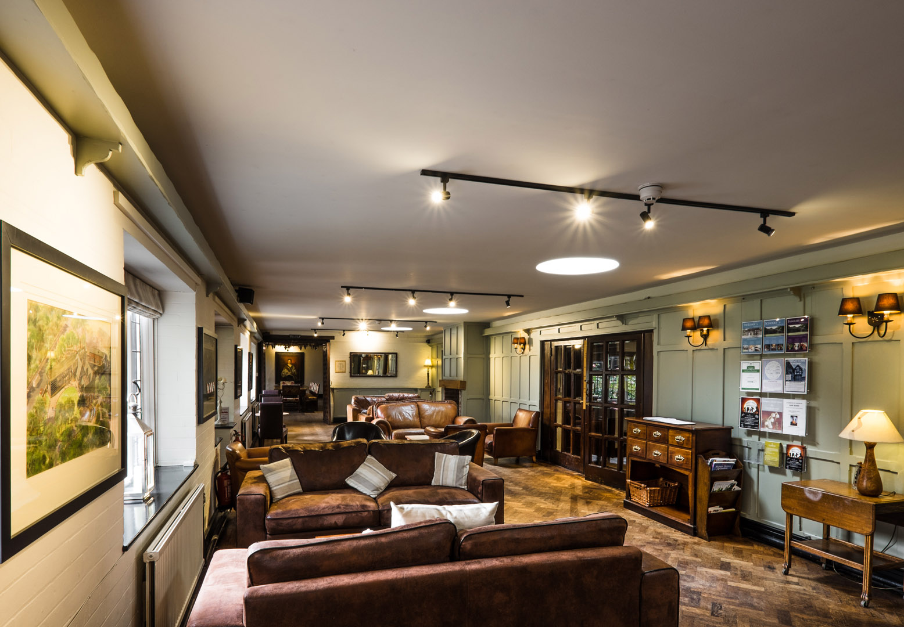
True Storytelling Institute
PRE-SESSION WEEK #5
“Helping Stories Along & BECOMING-Antenarrative process
“COFFEE in the LOBBY”
Notes:
<number>

Slide 3
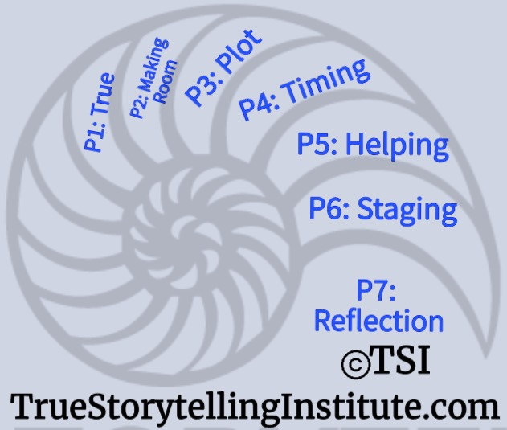
Welcome and ROADMAP: Grace Ann
Last Week:
Principle 4 Timing
& Being Processes
This week:
Principle 5 Helping
& Becoming Processes
and
Nuts and Bolts

Slide 4
STRUCTURE FOR TODAY: GA
PART I Check-in of Group Members; Roadmap: Lena
PART II Homework from Session 4: Lena
Part III Nuts & Bolts: Demonstrating for Breakouts: Grace Ann
PART IV Introduce Principle 5 Helping & Guiding: Jens
PART V ReStorying: David
PART VI Breakout: David
PART VII Debrief: Lena
PART VIII Homework & Masters Class: David
PART IX Post-Discussion “Lobby,” Q&A: Jim
Notes:
<number>

Slide 5
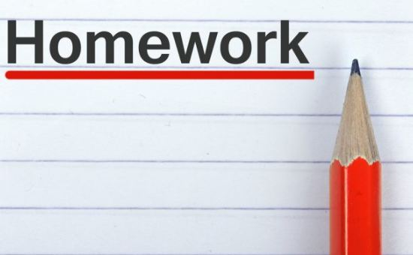
Lena – Last Session’s Homework: Boje Handout
PREZI on Embodied Restorying.
(click link); Chapter 5, True Storytelling book
Today’s Topic is Principle 5: Helping story along & BECOMINGS
Little Wow Moments & Opportune Moments meet in Restorying

Slide 6
Lena
Please bring a notebook and pen/pencil to each session.
Use the “Gallery View” so you can see each other while viewing Powerpoint.
Please do not give advice to others or use ‘should’ statements for self or others.
Speak more from the heart than from the head
Laser in, be concise, and share only one story instead of several.
CONFIDENTIALITY: Do not tell someone else’s story. Please DO NOT record any session of the presenters or the participants.
Please use Chat ONLY when asked to do so. Avoid “side talk.”
Please attend all sessions. If you must miss one, contact us so we can help you to catch up before you return.
Notes:
<number>

Slide 7
Session 5 TRAINING NUTS and BOLTS: Grace Ann
LAST WEEK: Keeping Time Schedules/ How to interrupt
THIS WEEK: DEBRIEF and CONNECTING THE DOTS
Embodied Restorying
PERMISSION, and Power of Self-authorship
Use Physical Objects and Quasi-Objects
Use Action, be EMBODIED, MOVE
Use Grounding (earth, water)
SciFi Company Case of ReStorying; Cheating Case
-Personal Restorying
-Organizational Restorying

Slide 8
Principle 5 HELPING
You must be able to help stories on their way and be open to experiment

Slide 9
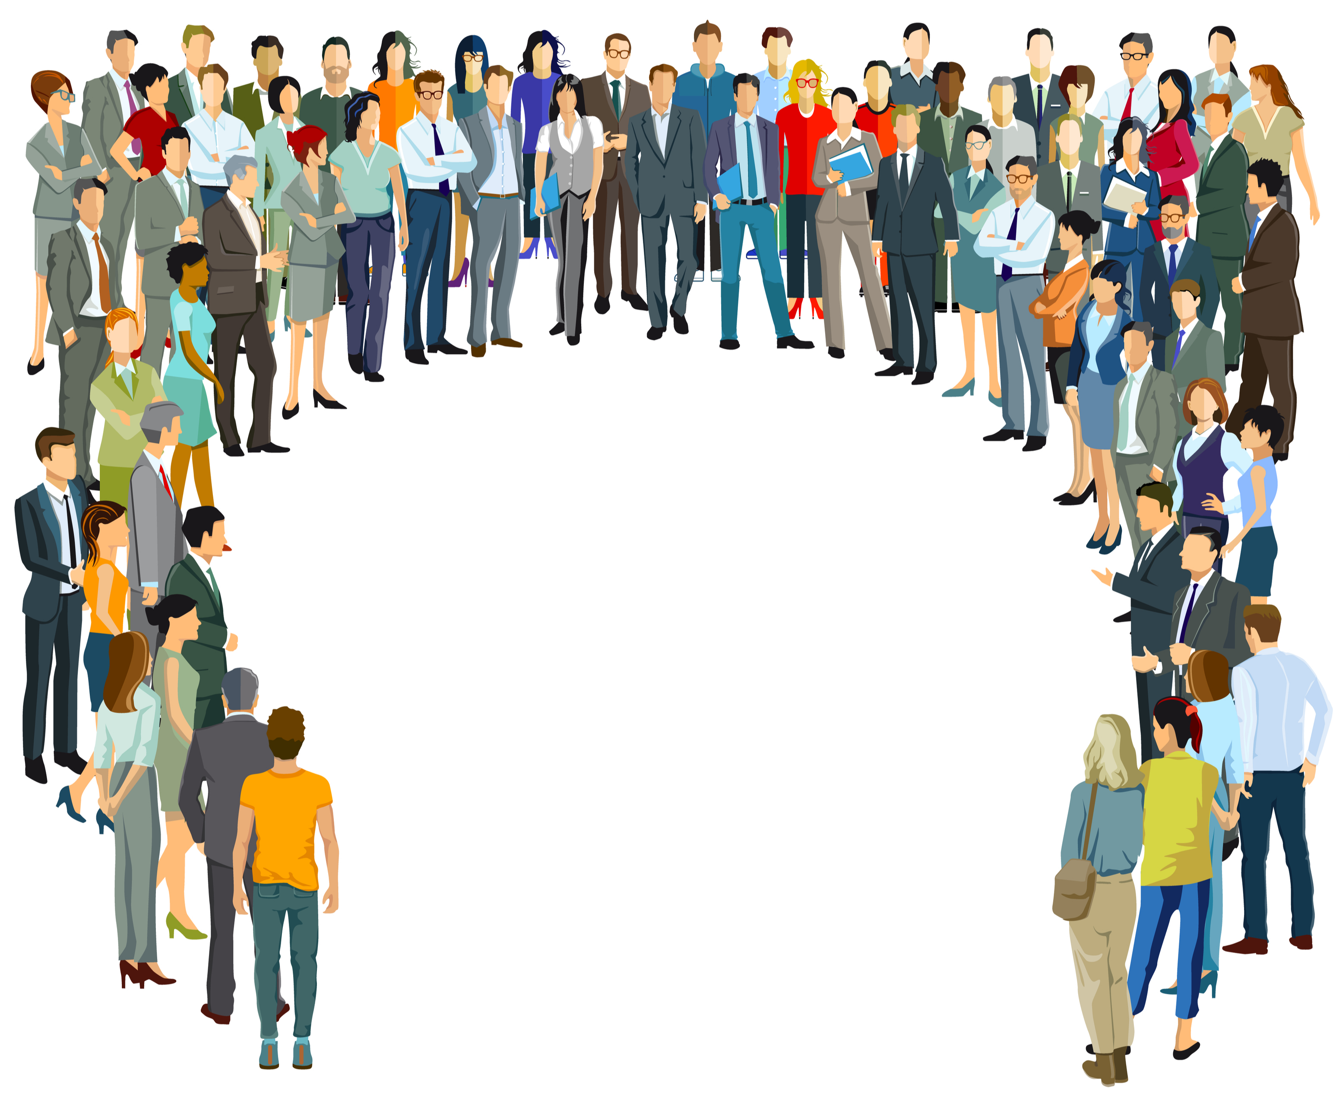
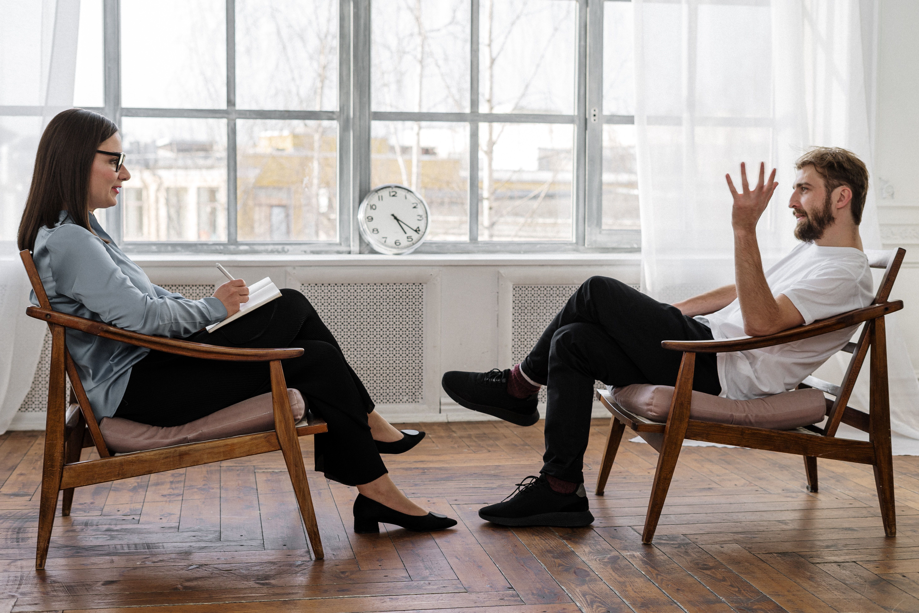
TS Guide – Projects or Coaching

Slide 10
How as a TS Guide to be in the event
Eventums
Heteroteles: To be there for the other one.
Synkatathesis: To be open and critical at the same time.
Lepsis: How being there with your body creates answers and questions.
Katafygé: The feeling for dramaturgy.
Prosoché: To be aware and the ability to surprise.
Ergon: The ability to finish and take responsibility.
Page 75

Slide 11
Questions for the TS Guide
Which stories of your own would challenge the story you hear?
Which one would help them along?
What are the dominant narratives and the counternarratives?
What are the untold stories?
What could become the ante-narratives – bets on the future and experiments?

Slide 12
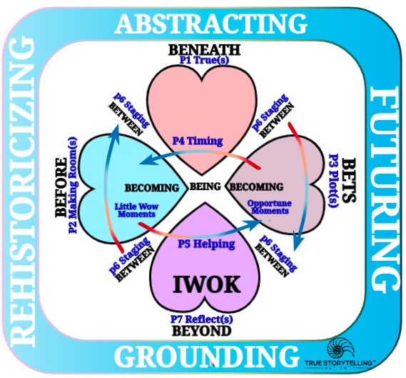
BIG PICTURE: Back to Past ‘Little Wow Moments” BECOMING ‘Back to the Future ‘Opportune Moments’
BEFORE-Heart (Find several ‘Little Wow Moments’ becoming ‘restorable’)
BETS-Heart Back to Future (Helping Stories Along’ becoming ‘Opportune Moments’

Slide 13
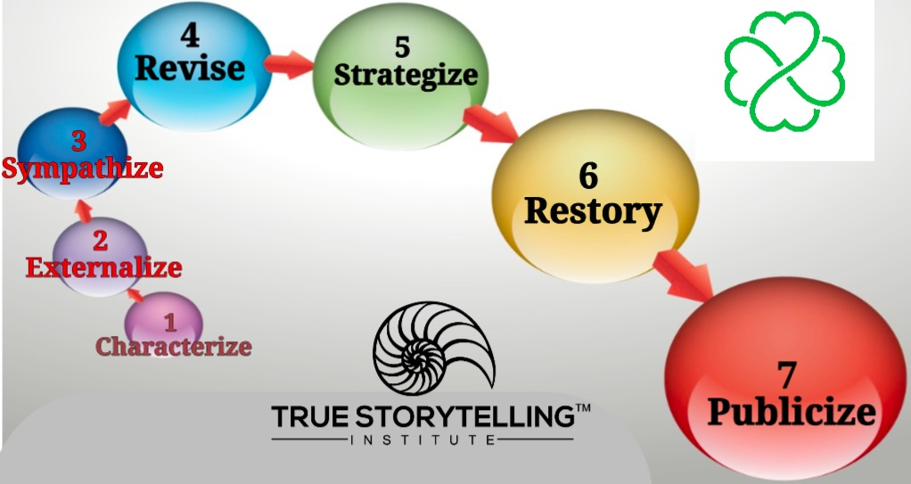
THE SPECIFIC 7 STEPS
P5: Helping Story Along links to ‘Little Wow Moments’
of Steps 4, 5, 6 of Embodied Restorying Process (ERP)

Slide 14
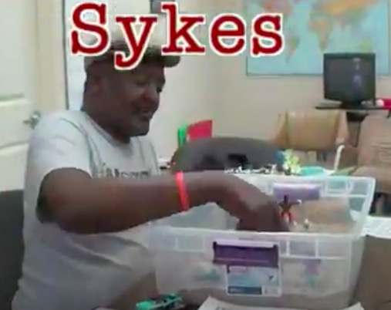
Video Demonstration of Principle 5: Helping Stories Along using Embodied Restorying Process YouTube (4 Minutes 3:04 – 7:33)

Slide 15
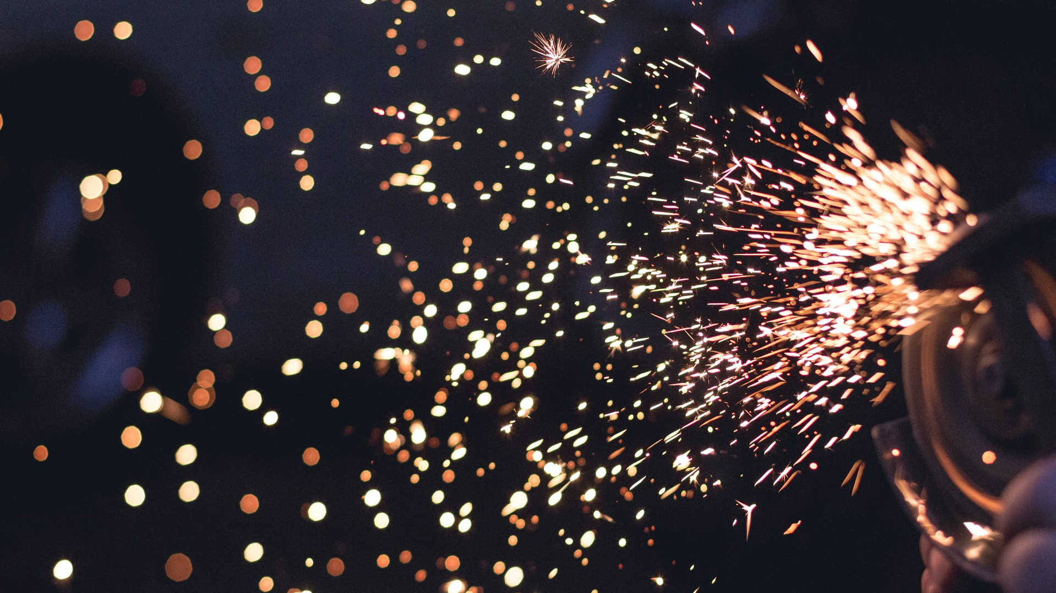
Back to the Past: What are ‘Little Wow Moments’ of Restorying?
How to Bring Little Wow Moments BACK TO THE FUTURE, Becoming ‘Opportune Moments’?
Questions

Slide 16
5-10 min
DEMONSTRATION/FISHBOWL: How might you use material artifacts to energize an Embodied Restorying Process on Zoom?
Notes:
<number>

Slide 17
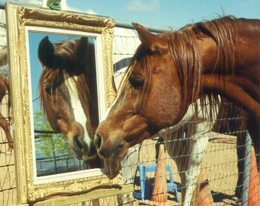
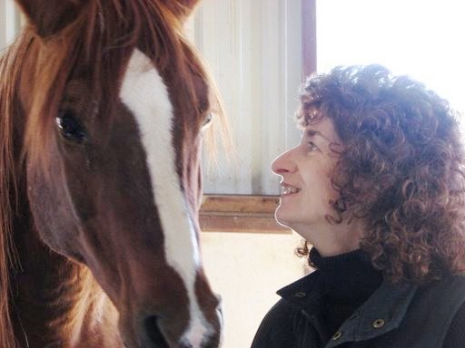
What is HorseSense?
And DEBRIEF
How Embodied Restorying Works with Horses and Veterans and their
Family System See Video

Slide 18
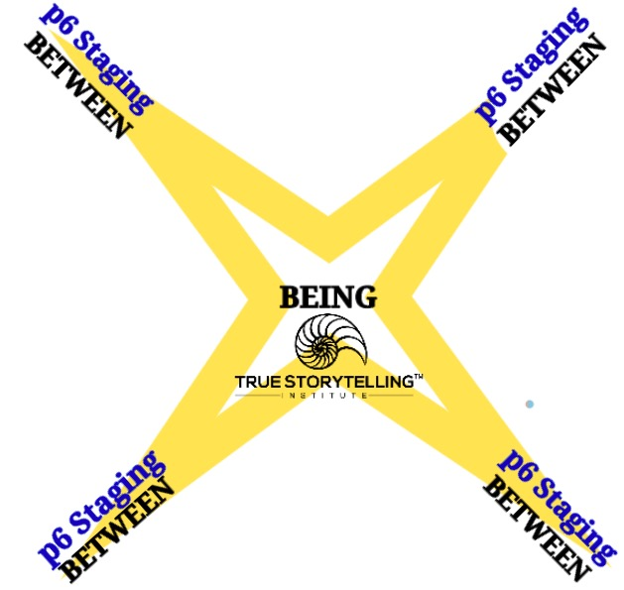
Next Week
P6: Staging
How it is Staging in-Between the Hearts

Slide 19
HOMEWORK due in Week 6:
PREZI on Embodied Restorying.
Embodied Restorying Process YouTube Homeless Veterans
Read Chapter 6, True Storytelling book, on
Principle 6: Staging
& the in-BETWEEN 4 hearts processes
Question: How could you use Zoom to stage a Restorying Event?
Notes:
<number>

Slide 20
True Storytelling Institute
POST-SESSION
“COFFEE in the LOBBY”

Slide 21
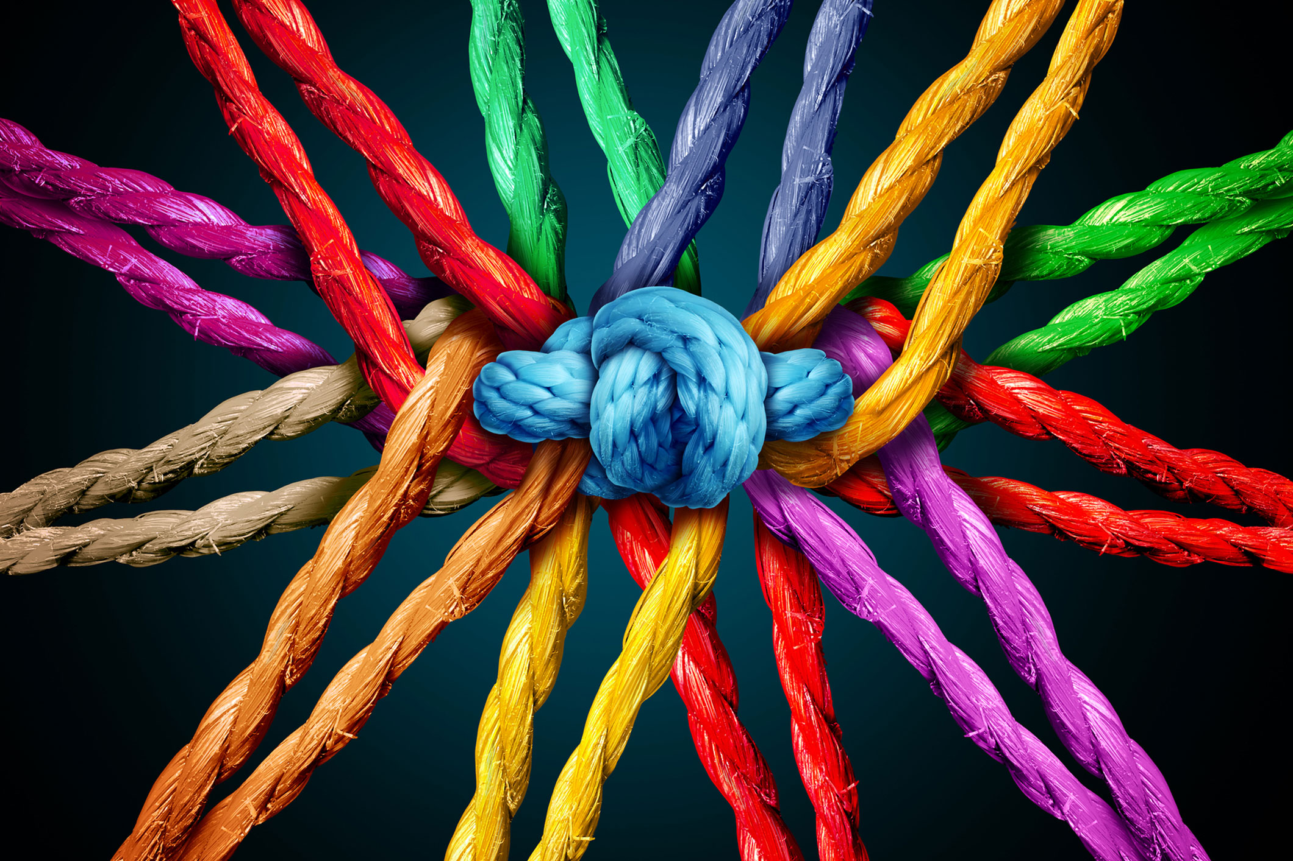
SCHEDULE for Session 5
8:45-9:00 Pre-session ”coffee:” Jim
9-9:05 Welcome; Check-in; and Agenda for the session Lena
9:05-9:10 Groundrules; homework; Lena
9:10-9:20 Nuts&Bolts; Embodiment & LWM; Connect Dots: GA
HOMEWORK due in Week 5: Continue reading the Boje Handout relevant sections, and see PREZI on Embodied Restorying. (click on this link)
Read Chapter 5, True Storytelling book, on Principle 5: Helping story along & the BETWEEN inter-section & Restorying
9:20-9:35 Principle 5 Helping Stories Along Jens
9:35-9:50 Principle 5 Embodiment- BEING spacetime-David
9:50-9:55 Examples and lead-in to Sand Tray demo: Jens
9:55-10:10 Sand Tray Demo —David
10:10-10:20 Debrief – Lena (& Jens?)
10:20- 10:25 Homework- Master Class on Wed; next concept: GA
10:25-10:30 Q&A & ”Connect the Dots” closing exercise
10:30-10:45 POST-session informal discussion: Lena
<number>
Notes:
<number>

