Slide 1
TRUE STORYTELLING
Train-the-Trainers
Level II session 4
<number>
Notes:
Just go over this slide
<number>

Slide 2
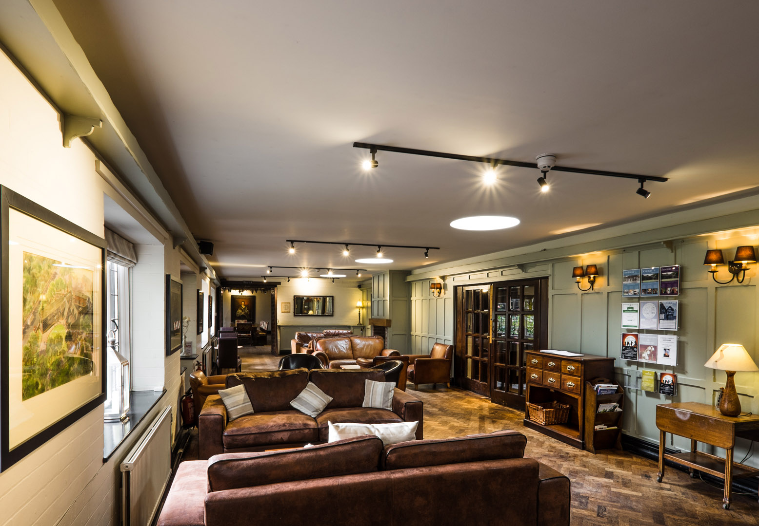
True Storytelling Institute
PRE-SESSION WEEK #4
“Timing and BETS Antenarrative process
“COFFEE in the LOBBY”
Notes:
<number>

Slide 3
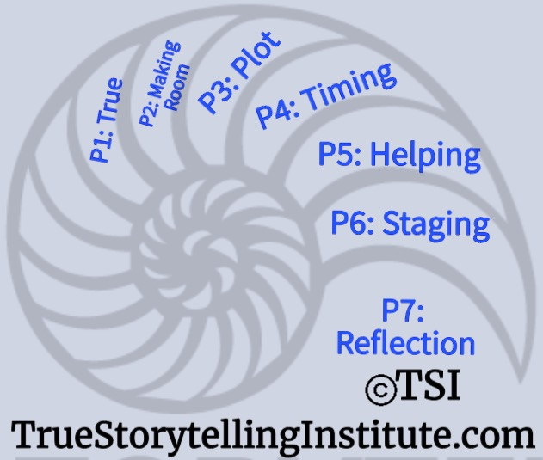
Welcome and ROADMAP: Grace Ann
Last Week:
Principle 3 Plots
& Bets on future Process
This week:
Principle 4 Timing
& Being Processes
and
Nuts and Bolts

Slide 4
STRUCTURE FOR TODAY: GA
PART I Check-in of Group Members; Roadmap: GraceAnn
PART II Nuts & Bolts Open & Close: Grace Ann
Part III Homework from Session 3: Jens
PART IV Introduce Principle 4 Timing: Lena
PART V Antenarratives BEING 4 Hearts, Q&A: David
PART VI Examples Timing & BEING: Jens
PART VII Breakout, Debrief: Jens
PART VIII Homework: Grace Ann
PART IX Post-Discussion “Lobby,” Q&A: Jim

Slide 5
Jens
Please bring a notebook and pen/pencil to each session.
Use the “Gallery View” so you can see each other while viewing Powerpoint.
Please do not give advice to others or use ‘should’ statements for self or others.
Speak more from the heart than from the head
Laser in, be concise, and share only one story instead of several.
CONFIDENTIALITY: Do not tell someone else’s story. Please DO NOT record any session of the presenters or the participants.
Please use Chat ONLY when asked to do so. Avoid “side talk.”
Please attend all sessions. If you must miss one, contact us so we can help you to catch up before you return.
Notes:
<number>

Slide 6
Session 4 TRAINING NUTS and BOLTS: Grace Ann
LAST WEEK: Keeping Time Schedules/ How to interrupt
-When to interrupt, when not to interrupt
-Mechanical Assistance
-Silent Reflection Time
THIS WEEK: OPENING & CLOSING;
TIMING and SEQUENCING your CONTENT
-Check-in
-General to specific? Concepts before doing?
-Roadmaps and Checklists
-Modeling before break-outs: Your examples
-Sitting In/Observer roles
-Debriefing: roles, assignments/questions

Slide 7
Jens – Last Session’s Homework: Plots & Bets
Storyboard Plot, & Bets on the future
Antenarrative Structures:
Linear, Cyclical, Spiral, Rhizomatic
Today’s Topic is Principle 4: Timing & the Eventing of BEING Process
You Must Have Timing (spacetimemattering of BEING)
“Everyone is selling-timing, all the time” (long-term & short-term)”
“deep time, surface time, opportune timing”

Slide 8
Principle 4: TIMING
You must create timing with BEING-eventing in spacetimemattering

Slide 9
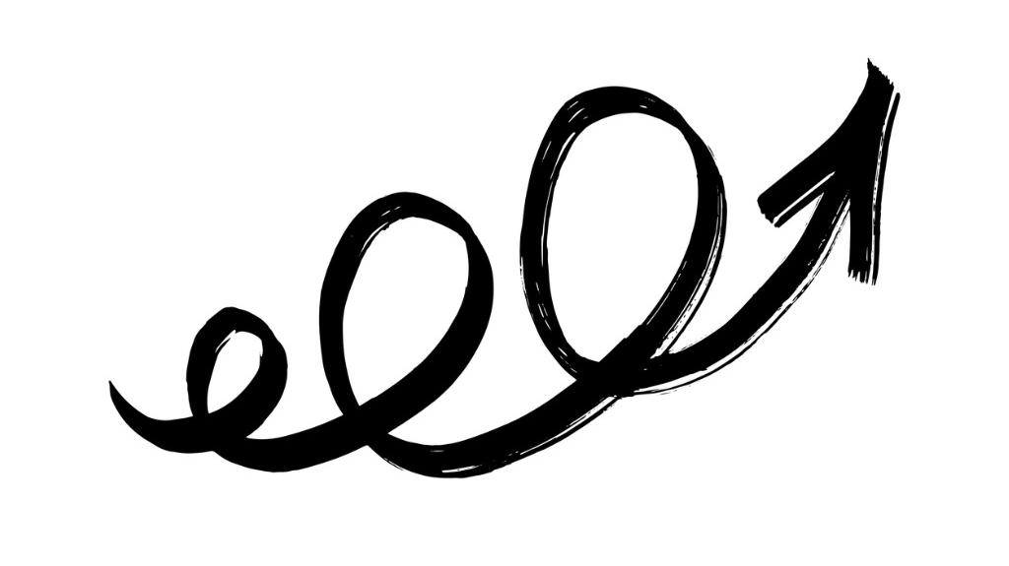
Principle 4 TIMING
You must create timing with BEING-eventing

Slide 10
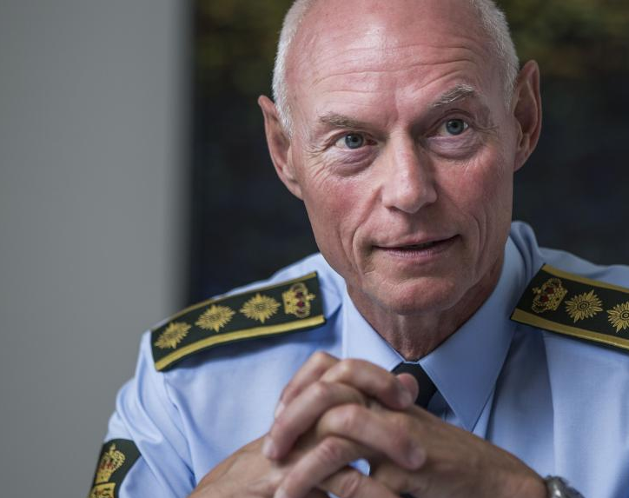
”Timing
is everything
in connection with
your credibility.”
Former Danish Police Chief, Jens Henrik Højbjerg, Page 75

Slide 11
New narrative
New time and being
New product?
Page 67

Slide 12
As a Trainer ask:
What is timing and why is it important?
What has defined our timing until now in the short and long run?
How does it unfold in different times and cultures?
What would be the right timing in the future?
What is your first step and what is the next step if you want to implement this strategy?
How can you know it’s the right timing and how can we create the courage to take risks?
How does Principle 4 support the other principles?

Slide 13
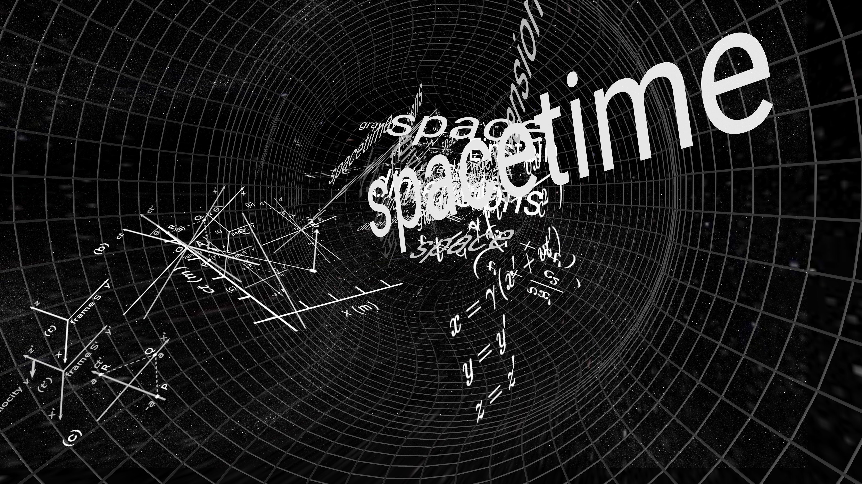
Timing & BEING
Chronological
Clock timing
Cycle time
Just In Time
Seasons
Kiros – opportune Moments
Chronotopes of SpaceTime
Primordial spacetimemattering
Stakeholders have quite different conceptions of Timing...

Slide 14
How To Guide Dialogism at cross-section of CHRONOS & KAIROS?
Examples

Slide 15
CLICK HERE

Slide 16
Dialogisms
are the
Cross-Section
of BEING

Slide 17
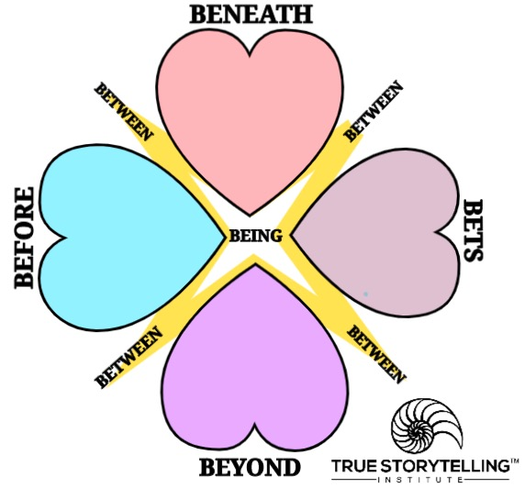
What is the Cross-Section of Chronos & Kairos timing (P4) with BEING?
BENEATH-Heart (Eventing defies language of worded-event)
BEFORE-Heart (Event was never, just change of eventing)
BETS-Heart (What is anticipated, eventing?)
BEYOND-Heart (Embodied reflection of oneness)
BEING is uncovering the eventing of eventing

Slide 18
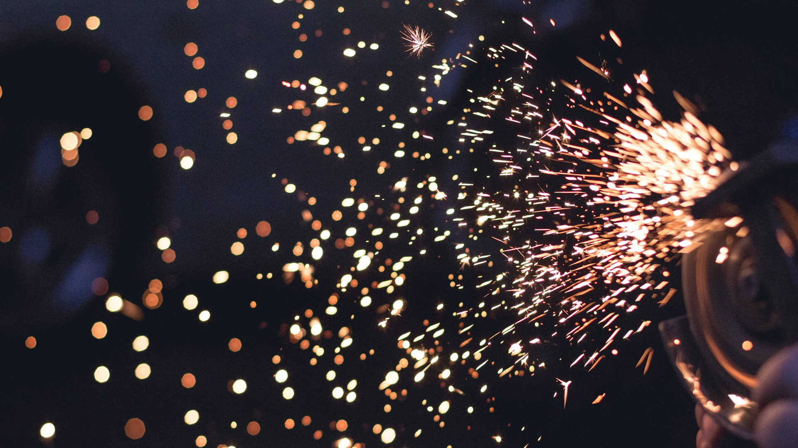
What kinds of timing in the situation-eventing?
Clock time, and opportune timing
What does a Guide do to move participants from debating to
BEING- dialogic ?
Questions

Slide 19
15 min total, 10 min BREAKOUT – David & Jens
2 min Jens: CEOs had lost their timing (stuck in clocktime), to SWITCH,
Jens said ‘This is not the end of the project… run next 6 years’ (selling ‘new’ project)
GA: Cheese metaphor
(What is the ’Eventing of Eventing’ of Timing & BEING?
2 min silent written prep for answers to questions below
BREAKOUT
2 min. per person; Total 10 minutes; groups of 3/4
QUESTION: In your work, when your stakeholders are
Stuck in Chronos (=clock time),
How can you Guide them to Kairos (=opportune moments)?
Any extra time: Please keep Repeating 1-minute each person rounds, until time is up.
Notes:
<number>

Slide 20
Debrief, Q&A: Jens
How did you Guide your stakeholders out of Stuckness in CHRONOS, into Kairos and BEING of eventing?
SOLID ENDING is Timing!

Slide 21
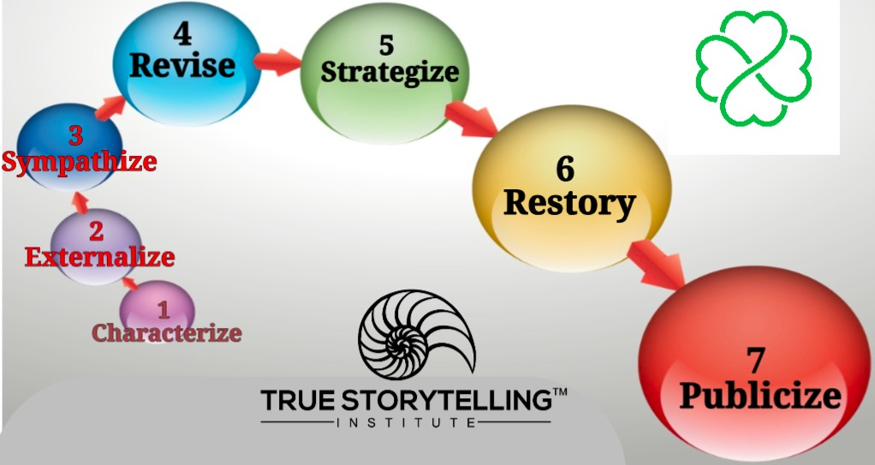
For next week: GA
P5: Helping Story Along links to ‘Little Wow Moments’
of Steps 4, 5, 6 of Embodied Restorying

Slide 22
HOMEWORK due in Week 5:
Continue reading the Boje Handout relevant sections, and see
PREZI on Embodied Restorying. (click on this link)
Read Chapter 5, True Storytelling book, on
Principle 5: Helping story along
& the BETWEEN inter-section & Restorying
Notes:
<number>

Slide 23
What is our Solid Ending?
NOW is the LOBBY
Joke – Grace Ann
Take Away: We now see how timing fits with opportune moments
The Closing of the Session… (Timing) clocktime running out…

Slide 24
True Storytelling Institute
POST-SESSION
“COFFEE in the LOBBY”

Slide 25
SCHEDULE for Session 3 (Grace Ann)
8:45-9:00 Pre-session ”coffee”
9-9:05 Welcome; Check-in; and Agenda for the session GA
9:05-9:10 Groundrules; word/phrase of homework; coaching; GA
9:10-9:20 Nuts&Bolts; Intros and Endings; Jokes/Triggers GA
9:20-9:35 Lena: Principle 4 Timing LENA
9:35-9:50 David: Principle 4 Process- BEING spacetime
9:50-9:55 Lena & Jens examples and lead-in to breakout
9:55-10:10. Breakout—Jens
10:10-10:20 Debrief – Jens and ALL
10:20- 10:25 Homework- transition to next concept: GA
10:25-10:30 Q&A JENS and ALL
10:30-10:45 POST-session informal discussion
<number>
Notes:
<number>

