Slide 1
TRUE STORYTELLING
Train-the-Trainers
Level II session 4
<number>
Notes:
Just go over this slide
<number>

Slide 2
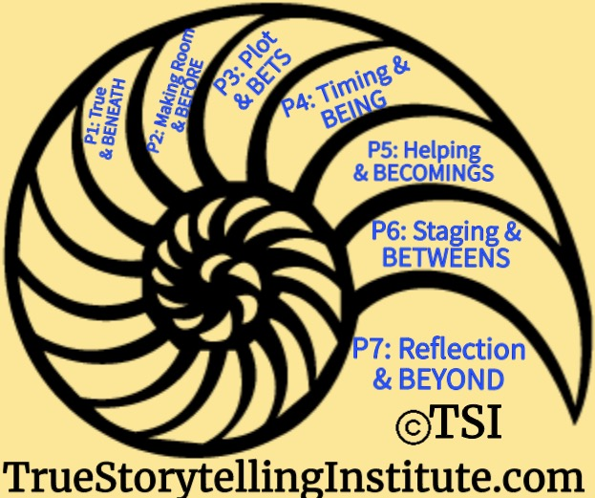
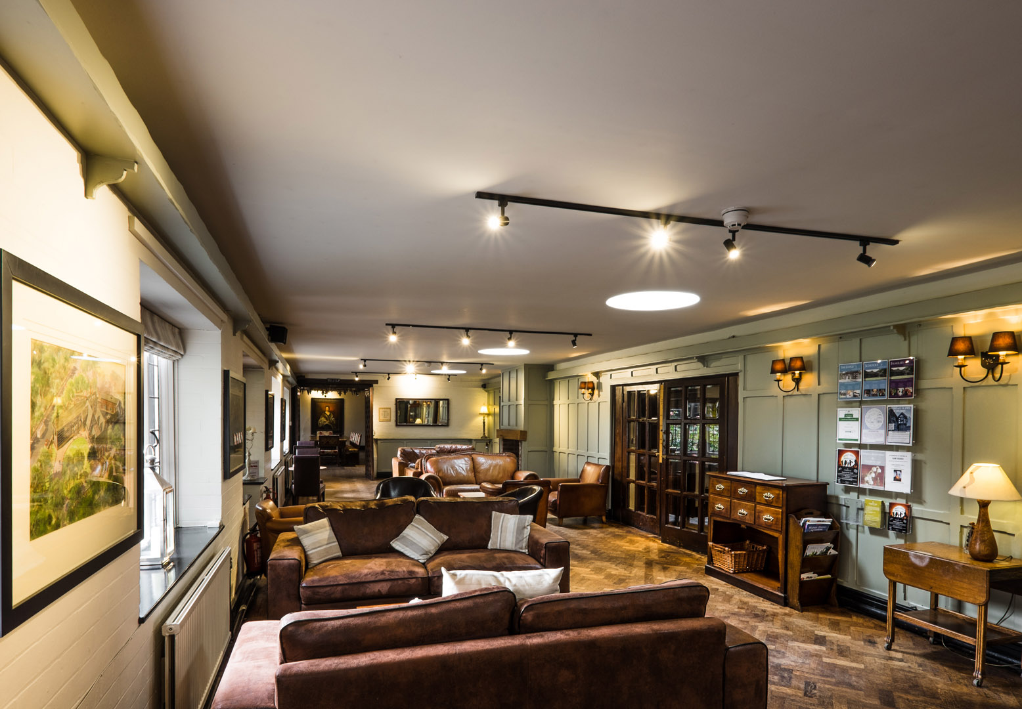
True Storytelling Institute
PRE-SESSION WEEK #4
“Timing and BETS Antenarrative process
“COFFEE in the LOBBY”
Notes:
<number>

Slide 3
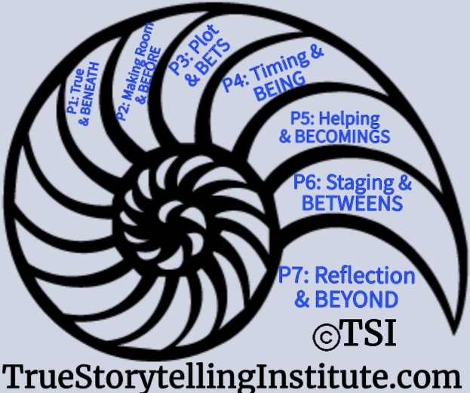
Welcome and ROADMAP: Lena
Last Week:
Principle 3 Plots
& Bets on future Process
This week:
Principle 4 Timing
& Being Processes
and
Nuts and Bolts

Slide 4
STRUCTURE FOR TODAY: Jens
PART I Check-in of Group Members; Roadmap: Jens
PART II Nuts and Bolts of Training: Grace Ann
PART III Introduce Principle 4 Timing Lena
PART IV Antenarratives BEING 4 Hearts, Q&A: David
PART V Examples Timing & BEING: Lena
PART VI Breakout, Debrief: Lena
PART VII Homework: Jens
PART VIII Post-Discussion, Q&A: Jim

Slide 5
Jens
Please bring a notebook and pen/pencil to each session.
Use the “Gallery View” so you can see each other while viewing Powerpoint.
Please do not give advice to others or use ‘should’ statements for self or others.
Speak more from the heart than from the head
Laser in, be concise, and share only one story instead of several.
CONFIDENTIALITY: Do not tell someone else’s story. Please DO NOT record any session of the presenters or the participants.
Please use Chat ONLY when asked to do so. Avoid “side talk.”
Please attend all sessions. If you must miss one, contact us so we can help you to catch up before you return.
Notes:
<number>

Slide 6
Jens – Last Session’s Homework
Last Week’s Homework: Plots & Bets
Principle 4: Timing & the Eventing of BEING Process
You Must Have Timing (spacetimemattering of BEING)
“Everyone is selling-timing, all the time” (long-term & short-term)”
“deep time, surface time, opportune timing”

Slide 7
Session 3 TRAINING NUTS and BOLTS: Grace Ann
LAST WEEK: Break-out Groups
-Last week’s post session
-Alternative Introductions
THIS WEEK: MORE on Break-out Groups
-Activity: You are in charge
-Instructions: numbers, turns, timing, question(s)
-Modeling: do’s and don’ts
-Sitting In/Observer roles: silence or their words
-Debriefing: emotions, results, frameworks
-Homework applications of concepts
-Privacy

Slide 8
Principle 4 TIMING
You must create timing
with BEING-eventing
In spacetimemattering

Slide 9
Principle 4 – you must have timing

Slide 10
As a trainee…
As a guide…
I understand that Principle 4 is about ‘timing.’ Timing is everything.
It’s important to have timing and if you don’t get it right, your ability to improvise and understand complexity is adversely affected and it is likely that your story will quickly fall apart.
Principle 4 is about finding that ‘opportune moment’ when the conditions are right for taking action.
Having the right timing will help you deal with failure and resistance, to help you focus on the long term and take the necessary steps to prepare.
I can support trainees knowledge of Principle 4 by asking the following questions:
What is timing and why is it important? (abstractising)
What has defined our timing until now in the short and long run? (rehistorising)
What would be the right timing in the future? (futurising)
What is your first step and what is the next step if you want to implement this strategy? (grounding)
How can you know it’s the right timing and how can we create the courage to take risks?
How does Principle 4 support the other principles?

Slide 11
Timing & BEING
Chronological
Clock timing
Cycle time
Just In Time
Seasons
Kiros – opportune Moments
Chronotopes of SpaceTime
Primordial spacetimemattering
Stakeholders have quite different conceptions of Timing...

Slide 12
How To Guide Dialogism at cross-section of CHRONOS & KAIROS?
Examples

Slide 13
Dialogisms are the Cross-Section of BEING

Slide 14
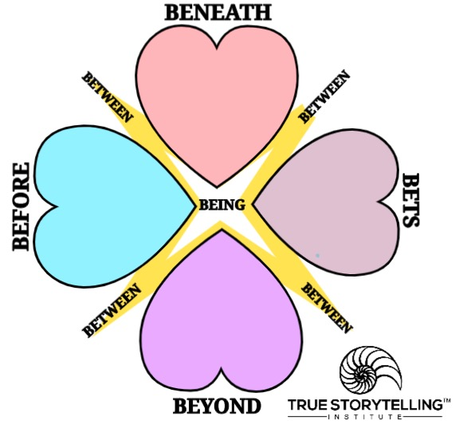
What is the Cross-Section of Chronos & Kairos timing (P4) with BEING?
BENEATH-Heart (Eventing defies language of worded-event)
BEFORE-Heart (Event was never, just change of eventing)
BETS-Heart (What is anticipated, eventing?)
BEYOND-Heart (Embodied reflection of oneness)
BEING is uncovering the eventing of eventing

Slide 15
What kinds of timing in the situation-eventing? Clock time, and opportune timing
Which spaces are actors negotiating?
Who is involved? People, resources, nature
Which mattering is happening? Sociomaterialities
How do we create movement to BEING-in-dialogical relationships?
What does a Guide do to move participations from debating toBEING- dialogic
Questions

Slide 16
INTRO TO BREAKOUT ROOM - David
15 minutes total in 2 groups of 4
2 min Lena explains/demonstrates questions (What is the ’Eventing of Eventing’ of Timing & BEING?
2 min silent written prep for answers to questions below
Jens Example: CEOs had lost their timing (stuck in clocktime), to SWITCH, Jens said ‘This is not the end of the project… run next 6 years’ (selling ‘new’ project)
BREAKOUT
2 min. per person; Total 10 minutes
QUESTION: When your stakeholders are Stuck in Chronos (=clock time), How to Guide to Kairos (=opportune moments)?
Any extra time: Please keep Repeating 2-minute each person rounds, until time is up.

Slide 17
Debrief, Q&A: Jens
How did you Guide you stakeholders out of Stuckness in CHRONOS, into Kairos and BEING of eventing?
SOLID ENDING is Timing!

Slide 18
P5: Helping Story Along links to ‘Little Wow Moments’ of Steps 4, 5, 6 of Embodied Restorying

Slide 19
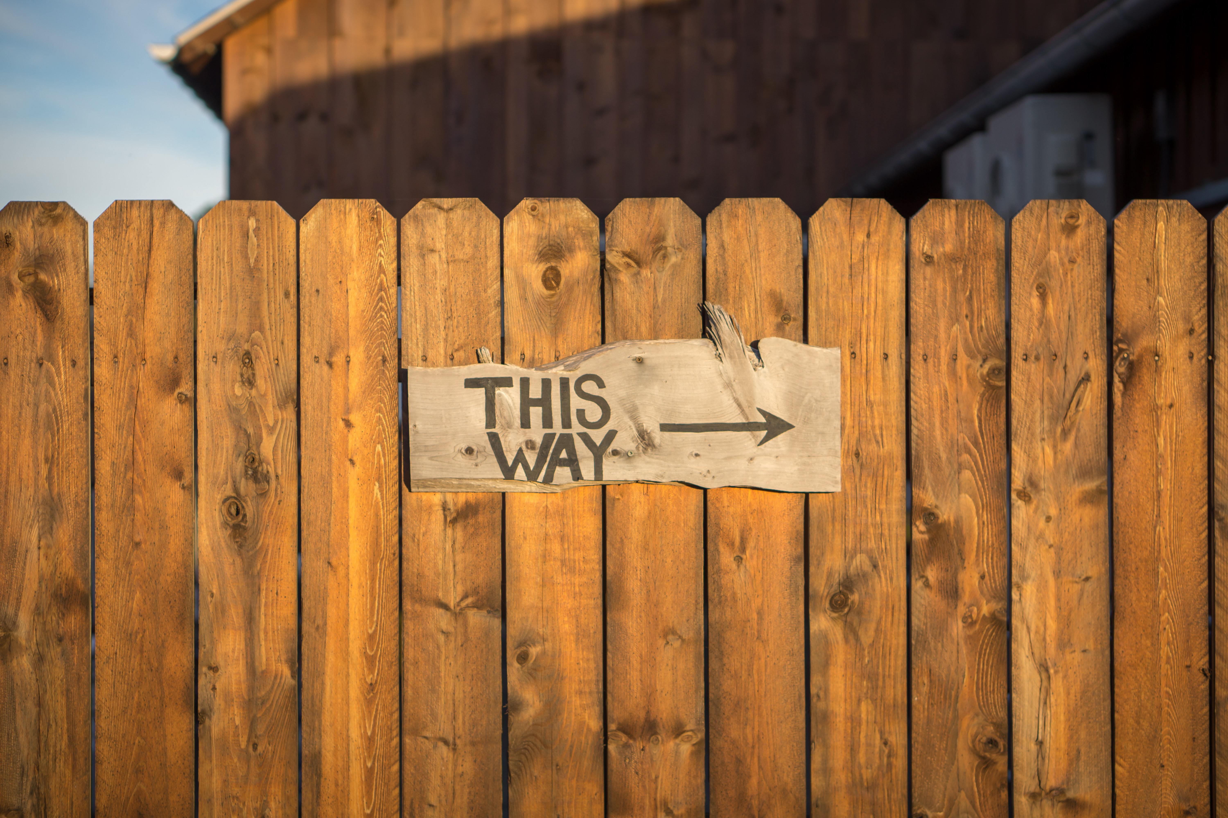
HOMEWORK due in Week 4:
Read the Boje Handout (try PREZI on Embodied Restorying)
Read Chapter 5, True Storytelling book, on
Principle 5: Helping story along
& the BETWEEN inter-section & Restorying
Reflect: What did you learn as a Trainee?
What did you learn as a Trainer?
What questions do you have now?

Slide 20
What is our Solid Ending?
NOW is the PARKING LOT
Joke – Grace Ann
Take Away: We now see how timing fits with opportune moments
The Closing of the Session… (Timing) clocktime running out…

Slide 21
True Storytelling Institute
POST-SESSION
“COFFEE in the LOBBY”

Slide 22
SCHEDULE for Session 3 (Grace Ann)
8:45-9:00 Pre-session ”coffee”
9-9:05 Welcome; Check-in; and Agenda for the session JENS
9:05-9:10 Groundrules; word/phrase of homework to be used later JENS
9:10-9:25 Nuts&Bolts; chat for feedback. GA
9:25-9:35 Lena: Principle 4 Timing LENA
9:35-9:50 David: Principle 4 Process- BEING spacetime
9:50-9:55 Lena/Jens examples and lead-in to breakout
9:55-10:10. Breakout—LENA
10:10-10:20 Debrief – LENA and ALL
10:20- 10:25 Homework- transition to next concept: JENS
10:25-10:30 Q&A JENS and ALL
10:30-10:45 POST-session informal discussion
<number>
Notes:
<number>

