Slide 1
TRUE STORYTELLING
Train-the-Trainers
Level II
<number>
Notes:
Just go over this slide
24

Slide 2
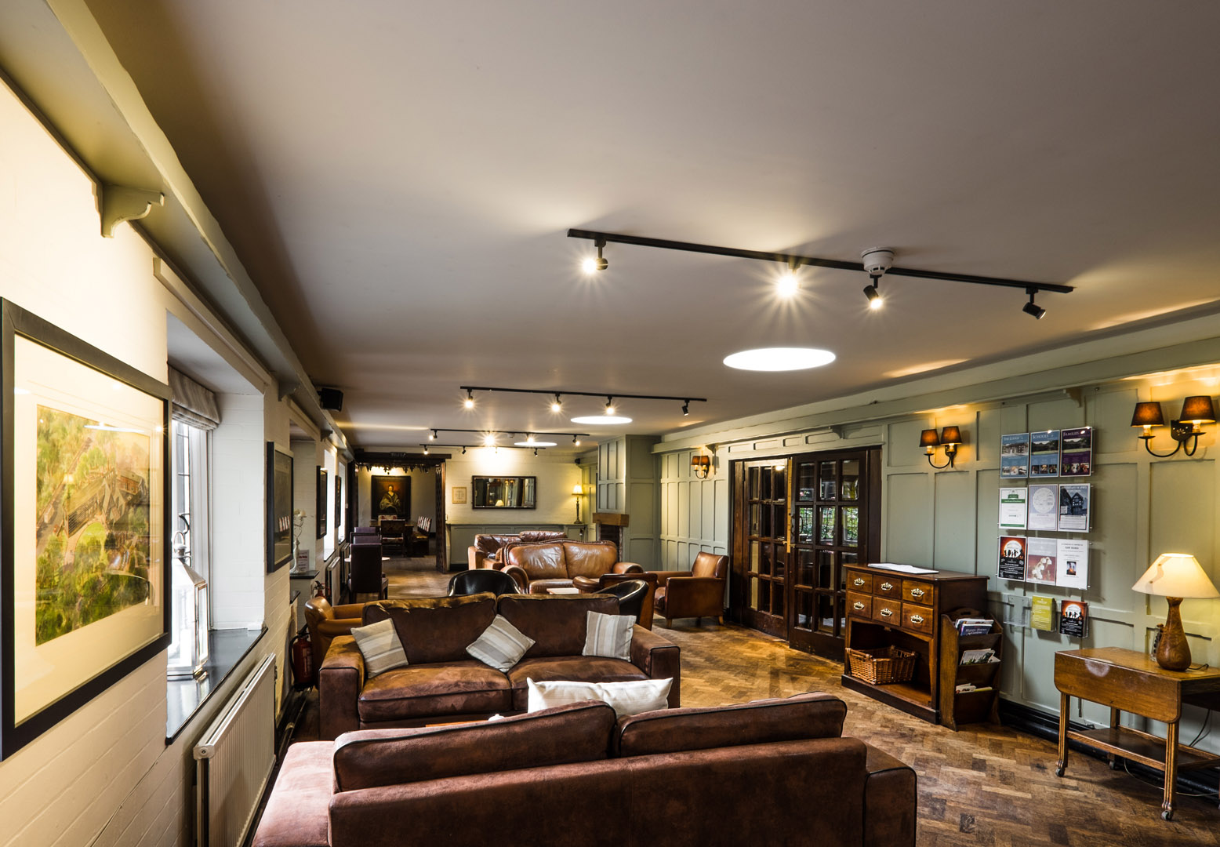
True Storytelling Institute
PRE-SESSION WEEK #3
“Plotting” & BETS Antenarrative process
“COFFEE in the LOBBY”
Notes:
<number>

Slide 3
Welcome and ROADMAP: Jens
Last Week:
Principle 2 Making Room
This week:
Principle 3 Plot & Bets
and
Nuts and Bolts

Slide 4
STRUCTURE FOR TODAY: Jens
PART I Check-in of Group Members; Roadmap: Jens
PART II Nuts and Bolts of Training: Grace Ann
PART III Introduce Principle 3 Plots: Lena
PART IV Antenarratives of Principle 3 Bets, Q&A: David
PART V More Principle 3 Plots: Lena
PART VI Breakout, Debrief: Lena
PART VII Homework: Jens
PART VIII Post-Discussion, Q&A: Jim

Slide 5
Jens
Please bring a notebook and pen/pencil to each session.
Use the “Gallery View” so you can see each other while viewing Powerpoint.
Please do not give advice to others or use ‘should’ statements for self or others.
Speak more from the heart than from the head
Laser in, be concise, and share only one story instead of several.
CONFIDENTIALITY: Do not tell someone else’s story. Please DO NOT record any session of the presenters or the participants.
Please use Chat ONLY when asked to do so. Avoid “side talk.”
Please attend all sessions. If you must miss one, contact us so we can help you to catch up before you return.
Notes:
<number>

Slide 6
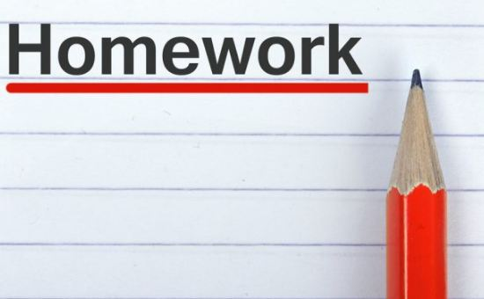
Jens – Last Session’s Homework
Last Week’s Homework: Storyboard
What did you learn?
How can you use storyboard as a trainer?
Principle 3: Plots and the BETS Process
“You must create stories with a clear plot, creating direction and helping people prioritize.”
BETS are made by people and organizations

Slide 7
Session 3 TRAINING NUTS and BOLTS: Grace Ann
LAST WEEK: Break-out Groups
-Last week’s post session
-Alternative Introductions
THIS WEEK: MORE on Break-out Groups
-Activity: You are in charge
-Instructions: numbers, turns, timing, question(s)
-Modeling: do’s and don’ts
-Sitting In/Observer roles: silence or their words
-Debriefing: emotions, results, frameworks
-Homework applications of concepts
-Privacy

Slide 8
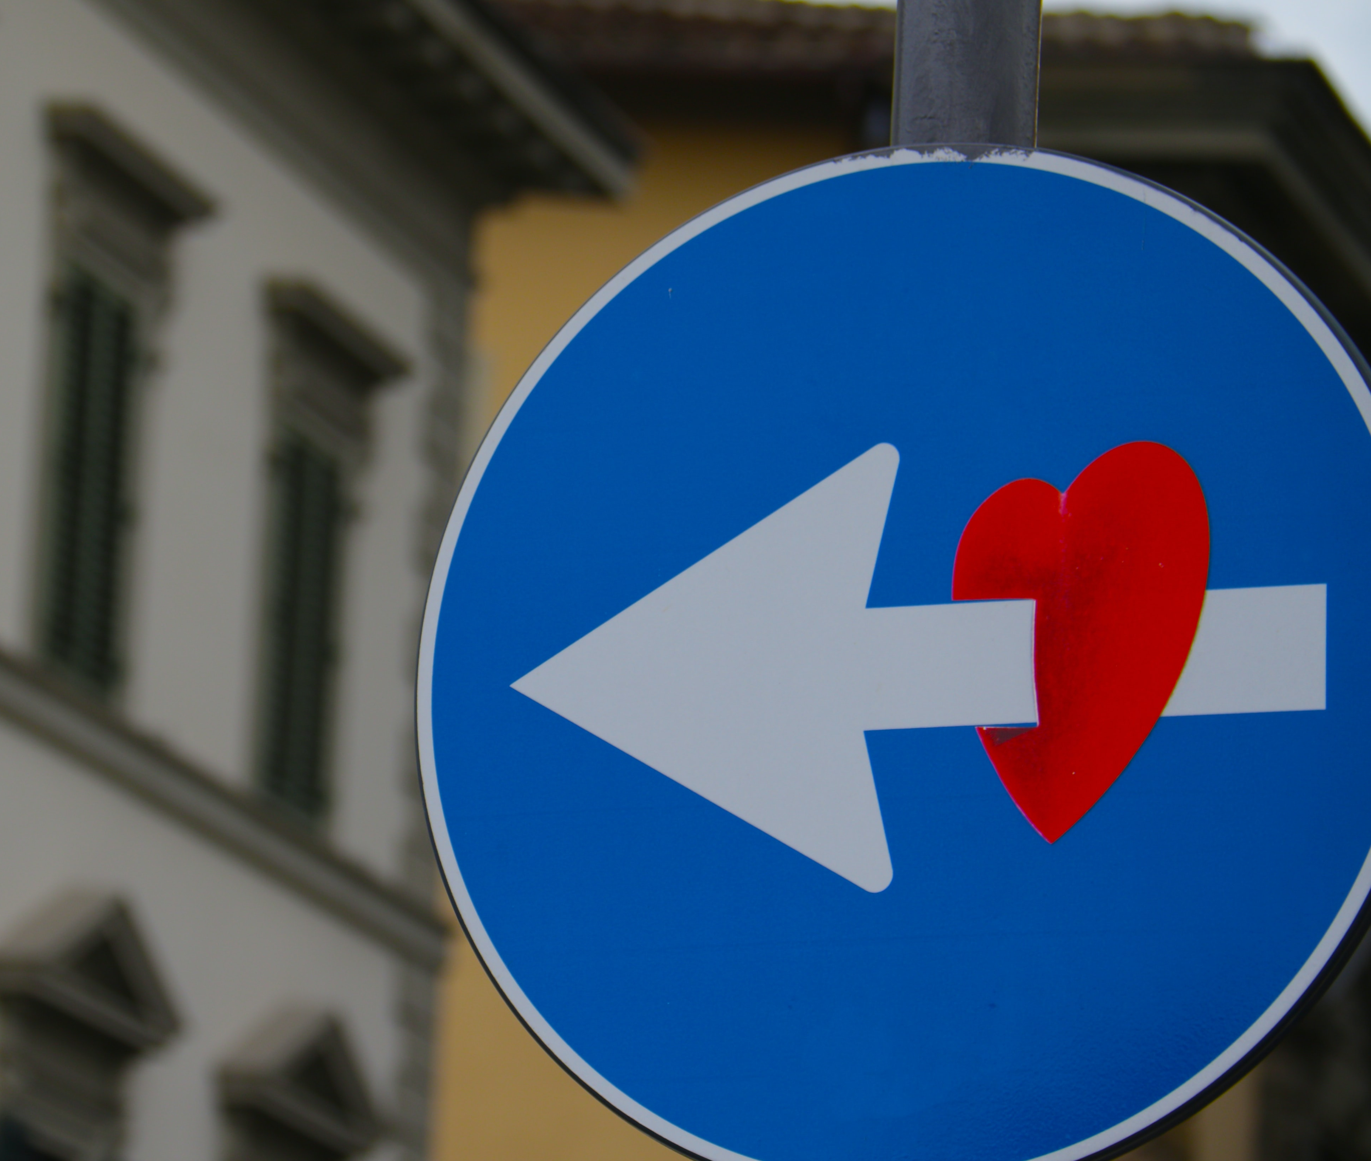
Principle 3 PLOT
You must create stories
with a clear plot
creating direction
and helping people prioritize

Slide 9
A GOOD PLOT SHOULD:
Create STRATEGIC DIRECTION
Embrace different stories
INVOLVE PEOPLE in finding the little wow moments already present in the future.
Light THE GLOW, create commitment
Answer The big WHY; WHAT GAME DO WE PLAY?
Use HEART language
Provide bets on the future

Slide 10
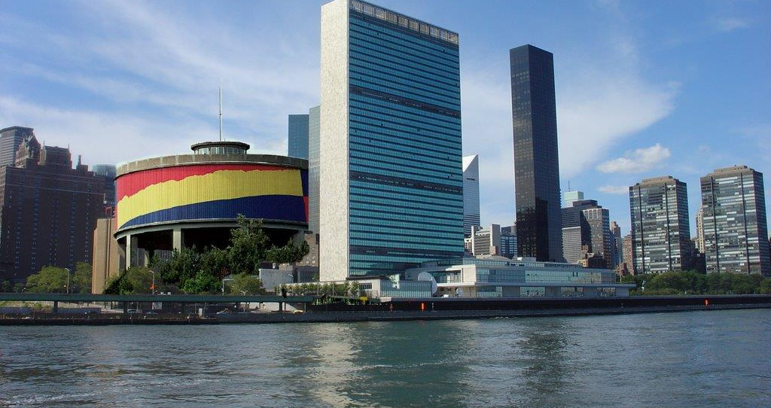
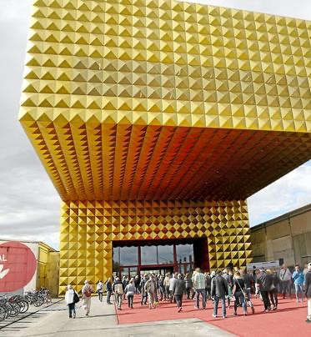
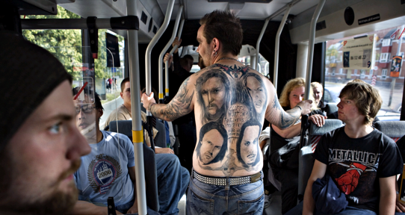
Examples

Slide 11
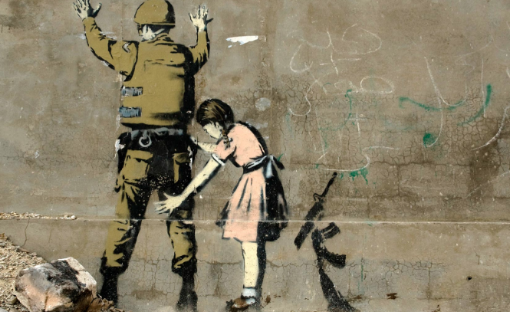
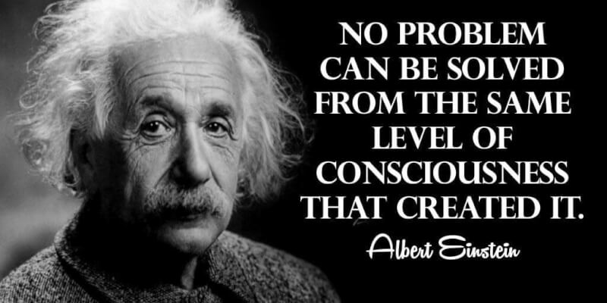
Principle 3: You must create stories with a clear plot creating direction and help people prioritize
We are ready to plan new future that is a PATTERN BREAKER from Past
We want a good plot that is TRUE STORYTELLING
It has Beginning, Middle & End to be Clear Direction
It tells WHY we are doing this
Best Plots have a TWIST, what Roland Barthes calls “PUNCTUM”
& the GAME being played “STUDIUM”
11
Notes:
In change people grasp for a narrative plot with clear why. A Punctum helps this.
Lars Bo H. presentation in Aalborg May 19 2018 spoke of the WHY in plot.
<number>

Slide 14
Notes:
Adapted from Bill Sharpe’s (2013) Three Horizons book
<number>

Slide 15
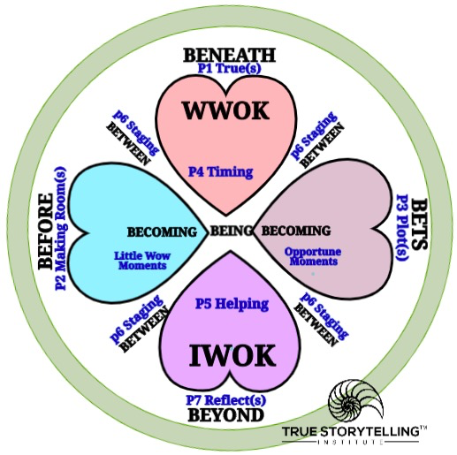
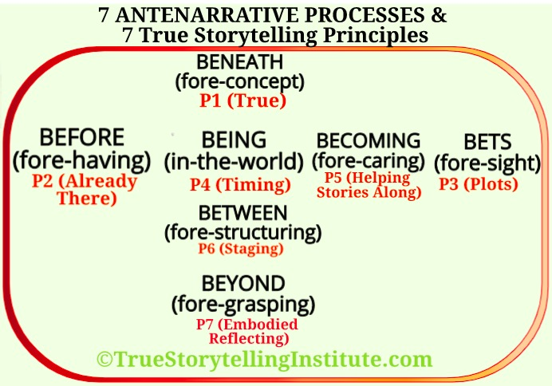
Old 1 Principle=1 Process Tool
The ‘New’ 4 HEARTs Tool

Slide 16
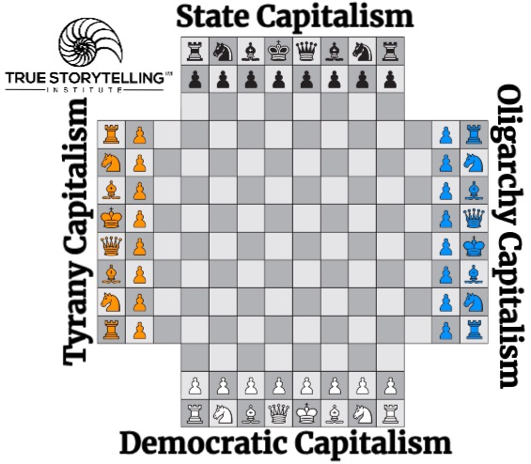
The Story of Four PLOTS (P3) and their BETS on the Future – 4 Capitalisms Playing Chess with the World
QUESTION: Is 4 Player Chess a linear GAME? Or Is it cycle of turn taking?

Slide 17
There are 4 capitalism playing chess. Each team places their bets and plots to win the center space, and capture opponents pieces.
Wolff ( 2020:iii-vi) says all 4 capitalisms try to solve the same problems:
1. Enterprises organized undemocratically
2. Unstable business cycles of boom & bust
3. Inequality of wealth & income
Each Capitalism BEFORE claims the Other capitalisms are the worst solutions (P2 Already There)
Each Capitalism is a Noun-character, with 6 Adjectives blaming the other guys, but none of them seem to work on the WHOLE SYSTEM (Studium), and therefore are not solving basic process problems creating the system problems.
A process is an action verb, the capitalisms are nouns, and instead of solving the 3 problems, each blames the other using these 6 adjectives.
1. racism
2. Unemployment
3. Sexism
4. Poverty
5. Inequality
6 Political corruption
while Other Capitalisms, increase them
POINT: its a Game of plotting with Noun and Adjectives of blame the
other capitalisms, without the Verb (process).

Slide 18
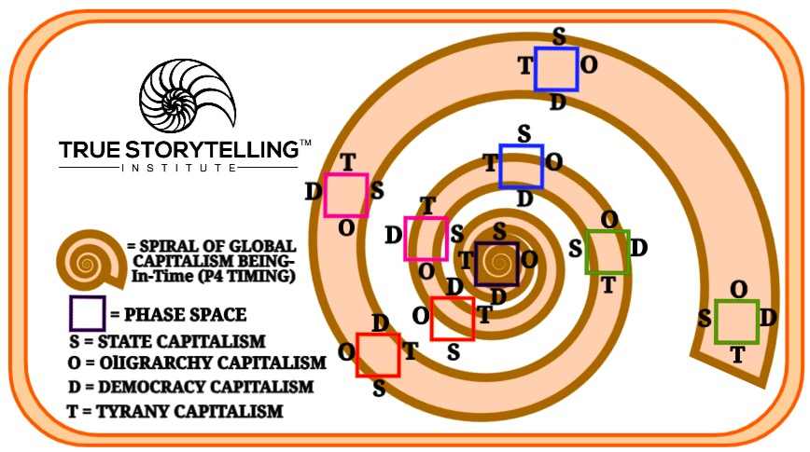
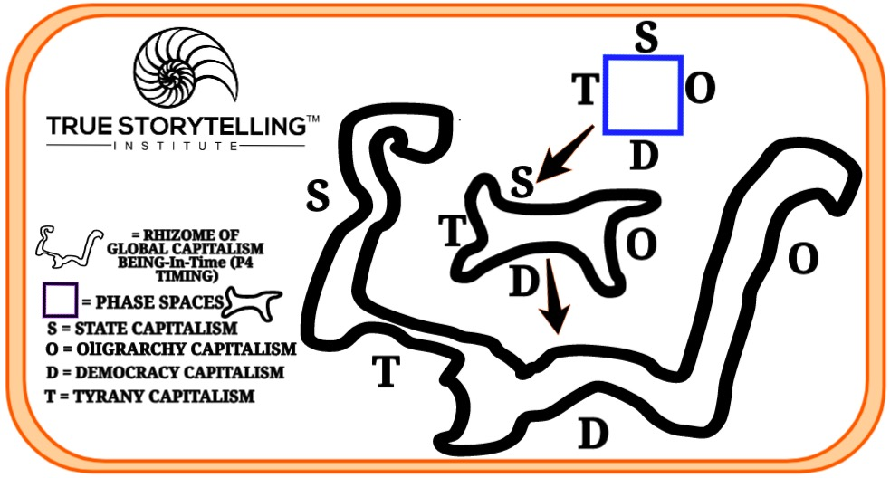
CYCLE of 4 Player Chess plotting & bets, is already a spiral because the pattern of the WHOLE is shifting
Turn by turn
The spiraling game of plotting and bets on the future shifts again, into the Rhizome
Which is quite UNSTABLE SITUATION
POINT: Know which STORYTELLING GAME is being played, as you guide a WHOLE SYSTEM CHANGE, and some BETS ON THE FUTURE can get made that give Peace & Well-Being cWholeness a chance to evolve

Slide 19
What is the beginning of the story? Are there any challenges and dreams that motivate the story?
Which event did change the story?
Who is involved? People, resources, nature
Which plot could create ownership? Does it light the glow?
How do we create a new story with a plot which breaks with the old one?
What is CLEAR direction to take for PLOT and BETS?
Questions

Slide 20
INTRO TO BREAKOUT ROOM - David
15 minutes total in 2 groups of 4
2 min Lena explains/demonstrates questions (What is a linear plot, or a cycle of moves?
What is a spiral plot? How is the world already a Rhizome of instability with no center?
2 min silent written prep for answers to questions below:
BREAKOUT
2 min. per person; Total 10 minutes
QUESTION: When were you STUCK in a plot, and what kind is it (include BETS of stakeholders)?
How could you as a GUIDE reshape a linear plot or cycle-myth to a spiral understanding of plotting and betting?
Any extra time: Repeat 2-minute rounds until time is up.

Slide 21
Debrief, Q&A: Jens
How did we change our “stuck” linear and cyclical problem storylines
into upsurging spirals of improvement?
Into different places in our story network?
How can we be a guide to help change problem plots for our clients?

Slide 22
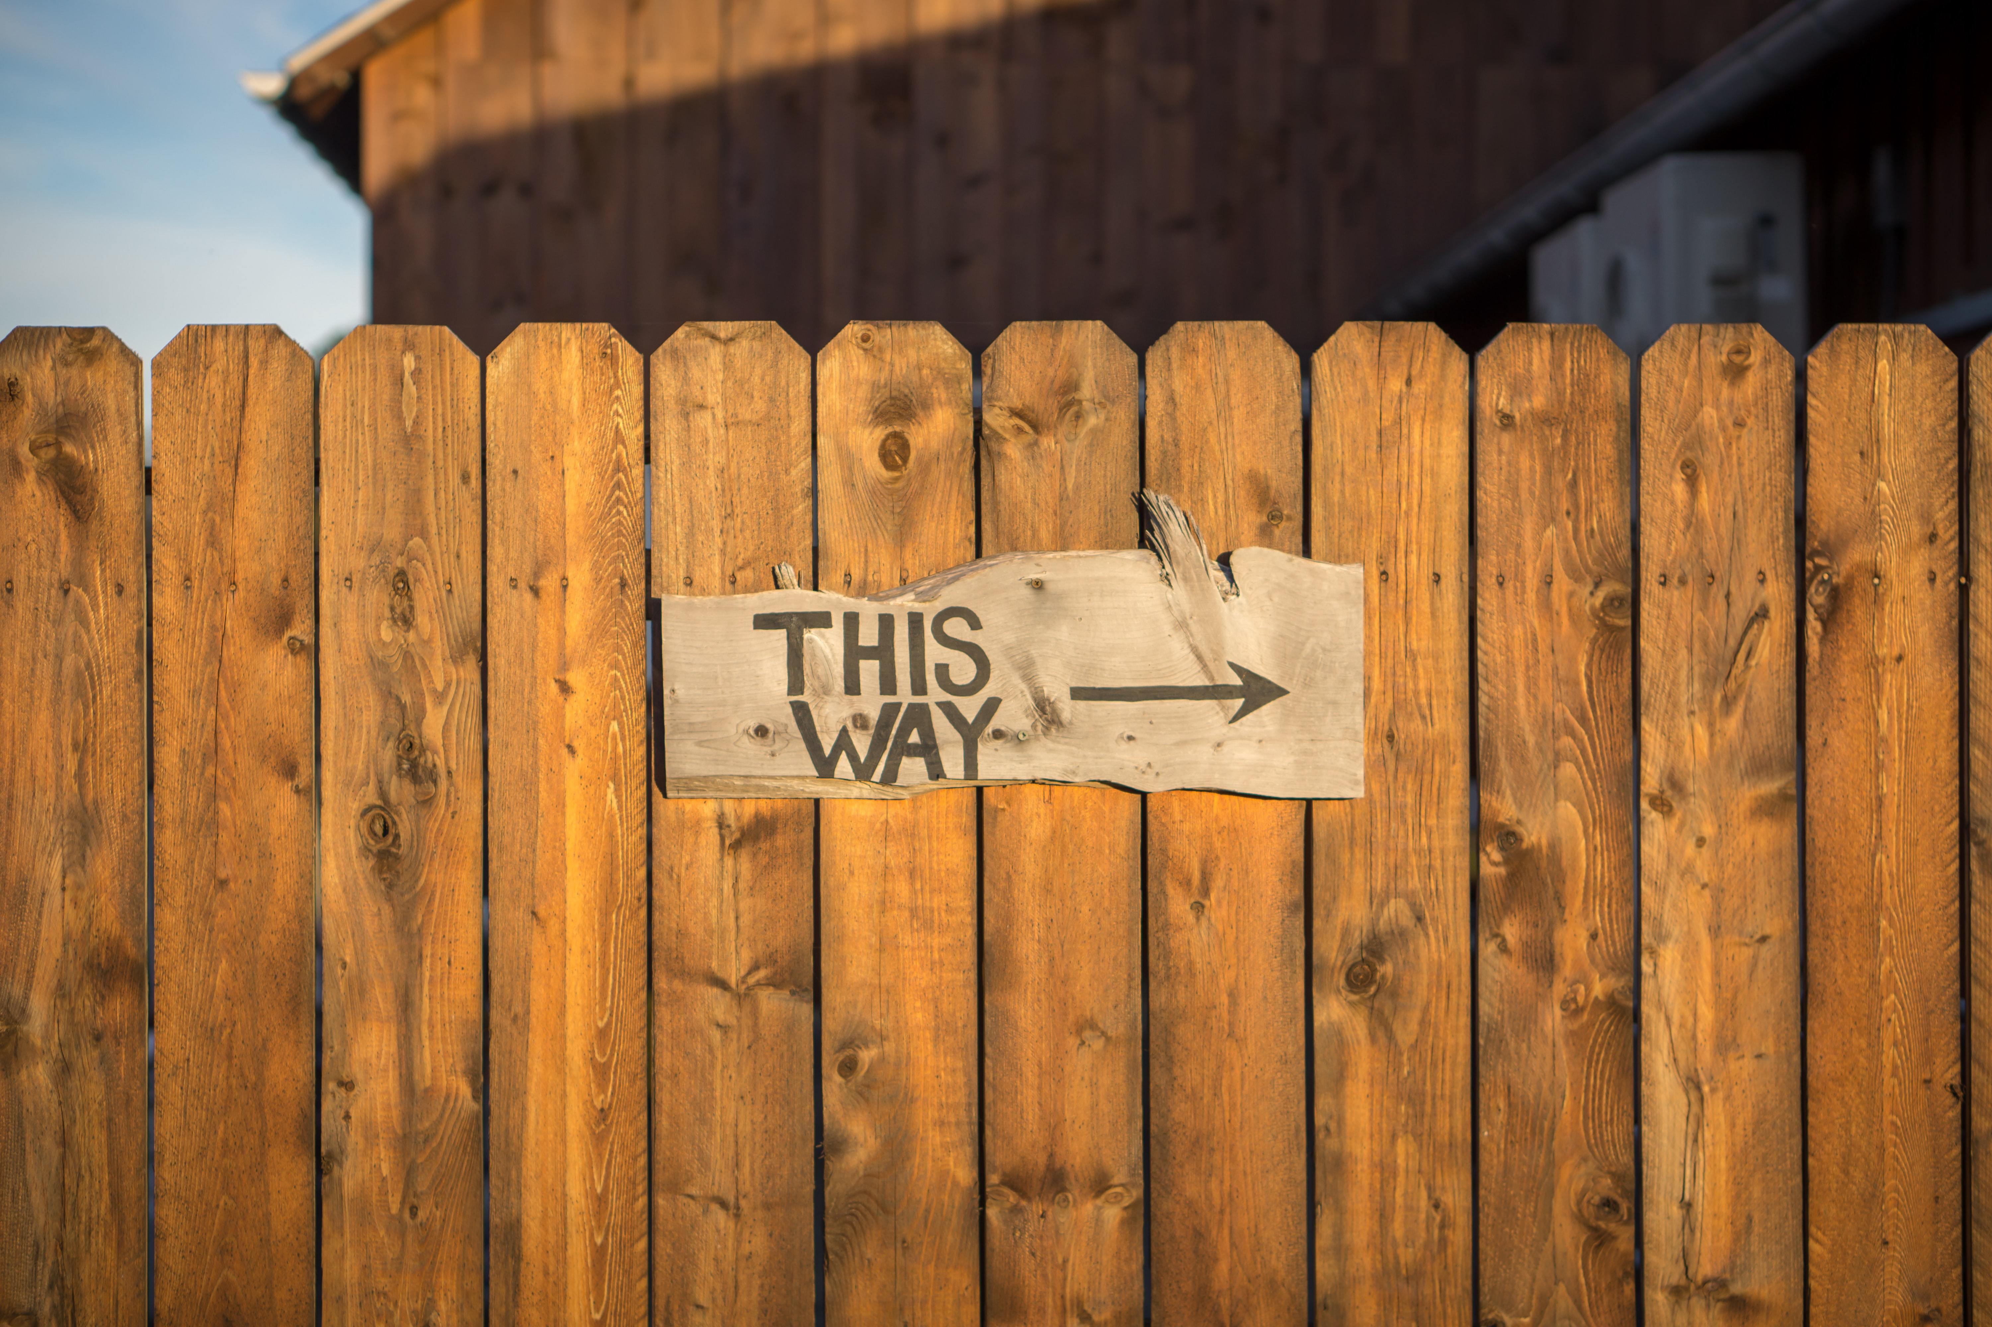
HOMEWORK due in Week 4:
Read the Boje Handout
Read Chapter 4, True Storytelling book, on
Principle 4: Timing and the BEING process
Reflect: What did you learn as a Trainee?
What did you learn as a Trainer?
What questions do you have now?

Slide 23
HOMEWORK
CLICK here to download slides from today
CLICK here to download the handout study for your Homework

Slide 24
More Information at:
https://true-storytelling.com
https://truestorytelling.blog
REMEMBER--PERSONAL COACHING
available to YOU from US:
TSI will reach out to you to set appointments.
TSI Trainer Program Coaching Sessions include
2 one-hour sessions.
Coach Trainer
David Karin
Grace Ann Anne-Marie
Jens Ken and Duncan
Lena Ben and Jim

Slide 25
True Storytelling Institute
POST-SESSION
“COFFEE in the LOBBY”

Slide 27
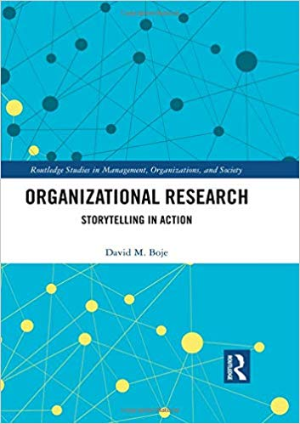
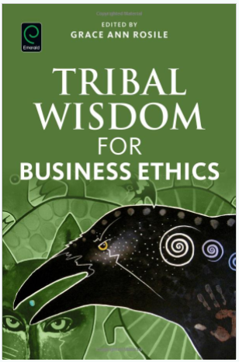
Antenarrative Books:
2019
2016
2011
2001
Notes:
<number>

Slide 28
SCHEDULE for Session 3 (Grace Ann)
8:45-9:00 Pre-session ”coffee”
9-9:05 Welcome; Check-in; and Agenda for the session JENS
9:05-9:10 Groundrules; word/phrase of homework to be used later JENS
9:10-9:25 Nuts&Bolts; chat for feedback. GA
9:25-9:35 Lena: Principle 3 Plots LENA
9:35-9:50 David: Principle 3 Process- BETS on the Future
9:50-9:55 Lena/Jens examples and lead-in to breakout
9:55-10:10. Breakout—LENA
10:10-10:20 Debrief – LENA and ALL
10:20- 10:25 Homework- transition to next concept: JENS
10:25-10:30 Q&A JENS and ALL
10:30-10:45 POST-session informal discussion
24
Notes:
<number>

