Slide 1

TRUE STORYTELLING
Train-the-Trainers
Level II session 7
1
Notes:
Just go over this slide
1

Slide 2
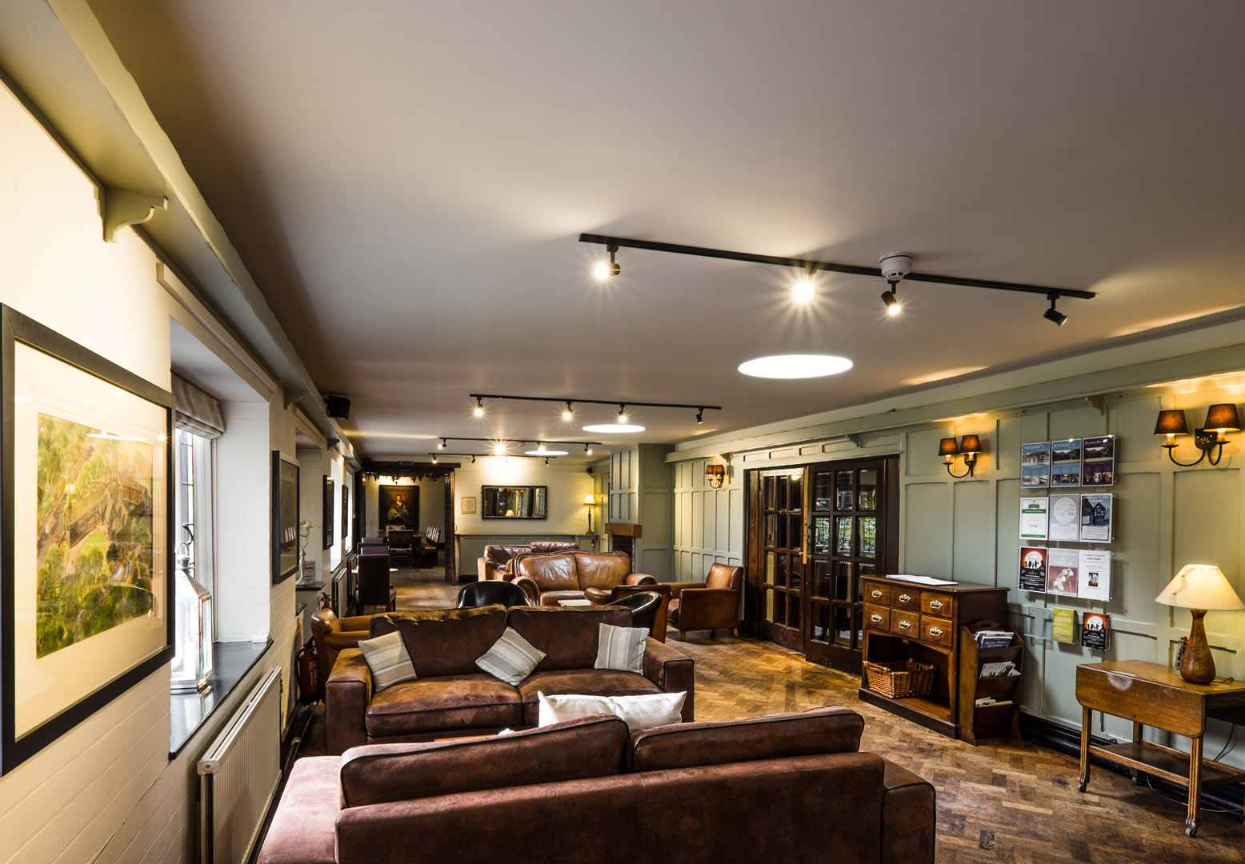
True Storytelling Institute
PRE-SESSION WEEK #7
“[Embodied] Reflecting & BEYOND-Antenarrative process”
COFFEE in the LOBBY
Notes:
2

Slide 3
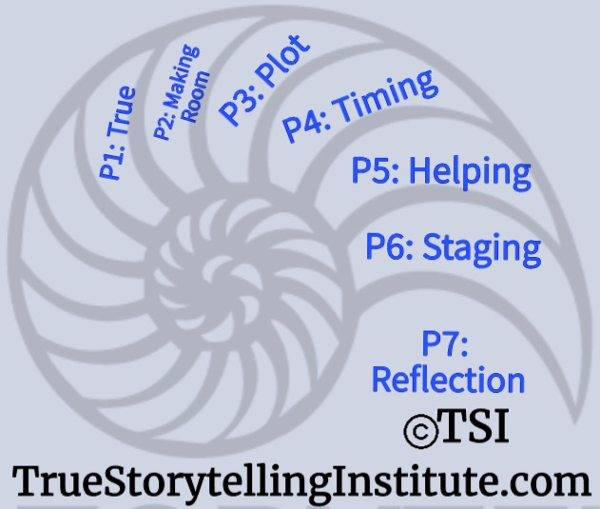
Welcome and ROADMAP: Jens
Last Week:
Principle 6 Staging
& Between ♥’s
This week:
Principle 7 Reflection &
BEYOND
and
Nuts and Bolts

Slide 4
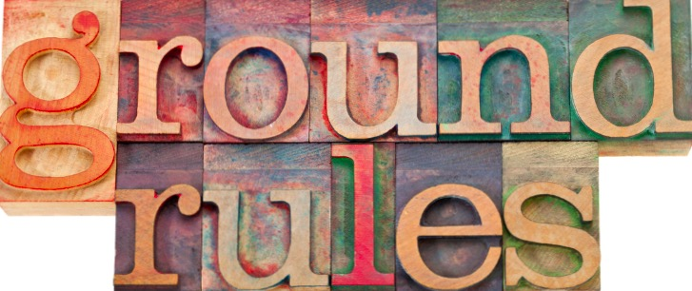
Grace Ann
Please bring a notebook and pen/pencil to each session.
Use the “Gallery View” so you can see each other while viewing Powerpoint.
Please do not give advice to others or use ‘should’ statements for self or others.
Speak more from the heart than from the head
Laser in, be concise, and share only one story instead of several.
CONFIDENTIALITY: Do not tell someone else’s story. Please DO NOT record any session of the presenters or the participants.
Please use Chat ONLY when asked to do so. Avoid “side talk.”
Please attend all sessions. If you must miss one, contact us so we can help you to catch up before you return.
Notes:
4

Slide 5

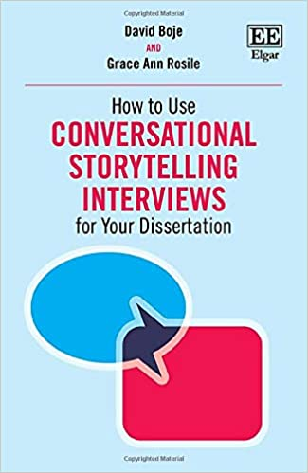
Roadmap and
STRUCTURE FOR TODAY: Lena
PART I Check-in of Group Members; Roadmap: Lena
Part II Groundrules & Nuts & Bolts: Grace Ann
PART III Introduce Principle 7 Reflecting & Guiding: Jens
PART IV Pre-Reflective BEYOND-♥ David
PART V Your 3-minute films (carrying over into “Lobby”)
PART VI GRADUATION! And NEXT STEPS
Notes:
5

Slide 6
NUTS and BOLTS Session 7
Reflection: WHICH Mirror?
Introspection/Self-Reflection Internal/External Attribution
Others: Johari Window
  Public, Hidden, Blind, Unknown
Let a Horse Be Your Mirror
Actual Mirror / Film

Slide 7
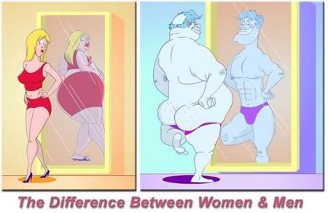
REFLECTION

Slide 8


Principle 7
You must reflect on the stories & how they create value
Notes:
Helping stories along, be open to experiment – local community, future audience, on the road nationally exhibitions, network internationally exhibition
8

Slide 9
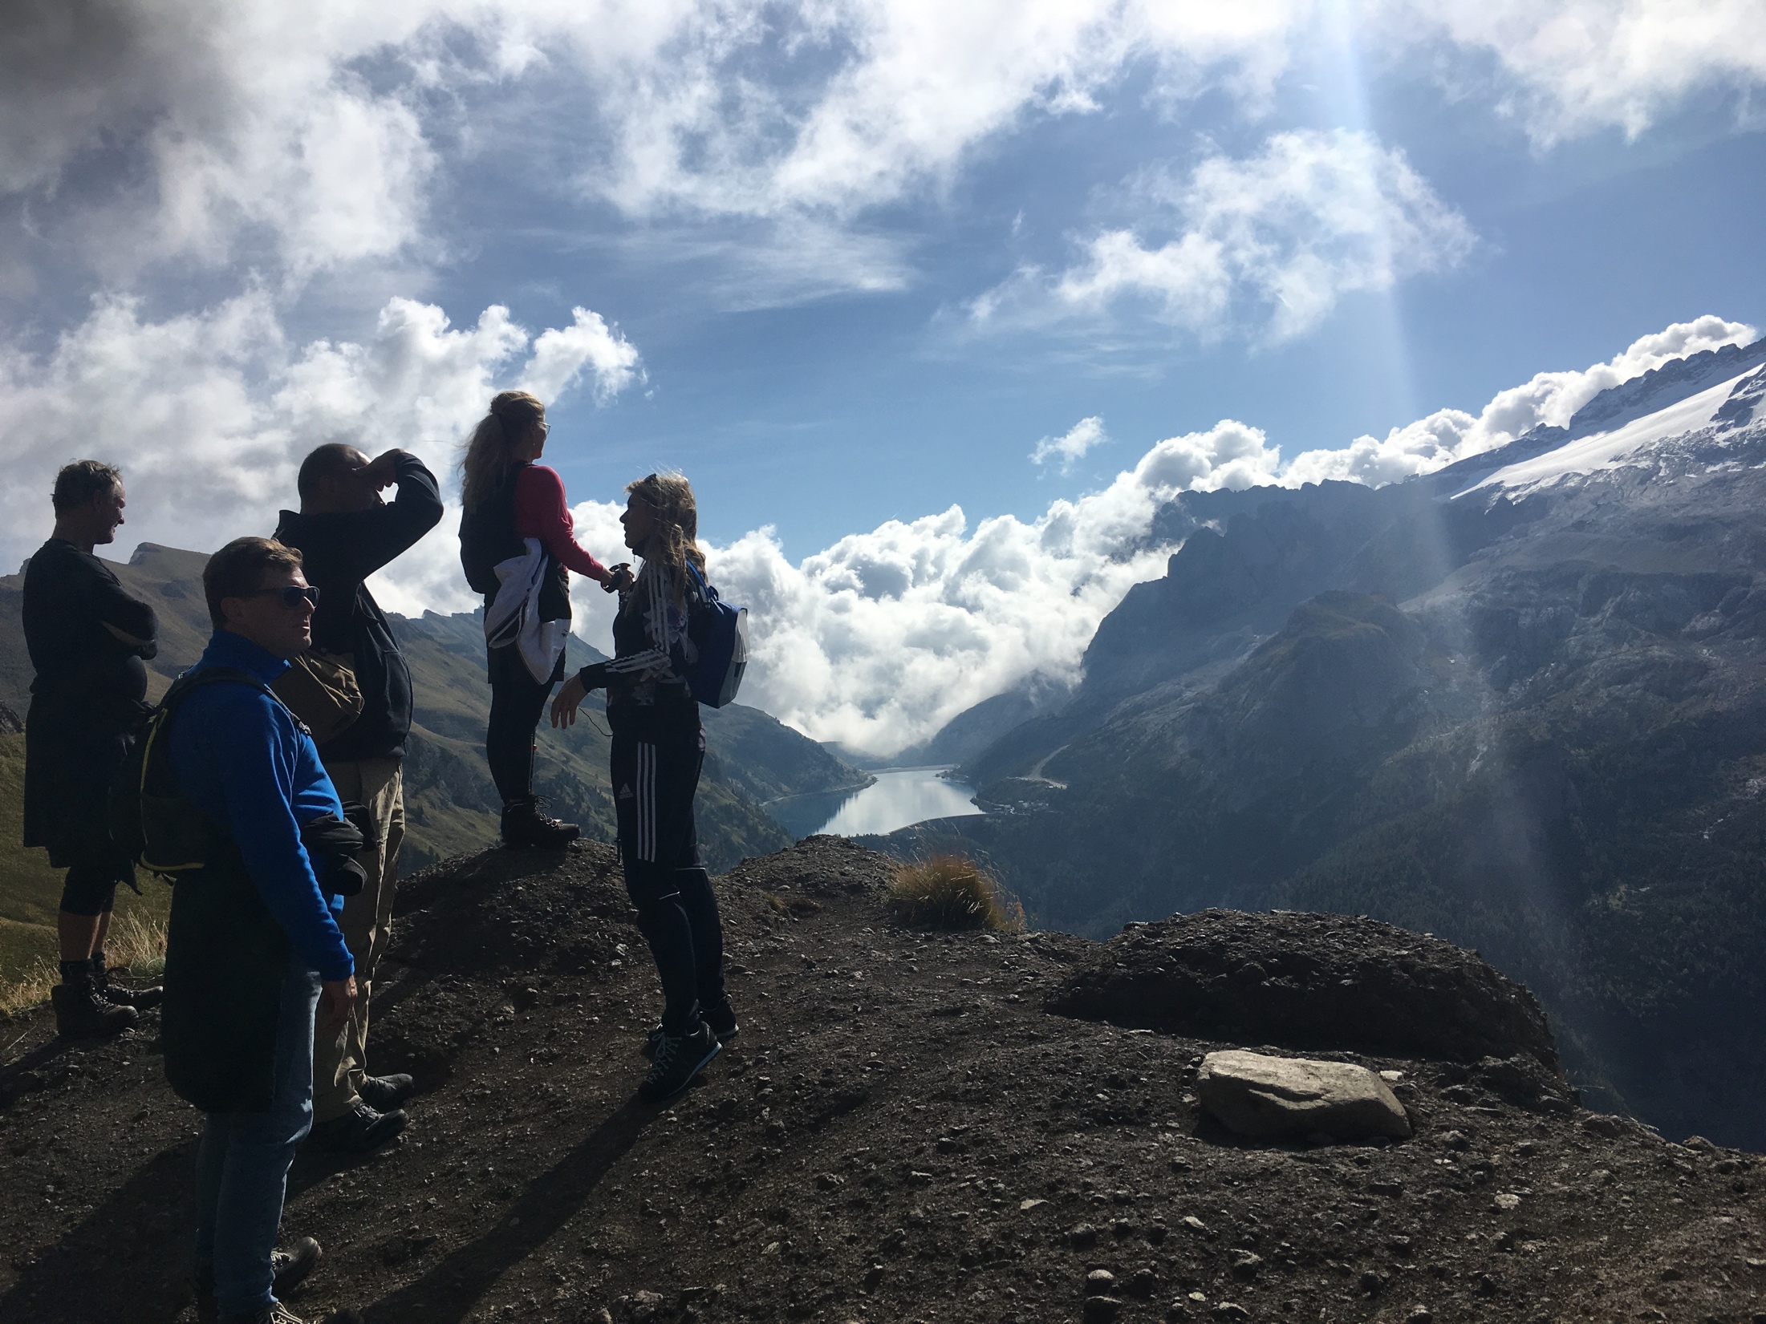
Mountain Leadership
Protreptic reflection

Slide 10

ABSTRACT/GENERAL
Concepts/values
CONCRETE
Storytelling – personal - organization

Slide 11

Questions for the TS Guide
What is the true story now compared to the past (rehistoricizing)?
How do the smaller stories fit into the bigger picture & what concepts/values illustrate stories (abstracting)?
Do you need to add or change anything (futuring)?
Have you recognized any side benefits which are important to share in stories (grounding)?
Reflect on values & concepts inspired from 7 principles?

Slide 12
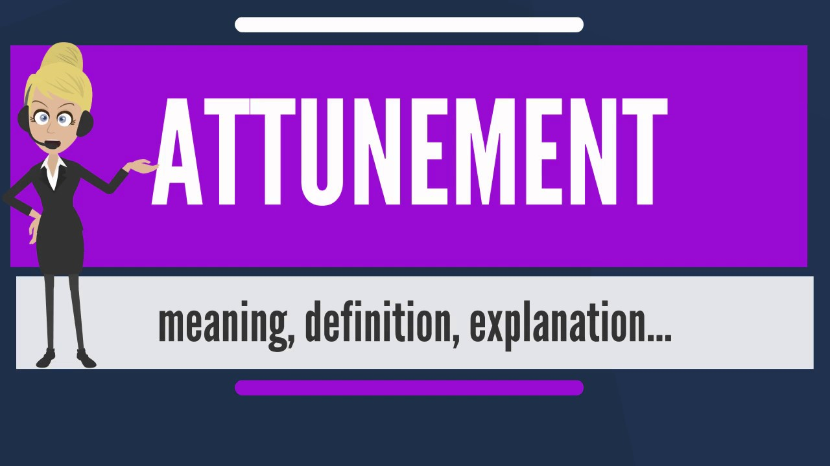
The BEYOND process of Body-ATTUNEMENT
Notes:
Story: I have been dong muscle-testing daily since I met Grace Ann Rosile. We use it with horses, and to get pre-reflective embodiment answers to yes/no questions. It is how I attune to space, the subject of the 2nd Masters Class.
QUESTION: What is Space?
“Space is not the setting (real or logical) in which things are arranged, but the means whereby the position of things becomes possible. This means that instead of imagining it as a sort of ether in which all things float, or conceiving it abstractly as a characteristic that they have in common, we must think of it as the universal power enabling them to be connected” (Merleau-Ponty, 2012: 284). https://voidnetwork.gr/wp-content/uploads/2016/09/Phenomenology-of-Perception-by-Maurice-Merleau-Ponty.pdf
We trace out our spatial relations to understand sustainability. A reflection on “space as the indivisible system governing the acts of unification performed by a constituting mind” (Merleau-Ponty, 2004: 284).
In True Storytelling, space-attunement is very practical. “What counts for the orientation of the spectacle is not my body as it in fact is, as a thing in objective space, but as a system of possible actions, a virtual body with its phenomenal ‘place’ defined by its task and situation. My body is wherever there is something to be done” (Merleau-Ponty, 2004: 291). We inhabit the virtual-spectacle that the Nature of things in their visual, auditory, tactile fields (spaces) already pre-constituted. Welcome to antenarrative processes.
The body is an ensemble of entanglements and relationships to our environment, already-there, constituted, shifting, unfolding, and changing, in-action, in circuits of existence of our habits of Being-in-the-world of place already-there.
Nature be always already (forestructuring BETWEEN) implicated in human projects (in spacetimemattering), and of human projects as already implicated/entangled in nature (BEYOND in our attunements). Nature is therefore already part of True Storyteling. We are already embedded in-Nature, entwined in ontology of Nature. We are already embedded in attunement-Nature. That is the very definition of quantum storytelling, to attune to vibrant energy mattering.
Unlike the 5 senses of sensemaking of the rational/empirical/intellectual/cognitive BENEATH-Heart, we are entangled already in the BEYOND-Heart of Nature. This is why IWOK is a very different attunement than WWOK.
Background: Merleau-Ponty argues for a Phenomenology of Perception book draws on biophysical responses are pre-reflective
Word attunement (aka Mood) comes from Martin Heidegger’s Being and Time book
Merleau-Ponty has a pre-reflective embodied reflection, whereas Heidegger’s 10 attunements are to our entanglements and uncoverings of Being-in-the-world
Attunement to the quantum field energies of our existence is through the body, our embodiment Nature
Muscle-testing energy work is a good example
Muscle testing is a holistic technique derived from the field of Kinesiology
For more see → https://discoverhealing.com/muscle-testing-energy-healing/
e.g. Straight Arm Muscle-Test
Hold your arm straight out in front of your body and ask yourself a question like “should I drink this cup of coffee?” or “would this supplement be advantageous to my body?” If your arm feels a bit weaker when you ask a question like this, the answer is ‘no’, whereas a strong, stable arm represents a positive, ‘yes’ answer.
e.g. Whole Body Stress Muscle-Test
Before you pour your third cup of coffee or bite into that apple, hold the cup or fruit in your hand. Be hyper aware of how your body responds; if you subtly sway forward, this indicates a ‘yes’ or strong response. If your body subtly sways backward, however, this indicates a ‘no’ or negative response and signals that your particular item won’t benefit you.
Take a deep breath, let it out, and try to relax your body completely. Then ask yourself a yes or no question, and see how embodiment answers.
10 Tips for Self-test Muscle Testing https://www.youtube.com/watch?v=fw3rd6PEpFQ
We attune constantly and never have complete attunement spatially. “The primordial level is on the horizon of all our perceptions, but it is a horizon which cannot in principle ever be reached and thematized in our express perception” (Merleau-Ponty, 2004: 295).
The 4 Hearts of True Storytelling is spatialzing, as well as temporalizing. You can discern it in this quote:
“There is, therefore, another subject beneath me, for whom a world exists before I am here, and who marks out my place in it. This captive or natural spirit is my body, not that momentary body which is the instrument of my personal choices and which fastens upon this or that world, but the system of anonymous ‘functions’ which draw every particular focus into a general project. Nor does this blind adherence to the world, this prejudice in favour of being, occur only at the beginning of my life. It endows every subsequent perception, of space with its meaning, and it is resumed at every instant” (IBID. p. 296).

Slide 13
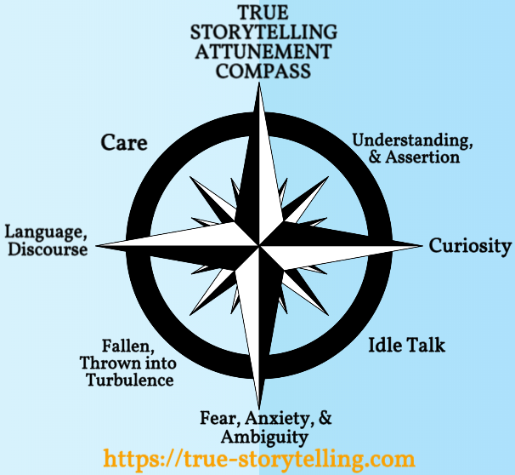
Notes:
This is a slide from the Foundation Module of TSI
The attunements comes from Martin Heidegger’s Being and Time.
Truth, Morality, Integrity, Ethics, Love
How do we live an Embodied Life of True Storytelling Attunement? Moving into Care and Understanding and not being suspended in Fear, anxiety, and Ambiguity.

Slide 14
Preparing for EMBODIED-NATURE- REFLECTION on our
True Storytelling Attunements Compass
Care – How are you caring for Self, Others, Nature?
Language & Discourse of Nature – What Polarizing Discourses are you Attuning to, or Not?
What is your attunement to Nature, Economic down spiral, etc.
How do you attune to Fear, Anxiety, & Ambiguity of the global Nature- situation?
What do you do about Idle Nature-Talk of Social Media?
When does Nature-Curiosity go too far?
How do you enter a Nature-Place of Understanding and Assertion?
Where does your TRUE STORYTELLING COMPASS point in your Ethical-Nature Life?
Notes:
Week end at summer house in Denmark to be in Tune, David – walks to the Ephemeral Pond while caring for desert trash, etc.
Where is the body? (Merleau-Ponty) connect attunements via the body, to know how out of tune, out of balance Mind-Body-Nature – when out of balance you can feel it – It’s Only Business.. IWOK its Harmony, in balance with nature – In it you know it, you see and hear the wind flowing through the Hackberry, Sumac, and Mesquite trees

Slide 15
Examples of Pre-Reflective Embodiment
When REFLECTION is pre-reflective embodied performance.
E.G. Steering a car into a parking place without reflection, movements are habitual in ‘Embodied Intelligence’
E.G. Learning to swing a golf club without hooking or slicing
E.G. Abduction – the Beyond of intuition that has no empiric or intellectual mooring
Experiment 1: Hold pen in right hand, then extend forefinger of left hand to touch the hand holding the pen.
Point: overcome duality of object (hand) and subject (hand) in embodiment
Experiment 2: Press hands together at fingertips, left touching right, then right touching left (repeat). The reflexivity of touching
Notes:
Be practiced repetition of embodied actions, we perfect performance-in-action habits
In the experiments, see Russon (1993: 293) “Just as between two spatial areas the boundary is at one and the same time the end of one area and the beginning of the next, the point of bodily contact is no more subject than object… All there is is the body, and it is the living process of self-differentiation in which indeterminate horizons of expectation are projected, along which paths determinateness emerges.”
“The body is thus the point where I touch the world, where I intervene, and, equally, where the world touches me” (Reynolds, 2004: 295). We are each bodies already involved in touching nature and being touched by the world (its primordial elements: air, water, fire, earth). All we have to do is overcome the dualism of body-nature separation, and see it’s illusion by embodying situatedness. We are already making contact with the living story webs of life we indwell. Living things have embodied situated agency (Reynolds, 2004). We can be aware of our embodied nature relations and move from ego-centric to we-centric care and understanding attunements. This is a radical shift in our sensemaking (Weick, 1995) to an antenarrative process embeddedness that is pre-reflective embodiment. Body-Nature cannot continue to be a dualism if we hope to achieve sustainability.
The experiments from Merleau-Ponty’s writings are described in Reynolds (2004). I summarize them here.
What is Embodied-Nature-Reflecting
?
it's about attunements. Attunements is an existential approach to ‘care’ and ‘understanding’ and making (true storytelling) assertions). The word attunement is used by Heidegger, and developed into Embodied Nature-Reflection by French philosopher Merleau-Ponty in his final three lectures
A multispecies storytelling (Haraway, 2018) dissolves our egos. The radical desires a ’True Storytelling’ one deeper than mainstream offers, one with less self-deception, more ecospiritual wisdom, and “overcoming the forgetfulness of our death-bound nature” (Fisher, 2012: 81).
It gets back to IWOK and WWOK Reflecting-Nature. WWOK perpetuates a nature-estranged way of storytelling that deanimates nature, what Carolyn Merchant (1980) says signals the ‘death of nature.’
In Living Storytelling (Kaylynn TwoTress) ‘all things have place, time, and mind or a mind-like quality’ (p. 87) and to WOOK that is just animism — attributing spirit/soul to animals, plants, rocks, mountains, rivers, and so on). But to Cajete animism is part of Native Science (2000). Maurice Merleau-Ponty is an exception, as a non-dualistic philosopher. In IWOK Gregory Cajete (2000) has an animistic reading of the world that is without apology.
In IWOK plants are spirit-filled.
Contrast it with TS Eliot’s poem Little Gidding.
“Plants ‘know; what their place in Nature is, but do we?” (Gagliano, 2013: 2). In her book she has experiments how seeds are cared for by trees, through microbial/fungi strands passing carbon, water, and nutrients from not just mother treet, but other trees in the canopy to the seedling, and actually monitoring if the seedling needs more or less, in carious conditions.
There is a parallel to Merleau-Ponty (Phenomenology of Perception): p, 72: "the body, by withdrawing from the objective world, will carry with it the intentional threads linking it to its surrounding and finally reveal to us the perceiving subject as the perceived world."
REFERENCES
Merleau-Ponty, M. (1964). Signs. Transl. ed R. C. McCleary. Evanston, IL: Northwestern University Press.
Merleau-Ponty, M. (1969). The Visible and the Invisible, trans. Alphonso Lingis (Evanston: Northwestern University Press. https://monoskop.org/images/8/80/Merleau_Ponty_Maurice_The_Visible_and_the_Invisible_1968.pdf
Merleau-Ponty, M. (2012). The Phenomenology of Perception. Transl. ed D. A. Landes. London; New York: Routledge. https://voidnetwork.gr/wp-content/uploads/2016/09/Phenomenology-of-Perception-by-Maurice-Merleau-Ponty.pdf
Reynolds, J. (2004). Merleau-Ponty and Derrida: intertwining embodiment and alterity (No. 32). Ohio University Press.
Russon, J. (1994). Embodiment and responsibility: Merleau-Ponty and the ontology of nature. Man and World, 27(3), 291-308.

Slide 16
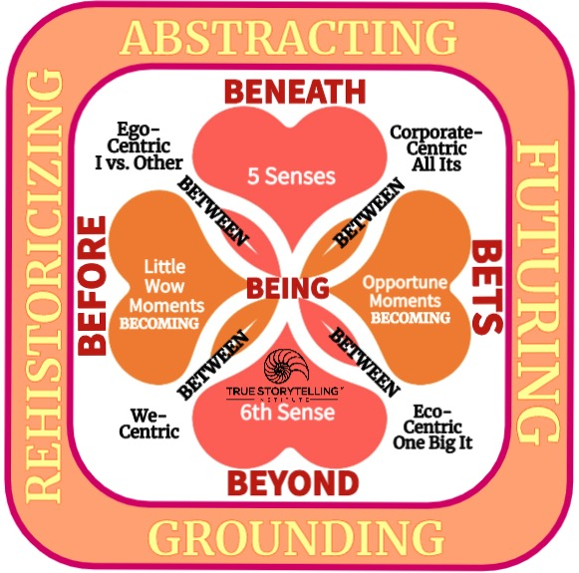
BIG PICTURE: Pre-Reflective Embodiment→ BEYOND
6th Sense of Pre-Reflective Embodiment
Reflective-Grounding in potentiality of ‘We-Centric’
The Onto-Story of BEING is not the ‘Now’ presentment
Onto-Story by uncovering all 4 ♥ SpaceTimeMattering
♥ of Embodiment Arc of ♥-Retrospection meets Pre-Reflective BEYOND-♥
Notes:
QUESTION: What is the bodily grounding of True Storytelling?
Embodied Attunement comes from existential philosophy of Merleau-Ponty, who late in life worked on the problem of Nature and our Embodied Reflection getting beyond representation, into what we call grounding, in the vibrant matter (Jane Bennett, 2008), how our body quantum vibrations have what Merleau-Ponty calls CONNEXION, what quantum storytelling calls vibrant mattering energy waves, and that is what we do in attunement.
“---- Chiasm, instead of the For the Other: that means that there is not only a me-other rivalry, but a co-functioning. We function as one unique body” (Merleau-Ponty, 1969: 160).
In True Storytelling we move from the ego-centric, to the we-centric (& eco-centric), from the egoistic-BENEATH-Heart to the BEYOND-Heart of embodiment, as we are uncovering all around BEING-there, we dwell in-BETWEEN.
“…self-reflective egos capable of self-conscious rationality and moral existence is only understandable in terms of the unreflective and intersubjective habits of cultural behavior and communication which are situated in this dynamic of embodied emergence” (Reynolds, 2004: p. 295).
The Self is first and foremost, body, therefore not a mind-body separation of duality (Reynolds, 2004). True Storytelling brings embodied reflection and pre-reflective entanglement to our conscious awareness so we make good, just, true, and beautiful decisions.
See article by Boje and Rosile on intersubjectivity of humans and dogs.
Boje, D. M., & Rosile, G. A. (2019). Conversational storytelling research methods: cats, dogs, and humans in pet capitalism. Communication Research and Practice, 5(4), 309-326. Also in the conversational storytelling book (2020) and in chapter 7 of True Storytelling book

Slide 17
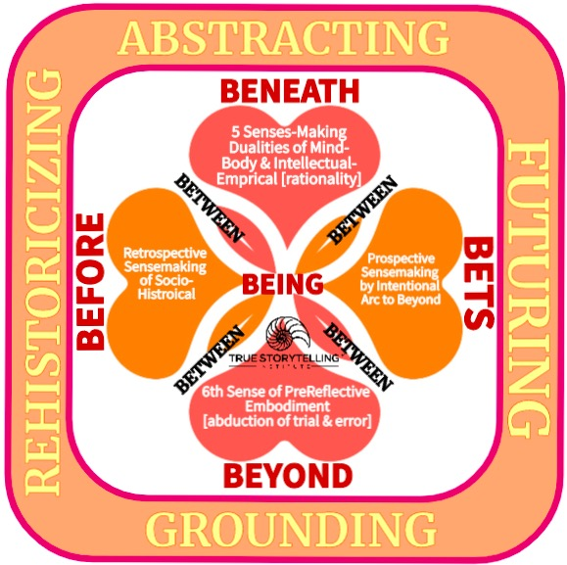
BEYOND is Pre-Reflective
Aka – Abduction
Aka – 6th Sense
Aka - Body Sense

Slide 18
Embodied Performances
3-min presentations

Slide 19
GRADUATION
True Storytelling Institute
POST-SESSION GRADUATION
https://www.youtube.com/watch?v=Kw-_Ew5bVxs

Slide 20

SCHEDULE for Session 7
8:45-9:00 Pre-session ”coffee:” Lena
9-9:05 Welcome; Check-in and Agenda for the session Lena
9:05-9:10 Groundrules; (homework at the end); GraceAnn
9:10-9:20 Nuts&Bolts of Embodied Reflection: GA
9:20-9:35 Principle 7 Embodied Reflection : Jens
9:35-9:50 Principle 7 Embodied Reflection: David
9:50-9:55 Set Up for Videos and Feedback Instructions:
3 min each video
+ 1 min feedback via CHAT and live
+ 1 min transition to next speaker
9:55-10:00 Transition to VIDEOS
10:00-10:30 VIDEOS plus feedback (6 5-min rounds)
10:30-10:45 GRADUATION! And NEXT STEPS
20
Notes:
20

