Slide 1
TRUE STORYTELLING
Train-the-Trainers
Level II session 6
1
Notes:
Just go over this slide
1

Slide 2
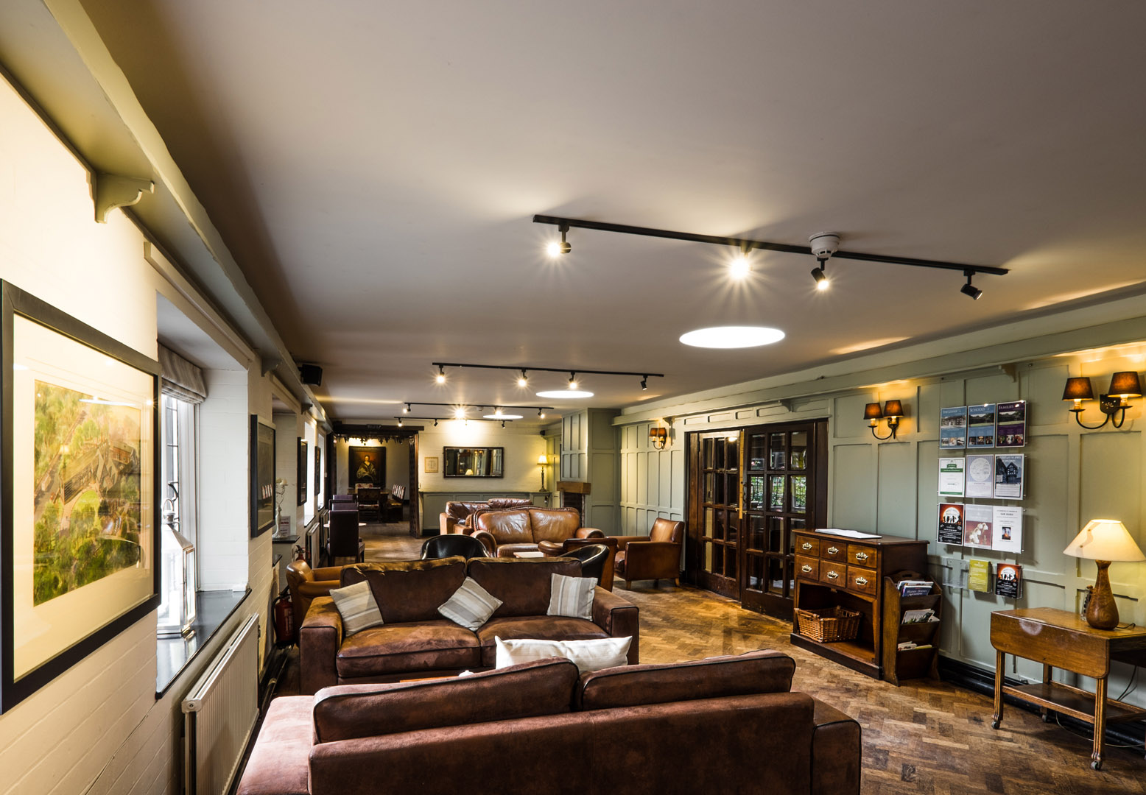
True Storytelling Institute
PRE-SESSION WEEK #6
“Staging & BETWEEN-Antenarrative process”
COFFEE in the LOBBY
Notes:
2

Slide 3
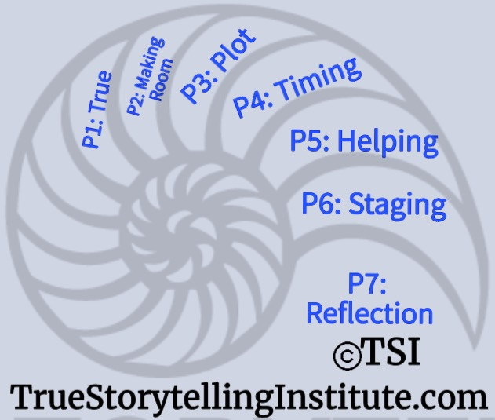
Welcome and ROADMAP: Jens
Last Week:
Principle 5 Helping
& Becoming Processes
This week:
Principle 6 Staging
& Between ♥’s
and
Nuts and Bolts

Slide 4
Jens
Please bring a notebook and pen/pencil to each session.
Use the “Gallery View” so you can see each other while viewing Powerpoint.
Please do not give advice to others or use ‘should’ statements for self or others.
Speak more from the heart than from the head
Laser in, be concise, and share only one story instead of several.
CONFIDENTIALITY: Do not tell someone else’s story. Please DO NOT record any session of the presenters or the participants.
Please use Chat ONLY when asked to do so. Avoid “side talk.”
Please attend all sessions. If you must miss one, contact us so we can help you to catch up before you return.
Notes:
4

Slide 5
STRUCTURE FOR TODAY: Jens
PART I Check-in of Group Members; Roadmap: Lena
PART II Homework from Session 4: Lena
Part III Nuts & Bolts: Memory Aids & Graphics Grace Ann
PART IV Introduce Principle 6 Staging & Guiding: Jens
PART V Staging Between the ♥’s David
PART VI Breakout: David
PART VII Debrief: Lena
PART VIII Homework: Lena
PART IX Post-Discussion “Lobby,” Q&A: Jim
Notes:
5

Slide 6
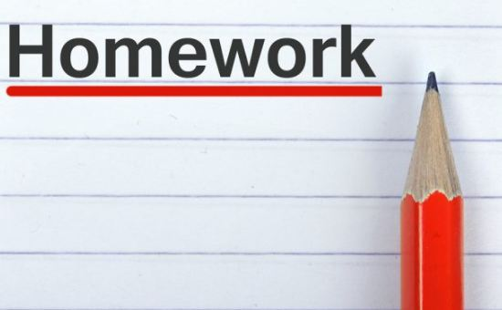
Lena – Last Session’s Homework: Getting your
Zoomable Restorying Kit together
(Click-Handout & the Click Slides) 2nd Masters
Today’s Topic is Principle 6: Staging the BETWEEN
You take the ‘New Story’ you helped along in restorying, and now
Make it communicate in the Staging

Slide 7
Session 6 Nuts & Bolts
Last week: Connecting the Dots & Quasi-Objects
THIS WEEK: STAGING and Memory Aids
6 X 6 rule; 18 point font
Material Objects; Nature; Music; Art
Use Physical Objects, Quasi-Objects, Action
Holmberg’s Error; The Pope Story

Slide 8
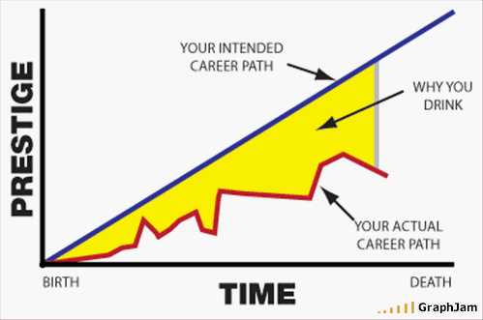
STORYBOARD of YOUR LIFE in GRAPH FORM

Slide 9
Principle 6 You must consider staging including scenography and artifacts
Notes:
Helping stories along, be open to experiment – local community, future audience, on the road nationally exhibitions, network internationally exhibition
9

Slide 10
Is about how appearance, space, nature, body, room, artifacts moves process on
Why staging works
Supports your true story
Create ommitment and engagement
Create ownership
Help you strategize
Create change
Help you publicize your re-story
Help stories along
Will get you from abstracizing to grounding
Is the BETWEEN

Slide 11
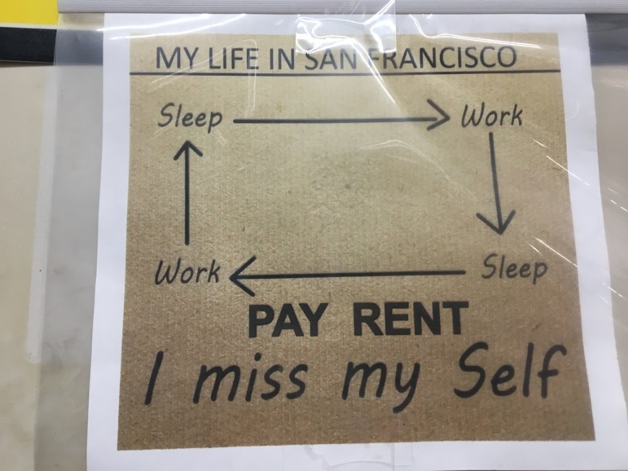
Symbols

Slide 12
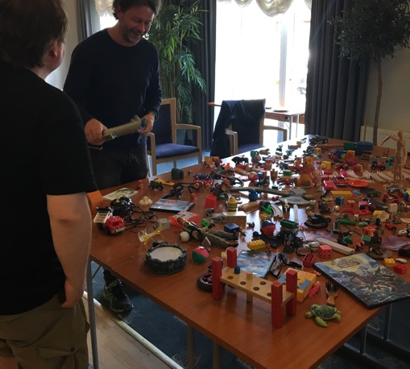
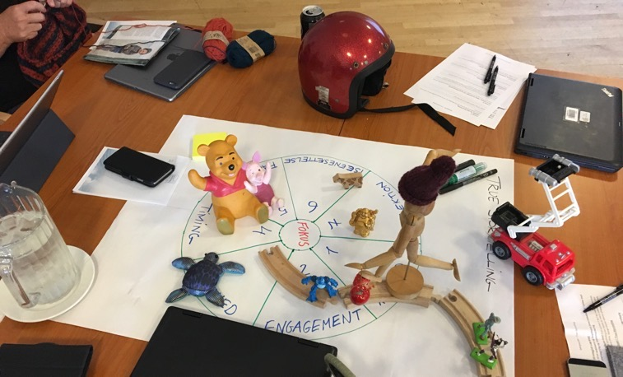
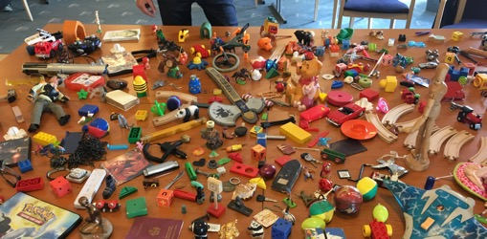
Materiality
Notes:
Development of strategic efforts and action plan
5 min: Introduction to the continuation of concrete case work in teams. Use artifacts as a tool to ensure progress in the process of qualifying, by Jens.
25 min: Continued work with specific cases and efforts, qualify the solutions that are needed and that you can go home and work on. It is based on your own experiences with strategic work as well as the 7 principles in True Storytelling.
12

Slide 13
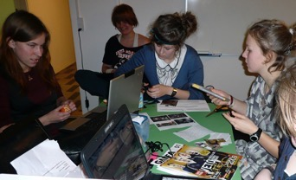
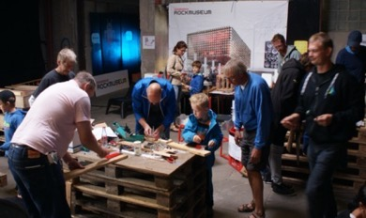
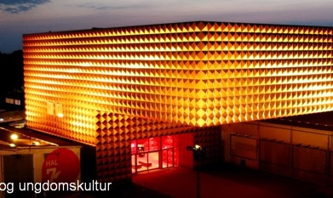
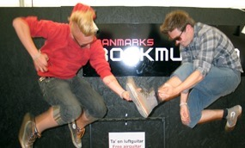
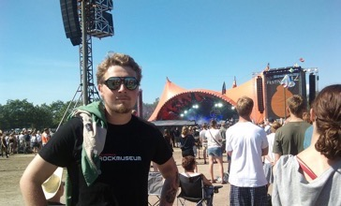
Body
Space, place, room
Notes:
13

Slide 14
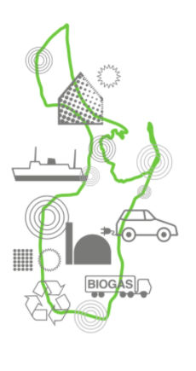
Ursula Von Leyden, EU President RE-STORY 2021
”The New European Bauhaus movement is intended to be a bridge between the world of science and technology and the world of art and culture.
It is about a new European Green Deal aesthetic combining good design with sustainability.”

Slide 15
Questions for the TS Guide
How have we used staging and artefacts in the past to support the true story (rehistoricizing)?
What should the staging illustrate in terms of concept & meaning (abstracting)?
How should staging look like in the future if it is to support & create commitment to the true story (futuring)?
How can we state and use artefacts now, which will support and create commitment to the true story (grounding)?
How to stage by doing Together-Telling?

Slide 16
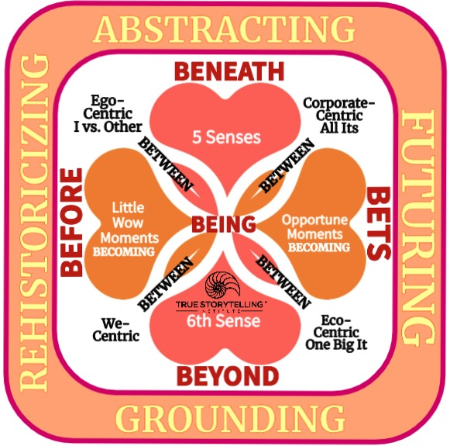
BIG PICTURE: Use Embodied Restorying Process to do Together-Telling → STAGING
Use ERP to do Staging BETWEEN the Hearts Forestructuring
Staging is Grounding in Scaling potentiality of ‘We-Centric’
Each Frame of Staging is movement of Eventing in Embodiment of a State of Affairs

Slide 17
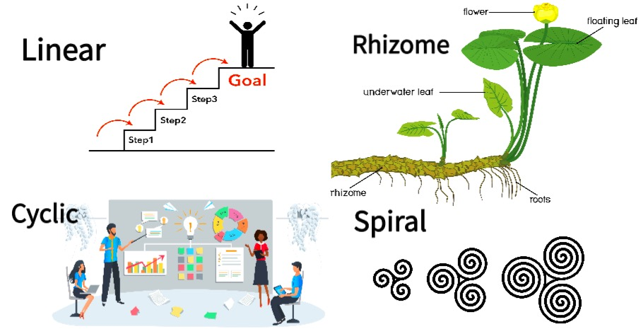
STAGING is Framing the Between to Scale Up Storyboard:
linear, cycles, spirals, or rhizome

Slide 18
BREAKOUT: 2 groups of 3 & one group of 4
TOTAL TIME: 12 min----
2 min silent prep plus
10 min breakout (2 min per person)
STAGING TOOLS for your New Story:
Material Objects. Music. Art. Charts/graphs. Settings.
Other People. Jokes.
Mnemonics. Key Words. Nature. Sound. Food. Costuming. Props. Lighting.
TASK:
Pick a STAGING tool and explain how you might use it in staging your storyboard.

Slide 19
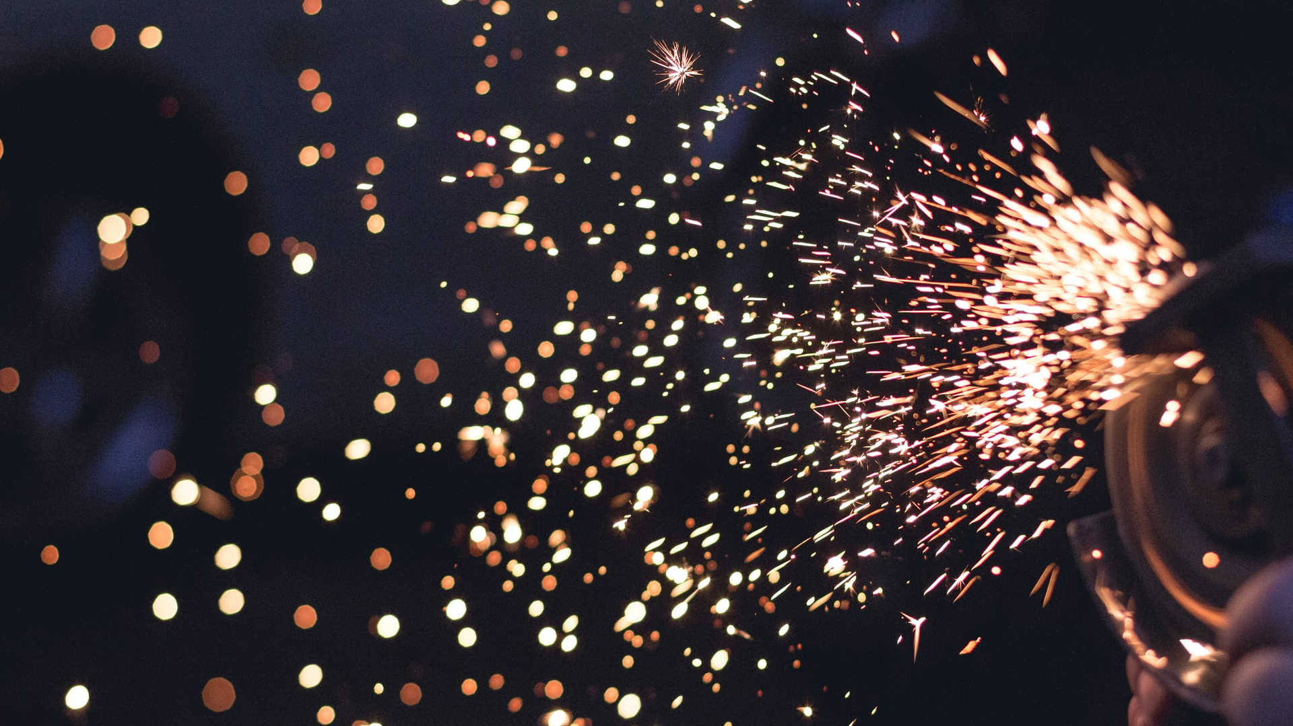
DEBRIEF Questions
How to communicate the ‘new story’ from Embodied Restorying Process (ERP) in the Staging of your storyboard?
Do you re-present linear (beginning-middle-end)?
Do you re-present a cycle?
Do you depict spiraling of events eventing?
Are they ready for rhizomatics?

Slide 20
Next Week
P7: Embodied
Reflecting

Slide 21
HOMEWORK due in Week 7: Bring your
Staging Storyboard up to the present
Read Chapter 7, True Storytelling book, on
Principle 7 You must reflect on the stories and how they create value
Consider: Embodying Reflection
Notes:
21

Slide 22
HOMEWORK due in Week 7:
Part 1: Outline a 15-minute presentation on EITHER:
a)one of the 7 True Storytelling principles, OR
b)your own storyboard developed in the past 6 weeks
This 15-minute presentation should be suitable for using at a professional meeting
like the Academy of Management (where speakers typically get 15 min) or the
Las Cruces New Mexico Annual Storytelling Conference, where the presentation
Is a sampling (just a small part) or a summary of a longer paper/presentation.
It should be an ACTIVE presentation involving the audience in some way.
Part 2: Be prepared to spend 3 MIN presenting your subject (the 15-min presentation above).
You will be asked to make this 3 MIN presentation at Session #7.

Slide 23
True Storytelling Institute
POST-SESSION
“COFFEE in the LOBBY”

Slide 24
SCHEDULE for Session 6
8:45-9:00 Pre-session ”coffee:” Jens
9-9:05 Welcome; Check-in; and Agenda for the session Lena
9:05-9:10 Groundrules; homework; Jens
9:10-9:20 Nuts&Bolts; Staging & Connect Dots: GA
HOMEWORK due in Week :
9:20-9:35 Principle 6 Staging Jens
9:35-9:50 Principle 6 Staging the Between David
9:50-9:55 Examples and lead-in to Breakout: Jens
9:55-10:10 Breakout: Staging and Your Storyboard
10:10-10:20 Debrief – David
10:20- 10:25 Homework
10:25-10:30 Q&A & Memory Aids: The Pope
10:30-10:45 POST-session and Rock Museum: Jens
24
Notes:
24

