Slide 1
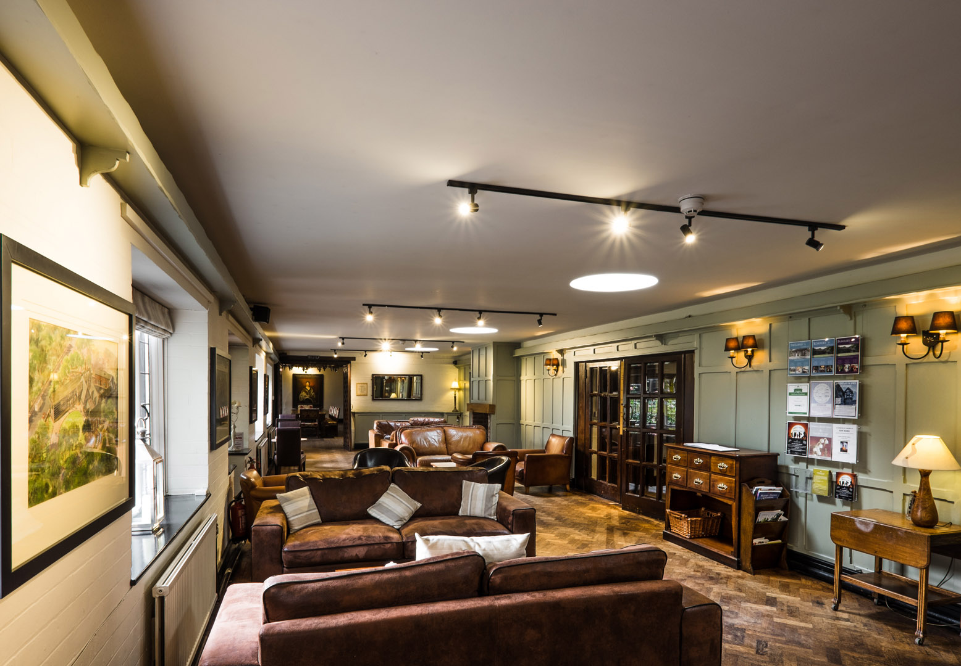
JENS WELCOME to True Storytelling Institute
WEEK 2 Principles 3 & 4
COFFEE in the LOBBY
8:45-9:00 AM Pacific
Notes:
1

Slide 2
TRUE STORYTELLING
Foundations Ethics
Level I session 2
2
Notes:
Just go over this slide
2

Slide 3
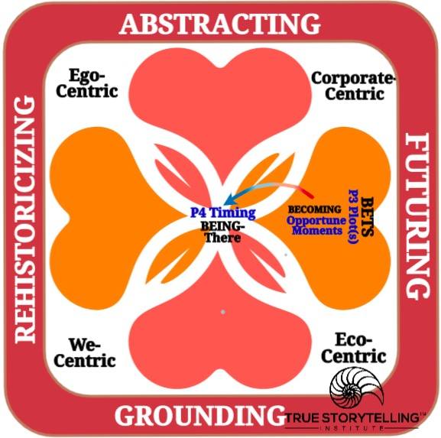
Welcome and ROADMAP: Jens
Week 2:
True Storytelling 7 Principles:
LAST WEEK:
(1)Truth and (2)Make room
THIS WEEK:
(3)Plot: to create direction
and help people prioritize
(4)Timing: both Chronos & Kairos
UPCOMING:
(5) Help stories along
(6) Staging
(7) Reflection

Slide 4
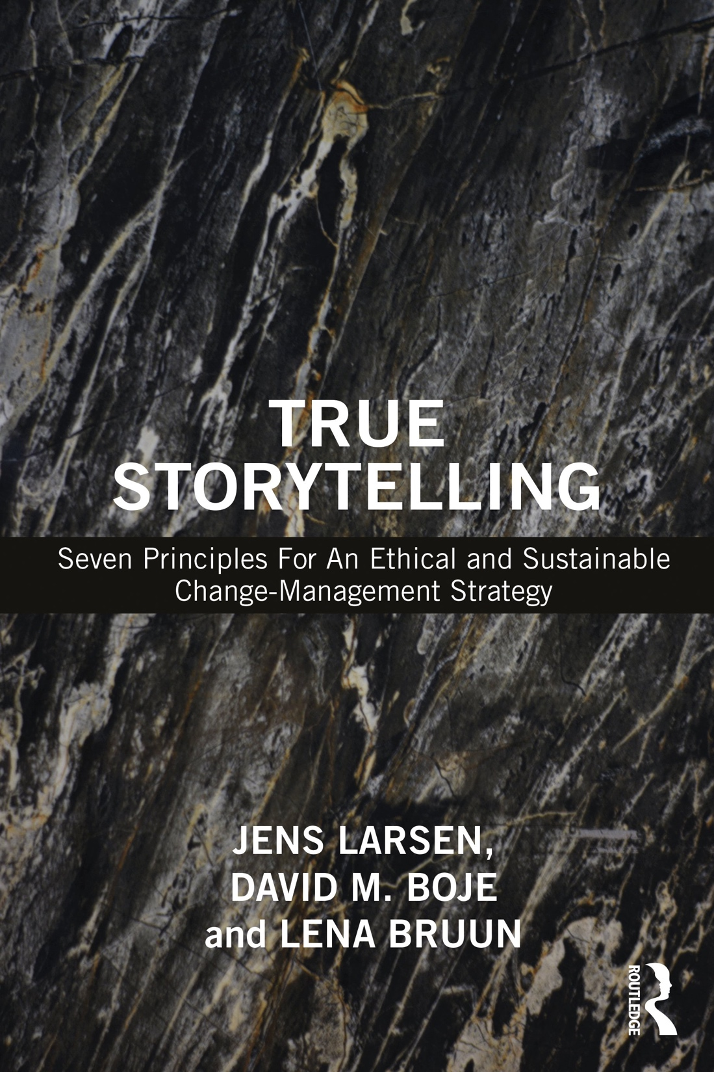
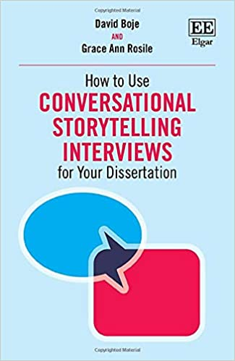
STRUCTURE for TODAY
PART I Pre-Session Check-In & Grounding
Part II Welcome, Roadmap, Groundrules: Jens
Part III Nuts & Bolts; Homework: Grace Ann
PART IV Homework BREAKOUT
PART V Debrief
PART VI Intro Principles 3 & 4, Plot & Timing: Jens
PART VII More Theory on Principles 3 & 4: David
PART VIII Storyboards & Examples
Part IX Homework and Q&A
Notes:
4

Slide 5
Please bring a notebook and pen/pencil to each session.
Use the “Gallery View” so you can see each other while viewing PowerPoint.
Please do not give advice to others or use ‘should’ statements for self or others.
Speak more from the heart than from the head
Laser in, be concise, and share only one story instead of several.
CONFIDENTIALITY: Do not tell someone else’s story. Please DO NOT record any session of the presenters or the participants.
Please use Chat ONLY when asked to do so. Avoid “side talk.”
Please attend all sessions. If you must miss one, contact us so we can help you to catch up before you return.
Notes:
5

Slide 6
Session 2 NUTS & BOLTS Grace Ann
1. Using a Story of your own:
The $800; David’s Becoming Vegetarian
SPACE-TIME-MATTERING
2. Timing of the Story: Chronos & Kairos
3. Plot of the Story: Antenarrative Structures
Linear, Cyclical, Spiral, Rhizomatic
Comedy, Tragedy, Romance/Adventure

Slide 7
BREAKOUT: USE LAST WEEK’S
2 Min silent prep;
2 min TOTAL to Tell Story and Apply Principles
FIRST: Briefly tell your homework story from Week 1 (1 min),
(an organizational problem you are having now).
SECOND: APPLY: (1 min each person)
Using your problem story apply Principles 3 & 4, by identifying:
1. MATERIAL OBJECTS (David = cafeteria line)
2. SPACE (David = behind Grace Ann)
3. OPPORTUNE MOMENTS (David = speaks to GA)
REMEMBER: NO SOLUTIONS YET! That will happen next week.
7

Slide 8
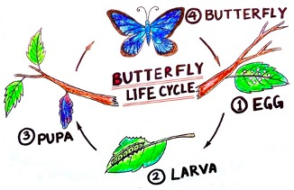
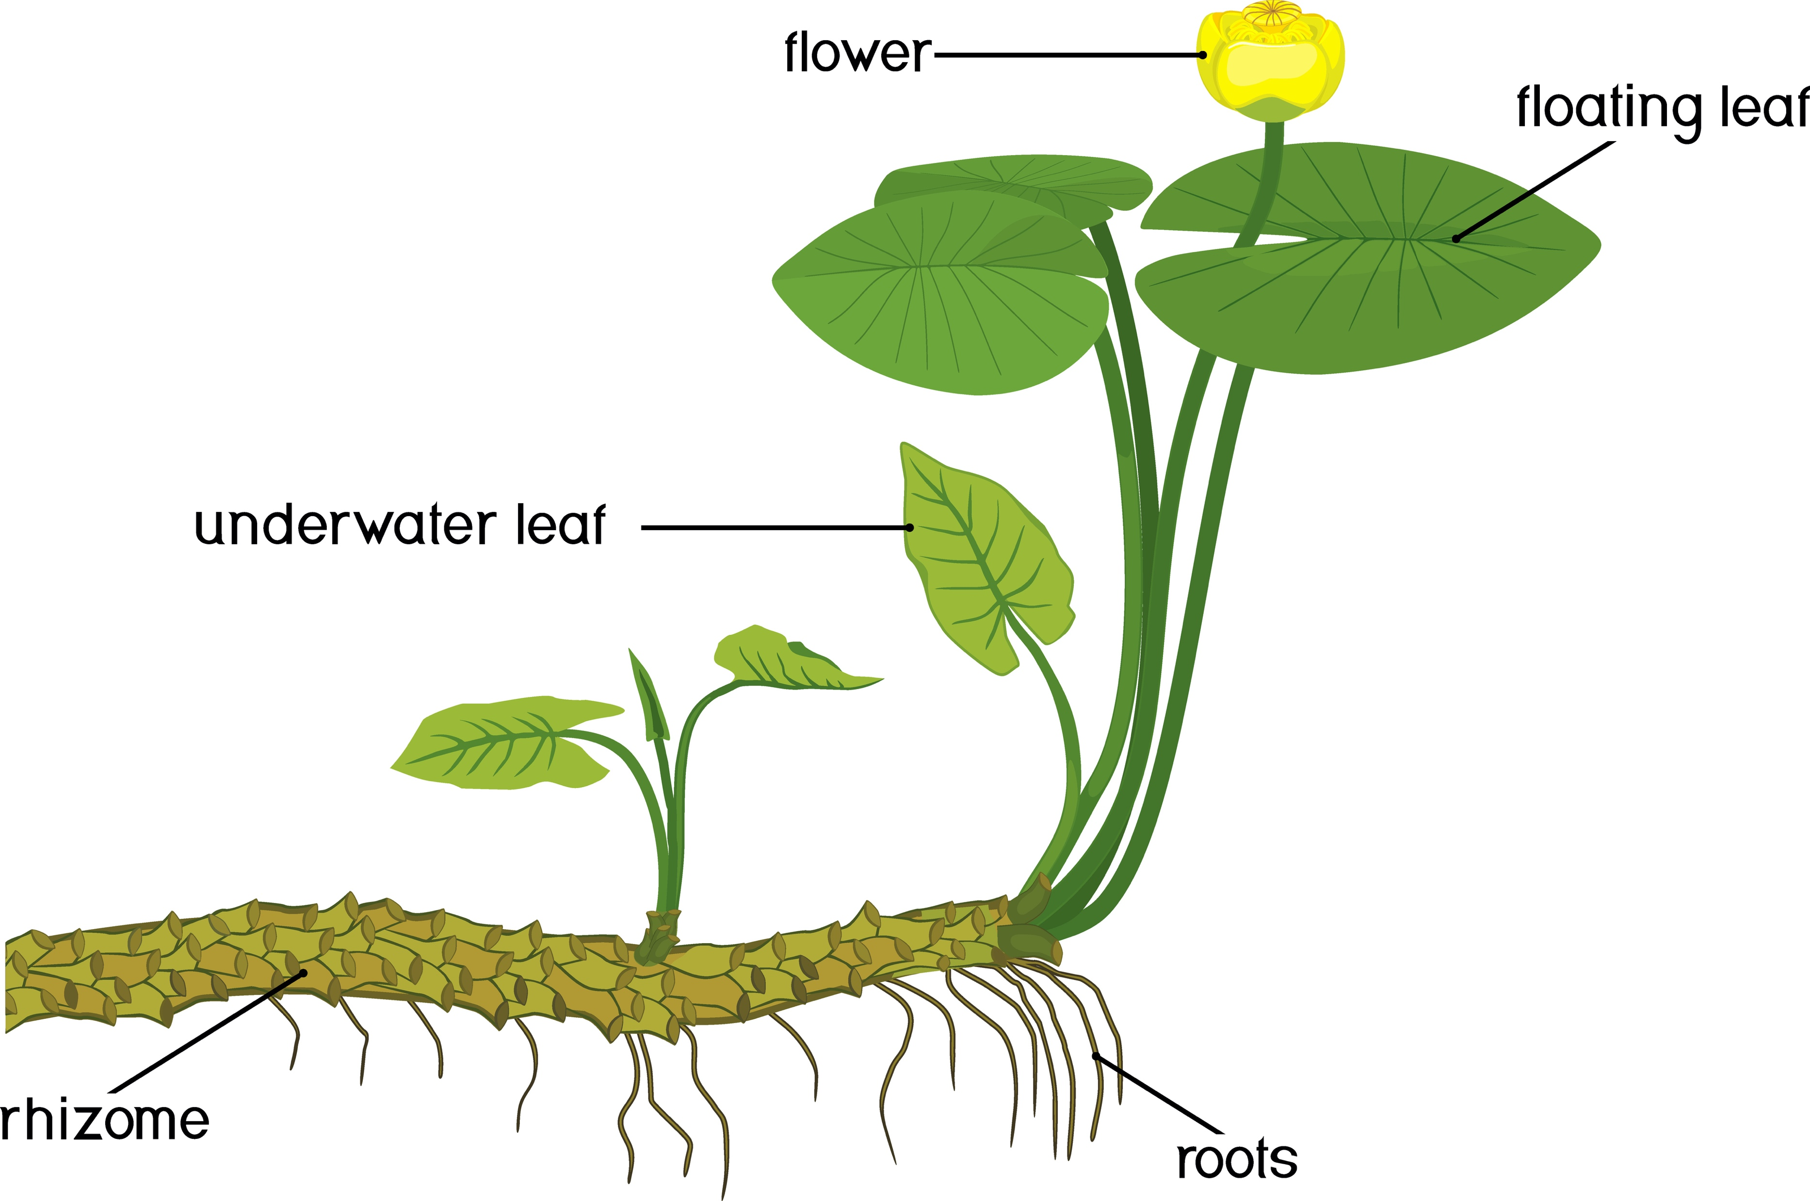
4 Kinds of Plots
B → M→ E
Linear Beginning-Middle-End Plotting
2. Cyclic repeating plots, exact same each time
3. Spiral improvements or down-spiral plots
4. Rhizomes that grow in all directions at once

Slide 9
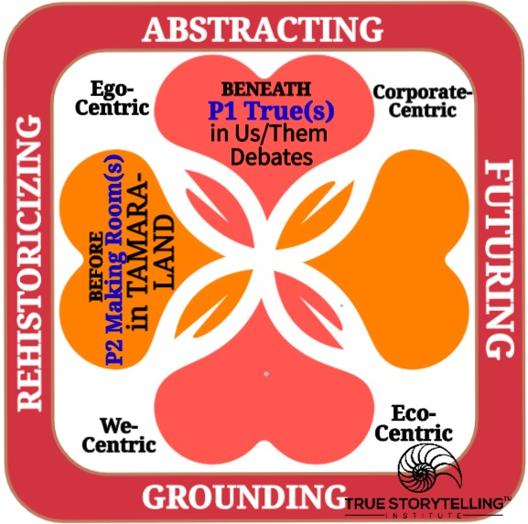
LAST WEEK
REVIEW
GUIDES link PRINCIPLES and PROCESSES for TOGETHER-TELLING outcomes!
Principle 1: What is True BENEATH DEBATES
Principle 2: Making Rooms in TAMARA-LAND
for True storytelling spaces respecting the stories already there
Notes:
Now
we go deeper into
what it means to facilitate and coach PRINCIPLES With PROCESSES,
for
an ethical life
Diane Dredge suggested Bus Tour with all the stakeholders on board on Tues May 8 2018 at Aalborg, at conference held there on storytelling
How to tell a motivating & inspiring story? MOST ENGAGING STORY WAITING TO BE TOLD IS YOURS! I was so shocked, surprised, stupid, suspicious (HOW DID YOU FEEL?)
What is ENGAGING & EMOTIVE-language? – when audience is ENERGIZED (look to body language) – START WITH CONTEXT (PAINT THE VIVID SCENE) e.g. in my driving through woods, icy roads, snowing, on mountain road ADD DIALOGUE
A PROBLEM, an OBSTACLE to OVERCOME: E.g. When I was first person in family ever to go to college? SET UP FOR THE TIMING POINT (THE ARC is SET) THEN SURPRISING TURNING POINT seeYouTube: Jim Carey
A proud moment when MORAL OF STORY →YOU inspired others? THE RESOLUTION E.g. When Bo Kimble died, the team used my motto to move forward
9

Slide 10
Principle 3 PLOT
You must create stories
with a clear plot
creating direction
and helping people prioritize
Principle 4 TIMING
You must create stories

Slide 11
A GOOD PLOT SHOULD:
Create a plot which have the the space for the people involve and help them to prioritize.
Create a story with a plot which break with the old one.
Create a simple plot although it is a complex story.
Page 60,: True Storytelling book

Slide 12
CHRONOS
Clocktime
What is the first step and what is the next step if we want to implement the strategy?
Kairos
Clocktime
What would be the right timing in the future?
How can you know it is the right timing and how can we create the courage to take risks?
Page 70-71: True Storytelling book

Slide 13
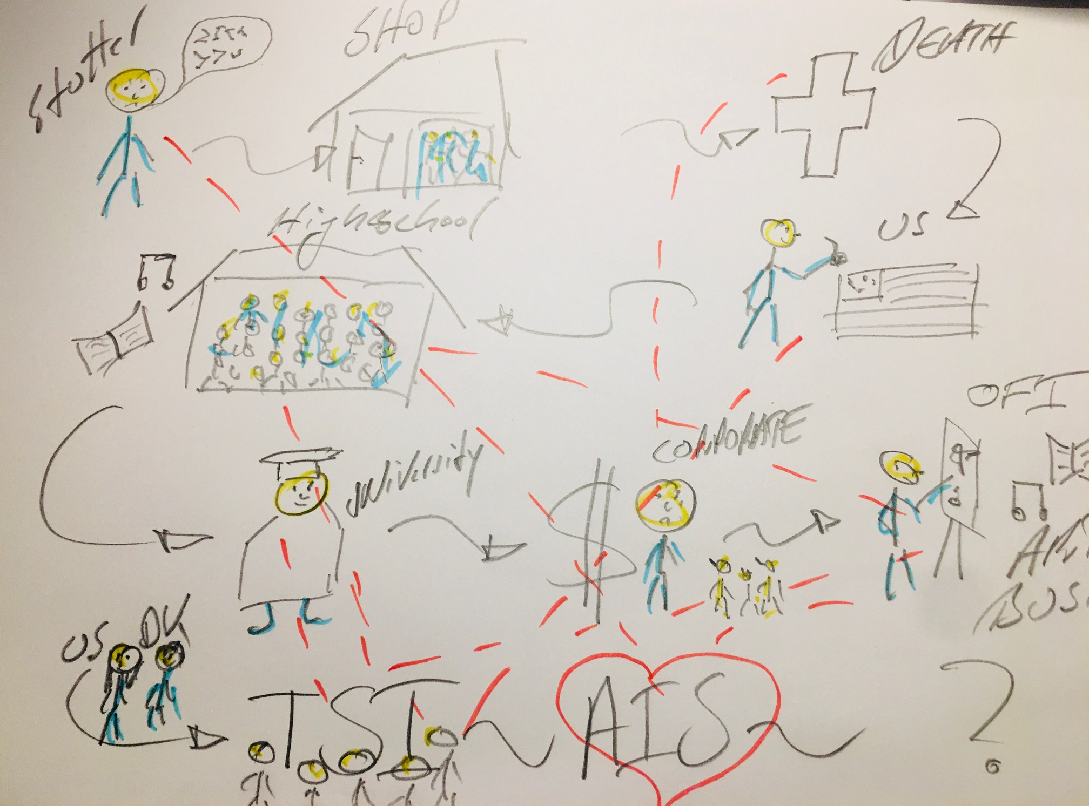

Slide 14
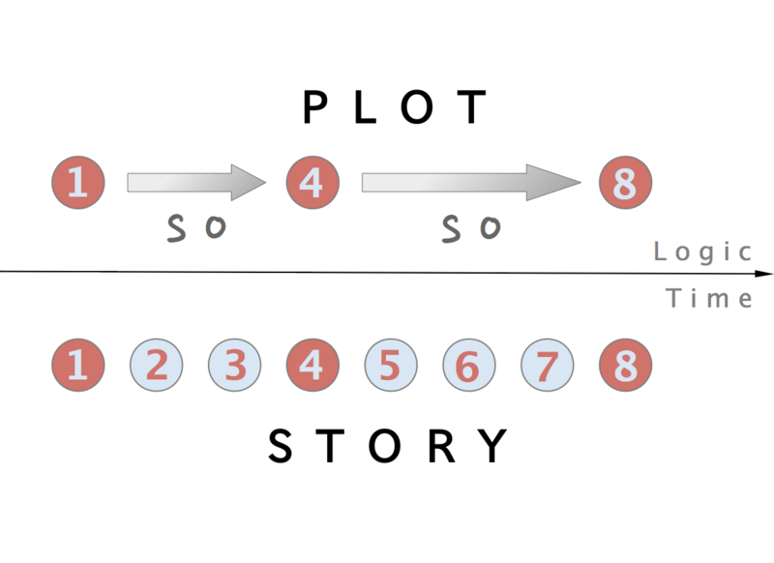
On Difference of Narrative-Plot of Beginning, Middle, End; and Story-Events Left Out
Notes:
Boje→ For 2 thousand years Plotting has reduced story events. To Beginning, Middle, End simplifications, fossilizing a few events to stand in representation for lots of untold stories (events left out of the dominant plot). Plots fossilize, and become difficult to change. Dominant BME plots are linear, and while they do give a direction, it can be the wrong one, and the situation of Being goes unnoticed. Fossilized Plots carry a necessity of fulfillment, even when they are wrong, or tragic, or explotative.
Source Wikipedia – public domain rules apply https://en.wikipedia.org/wiki/Plot_(narrative)#/media/File:Plot_v._story_en.png

Slide 15
Principle 3, Plot
– What are strategic BETS on the FUTURE?
Principle 4 Timing
Timing is part of the BEING of Space & Time
There are types of timing, types of spaces
SPACETIME is inseparable
respecting the stories already there
(BEFORE)
Notes:
3 Questions:
Did you check it out?
Do you believe in it?
Can you sustain (get energized & not burn out) in long future?
1st True Storytelling Principle:
You yourself must be true and prepare the energy and effort for a sustainable future.

Slide 17
What is BEING of SpaceTimeMattering?

Slide 20
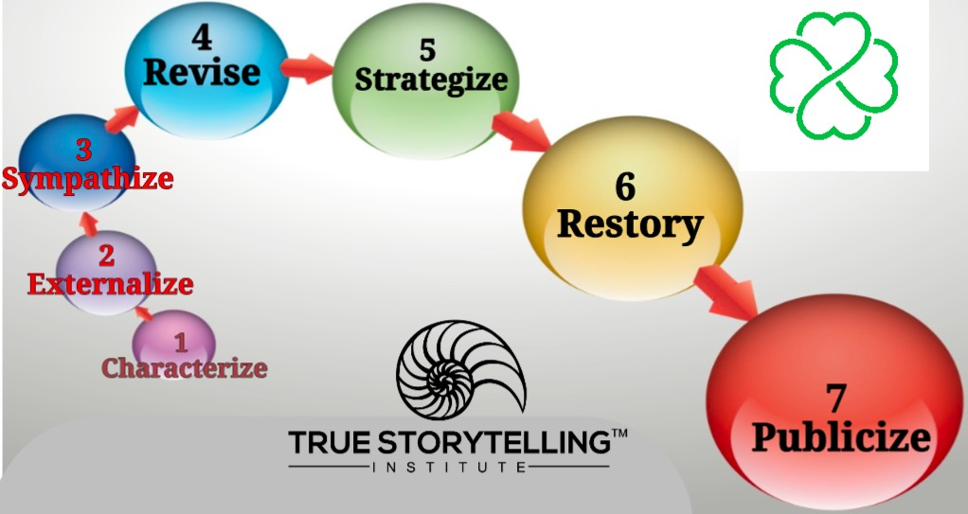
Debrief: Process Consulting
Getting Ready to Strategize

Slide 21
Do a Storyboard (can use photos, draw, or use icons)
Next Week, bring a material object that communicates an ethical Story you are trying to unfold in your life
READING for next week: Chapters 5 & 6 in “True Storytelling”
FUTURE SESSIONS:
Session #3: Principle 5 Helping Stories Along (BECOMING PROCESS of Conversational Restorying) and Principle 6 Staging (Conveying your plot to your audience, by BETWEEN Process).
Session #4: Principle 7 Embodied Reflection (BEYOND of 6th Sense Process: Aligning the head/heart dialogues with your embodied outer dialogues with others).
21

Slide 22
True Storytelling Institute
Check Out
COFFEE in the LOBBY
Notes:
22

Slide 23
TRUE STORYTELLING
Foundations Ethics
Level I session 2
23
Notes:
Just go over this slide
23

Slide 24
Grace Ann- Time Schedule for Today
TRUE STORYTELLING FOUNDATION MODULE Session #2
(All times are Pacific time)
8:45am Pacific DOORS OPEN (to zoom room);
Please arrive EARLY for a technology check and settling in.
8:50-9:00 "Presence" Activity—The Mountain Walk with Jens
9:00-9:05am Welcome Grace Ann
9:05-9:10 Roadmap; Groundrules Jens
9:10-9:25 Nuts & Bolts: Use Your Stories Grace Ann
9:25-9:30 Intro 2min silent prep; Last week’s homework
9:30-9:35 BREAKOUT: 2 persons/group, 2 min/person
9:35-9:45 Debrief
9:45-10:00 Principles 3 & 4 Introduction Jens
10:00-10:15 Go Deeper into Principles 3 & 4 David
10:15-10:20 Storyboard Examples: David & Jens
10:20-10:25 Connect the Dots Grace Ann, Jens, & David
10:25-10:30 Homework David Walk the Mountain Jens
10:30-10:45 Q&A, (optional) Walk the Mountain Jens

