Slide 1
TRUE STORYTELLING
Train-the-Trainers
Level II Session 1
<number>
TRUE STORYTELLING INSTITUTE ®TSI
Notes:
Just go over this slide
32

Slide 2
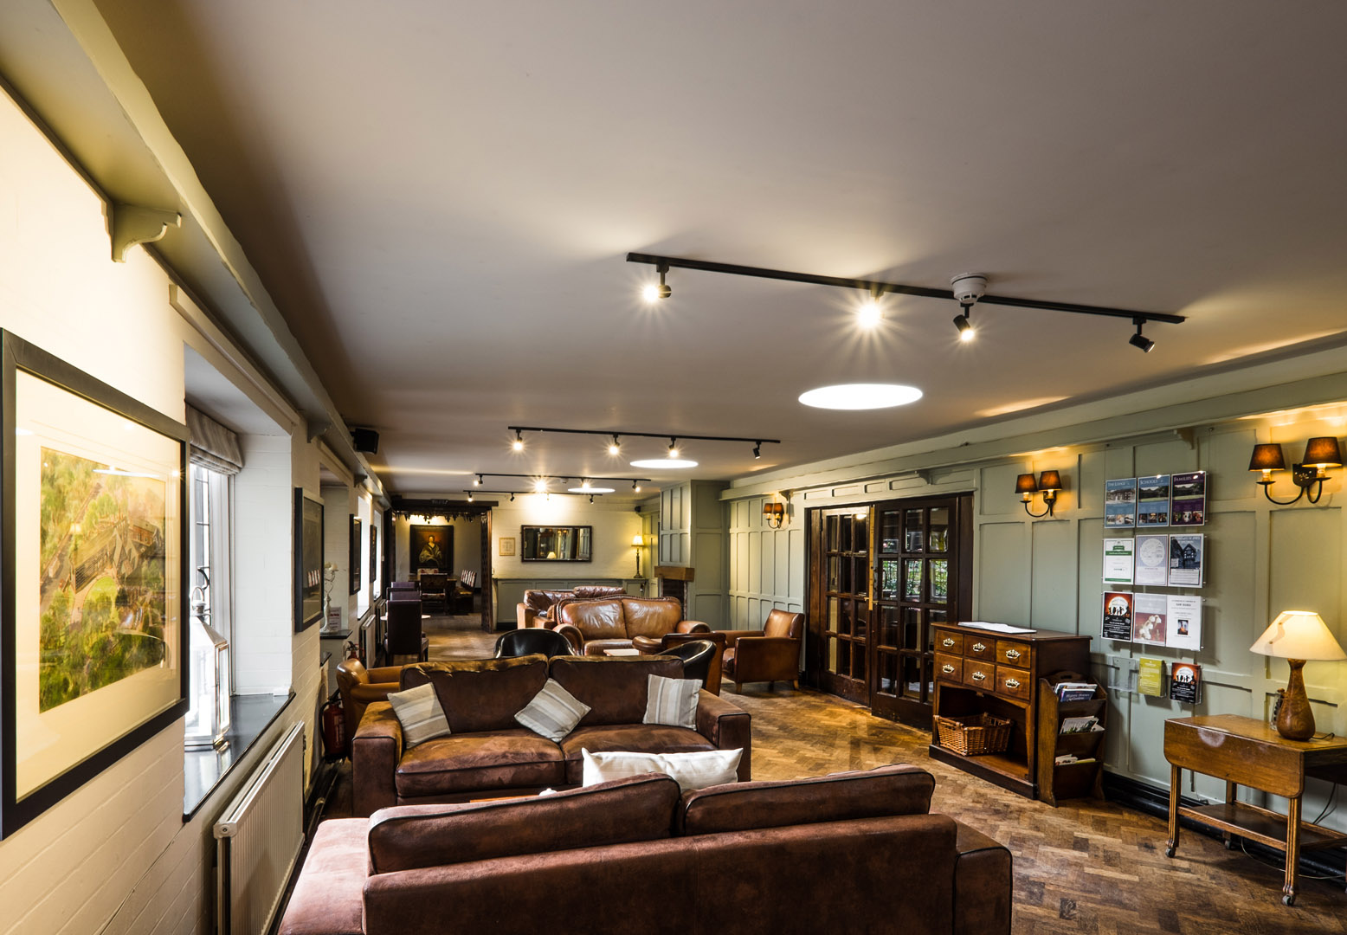
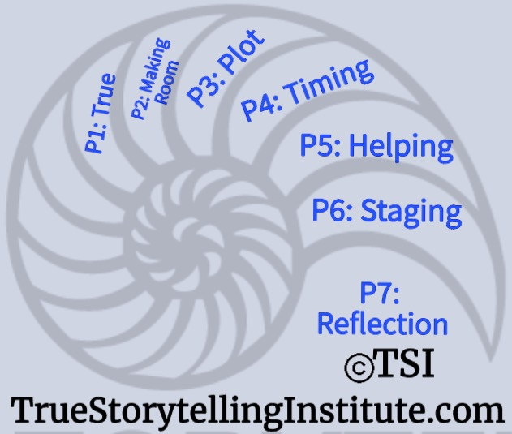
True Storytelling Institute
PRE-SESSION WEEK #1
What is True & BENEATH-Antenarrative process?
COFFEE in the LOBBY
A risk I took was…
A challenge I had was…
A success I had was…
I am proud of myself for…
Notes:
<number>

Slide 3
STRUCTURE FOR TODAY
PART I INTRO of Group; ROADMAP: Lena
What are our Goals and What is New You Will Learn
PART II NUTS & BOLTS of aTRAINING MODULE Grace Ann
PART III SEVENS: David
How do the TSI 7 Principles relate to the 7 Antenarrative Processes? What is the Beneath-process of the fore-concepts?
PART IV GUIDING: Jens - Learning to be a TSI Guide
PART V WRAP-UP: Jim - Homework and Check Out

Slide 4
Grace Ann
Please bring a notebook and pen/pencil to each session.
Use the “Gallery View” so you can see each other while viewing Powerpoint.
Please do not give advice to others or use ‘should’ statements for self or others.
Speak more from the heart than from the head
Laser in, be concise, and share only one story instead of several.
CONFIDENTIALITY: Do not tell someone else’s story. Please DO NOT record any session of the presenters or the participants.
Please use Chat ONLY when asked to do so. Avoid “side talk.”
Please attend all sessions. If you must miss one, contact us so we can help you to catch up before you return.
Notes:
<number>

Slide 5
PART I Goals (Lena):
What is the connection between Level 1 and
the Level 2, Train the Trainer module?
Train the Trainer program shows Guides how to facilitate modules in level 1.
Guides -should know the 7 principles in depth and already have the Level 1 certificate
Train the Trainer course is 7 sessions, a personal project to be presented at a conference, and leading one or more alumni sessions (‘Heaven On Earth’).
4
Notes:
Story inspired from interview with Maiken Bork Clausen who buy educations for
the staff in the Danish Parlament.

Slide 6
PART I (Lena)
Train the Trainer Program Goals
Participants will be able to:
Define and give a written short personal story demonstrating each of the 7 True Storytelling principles, as judged by the TSI founding team.
Conduct exercises and True-Storytelling-style break-out rooms for all Level 1 modules.
Facilitate de-briefing of break-out rooms.
Guide TS change projects.
Demonstrate their ability to apply their co-facilitating experience independently.
Notes:
See Ch. 1, especially p. 16-18 in True Storytelling book for more details.
<number>

Slide 7
PART I: ROADMAP FOR New Skills & Tools (Lena)
Where we are coming from
Past sessions we have experienced
Work experiences
Where we are headed
BENEFITS
Level II TSI Guides learn
7 Principles of Personal & Organizational Development
7 Restorying Steps for People & Organizations to Get Unstuck from Past
7 Secret Antenarrative Processes Pre-constitutive of all Stories & Narratives
Successful Completion Entitles You to Conduct Level I Modules

Slide 8
PART II: TRAINING PROCESS-structure of sessions (Grace Ann)
SAMPLE
8:45-9:00 Pre-session ”coffee”
9-9:05 Welcome and Agenda for the session
9:05-9:10 Review Groundrules; review homework
9:10-9:20 Intro TS Principle & Tool for the session; chat for feedback
9:20-9:25 Intro Breakout and model the process with own stories
9:25-9:30 Review time limits & process; 2 min silent/written prep
2-3 per group, 1-3 min per person, 1 or 2 rounds
9:30-9:40 BREAKOUT
9:40-9:45 DEBRIEF, chat feedback, transition to next concept
9:45-9:55 Intro Concept/Tool; chat for feedback
9:55-10:00 Intro Breakout and model the process with own stories
10:00-10:05 Review time limits & process, 2 min silent/written prep
10:05-10:15 BREAKOUT
10:15-10:20 DEBRIEF, chat feedback, wrap up
10:20-10:25 HOMEWORK assignment
10:25-10:30 Final Q&A
10:30-10:45 POST-session informal discussion
10:45-? Team de-brief
4
Notes:
<number>

Slide 9
TRAINING SKILLS
Nuts-and-Bolts CHECKLIST
Part 1 / Session #1:
What to do in the Pre-meeting and Post-meeting 15 minutes
2. Introductions of self and of participants: timing, what to include, how to move from person to person on zoom or in person.
3. How to present groundrules/guidelines
4. Reviewing previous sessions and reviewing any homework/ongoing projects
Notes:
<number>

Slide 10
TRAINING SKILLS
Nuts-and-Bolts CHECKLIST
Part 2 / Session #2:
5. Using “active” methods for conveying theory/lecture
6. Giving instructions for break-out groups
7. Modeling a break-out group process
8. Sitting in on break-out groups
9. Debriefing a break-out group and moderating discussions
10. Asking for and Responding to questions/comments
Notes:
<number>

Slide 11
TRAINING SKILLS
Nuts-and-Bolts Checklist
Part 3 / Session #3:
11. Using training assistants
12. Using “chat”
13. Using video clips
14. Assigning homework
15. Evaluating the session
Notes:
<number>

Slide 13
TOOL 1: True Storytelling has INTEGRATION and WHOLENESS with head and heart and speech ALIGNED
Notes:
To travel back from space and integrate it into our own life. TS is when the are connection between head and heart. SAY MORE ABOUT THAT…..
<number>

Slide 14
TOOL 2:REFLECTING-NATURE
Western Ways of Knowing
WWOK
Indigenous Ways of Knowing IWOK
Humans Separated from Nature
Compartmentalized
Disembodied Consciousness
Placeless
Nature → Resources
Exploitation
De-spirited
Human & Nature Inseparable
Holistic
Embodied Consciousness
Emplaced
Nature → Aliveness
Stewardship
Spiritual

Slide 15
TOOL 3 True Storytelling
CORE VALUES

Slide 16
PART III: What is the BENEATH? (David)
Stories & Narratives are composed of pre-conceived SURFACE values, concepts, & motives, so GUIDES go BENEATH to core values…
On the surface is the ‘Domination of the Obvious’
Going BENEATH the words, labels, judgements, and polarities, gets to CORE values & CORE concepts & CORE motives
BENEATH the surface is the changes, movements, the flow, and its what is changeless about the world and universe
Going BENEATH the Narrative-Counternarrative arguing, the polarities, we get to the changes and the changeless

Slide 17
There are 7 antenarrative processes that are the STUFF that all stories & narratives are made from:
Beneath words & thoughts are CORE BELEFS & CORE VALUES (P1)
Before is all the history (P2)
Bets refer to the future (plot, strategy...) (P3)
Being is in the NOW (P4)
Becoming is the emergent (P5)
Between is infrasructure (P6)
Beyond is intuitive or a 6th sense (P7)

Slide 18
A Guide gives Short introduction, then has tools to go deeper by Guiding Dialogue. (DAVID)
Principle 1
Truth - You yourself must be true and prepare
the energy and effort for a sustainable future
Principle1 relates to GOING BENEATH SURFACE
to get to CORE values.
17

Slide 20
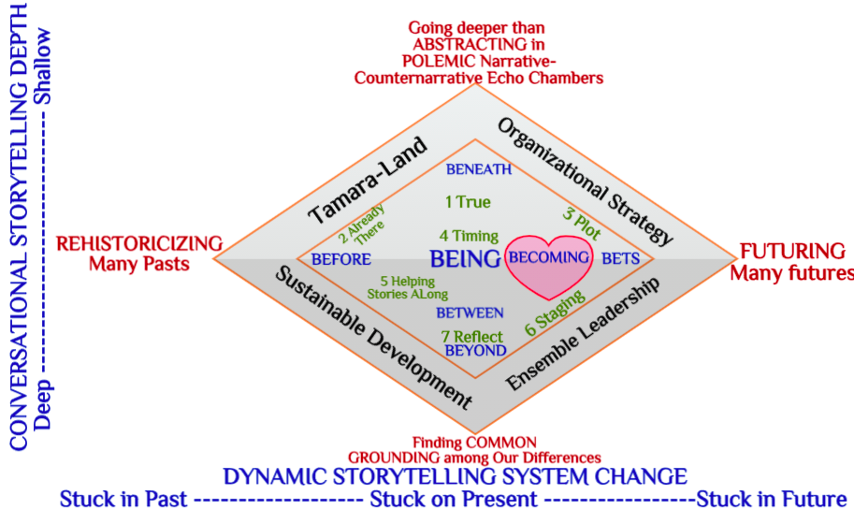
GOING BENEATH into the DEPTHS of STORYTELLING WE FIND COMMON GROUND GOING into TIME we find many BEFORES and MANY BETS ON THE FUTURE THIS IS A MAP OF HOW principles and antenarrative processes intersect in most every organization. It is also a Diagnostic Tool to discern where processes are likely to dwell

Slide 21
TSI GUIDE can use this tool for each of 7 True Storytelling Principles
Here is how to use it for Principle 1

Slide 22
Guiding Dialogue is about 3 I’s This tool goes deeper into ALIGNMENTS

Slide 23
A Guide helps participants travel from surface values to core values
Notes:
<number>

Slide 24
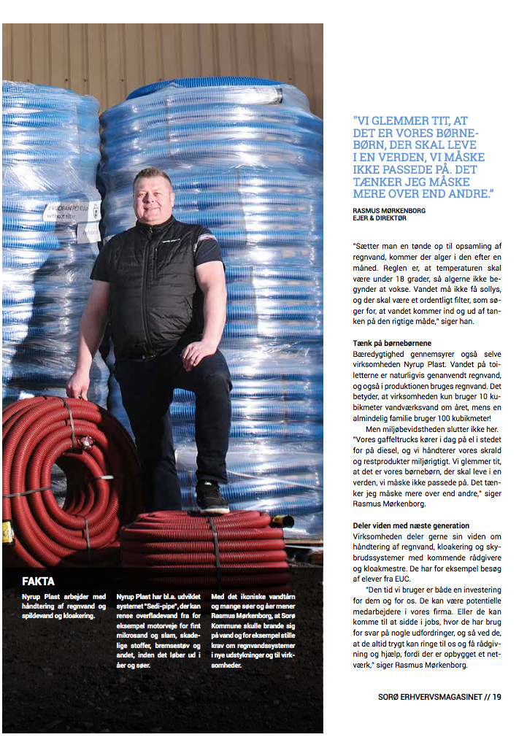
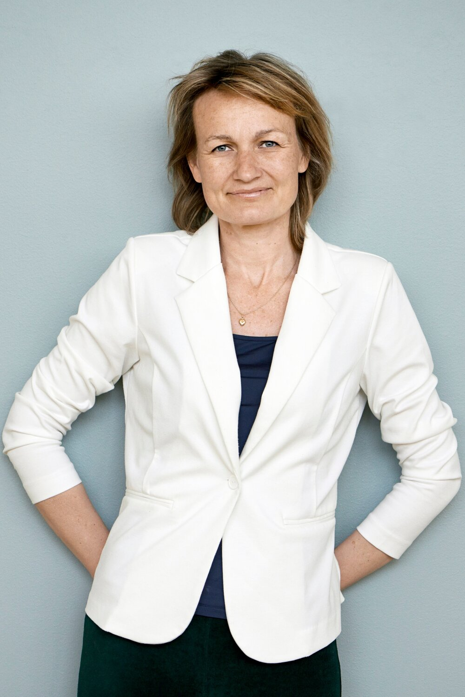
Part III: Tool: Principle 1
Protreptic Dialogue
Attune yourself and others to what is most important in life
2. Help people to act from Core Values instead of momentary emotions
3. Commitment increases when actions are linked to important Core Concepts

Slide 25
TRUE

Slide 26
Part III: Tool: Principle 1
Protreptic Dialogue
If we get to a deeper understanding of the CORE-concepts/values which are important for us.
It will change the way we live and work.

Slide 27
Protreptic Dialogue
ABSTRACT/GENERAL
Concepts
CONCRETE
Personal stories

Slide 28
Part IV: Example of protreptic questions
”Why is true important for your life?”
”What do you mean with the word true?”
”What is the opposite of true?”
”Which values does it take to be true?”
”Which attunements connect to true?”
”What is a metaphor for true?”
”What is the original meaning of true?”

Slide 29
BREAK OUT #1
Principle 1
Why is it important to live a true life?
What is the meaning of ”True” for you?
BREAKOUT ROOM DISCUSSION
Notes:
Now we want you to start your journey we us. The first exercise is about principle one and we want you to reflect on your situation in the begining of your journey and what can support you ahead
<number>

Slide 30
INTRO TO BREAKOUT ROOM
10 minutes total, in pairs of A & B
2 min JENS explains/demonstrates questions
2 min silent written prep
WRITE 3 words about each question
1. Why is it important to live a true life?
2. What is the meaning of ”True” for you?
BREAKOUT
5 min
Person A explains their 3 words for Question 1, then Question 2
5 min
Person B explains their 3 written words for Question 1, then Q 2

Slide 31
DE-BRIEF: in CHAT,
write 3 words that mean “true” for you.
SUMMARY:
1. Lena – the Goals We Accomplished Today
2 Grace Ann – the Training Process
3. David – the Antenarrative Process of the BENEATH
4. Jens – being a TSI Guide in each session
5. Jim – Keeping it Practical and Real

Slide 32
Principle 2: Make Room
“True storytelling makes spaces that respect the stories already there”
Personal sustainability
What could support you as a TSI Trainer?
Read Chapter Two – True Storytelling Book

Slide 33
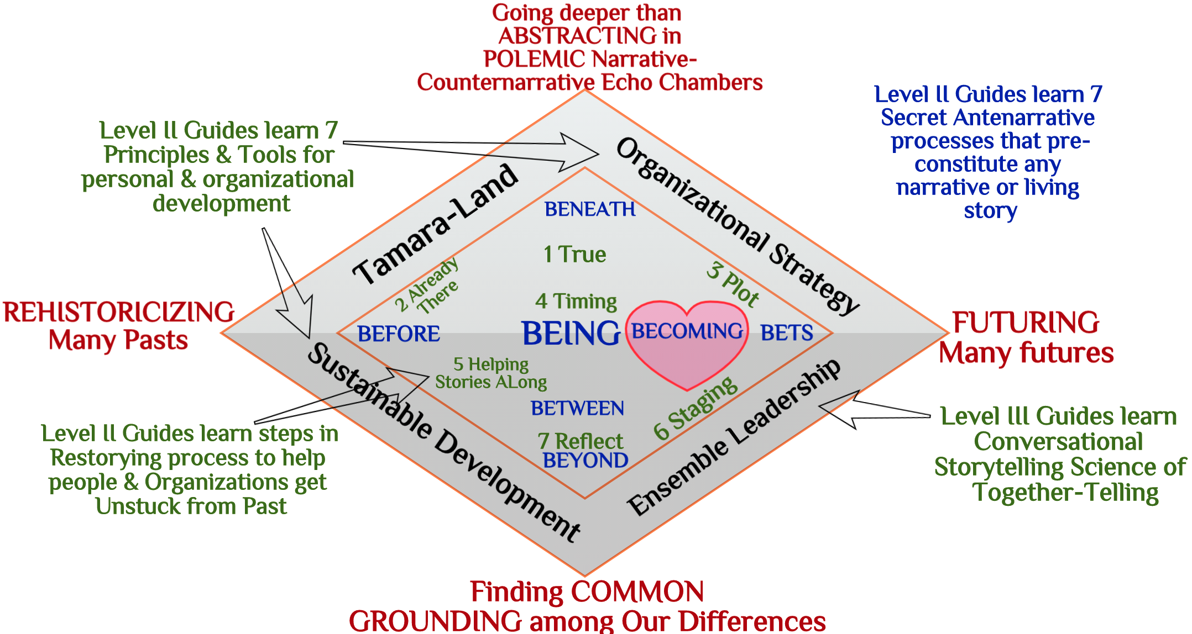
PART III: How True Storytelling Principles & 7 Antennarrative Processes are Related (David)

Slide 34
The LOBBY This room will be open for another 15 minutes to ask questions, discuss, or just visit.

