Slide 1
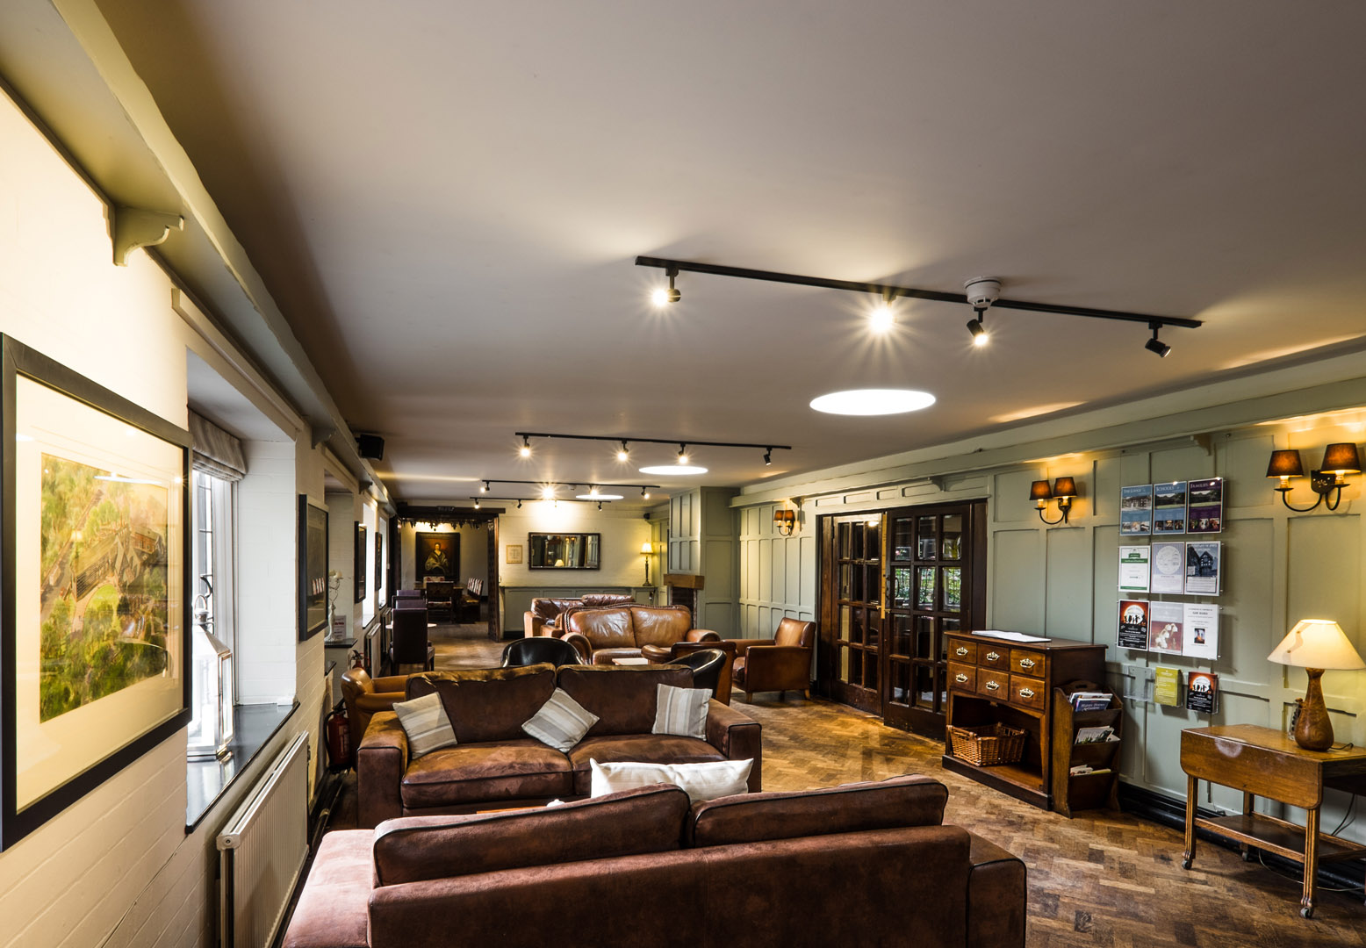
JENS WELCOME to True Storytelling Institute
WEEK 1 Principles 1 & 2
COFFEE in the LOBBY
8:45-9:00 AM Pacific
Notes:
1

Slide 2
TRUE STORYTELLING
Foundations Ethics
Level I session 1
2
Notes:
Just go over this slide
2

Slide 3
Welcome and ROADMAP: Jens
Week 1:
Nuts and Bolts
Principle 1 True &
Principle 2 Making Room
WITH
Process 1 Beneath &
Process 2 Before
Ethics focus:
True Storytelling Principles
for an Ethical Life

Slide 4
Session 1 NUTS & BOLTs Grace Ann
1. How to use a Talking Stick; Silence
2. Time Schedules
3. Time Keepers: Effective Methods
4. Dealing with Emotions
5. Building Your True Storytelling Library

Slide 5
Jens
Please bring a notebook and pen/pencil to each session.
Use the “Gallery View” so you can see each other while viewing PowerPoint.
Please do not give advice to others or use ‘should’ statements for self or others.
Speak more from the heart than from the head
Laser in, be concise, and share only one story instead of several.
CONFIDENTIALITY: Do not tell someone else’s story. Please DO NOT record any session of the presenters or the participants.
Please use Chat ONLY when asked to do so. Avoid “side talk.”
Please attend all sessions. If you must miss one, contact us so we can help you to catch up before you return.
Notes:
5

Slide 6
Grace Ann- Time Schedule for Today
TRUE STORYTELLING FOUNDATION MODULE Session #1
(All times are Pacific time)
8:45am Pacific DOORS OPEN (to zoom room);
Please arrive EARLY for a technology check and settling in.
"Presence" Activity
9:00am Welcome; Roadmap; Groundrules. Grace Ann
9:15am Nuts & Bolts: Grace Ann
9:30am Principles 1 & 2 Introduction Jens
9:45am Go Deeper into Principles 1 & 2 with 2 Processes David
10:00am BREAKOUT ACTIVITY
10:15am Debrief: Connect the Dots Jens
10:25am Homework & Concluding Exercise David & Grace Ann
10:30am CLOSE
10:30-10:45 Post-session (optional) Q&A for those who have questions

Slide 7
Guidelines for
Using the Talking Stick method in Groups
First speaker has the stick, shares their story, then picks the next speaker
Listeners - DEEP listening, NO questions, NO advice, ALLOW silence
Stick holders: you speak; share ONE story; when done say ‘Ho’ or ‘Complete’ or ‘I’m Done’
It is OK to ‘pass’ and wait for another opportunity;
If time remains after all have shared once, do another round.

Slide 8
Grace Ann
True Storytelling Facilitator/
Coach SKILLS
You will learn how to:
Use four ethics approaches;
Align the mind and the heart;
Align head/heart with others (walk the talk);
Apply Tribal Wisdom ‘storytelling ethics;’
Apply ethics of Doing & Being to your living story;
Be a (protreptic) coach not interrogator/ fault-finder;
Deepen your practice of embodied reflection.
8

Slide 9
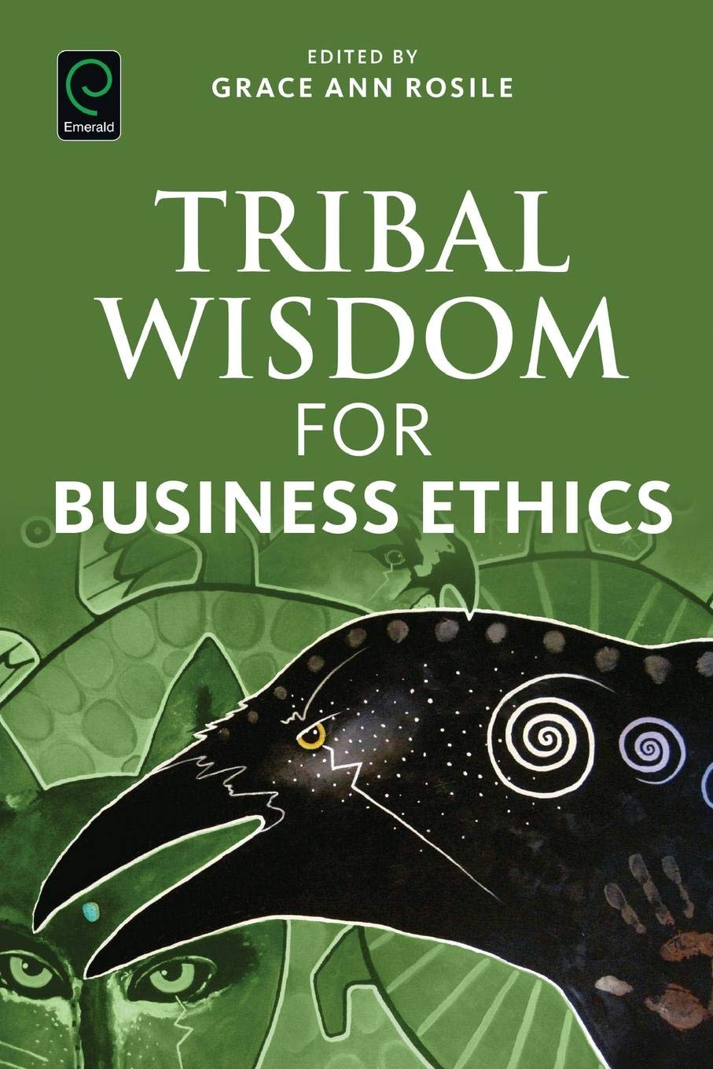
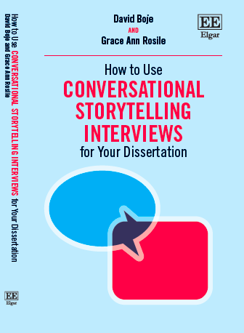
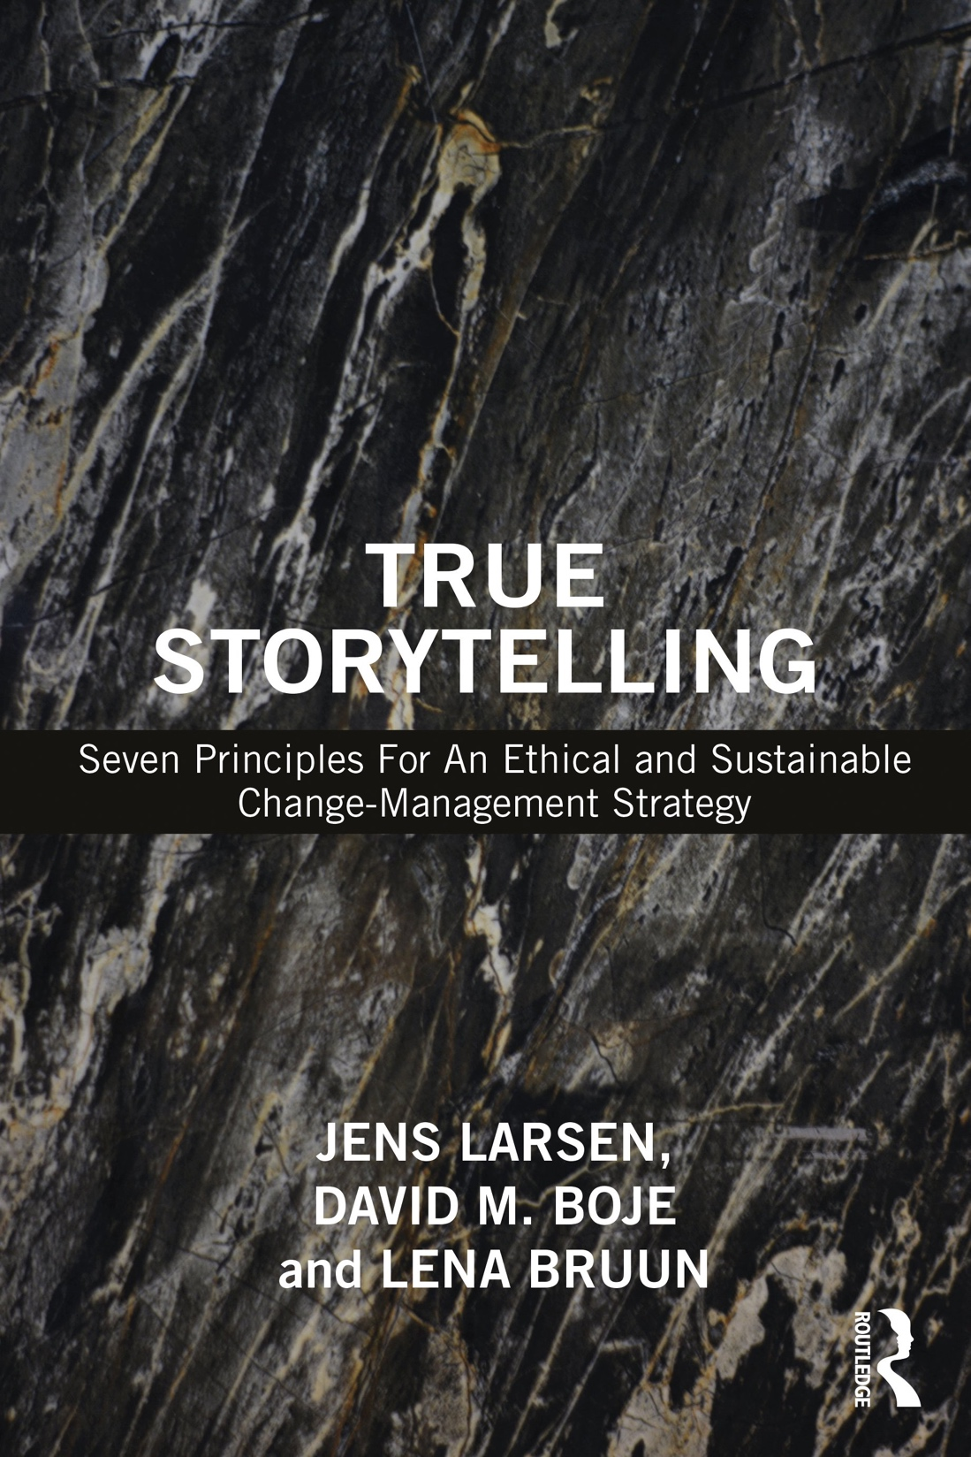
Grace Ann→BUILD YOUR LIBRARY
Tribal Wisdom (Rosile 2016)
True Storytelling
(Larsen, Boje & Bruun 2021)
Conversational Storytelling (Boje & Rosile 2020)
9

Slide 10
Grace Ann → 2 Ethical Approaches
Western Ways of Knowing
WWOK
Indigenous Ways of Knowing IWOK
Humans Separated from Nature
Compartmentalized
Disembodied Consciousness
Placeless
Nature → Resources
Exploitation
De-spirited
Human & Nature Inseparable
Holistic
Embodied Consciousness
Emplaced
Nature → Aliveness
Stewardship
Spiritual

Slide 11
Jens Defines PROTREPTIC
Focuses on the life of the story not the storyteller;
Focuses the context of the story:
its timing,
its ability to inspire and motivate,
its embeddedness in other stories, told & untold.
The "Protreptic Guide"
avoids blaming the people,
makes the problem is its own character,
allows the problem/character to be acted
upon by the people in the story
Notes:
HOW TO become a (protreptic) coach instead of an inquisitor (interrogator) or fault-finder:
Replace persuasive storytelling with respect for the uniqueness and autonomy of the other person’s story;
Coach people using talking stick story circles;
Do advanced ‘process coaching’ using conversational storytelling;
Acquire skills in process consultation using story circles that are open dialogue conversations.
PROTREPTIC: focuses more on the life of the story itself and not on the storyteller, and thus it considers the context of the story, its timing, its ability to inspire and motivate people, and its embeddedness in other stories, both told and untold, that help or hinder it. The "Protreptic Guide" approach helps us to avoid blaming the people in a given story, and instead, allows the problem to be its own character, thus better able to be acted upon and managed by the people in the story.

Slide 12
Jens
Principle 1, True
– You yourself must be true and prepare the energy and effort for a sustainable future
(GO BENEATH!)
Principle 2 Make room True storytelling makes spaces
respecting the stories already there
(BEFORE)
Notes:
3 Questions:
Did you check it out?
Do you believe in it?
Can you sustain (get energized & not burn out) in long future?
1st True Storytelling Principle:
You yourself must be true and prepare the energy and effort for a sustainable future.

Slide 13
Watch the
BEFORE!
GOING BENEATH THE WORDS & CONCEPT DEBATES
A deeper understanding for
ethics and values will change
the way we live and work

Slide 14
Principle 1, True
– You yourself must be true and prepare the energy and effort for a sustainable future
GO BENEATH the words!
Principle 2 Make room True storytelling makes spaces
respecting the stories already there
WAVES coming BEFORE you…
Notes:
Where are the waves we can surf which will support our true strategy and when is the right moment to catch them?
Do you already work with something which is similar to this?
Are there any partners or trend you can connect to you have not thought about yet?
Where are the waves we can surf which will support our true strategy and when is the right moment to catch them?
Do you already work with something which is similar to this?
Are there any partners or trend you can connect to you have not thought about yet?
Principle 2 Make room True storytelling makes spaces
respecting the stories already there

Slide 15
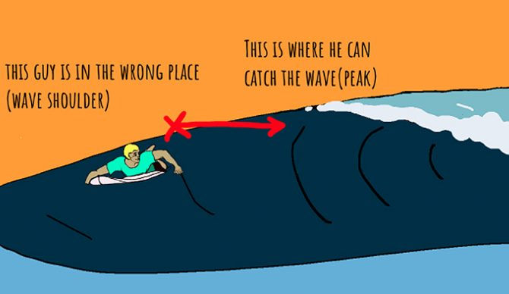

Slide 16
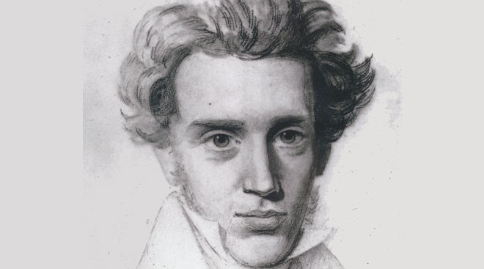
“Its’ not about living a good life, but a true life [an ethical life]”
Søren Kierkegaard
Danish Philosopher

Slide 17
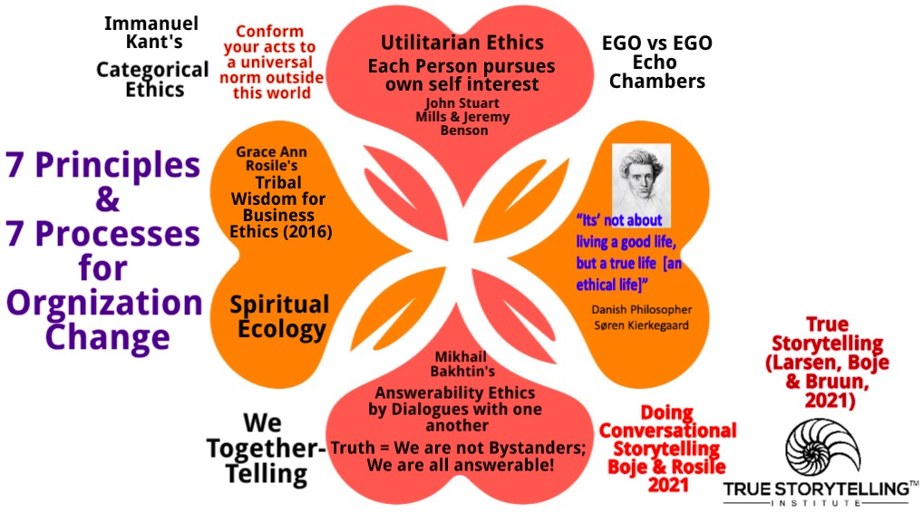

Slide 18
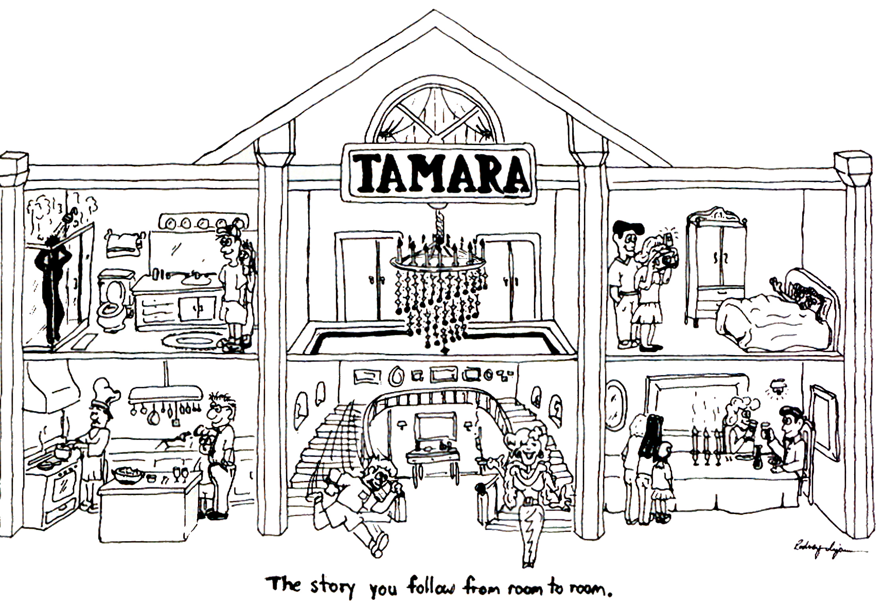
Many stories, many rooms:
What does it mean to live a TRUE Life?
The factorial of 6 rooms in TAMARA-LAND Is exactly 720
The factorial of 12 rooms is exactly 479,001,600
18

Slide 19
A TOOL for TAMARA-LAND
Notes:
True Storytelling has
WHOLENESS: of head and heart & INTEGRITY: from Integral = whole and this means CONGRUENCE of head and heart
To travel back from space and integrate it into our own life. TS is when the are connection between head and heart. SAY MORE ABOUT THAT…..
19

Slide 20
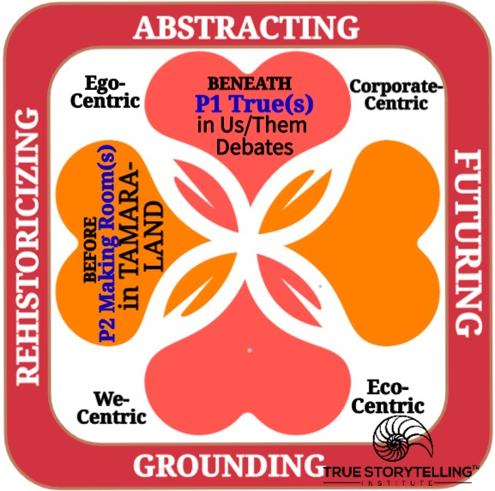
SUMMARY
→ETHICAL LIFE
GUIDES link PRINCIPLES and PROCESSES for TOGETHER-TELLING outcomes!
Principle 1: What is True BENEATH DEBATES
Principle 2: Making Rooms in TAMARA-LAND
for True storytelling spaces respecting the stories already there
Notes:
Now
we go deeper into
what it means to facilitate and coach PRINCIPLES With PROCESSES,
for
an ethical life
Diane Dredge suggested Bus Tour with all the stakeholders on board on Tues May 8 2018 at Aalborg, at conference held there on storytelling
How to tell a motivating & inspiring story? MOST ENGAGING STORY WAITING TO BE TOLD IS YOURS! I was so shocked, surprised, stupid, suspicious (HOW DID YOU FEEL?)
What is ENGAGING & EMOTIVE-language? – when audience is ENERGIZED (look to body language) – START WITH CONTEXT (PAINT THE VIVID SCENE) e.g. in my driving through woods, icy roads, snowing, on mountain road ADD DIALOGUE
A PROBLEM, an OBSTACLE to OVERCOME: E.g. When I was first person in family ever to go to college? SET UP FOR THE TIMING POINT (THE ARC is SET) THEN SURPRISING TURNING POINT seeYouTube: Jim Carey
A proud moment when MORAL OF STORY →YOU inspired others? THE RESOLUTION E.g. When Bo Kimble died, the team used my motto to move forward
20

Slide 21
2 min Example Answer (David’s Story)
2 min Silent Prep, write your answer
Go to Breakout for 10 min
#1. Think of a successful change project with which you were personally involved. Describe briefly (1min).
#2. Describe an example of how head and heart were aligned in this change project. (If NO alignment was anywhere, did this hurt the project?) (1 min).
#3. What was an untold/forgotten story, a ”little wow moment,” or evidence of a an incoming “wave,” that was important to the success of this project? (1min).
If extra time: Take turns giving other examples of answers to questions 2 and/or 3.
Debrief
3 QUESTIONS for Breakout
2 pairs
3 min per partner
1 observer
Time 10 min
21

Slide 22
Homework: Choose an organizational problem you are having now, that you would like to use to apply True Storytelling principles to change this problem situation over the next 3 sessions. Write this in your notebook.
READING for next week: Chapters 3 & 4 in “True Storytelling”
FUTURE SESSIONS:
Session #2 Principle 3 Plotting with PROCESS: BETS ON FUTURE and Principle 4 Timing with PROCESS: BEING (Identifying patterns and exceptions and choosing your timing in TAMARA spaces & times).
Session #3: Principle 5 Helping Stories Along (BECOMING PROCESS of Conversational Restorying) and Principle 6 Staging (Conveying your plot to your audience, by BETWEEN Process).
Session #4: Principle 7 Embodied Reflection (BEYOND of 6th Sense Process: Aligning the head/heart dialogues with your embodied outer dialogues with others).
22

Slide 23
True Storytelling Institute
Check Out
COFFEE in the LOBBY
Notes:
23

Slide 24
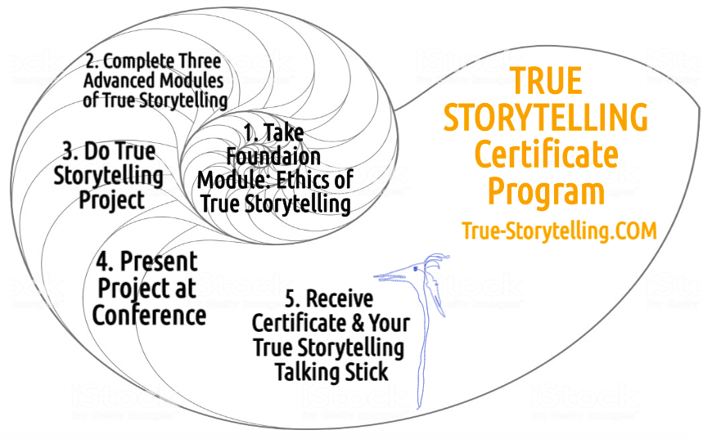
Become a True Storyteller
“Its’ not about living a good life, but a true life
[an ethical life]” – Kierkegaard
Founders:
Jens Larsen oldfriendsindustries@gmail.com ,
David M. Boje davidboje@gmail.com ,
Grace Ann Rosile garosile@nmsu.edu ,
Lena Bruun lenabruunjensen@gmail.com
Jim Sibel jrsibel@gmail.com
True-storytelling.com Truestorytelling.blog
TrueStorytellingInstitute.com

Slide 25
TRUE STORYTELLING
Foundations Ethics
Level I session 1
25
Notes:
Just go over this slide
25

