Slide 1
© TSI True Storytelling Institute
AGENDA © TSI True Storytelling Institu- © TSI True Storytelling Institute
8:45-9 Review Hom© TSI True Storytelling Instituework before session starts at 9am Pacific time
9-9:05 Welcome, Review Groundrules, True Storytelling – Agenda (Oscar)
9:05-9:10 T.S. P7 Embodied Reflecting, Review Homework (Rico Smith)
9:10-9:15 Oscar’s MicroActions (to create Wow Moments) & Self-Care for Reflecting/Ethics
9:15-9:20 Attunement Compass and Attunement Checklist
9:15-9:17 2 min SILENT PREP for Breakout #1
9:17-9:27 BREAKOUT #1 2 persons per group, 2 min/ person to share MicroActions +values
9:27-9:32 Debrief: share stories of MicroActions in line with values to create Wow Moments
9:32-9:35 Embodied REFLECTION: Attunement + Integrity = Self-Care
9:35-9:38 3 min Prep WRITE IN CHAT 3 ideas for self-care of the MIND/BODY
9:38-9:48 Breakout #2, in groups of 3, give 3 kinds of mind-body self-care you can use
9:48-9:55 Debrief: Share ideas on mind-body self-care
9:55-10:00 Q&A on CHAT, while discussing examples from breakouts, Oscar’s examples
10:00-10:10 Final Steps: Support Networks in CHAT; enroll with Ken; Q&A open
10:10-10:20 POPCORN: a word or phrase on what you got from today, and a MicroAction
10:20-10:25 Q&A--WRITE your questions in CHAT. ANSWERS as time allows, & via email
10:25-10:30 Books/videos and handouts for your library.

Slide 2
True Storytelling: Session #4 of 4 on Intercultural Racism Conversations
9am Pacific/10am Mountain Time on
24, 31 Aug, and 14 & 21 Sept
Join Zoom Meeting
https://us02web.zoom.us/j/89397616259
Meeting ID: 893 9761 6259
Passcode: endracism
© TSI True Storytelling Institute

Slide 3
Intercultural Conversations to Impact Racism
True
Storytelling
© TSI True Storytelling Institute
Facilitated by
David M. Boje and Oscar Edwards
Assistants: Grace Ann Rosile, Jens Larson, Lena Bruun Jensen, James Sibel, Ken Long
Notes:
Image is from free downloads https://www.pexels.com/photo/hands-heart-love-305530/

Slide 4
Review of Groundrules
© TSI True Storytelling Institute
1. Bring a notebook and pen/pencil.
2. Listen.
3. NO advice to others, NO “should” statements for self or others.
4. Speak from the heart more than the head.
5. Laser in, be concise, share only 1 story not several.
6. CONFIDENTIALITY: do not repeat or tape someone else’s story.
7. If you must miss a session, contact us for homework to catch up.

Slide 5
AGENDA for TODAY
Review Homework: NEW (restoried) Storyboards
Introduce T.S. Principle 7: Reflecting
Review T.S. Ethics Compass
Introduce Attunement as a Reflecting process
Introduce Self-Care as a part of Reflecting
Identify MicroActions to create new Wow Moments
Combine Self-Care with MicroActions
Plan Follow-up: Alumni Groups, T.S. seminars, partners
© TSI True Storytelling Institute

Slide 6
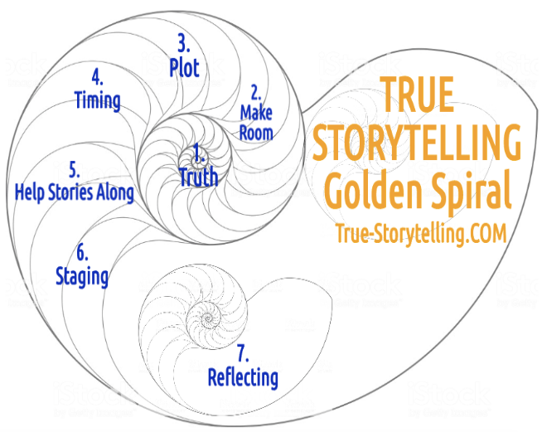
True Storytelling – 7 Principles for Impacting Racism
Session#4
P7
REFLECTING
You are not
In Nature,
You ARE
Nature
Notes:
What is ‘Truth’? – It is the ancient Greek dialogues that bring True Storytelling out of hiding.
A ancient indigenous Guide before Aristotle and Plato would help people find a way of Being-in-the-world of Being-true
In today’s corporations, media, government, and our daily lives, The Being-true of ‘Truth’ has been diminished.
As Walter Benjamin (1968, in 1930s essay The Storyteller) put it, ‘True’ “Storytelling is coming to an end”.
See p. 4 and read his story of the ‘True Storyteller’ https://arl.human.cornell.edu/linked%20docs/Walter%20Benjamin%20Storyteller.pdf
“From this story it may be seen what the nature of true storytelling is” (p. 4).
TRUTH in True Storytelling is what Parmenides called “The Goddess of Truth”… “both in truth and in untruth: (Heidegger, Being and Time, 1962: section #223).
As True Storytelling Guides, you encounter the Truth and Untruth of your own inner and outer dialogues.
We live in societies that cover up what is Truth and Untruth, and what a True Storytelling guide does is uncover the Truth (#226).

Slide 7
This Was Last Week’s Assignment
MAKE a new storyboard for our next (final) session, based on your re-storying process, including the defeat of the external problem monster.
WRITE at least 1 reason why your story is “True Storytelling.”
WRITE at least 1 LETTER/email/video clip where you briefly explain your NEW story, and ask for support (in at least 1 specific way) from this person or persons in your network.
WRITE 1-3 ways you will take care of yourself while re-story-ing.
EMAIL ALL your answers to David (davidboje@gmail.com) by midnight Sunday, 20 Sept.

Slide 8
Rico Smith Storyboard from session 3

Slide 9
SESSION 4 → ATTUNEMENT & REFLECTION

Slide 10
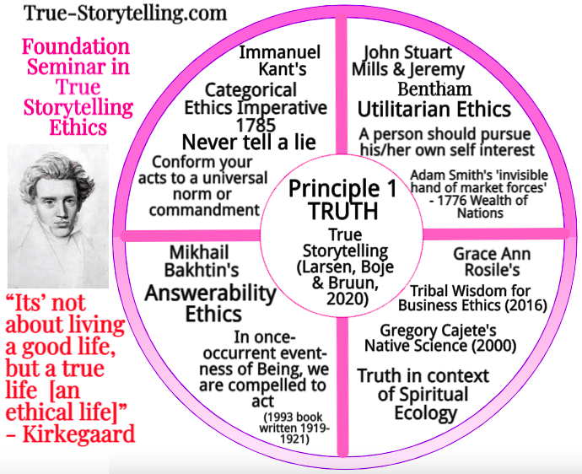
Invitation to our ETHICS MODULE
Danish Philosopher
Søren Kierkegaard
Notes:
Bakhtin’s (1993, written in 1920s) is online at https://www.musework.nl/image/2015/6/11/bakhtin_mikhail_toward_a_philosophy_of_the_act.pdf Read pp. 2-3 for his Notion of two-sided answerability, the special answeraility of content and the Moral Answerability of Being – Being that one person in once-occrrent event-ness of Being who is compelled to act and intervene, ) because we are part of the social, not just individuals, we live In the systemtemic event. That is the basis of True Storytelling Ethics.
It is how to do what Søren Kierkegaard ask, to live a ture life, an ethical life as a True Storytelling

Slide 11
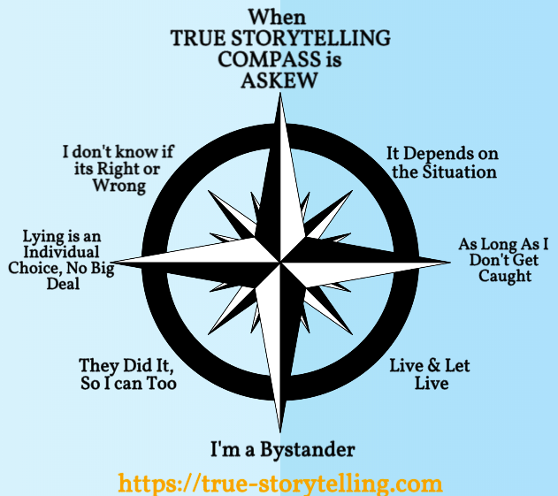

Slide 12
Notes:
The attunements comes from Martin Heidegger’s Being and Time.

Slide 13
Checklist for EMBODIED REFLECTION and ATTUNETMENT on our True Storytelling Compass
Care – How are you caring for Self, Others, Nature?
Language & Discourse – What Polarizing Discourses are you Attuning to, or Not?
What is your attunement to Covid-19, to Economic down spiral, etc.
How do you attune to Fear, Anxiety, & Ambiguity of the global situation?
What do you do about Idle Talk of Social Media?
When does Curiosity go too far?
How do you enter a place of Understanding and Assertion?
Where does your TRUE STORYTELLING COMPASS point in your Ethical Life?

Slide 14
Breakout #1: In what ways is one (or more) of your MicroActions in line with your values (and thus attuned to the situation)?
2 minutes silent prep
Go to Breakout Group (subgroups 3 each)
Choose TimeKeeper and who goes first
2 minutes each – Sharing how MicroAction is in line with values (10 minutes total)

Slide 15
Debrief
Large Group: Share stories for
MICRO-ACTIONS in line with VALUES
While the sharing continues,
write in CHAT your
QUESTIONS and THUMBS-UPS, and also…

Slide 16
Embodied Reflection: Attunement + Integrity = Self-Care
ATTUNEMENT =
To bring into harmony
INTEGRITY =
WHOLENESS, one-ness, matching values with ethical actions
SELF-CARE is attunement and leads to integrity
Attunement reduces inconsistencies & creates integrity
With Integrity we are Ethical (doing the right thing)
When we are Ethical we feel good about ourselves AND
Our words and actions are consistent, powerful, effective

Slide 17
In CHAT, while in silent prep:
WRITE (short, one phrase or sentence)
ideas for self-care OF YOUR HEART
MIND/BODY/SPIRIT
to use while doing your MicroActions to
create your NEW STORY.

Slide 18
Breakout #2 –in new Groups of 3 – How will you do 3 kinds of Self-Care for YOUR MIND/BODY/SPIRIT as you implement your NEW STORY?
3 minutes silent prep
Go to Breakout Group
Choose TimeKeeper and who goes first
2 minutes each –
Self-Care for YOUR HEART :
MIND/BODY/SPIRIT
If extra time, discuss with partners

Slide 19
Debrief Breakout #2
Large Group shares stories of self-care of the HEART mind/body/spirit while engaging in MicroActions to create more Wow Moments
Notice any SYSTEMIC/STRUCTURAL implications

Slide 20
Final Step in Re-Story-ing: Support Networks
HOW to USE CHAT to do 1, 2, and 3 below:
Click on that person’s picture in your “Gallery” view, OR
Click on CHAT, scroll down names, select person
Invite a few people here, now, to be part of your own support network (use CHAT, under TO: invite someone, and give them your email/contact info)
2. Join an Alumni Group (FREE!) – Type ‘Alumni’
In CHAT to Ken Long, or send email longke@yahoo.com
3. Enroll in another True Storytelling workshop! Type ‘Enroll’ in Chat
4 weeks each, 7 Keys to Transform World (Oct.), Ethics (Nov.), Storytelling Conference (Dec.) and any topic for 2021 _____?
10 min Q&A while people CHAT now to do #1, #2, and #3
Notes:
While debrief is continuing,
PLEASE Write in CHAT what topics/modules you would like to see us offer NEXT.

Slide 21
CONGRATULATIONS to those completing the four sessions of True Storytelling INTERCULTURAL CONVERSATIONS to END RACISM MODULE! If you would like this module done in your community Type End Racism in CHAT

Slide 22
POPCORN
Raise your hand (literally or virtually)
Give a word or phrase that reflects what you got from today’s session

Slide 23
For your Library - Preorder
AND FREE:
Glenn Aparicio Parry PODCAST with
Oscar and David
https://originalthinking.us/media/podcasts/ now available CLICK HERE FOR VIDEO
© TSI True Storytelling Institute

Slide 24
These are links to download your slides and special handouts
SESSION ONE slides Aug 24 2020
SESSION TWO slides Aug 31 2020
HANDOUT How to Make a Storyboard & Restory by Grace Ann Rosile
SESSION THREE slides for Sep 14 2020
HANDOUT How to Deconstruct Systemic Racism and The Victim-Persecutor-Rescuer Cycle - Tool by David M. Boje
Session Four - Embodied Reflecting and Next Steps Sep 21 2020
SESSION FOUR Homework Storyboard with New Story Sep 21 2020

Slide 25
Thank you! We have enjoyed sharing stories! for More information or to invite us lenabruunjensen@gmail.com True Storytelling, see:
https://true-storytelling.com
https://truestorytelling.blog
Thank you from Jens, Lena, Grace Ann, David and our guest co-host Oscar
look for follow-up email…
Q&A – put questions in CHAT

