Slide 1
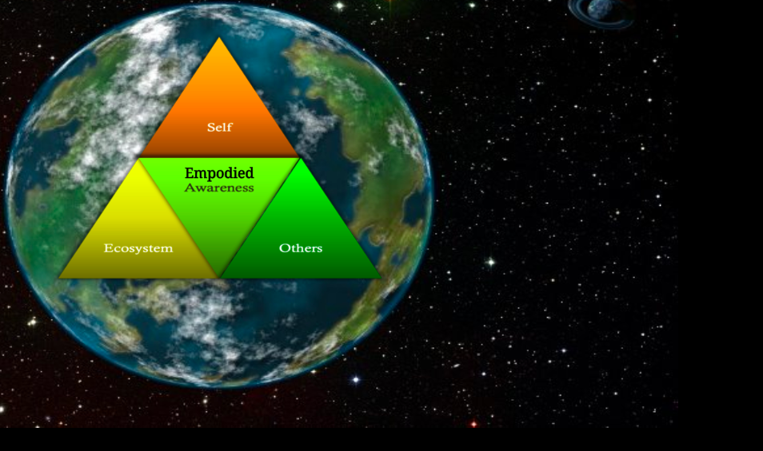
The 7th Principle of True Storytelling
Reflection
You are not in Nature
You are Nature
Brought to you by Gaia Storytelling Lab of EUSG

Slide 2
What is embodied REFLECTION (Principle 7)?
“Reflection shows us that our image of happiness is thoroughly colored by the time in which the course of our existence has assigned us” (Walter Benjamin, 1968: 254).

Slide 3
Merleau-Ponty on Embodiment
Our understanding of the phenomena of embodiment is primarily by way of Merleau-Ponty's classic work, Phenomenology of Perception.
Unreflective mortal existence is a problem for our Reflection (True Storytelling Principle 7).
Our self-reflection is a characteristic of the body, and the body does not lie.
Dynamic reflective embodiment is understood here, is about processes of Becoming (forecaring as its called in Bojean antenarrative).

Slide 4
Embodiment Reflection
Our reflective storytelling consciousness of our living embodied contact always in Gaia-world because we are Nature, not in Nature?
Our body is the point of contact in Nature-world.
Embodiment is transgression of our bodily life-in-the-World.
We are embodiment in biological social Ground in Do-Be-Do-Be of our action in embodied emergence (Becoming).
Our embodied participation Beingness of our Natural World 🌎 can become lives of self-consciousnesses answerability in act and deed.

Slide 5
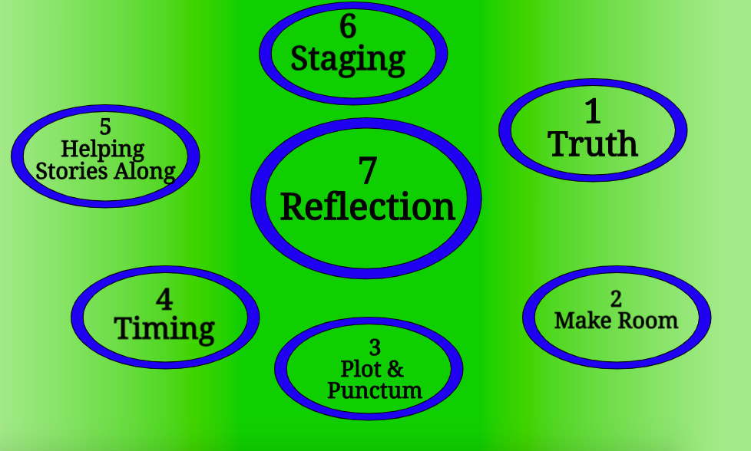

Slide 6
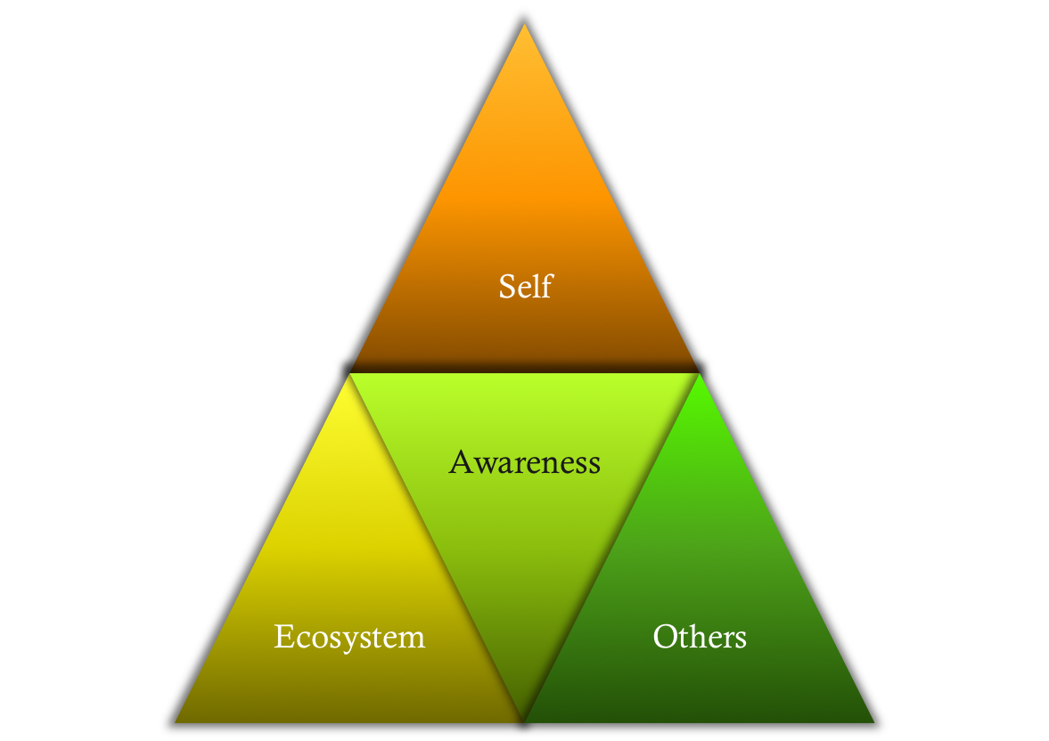
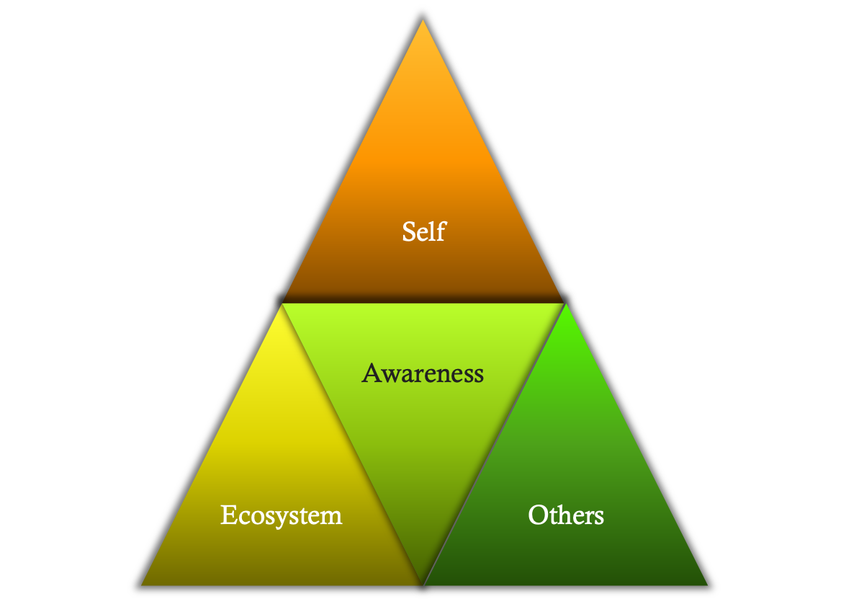
Relational introspection
Defined as: threefold dynamic awareness of the self, others, and the ecosystem (Wakefield, 2012)

Slide 7
Preparing for Productive Interactions Basic SOS Model
Self
Do I know myself well?
What is my intention for this situation?
How do I feel today?
Am I in tune with my emotions?
What am I projecting (voice, body language,
word choice)?
Have I set appropriate boundaries?
Others
Who are these people around me?
What are their limitations?
What do they need?
What do they expect of me?
Are they truly present and focused on the task at hand?
What can we accomplish together?
Situation
What’s the context (business, social, family)?
What’s going on around us?
Are things changing or is the situation stable?
Is this a healthy environment? If not, what are my choices?
Self
Others
Success
Situation
tlhenderson@tonya.today
719-440-7067
Copyright Tonya Lynn Henderson 2012

Slide 10
20 MINUTES Plans for Next True Storytelling Seminar (we take break for a month; restart in June
WHAT TOPICS DO YOU WANT?

Slide 11
More information on True Storytelling
https://true-storytelling.com
And https://truestorytelling.blog
Thank you

