Slide 1
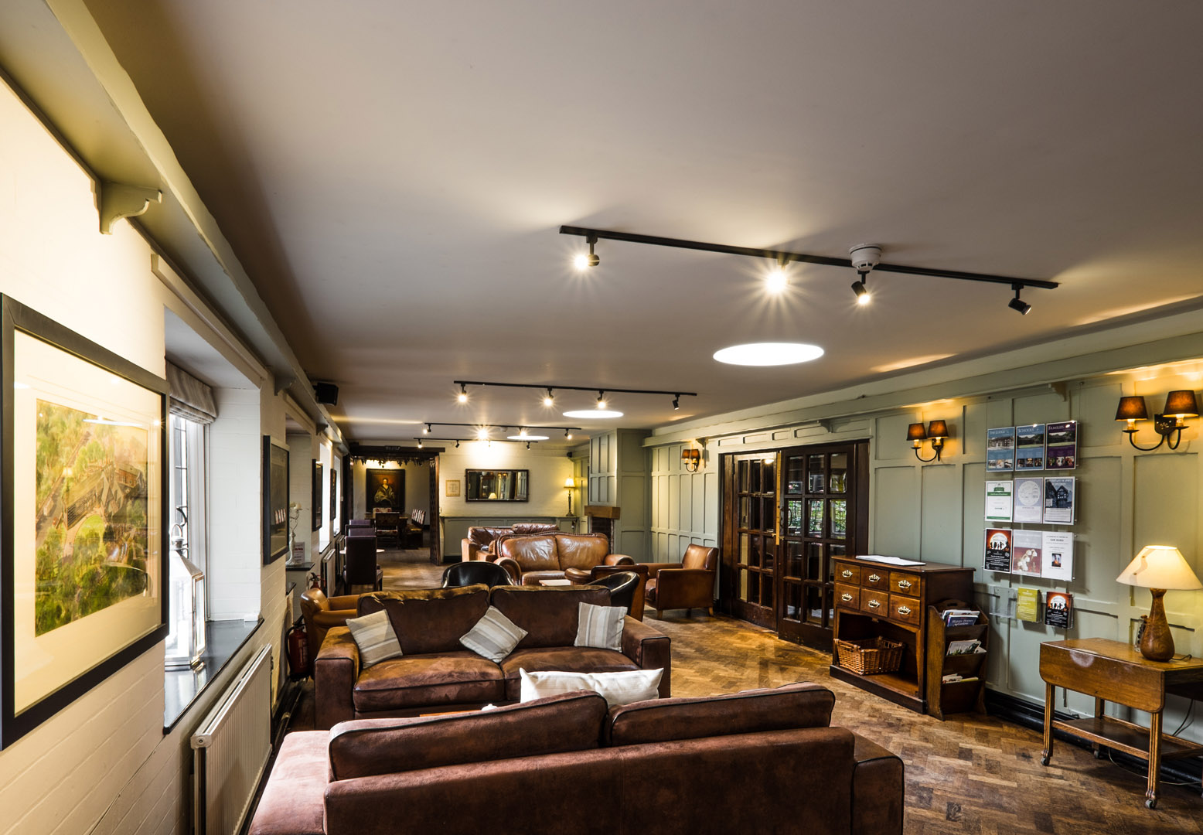
WELCOME to True Storytelling Institute
ODC 2.0 Session 3 Principles 5 & 6
COFFEE in the LOBBY
8:45-9:00 AM Pacific
Notes:
1

Slide 2
___1. The stallion is the leader of the herd.
___2. The stallion determines the actual path the herd will follow.
___3. There is only one stallion for each herd.
___4. Stallions will aggressively fight off threats to their herd.
___5. Stallions are naturally very aggressive in the breeding process, and they dominate the mares.
___6. A stallion will completely ignore his human partner to get to a mare who is “in season.”
___7. A stallion’s aggressiveness comes from his instinct to preserve his species.
TRUE
or
FALSE?

Slide 3
TRUE STORYTELLING
Organizing, Developing,
& Changing (ODC 2.0)
Level I session 3
3
Notes:
Just go over this slide
3

Slide 5
Please bring a notebook and pen/pencil to each session.
Use the “Gallery View” so you can see each other while viewing PowerPoint.
Please do not give advice to others or use ‘should’ statements for self or others.
Speak more from the heart than from the head
Laser in, be concise, and share only one story instead of several.
CONFIDENTIALITY: Do not tell someone else’s story. Please DO NOT record any session of the presenters or the participants.
Please use Chat ONLY when asked to do so. Avoid “side talk.”
Please attend all sessions. If you must miss one, contact us so we can help you to catch up before you return.
Notes:
5

Slide 6
ROADMAP
Week 1:
Principles 1 & 2
Last Week:
Principles 3 & 4
This Week:
Principles 5 & 6
Next Week:
Principle 7

Slide 7
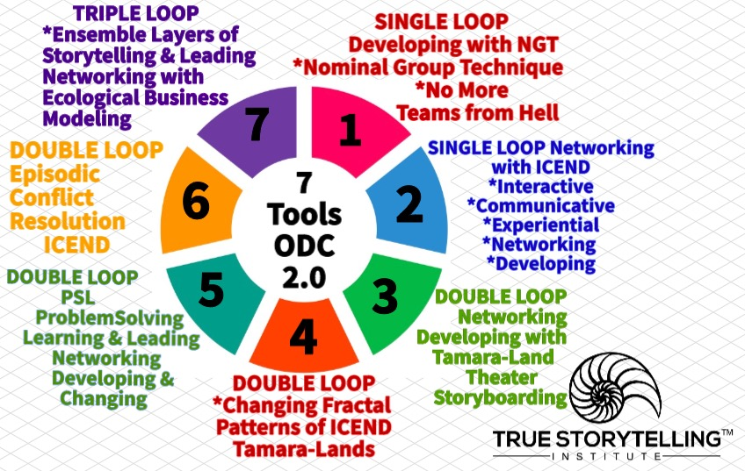
ROADMAP for Session #3 ODC 2.0
Last Week Tools 3 & 4 to intervene in Double Loop
This Week Tools 5 & 6
How Restorying works with Fractal Pattern problem solving and conflict resolution
Breakout to practice PSL
Notes:
Week 1:
Nuts and Bolts
Principle 1 True &
Principle 2 Making Room
WITH
Process 1 Beneath &
Process 2 Before
Ethics focus:
True Storytelling Principles
for an Ethical Life

Slide 8
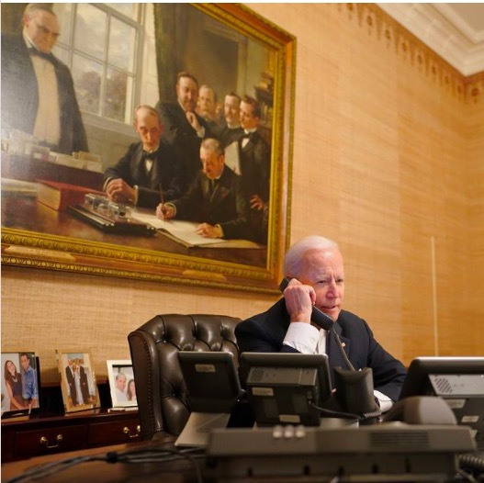
CONNECT last week & this week: Polyphony & Stylistics = Staging
Text = anything that give you a message
Polyphony = many voices
Polyphony Dialogism = many voices in a conversation, even in single loop
Stylistic Dialogism – many styles parodying one another, even in single loop
What messages are in this image?
CLICK HERE TO Read More at
TSI’s THINKTANK

Slide 9
ODC Session 3 NUTS & BOLTs Grace Ann
Herd Behavior QUIZ
Boss Mares and Alpha vs. Delta leadership
Herd vs. Collective Intelligence Networking
Alternatives to Hierarchy
Ensemble Story Co-Creation
Tool 6: Conflict Resolution - - Organizational Mirror; Navajo Peacemaking

Slide 10
___1. The stallion is the leader of the herd.
___2. The stallion determines the actual path the herd will follow.
___3. There is only one stallion for each herd.
___4. Stallions will aggressively fight off threats to their herd.
___5. Stallions are naturally very aggressive in the breeding process, and they dominate the mares.
___6. A stallion will completely ignore his human partner to get to a mare who is “in season.”
___7. A stallion’s aggressiveness comes from his instinct to preserve his species.
TRUE
or
FALSE?

Slide 11
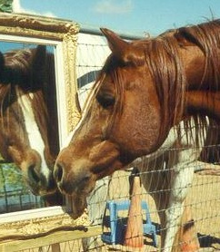
HERD BEHAVIOR: Alpha and Delta leaders
OD as COLLABORATIVE STORY CO-CREATION
and Collective Intelligence Networking
Networking and Ensemble Story Processes
Together-Telling (relates to Principle #5 Helping Along)
Elicitation
Role-sharing
Authorship
Collaborative Mediums/Theatrics (relates to P#6 Staging)
Socio-Materiality (objects) and Political Economy (money)
Notes:
Lend me your ear
Why don't you, yes but
All talk and no listening,
Have we been here before?

Slide 12
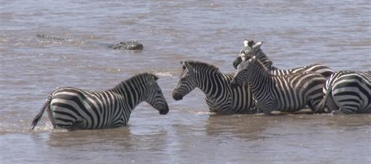
Zebra Mare directs the herd how to cross

Slide 14
BREAKOUT: CONNECT the DOTS
10 min + 5 min prep + debrief
2 min SILENT PREP
Think of a time when you saw multiple groups working together and networking harmoniously and effectively. What were one or two KEY SUCCESS FACTORS that contributed to that success?
In groups of 3 or 4, 2 min per person, tell your success factors.
Debrief: 10 min
Do success factors connect with 7 Principles? With Tools?
Principle #5 Helping Stories Along and P#6 Staging
TOOLS:
Nominal Group/Team From Hell
ICEND; Networking; Problem Solving PSL;
Conflict Resolution; Ensemble Networking
Team From Hell
Team From Heaven

Slide 15
Example of Networking for Place-Based Change BALLE
Notes:
Tool 1: NGT for BENEATH (we find games people play in 1st Loop pf Principle 1: what is true (on surface); prep for Tool 5, session 3)
Tool 2: ICEND – Interactive Communicative Experiential Networking Developing. It uses NGT or the Talking Stick Circles approach (we find Networking between rooms by passageways- BEFORE (already there) of the networking’s deep history (below surface history)
Tool 3: Storyboarding Tamara-Land Networking pathways (BECOMING (washing out Little Wow Moments) of not just timing, but moving space to space, in pathways) [begins Double Loop, of restorying process]
Tool 3: Cause & Effect Map (Fishbone), the space time mattering that is Entangles as SpaceTimeMattering of BEING, the truth of which we can uncover, to get to ‘essence of BEING’- Deeper level of What is True in system’s socio-materialities.

Slide 16
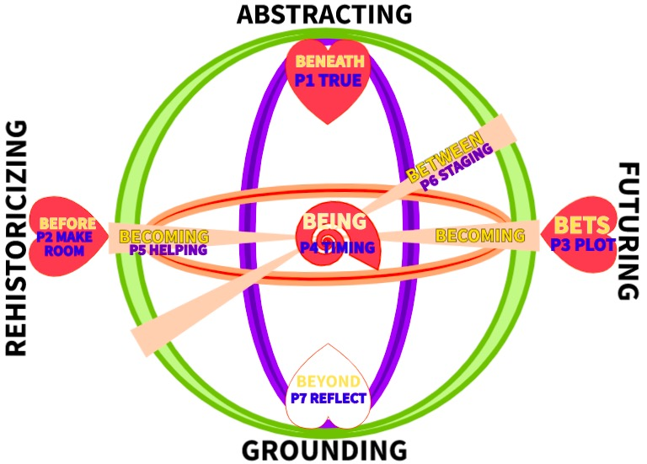
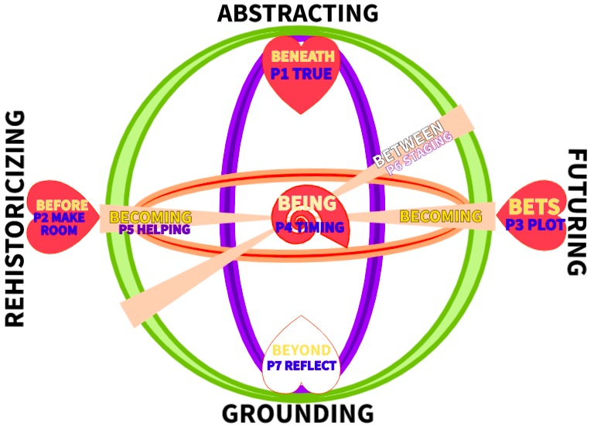
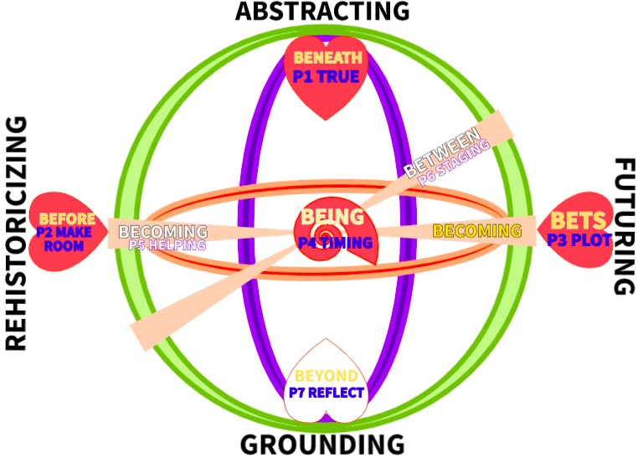
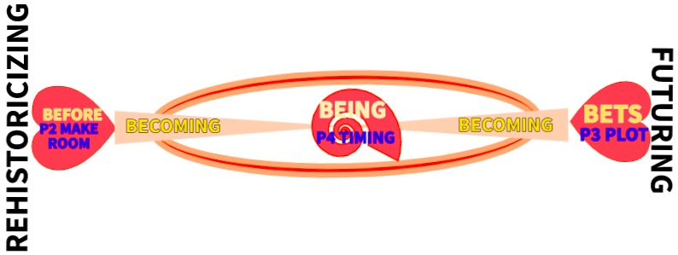
The Two Principles & Two Processes

Slide 17
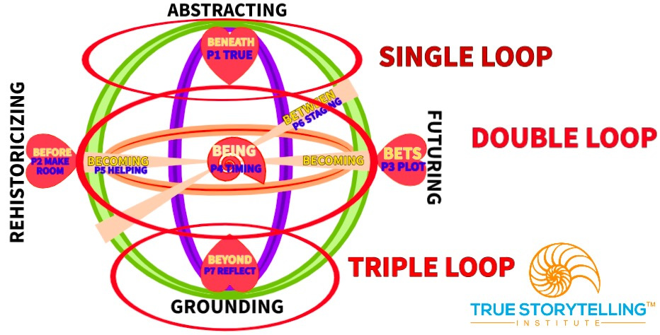

Slide 18
Going Beyond Open Systems to Multi-Brain Networking Ensembles
Louis R. Pondy & Kenneth Boulding foresaw Beyond Open Systems (i.e. Double Loop)
Two kinds of Becoming in Double Loop, part of Double Loop, that connect Before-Heart (Little Wow Moments) to Bets-Heart (opportune moments) in the restorying process
When does Human Networking exhibit this Collective Intelligence Fractality?
PSL² Problem Solving Learning & Leading in groups is about Principle 5: Helping (Restorying) along

Slide 19
TOOL: PSL² Problem Solving Leading & Learning Principle 5: Helping the New Story Along (Becoming)

Slide 20
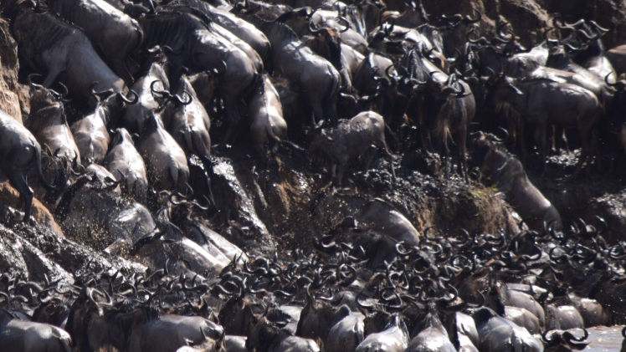
Wildebeest put brains together to find way up river bank

Slide 21
PSL² Problem Solving to Promote Collective Intelligence Networking in the Restorying
BREAKOUT
How to deal with problem solution Team From Hell behaviors:
Hard Sell
Lend me your ear
Why don't you, yes but
All talk and no listening,
Have we been here before?
DEBRIEF:
How is this related to Restorying?
What is the fractal change?

Slide 22
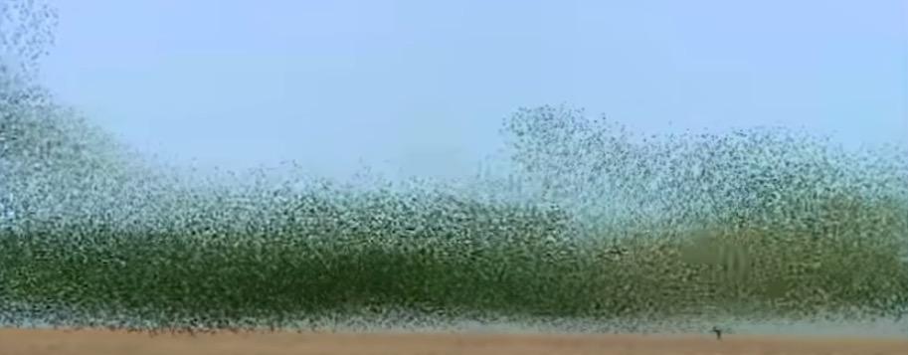
Parrots Swarm, and make micro-second decisions of collective intelligence
Budgee Parrots Swarm and make micro-second decisions of collective intelligence
See YouTube

Slide 23
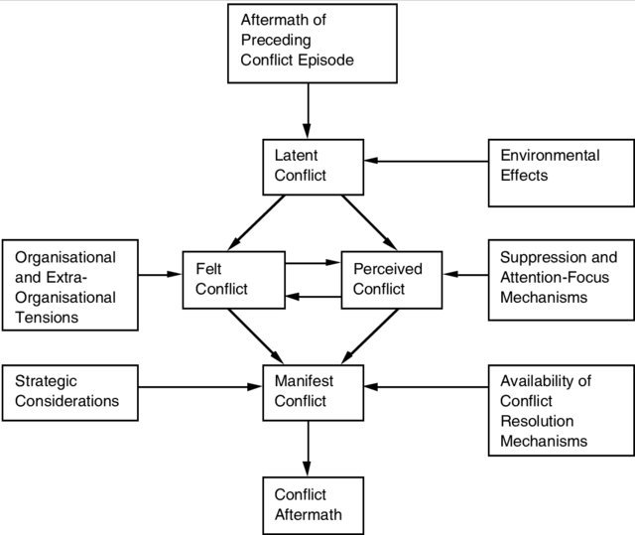
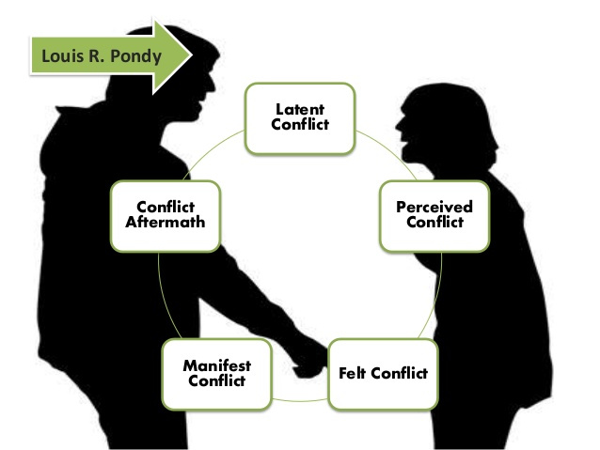
Tool 6 From 1st Loop of Escalation to 2nd Loop of Resolution prepares the staging

Slide 24
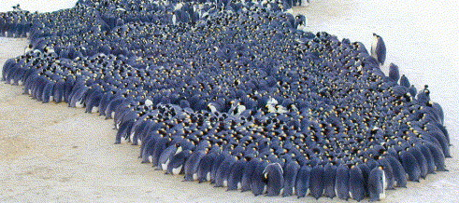
Emperor Penguins Waddling is Collective Intelligence Networking

Slide 25
Homework: Do a Tamara-Land (multi-room) storyboarding, Staging some new story of Collective Intelligence Networking
READING for next week: Chapter 7 in “True Storytelling”
Online study guide ODC 2.0 and the McDonald’s Case on Dialogisms at https://truestorytelling.blog
Review all 7 Tools at the blog. Study the Fractal Visual Language of Storytelling at TSI Think Tank FUTURE SESSIONS:
Session #4: Principle 7 Embodied Reflection (BEYOND of 6th Sense Process: Aligning the head/heart dialogues with your embodied outer dialogues with others).
Getting Ready for DEI 2.0 Module
25

Slide 26
Walk the Mountain with any final questions about:
How does PSL² (Problem Solving Learning & Leading) help new stories along?
In what ways can Storyboarding of
Tamara-Land relationships between Material (software & hardware) and Social help to make visible the collective human behavior routines?
How can you foster collective intelligence among your own stakeholders?

Slide 27
TRUE STORYTELLING
Organizing, Developing,
& Changing (ODC 2.0)
Level I session 3
27
Notes:
Just go over this slide
27

Slide 28
True Storytelling Institute
Check Out
COFFEE in the LOBBY
Notes:
28

