Slide 1
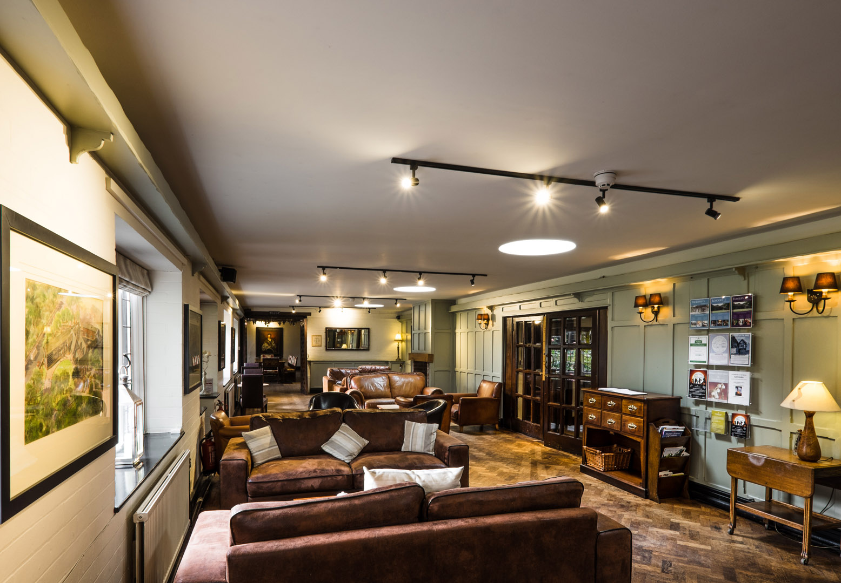
WELCOME to True Storytelling Institute
ODC 2.0 Session 2 Principles 3 & 4
COFFEE in the LOBBY
8:45-9:00 AM Pacific
Notes:
1

Slide 2
TRUE STORYTELLING
Organizing, Developing,
& Changing (ODC 2.0)
Level I session 2
2
Notes:
Just go over this slide
2

Slide 4
Please bring a notebook and pen/pencil to each session.
Use the “Gallery View” so you can see each other while viewing PowerPoint.
Please do not give advice to others or use ‘should’ statements for self or others.
Speak more from the heart than from the head
Laser in, be concise, and share only one story instead of several.
CONFIDENTIALITY: Do not tell someone else’s story. Please DO NOT record any session of the presenters or the participants.
Please use Chat ONLY when asked to do so. Avoid “side talk.”
Please attend all sessions. If you must miss one, contact us so we can help you to catch up before you return.
Notes:
4

Slide 6
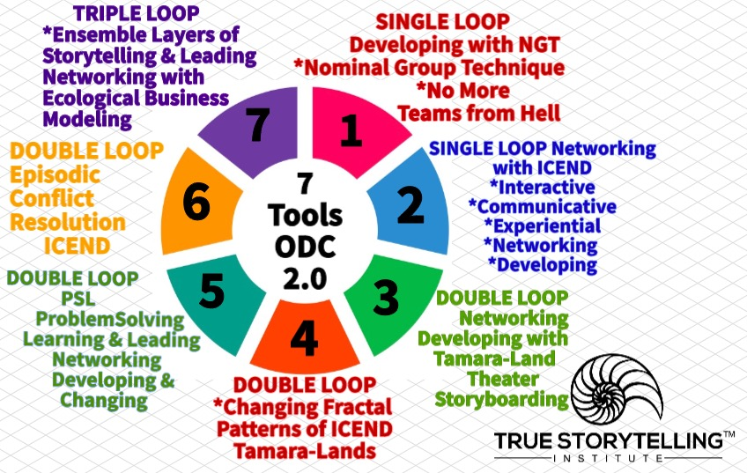
ROADMAP for Session #2 ODC 2.0
Last Week Tools 1 & 2 to intervene in Single Loop
This Week more Tool 2 ICEND
Introduce Tool 3 and Tool 4
Tamara-Land and
Changing its Fractal Pattern
Breakout to practice Tool 4
Notes:
Week 1:
Nuts and Bolts
Principle 1 True &
Principle 2 Making Room
WITH
Process 1 Beneath &
Process 2 Before
Ethics focus:
True Storytelling Principles
for an Ethical Life

Slide 7
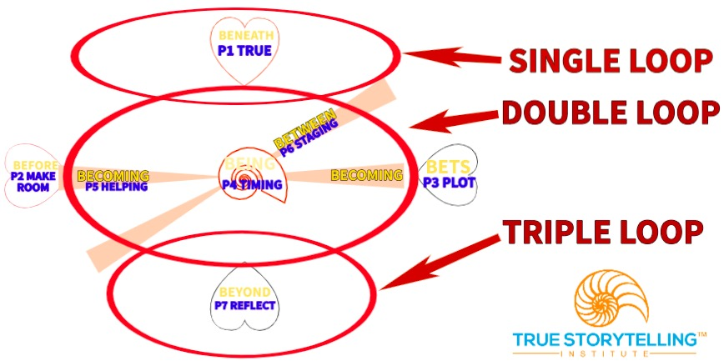
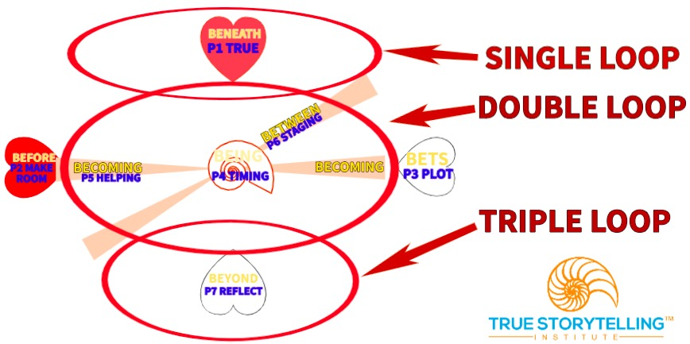
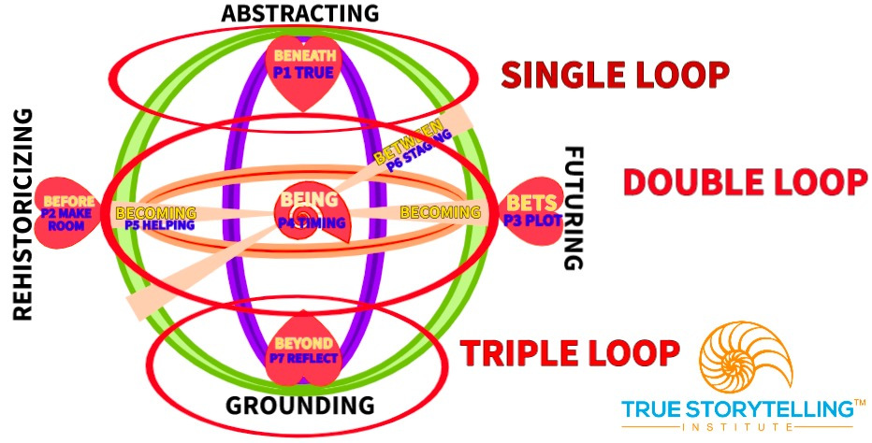
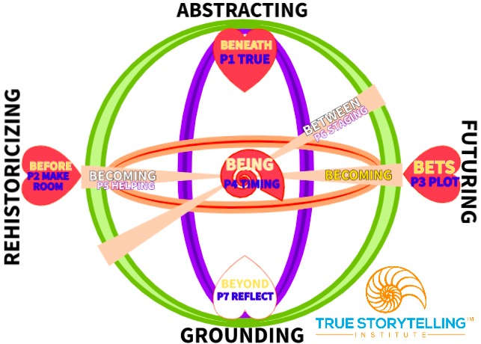
Three Loops
Session #2 ODC 2.0
TODAY:
Single Loop: Learn to do
Double Loop: Learn to learn
Triple Loop: Learn to learn in
harmony with nature & ethics
FRACTILE patterns
Notes:
Week 1:
Nuts and Bolts
Principle 1 True &
Principle 2 Making Room
WITH
Process 1 Beneath &
Process 2 Before
Ethics focus:
True Storytelling Principles
for an Ethical Life

Slide 8
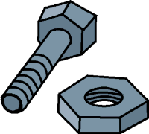
Session 2 NUTS & BOLTs Grace Ann
1. Keep adding to your 7 principles personal experience stories - 7 Story Types for ODC 2.0 (use Microsoft TODO App)
2. Review Nominal Group.
3. Review single, double, and triple loop learning.
4. Review fractiles (patterns)

Slide 9
Describe the Problem- - be specific.
What is the Goal?
Goals should be measurable, observable, & reasonable.
What is your strategy?
Does it fix, prevent, or eliminate the problem?
Single Loop: Car, flat tire, put air in the tire.
Double Loop: Car, flat tire, repair the hole, then put in air.
Triple Loop: Car, tires fine, car won’t start. Why? Patterns.
IDENTIFY FRACTILES (patterns) (doctor’s prognosis story)
Single Loop: lack of respect, attacks on others,
blaming others, off track personal issues, unprepared
Double Loop: lack of accountability (charging for games),
criteria too restrictive so killing ideas for solutions.
CHANGE THE PATTERNS: Nominal group & elevator story
REVIEWING HOMEWORK from
The Team From Hell Exercise
Part 2

Slide 10
Review & Connect the Dots:
The Team From Hell tool uses True Storytelling principles
Principle #1 Truth:
TFH uncovers taboo topics and untold stories of problems in teams.
Principle #2 Make room for stories already there:
Each team member has their own stories.
Principle #3 Plot:
Each TFH behavior threatens team success.
Each goal and objective is a plot for success.
Principle #4 Timing:
Objectives may prevent TFH behaviors before they happen.

Slide 11
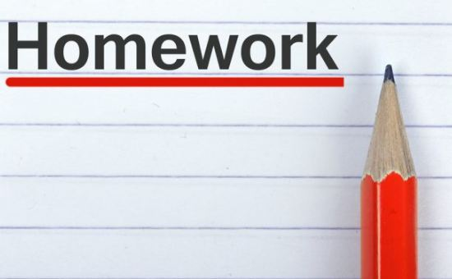
LAST WEEK’S
REVIEW
Homework: Write in your notebook an example of single, double, and triple loop learning based on your own problem focus from your own context.
READING for next week: Chapters 3 & 4 in “True Storytelling”
Make your own 7 principles personal experience stories - 7 Story Types for ODC 2.0 uses Microsoft TODO App
Online study guide ODC 2.1 and the McDonald’s Case on Dialogisms at https://truestorytelling.blog
Try Ken’s NGT video, and the spreadsheet to calculate NGT rankings.
11

Slide 12
Example of Networking for Place-Based Change BALLE
Notes:
Tool 1: NGT for BENEATH (we find games people play in 1st Loop pf Principle 1: what is true (on surface); prep for Tool 5, session 3)
Tool 2: ICEND – Interactive Communicative Experiential Networking Developing. It uses NGT or the Talking Stick Circles approach (we find Networking between rooms by passageways- BEFORE (already there) of the networking’s deep history (below surface history)
Tool 3: Storyboarding Tamara-Land Networking pathways (BECOMING (washing out Little Wow Moments) of not just timing, but moving space to space, in pathways) [begins Double Loop, of restorying process]
Tool 3: Cause & Effect Map (Fishbone), the space time mattering that is Entangles as SpaceTimeMattering of BEING, the truth of which we can uncover, to get to ‘essence of BEING’- Deeper level of What is True in system’s socio-materialities.

Slide 13
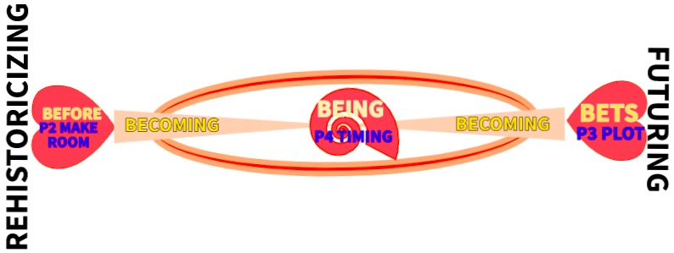
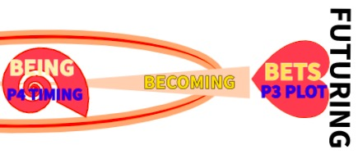
The Two Principles Two Processes
Can be BECOMING of Double Loop of retrospective-prospective sensemaking

Slide 14
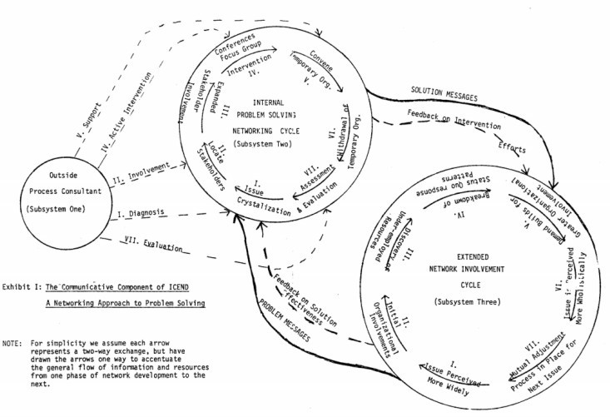
Tool 2 The BEFORE PROCESS Talking Stick for ICEND (Interactive, Communicative, Experiential, Networking Developing
Subsystem One: Outside Process Consultation Cycle
I. Diagnosis
II. Involvement
III. Active Intervention
IV. Support
V. Evaluation
Subsystem Three: Extended Network Involvement Cycle
I. Issue Perceived More Widely in the Extended Network
II. Initial Organizational Involvement beyond Temporary Organization
III. Discovery of Under-employed Resources
IV. Breakdown of Status Quo Response Patterns (Subsystem II Interventions in Extended Field)
V. Demand Builds for Greater Organizational Involvement
VI. Breakdown of Status Quo Responses
Subsystem Two: Internal Problem Solving & Networking Cycle
I. Issue Crystallization (issues that bring form community)
II. Locate Stakeholders
III. Expanded Stakeholder Involvement
IV. Search Conferences & Focus Group Intervention
V. Convene Temporary Organization
VI. Withdrawal of Temporary Organization (before bureaucracy sets in)
VII. Assessment & Evaluation

Slide 15
Tool 3: Storyboarding Your Organization’s Tamara-Land
Map the BECOMING process networking as the people move from room to room, making sense of what Networking is emerging

Slide 16
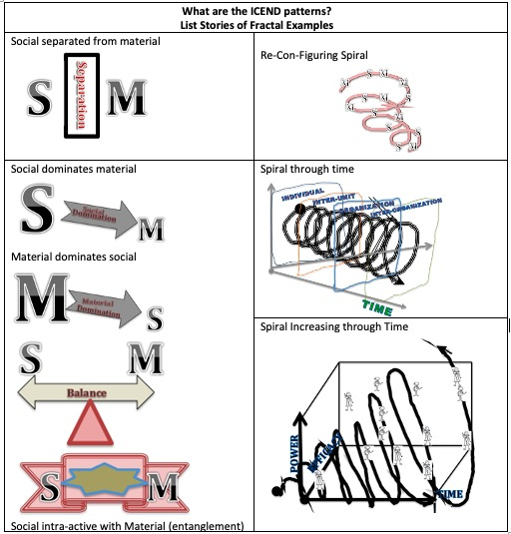
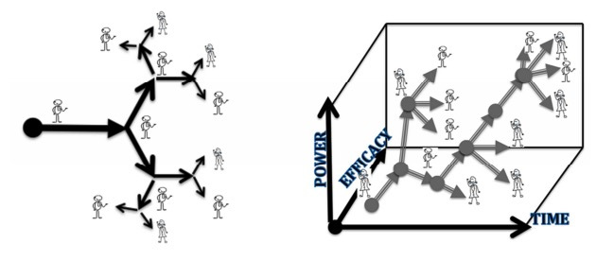
Tool 4: Mapping Fractal Patterns Fractals are self-similar patterns recurring across micro to macro scales

Slide 17
Changing
Fractals From Hell
BREAKOUT
3 groups of 3 or 4 per group.
30 second suggestions, 10 min for this breakout, then debrief.
TASK: Identify a problem Fractal Pattern in your organization.
How to change the Fractal Pattern Relation of Social (S) and Material (M)
DEBRIEF:
What was goal of your Fractal Change Strategy?
What Direction is this Fractal Going (Principle 1 – Plot/Bets)?
What are the Spaces of its Tamara-Land and the Timing and Mattering of its BEING Here-and-Now?

Slide 19
Homework: Write stories in your notebook with an example of single, double, and triple loop learning based on your own organization system. What is the networking? Current Fractal Pattern? What tools could you begin using?
READING for next week: Chapters 5 & 6 in “True Storytelling”
Online study guide ODC 2.0 and the McDonald’s Case on Dialogisms at https://truestorytelling.blog
Review all 7 Tools at the blog. Study the Fractal Visual Language of Storytelling at TSI Think Tank FUTURE SESSIONS:
Session #3: Principle 5 Helping Stories Along (BECOMING PROCESS of Conversational Restorying) and Principle 6 Staging (Conveying your plot to your audience, by BETWEEN Process). This is where the 2nd Loop is the focus, so Double Loop of Open Systems Happens
Session #4: Principle 7 Embodied Reflection (BEYOND of 6th Sense Process: Aligning the head/heart dialogues with your embodied outer dialogues with others).
19

Slide 20
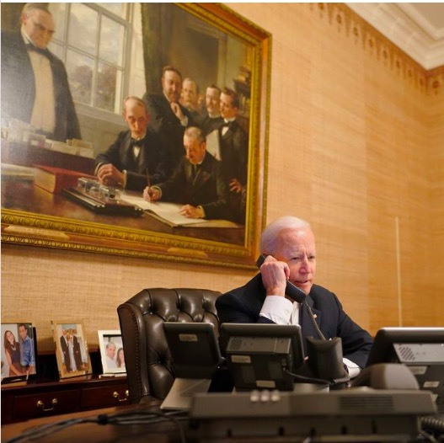
Preparations for next Session
Polyphony Dialogism – many voices in a conversation, even in single loop
Stylistic Dialogism – many styles parodying one another, even in single loop
CLICK HERE TO Read More at
TSI’s THINKTANK

Slide 21
Walk the Mountain with any final questions about:
How do you change a Single Loop Fractal Pattern into Double Loop?
How to Storyboard the Tamara-Land relationships between Material (software & hardware) and Social that controls Human Behavior routines
Relating Double Loop to your own context

Slide 22
TRUE STORYTELLING
Organizing, Developing,
& Changing (ODC 2.0)
Level I session 2
22
Notes:
Just go over this slide
22

Slide 23
True Storytelling Institute
Check Out
COFFEE in the LOBBY
Notes:
23

Slide 24
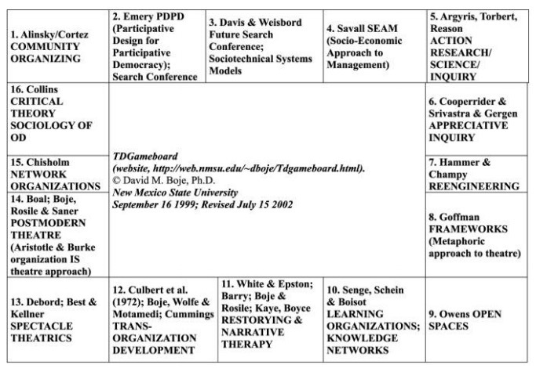
Please Click Here to Visit TD Gameboard
FOR
FUTURE
REFERENCE

