Slide 1
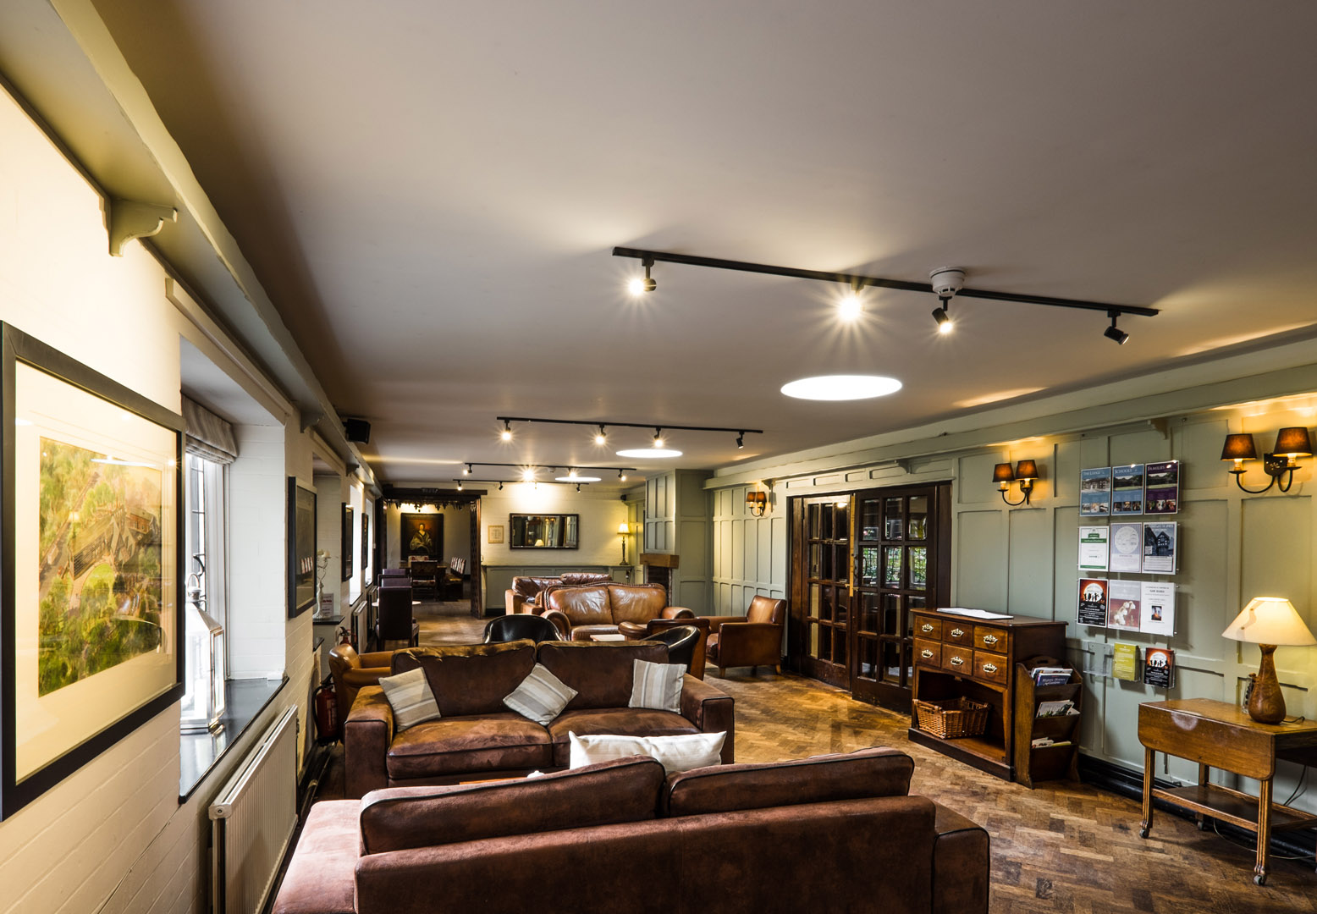
WELCOME to True Storytelling Institute
ODC 2.0 WEEK 1 Principles 1 & 2
COFFEE in the LOBBY
8:45-9:00 AM Pacific
Notes:
1

Slide 2
TRUE STORYTELLING
Organizing, Developing,
& Changing (ODC 2.0)
Level I session 1
2
Notes:
Just go over this slide
2

Slide 4
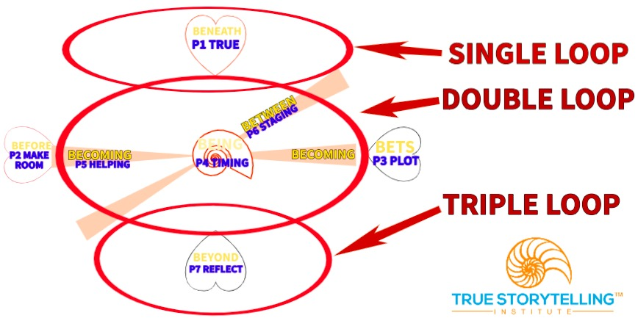
ROADMAP for Session #1 ODC 2.0
TODAY:
Single Loop ODC 1.0
Nuts & Bolts,
The Team from Hell
Principles 1 and 2,
Single Loop ODC 1.0 vs.
Double-Triple Loops
of ODC 2.0
Notes:
Week 1:
Nuts and Bolts
Principle 1 True &
Principle 2 Making Room
WITH
Process 1 Beneath &
Process 2 Before
Ethics focus:
True Storytelling Principles
for an Ethical Life

Slide 5
Please bring a notebook and pen/pencil to each session.
Use the “Gallery View” so you can see each other while viewing PowerPoint.
Please do not give advice to others or use ‘should’ statements for self or others.
Speak more from the heart than from the head
Laser in, be concise, and share only one story instead of several.
CONFIDENTIALITY: Do not tell someone else’s story. Please DO NOT record any session of the presenters or the participants.
Please use Chat ONLY when asked to do so. Avoid “side talk.”
Please attend all sessions. If you must miss one, contact us so we can help you to catch up before you return.
Notes:
5

Slide 6
Challenges with changes in organization
70 % strategy implementation fails
Mckinsey Quarterly(2008):Creating Organizational Transformattion.
McKinsey Global Survey Results (2010): What Succesful Transformations Share.

Slide 7
As a consultant you can use
True Storytelling QUESTIONS
as TUNING FORKS for:
Planning
Facilitating
Reflecting
p. 116

Slide 8
What you will learn from the True Storytelling ODC Module

Slide 9
Session 1 NUTS & BOLTs Grace Ann
1. What is Single Loop ODC 1.0
2. What is Double & Triple Loop ODC 2.0?
3. Building Your True Story Library
4. How to use the Nominal Group Tool

Slide 10
YOU LIST: silently and alone, write a list of 3-7 problems/issues that would
make your group the “TEAM from HELL.”
ROUND-ROBIN LIST: each person gives one problem, until all are listed.
FOR EACH ITEM, BRIEFLY TELL YOUR STORY, telling your experience
about why/how this bothers you. For example, “One person was constantly on their cell phone, so we had to keep repeating things.”
TOP 7 LIST: From the full list, the group decides together on the top 7.
RATE the 7: Individuals silently rate each problem (7=worst, 1=least bad).
TOTAL: Add up the rating of each problem by each person; write totals.
TOP 3: Choose the top 3 problems based on the highest sum-of-all-ratings totals above.
NEXT we MOVE to Part 2: Restory each of the top 3 problems
“Nominal” = “in name only,” prevents Groups Think (a person or idea dominating)
The Team
From Hell
Exercise,
Part 1:
Tool #1 Nominal Group Technique (NGT)
For Ensemble Storytelling
Together-Telling

Slide 11
Each group takes ONE of the top 3 problems, and creates a goal that would eliminate that problem.
Then design 3 strategies to make sure the goal is reached.
Example:
PROBLEM #1: People constantly on cell phones.
GOAL #1: No one uses cell phones during our meetings, except for extreme emergencies.
Goals should be measureable, observable, & reasonable.
STRATEGY #1: Park cell phones near the door with ringers off.
STRATEGY #2: Have meetings at the same time so people can know in advance when someone will be unavailable.
STRATEGY #3: Program an automated answer indicating the receiver is in a meeting and the expected time when done.
The Team From Hell Exercise
Part 2
Deconstruct and Restory

Slide 12
For your STRATEGIES, REMEMBER you can use humor and fun and food!
Example: Anyone who forgets and answers their phone for non-emergencies buys snacks/drinks for the next meeting.
RESULTS using this method:
9 of10 groups rated their experience “very good” to “best ever”
Teammates stayed friends for years after the class was over.
Even opposites became buddies.

Slide 13
BREAKOUT
3 groups of 3 or 4 per group.
30 second suggestions, 10 min per group.
TASK: Each group takes one problem plus its goal, and devises 3 strategies to assure the goal is met.
DEBRIEF:
What was your goal and its 3 strategies?
Follow-up Discussion:
Where did you see Principle One: True being used in this process?
Where did you see Principle Two: Make Room (for stories already there) used in this process?

Slide 14
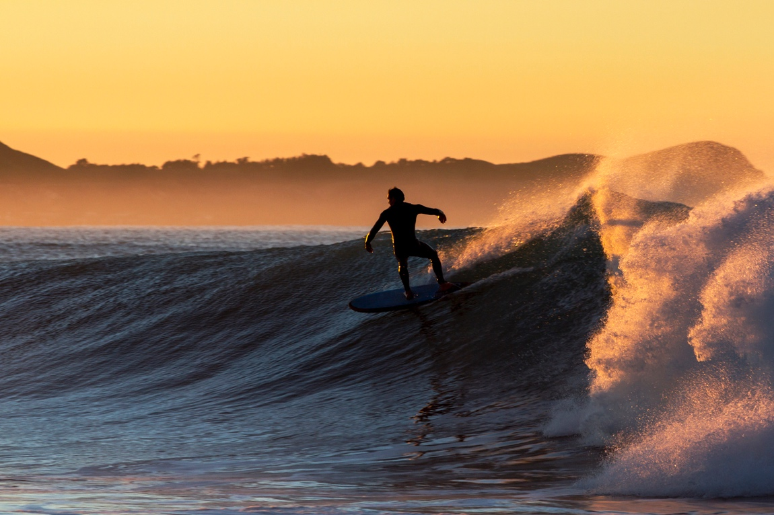
Principle 1, True
– You yourself must be true and prepare the energy and effort for a sustainable future
GO BENEATH the words!
Principle 2 Make room True storytelling makes spaces
respecting the stories already there
WAVES coming BEFORE you…
Notes:
Where are the waves we can surf which will support our true strategy and when is the right moment to catch them?
Do you already work with something which is similar to this?
Are there any partners or trend you can connect to you have not thought about yet?
Where are the waves we can surf which will support our true strategy and when is the right moment to catch them?
Do you already work with something which is similar to this?
Are there any partners or trend you can connect to you have not thought about yet?
Principle 2 Make room True storytelling makes spaces
respecting the stories already there

Slide 15
Principle 1: True
What is you, your team and the organization narrative now?
Do you/they believe in the need for changes?
Does it make sense?
Is the new strategy/changes sustainable (human, financially and in terms of resources)?
How can we work with “forecare” and “Together-telling” to get closer to the ethical and true? (TOOLS)
Truestorytellinginstitute.com

Slide 16
Principle 2: Making room
What are you, the team and your company already doing that supports sustainability?
Are there movements (waves) in time or the environment the company can relate to?
What is the challenge for the company already working on change and development?

Slide 17
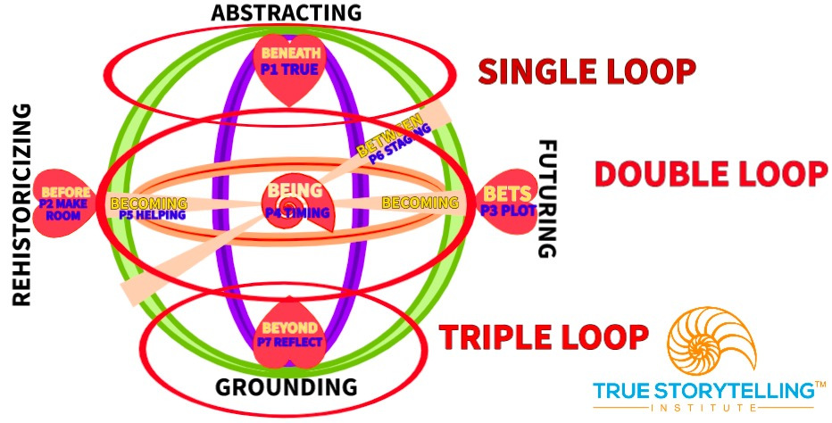
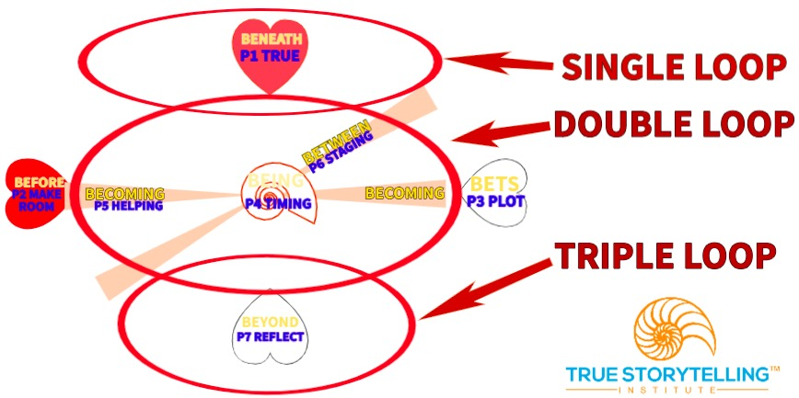
ODC 2.0 is a journey to move from Single Loop to Double & Triple Loop, including Fractals

Slide 18
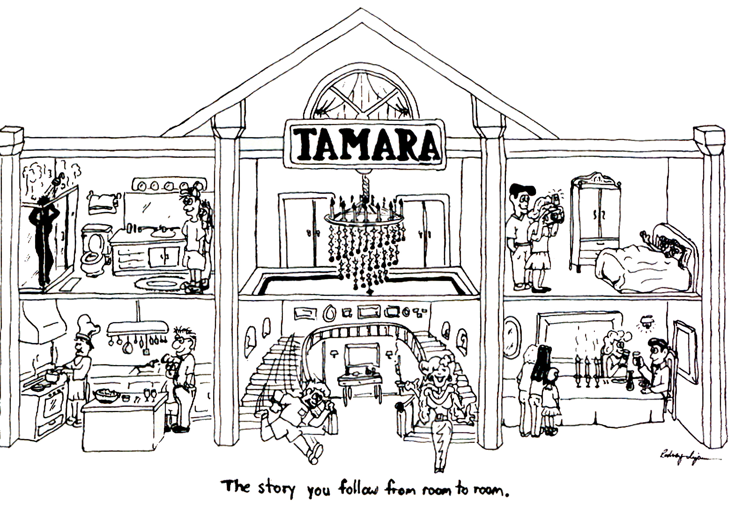
Why We Need Double & Triple Loop in ODC 2.0
The factorial of 6 rooms in TAMARA-LAND Is exactly 720
The factorial of 12 rooms is exactly 479,001,600
18

Slide 19
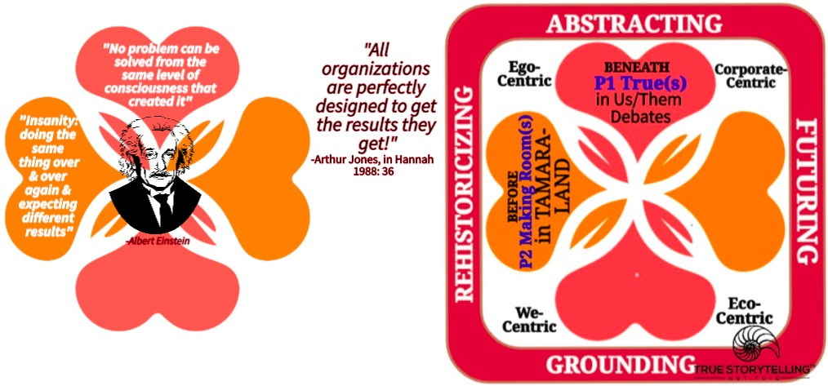
Principles 1 & 2 (TRUE & MAKING ROOM)
Quantum Story Processes
(BENEATH & BEFORE)

Slide 20
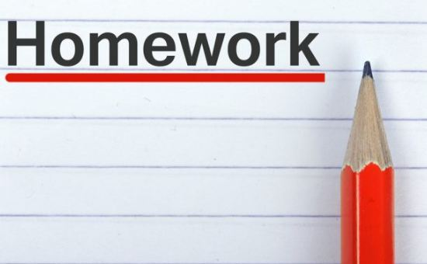
Homework: Double-Loop and Triple-Loop: What do they mean for the Team From Hell? For example, single loop might be that a group meets and each contributes a chapter to the final report and so are successful. Double loop might suggest that each group member might have to wait to see the previous chapter before they write their chapter, thus having a plan (plot) which takes into account timing. Rather than focus only on the goal, double-loop learning reflects on the learning process itself. Triple loop learning might involve the group inviting in outside experts on environment or the pandemic to broaden the scope of what they define as the problem domain. Write this in your notebook with an example of single, double, and triple loop learning based on your own problem focus from your own context.
READING for next week: Chapters 3 & 4 in “True Storytelling”
Make your own 7 principles personal experience stories - 7 Story Types for ODC 2.0 uses Microsoft TODO App
Online study guide ODC 2.1 and the McDonald’s Case on Dialogisms at https://truestorytelling.blog
Try Ken’s NGT video, and the spreadsheet to calculate NGT rankings. FUTURE SESSIONS:
Session #2 Principle 3 Plotting with PROCESS: BETS ON FUTURE and Principle 4 Timing with PROCESS: BEING (Identifying patterns and exceptions and choosing your timing in TAMARA spaces & times).
Session #3: Principle 5 Helping Stories Along (BECOMING PROCESS of Conversational Restorying) and Principle 6 Staging (Conveying your plot to your audience, by BETWEEN Process).
Session #4: Principle 7 Embodied Reflection (BEYOND of 6th Sense Process: Aligning the head/heart dialogues with your embodied outer dialogues with others).
20

Slide 21
Walk the Mountain with any final questions about:
Homework regarding single, double, and triple loop learning
Nominal Group method
The Team From Hell exercise
Strategies to assure achievement of goals
Relating ODC 2.0 to your own context

Slide 22
TRUE STORYTELLING
Organizing, Developing,
& Changing (ODC 2.0)
Level I session 1
22
Notes:
Just go over this slide
22

Slide 23
True Storytelling Institute
Check Out
COFFEE in the LOBBY
Notes:
23

