Slide 1
TRUE STORYTELLING
Train-the-Trainers
Masters Class 2
17 Feb 2021
<number>
Notes:
Just go over this slide
<number>

Slide 2
True Storytelling Institute
PRE-SESSION Masters Class
“How 5 Tom Petty Lyrics Explains
Embodied Restorying Process (ERP)”
Notes:
<number>

Slide 3
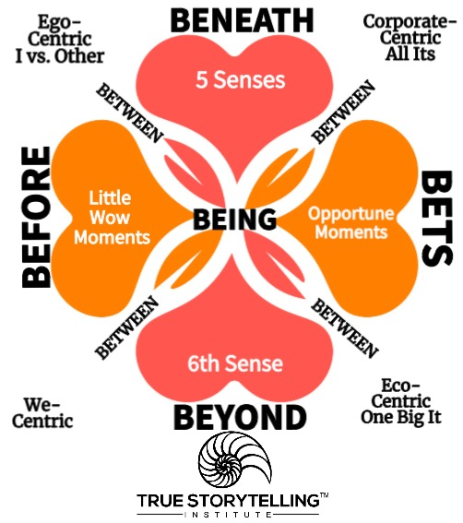
Welcome to ROADMAP
Principle 4 Timing is
Before → Being → Bets
Principle 5 Helping Stories
& Becoming of ‘Little Wow Moments’ BEFORE becomes
“Opportune Moments’ BETS
Principe 6 Staging the BETWEEN the 4 Hearts
Principle 7 Embodied Reflecting by Guiding into Depth of Space
Beneath→ Being → BEYOND

Slide 4
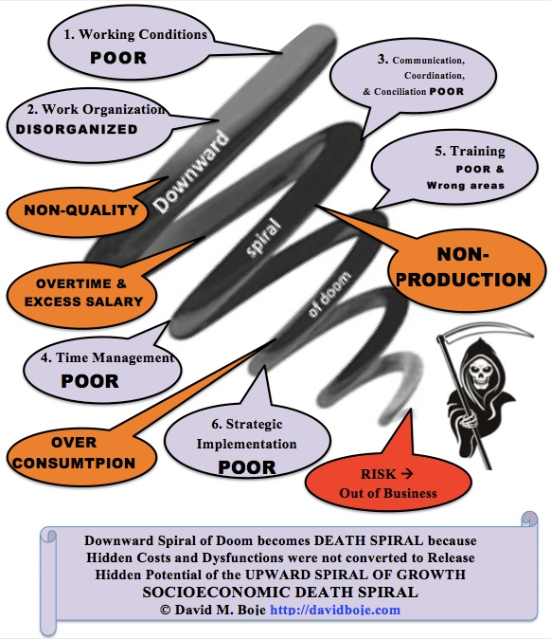
Why is this useful to you?

Slide 5
STRUCTURE FOR TODAY
PART I The Space Exercise in Sense-Giving
PART II Bell Apparatus & ‘System Change’ Breakout
PART III What is Horsesense ERP? Grace Ann
PART IV Tom Petty songs & steps 1 to 3 Breakout
PART V Tom Petty songs 4 &5 and steps 4 to 6 Breakout
PART VI Step 7 After-care Breakout & Debrief
PART VII Sound Wave Diffraction Interference
PART VIII 4 Principles of Protreptic Guides
PART IX Post-Discussion “Lobby,” Q&A
Notes:
<number>

Slide 6
Please bring a notebook and pen/pencil to each session.
Use the “Gallery View” so you can see each other while viewing Powerpoint.
Please do not give advice to others or use ‘should’ statements for self or others.
Speak more from the heart than from the head
Laser in, be concise, and share only one story instead of several.
CONFIDENTIALITY: Do not tell someone else’s story. Please DO NOT record any session of the presenters or the participants.
Please use Chat ONLY when asked to do so. Avoid “side talk.”
Please attend all sessions. If you must miss one, contact us so we can help you to catch up before you return.
Notes:
<number>

Slide 7
Part I – Space Exercise in sense-giving (2 minutes)

Slide 8
PART II Bell Apparatus & ‘System Change’
The Story
Your Breakout: Please tell a story of a Material Thing that was deep part of the spacetime of a system you personally experienced.
MAIN POINT: We exist in six spaces spacing of a system we want to change:
Technological space
Musical (sound) space
Maritime (& Desert) space
Mathematical (fractals) space
Physical (physics) space
Aesthetic space

Slide 9
Another One By Ron Padgett (poem written for the movie Paterson)
When you’re a child you learn there are three dimensions: height, width, and depth. Like a shoebox. Then later you hear there’s a fourth dimension: time. Hmm. Then some say there can be five, six, seven… I knock off work, have a beer at the bar. I look down at the glass and feel glad.

Slide 10
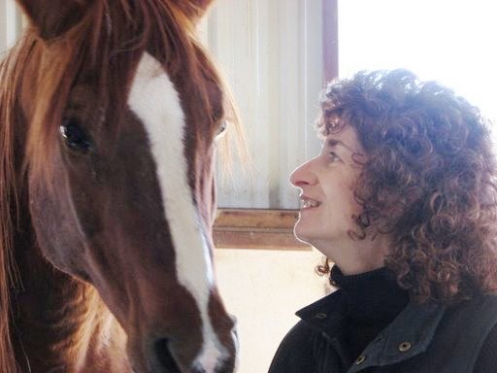
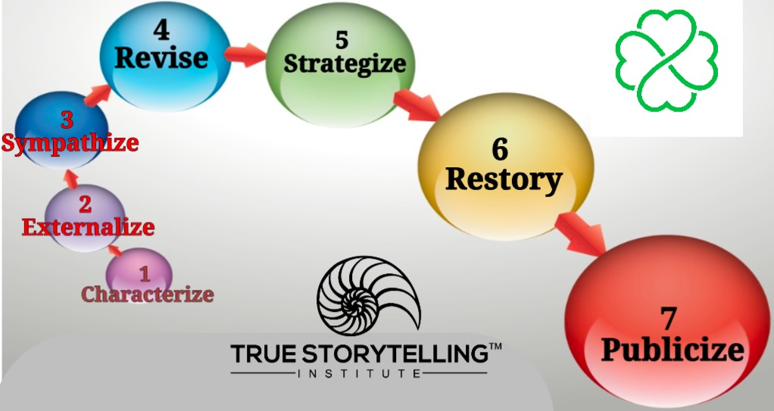
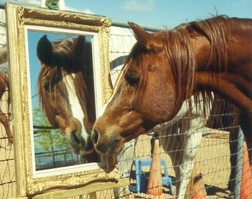
Story of Meeting David Epston in New Zealand in 1996
How Embodied Restorying Works with Horses and Veterans and their Family System? See Video
PART III What is Horsesense ERP? Grace Ann

Slide 11
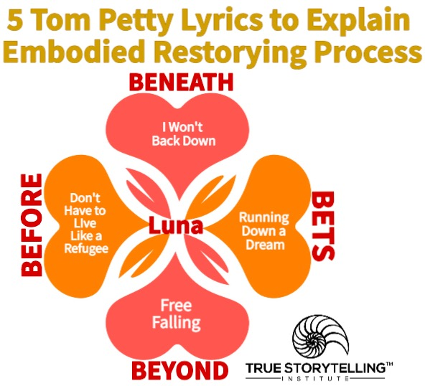
PART IV to VI Tom Petty songs OVERVIEW

Slide 12
PART IV Tom Petty songs & steps 1 to 3, then your Breakout Link to Article (Journal of Veterans Affairs)
1. Characterize: “Describe you at your ‘best,’ or your family at their best, either in words or by arranging a scene in the sand tray. What would a favorite grandparent, parent, teacher, family member, or best friend, say about you?
2. Externalize: “Describe your ‘old story,’ your description of you/your family in the past. Feel free to make any problems or struggles into another character in your story (use an object in the sand tray to describe this character/problem).”
3. Sympathize: “How has the problem (the old story) benefitted you or how is it understandable?”

Slide 13
BENEATH – Heart "Well, I Won't Back Down"
No, I won't back down
You can stand me up at the gates of hell
But I won't back down
No, I'll stand my ground
Won't be turned around
And I'll keep this world from draggin' me down
Gonna stand my ground
And I won't back down
(I won't back down) Hey, baby
There ain't no easy way out

Slide 14
BEFORE – Heart "Live Like a Refugee"
We got somethin', we both know it, we don't talk too much about it
Ain't no real big secret, all the same, somehow we get around it
Listen, it don't really matter to me baby
You believe what you want to believe, you see
You don't have to live like a refugee
(Don't have to live like a refugee)
Somewhere, somehow, somebody must have kicked you around some
Tell me why you want to lay there, revel in your abandon

Slide 15
PART V Tom Petty songs 4 &5 and steps 4 to 6 Breakout
4. Revise: “Identify negative consequences of the problem.” This helps reaffirm the commitment to change them.
5. Strategize: “Find the ‘little wow moments’ of exception to the usual ‘same old story.’” For example, “How did you overcome the problem this time?”
6. Restory: “Re-write history and write a new future life/family story. This time, highlight all the ‘little wow moments’ from family members and make them the ‘new normal’ of your Future.

Slide 16
BEYOND – Heart "Free Fallin’"
She's a good girl, loves her mama
Loves Jesus and America too
She's a good girl, who's crazy 'bout Elvis
Loves horses and her boyfriend too
And it's a long day livin' in Reseda
There's a freeway runnin' through the yard
And I'm a bad boy, cause I don't even miss her
I'm a bad boy for breakin' her heart
Now I'm free
Free fallin'
Yeah, I'm free
Free fallin'

Slide 17
BETS – Heart "Runnin’ Down a Dream"
It was a beautiful day, the sun beat down
I had the radio on, I was drivin'
Trees went by, me and Del were singin'
Little Runaway
I was flyin'
Yeah, runnin' down a dream
That never would come to me
Workin' on a mystery, goin' wherever it leads
Runnin' down a dream
I felt so good, like anything was possible
Hit cruise control and rubbed my eyes
The last three days the rain was unstoppable
It was always cold, no sunshine

Slide 18
BEING & In-BETWEEN "Luna"
White light cut a scar in the sky
Thin line of silver
The night was all clouded with dreams
Wind made me shiver
Black and yellow pools of light
Outside my window
Luna come to me tonight
I am a prisoner
Luna glide down from the moon
The clouds are all silver and black
Floating around me
Luna come into my eyes
Luna surround me
With black and yellow pools of light
Fall by my window
Luna come to me tonight
I am a prisoner
Luna glide down from the moon

Slide 19
PART VI Step 7 After-care Breakout & Debrief
7. Publicize: “Identify a support network and write letters to potential supporters to request participation in the new story of the future. It does not matter if the letter recipients respond or not.
Now that you have the ‘New Story’ its time to do the Staging to publicize it

Slide 20
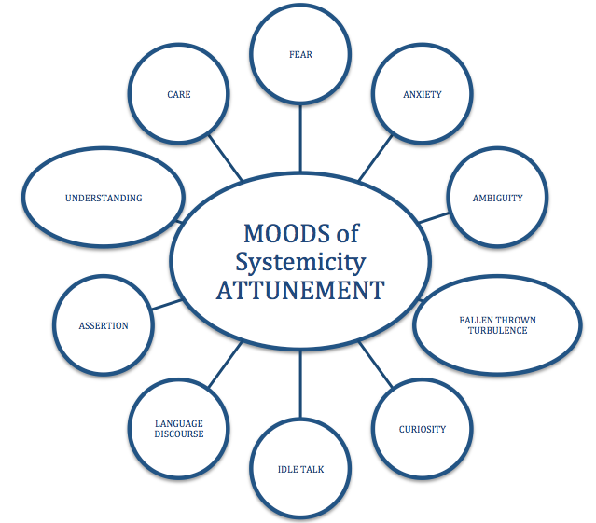
Why it works?
Homework: Pick your own 5 songs that help story along
In a system you would like to change, that you are part of.
How do you Guide Restroying from attunements of Fear, Anxiety, Ambiguity, & Turbulence to Assertion, Understanding, and Care?

Slide 21
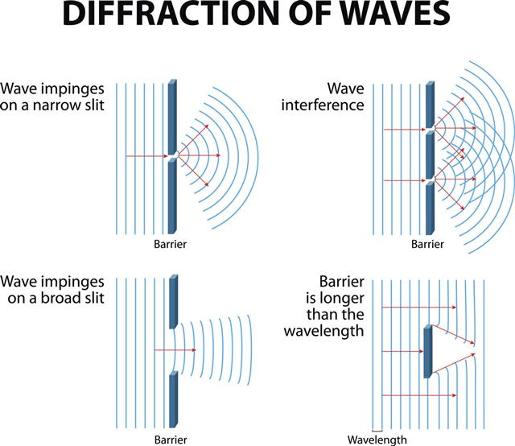
PART VII Sound Wave Diffraction Interference
Storytelling Sound of Music
Waves Diffract in all directions
Until a barrier, then interference...

Slide 22
PART VIII 4 Principles of Protreptic Guide (Kirkeby, 2009: adapted pp. 163-166)
1. Anchor in a dialogue the transgressive experience that breaks out of the sunlight. in Mr. Military story → wife and child. In BEYOND-Heart is the encounter with Nature forces. Being in combat, Nature gets displaced, and it can return to Doug.
2. In BEFORE-Heart, the ‘truth for empirical knowledge’ of BENEATH (debates) is not helping the story along (principle 5). Mr. Military is still living on the road to self-deception (PTSD, or something akin to it), because in-the-BEFORE, they is how he survived the Afghanistan war, → his ‘reality principle.’

Slide 23
PART VIII 4 Principles of Protreptic Guide (Kirkeby, 2009: adapted pp. 163-166)
3. Mr. Military needs the Free Fallin’ into the BEYOND-Heart to find Doug, because Mr. Military (without Doug) is without the means to establish a path directly from BENEATH or BEFORE to BETS.
4.The setting of eventing-the-event and its contextual framing have five facets. Here the Greek Square gets a plus-one:
* The Beautiful (family)
* The Just
* The Good (soldier)
*The True (empirics of surviving) PLUS
* THe‘Values of Military Culture that says ‘man up, suck it up, don’t back down ever’.
In Sum, Mr. Military is obligated by the military system narrative to be acting and leading according to Military-Institutional-Ethics, and to swallow his own person-ethics

Slide 24
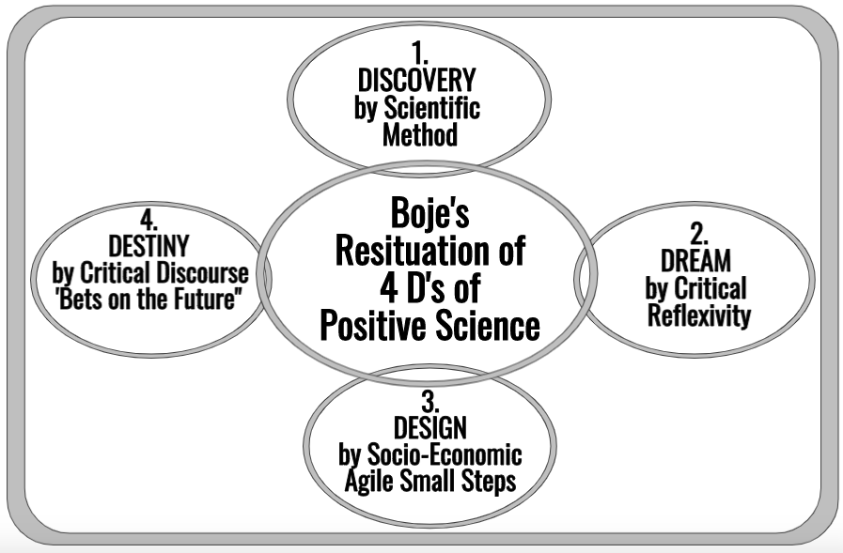
How Appreciative Inquiry and Embodied Restorying Combine?
Boje & Rosile, 2020: p. 79

Slide 25
Next Week
P6: Staging
How it is Staging in-Between the Hearts

Slide 26
HOMEWORK due in Week 6:Build Your
Zoom → Embodied Restorying Tools
Hold a practice session with either a cohort member or with one or two friends or relatives. How could you use Zoom to stage a Restorying Event?
Pick your own 5 songs that help story along
In a system you would like to change, that you are part of.
How do you Guide Restorying from attunements of Fear, Anxiety, Ambiguity, & Turbulence to Assertion, Understanding, and Care?
Notes:
<number>

Slide 27
PART IX Post-Discussion “Lobby,” Q&A

