Slide 1
Agenda for 2nd Foundation session June 29 Principles 3&4
10 Min. Welcome by Lena, Grace Ann, Jens:; what to expect from today: etc. Keep it short.
10 Min. Presentation of the participants: 30 seconds Name, home, one sentence homework
15 Min Principles 3 & 4 Together in spiral shell
10 Min. 1st Breakout (groups of 3) – story conversions Maori Method of no questions):
10 Min- Plenary sharing - David: self-correcting storytelling conversations
20 Min. 2nd Breakout (groups of 3) – self-correcting with counter-story & confirming-story turns
10 min. Debrief, Check in, and homework
Notes:
How can True Storytelling Gain Legitimacy in our lives?
A Heart-of-Care is defined as ethical Truth of ‘True Storytelling’s’ potential-for-Being-in-the-world, revealing itself as care (see Heidegger #228).
http://pdf-objects.com/files/Heidegger-Martin-Being-and-Time-trans.-Macquarrie-Robinson-Blackwell-1962.pdf
These 4 sessions are rooted in Ole Fogh Kirkeby’s The New Protreptic, what we are calling becoming a True Storytelling Guide. We don’t use the word Protreptic at this introductory level, but later a module just on this can be developed. See
The Foundations Seminar is required to earn a True Storytelling Certificate and your very own Talking Stick with animal of your choice carved on it. You may supply your own stick if you choose.

Slide 2
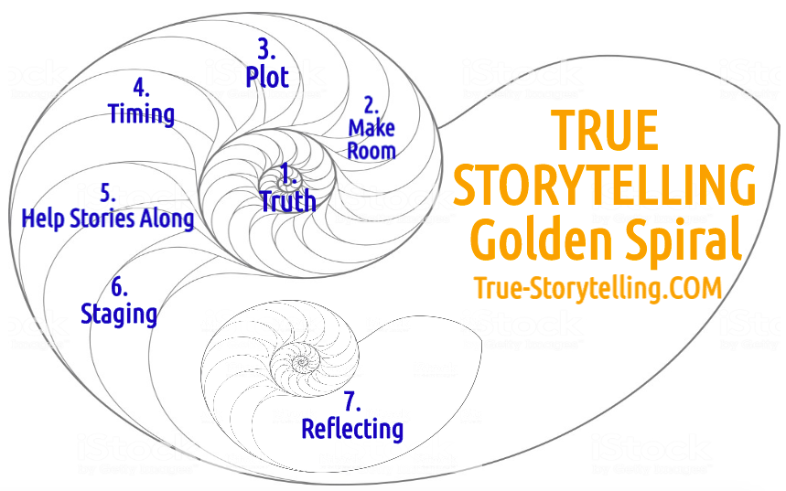
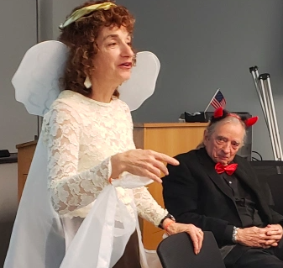
‘True’ STORYTELLING Principles 3 & 4 Plot & Timing Work Together
Jens Larsen
David Boje
Lena Bruun
Grace Ann Rosile

Slide 3
The Seven Principles in True Storytelling:
(1)Truth
(2)Make room
(3)Plot: You must create stories with a
clear plot creating direction
and help people prioritize
(4)Timing: You must have
timing
(5) Help stories along
(6) Staging
(7) Reflection

Slide 4
What You Can Learn From Today
How to navigate in complexity because you have insight in quantum physics and indeginous ways of knowing
How to work with timing and plots through Conversational Storytelling Process
How to step into Truth in your daily experience with heart and head
Creating a” solid foundation of Truth-Telling with Grace” (Anastasia, 2015: p. 50).
Learn what constitutes a living story web on a foundation of Truth
More

Slide 5
Ground rules
Please bring a notebook and pen/pencil to each session, and colored markers may be required for some sessions.
Please do not give advice to others or use ‘should’ statements for self or others.
Speak more from the heart than from the head
Laser in, be concise, and share only one story instead of several.
CONFIDENTIALITY: Do not tell someone else’s story. No recording of any session by us or you.
Please attend all four sessions. If you must miss one, contact us so we can schedule a session to catch you up before you return.

Slide 6
Agenda for 2nd Foundation session June 29 Principles 3&4
5 Min. Welcome & what to expect from today: etc. Keep it short.
10 Min. Presentation of the participants: 30 seconds Name, homework sentence
15 Min Principles 3 & 4 Together in spiral shell
10 Min. 1st Breakout (groups of 3) – story conversions Maori Method of no questions):
10 Min- Plenary sharing - David: self-correcting storytelling conversations
20 Min. 2nd Breakout (groups of 3) – self-correcting with counter-story & confirming-story turns
10 min. Debrief, Check in, and homework
Notes:
How can True Storytelling Gain Legitimacy in our lives?
A Heart-of-Care is defined as ethical Truth of ‘True Storytelling’s’ potential-for-Being-in-the-world, revealing itself as care (see Heidegger #228).
http://pdf-objects.com/files/Heidegger-Martin-Being-and-Time-trans.-Macquarrie-Robinson-Blackwell-1962.pdf
These 4 sessions are rooted in Ole Fogh Kirkeby’s The New Protreptic, what we are calling becoming a True Storytelling Guide. We don’t use the word Protreptic at this introductory level, but later a module just on this can be developed. See
The Foundations Seminar is required to earn a True Storytelling Certificate and your very own Talking Stick with animal of your choice carved on it. You may supply your own stick if you choose.

Slide 7
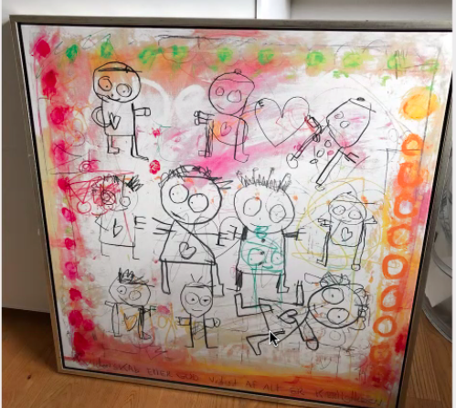
Plot and timing

Slide 8
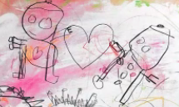
Today We Practice Conversational Storytelling in Plot & Timing

Slide 9
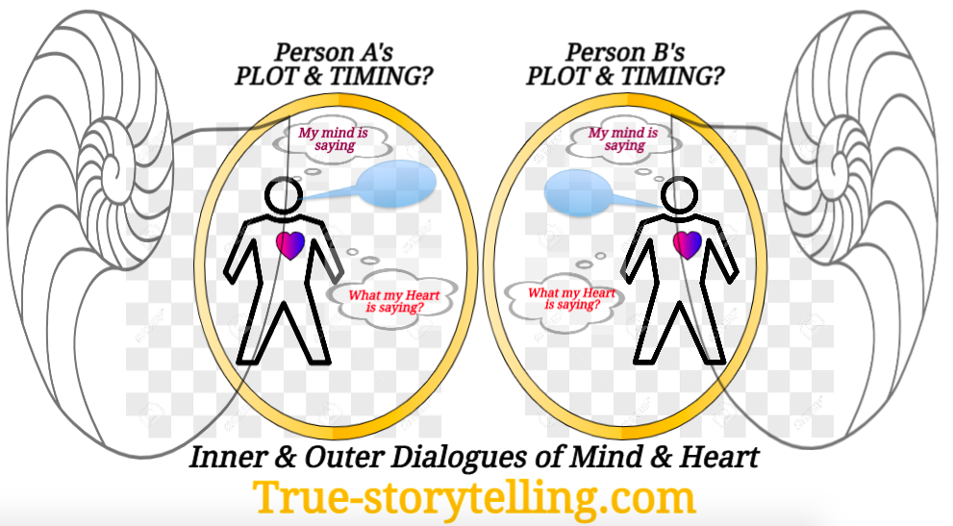

Slide 10
How to Seek Truth in Conversational Storytelling
Self-correcting Conversational Storytelling Interviewing
in the moment;
chaining counterstories and parallel stories,
explorations in a safe space of the give and take, the back and forth

Slide 12
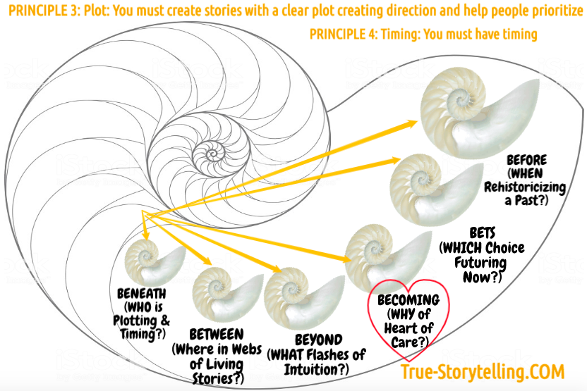
More

Slide 13
BREAKOUT #1: Conversational Storytelling WITHOUT questions! Question: WHEN DID YOU FOLLOW A HUNCH?
Maori Storytelling is a back-and-forth conversational storytelling. It is not interrogation.
Create a safe non-judgmental space for listening.
Use a RECIPROCAL process of your sharing, they share back, you share again, etc.
In this Practice Session, No Questions of any kind.
Limit two minutes per person.
Use CHAINING – your story, links to stories just told
Please Use Deep Story-Listening Skills

Slide 14
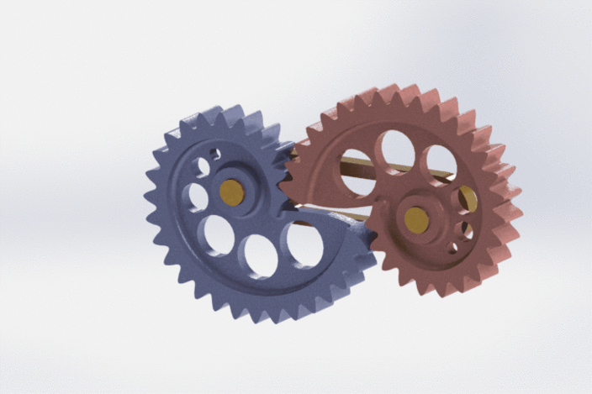
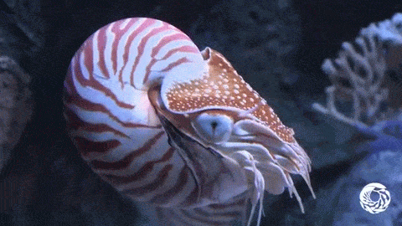
TRUE STORYTELLING is Three Spirals in ONE WHOLE
NARRATIVE-Counternarrative
PASTS
ANTENARRATIVE
FUTURES
LIVING STORY
WEBS
PRESENTS

Slide 17
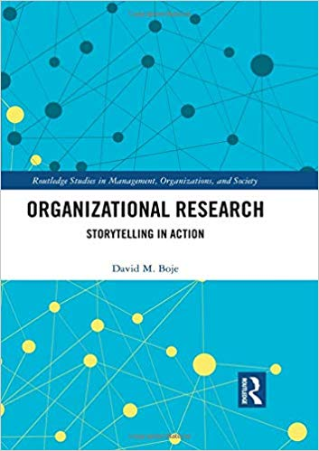
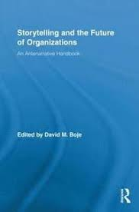
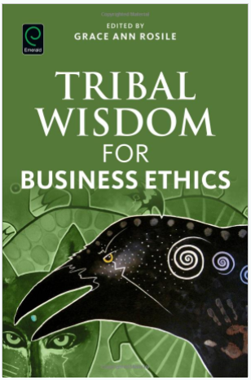
Antenarrative Books:
2019
2016
2011
2001

Slide 18
Narrative & Counternarrative – Gear Spirals

Slide 19
Living Story Web – Sunflower Spiral

Slide 20
Antenarrative - Nautilus Spiral

Slide 21
Lynn Moorer, an attorney, struck by a customer after she asked - where their face mask was
Man said, ‘show me the law,’”
Moorer said. “Well - OK, I’ll show you just hang on a minute and I’ll show you the governor’s order,' which — because I’m an attorney — I carry that around in my purse with me, recognizing that a number of people, you know, who are confused about the mask requirement might not realize it.”
Moorer said as she pulled out the order, the man "smacked" her across the face and called her a b**ch.
Moorer → “got a pretty good bruise” on the side of her face and she’s had headaches MORE

Slide 22
What is STORYTELLING SCIENCE?
Abduction: a hunch or intuitive guess.
Example: I wear a mask mostly because I went to Catholic schools and I always follow the rules, so my automatic inclination is to wear the mask. Use Intuitive hunch, and let the story emerge.
Induction: Conclusion from observation.
Example: I know someone who got covid and they did/did not wear a mask, therefore I do/do not wear a mask. Check it out with a story of your own, by confirming or giving a gentle counterstory
Deduction: Generating a theory.
Example: If medical doctors recommend the mask, they must be good. Alternatively, my theory might be that I never trust the medical establishment so I have a theory the mask will not protect me from covid. My friends have similar stories, so I draw my theory from several conversations.
Notes:
Charles Sanders Peirce 4 Tests of Self- Correcting Induction:
Test One: Try to dismiss the precepts by Your Own Reflection
Test Two: Ask other people if they see and hear the same thing
Test Three: Use your knowledge of laws of nature
Test Four: Do experiments to see if the precept is illusory. Charles Sanders Peirce (Vol. 2.142)

Slide 23
Skills to learn in Conversational Storytelling
in the moment;
chaining counterstories and parallel stories,
explorations in a safe space of the give and take, the back and forth

Slide 24
Second Breakout – Using Self-Correcting Method on Conversational Storytelling
TOTAL time: 20 minutes 1. Pick person to answer this question: Tell Story of when you Intervened
2. No Questions are to be asked at any time in the breakout. 3. Conversationally, each tells their story by CHAINING to the previous story. Choose whether your story will CONFIRM a prior story, or gently offer a COUNTER story to the prior story or stories.
LIMITS: 2 min per person and ONLY ONE story.

Slide 25
Homework – do a storyboard of plot & timing

Slide 26
MORE
Notes:
WHO: they are protagonists that are indigenous with sacred space. WHAT - boundaries are in confusion between city state, county and federal governing of public land WHERE in nature of aliveness of ecosystem BELONGING we are the water HOW plan is to have Friday Zoom sessions to emerge ground up diversity of community to have goals of stewardship PROMOTE looking in to my vulnerabilities and out into how to bring together community WITH heart-of-care, EMBARK on the journey

Slide 27
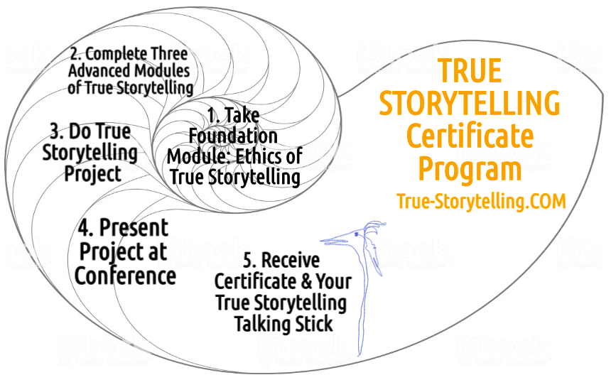
Become a True Storyteller
“Its’ not about living a good life, but a true life
[an ethical life]” – Kierkegaard
Hosts:
Jens Larsen oldfriendsindustries@gmail.com ,
David M. Boje davidboje@gmail.com ,
Grace Ann Rosile garosile@nmsu.edu ,
Lena Bruun lenabruunjensen@gmail.com
True-storytelling.com Truestorytelling.blog

Slide 28
Thank you More information on True Storytelling
https://true-storytelling.com
https://truestorytelling.blog
Homework
Do a Storyboard (can use photos, or draw, or us icons)
Write in Notebook 2 experiences of Priniple 3 (plot in Living Story Web way) and 2 experiences of Principle 4 (Timing that is opportune moment)
One example of using self-correcting (by telling parallel story, or counterstory in conversation with another person
Next Week, bring material objects that communicate a ethical Story you are trying to unfold in you life

