Slide 2
NOTES Some Examples of Results
Start with Anne-Marie & Mikael, …

Slide 3
NOTES Checking in from Last Session
Where am I now and where do I need to go?
Why am I here?
How you practiced:
Principle 1: You yourself must be true and prepare the energy and effort for a sustainable future?
Principle 2: Make Room for the stories already there

Slide 4
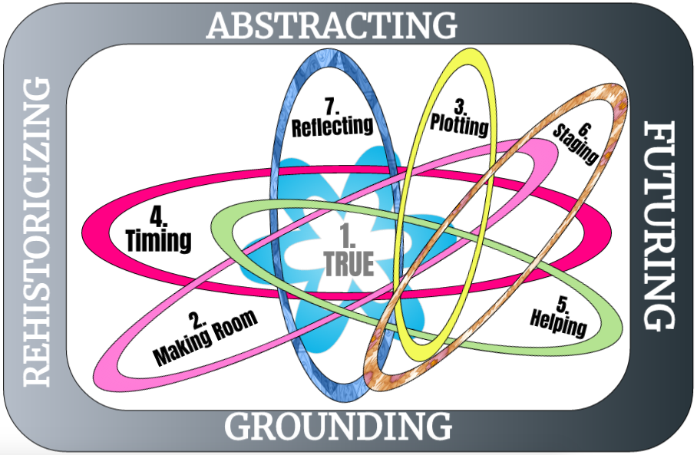

Slide 5
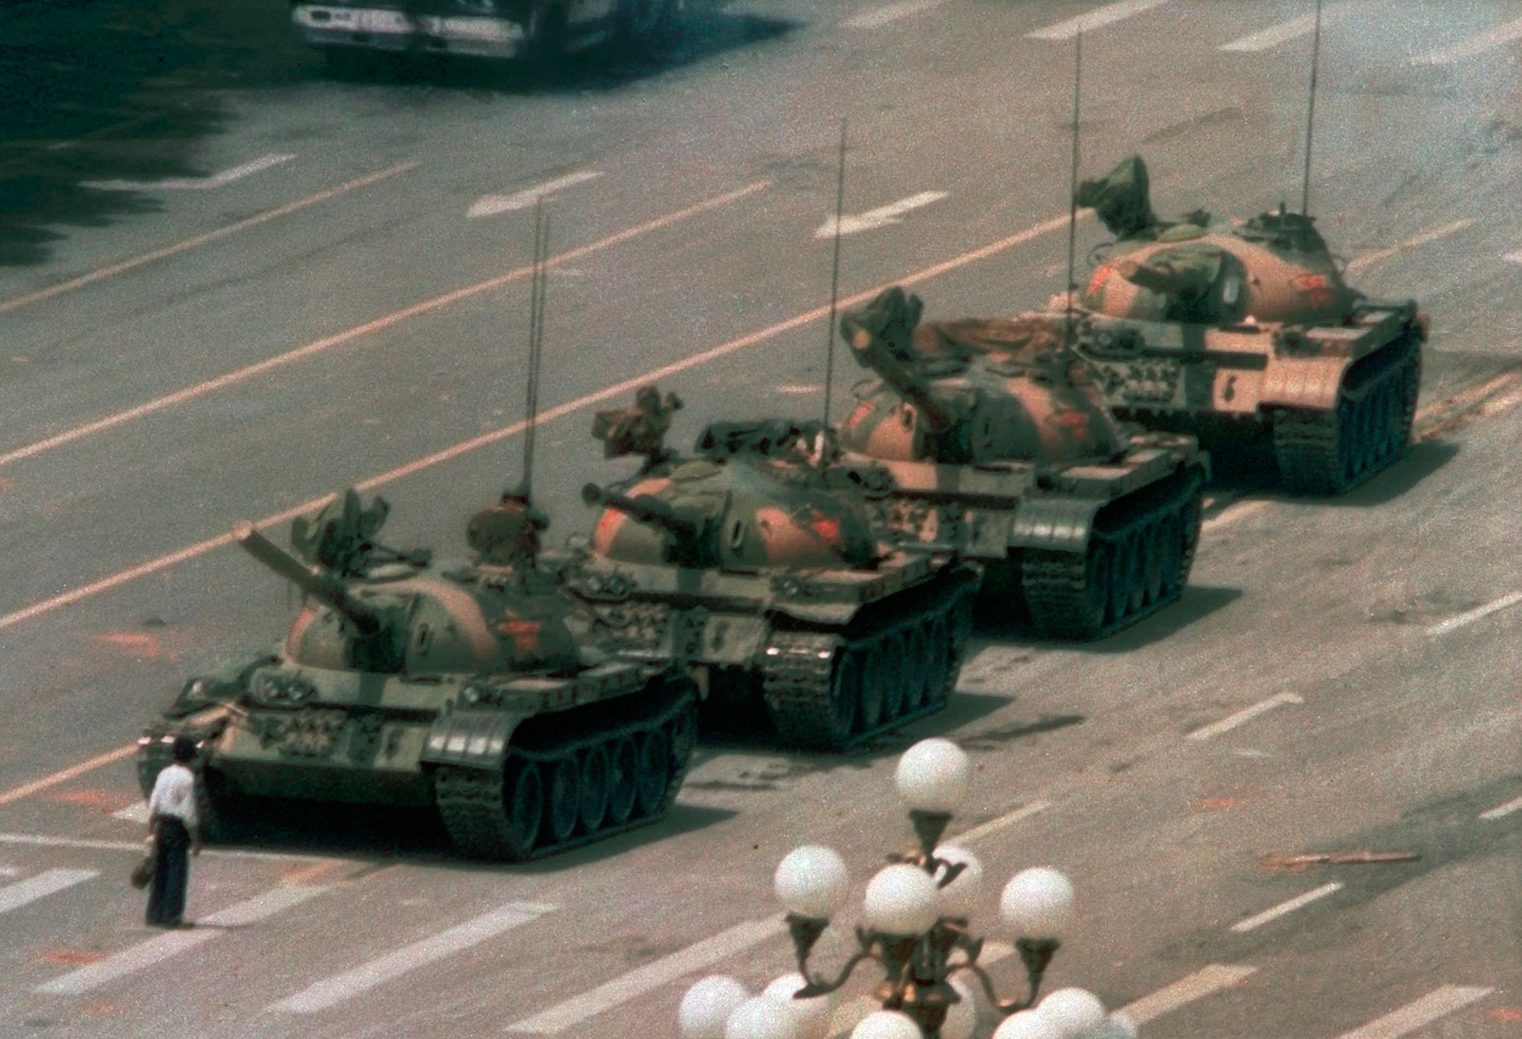
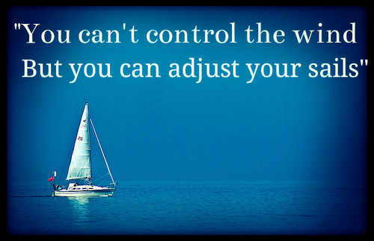

Slide 6
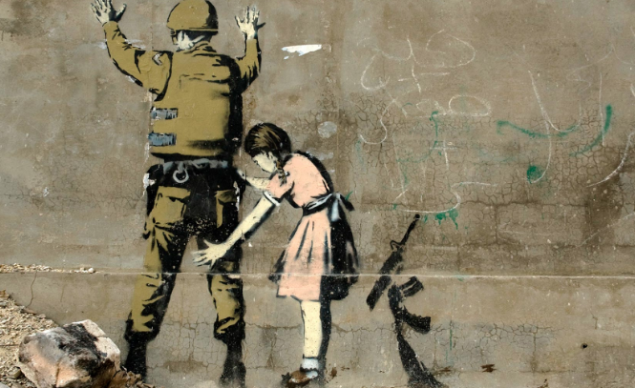
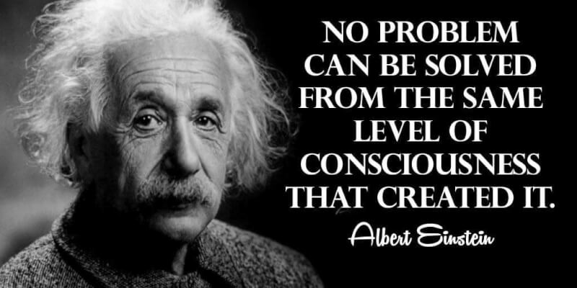
Principle 3: You must create stories with a clear plot creating direction and help people prioritize
We are ready to plan new future that is a PATTERN BREAKER from Past
We want a good plot that is TRUE STORYTELLING
It has Beginning, Middle & End to be Clear Direction
It tells WHY we are doing this
Best Plots have a TWIST, what Roland Barthes calls “PUNCTUM”
Notes:
In change people grasp for a narrative plot with clear why. A Punctum helps this.
Lars Bo H. presentation in Aalborg May 19 2018 spoke of the WHY in plot.

Slide 7
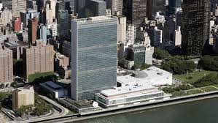
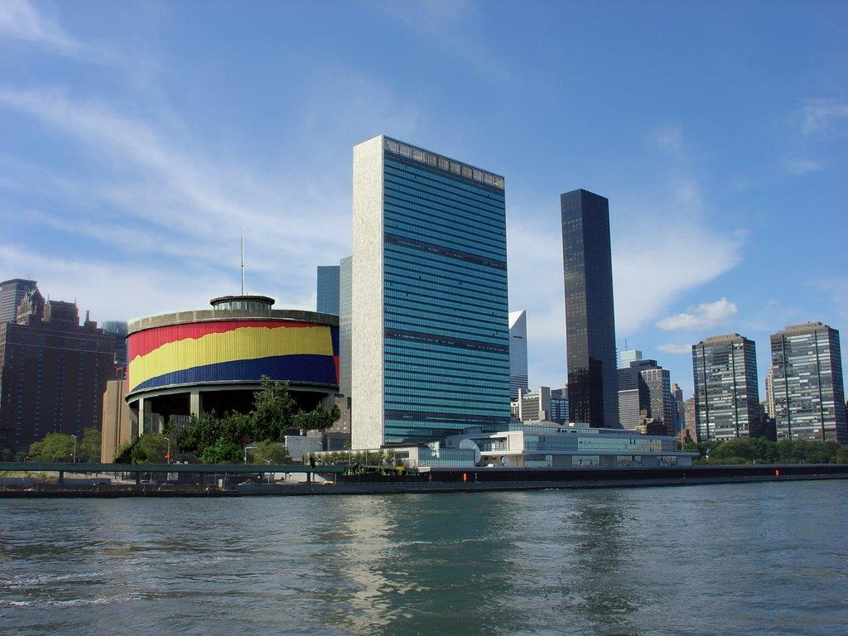
Principle 3: You must create stories with a clear plot creating direction and help people prioritize
STUDIUM of PLOT is its historical, social, cultural, political, or economic historical FRAME & CONTEXT
PUNCTUM of PLOT is co-presence of a TRUTH layer of meaning that jumps out at the viewer
Soro Municipality adds its PUNCTUM
The UN Building in historical context

Slide 8
Principle 3: Creating Clear Plot Direction
Pick 2 Material Objects to represent your Plot
Make 1st Object the STUDIUM
Make 2nd Object the PUNCTUM
Notes:
Studium is the first material object expressing your emplotment
Punctum is the second object “that accident within a photograph—that accident which pricks, bruises you.”

Slide 9
Notes:
Adapted from Bill Sharpe’s (2013) Three Horizons book

Slide 10
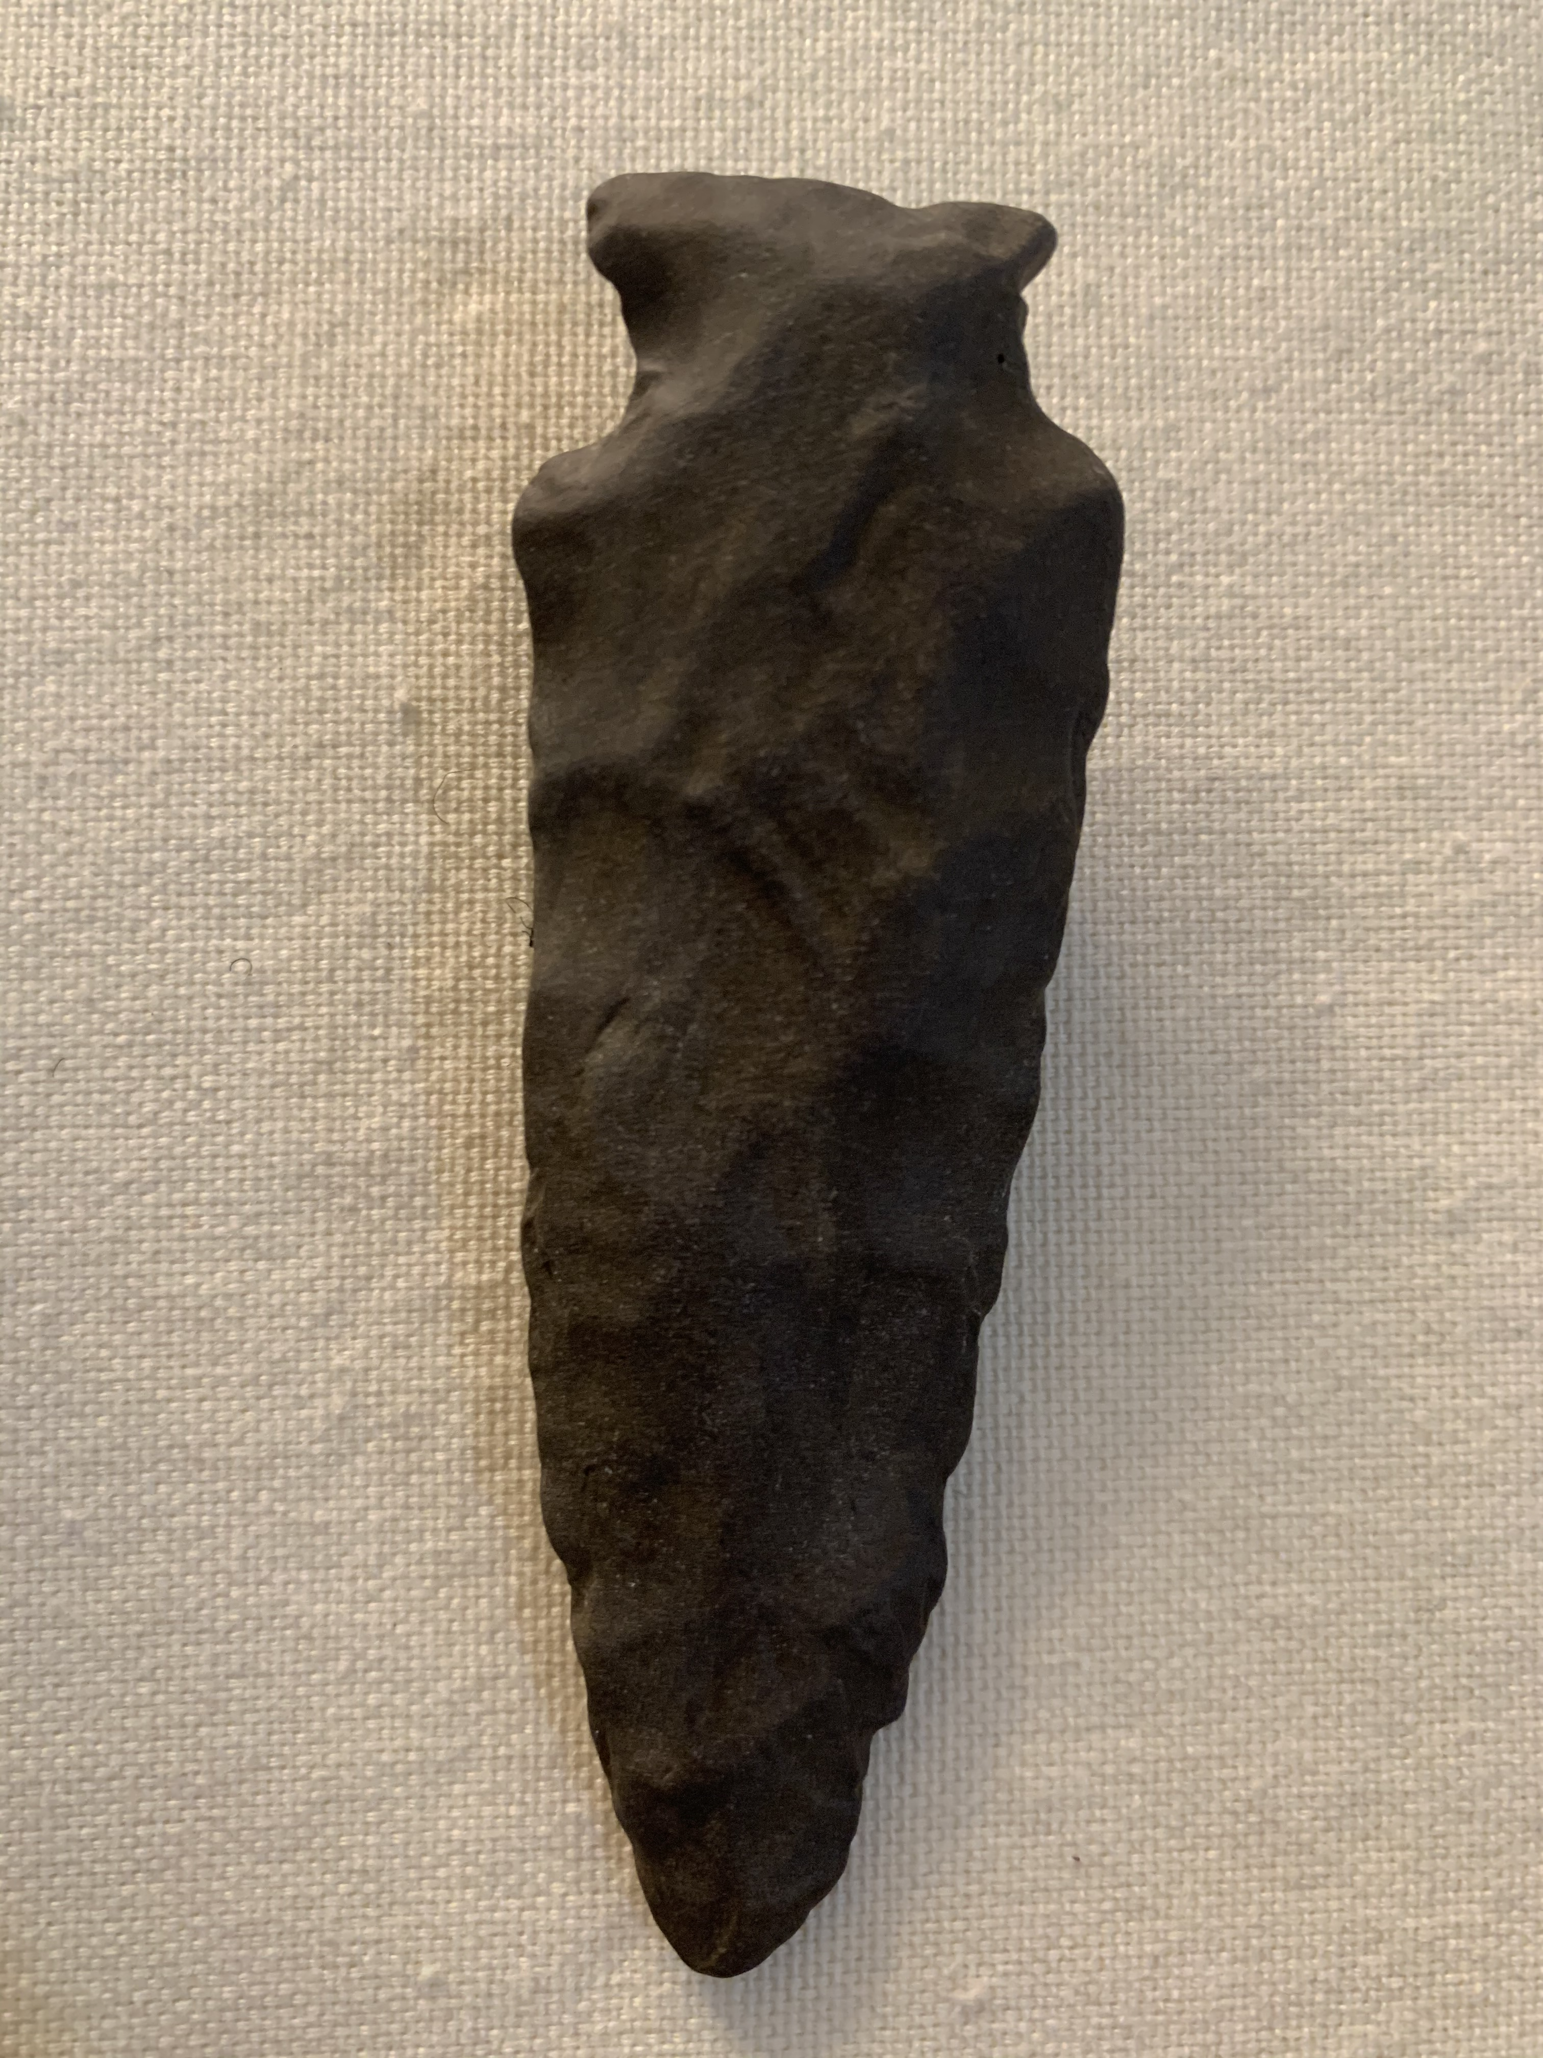
True Storytelling Principle 4 You must have timing.
Place & time when conditions are right for the accomplishment of a crucial ’intelligent’ action (serendipity, aka Kairos)
NOT the Beginning Middle type of Narrative Plot we just did (habit of business as usual, aka Chronos)
Rather it is the fleeting RIGHTNESS of PLACE and TIME, and Material-Circumstance for an Opportune Moment
E.g. David’s Story of Meeting Grace Ann & an opportune moment of action
Notes:
Serendipity comes together in a moment Now → Find the sweet spot in the wave for surfing
Preparing for the opportunity is the other aspect of Principle 4
In same room there are a lot of different times, iPhone in an old building, the timing complex
Org quantum theory – a noticing and finetuning of the subtlities ad weak linkages that clue you with right story with right person at right time

Slide 11
Back to Blissful Ignorance
Descend into Unpleasant, but truth reality

Slide 12
Breakout exercise in True Storytelling Principles 3 and 4
Breakout room - 25 minutes –
Practice Principles 3 & 4: Identifying patterns and exceptions (studium and punctum) and choosing your timing.
Pick your Material Object to represent your Plot
Make your Object the STUDIUM in your storytelling-strategy (plot)
Come up with a PUNCTUM to express a shade of meaning for your storytelling strategy (plot)
Guidelines for Practice using Indigenous style of storytelling conversations:
First person, share story about Material Object,
Next person, Link your own Material Object to one you just heard,
Continue to storytelling conversation until all have shared
If time remains, discuss:
How do the Objects of each participant relate to one another
What is the Timing of Your Strategic Direction (Clear Plot)?

Slide 13
Next session
Homework: Practice Principles 3 (plot) and 4 (timing) in your own organization and report results next week
Session #3 (Principles 5 & 6) Helping Stories Along and Staging: Supporting your plot and designing your setting.
Session #4 (Principle 7) Reflection: Assuring commitment to sustainable change.

Slide 14
Thank you More information on True Storytelling
https://true-storytelling.com
Thank you

