Slide 1
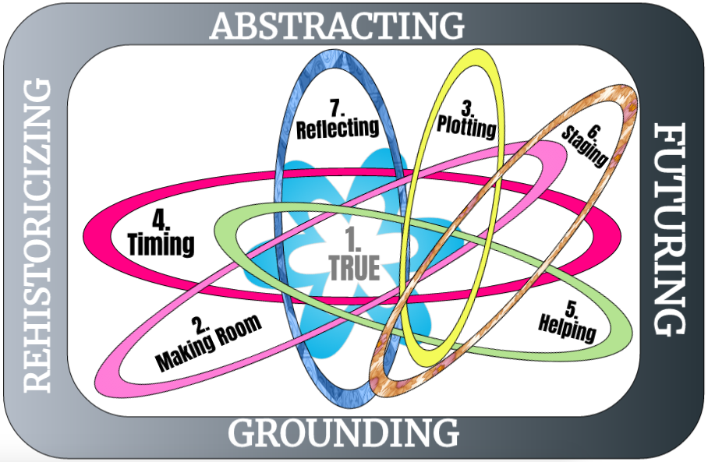
Agenda for 1st Monday Meeting
Welcome by David, 5 minute
Lena, Grace Ann, Jens: We introduce yourself in a few lines
David: What is the intension of the seminars
10 min. Presentation of the participants: 30 seconds Name, home and passion
15 Minutes - Power point:
We demonstrate the first principles exercise (Jim’s challenge, and volunteer)
Breakout room - 25 minutes - Ideas to process in indigenous style of storytelling conversations:
10 Minutes- All together: Sharing a story from each group
15 Minutes Wrap up - see you next week

Slide 2
Introduction (your name, location & your passion) to TRUE STORYTELLING: Connect Your #1 Challenge to the 7 Principles
Hosts:
Jens Larsen oldfriendsindustries@gmail.com ,
David M. Boje davidboje@gmail.com ,
Grace Ann Rosile garosile@nmsu.edu ,
Lena Bruun lenabruunjensen@gmail.com
True-storytelling.com

Slide 3
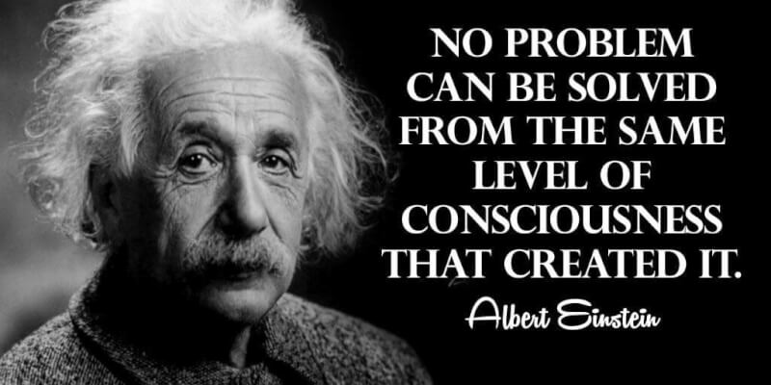

Slide 4
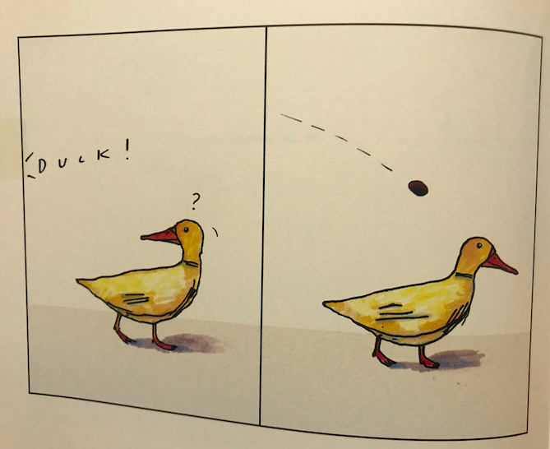

Slide 5
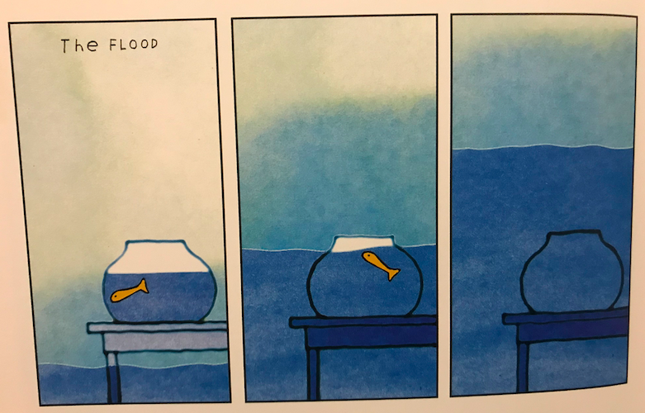

Slide 6
What participants can expect:
Identify the four directions of storytelling strategy and change
Explore indigenous practices of storytelling for ethics and environment
Practice greater wholeness through ensemble leadership
Network with other leaders in a safe place for development
Realize the 'living story' of your ideal leadership life
Create commitment to sustainable changes.
True-storytelling.com

Slide 7
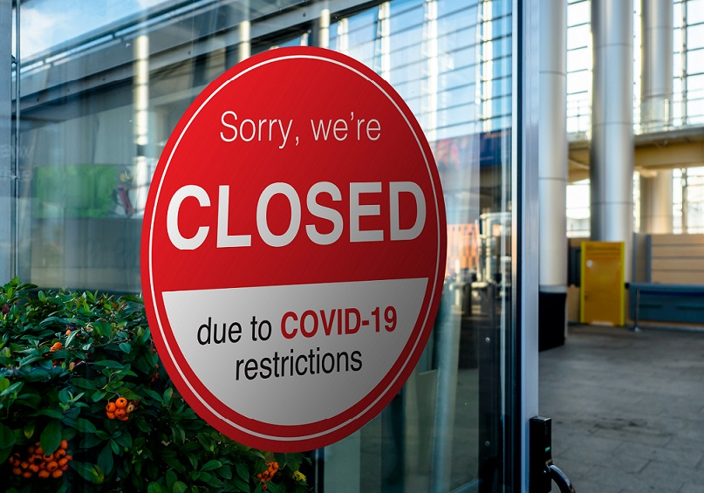
What is the challenge of the New Normal?
70 % strategy implementation fails
Mckinsey Quarterly(2008):Creating Organizational Transformattion.
McKinsey Global Survey Results (2010): What Succesful Transformations Share.
Financial crisis
Climate changes
Stress and burnout

Slide 8
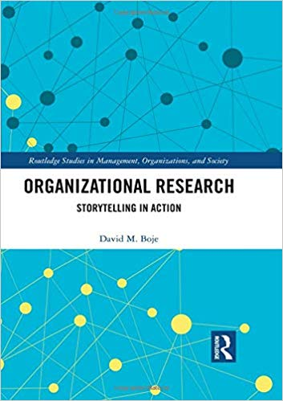
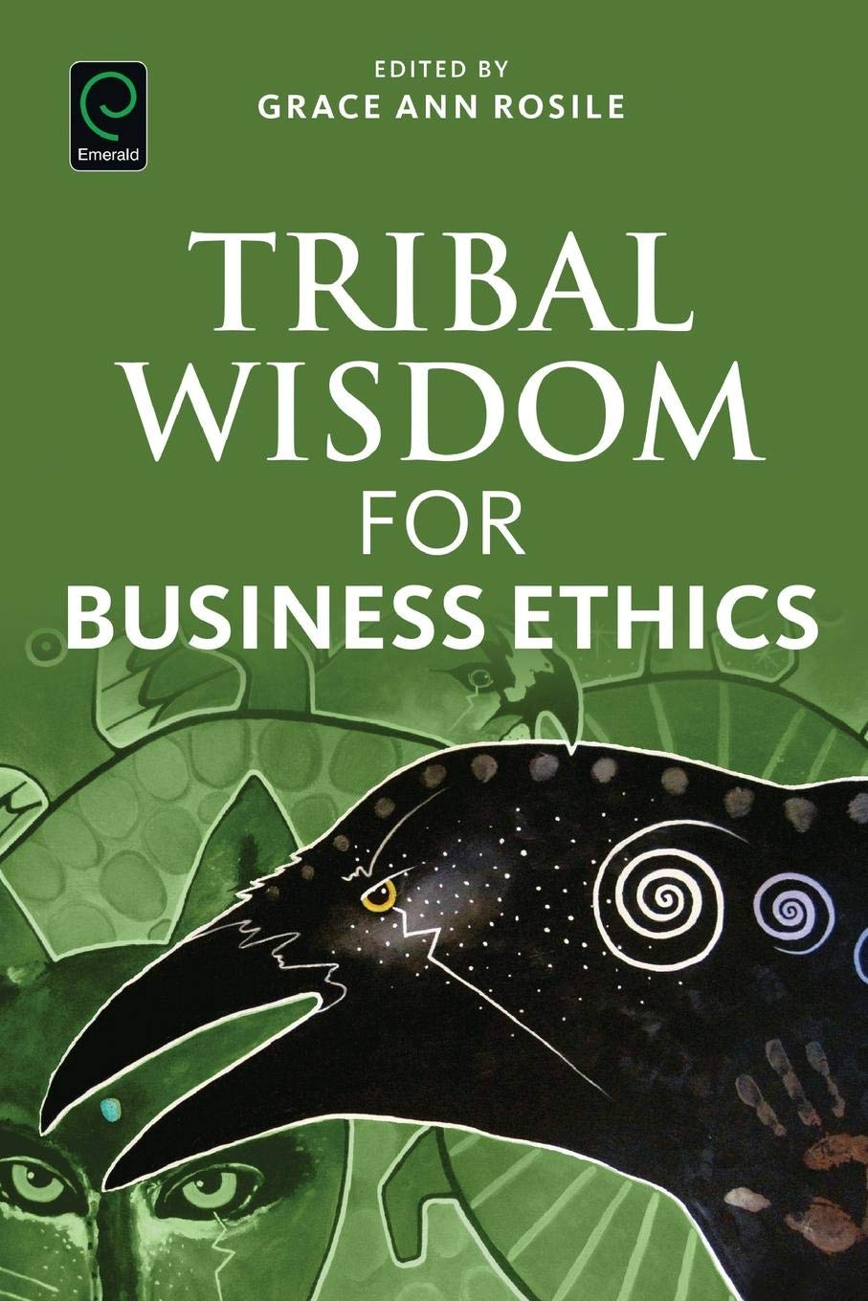
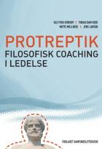
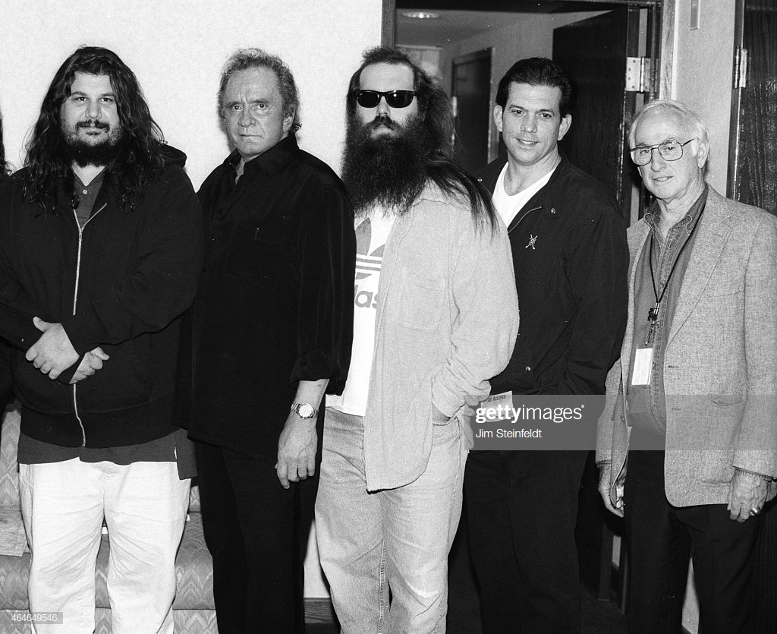
True Storytelling Alternative theory to navigate in the New Normal
It is an ethical answerability to community and ecology
Storytelling, arts, philosophy
It is quantum notion of we are all interconnected.
Everything is vibrant energy
Organization
Research
Indigenous
Storytelling
Niels Bohr, Quantum Physic
Rick Rubin & Johnny Cash
Arts
Ethics/Leadership

Slide 9
True Storytelling – 7 Principles and a mindset to work with sustainable changes management

Slide 10
1st True Storytelling Principle: You yourself must be true and prepare the energy and effort for a sustainable future.
4 Questions:
Did you check it out?
Do you believe in it?
Can you sustain (get energized & not burn out) in long future?
Sustainable in environment
Sustainable in well-being
Sustainable in economy…
Notes:
Example: Living Stories with a Place, A Time, and a Truth of lived experience
Happening Here and Now
In the middle, unfolding, emerging, happening
Goes from strategic level of power, to what is best for the world in Council of Elrond
Tell LESS is MORE
BE AUTHENTIC - Create an emotional component that resonates with the audience YouTube Peter Guber of Mandalay Group, so they retell it forward owning; See article 4 truths of the storyteller HBR

Slide 11
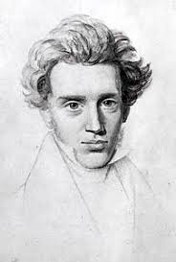
1stPrinciple: Truth You yourself must be true and prepare the energy and effort for a sustainable future. 2 KEY CONCEPTS:
1. “It´s not about living a good life, It is about living a true life.”
What Kierkegaard means with “true” is to live an ethical life
where you have a responsibility for yourself, to your community
and to the Earth.
True Storytelling, (Larsen, Boje, Bruun), Routledge Sept. 2020
2. FORECARING
Danish Philosopher
Søren Kierkegaard
To care “before” means to care for the future,
to create an atmosphere where the right ideas
can emerge.
True Storytelling, (Larsen, Boje, Bruun)
Notes:
Example: Living Stories with a Place, A Time, and a Truth of lived experience
Happening Here and Now
In the middle, unfolding, emerging, happening
Goes from strategic level of power, to what is best for the world in Council of Elrond
Tell LESS is MORE
BE AUTHENTIC - Create an emotional component that resonates with the audience YouTube Peter Guber of Mandalay Group, so they retell it forward owning; See article 4 truths of the storyteller HBR

Slide 12
Principle 2: Make Room True storytelling makes spaces respecting the stories already there
”Surfing (….) take the form of entering into an existing wave. (…) The key thing is how to get taken up in the motion of a big wave, (…), to ‘get into something’ instead of being the origin of an effort.”
Deleuze, G., & Guattari, F. (1994). What is philosophy?. Columbia University Press.
True Storytelling (Larsen, Boje, Bruun) Routledge 2020
Notes:
Diane Dredge suggested Bus Tour with all the stakeholders on board on Tues May 8 2018 at Aalborg, at conference held there on storytelling
How to tell a motivating & inspiring story? MOST ENGAGING STORY WAITING TO BE TOLD IS YOURS! I was so shocked, surprised, stupid, suspicious (HOW DID YOU FEEL?)
What is ENGAGING & EMOTIVE-language? – when audience is ENERGIZED (look to body language) – START WITH CONTEXT (PAINT THE VIVID SCENE) e.g. in my driving through woods, icy roads, snowing, on mountain road ADD DIALOGUE
A PROBLEM, an OBSTACLE to OVERCOME: E.g. When I was first person in family ever to go to college? SET UP FOR THE TIMING POINT (THE ARC is SET) THEN SURPRISING TURNING POINT seeYouTube: Jim Carey
A proud moment when MORAL OF STORY →YOU inspired others? THE RESOLUTION E.g. When Bo Kimble died, the team used my motto to move forward

Slide 13
Some ground rules
Ethics of who owns the story
Agreements on who can tell a story

Slide 14
First breakout exercise in True Storytelling Principle 1 and 2
Breakout room - 25 minutes –
Practice Principles 1 & 2
Principle 1: You yourself must be true and prepare the energy and effort for a sustainable future?
Principle 2: Make Room for the stories already there
Guidelines for Practice using Indigenous style of storytelling conversations:
First person, share story about your leadership challenge now,
Next person, Link your own challenge story to one you just heard,
Continue to storytelling conversation until all have shared
If time remains, discuss:
What could be a true story in the New Normal
Which stories or waves are already there that would support your true story?

Slide 15
Next session
Homework: Practice Principles 1 and 2 in your own organization and report results next week
Session #2 (Principles 3 & 4) Plotting and Timing: Identifying patterns and exceptions (studium and punctum) and choosing your timing.
Session #3 (Principles 5 & 6) Helping Stories Along and Staging: Supporting your plot and designing your setting.
Session #4 (Principle 7) Reflection: Assuring commitment to sustainable change.

Slide 16
Thank you More information on True Storytelling
https://true-storytelling.com
Thank you

