Slide 1
Agenda for Ensemble Facilitators
Jens will host the meeting - say welcome etc. and then we can share.
1. Welcome - People are checking in at David’s zoom.
2. 10 minutes- Check in - 1 minute. Where are you now and where do you want to be after the seminar
3. Introducing principle 5 and 6 - Jens hosting with you.
4. 10 minutes -David – unfold Eric’s story – helping stories along and the clam shell model
5. 20 minutes - Breakout rooms with questions – end 9:10
6. 10 Minutes - All together - Sharing a few stories. The facilitators can ask in the group if somebody want to share a story
7. Short wrap up and homework

Slide 2
Principles 5 and 6 Helping Story Along and the Staging of the Launch of your New Leadership Story
Jens Larsen, Lena Bruun, Grace Ann Rosile and David Boje
https://true-storytelling.com
And our new site for you
https://truestorytelling.blog

Slide 3
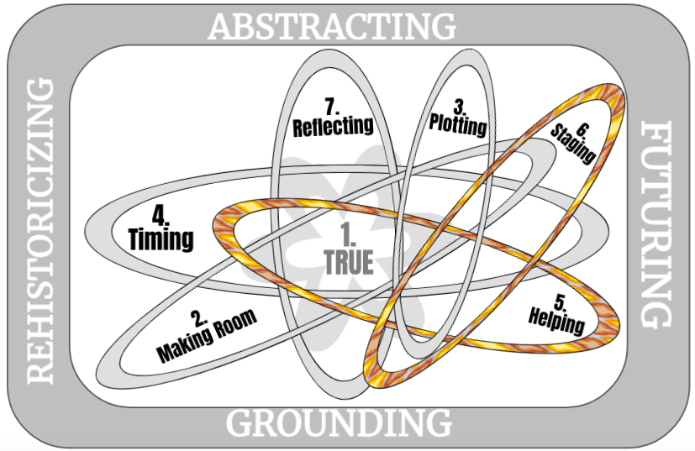
You yourself must be true and prepare the energy and effort for a sustainable future
Make room: True storytelling makes spaces respecting the stories already there
Plot: You must create stories with a clear plot creating direction and help people prioritize
Timing: You must have timing
Help stories along: You must be able to help stories on their way and be open to experiment
Staging: You must consider staging including scenography and artifacts
Reflection: You must reflect on the stories and how they create value

Slide 5
Principles 5 & 6 are the Climax of our Seminar
There are different kinds of STORY ARCS – the U and Π
We can give the example of how this seminar moves from SOLO LEADERSHIP to ENSEMBLE LEADERSHIP in its 4 sessions
Principles 5 (Helping Story Along) is an uncovering of your leadership, while Principle 6 (Staging) takes that ‘new story’ and brings it onto stage for some audience in very deliberate signposts (artifacts), which we will illustrate.
Part of the process of Helping Story is a method called ‘self-correcting induction’

Slide 6
Principle 5: Help stories along: You must be able to help stories on their way and be open to experiment
How do we Help the Story of our Leadership Challenge along?
It is by doing self-correction, so we move from Being-in-Untruth of our potential, and into the Being-True.
Today you are to develop a new story and uncovering of Helping Story Along for you.
Notes:
As Walter Benjamin puts it:
“From this story It may be seen what the nature of true-storytelling is” (p. 90).

Slide 7
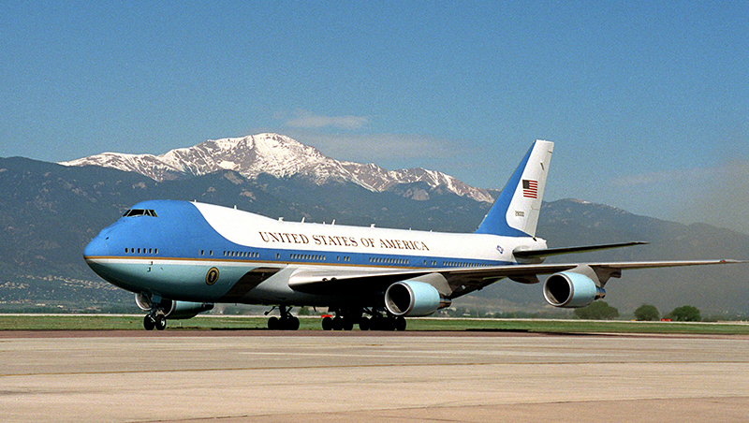
A story about working in Airforce One and Two

Slide 8
Principle 5 Help stories along
You must be able to help stories on their way and be open to experiment

Slide 9
Self-Correcting Conversations
From Boje & Rosile, Doing Conversational Storytelling… book (Edward Elgar Press, in press
Drawing by Mark van der Heit)
Notes:
IWOK ‘together-telling’ from New Zealand, ‘living story webworks’ in indigenous peoples, and ‘conversational storytelling’ of self-correcting during self-organizing as processes

Slide 10
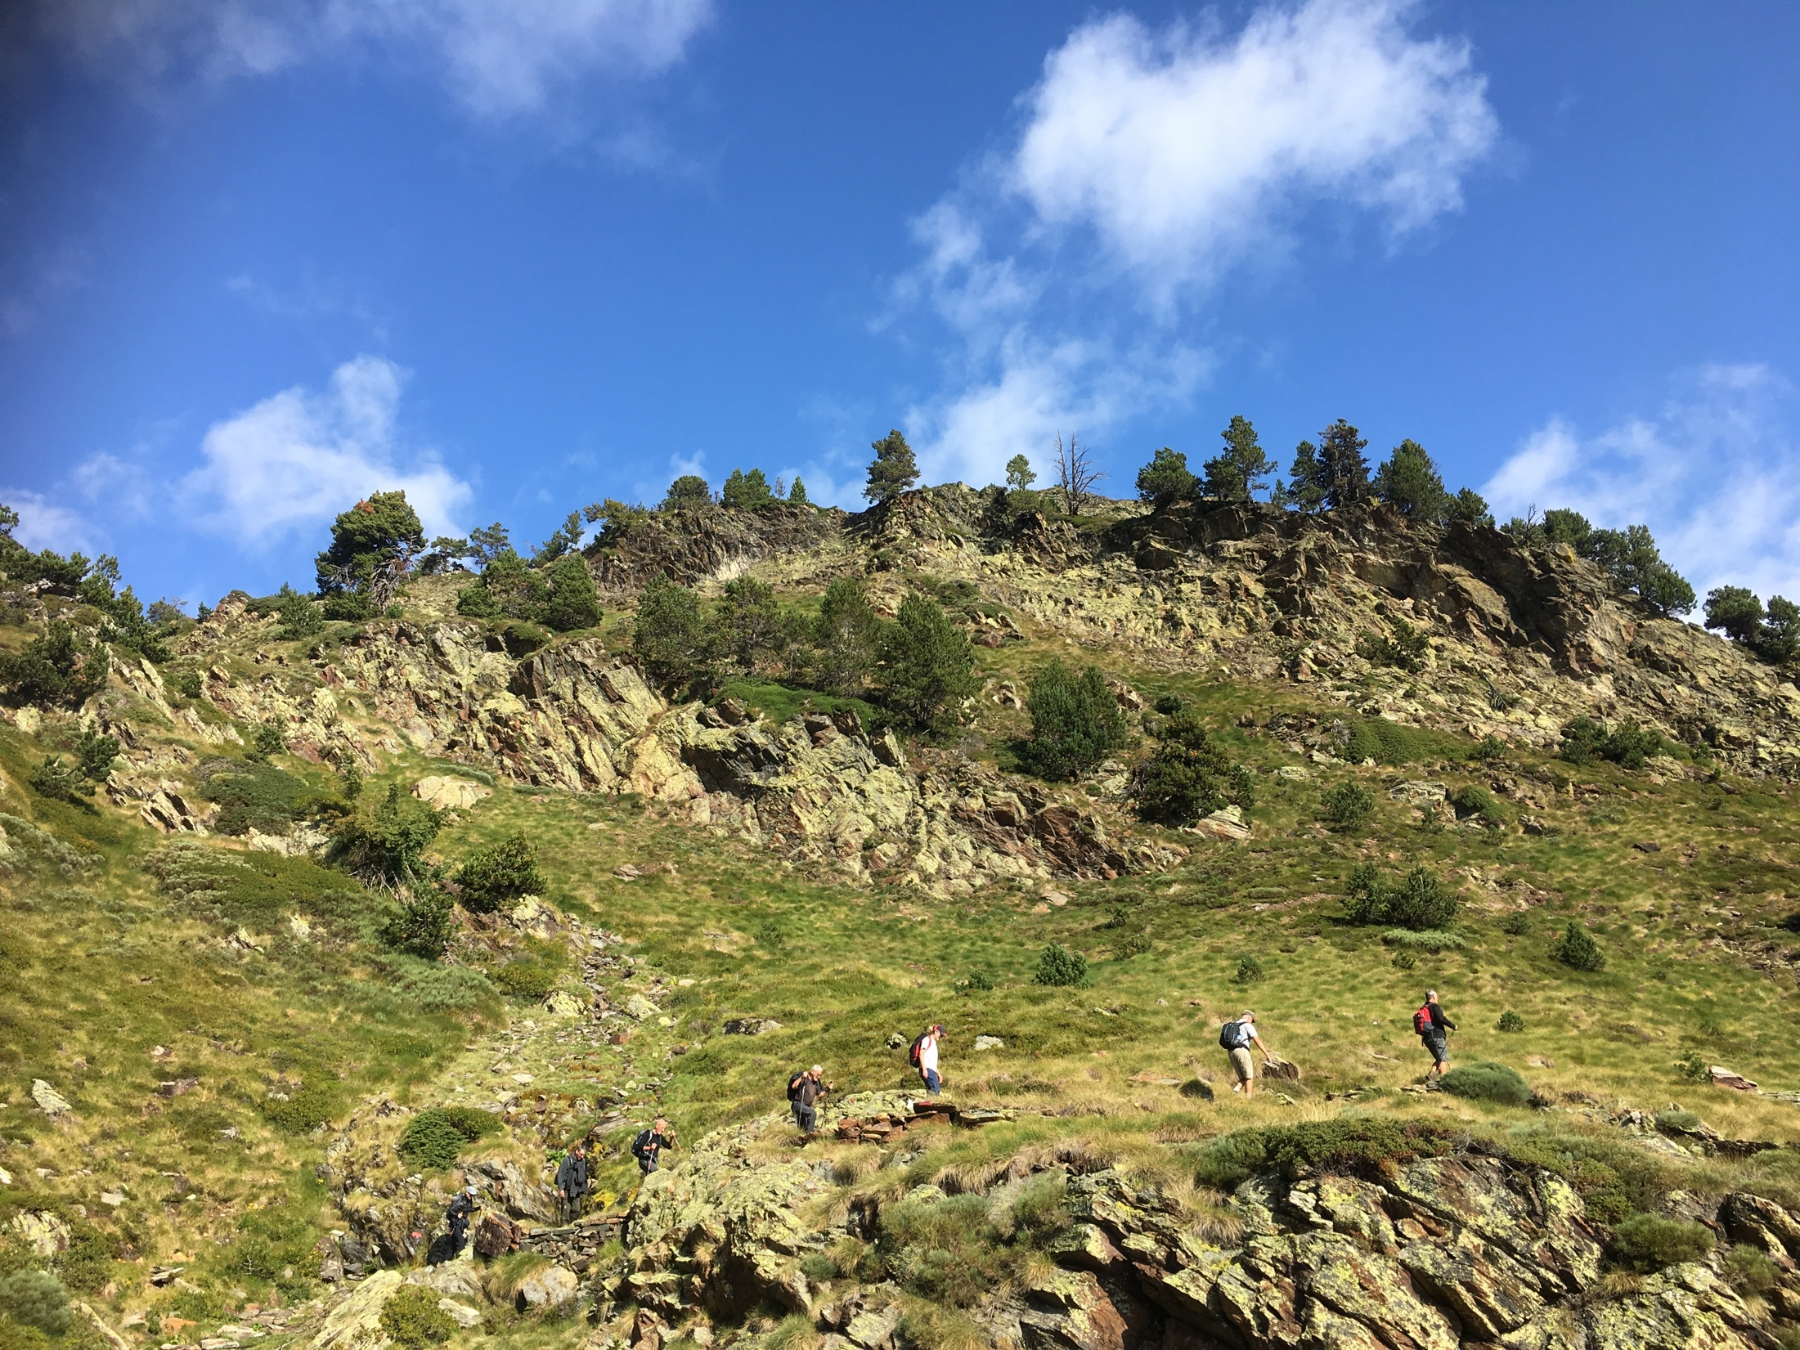
Principle 6: You must consider staging including scenography and artifacts
How are material & social agents part of the staging & artifact of RESTORYING?

Slide 11
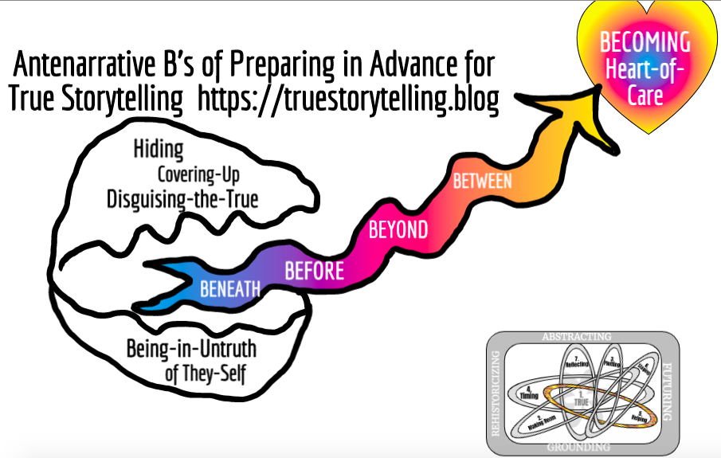
BETS

Slide 12
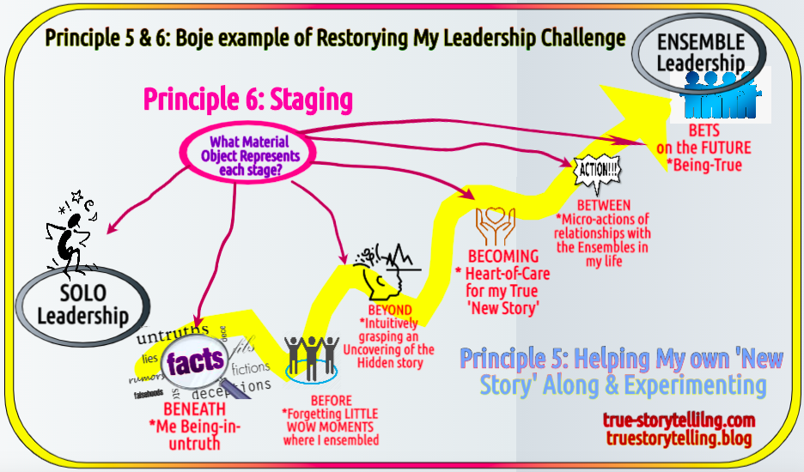

Slide 13
BREAK OUT TASK
Principle 5
How have the past 2 sessions helped your story along?
Principle 6
Share a story about the object you brought.
How can it support the way you stage your challenge and true story?

Slide 14
Homework: Principle 7: Reflection and Value
Reflect upon your journey through this seminar, its 4 sessions, and any and all transformations and changes you are making, as you Help Your Story Along, as you begin Staging the Launch of your ‘New Leadership Story’. Can you storyboard it?
If your new story has anything to do with Ensemble Storytelling, with a new viewpoint with new micro-actions, please make note of that for our final session next week
Visit https://truestorytelling.blog
and Make a Post
Thank You

