Slide 1
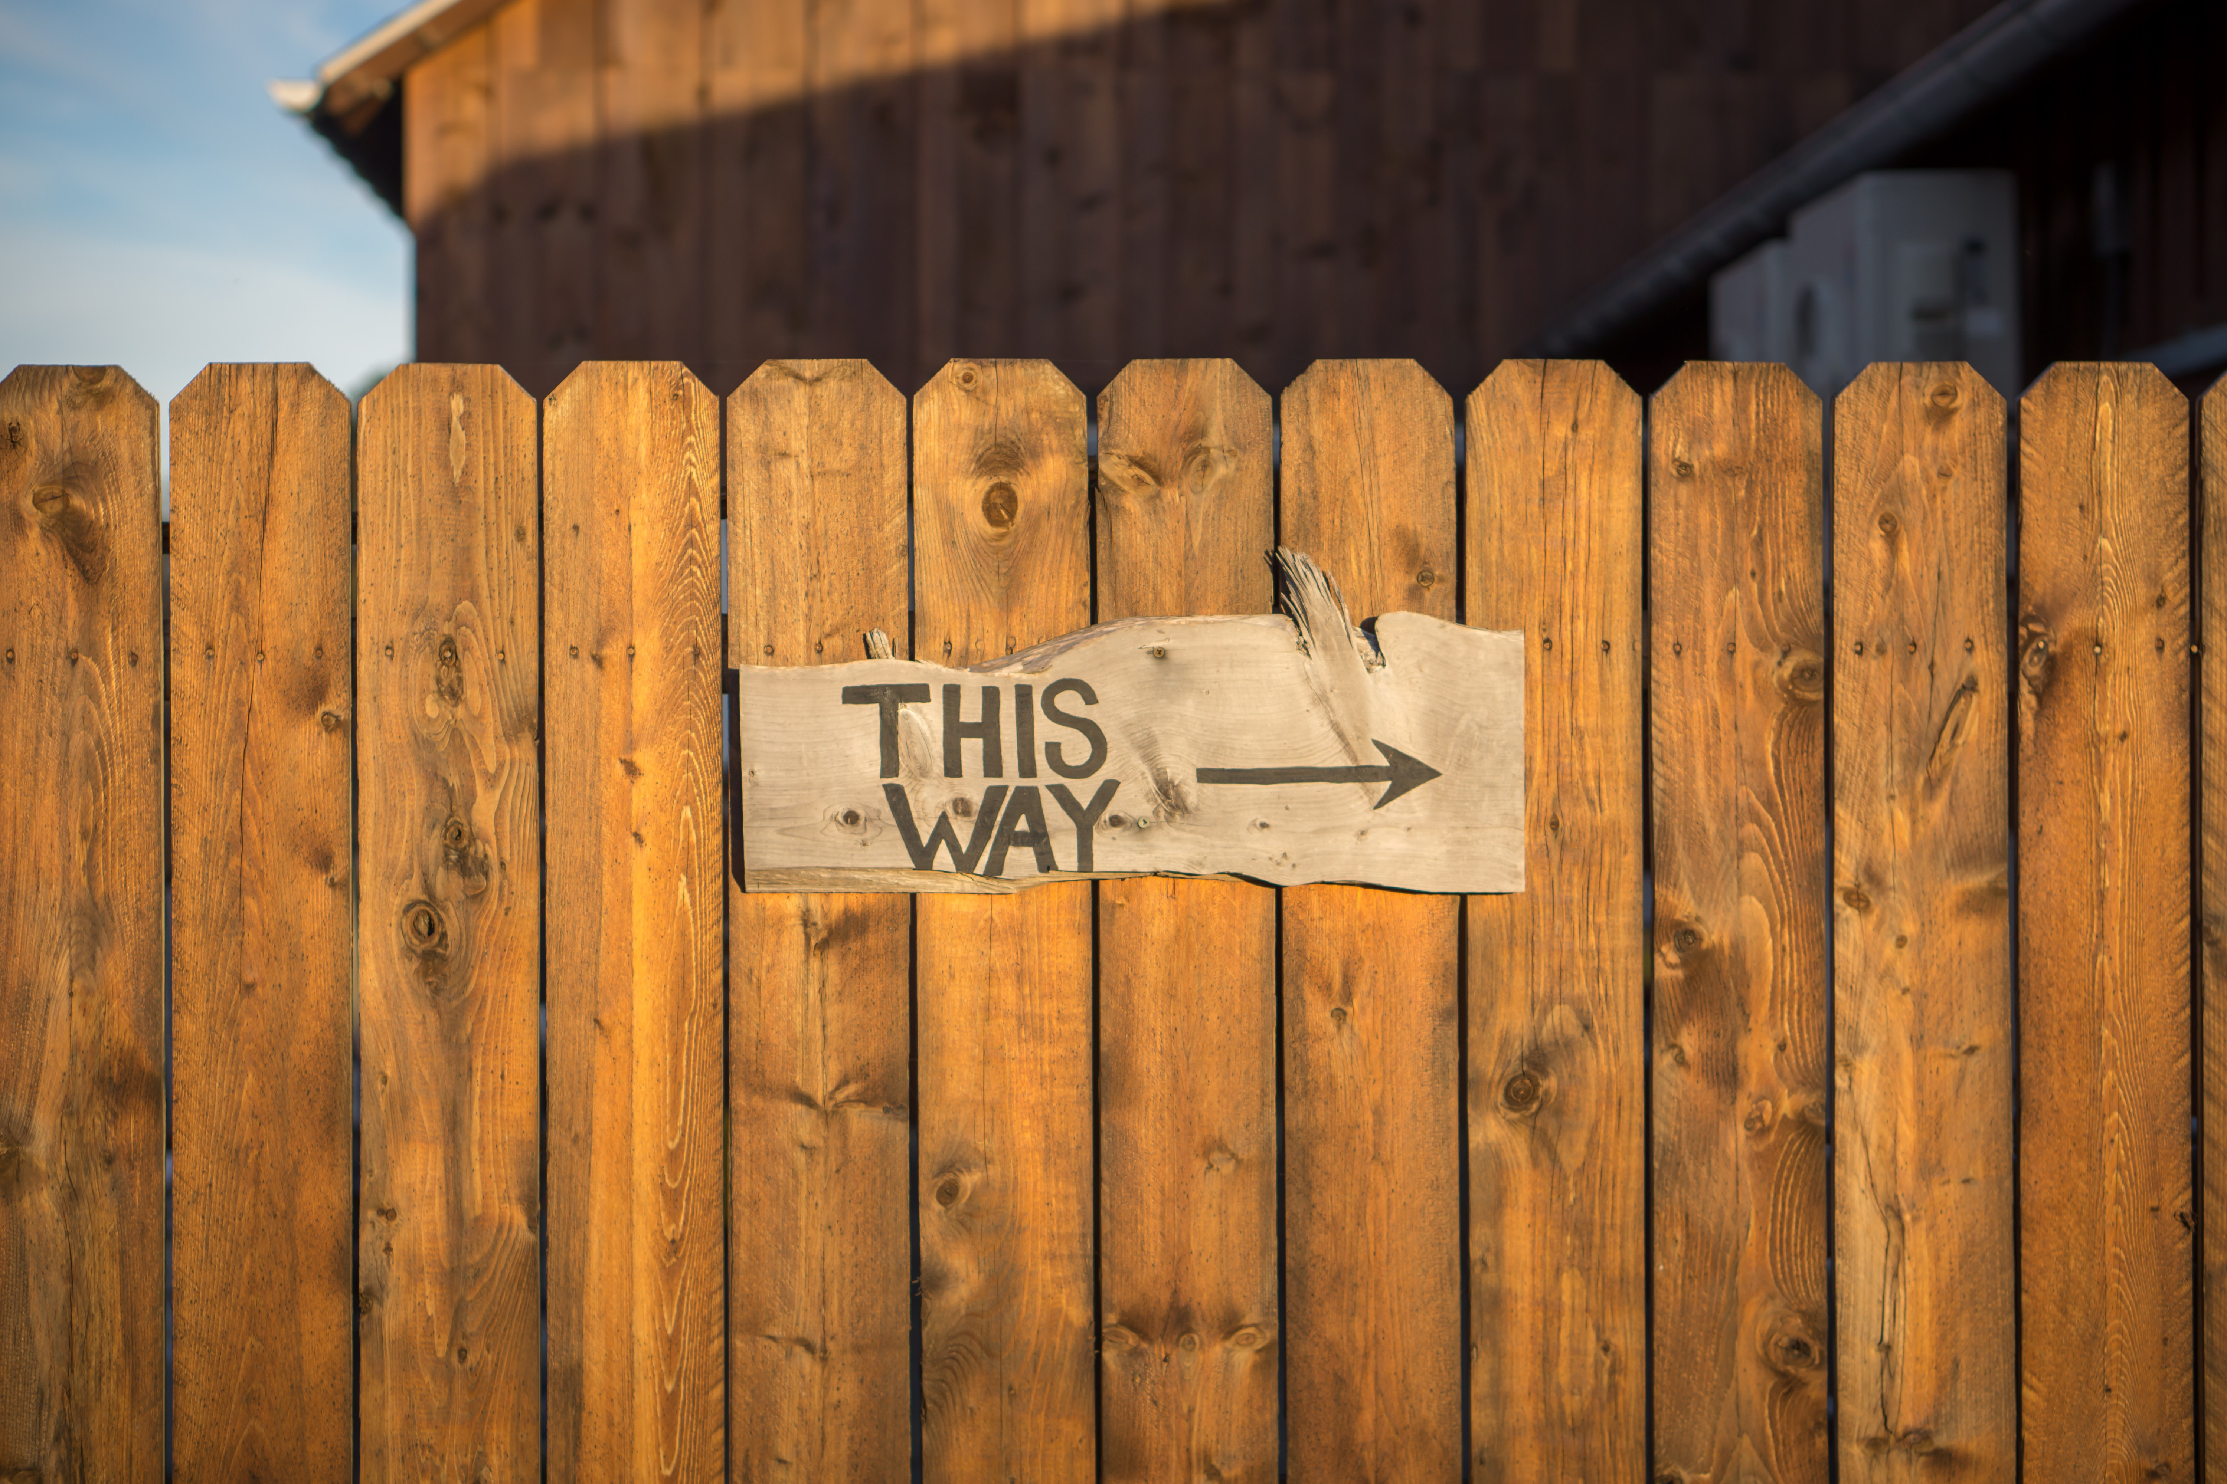
TRAINING PROCESS- structure of session (Grace Ann)
8:45-9:00 Pre-session ”coffee”
9-9:05 Welcome; Check-in; and Agenda for the session
9:05-9:10 Groundrules; word/phrase of homework to be used later
9:10-9:25 Nuts&Bolts GA; chat for feedback
9:25-9:30 Jens: Principle 2 Making Room
9:30-9:45 David: Processes for P2 Before of Deep history, 3 tools
9:45-9:55 Jens: examples and lead in to breakout
9:55-10:10. Breakout—Lena
10:10-10:20 DeBrief
10:20- 10:25 Homework-Lena; transition to next concept
10:25-10:30 Q&A
10:30-10:45 POST-session informal discussion
10:45-? Team de-brief
1
Notes:
1

Slide 2

TRUE STORYTELLING
Train-the-Trainers
Level II
2
TRUE STORYTELLING INSTITUTE ®TSI
Notes:
Just go over this slide
2

Slide 3
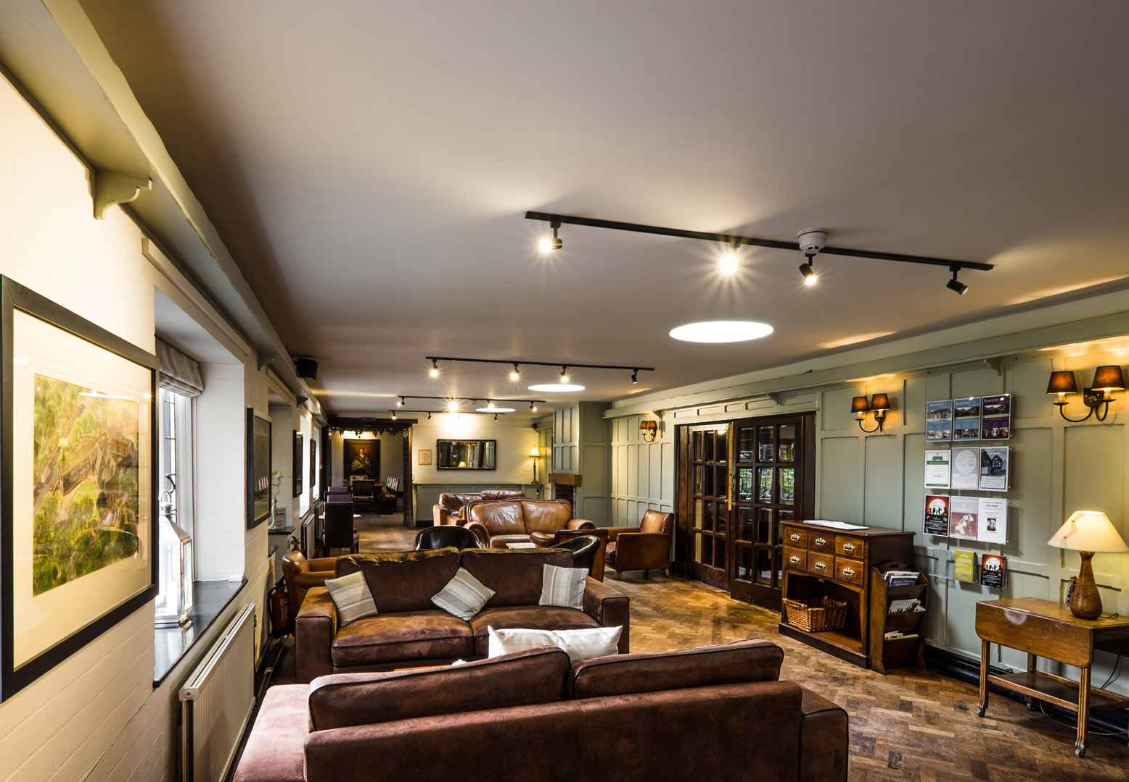
True Storytelling Institute
PRE-SESSION for WEEK #2 “Make Room”
“COFFEE in the LOBBY”
Notes:
3

Slide 4
ROADMAP: Lena
Last Week:
Principle 1 True
This week:
Principle 2 Making Room
and
Nuts and Bolts

Slide 5
SAFE ISLAND Agenda for Today
PART I Check-in of Group Members; Roadmap: Lena
PART II Nuts and Bolts of Training: Grace Ann
PART III Introduce Principle 2 Making Room: Jens
PART IV Processes of Principle 2, 6 eventums, Q&A: David
PART V Breakout, Debrief: Lena
PART VI Homework: Lena
PART VII Post-Discussion, Q&A: Jim -

Slide 6
Ground Rules
Please bring a notebook and pen/pencil to each session.
Use the “Gallery View” so you can see each other while viewing PowerPoint.
Please do not give advice to others or use ‘should’ statements for self or others.
Speak more from the heart than from the head.
Laser in, be concise, and share only one story
instead of several.
CONFIDENTIALITY:
Do not tell someone else’s story. Please DO NOT record any session of the presenters or the participants.
Please use Chat
ONLY when asked to do so. Avoid “side talk.”
Please attend all sessions. If you must miss one, contact us so we can help you to catch up before you return.

Slide 7


Principle 2: Make Room
“True storytelling makes spaces that respect the stories already there”
Personal sustainability
What could support you as a TSI Trainer?
Read Chapter Two – True Storytelling Book

Slide 8

TRAINING NUTS and BOLTS:
LAST WEEK: Pre- and Post-Sessions
-Last week’s post session
-Alternative Introductions
THIS WEEK: Break-out Groups
-Activity: Best and Worst
-Instructions: numbers, turns, timing, question(s)
-Modeling: do’s and don’ts
-Sitting In/Observer roles
-Debriefing: emotions, results, frameworks, applications
-Privacy

Slide 9
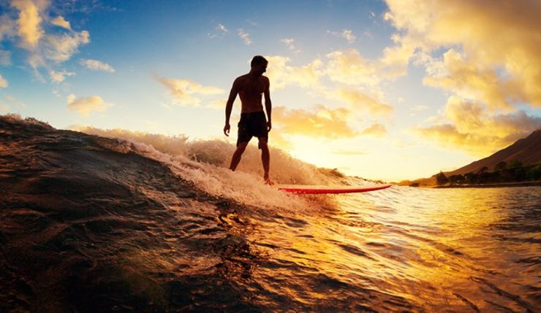
Principle 2 Make room
True storytelling makes spaces
respecting the stories already there

Slide 10
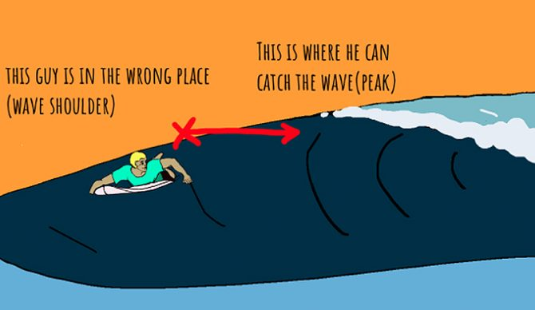

Slide 11
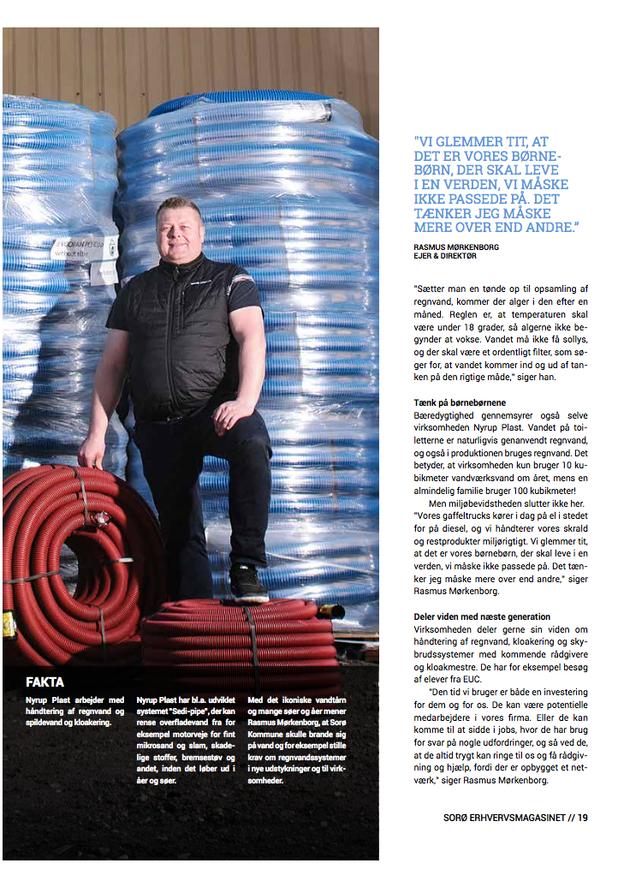

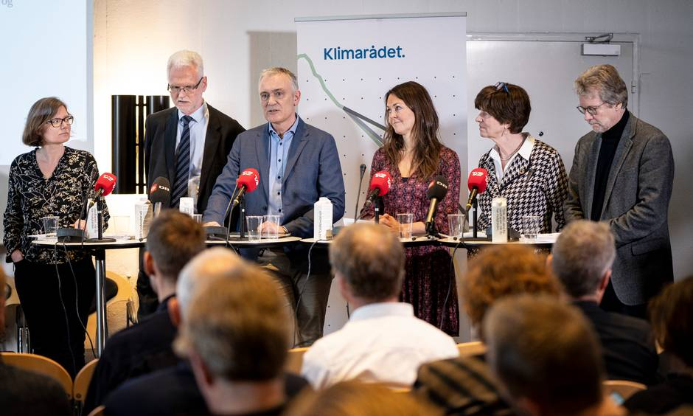
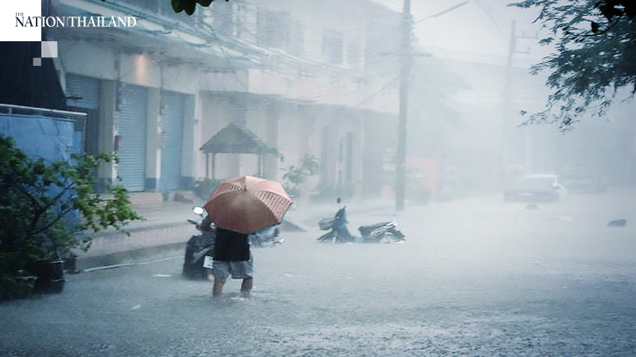
Principle 2 Make room
True storytelling makes spaces
respecting the stories already there

Slide 12
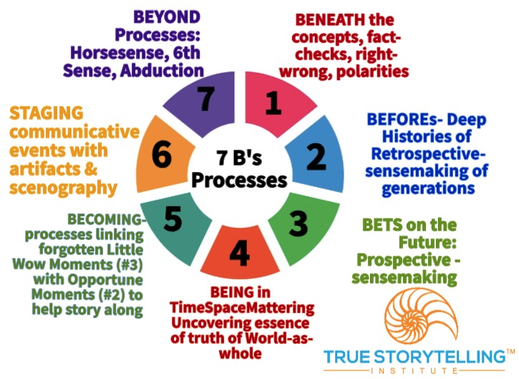
Processes
Guides can use #2 BEFORE
– deep histories
Notes:
Stories & Narratives are composed of pre-conceived SURFACE values, concepts, & motives, so GUIDES go BENEATH to core values…
On the surface is the ‘Domination of the Obvious’
Going BENEATH the words, labels, judgements, and polarities, gets to CORE values & CORE concepts & CORE motives
BENEATH the surface is the changes, movements, the flow, and its what is changeless about the world and universe
Going BENEATH the Narrative-Counternarrative arguing, the polarities, we get to the changes and the changeless
What is the BENEATH?
Stories & Narratives are composed of pre-conceived
SURFACE values, concepts, & motives
→ Guides go BENEATH to core values
On the surface is the ‘Domination of the Obvious’
BENEATH the words, labels, judgements, and polarities is the CORE
→ Guides gets to CORE values & CORE concepts & CORE motives
BENEATH the surface is the changes, movements, the flow, and it’s what is changeless about the world and universe
BENEATH the Narrative-Counternarrative arguing, the polarities
→ Guides get to the changes and the changeless

Slide 13
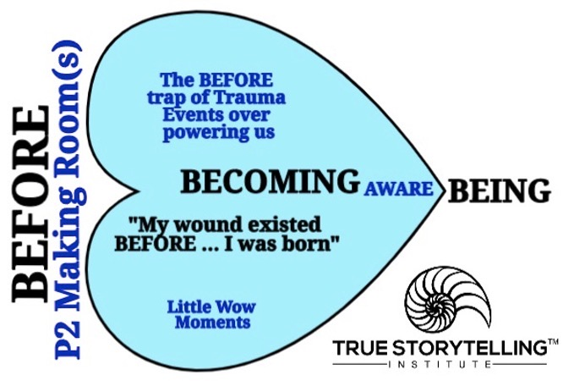

Slide 14
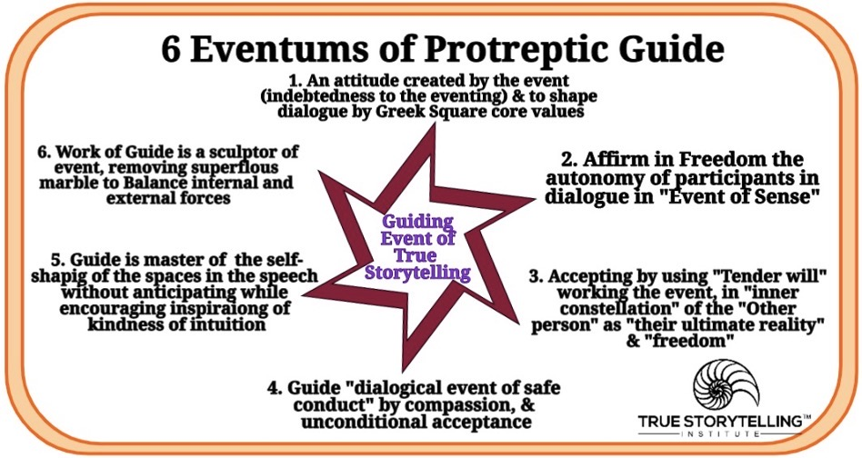
Train the Trainers:
Tool 6, Eventums
Page 75-76 – redo slide using the phrases

Slide 15
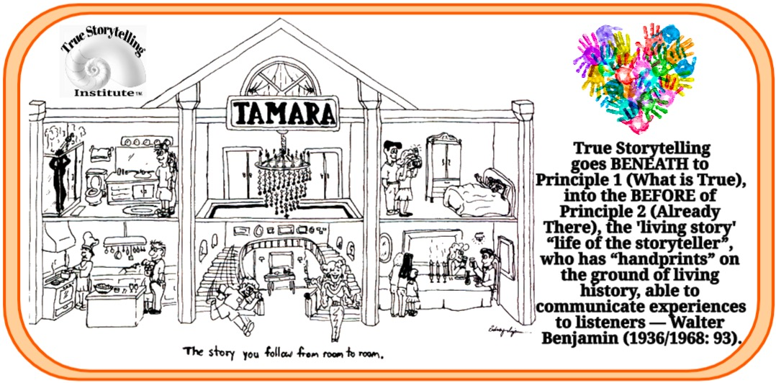
Tool 7: Tamara-Land – storytelling organizations

Slide 16
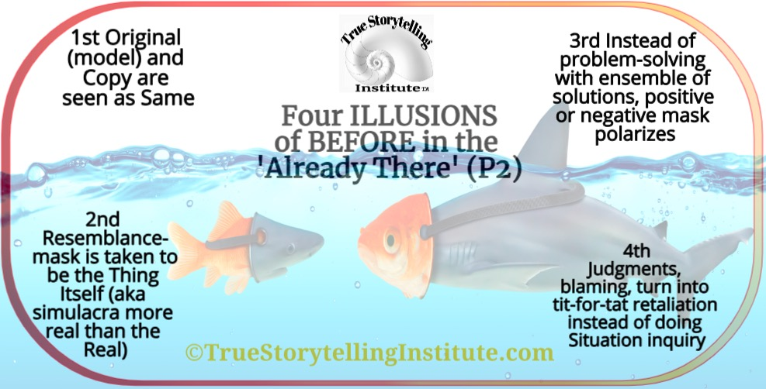
Train the Trainers: Tool 8 ‘Four Illusions”

Slide 17
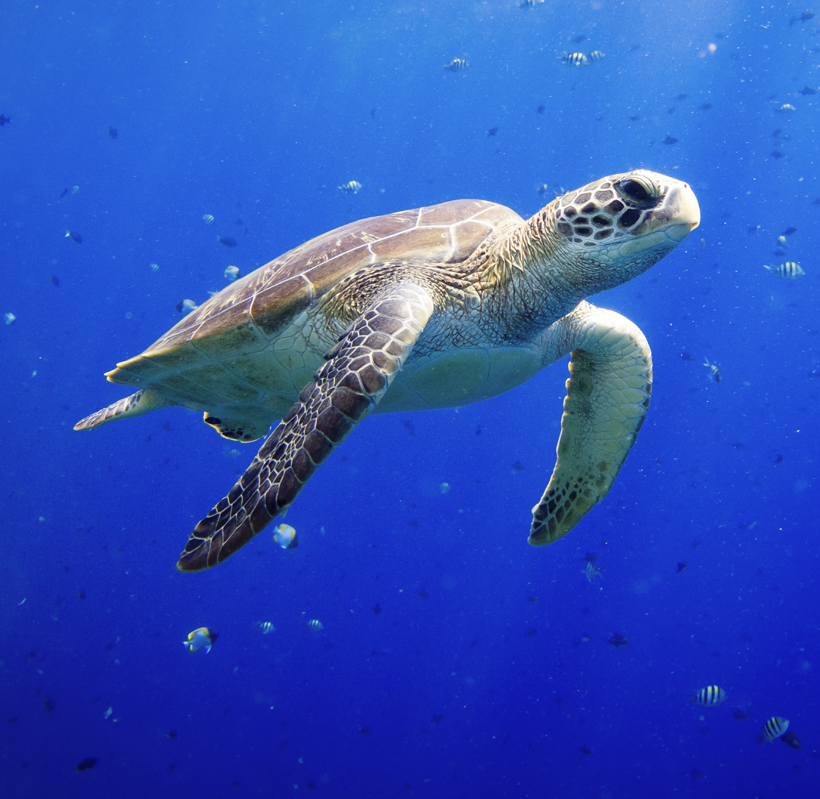
P2: What is Already There in the BEFORE?
After nearly 50 years of existence, recycling has proven to be an utter failure at staving off environmental and social catastrophe (see source)

Slide 18
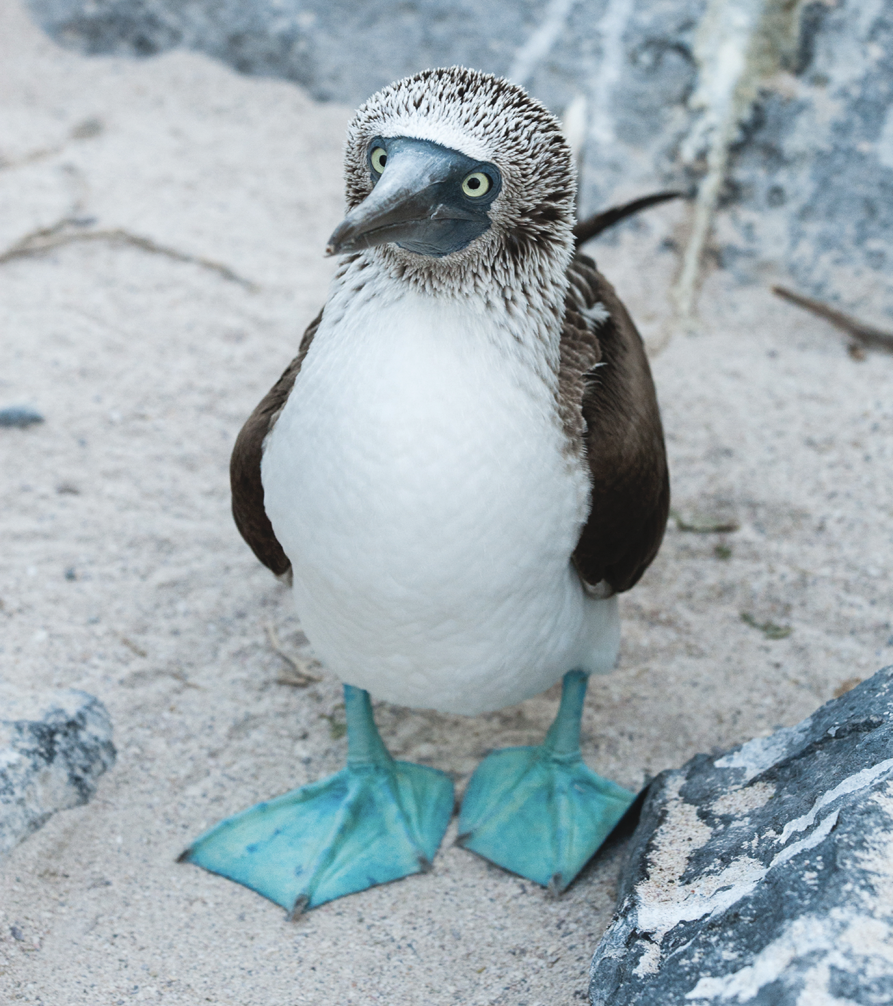
How did this happen?
In 1970, oil companies rewrote history:
"If the public thinks that recycling is working, then they are not going to be as concerned about the environment," Larry Thomas, former president of the Society of the Plastics Industry (Source)

Slide 19

INTRO TO BREAKOUT ROOM
15 minutes total in groups of 3 or 4
2 min explains/demonstrates questions to Faith Groups and Consumer Groups aligning to Agricultural Workers to affect growers & corporations
2 min silent written prep
BREAKOUT
2 min. per person; Total 8 or 10 minutes
QUESTION:
What stories are already there that you can connect to in your situation?
Notes:
Workers that pressure Corporate Social Responsibility which pressures growers (BUILD VISUAL OF CONNECT THESE DOTS)...
Any extra time:
What we had in common; where we diverged.

Slide 20
Debrief
What stories already there would support your project?
How did you identify the stories already there?
Notes:
What would happen if you had not respected stories already there?
What stories already there would support your project?

Slide 21
Next Week →Principle 3: Plotting
“You must create stories with a clear plot, creating direction and helping people prioritize.”
As a Trainer:
This is coming up. Begin to gather material objects relevant to your project
Eyes of a Trainer helping Participants:
Explain the purpose of using the material objects as a tool.
Read Chapter Three – True Storytelling Book;
Handout on 6 Eventums of Protreptic Guides of True Storytelling and the Antenarrative Processes to unvover spacetimemattering
Handout for Guides relating all 7 TSI Principles to all 7 antenarrative processes and how to integrated them
Prezi of 4 Hearts Model This is the Link

Slide 22
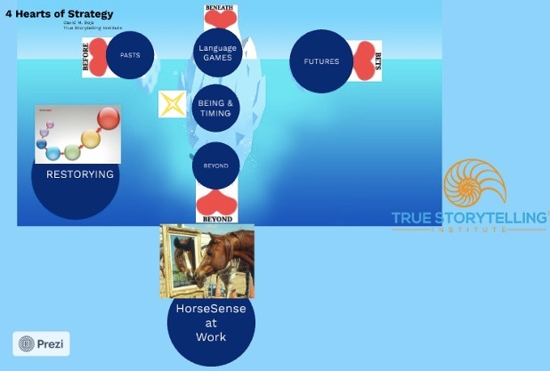
You can Explore the 4 Hearts, Restorying, and HorseSense in Prezi
This is the Link

Slide 23
Principle 2 Making room
“True storytelling makes spaces respecting the stories already there.”
Where are the waves we can surf which will give us the energy
and when is the right moment to catch them?
Do you already work with something which is similar to this?
How do you actually do it?
Are there any partners or trend you can connect to you have
not thought about yet?
How would you describe this in a concept?
How can this emerge into the future?
Page 45

Slide 24
PERSONAL COACHING available to YOU from US:
TSI Trainer Program Coaching Session one-hour session between now and 6 July on your current project
Coach Trainer
David Oscar
Grace Ann Barbara
Jens Ernest
Lena Rico
Jim Karin
Grace Ann Ken
Jens Duncan

Slide 25
True Storytelling Institute
POST-SESSION
“COFFEE in the LOBBY”

Slide 26
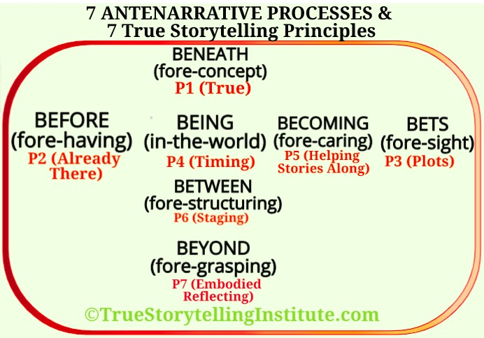

Slide 27


Slide 28
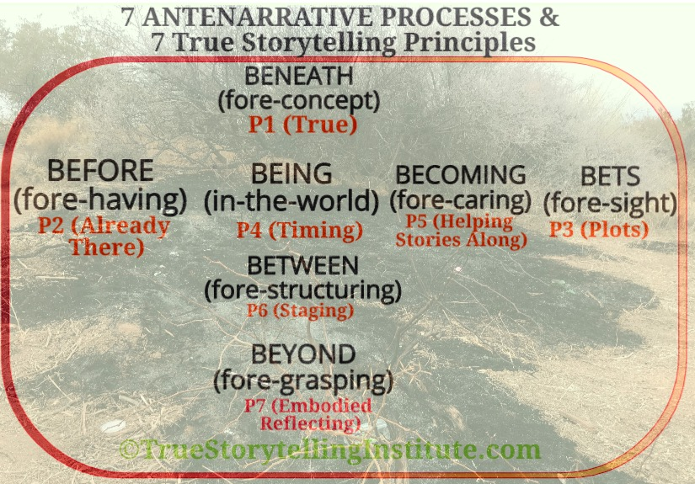

Slide 29

"All new sports – surfing, windsurfing, hang-gliding – take the form of entering into an existing wave. There is no longer an origin as a starting point, both a sort of putting-into-orbit. The key thing is how to get taken up in the motion of a big wave, a column of rising air, to 'get into something' instead of being the origin of an
effort.”
Page 33

Slide 30
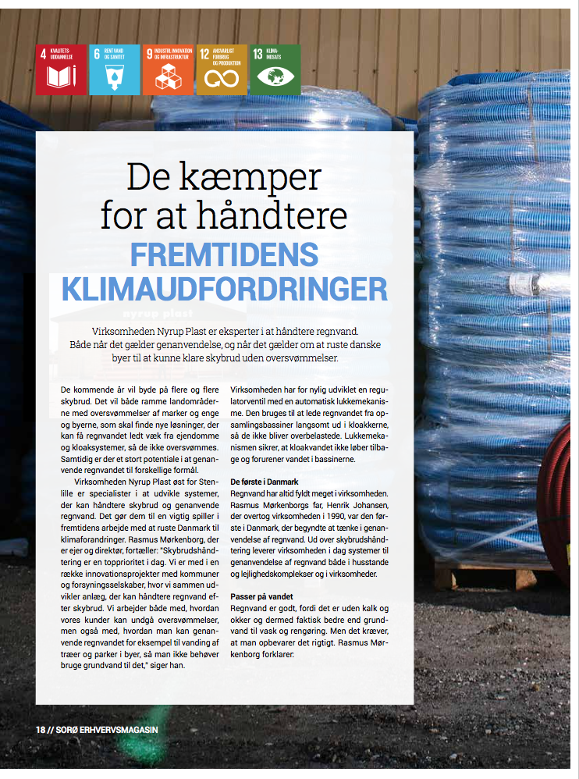
They fight to deal with the climatechanges of the future
Page 41

