Slide 1
True Storytelling: Session #3 of 4 on Intercultural Racism Conversations
9am Pacific/10am Mountain Time on
24, 31 Aug, and 14 & 21 Sept
Join Zoom Meeting
https://us02web.zoom.us/j/89397616259
Meeting ID: 893 9761 6259
Passcode: endracism

Slide 2
Intercultural Conversations to Impact Racism
True
Storytelling
Facilitated by
David M. Boje and Oscar Edwards
Assistants: Grace Ann Rosile, Jens Larson, Lena Bruun Jensen, James Sibel, Ken Long
Notes:
Image is from free downloads https://www.pexels.com/photo/hands-heart-love-305530/

Slide 3
AGENDA
9-9:05 Welcome, Agenda, Review Groundrules, True Storytelling, Roadmap
9:05-9:10 True Storytelling, Roadmap, Review Homework
9:10-9:15 Summary of Oscar’s Externalized Problem, and 3 Little Wow Moments
9:15-9:17 SILENT PREP for Breakout #1
9:17-9:27 BREAKOUT #1 3-4 persons per group, 2 min per person to share wow moments
9:27-9:32 Debrief: seek patterns in Little Wow Moments, design strategies to recreate them
9:32-9:35 “Help Along” change by re-story-ing; de-construct to help re-construct/re-story
9:35-9:40 David’s story of Nickerson Gardens, and de-construction storyboard
9:40-9:45 Re-story-ing and Staging with Nickerson example, ending with 3 min silent prep
9:45-9:55 Breakout #2, in PAIRS, 4 min each to answer 6 questions
9:55-10:10 Debrief: Q&A on CHAT, while discussing examples from breakouts
10:10-10:15 HOMEWORK: New Storyboard, True Story link, letter for support, self-care
10:15-10:20 POPCORN: a word or phrase that reflects today’s session
10:20-10:25 Q&A--WRITE your questions in CHAT. ANSWERS as time allows, & via email follow-up.
10:25-10:30 Books/videos for your library.

Slide 4
Review of Groundrules
1. Bring a notebook and pen/pencil.
2. Listen.
3. NO advice to others, NO “should” statements for self or others.
4. Speak from the heart more than the head.
5. Laser in, be concise, share only 1 story not several.
6. CONFIDENTIALITY: do not repeat or tape someone else’s story.
7. If you must miss a session, contact us for homework to catch up.

Slide 5
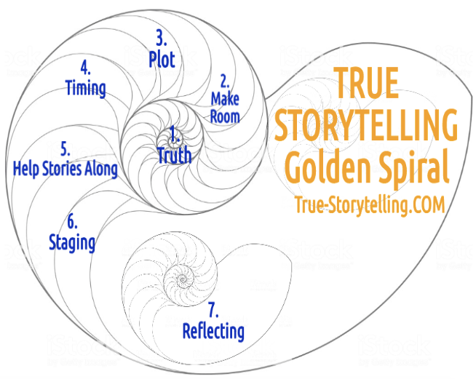
True Storytelling – 7 Principles for Impacting Racism
Session#3
Principle 5: Help Stories Along &
Principle 6: Staging
Notes:
What is ‘Truth’? – It is the ancient Greek dialogues that bring True Storytelling out of hiding.
A ancient indigenous Guide before Aristotle and Plato would help people find a way of Being-in-the-world of Being-true
In today’s corporations, media, government, and our daily lives, The Being-true of ‘Truth’ has been diminished.
As Walter Benjamin (1968, in 1930s essay The Storyteller) put it, ‘True’ “Storytelling is coming to an end”.
See p. 4 and read his story of the ‘True Storyteller’ https://arl.human.cornell.edu/linked%20docs/Walter%20Benjamin%20Storyteller.pdf
“From this story it may be seen what the nature of true storytelling is” (p. 4).
TRUTH in True Storytelling is what Parmenides called “The Goddess of Truth”… “both in truth and in untruth: (Heidegger, Being and Time, 1962: section #223).
As True Storytelling Guides, you encounter the Truth and Untruth of your own inner and outer dialogues.
We live in societies that cover up what is Truth and Untruth, and what a True Storytelling guide does is uncover the Truth (#226).

Slide 6
ROADMAP
First week: what is TRUE
We are one race
Second week: PLOT and TIMING
PLOT and TIMING of systemic racism shown in STORYBOARDS
Externalized the problem as a CHARACTER in the story
This week: HELPING stories ALONG and STAGING
HELP stories ALONG with LITTLE WOW MOMENTS to create a STRATEGY
STAGING stories with human support networks and material objects
Next week:
Success Stories; REFLECTING: what worked, what did not work, and self-care

Slide 7
Review Homework: STORYBOARD with EXTERNALIZED problem
EXAMPLE problem story:
White woman cuts in front of black man (Oscar) in line, no one objects
EXTERNALIZED problem:
The Check-out Line Dragon
CHAT: WRITE the names of your externalized problem characters
Examples: Check-out Line Dragon, Tank Dragon, Status Quo Monster

Slide 8
Summary of Oscar’s ”Little Wow Moments”
Storyboard: White woman cuts in line in front of Oscar (black man) at butcher counter, Oscar says nothing; people in line say nothing; butcher apologizes
Externalized Problem: The Line-Cutting Dragon
Little Wow Moment #1: Home Depot, Oscar objects to a line cutter, another clerk supports Oscar, Oscar is served first
Little Wow Moment #2: Person in line invites Oscar to go ahead of him
Little Wow Moment #3: Others in the line call out the line cutter.
PATTERNS/ACORNS?? Norms of no eye contact; Awareness; Physical Structure

Slide 9
BREAKOUT #1: Little Wow Moments
Little Wow Moments are: Acorns from your story TREE;
Overlooked/forgotten success stories, unique outcomes, small steps
Overlooked potentials for success, patterns
PREP: 1 min. in SILENCE to write down 2-3 Little Wow Moments
BREAKOUT: 3-4 persons per breakout room
CHOOSE timekeeper and CHOOSE who will go first
TELL the story of 2-3 Little Wow Moments (2 min per person)
TOTAL 10 min, 2 min per person

Slide 10
Debrief (5 min)
Report out some examples of Little Wow Moments
Seek PATTERNS in the stories of Little Wow Moments
PATTERNS are systems
Strategies to re-create these patterns are thus SYSTEMIC & STRUCTURAL

Slide 11
CHANGE “the” story by RE-STORY-ING
What we have done so far:
BEGAN with current storyboard (line-cutting, Nickerson Gardens)
EXTERNALIZED the problem, (Check-out Line Dragon, Tank Dragon)
ANALYZED pros and cons (faster if I let it pass; more people will do it more often, and it may carryover to other contexts)
IDENTIFIED Little Wow Moments
NEXT: RE-STORY and HELP ALONG your new story
DE-CONSTRUCT the problem story (so we can re-construct)
PATTERNS in LITTLE WOW MOMENTS of success stories of defeating the problem
Strategies: small steps, pilots, experimenting, documenting
STAGING Support: Human networks, material objects (take a number?)

Slide 12
De-CONSTRUCTION
Dualities
Reversal of Hierarchy of Dualities
3. Reinterpret
4. Hearing the Rebel Voice/Untold Story
5. What is Between-the-Lines
6. Deny the Dominant Plot with Counterplots
7. Find exceptions, your ACORNS, Little Wow Moments

Slide 13
David’s Story of Nickerson Gardens/South Central LA: De-construct, then re-construct and re-story
Tanks with battering rams used to knock down front doors
Residents NEVER hired to work jobs in the community, because-
Assumptions that residents were druggies, not families
David publicized an alternate story of families with children
Little Wow Moments: aspiring opera singers; mothers & kids, leaders
David’s experiment: Resident Manager Training
Result: Resident Manager Training grads were IDEAL employees

Slide 14
De-CONSTRUCT the Story; Patterns are SYSTEMS

Slide 15
Breakout #2 RE-STORYING and STAGING
3 minutes of silence to prepare, 3 min each to answer in pairs, discuss
1) 1 sentence = What is your story with an externalized problem?
View of residents as drug addicts/criminals so Tank Dragon knocks down their doors.
2) Little Wow Moments:
LWM’s = Nora King, moms & children, opera singers, charity fundraisers, leaders.
3) How will you recreate patterns you saw in Little Wow Moments?
Write article about talented Nickerson residents, bring training and jobs to them.
4) Re-storied NEW STORY:
Nickerson residents get training AND jobs in their home community, defeat Tank Dragon.
5) What material objects will you use to help stage your new story?
Resident Manager’s Training Manual, Classroom space
6) What people will you enlist as your support network?
University students, community leaders

Slide 16
Debrief
Q&A WRITE your questions in CHAT
EXAMPLES from breakouts
Little Wow Moment PATTERNS to defeat Problem Monster
Patterns are SYSTEMS,
so your STRATEGIES to DEFEAT the Problem are SYSTEMIC!
See how easy that is?

Slide 17
HOMEWORK
MAKE a new storyboard for our next (final) session, based on your re-storying process, including the defeat of the external problem monster.
WRITE at least 1 reason why your story is “True Storytelling.”
WRITE at least 1 LETTER/email/video clip where you briefly explain your NEW story, and ask for support (in at least 1 specific way) from this a person or persons in your network.
WRITE 1-3 ways you will take care of yourself while re-story-ing.
EMAIL ALL your answers to David (davidboje@gmail.com) by midnight Saturday, 13 Sept.

Slide 18
POPCORN
Raise your hand (literally or virtually)
Give a word or phrase that reflects what you got from today’s session

Slide 19
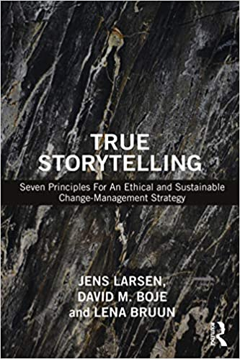
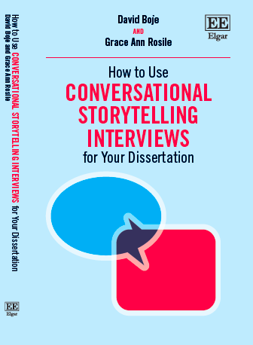
For your Library - Preorder
FREE: Glenn Aparicio Parry PODCAST with Oscar and David
https://originalthinking.us/media/podcasts/ now available

Slide 20
These are links to download your slides and special handouts
SESSION ONE slides Aug 24 2020
SESSION TWO slides Aug 31 2020
HANDOUT How to Make a Storyboard & Restory by Grace Ann Rosile
SESSION THREE slides for Sep 14 2020
HANDOUT How to Deconstruct Systemic Racism and The Victim-Persecutor-Rescuer Cycle - Tool by David M. Boje

