Slide 1
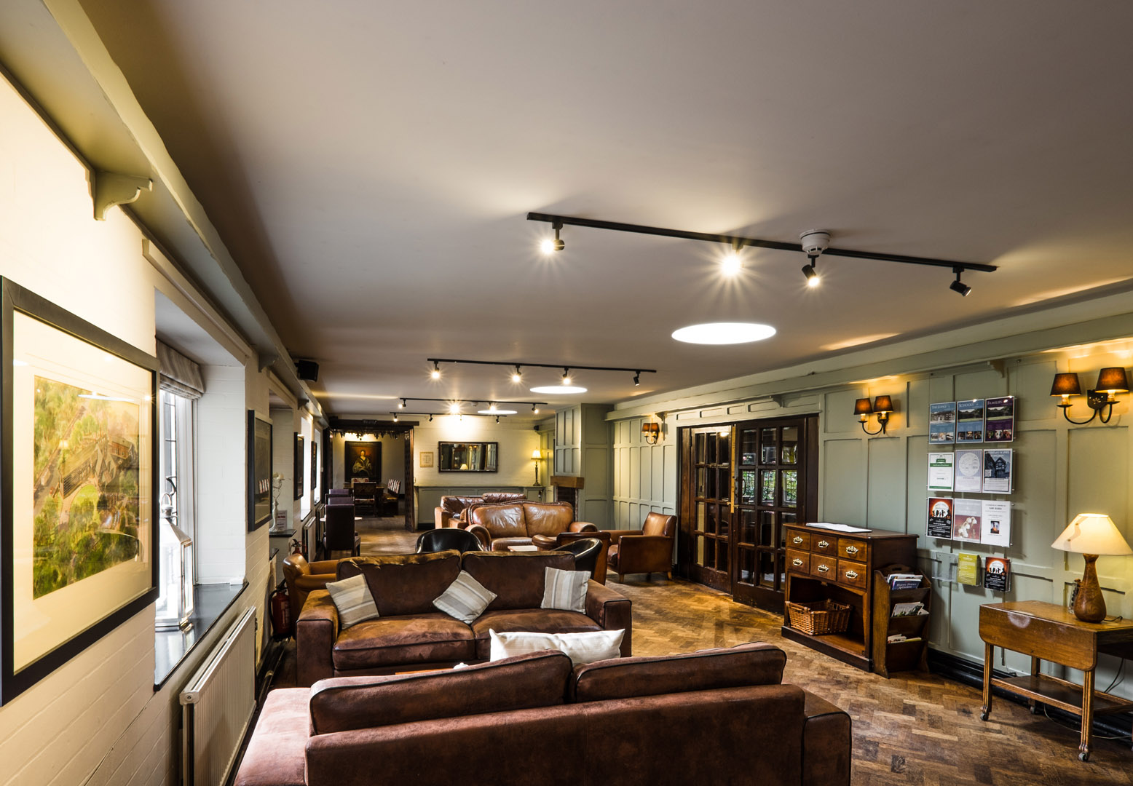
WELCOME to True Storytelling Institute
DEI 2.0 Session 3 Principles 5 & 6
COFFEE in the LOBBY
8:45-9:00 AM Pacific
Notes:
1

Slide 2
TRUE STORYTELLING
Diversity, Equity, & Inclusion (DEI, 2.0)
Level I session 3
Notes:
Just go over this slide
2

Slide 4
Please bring a notebook and pen/pencil to each session.
Use the “Gallery View” so you can see each other while viewing PowerPoint.
Please do not give advice to others or use ‘should’ statements for self or others.
Speak more from the heart than from the head
Laser in, be concise, and share only one story instead of several.
CONFIDENTIALITY: Do not tell someone else’s story. Please DO NOT record any session of the presenters or the participants.
Please use Chat ONLY when asked to do so. Avoid “side talk.”
Please attend all sessions. If you must miss one, contact us so we can help you to catch up before you return.
Notes:
4

Slide 5
ROADMAP for All Sessions DEI 2.0
Session 1:
Principles 1 & 2
Session 2:
Principles 3 & 4
Session 3:
Principles 5 & 6
Session 4:
Principle 7

Slide 6
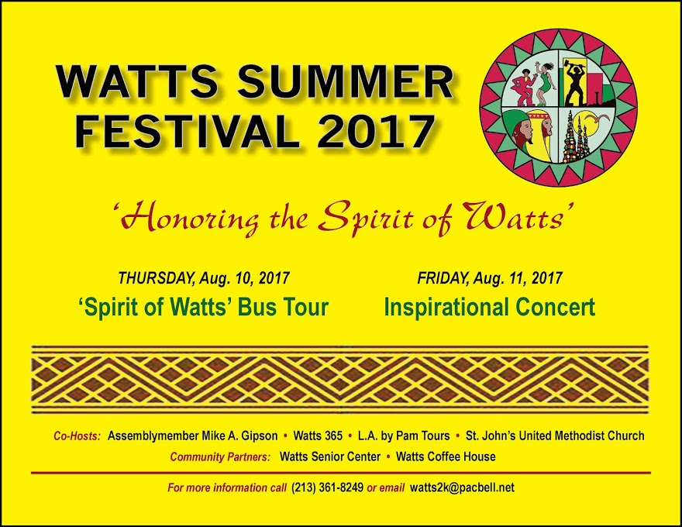
Principles 5 & 6 Helping Stories Along & Staging
How can
“festival”
help you
to restory
and create the
new True Story
you want?

Slide 7
DEI Session 3 NUTS & BOLTs Grace Ann
BYSTANDER THEORY & ANSWERS
Unique outcomes/little wow moments
True Stories can create ACTIVE BYSTANDERS
Storyboards enrich the story
Problem Analysis & Root Causes
BREAKOUT: Your wow moments, personal & systemic

Slide 8
DEI Session 3 NUTS & BOLTs
BREAKOUT with Grace Ann
3-4 per group, 2 min per person.
Please save Q&A for the debrief.
BYSTANDER THEORY & ANSWERS
WHAT: Give an example of a unique outcomes/little wow moment that you experienced at either the personal or systemic/organizational level.
WHY: What key factors created that success?

Slide 9
Debrief Questions
1 min per person
BYSTANDER THEORY & ANSWERS
WHAT:
What were unique outcomes/little wow moments?
WHY:
What key factors created that success?
HOW:
How can you recreate that success and make it the new dominant “True Story”?

Slide 10
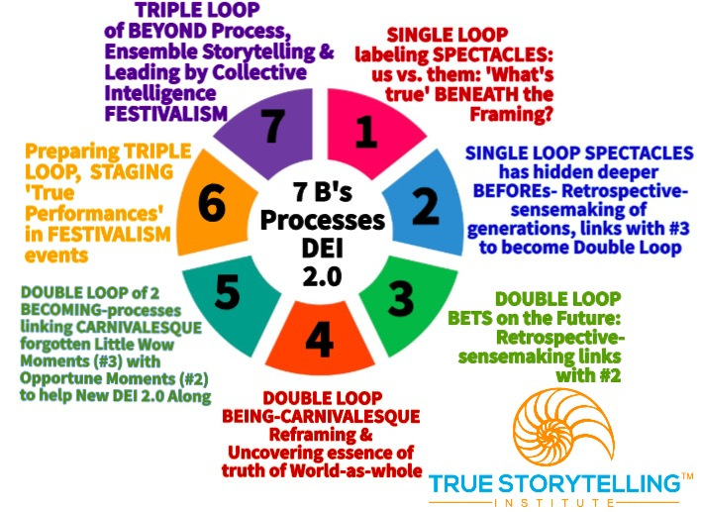
Todays learning: Processes for Session #3 DEI 2.0
Processes 5 & 6
5. BECOMING linking CARNIVALESQUE the forgotten and opportune moments
6. STAGING in FESTIVALISM events

Slide 11
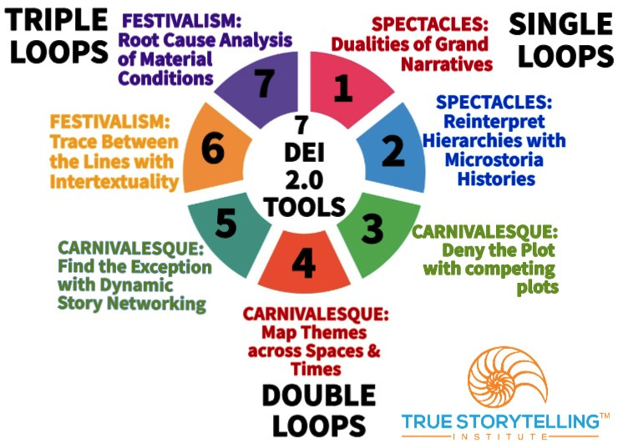
Todays learning: Tools for Session #3 DEI 2.0
Tools 5 & 6
5th Tool
Exception with Dynamic Story Networking Maps with ICEND
Chap. 4 in Narrative book
6th Tool
Trace BETWEEN with Intertextuality
Chap. 5 in Narrative Book

Slide 12
What is the business of DEI 2.0 Training?
Now it is:
- attract Millennials by offering ‘openness’
- diversity (racial & ethnic) pays off for the bottom line
- competitive advantage with gender diversity
- BIG business → still NO True Change??...
WHAT DEI STORY IS NEXT?

Slide 13
Hope for DEI Training in the TRIPLE LOOP!

Slide 14
De-CONSTRUCTION
Find Dualities
Reverse the Hierarchy of Dualities
3. Deny the Dominant Plot with Counterplots
4. Hearing the Rebel Voice/Untold Story
5. What is Between-the-Lines
6. Reinterpret / Rewrite History
7. Find exceptions, your ACORNS, Little Wow Moments
8. Reconstruction in Festival Staging of New Story

Slide 15
Narrative Networking - An embedded approach
STORY MAPPING: a map of antenarrative territory → who’s related to who, with which story?
STORY WEB: tracing patterns in the Tamara of the story exchange → how does a story travel through the web?
STORY INTENSITY: mappings of combinations of person, group and/or interorg. story networks →ex. same person, different stories, passing again and again
Notes:
STORY MAPPING: Understand complex dynamics of storytelling among people across their social networks → a map of antenarrative territory → wo’s related to who, with which story?
STORIES WEB: Explore intertextual aspects of stories in relations to connective interchange → tracing patterns of story in the Tamara of the story exchange → how does a story travel through the web?
STORY INTENSITY: Set-up virtual complex of hyper-links to re-enact the interconnectivity of a story network → mappings of combinations of person, group and/or interorg. story networks →→ex. same person, different stories, again and again

Slide 16
Example Storyboard: Problem Network
Notes:
https://medium.com/transition-design-racism/mapping-racial-inequity-in-pittsburgh-wicked-problem-stakeholders-63d061fbc6f2

Slide 17
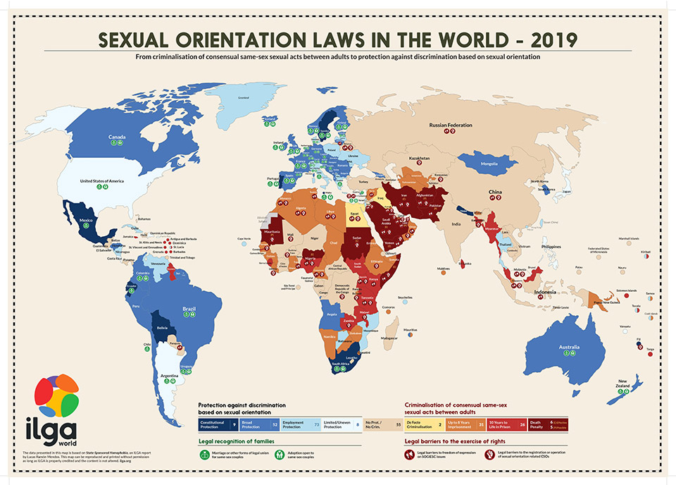
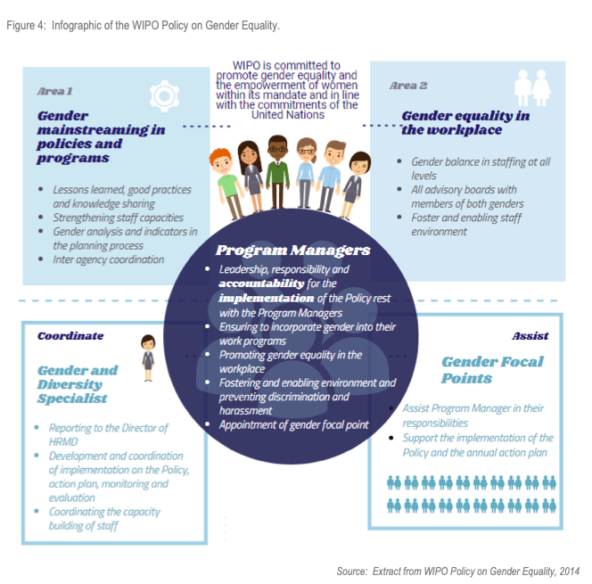
Which storyboard example inspires you to want to try it?
Go-Around
1 min per person

Slide 18
Types of Story Maps (I/II)
Story as LINKS in network maps
Story to CONTEXT network maps
Story as NODES in network maps
Story
Person
Place
Organization
Context
Story Cluster
Notes:
Person to Person related by STORY
Context to Context related by STORY
Story Cluster to Story Cluster related by STORY

Slide 19
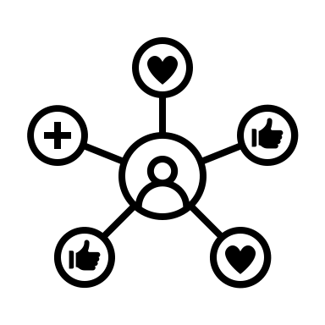
Types of Story Maps (II/II)
past
present
future
Story and TIME networking
Story and MULTI-DIMENSIONALITY
1. story
2. story
future
past
present
1. story
2. story
Notes:
Story to Story through time sequence
Story to multi-dimensionality

Slide 20
HOMEWORK EXAMPLES
Notes:
https://www.wipo.int/export/sites/www/about-wipo/en/oversight/iaod/evaluation/pdf/policy_gender_equality.pdf

Slide 21
Protection against discrimination based on sexual orientation
Constitutional Protection 11
Broad Protection 57
Employment Protection 81
Limited/Uneven Protection 7
No Prot./No Crim. 43
Criminalisation of consensual same-sex sexual acts between adults
De Facto Criminalisation 2
Up to 8 Years Imprisonment 30
10 Years to Life in Prison 27
Death Penalty 6
Notes:
https://ilga.org/maps-sexual-orientation-laws

Slide 22
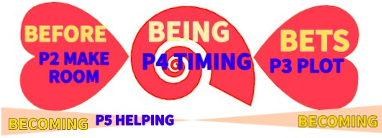
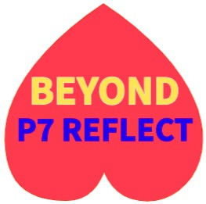
Intertextuality Analysis
Whose social identities get constituted?
Who has access to being included in the text?
Who does the text quote?
Who speaks for whom?
What institutions commision the text?
Whose conventions does the text incorporate?
Who is the text distributed for consumption?
Who are the audiences this text is designed to be interpreted and read by?
Global social contexts
Precedent
texts
Anticipated
Texts
How are parts of other texts incorporated into the text?
How are various stories incorporated?
What is the time and place of each utterance?
Where are the footprints of the author?
P6 STAGING BETWEEN
What is selected as newsworthy for target audiences?
What are the ‘common sense’ or ‘insider’ terms?
What are the parodies, ironies and metaphorization?
What interpretative matrix does the author construct for readers to consume??
Local contexts

Slide 23
Intertextuality points – stitch and weave QUESTIONS??
Textual productivity → redistributive productivity
Social and historical intertextual networks → a text,
an utterance is at one and the same time
past, present and future.
AND TIME may be FUTURE → PAST → PRESENT
Intertextual distribution and consumption → struggles for power are dialogically embedded
Intertextuality and carnical → inter-related, a polyphonic intertextual system that recontextualizes power struggles

Slide 24
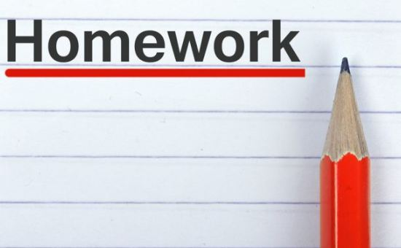
For Week 4: Chapter 7 in True Storytelling; Chapter 6 in Narrative Methods
Please pick one of the Network mapping storyboard examples. Do one for your own system.
Principle 7: Reflect on the stories and how they create CARNIVALESQUE THEATER:
Final Resituation Path (& Rebel Voices) with Root Cause Analysis
TO DO: Take notes on finding Festival Theater.
Online Resources: Introduction to True Storytelling Institute’s Diversity, Equity, Inclusion DEI 2.0 Module Overview; Taking the True Storytelling’s Diversity, Equity, and Inclusion (DEI 2.0) Journey and Visual Language of True Storytelling for DEI 2.0 Tools: The Enron Dramaturgy Case

Slide 25
TRUE STORYTELLING
Diversity, Equity, & Inclusion (DEI, 2.0)
Level I session 3
25
Notes:
Just go over this slide
25

Slide 26
True Storytelling Institute
Check Out
COFFEE in the LOBBY
Notes:
26

Slide 27
Intertextuality Analysis
Whose social identities get constituted?
Who has access to being included in the text?
Who does the text quote?
Who speaks for whom?
What institutions commision the text?
Whose conventions does the text incorporate?
Who is the text distributed for consumption?
Who are the audiences this text is designed to be interpreted and read by?
Global social contexts
Precedent
texts
Anticipated
Texts
How are parts of other texts incorporated into the text?
How are various stories incorporated?
What is the time and place of each utterance?
Where are the footprints of the author?
P6 STAGING BETWEEN
What is selected as newsworthy for target audiences?
What are the ‘common sense’ or ‘insider’ terms?
What are the parodies, ironies and metaphorization?
What interpretative matrix does the author construct for readers to consume??
Local contexts

Slide 28
Festival DNA: Greek & Roskilde festivals
Dionysos parties, Medieval theater, Roskilde Festival
Performance culture: Internal connections among a number of art forms, myths, and rituals, as well as natural scientific ﻿﻿thought and practice.
”Festival’s historicity, diversity, complexity, and paradigmatic strength.”
Harsløf, Olav (2020). “The Great Festival”
Notes:
Dionysos parties organised by the state with integrated democracy
Medieval times where carnivalesque ment laughing of authorities and how Bakhtin kind of bridged it to modern festivals
Demonstrate ﻿﻿there are internal connections among a number of art forms, myths, and rituals, as well as natural scientific ﻿﻿thought and practice.
Explain the ”festival’s historicity, diversity, complexity, and paradigmatic strength.”
Rooted in ﻿Victor Turner and Richard Schechner’s studies and theoretical formations that they began to develop in the 1960s.
Harsløf, Olav (2020). “The Great Festival”

