Slide 1
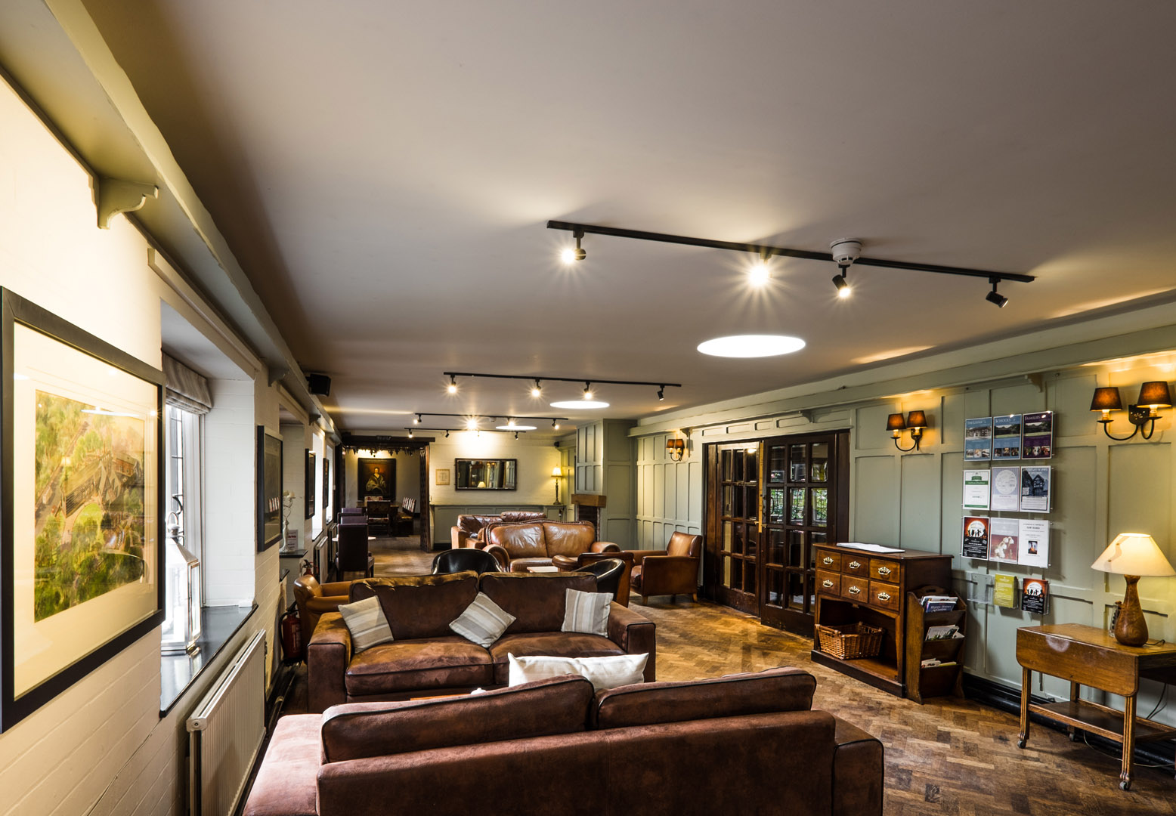
WELCOME to True Storytelling Institute
DEI 2.0 Session 2 Principles 3 & 4
COFFEE in the LOBBY
8:45-9:00 AM Pacific
Notes:
1

Slide 2
TRUE STORYTELLING
Diversity, Equity, & Inclusion (DEI, 2.0)
Level I session 2
2
Notes:
Just go over this slide
2

Slide 4
Please bring a notebook and pen/pencil to each session.
Use the “Gallery View” so you can see each other while viewing PowerPoint.
Please do not give advice to others or use ‘should’ statements for self or others.
Speak more from the heart than from the head
Laser in, be concise, and share only one story instead of several.
CONFIDENTIALITY: Do not tell someone else’s story. Please DO NOT record any session of the presenters or the participants.
Please use Chat ONLY when asked to do so. Avoid “side talk.”
Please attend all sessions. If you must miss one, contact us so we can help you to catch up before you return.
Notes:
4

Slide 5
ROADMAP for All Sessions DEI 2.0
Session 1:
Principles 1 & 2
Session 2:
Principles 3 & 4
Session 3:
Principles 5 & 6
Session 4:
Principle 7

Slide 6
ODC Session 2 NUTS & BOLTs Grace Ann
Win-Lose political economy fosters us vs. them
Unconscious behaviors:
Attribution Theory = blame other’s failure on them
What is the game? Alternative Football
ALTERNATIVE SYSTEMS:
Did you ever ask less? Bid more?

Slide 7
ODC Session 2 NUTS & BOLTs Grace Ann
IMAGINING ALTERNATIVE SYSTEMS:
IWOK Barter economy, ask-bid process, use vs. ownership, disclosure
Active Bystander: Barbara’s comments on black student, and no black faces in photo
Deconstruct Grand Narratives, look for Microstoria already there
WHAT GAME ARE WE PLAYING?
Next: David discusses Structural Inequality and Structural Racism

Slide 8
WHAT IS STRUCTURAL INEQUALITY?
“Structural inequality is a system of privilege created by institutions within an economy. These institutions include the law, business practices, and government policies. They also include education, health care, and the media” (More).
Trend “Structural inequality seems to be worsening. Between 1979 and 2007, after-tax income increased 275% for the wealthiest 1% of households. It rose 65% for the top fifth. The bottom fifth only increased by 18%” (IBID.).

Slide 9
WHAT IS SYSTEMIC RACISM?
“Institutional racism, also known as systemic racism, is a form of racism that is embedded through laws within society or an organization. It can lead to such issues as discrimination in criminal justice, employment, housing, health care, political power, and education, among other issues” (More).
Example: Australia: “The treatment of the Indigenous people by the colonisers has been termed cultural genocide.”
Example Canada: “Until 1951 the various Indian Acts defined a ‘person’ as “an individual other than an Indian”, and all indigenous peoples were considered “wards of the state.” (More).

Slide 10
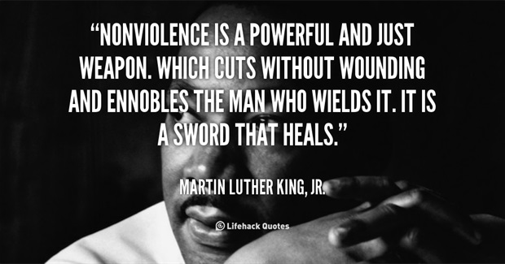
What you will learn today
Principle 3: Plot
3rd Tool
Deny Plots of Grand Narratives
Chapter 8 in Narrative book
Principle 4: Timing
4th Tool
Other Side of the Story
Mapping Themes of Grand Narratives
Chapter 9 in Narrative Book
Carnival Resistance is non-violent consciousness raising of the consequences of ongoing Spectacles of hate, fear, and oppression (Boje, 2017).

Slide 11
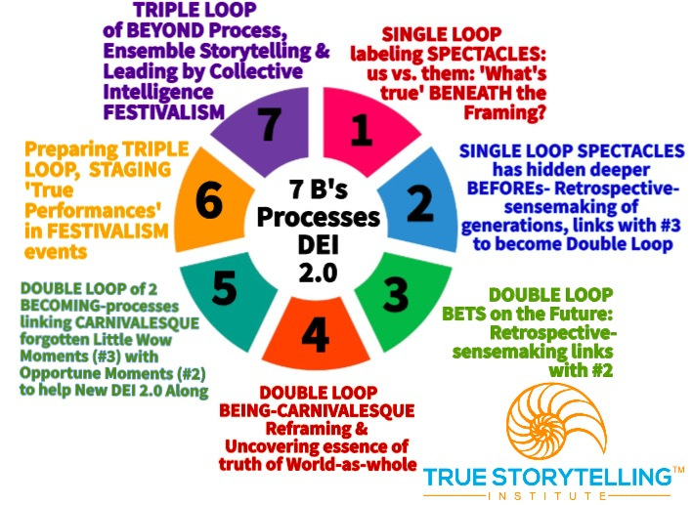
Processes for Session #2 DEI 2.0
Processes 3 & 4
3. BETS plots are making
4. BEING is Uncovering the Essence of Truth in Time and Space
Notes:
Principle 1: What is True and SPECTACLE: Duality Search (Grand Narrative Chapter 2)
Principle 2: Already there and SPECTACLE: Reinterpret Hierarchy (Microstoria Chapter 3)

Slide 12
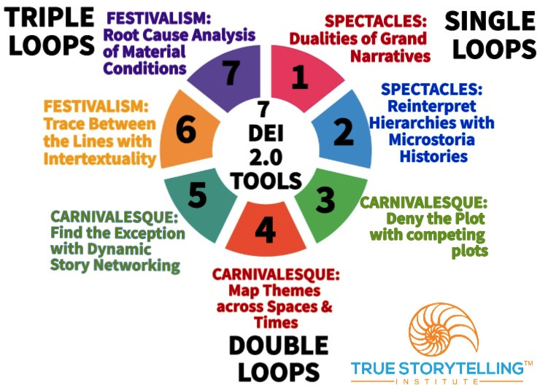
Tools for Session #2 DEI 2.0
Tools 3 & 4
3rd Tool
Deny the Plots of Grand Narrative
Ch. 8 in Narrative book
4th Tool
Mapping Themes
of Grand Narratives
Chapter 9 in Narrative Book
Notes:
Week 1:
Nuts and Bolts
Principle 1 True &
Principle 2 Making Room
WITH
Process 1 Beneath &
Process 2 Before
Ethics focus:
True Storytelling Principles
for an Ethical Life

Slide 13
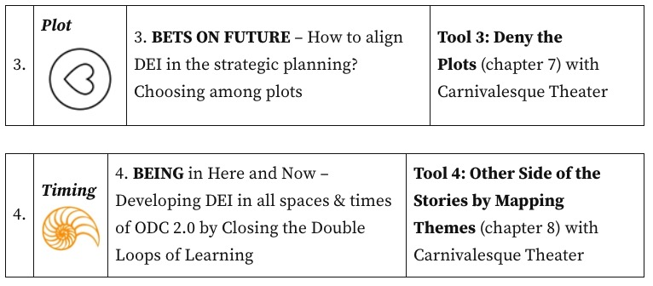

Slide 14
Carnival of Non-Violent Resistance
Single Loop:
Learn how to decipher the Spectacle of Discrimination and its Microaggressions
Double Loop:
Learn how to be Carnivalesque to raise awareness of disparities and opportunities
TRIPLE LOOP:
Uses Ensemble Storytelling Networking
For Festival Impact

Slide 15
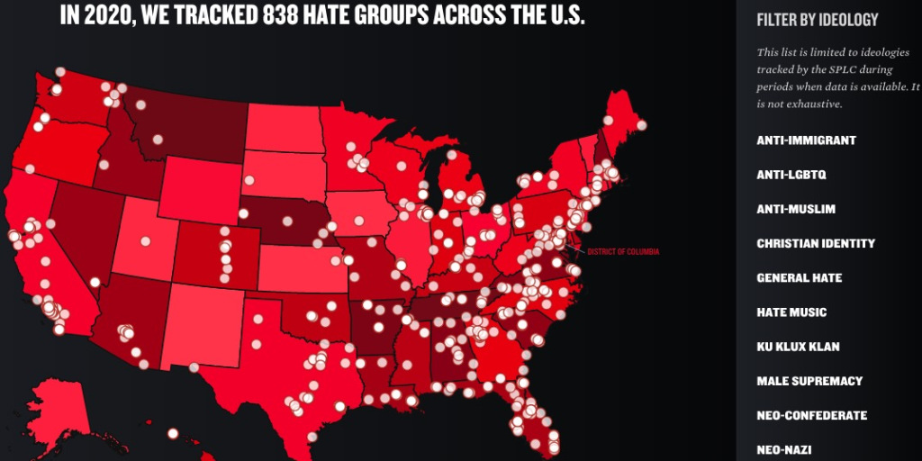
What is the result of the Big Fear?

Slide 16
Notes:
We look for non-violent resistance to replace passive bystander-ness. Group discussions, especially True Storytelling Conversations, counteract the tendency towards bystander behavior.

Slide 17
BREAKOUT: Tools 1 & 2 Principles 1 & 2
Groups of 3 or 4, 2 min per person
2 min example story:
Jim’s Story & Grace Ann’s Story
2 min silent prep
10 min breakout
1 min back to main room
YOUR ASSIGNMENT:
OPTION 1: Tell one story of a time when you offended someone, or were the “oppressor,” without intending it or realizing it in that moment.
OPTION 2: Tell one story when you Resisted Systemic or Structural Racism
Debrief: 10 min

Slide 18
DEBRIEF Questions
What feelings did you experience when you addressed bias?
What lesson will you take with you to apply when you are in a position to call attention to offensive and/or oppressive behaviors? (What would you say and/or do to NOT be just a bystander?)
What is your favorite question to ask when deconstructing the endless stream of false stories about “us vs. them”?

Slide 19
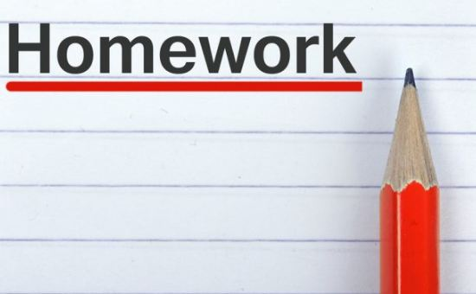
Week 3: Read Chapter 5 & 6 in True Storytelling; And Chapters 4 & 5, in Narrative Methods
Topics Next Session:
Principle 5: Helping new story with CARNIVALESQUE THEATER:
Find the Exception Chapter 4 in Narrative book )
Principle 6: Staging your FESTIVAL THEATER:
Trace between the lines (Chapter 5 in Narrative book)
TO DO: Take notes on ways non-violent Carnival counters Spectacle plots.
Online Resources: Introduction to True Storytelling Institute’s Diversity, Equity, Inclusion DEI 2.0 Module Overview; Taking the True Storytelling’s Diversity, Equity, and Inclusion (DEI 2.0) Journey and Visual Language of True Storytelling for DEI 2.0 Tools: The Enron Dramaturgy Case

Slide 20
TRUE STORYTELLING
Diversity, Equity, & Inclusion (DEI, 2.0)
Level I session 2
20
Notes:
Just go over this slide
20

Slide 21
True Storytelling Institute
Check Out
COFFEE in the LOBBY
Notes:
21

Slide 22
What Tools 3 & 4 can do
Exposing racist and misogyny constructions of reality and countering with True Storytelling of the ‘essence of truth.’
Deconstructing the endless stream of baseless conspiracy theories
Denial of severity of COVID19 pandemic by no mask, ‘re-open’ and don’t vaccinate campaigns. What were the hidden costs of these conspiracy theories? Lives lost, social and economic misery.
Preemptive declarations of election fraud with actions “Stop the Steal’
8.15″Stolen election” conspiracy theory
9.3COVID-19 pandemic
6.1Antisemitism
6.2Anti-Armenianism
6.3Anti-Baháʼísm
6.4Anti-Catholicism
6.5Antichrist
6.6Bible and Jesus
6.7Islam
6.8Anti-Islamic
6.9Racism

