Slide 1
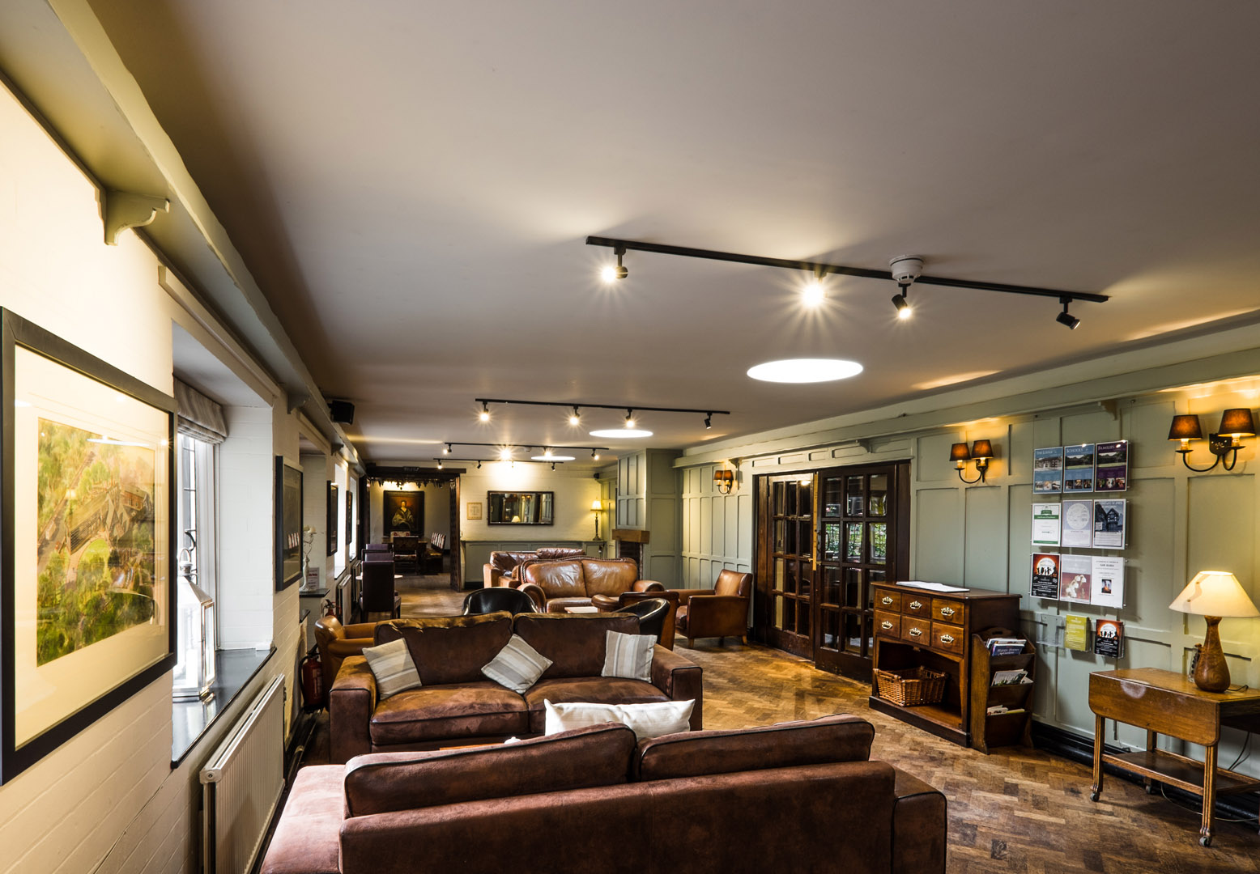
WELCOME to True Storytelling Institute
DEI 2.0 Session 1 Principles 1 & 2
COFFEE in the LOBBY
8:45-9:00 AM Pacific
Notes:
1

Slide 2
TRUE STORYTELLING
Diversity, Equity, & Inclusion (DEI, 2.0)
Level I session 1
2
Notes:
Just go over this slide
2

Slide 4
Please bring a notebook and pen/pencil to each session.
Use the “Gallery View” so you can see each other while viewing PowerPoint.
Please do not give advice to others or use ‘should’ statements for self or others.
Speak more from the heart than from the head
Laser in, be concise, and share only one story instead of several.
CONFIDENTIALITY: Do not tell someone else’s story. Please DO NOT record any session of the presenters or the participants.
Please use Chat ONLY when asked to do so. Avoid “side talk.”
Please attend all sessions. If you must miss one, contact us so we can help you to catch up before you return.
Notes:
4

Slide 5
ROADMAP for All Sessions DEI 2.0
Session 1:
Principles 1 & 2
Session 2:
Principles 3 & 4
Session 3:
Principles 5 & 6
Session 4:
Principle 7

Slide 6
Categories of EEO Complaints in the US
OTHER SOURCES OF BIAS:
Skin Color
Mental or Physical Disability
Genetic Information
Relationship to someone who may be discriminated against
Pregnancy or Parenthood
LGBTQ Discrimination
Linguistic/Cultural Discrimination
National Origin
Socio-Economic Discrimination
(see source)

Slide 7
ODC Session 1 NUTS & BOLTs Grace Ann
DUALISM: how we learn, how we judge
DECONSTRUCTION: categories & stories
Intersectionality: multiple categories together
Microaggression: smaller offensive behaviors
How can Storytelling deconstruct all the above?
True & Making Room (Hospital Residencies, Immokalee bus)

Slide 8
WHAT IS INTERSECTIONALITY?
THE BEFORE HEART of History (Principle 2 Already there).
Intersectionality is a framework to study the history of relationships among multiple dimensions and modes of discrimination and privilege
“Demarginalizing the Intersection of Race and Sex. The paper CLICK HERE TO READ THE COMPL ETE PAPER centers on three legal cases that dealt with the issues of both racial discrimination and sex discrimination: DeGraffenreid v. General Motors, Moore v. Hughes Helicopter, Inc., and Payne v. Travenol.

Slide 9
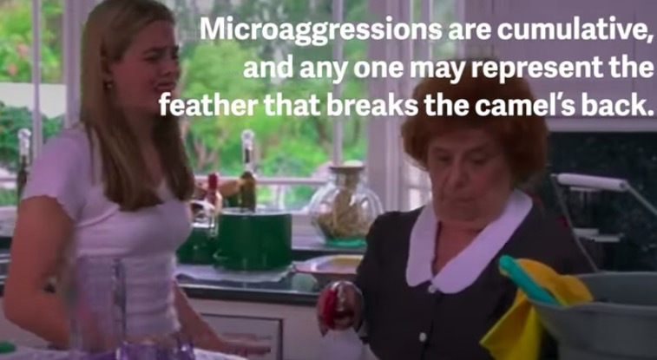
What are Microaggressions?
Examples from Movies CLICK HERE

Slide 10
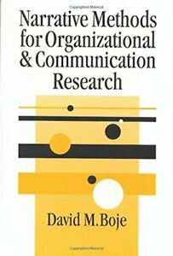
What you will learn today
Build Your Library
Principle 1: TRUE
What is True about SPECTACLE of DEI 1.0:
1st Tool Duality Search
Grand Narrative Chapter 2 in Narrative Book
Principle 2: Make Room
What is Already there, hidden by SPECTACLE
2nd Tool Reinterpret Hierarchy
Microstoria Chapter 3 in Narrative Book

Slide 11
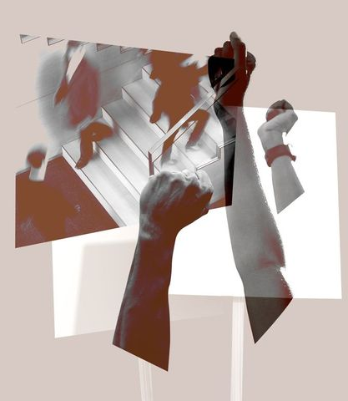
Articles that awaken the soul with LINKS
Oswick, Cliff. (2011). The social construction of diversity, equality, and inclusion. Equality, inequalities, and diversity: Contemporary challenges and strategies. British Journal of Management, 25(1), pp. 23- 39. Click Here for article PDF
The Diversity and Inclusion Industry Has Lost Its Way 2021 by Kim Tran Click here
Chavez, C.I. and J.Y. Weisinger (2008). ‘Beyond diversity training: a social infusion for cultural inclusion’, Human Resource Management, 47, pp. 331-350. (Click for PDF on Academia service).

Slide 12
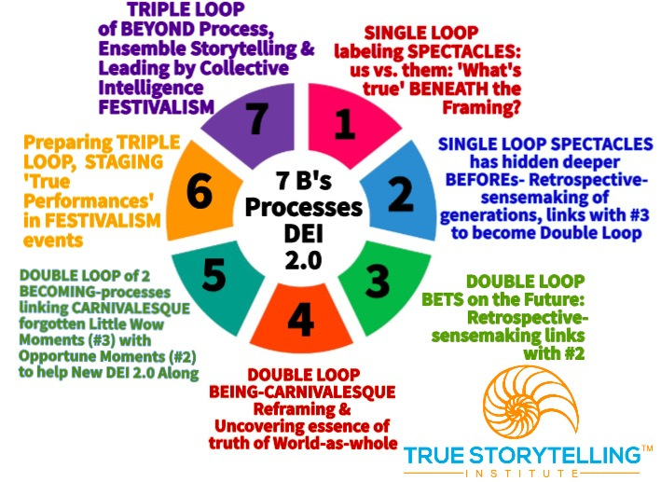
Processes for Session #1 DEI 2.0
Processes 1 & 2
Go BENEATH the framing to the labeling
Go BEFORE to already there, Microstoria being ignored
Notes:
Principle 1: What is True and SPECTACLE: Duality Search (Grand Narrative Chapter 2)
Principle 2: Already there and SPECTACLE: Reinterpret Hierarchy (Microstoria Chapter 3)

Slide 13
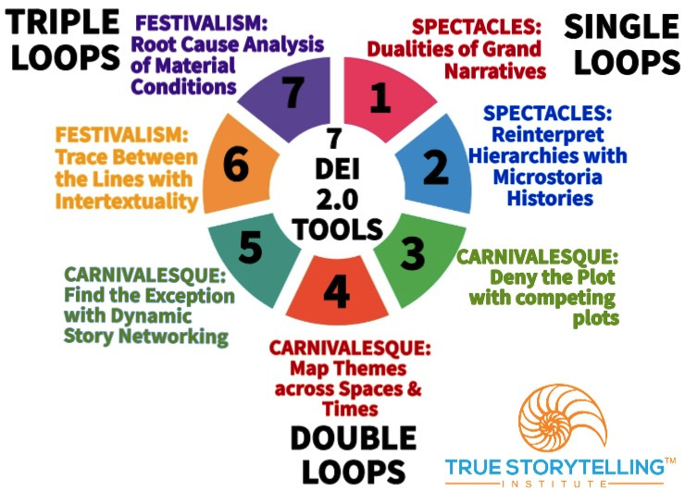
Tools for Session #1 DEI 2.0
Tools 1 & 2
Deconstruct BENEATH Dualities of Grand Narratives
Reinterpret the BEFORE histories of Hierarchies hiding the Microstoria
Notes:
Week 1:
Nuts and Bolts
Principle 1 True &
Principle 2 Making Room
WITH
Process 1 Beneath &
Process 2 Before
Ethics focus:
True Storytelling Principles
for an Ethical Life

Slide 14
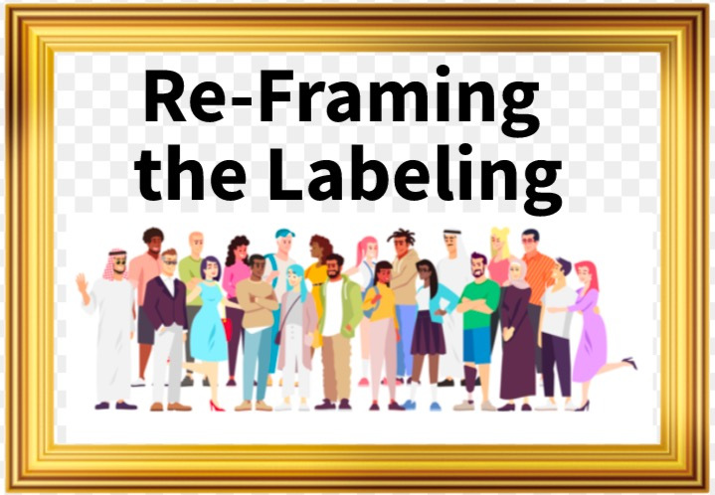
Re-Framing the Loops
Single Loop: Learn how to decipher the Spectacle of Discrimination and its Microaggressions
Double Loop: Learn how to be Carnivalesque to raise awareness of disparities and opportunities
TRIPLE LOOP: Uses
Ensemble Storytelling Networking
For Festival Impact

Slide 15
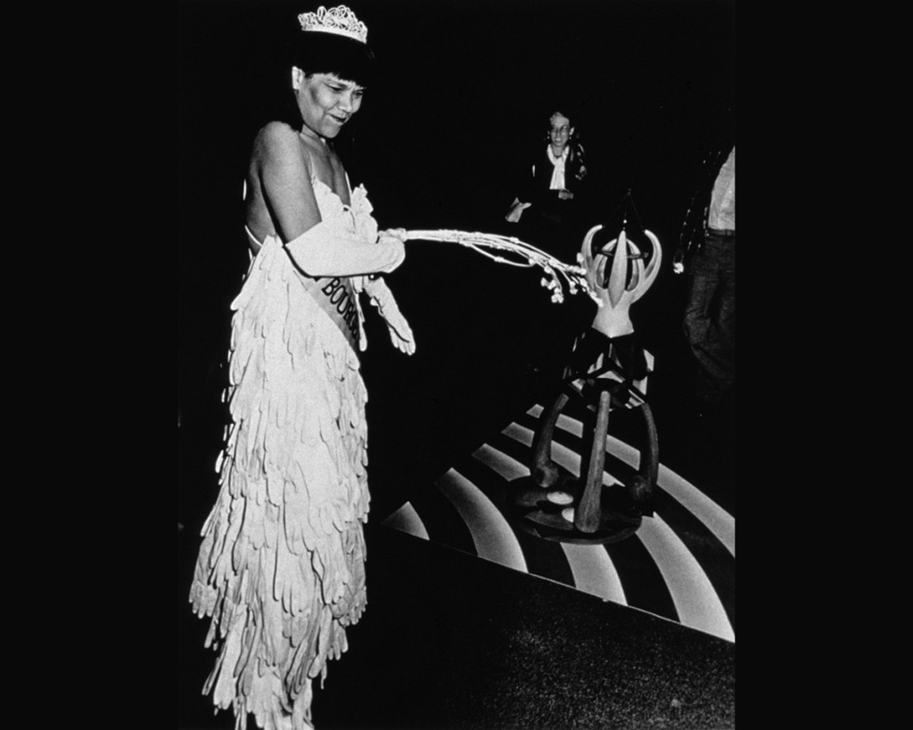
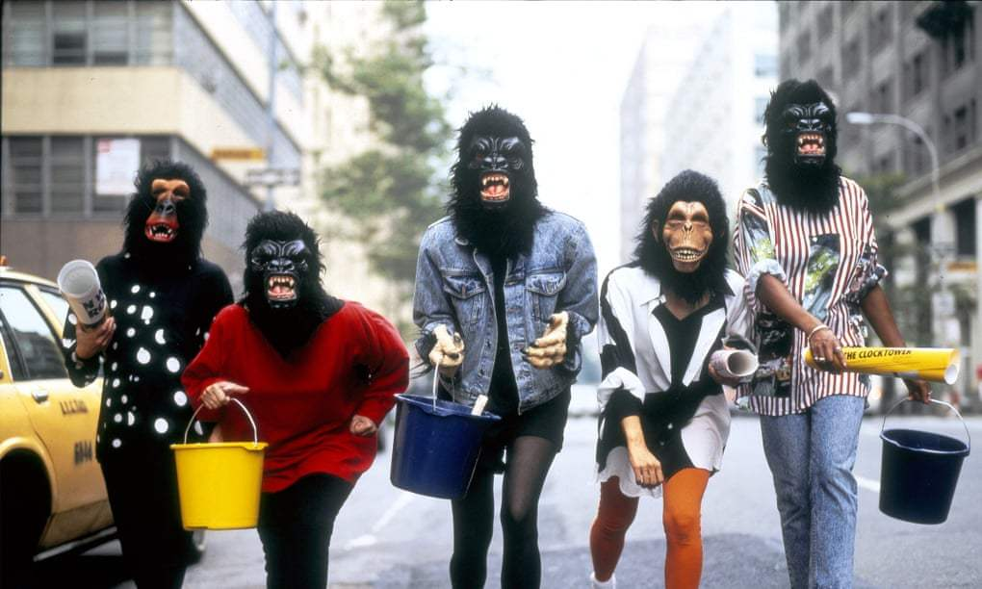
Raising Awareness: Race & Gender
Guerrilla Girls
Lorraine O’Grady

Slide 16
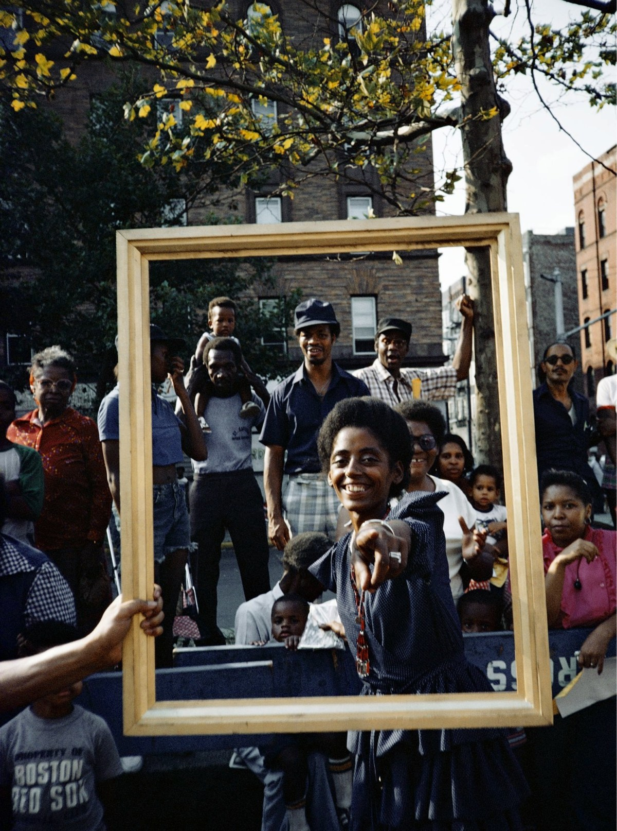
BREAKOUT: Tools 1 & 2 Principles 1 & 2
Groups of 3 or 4, 2 min per person
2 min example story:
Nickerson’s mothers & children & opera singers
2 min silent prep
10 min breakout
1 min back to main room
YOUR ASSIGNMENT:
Tell one story (Microstoria) of unnoticed stories beneath the Grand Narrative (Dominant Story)
Debrief: 10 min

Slide 17
DEBRIEF Questions
How do smaller stories fit into the big picture?
What is the True Story?
Worker-Driven Solutions
Together-Telling

Slide 18
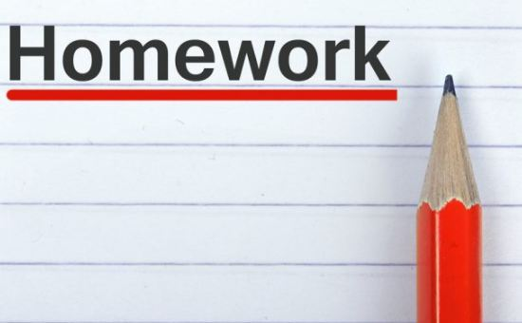
IF YOU HAVE NOT ALREADY, please read the chapters below
(and feel free to review if you have already read them!)
Week 1: Chapters 1 & 2 in True Storytelling, & Chapter 2 & 3 in Narrative book
Week 2: Read Chapter 3 & 4 in True Storytelling; And Chapters 7 & 8, in Narrative Methods
Topics Next Session:
Principle 3: Plot and CARNIVALESQUE:
Deny the Plot (Competing Plots of differing groups Chapter 7 in Narrative book )
Principle 4: Timing and CARNIVALESQUE:
Other Side of the Story (Mapping Themes in space and in time Chapter 8 in Narrative book)
TO DO: Take notes on the microaggressions, intersectionalities, and microstorias you notice in your own systems.
Online Resources: Introduction to True Storytelling Institute’s Diversity, Equity, Inclusion DEI 2.0 Module Overview; Taking the True Storytelling’s Diversity, Equity, and Inclusion (DEI 2.0) Journey and Visual Language of True Storytelling for DEI 2.0 Tools: The Enron Dramaturgy Case

Slide 19
TRUE STORYTELLING
Diversity, Equity, & Inclusion (DEI, 2.0)
Level I session 1
19
Notes:
Just go over this slide
19

Slide 20
True Storytelling Institute
Check Out
COFFEE in the LOBBY
Notes:
20

