Slide 1
Boje Slides for SESSION 2 The BEFORE Antenarrative Process AND Principle 2 ‘Already There’ and Preview of Session 3

Slide 2
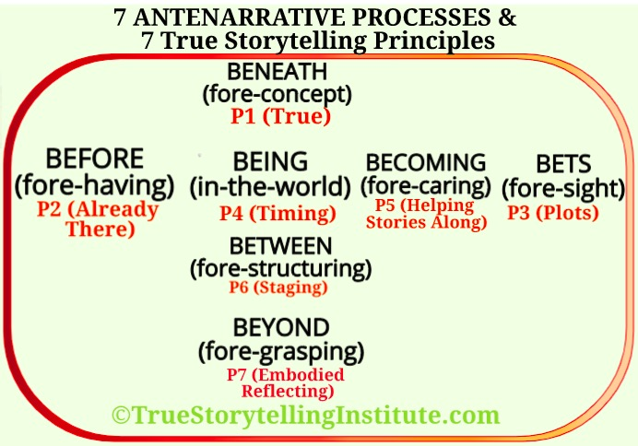

Slide 8
FOR NEXT SESSION 3 What is the relation of BETS on Future antenarratives and the Principle 3 (PLOTS)?

Slide 9
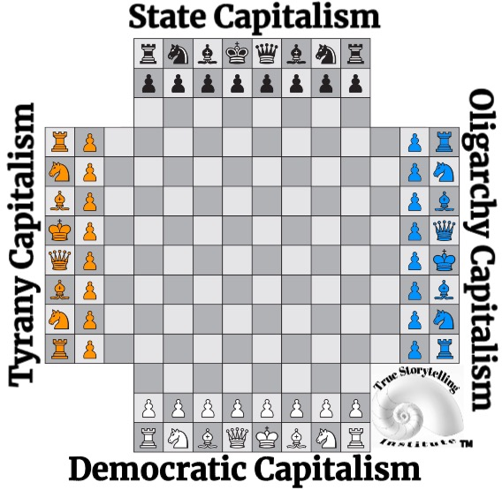
The Story of Four PLOTS (P3) and their BETS on the Future – 4 Capitalisms Playing Chess with the World

Slide 10
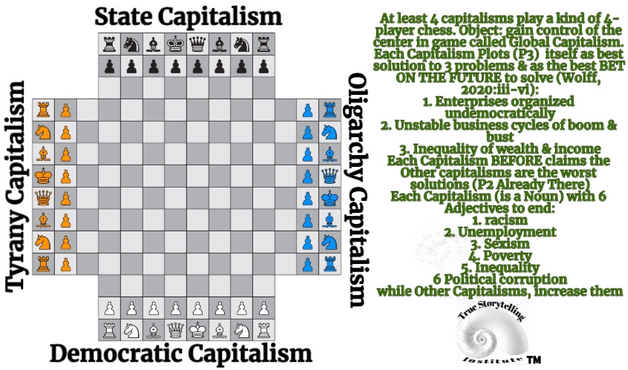

Slide 11
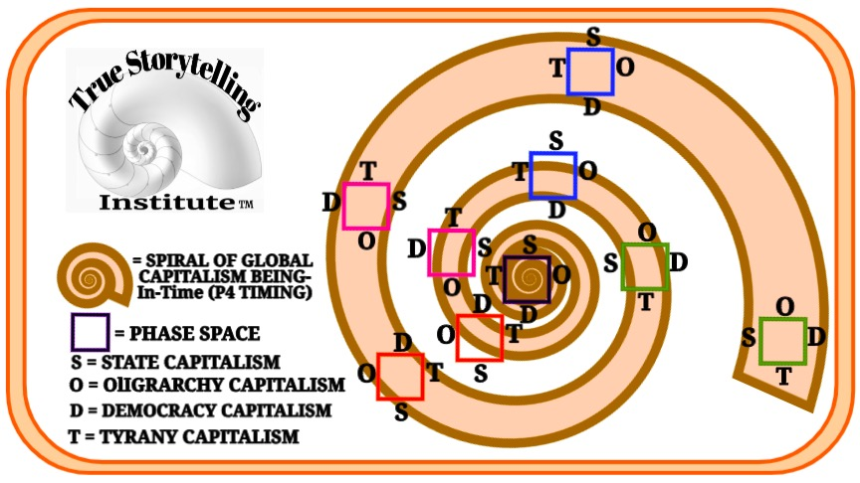

Slide 12
