Slide 1
TRUE STORYTELLING
Train-the-Trainers
Level II
For Guides Only!
<number>
Notes:
Just go over this slide
<number>

Slide 2
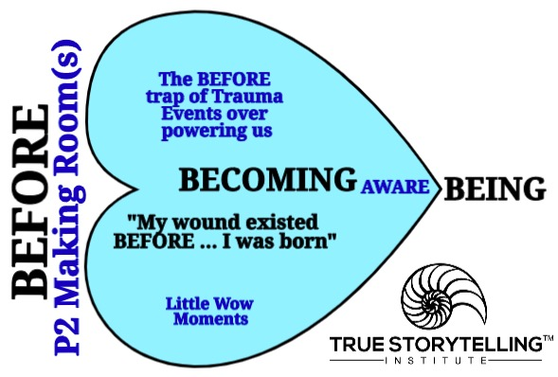
The BEFORE-Heart is ‘For Guides Only’

Slide 3
The FUTURING-Heart is ‘For Guides Only’

Slide 4
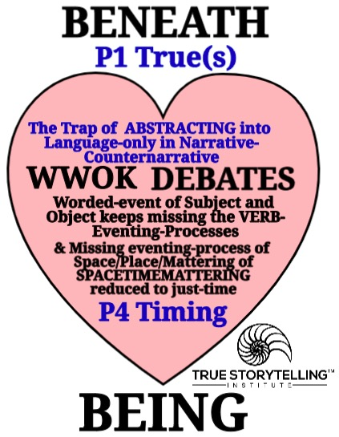
The BENEATH-Heart is ‘For Guides Only’

Slide 5
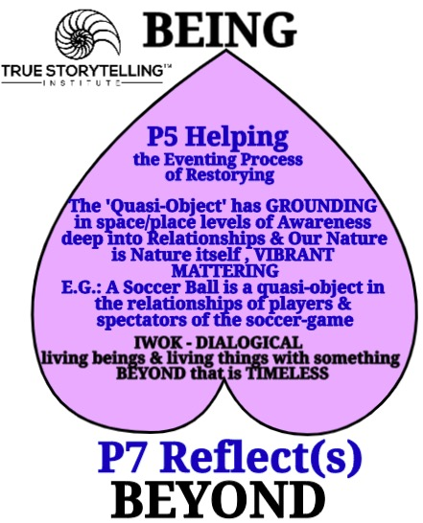
The BEYOND-Heart is ‘For Guides Only’

Slide 6
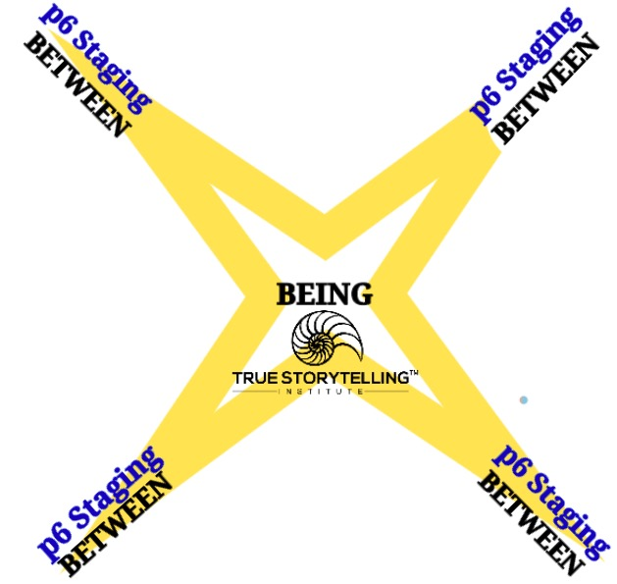
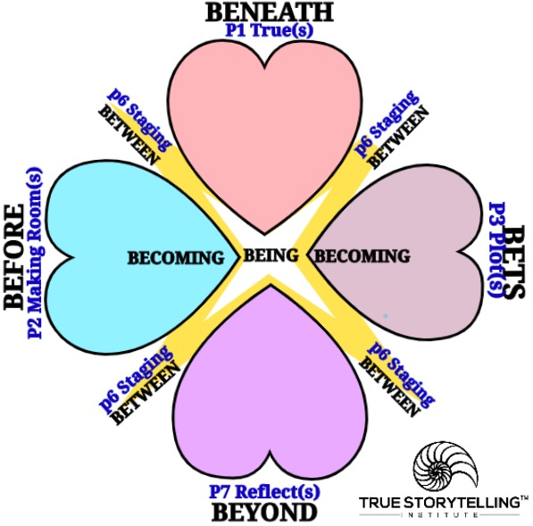
Storyboarding the
in-Between-the-Hearts

Slide 7
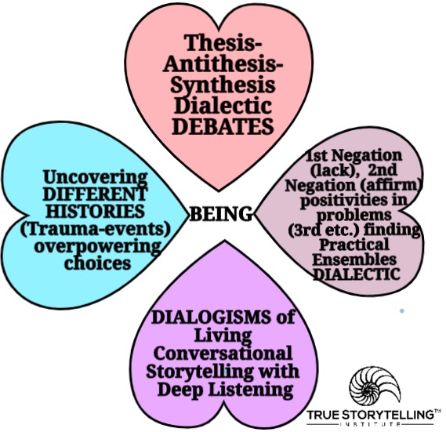
What are 4 Kinds of StorytellingConversations

Slide 8
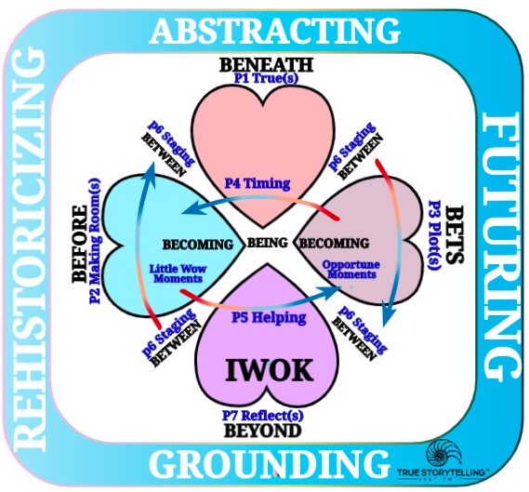
Question: What Directions is TIMING?

Slide 10
The BENEATH and BEFORE Principle 1 (True) & Principle 2 (Make Room)
P4 (Timing): When time is flattened out, it is a pre-conception, a narrative of selected (cherry-picked events & characters & themes) of the BENEATH.
BEFORE: History, is not usually the whole history, its a partial account, and BME, becomes a part substituting for the Whole of history.
Some with BENEATH, a simplifying concept substitutes for depth of a problem, so the roots of the problem, never gets into the narrative.

Slide 11
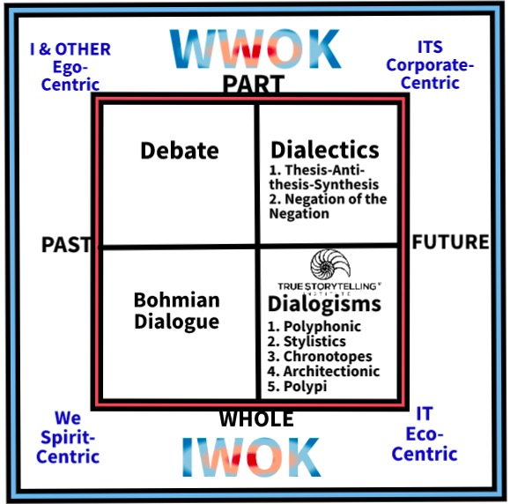

Slide 12
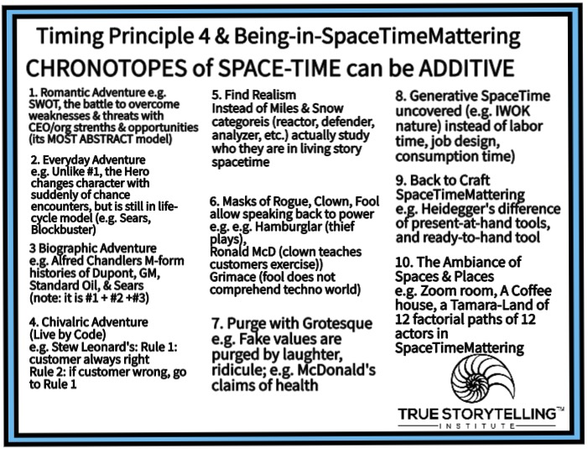

Slide 13
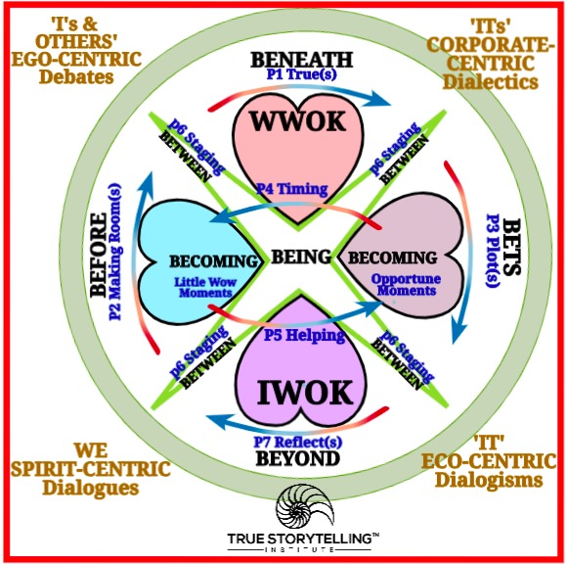

Slide 14
Question: What is the Essence of Truth?
Core concepts of BEING in spacetimemattering UNCOVERING Truth
-Truth of unconcealment
-Freedom
-Letting be
-Self Correcting process of Uncovring
Essential truth, the unconcealment of BEING (Principle 5 Timing) of freedom in open dialogue of True Storytelling: “Freedom was first determined as freedom for what is opened up in an open region” (Heidegger, The Essence of Truth 1931/2013: Section V).

Slide 15
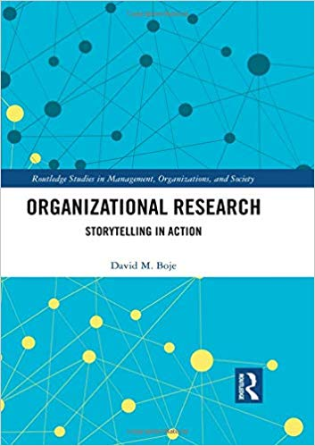
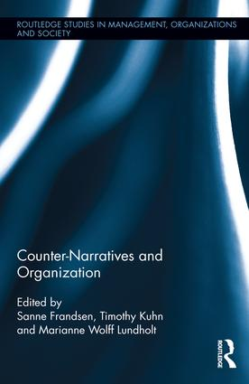
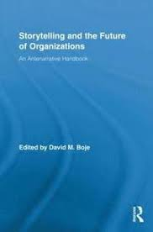
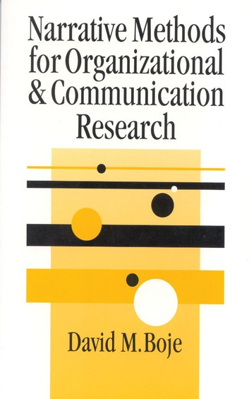
Antenarrative Books:
2019
2016
2011
2001
Notes:
<number>

Slide 16
SpaceTimeMattering is INSEPARABLE in BEING
The 7 antenarrative processes put space and time and mattering together, so all three are the inseparable ‘essence of truth’ (Heidegger, 1931/2013, on line).
Hegel’s dialectic makes time the truth, and space the metaphor by abstracting (BENEATH/Principle 1 What is True), and looses touch with mattering. In other words, Space, in Hegel, can only have truth as time (metaphor), and this is the problem with the dialectic, “the negation of space” (#430).

Slide 17
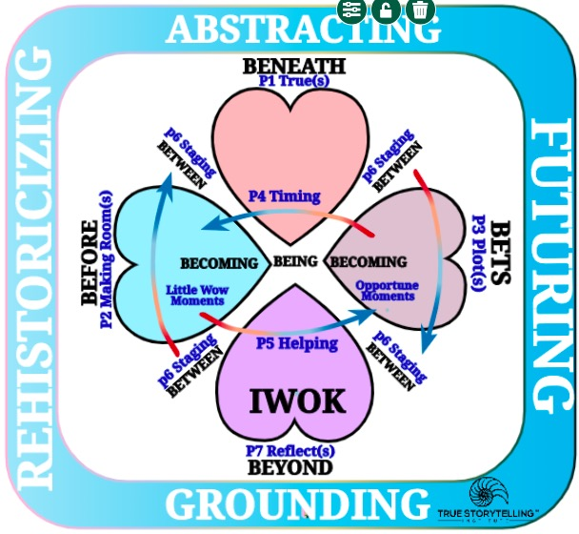

Slide 18
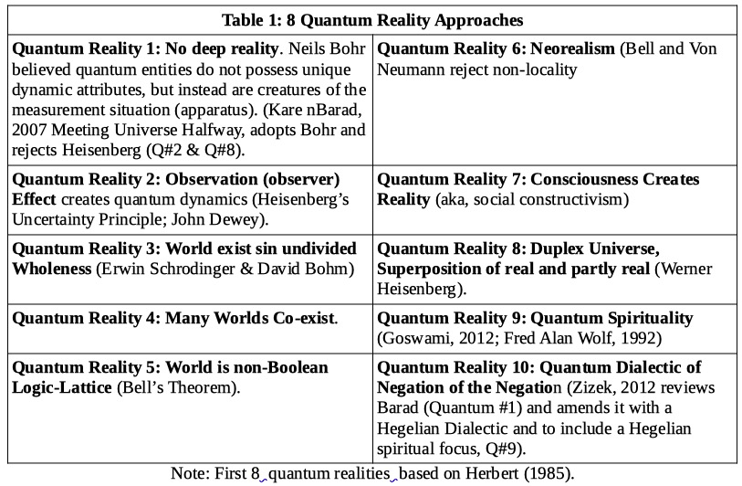

Slide 22
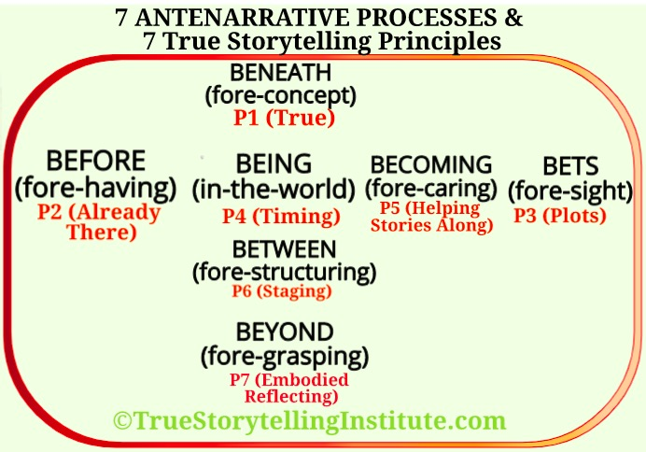
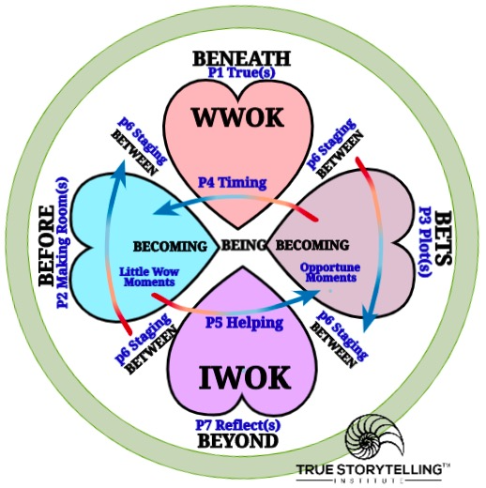
Old 1 Principle=1 Process Tool
The ‘New’ 4 HEARTs Tool

Slide 23
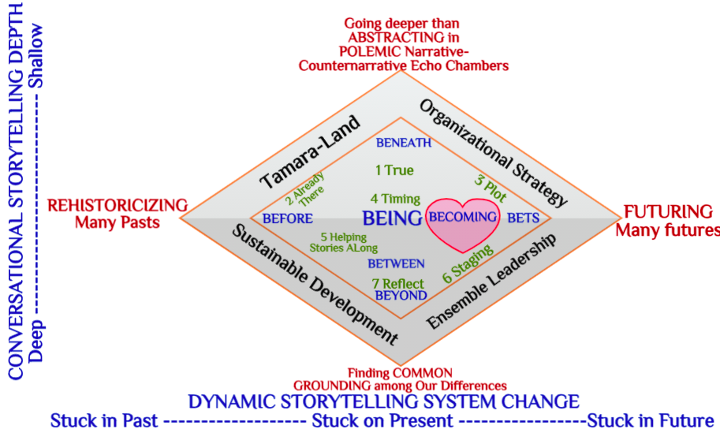

Slide 25
Notes:
Adapted from Bill Sharpe’s (2013) Three Horizons book
<number>

Slide 26
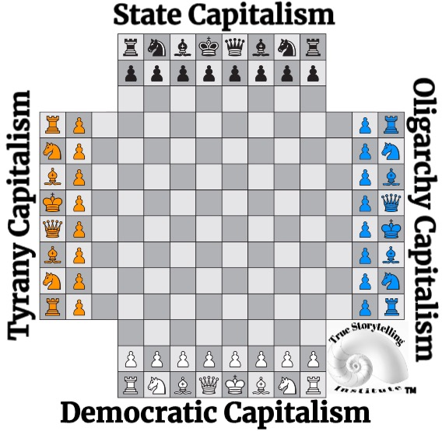
The Story of Four PLOTS (P3) and their BETS on the Future – 4 Capitalisms Playing Chess with the World
QUESTION: Is 4 Player Chess a linear GAME? Or Is it cycle of turn taking?

Slide 27
There are 4 capitalism playing chess. Each team places their bets and plots to win the center space, and capture opponents pieces.
Wolff,( 2020:iii-vi) says all 4 capitalisms try to solve the same problems:
1. Enterprises organized undemocratically
2. Unstable business cycles of boom & bust
3. Inequality of wealth & income
Each Capitalism BEFORE claims the Other capitalisms are the worst solutions (P2 Already There)
Each Capitalism is a Noun-character, with 6 Adjectives blaming the other guys, but none of them seem to work on the WHOLE SYSTEM (Studium), and therefore are not solving basic process problems creating the system problems.
A process is an action verb, the capitalisms are nouns, and instead of solving the 3 problems, each blames the other using these 6 adjectives.
1. racism
2. Unemployment
3. Sexism
4. Poverty
5. Inequality
6 Political corruption
while Other Capitalisms, increase them
POINT: its a Game of plotting with Noun and Adjectives of blame the other capitalisms,
without the Verb (process).

Slide 28
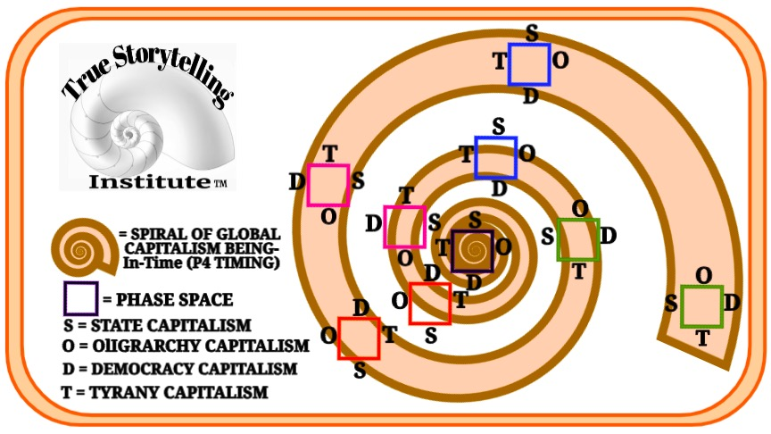
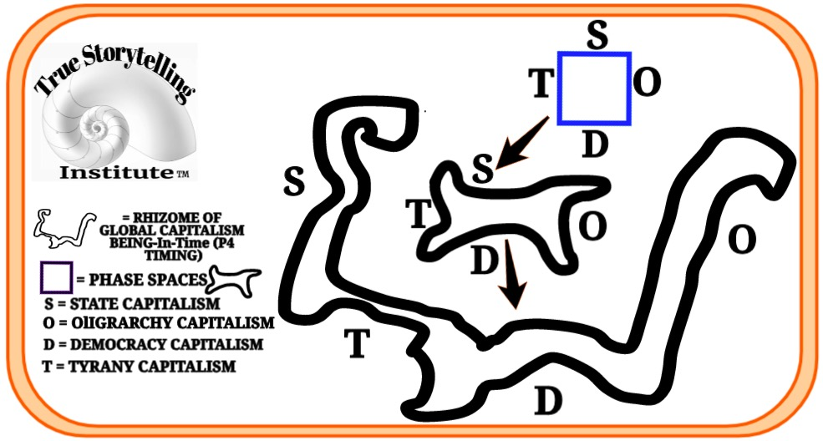
CYCLE of 4 Player Chess plotting & bets, is already a spiral because the pattern of the WHOLE is shifting
Turn by turn.
The spiraling game of plotting and bets on the future shifts again, into the Rhizome
Which is quite UNSTABLE SITUATION
POINT: Know which STUDIUM GAME is being played, as you guide a WHOLE SYSTEM CHANGE, and some BETS ON THE FUTURE can get made that give Peace & Well-Being a chance

