Slide 1
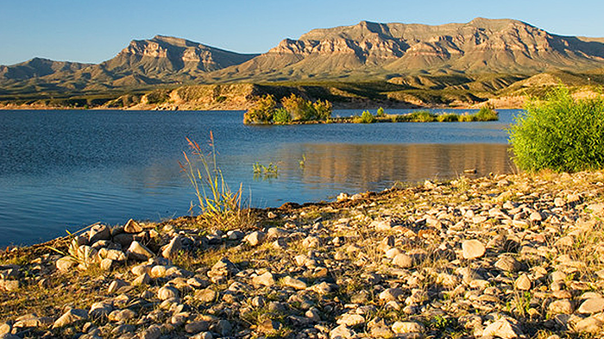
Whites WOKE your WOK
David Michael Boje
Caballo, New Mexico in the Land of Enchantment
Tellsittrue.com

Slide 2
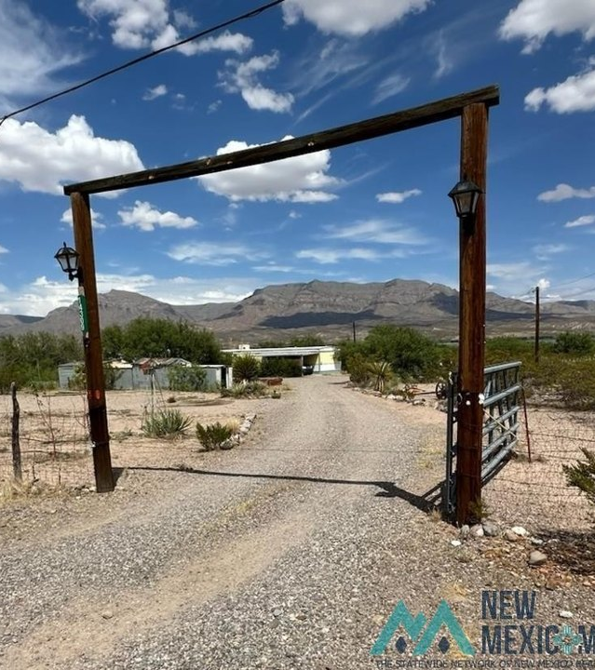
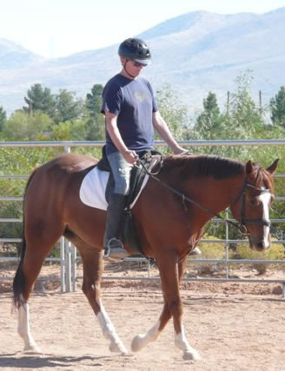
I’m David Michael Boje
I am not indigenous to this place, our mobile homes in Caballo, New Mexico
(Caballo is Spanish for horse).
Population of Caballo is 72 White People
Why we moved here?
Notes:
https://www.nmlegis.gov/handouts/LGC%20100412%20Item%208%20Chihene%20Nde%20Nation%20Presentation.pdf

Slide 3
Agenda - Whites WOKE your WOK
What is WOKE and WOK?
How have they changed over the years, decades, centuries?
How many WOKEs are there? 2, 3, more
How many WOKs are there?2, 3, 4, 10 or more
How do Non-Natives to a place, develop Land Ethics?
Invite to Cornucopia Conference Dec. in New Mexico

Slide 4
Caballo the Nameless City till 1930s
Before it was named Caballo, this area, now Caballo Lake was nameless.
Named Lake Caballo, but it’s really a reservoir built in the 1930s, part of the New Deal Program during the Great Depression.
What was the River Before the Elephant Butte (originally, Hot Springs) and Caballo dams,
MORE DAMS:
Vado Reservoir: Part of the Middle Rio Grande Conservancy District.
Heron Reservoir: Part of the San Juan–Chama Project, which brings water from the Colorado River Basin.
Nambe Reservoir: Located in the Middle Rio Grande.
Cochiti Reservoir: Located in the Middle Rio Grande.
Jemez Canyon Reservoir: Located in the Middle Rio Grande.
Galisteo Reservoir: Located in the Middle Rio Grande

Slide 5
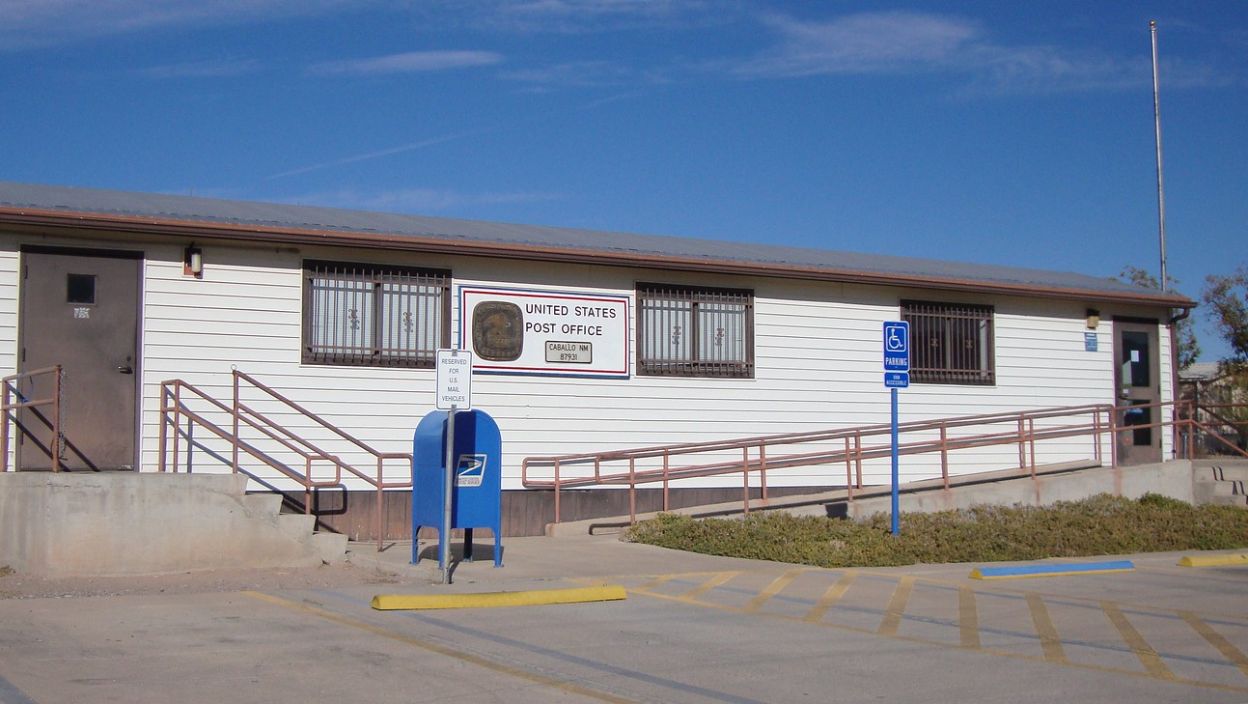
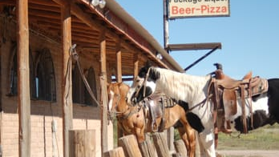
Welcome to an All-White Small City
Only 72 people live here
No White (Hispanic) or Black or African American (Non-Hispanic) residents.
No Indigenous residents in the Caballo census.
All are White here
Can Whites be WOKE?

Slide 6
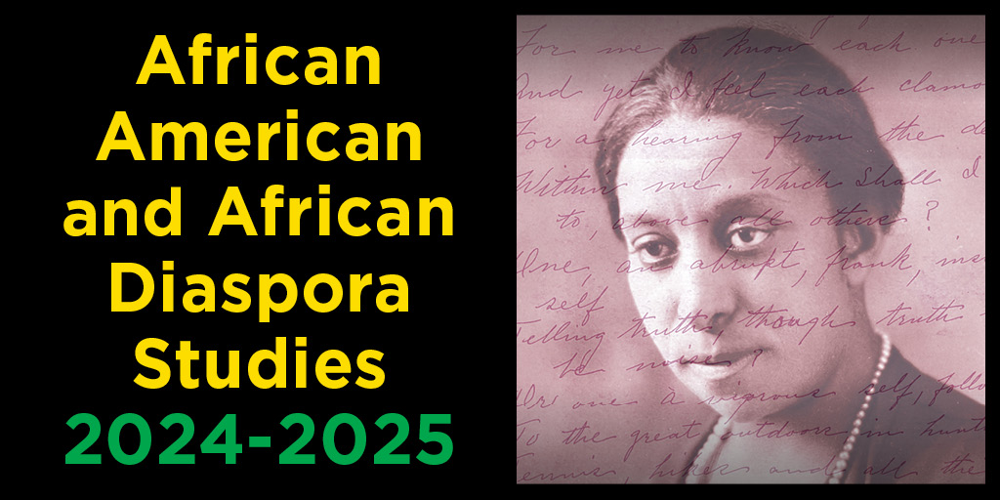
WOKE began as African-American Term
Not a White folk term,
but language changes

Slide 7
Notes:
https://www.naacpldf.org/woke-black-bad/

Slide 8
Stay Woke
Woke' is derived from African-American everyday speech originally meaning alertness to racial prejudice & discrimination.

Slide 9
WOKE gets Appropriated
Notes:
https://www.naacpldf.org/woke-black-bad/

Slide 10
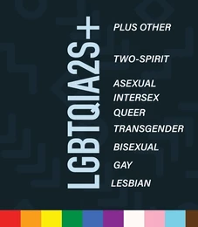
WOKE Appropriated
Lately WOKE has come to be slang for a broader awareness of social inequalities among 'ways of knowing’.
Including prejudice & discrimination against LGBTQIA2S+
EVER WONDER WHAT THE 2S STANDS FOR?
LEARN ABOUT SUPPORTING YOUTH WHO IDENFITY AS TWO-SPIRIT
Notes:
https://support.google.com/websearch?p=ai_overviews&hl=en

Slide 11
What does W-WOK Mean?
Western Ways of Knowing, based on Western Knowing;
Or Western science based on the scientific method and emphasize logic, rationality, and objectivity
Positivism
A philosophical tradition that rejects the spiritual or metaphysical realm as a source of knowledge.
Anthropocentric
Western science is sometimes criticized for being anthropocentric, meaning that it views humankind as the most important element of existence.
Reductive
Western science is sometimes criticized for presenting a subject or problem in a simplified form.
-Google Generative AI

Slide 12
What is history of W-WOK?
The history of "Western Ways of Knowing" primarily traces its roots back to ancient Greek philosophy, where thinkers like Socrates, Plato, and Aristotle laid the foundation for a logic-based, rational approach to understanding the world, emphasizing observation, analysis, and the pursuit of objective truth; this approach was further developed and refined through the European Renaissance and Enlightenment periods, leading to the modern scientific method, which heavily influences how knowledge is constructed in the West today, often prioritizing quantitative data and empirical evidence over other forms of knowing.
-Google Generative AI

Slide 13
What about Indigenous-WOK?

Slide 14
Is Everyone Indigenous?
No, not everyone is indigenous, but the term "indigenous" is inclusive of a wide range of cultures and peoples:
Definition
Indigenous people are the original inhabitants of a specific area, with deep historical connections to that place. They are culturally distinct societies and communities with their own languages, traditions, and belief
(Google Search Engine Answer from its -Google Generative AI).

Slide 15
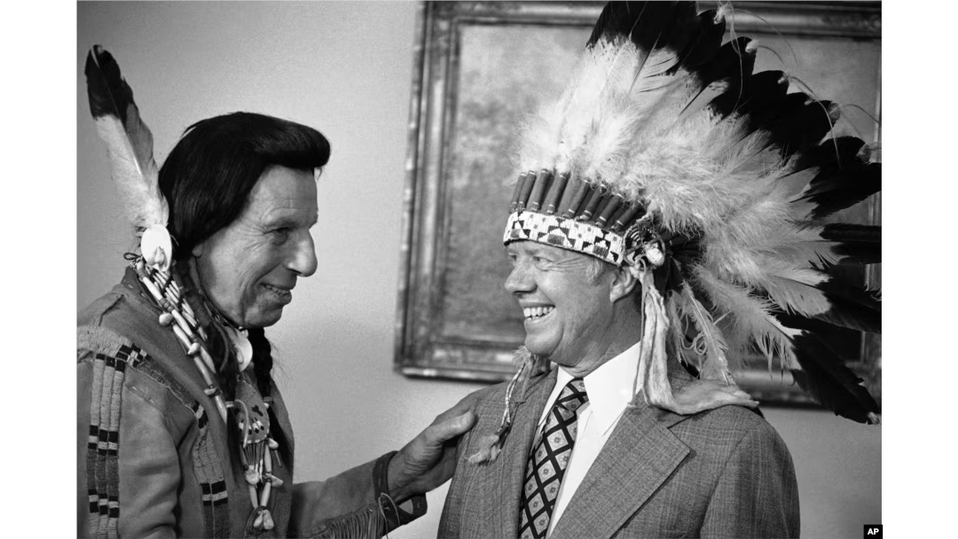
Can Whites call themselves Indigenous?
Make America Beautiful ad
“The whole Crying Indian thing is pretty crystal clear — wrong, wrong, wrong,”
Notes:
Actor William Conrad plays an Indian 1972. Jimmy Carter press op -- https://www.nytimes.com/2023/02/27/us/native-american-pollution-ad.html

Slide 16
Was Everyone Indigenous at the beginning?
No, not everyone was indigenous at the beginning, and there is a great deal of diversity in the history of human migration:
Modern humans outside of Africa - According to a Harvard University study, modern humans outside of Africa are descended from a single founding population.
First Americans - The first people to arrive in North America were the Clovis people, who came over a land bridge from Asia and Siberia around 13,000 to 13,500 years ago.
Indigenous peoples of the Americas - Indigenous peoples of the Americas migrated from Sub-Saharan Africa.
Iceland -The first people to arrive in Iceland were Gaelic monks and then the Vikings, but their descendants are not considered Indigenous.
Scandinavians- Most Scandinavians can trace their ancestry to migrations in 4000 and 2500 B.C., but the Sami reindeer herders are considered Indigenous because their Siberian ancestors arrived closer to 1500 B.C.
(Google Search Engine Answer from its -Google Generative AI).

Slide 17
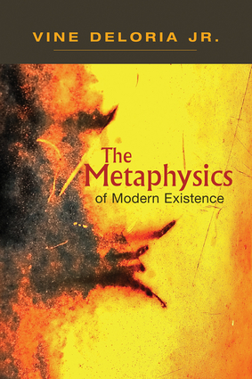
What did W-WOK do to Indigenous People?
"In recent years there has been an awakening to the fact that Indian tribes possessed considerable knowledge about the natu­ral world. Unfortunately, much of this appreciation has come too late to enable anyone, white or Indian, to recapture some of the most important information on the lands, plants, and animals of the continent. In a parallel but unrelated development, Indian religious traditions are now of major interest to whites, whose own religious traditions have either vanished or been swamped in reactionary fundamentalism"
His book The Metaphysics of Modern Existence

Slide 18
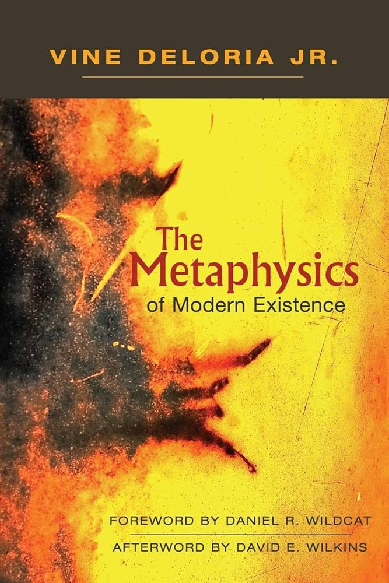
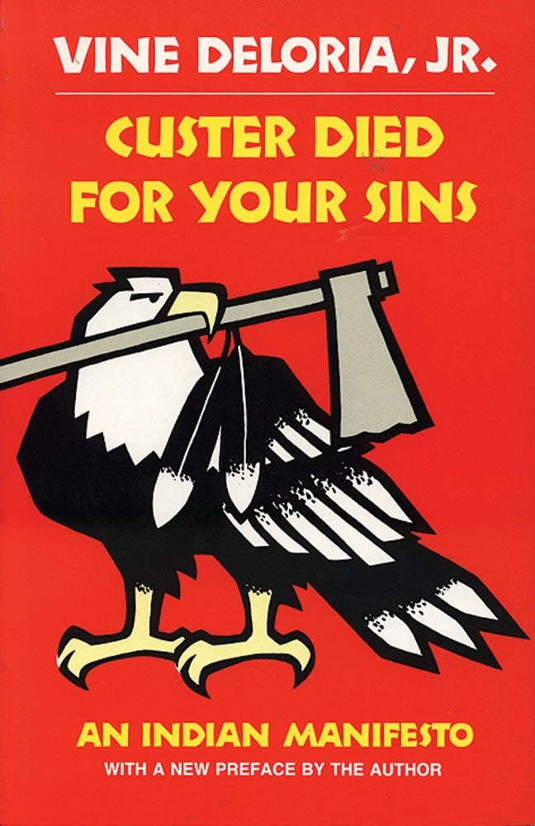
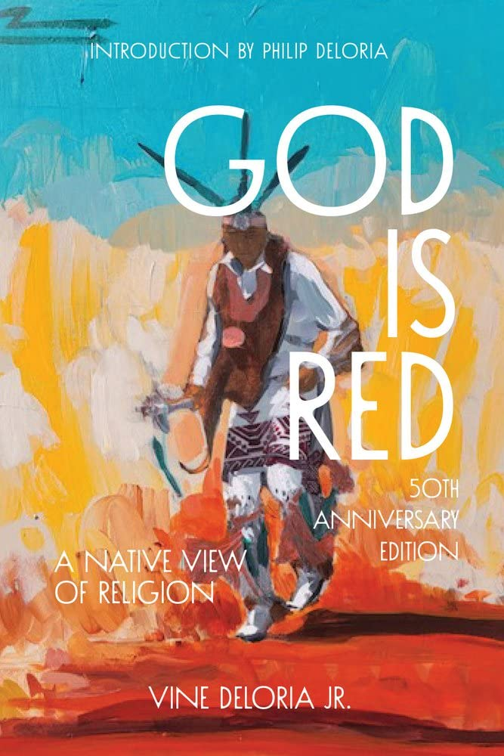
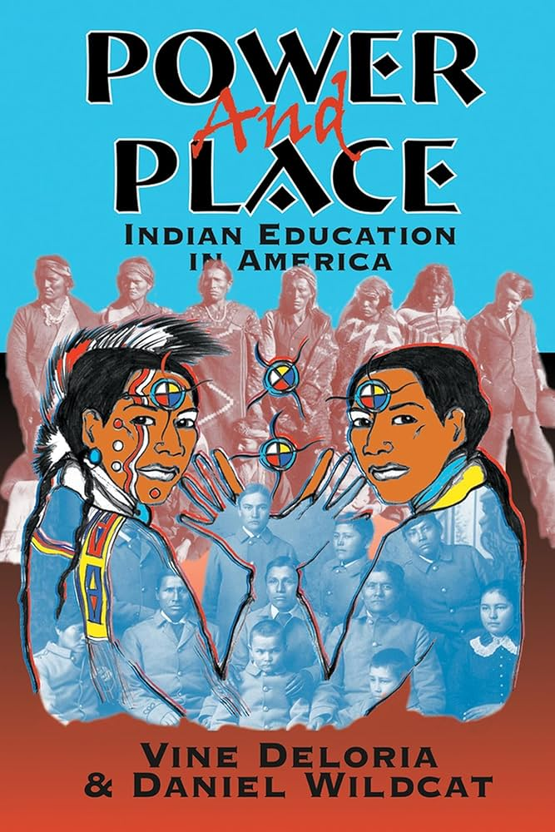
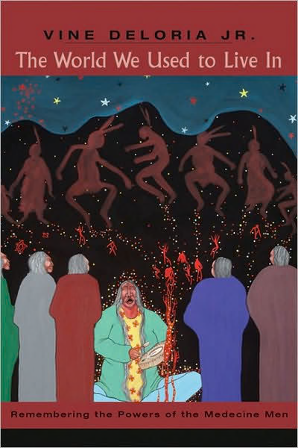
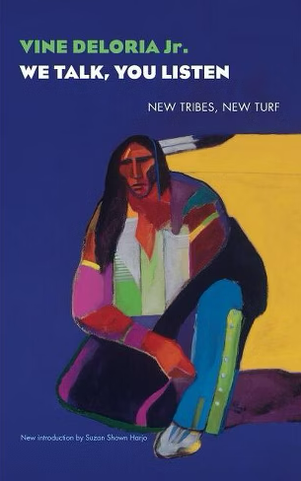
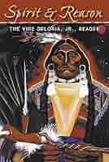
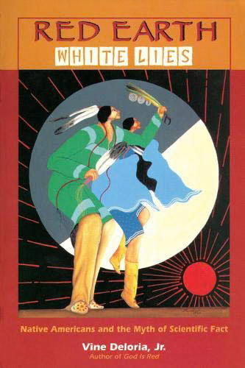
Vine deloria Jr.

Slide 19
American Indian Metaphysics
For many centuries whites scorned the knowledge of American Indians, regarding whatever the people said as gross, savage super­stition and insisting that their own view of the world, a complex mixture of folklore, religious doctrine, and Greek natural sciences, was the highest intellectual achievement of our species
-Deloria Chap 1: American Indian Metaphysics

Slide 20
Blackfoot Metaphysics
But Where is Western Metaphysics Taking Us?
We as homo sapiens, are we better off as a result of it?
Is it really advancing the reasons for our existence?
(If we ever stop and think about it)
Is our current metaphysics not another passing phase?
Maybe there are other metaphysics that we should take a look at.
-Leroy Little Bear

Slide 21
Energy Waves are the Spirit
Everything in Creations consists of energy waves
-Leroy Little Bear

Slide 22
Everything is Animate
Everything in Creation is Animate and imbued with Spirit
-Leroy Little Bear

Slide 23
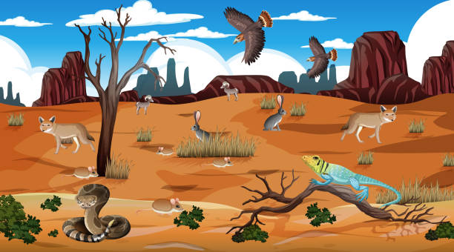
Everything is Related
All My Relations
-Leroy Little Bear

Slide 24
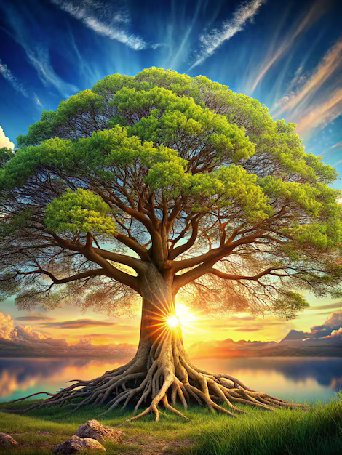
RENEWAL
Reality Requires Renewal for Continuing Existence
- Leroy Little Bear

Slide 25
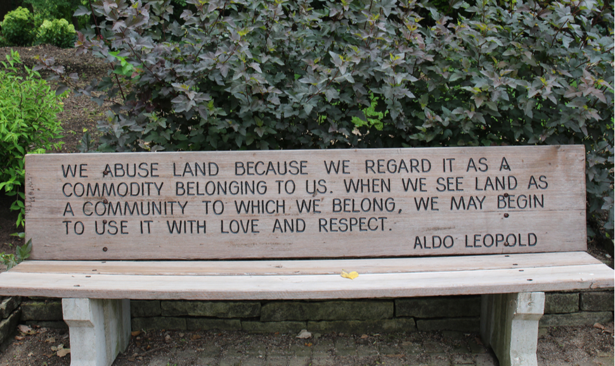
What is W-WOK land ethic?

Slide 26
←WE live
in
Caballo

Slide 27
History of indigenous Peoples where I live
Evidence of human occupation dating back at least 11,000 years:
Clovis culture: Hunter-gatherers left behind stone tools and evidence of campsites.
Ancestral Puebloans: Built stone and adobe brick houses after the invention of agriculture.
Pueblo peoples: Descended from the Ancestral Puebloans, they lived along major rivers like the Rio Grande, Pecos, and San Juan.
Spanish arrival: In the 1500s, Spanish missionaries converted many Native Americans to Catholicism, but Native beliefs and customs persisted.
Today: New Mexico is home to 23 tribes, pueblos, and nations, each with its own government, traditions, and culture.

Slide 28
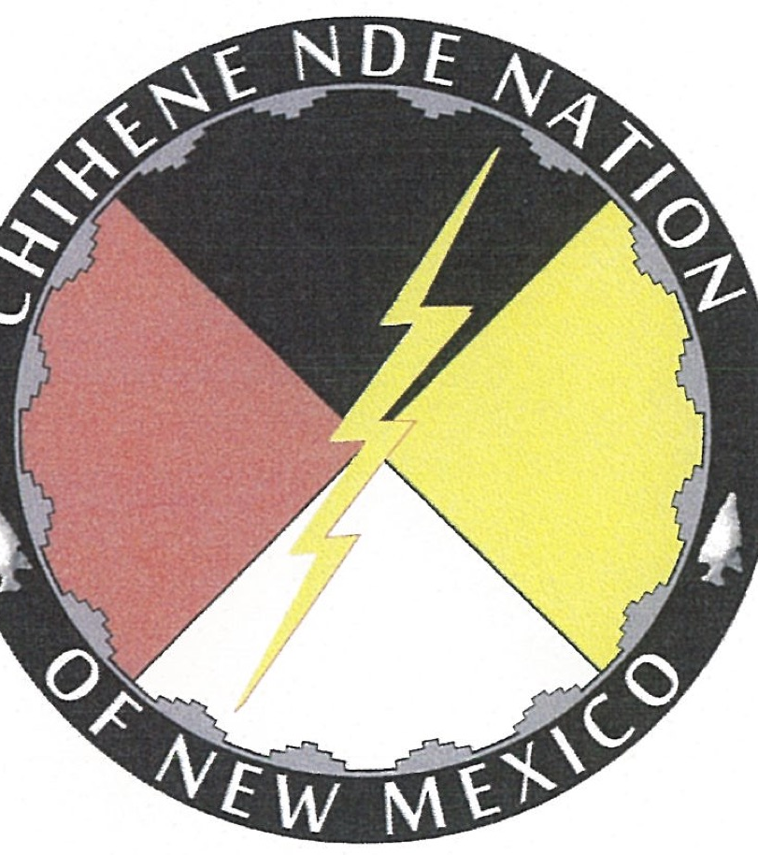
Chihene Nde Nation where I live
The Chinese Nde people (include Warm Springs Apache is seeking acknowledgement of their existence of these people
In Sierra County, NM the ‘Chi'hene Nde Nation’ still practice Indigenous Land Ethics around Caballo mountains, Sierra County, New Mexico.
Part of Apache people arrived here between 1000 and 1500 A.D.
Indigenous people in the Americas, 15,000 - 25,000 years ago,

Slide 29
Other Indigenous Peoples along Rio Grande where I live
Manso people The ancestral and present-day homelands of the Manso people include the area around Las Cruces.
Piro-Manso-Tiwa tribe The present-day homelands of the Piro-Manso-Tiwa tribe include the area around Las Cruces.
Pueblo people The Pueblo people lived in small towns along the Rio Grande valley.
Navajo and Apache These nomadic peoples also lived in the region before the Spanish colonized New Mexico in the sixteenth century.

Slide 30
Census of Sierra County, NM Where I Live
Race and Hispanic Origin
White alone, percent |  91.5%
Black or African American alone, percent(a) |  1.3%
American Indian and Alaska Native alone, percent(a) |  3.3%
Asian alone, percent(a) |  0.9%
Native Hawaiian and Other Pacific Islander alone, percent(a) |  0.1%
Two or More Races, percent |  3.0%
Hispanic or Latino, percent(b) |  30.2%
White alone, not Hispanic or Latino, percent |  64.4%

Slide 31
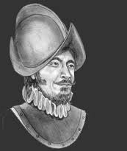
Census of Truth or Consequences, New Mexico 20 miles north of where I live
The five largest ethnic groups in Truth or Consequences (6030 people) are: White (Non-Hispanic) (56%), White (Hispanic) (17.8%), Two+ (Hispanic) (13.4%), American Indian & Alaska Native (Non-Hispanic) (5.04%), and Other (Hispanic) (4.71%).
Sierra County population, 11,576.
The Apache Indigenous people roamed Sierra County, New Mexico region by the time Francisco Vázquez de Coronado's expedition arrived in 1540

Slide 32
Can’t we just Braid W-WOK with I-WOK? Like the Māori do

Slide 33
Chinene Homeland where I live
The Chi'hene people consider the area around Ojo Caliente to be the sacred center of their homeland.
The Chi'hene people are known for their respect for women, who have strong voices in decisions that affect the community.

Slide 34
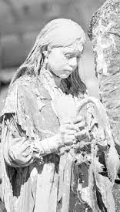
White Painted Woman

Slide 35
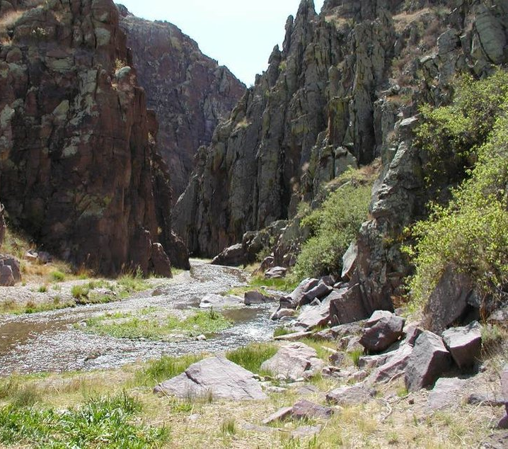
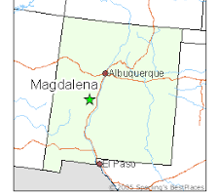
Chinene Creation Story – White Painted Woman
“We are taught that we came to be as people on the Saint Augustine Plains, near that is today Magdalena NM, when White Painted Woman came to rest on the plains in an Abalone shell and began giving birth to our people.
Soon after creation our people moved into what has been known as the Monticello Box Canyon in the Canada Alamosa or the Oho Caliente.
We are taught that our people lived together in the canyon as a people util they grew too numerous for the natural resources in the canyon to support
It was at this time that our ancestors broke into what became known as the four main Bands of the Chiracahua Apache the Chinese, Bedonkohe, Chokonen, and Nandi.”
←WE live
In Caballo
Notes:
https://www.nmlegis.gov/handouts/LGC%20100412%20Item%208%20Chihene%20Nde%20Nation%20Presentation.pdf

Slide 36
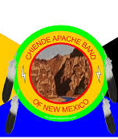
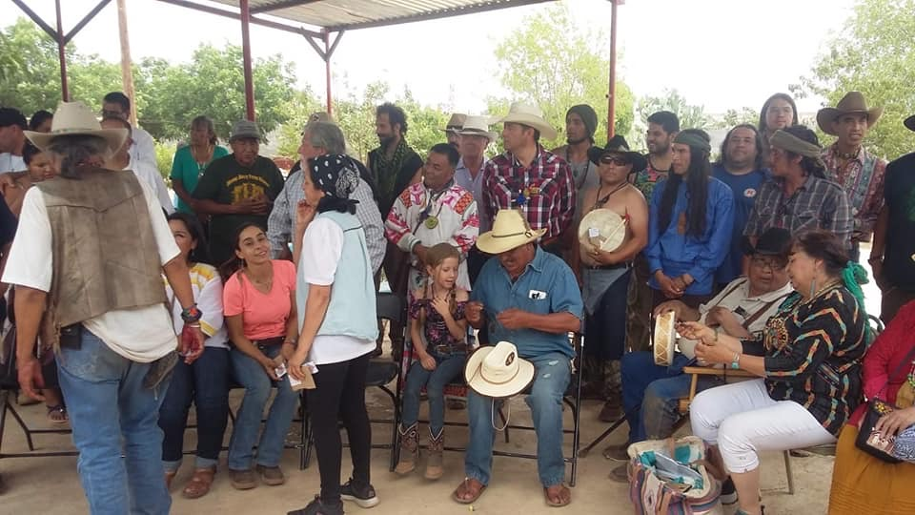

Slide 37
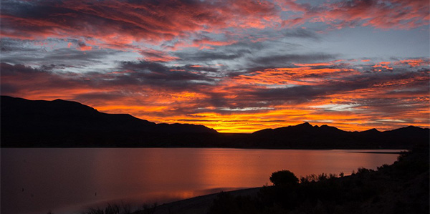
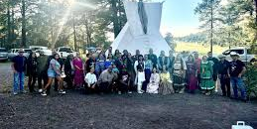
The Caballo Mountains, just south of Truth or Consequences (originally, Hot Springs), rise to an elevation of 7,065 feet.

Slide 38
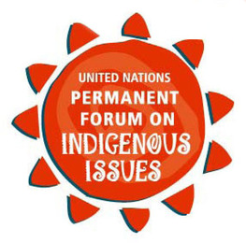
United Nations Permanent Forum on Indigenous Issues Says, White can call themselves Indigenous, if and only if:
1. Self-identification as Indigenous peoples at the individual level and accepted by the community as their member. 2. Historical continuity with pre-colonial and/or pre-settler societies. 3. Strong link to territories and surrounding natural resources. 4. Distinct social, economic or political systems. 5. Distinct language, culture and beliefs. 6. Resolve to maintain and reproduce their ancestral environments and systems as distinctive peoples and communities.
https://www.stonecirclepress.com/blog-9658-ancient-spirit-rising/are-white-people-indigenous

Slide 39
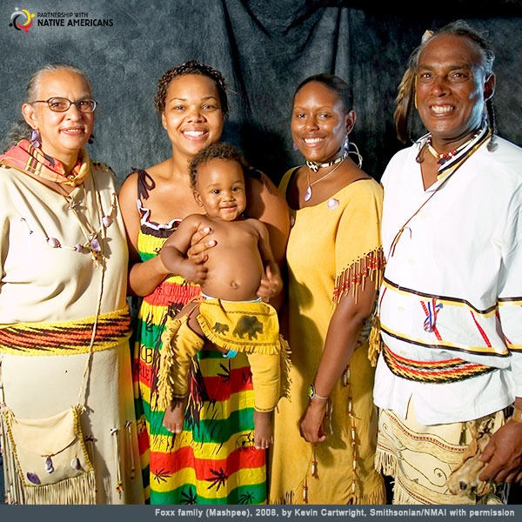
Can African Americans call themselves Indigenous?
Yes! “Black Natives exist! We are Indigenous peoples of (what is currently known as) the Americas and the Caribbean, and we are also the descendants of Indigenous peoples of Africa.
This identity often includes Freedmen—the free men and women who were once enslaved by citizens of the Five Tribes (Cherokee, Chickasaw, Creek, Seminole, and Choctaw)—and their descendants.
Black Natives and Freedmen are the legacy of our Black and Native ancestors”
Notes:
https://americanindian.si.edu/ancestors-know/reflections/black-native-identity-and-futurity/
https://nativepartnership.org/blog/history-culture-justice-category/black-history-month-and-the-contributions-of-afro-indigenous-americans/

Slide 40
Can White People Have an Indigenous Land Ethic?
Yes, white people can adopt and practice an Indigenous land ethic, although it's important to acknowledge the complex historical context and understand that it cannot fully replicate the deep cultural connection Indigenous people have with the land; they can still strive to learn from and incorporate Indigenous perspectives on land stewardship into their own practices, while recognizing the need to actively work against the legacy of colonialism on which their presence on that land is often based (Google Search Engine Answer).

Slide 41
Cycle of 6 Rs of Indigenous I-WOK Land Ethics
Respect
Relevance
Reciprocity
Responsibility
Renewal
Relationships

Slide 42
Indigenous Land Ethics
… based on the idea that humans and the land are connected, and that caring for one cannot be separated from caring for the other. Indigenous ethics often include values such as honor, trust, honesty, and humility, and a commitment to the collective.

Slide 43
What can we non-Natives do?
Offering recognition and respect
01
Counteracting the “doctrine of discovery”
02
Creating awareness of the history that led to the current situation
03
Repairing relationships with Native communities and the land
04
Notes:
Patricia M. Jostad, Leo H. McAvoy & Daniel McDonald
Pages 565-581 | Received 07 Nov 1994, Accepted 20 Dec 1995, Published online: 21 Nov 2008
Cite this article https://doi.org/10.1080/08941929609380996

Slide 44
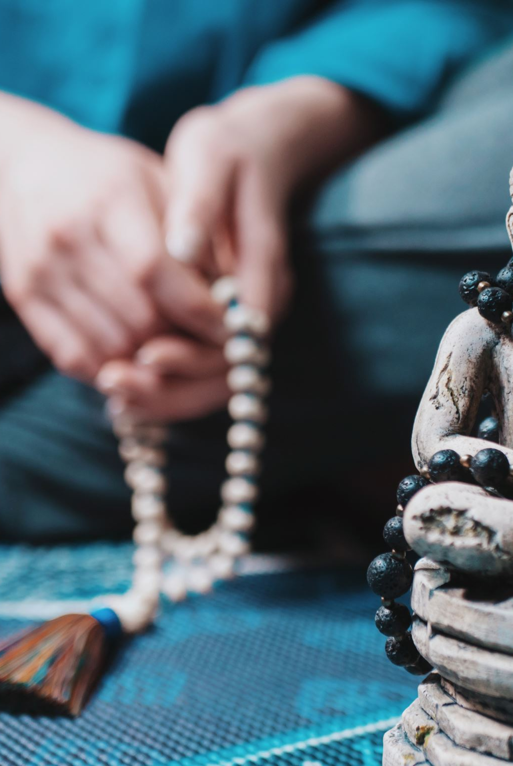
Indigenous Land Ethics
“All is spiritual”: There is no separation between the spiritual and the secular.
“Right Action”; (individual choice of action is based on the belief system);
“All Is Interrelated”; (everything is interconnected in an egalitarian system); and
“Mother Earth”; (the Earth is the physical and spiritual mother of creation).
“Right action”: Individual choices are based on the belief system.
“All is interrelated”: Everything is interconnected in an egalitarian way.

Slide 45
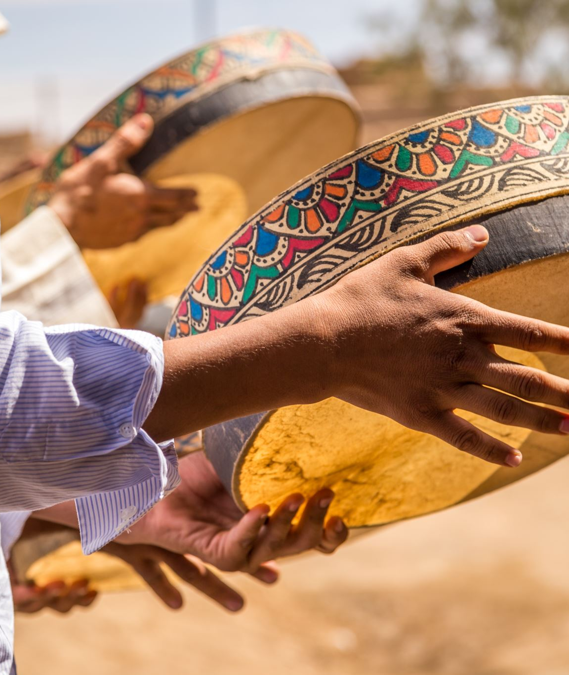
7 Directions
The Tewa-speaking Pueblo peoples practice the seven directions and live in seven distinct communities called "pueblos"

Slide 46
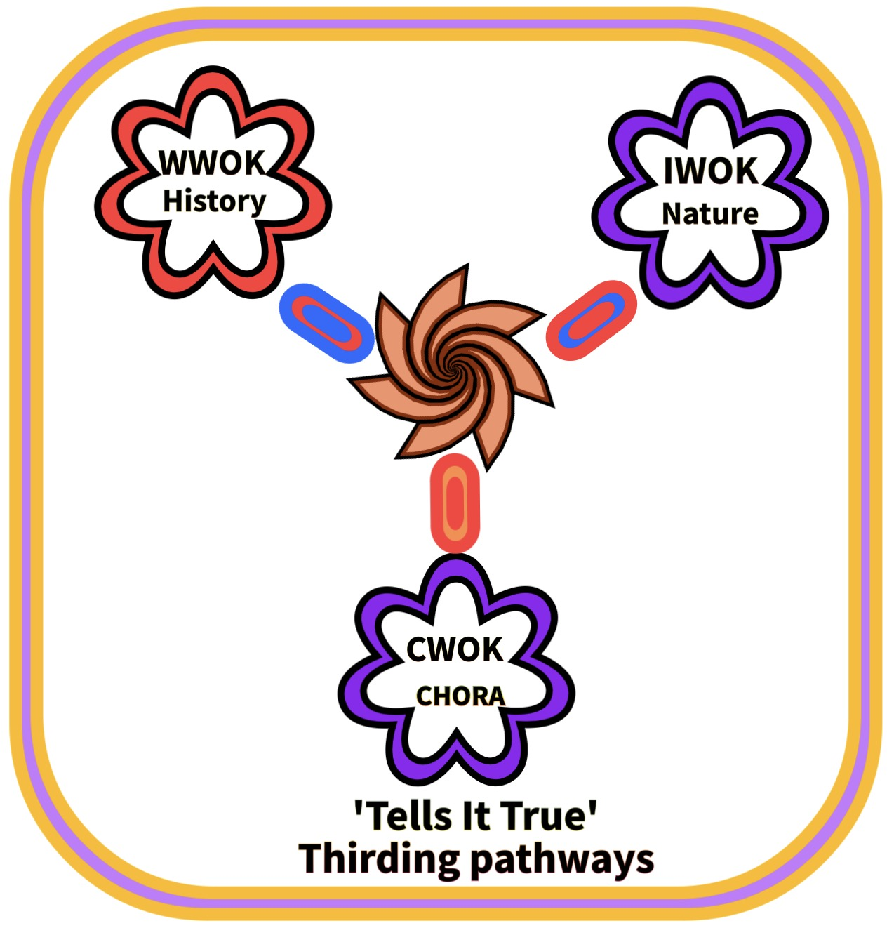
Introduction to CHORA WAYS OF KNOWING C-WOK
Gerri McCulloh and David Michael Boje

Slide 47
There are more than two WOKs to braid?
What about Ways of Knowing before Aristotle and Plato?

Slide 48
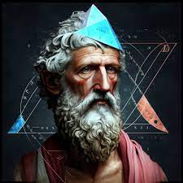
Back to Pythagoras
Pythagoras of Samos (570 to approx. 500 BCE) was an ancient Ionian Greek philosopher, polymath and the eponymous founder of Pythagoreanism.
The Ionians were one of the four major tribes that the Greek
His political and religious teachings were well known in Magna Graecia and influenced the philosophies of Plato, Aristotle
Notes:
Source material TOWARD AN ACOUSTIC RHETORIC: VITAL MATERIALISM’S DIFFRACTIONS
BY GERRI ELISE MCCULLOH, B.A., M.A.
A dissertation submitted to the Graduate School in partial fulfillment of the requirements for the degree
Doctor of Philosophy
Major Subject: Rhetoric and Professional Communication
Minor Subject: Business Management
New Mexico State University
Las Cruces, New Mexico
November 2015
Copyright 2015 by Gerri Elise McCulloh

Slide 49
Are there Male and Female WOKs
You guessed it
The struggle of Patriarchy and Matriarchy was happening back in Pythagoras day.

Slide 50
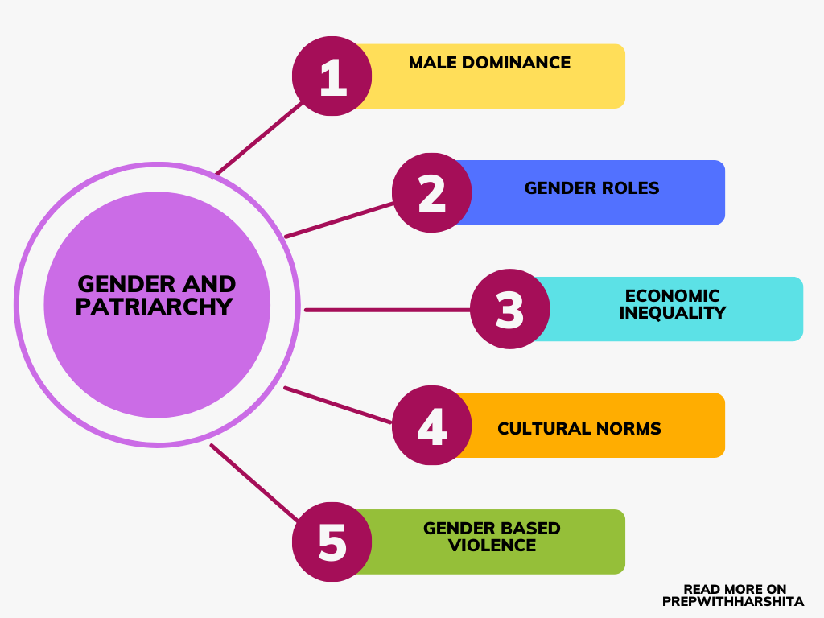
What happened from Pythagoras to today?
1000 to 500 BCE 3000 the move from matriarchy to patriarchy occurred. Note: The concepts of matriarchy and patriarchy are European ways of thinking about societal power

Slide 51
What is Chora as Pythagorean Thirding?
“Agential separability, for Barad, is “exteriority within” and is therefore within a very different thirding of material-discourse [Karen Barad, Meeting the Universe Halfway: 377]” (McCulloh, 2015: 166).

Slide 52
What is Chora?
Chora as the generative place where vital material is energized and marked by dunamis or dynamis; this is an echo of matriarchal generativity… and renewal
“I will look at Chora as generative place that can be accessed through vital materialism’s diffractions: sound and acoustic sensibility” (McCulloh, 2015: 232).
Chora is understood acoustically through feminist materialism (IBID.).
“There is indeterminacy and contingency in naming. Chora as Pythagorean Thirding” (IBID).

Slide 53
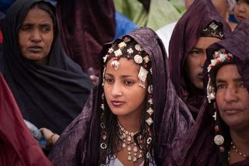
What happened from Pythagoras to today?
570 to approx. 500 BCE Pythagoras lived and emphasized Kairotic time (acoustic vibrant materiality; acoustic fields of music, Kosmos harmonics). Pythagoras lived at end of an era still holding women equal to men (matriarchy & patriotism). Aion (Greek: Αἰών), … . The future is a returning version of the past, later called aevum, and Vedic Sanskrit.
15th & 16th century. Genocide of indigenous populations around the world primarily occurred during the period of European colonization, starting with Christopher Columbus' arrival in the Americas in 1492, leading to a massive decline in indigenous populations & Indigenous Ways of Knowing (IWOK) across the globe, due to violence, disease, and displacement.,
Tuareg are Berber people practicing matrilinear customs, living a nomadic lifestyle in the Saharan dessert (more examples).

Slide 54
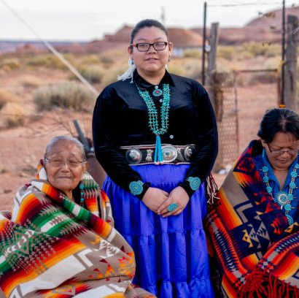
What happened from Pythagoras to today?
17th & 18th centuries Age of Enlightenment, Newtonian Physics ‘Principia in 1687 (time becomes clockworks, clocktime), Age Reason, as we call it: ‘Western Ways of Knowing (WWOK)’, acted to drastically reduce Kairos to Chronos (linear, one-way, chronological time) and Aion time (perpetual cyclical and ritual). Example Newtonian clocktime, cosmos as clockwork.
19th century continued decline of Ways of Knowing (IWOK) as WWOK gained more and more dominance, worldwide. Kairos time is reduced to just ‘opportune moments’ losing its Pythagorean living vibrant materialism, and its acoustic fields. Some indigenous societies have a balance between men and women, with each gender having their own responsibilities, with colonization most became patriarchal.
Photo of Hopi - The Hopi (northeastern Arizona Rez.) are traditionally both matriarchal and matrilineal, with egalitarian roles in the community, and no sense of superiority or inferiority based on sex or gender.

Slide 55
OK, but are there more than three WOK’s
Yes, yes, yes

Slide 56
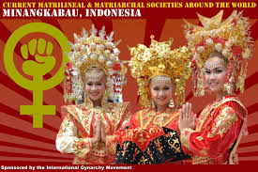
What happened from Pythagoras to today?
In 2007-2014, strands of vibrant materialist work take hold. Vibrant materialists believe that matter has vitality and life, even if it appears lifeless), but are less focused on Pythagorean acoustic harmonics. Examples: Karen Barad (intra-active material/discursive), Donna Haraway (material-semiotic), Jane Bennet (vibrant-matter), and Mira J. Hird (material feminism) rekindle vibrant materialist way of knowing.
2015, Gerri McCulloh revitalizes ‘Chora’way of knowing: (materially generative space-place) as a revival of Pythagorean Kairotic vital acoustic materialism and aligned with vibrant materialists works that destabilizes human-centric view in favor of humans no more important than millions of species inhabiting planet.
For McCulloh Chora is Pythagorean and can contribute ‘soundscapes’ to vital materialisms, and respect for the few remaining matriarchically-oriented. Today most societies are patriarchal.
The Minangkabau
This society is one of the largest surviving matriarchal societies, with women ruling the domestic realm and the belief that the mother is the most important person in society

Slide 57
But are there more than these four WOKs?
Western and Non-Western-WOK, E.G. Eastern-WOK
Non-Western and Indigenous –WOK
Are there more?
Such as Feminist WOK, etc.

Slide 58
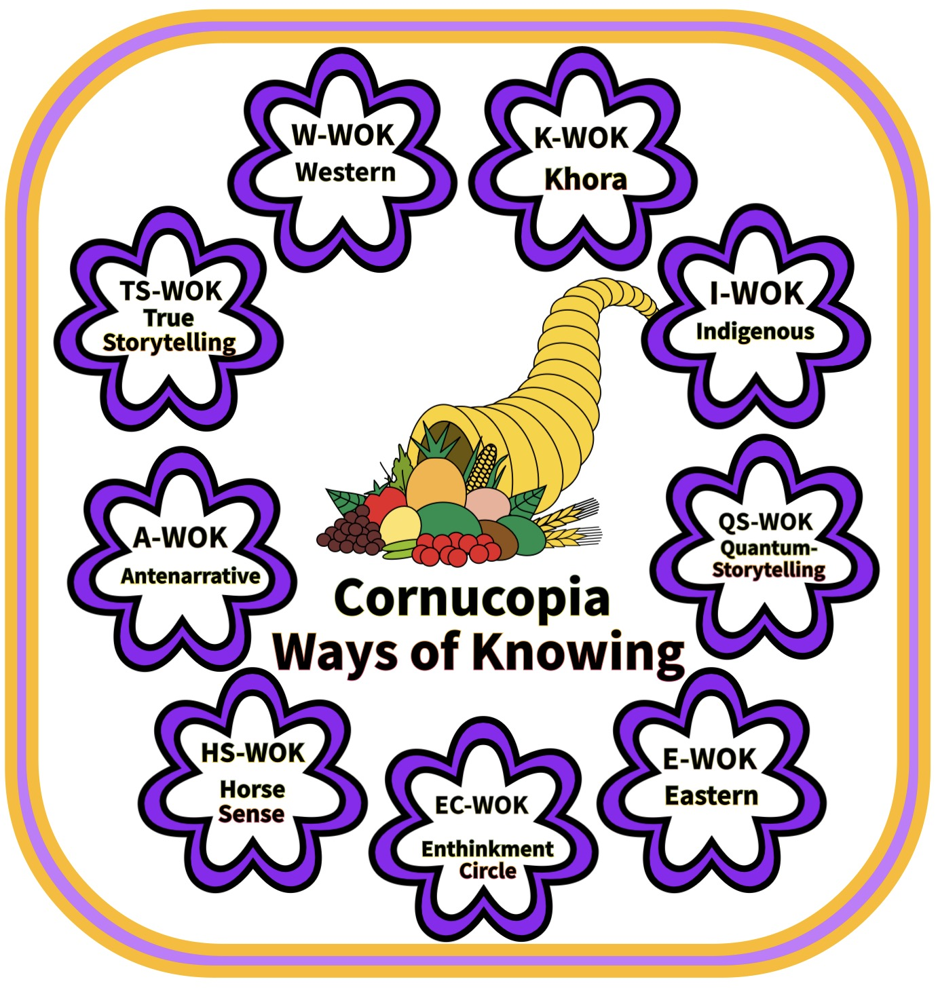
14h Annual CONFERENCE', 15-18 Dec 2024 at Las Cruces, New Mexico

Slide 59
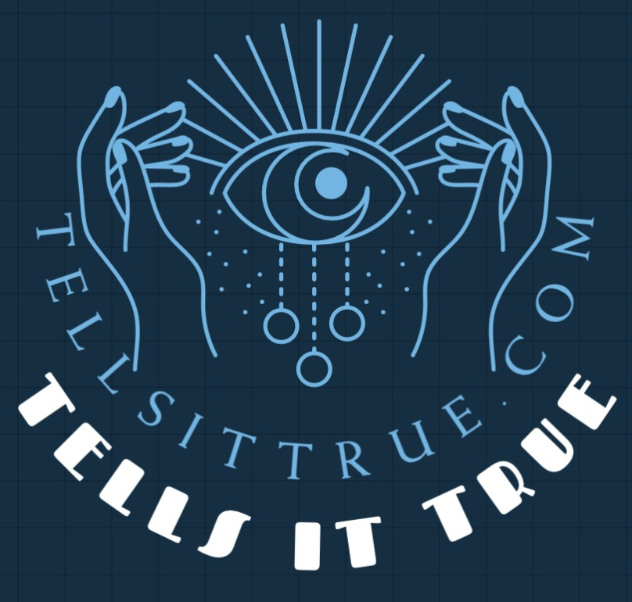
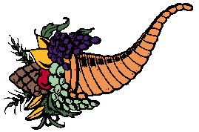
More info about Cornucopia of Woke & WOKs
Annual December Quantum Storytelling Conference –
Quantum-Storytelling.com
Tellsittrue.com
TrueSTORYTELLING.org
davidboje@gmail.com
Antenarrative.com

