Slide 1
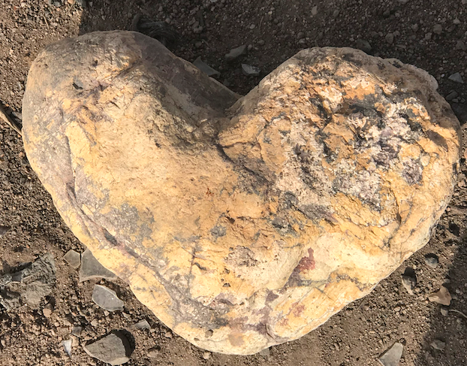
Rock Divination: Talk with your Rock
David M. Boje, Ph.D. Storytelling Professor &
Shamanic Practitioner, Las Cruces NM
GATHERING OF CIRCLES Aug 1 2020
https://davidboje.com/shamanic for the Slides
Notes:
How many of you talk to rocks?
How many collect rocks as you travel?
How many believe rocks are alive?
How many thing rocks have spirit?

Slide 2
WHAT ROCK IS STORYTELLING to You?
Open With Sacred Space for Stardust and Star-rock of our inner body, and its relation to interstellar universe
LEVEL 1: Rock & Stardust Native Science (We are Rock & Stardust)
LEVEL 2: Shamanic Intention – Rorschach Test (Metaphor)
LEVEL 3: Powerful Rocks for Shamanic Divination
Notes:
Rock divination is a way of tuning the earth energy in you and the earth energy in the rock. The rock has vibrant matter energy a memory of all of the places it has been in all of the events and has been exposed to.
LEVEL 1: Rock & Stardust Native Science (We are Rock & Stardust)
Our bodies made of old star dust (Carl Sagan)
Star atoms contribute to our organic molecules in the MICROCOSMOS
LEVEL 2: Shamanic Intention – Rorschach Test (Metaphor)
How Farmers Did Divination thousand years ago
Core Shamanism Method (intro)
LEVEL 3: Powerful Rocks for Shamanic Divination
Pendulum to ask a yes or no question
Shamanic Vibratory Energy Connection to your Body Energy – e.g. Boji Stones Male and Female Energy & Connecting to ‘Heart Stone’ in Desert Pond
Blue Celestite Imbued with Divine Energy for Inner Peace, Conflict Negotiation
The Record Keeper Crystal
Heart Stone to Create Sacred Space in Pond that was collapsing

Slide 3
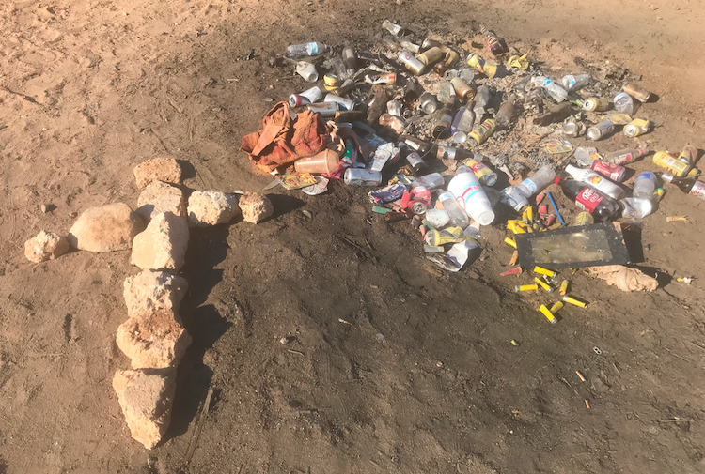
Caring for Pond Being Trashed
Creating Sacred Space – Heart Stone Example

Slide 4
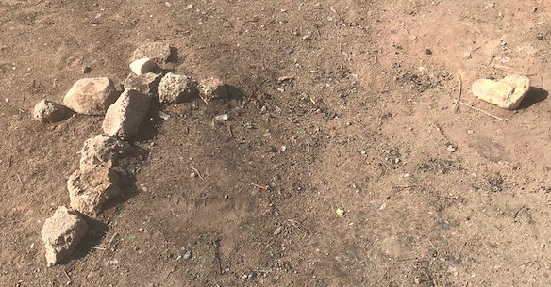
Powerful Rocks for Shamanic Divination CROSSING ALL 3 LEVELS
Creating Sacred Space – Heart Stone Example

Slide 5
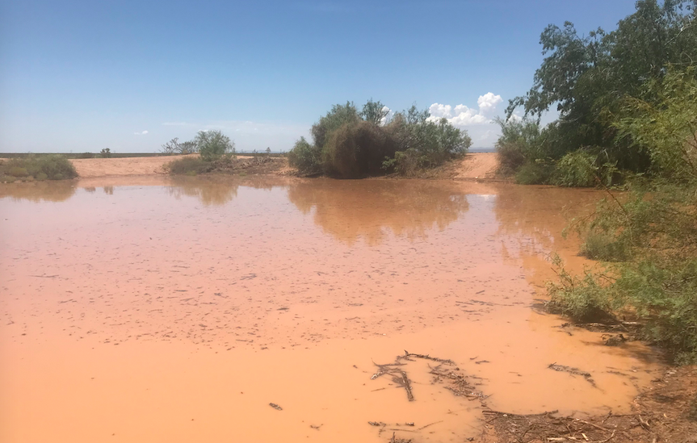
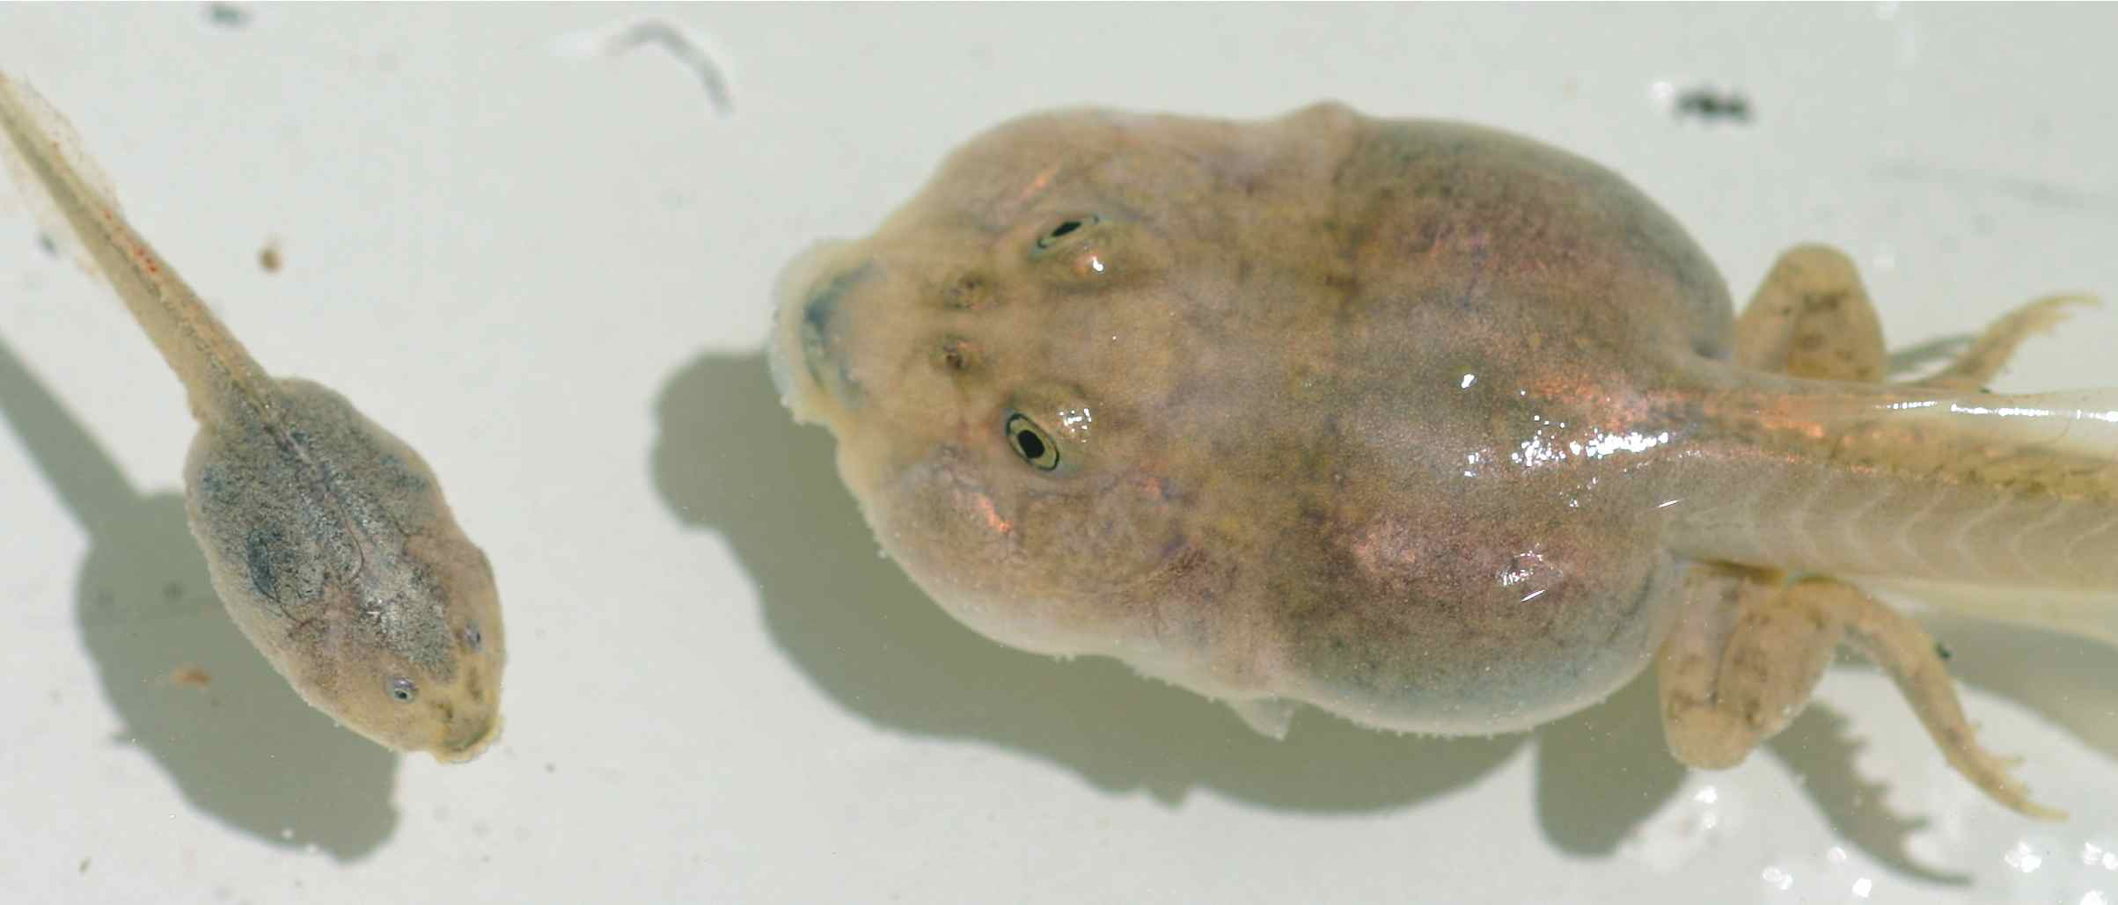
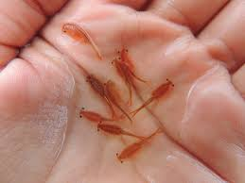
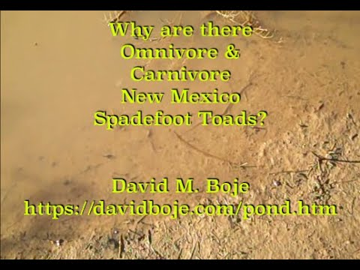
Shamanic Divination https://www.youtube.com/watch?v=ALL4z8ANyWE
Creating Sacred Space – Heart Stone Example

Slide 6
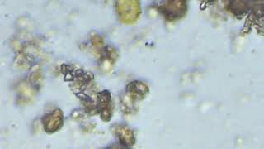
Shamanic Journey to the Microcosmos https://youtu.be/TpwWcYq439U
Stardust and living beings seen at 1500 amplification in Boje’s new microscope

Slide 7
LEVEL 1: Nearly All Elements of Human Body Made of Stardust (Dr. Ashley King)
Notes:
We are made of first generation stars of the Universe in its Big Bang, These first stars 50 times bigger than sun (Ashley says.
When stars die, they shed their star dust, in galactic chemical evolution
Stars start making planets and then start to make water and other ingredients required for life

Slide 8
LEVEL 1: ROCKS ARE Very OLD STAR & PLANET SPIRITS: Moon was formed 95 million years after the birth of the Solar System in collision of planet Theia with Earth
Notes:
Our solar system is 4.571 billion years old. The sun is about half way through its life span, and has about 5 billion years left. It will become 2,000 times brighter in its declining years
Our Milky Way Galaxy is 13.2 billion years old in a universe estimated to be 13.8 billion years old.

Slide 9
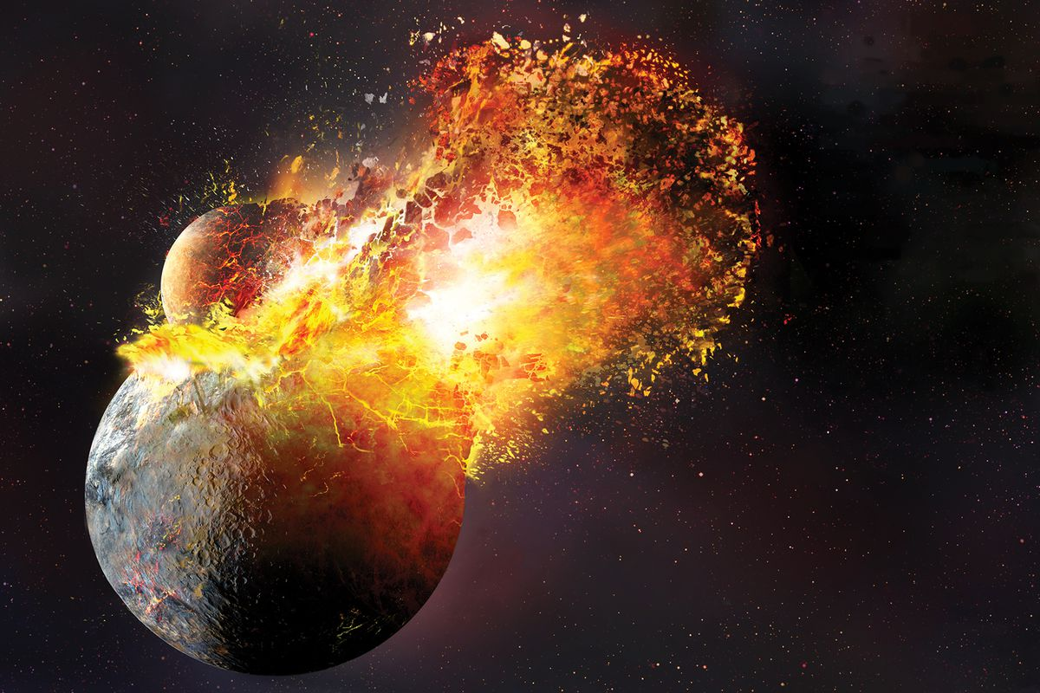
LEVEL 1: Why is this Story so Important?
Moon was formed 95 million years after the birth of the Solar System
Planet Theia collides with Earth
Theia Brings Water to Earth 4.4 billion years ago from Asteroid belt or from Nearby?
Notes:
And ---? 3.36 Billion years ago the Asteroid VESTA impact event with Earth vaporized all the water, Yucatán, Mexico,
LEVEL 1: Giant-impact hypothesis story of the Moon formed by collision between the proto-Earth and a Mars-sized planetesimal called Theia, approximately 4.4 billion years ago
HOW ROCKS SOLVED THE INTERSTELLAR WATER MYSTERY They found that the timing likely coincided with a cosmic smash-up that created the moon. Scientists generally agree that the moon formed from debris left over when the Mars-sized object, known as Theia, slammed into Earth about 4.4 billion years ago. https://www.nbcnews.com/mach/science/how-did-earth-get-its-water-scientists-think-they-ve-ncna1011441 https://www.nbcnews.com/mach/science/how-did-earth-get-its-water-scientists-think-they-ve-ncna1011441

Slide 10
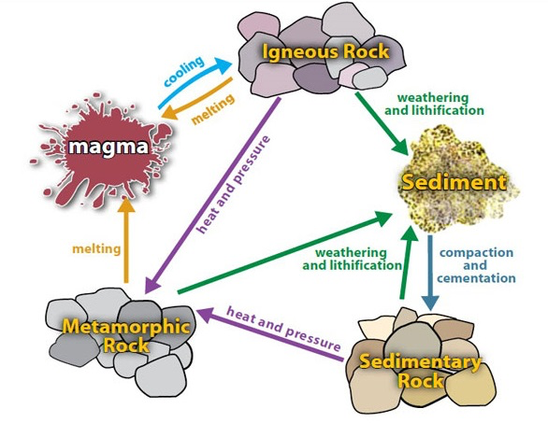
LEVEL 1: Rock Science & NATIVE SCIENCE (Story of Rock-Metamorphosis)

Slide 11
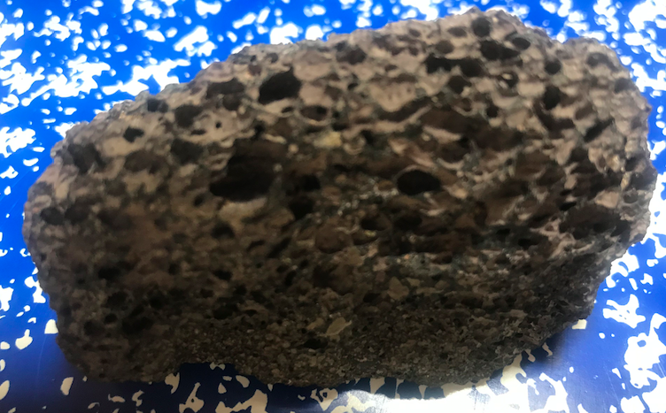
Level 1 How Old are Rocks?
Volcanic Rocks are very old souls, Earliest rocks from molten years of Earth, 4.4 billion years ago, cooling of magma, and solidified
Notes:
HOW ROCKS SOLVED THE WATER STORYTELLING MYSTERY?
The asteroid Vesta with its carbonaceous chondrite rocks, it is interstellar water, migrated from the asteroid belt as the Earth formed, but that water evaporated, in the molten years of Earth formation.

Slide 12
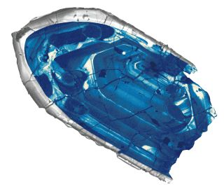
Australia, researchers have confirmed the crystal isoldest rock fragment ever found on Earth — 4.375 billion years old, plus or minus 6 million years.
Notes:
By zapping single atoms of lead in
Oldest rocks on earth found to be 4.03 billion years old (silicate crystals 4.3 billion years old in Australia). Rocks with fossils date to 4.29 billion years in Hemitite tubes of volcanic rock

Slide 13
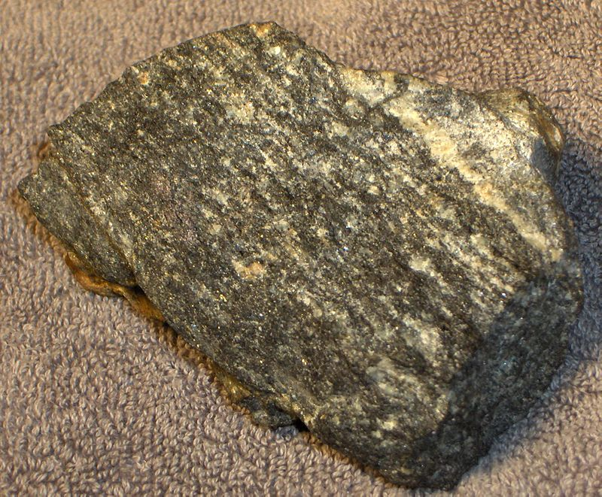
sample of gneiss from the site of the Earth's oldest dated rocks (the Acasta River area of Canada). This sample has been dated at 4.03 billion years old.

Slide 14
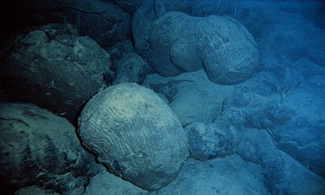
A sample of pillow basalt (a type of rock formed during an underwater eruption) was recovered from the Isua Greenstone Belt and provides evidence that water existed on Earth 3.8 billion years ago.

Slide 15
The Great Oxidation Event 2.4 Billion Years Ago caused by cyanobacteria doing photosynthesis
Notes:
Banded Iron formation at Fortescue Falls

Slide 16
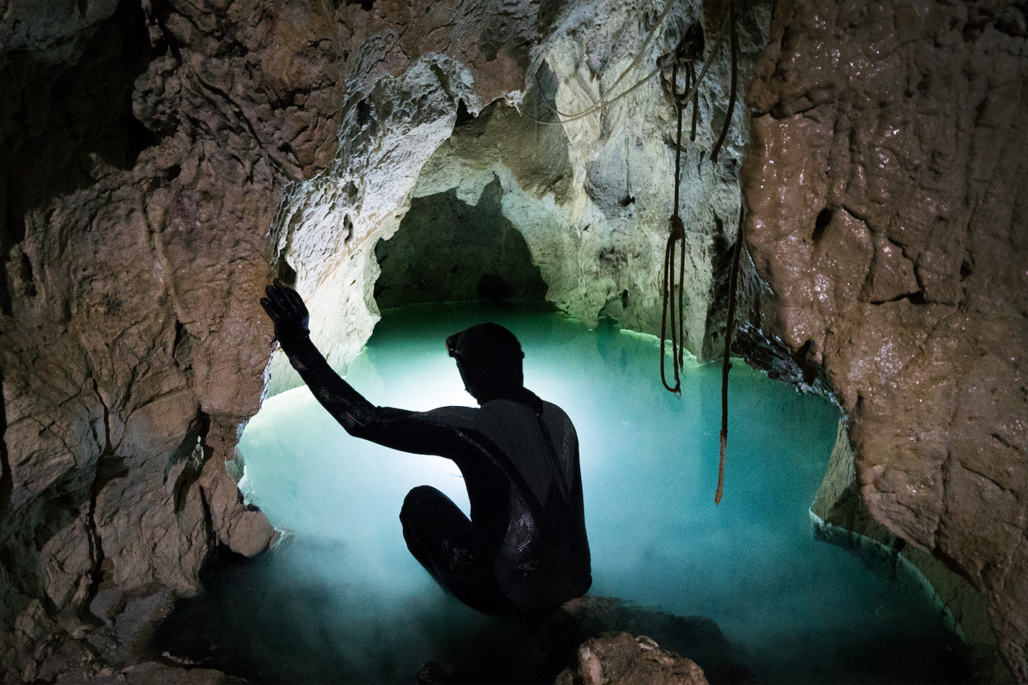
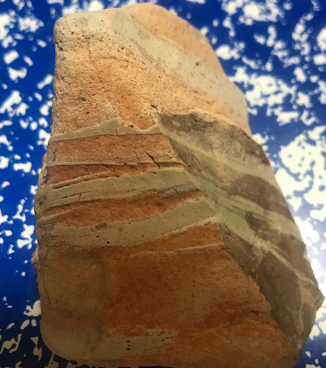
Summary Level 1: Rocks are Old and Wise Existence
Oldest Pool of Water on the Planet, found two miles down into Earth, has water from Planet Theia impact 4.2. billion years ago
Sandstone is porous and stores moving aquifer water beneath the Earth’s surface

Slide 17
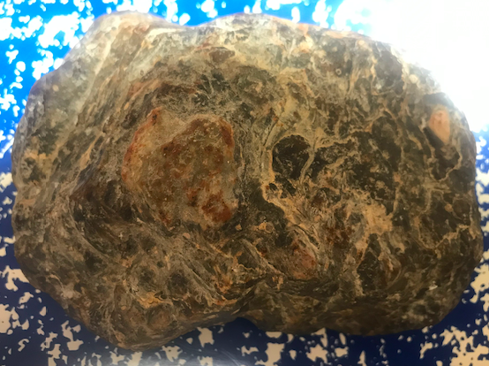
LEVEL 2: Shamanic Intention – Rorschach Test (Metaphor)
Can work is you have intention and work with power animals &/or spirit guides

Slide 18
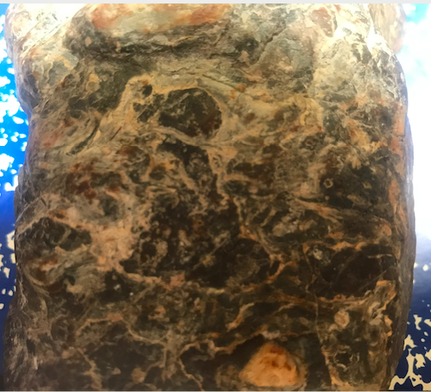
LEVEL 2: Shamanic Intention – Rorschach Test (Metaphor)
Can work is you have intention and work with power animals &/or spirit guides

Slide 19
LEVEL 2: Shamanic Intention – First BREAKOUT Group
Pick a rock you have near by, one with some character
Set an Intention: write down one sentence with one of these words: What, Where, Who. Why?
Journey with Drumming (close eyes (cover eyes), lay down if you like)
Ask for connection of power animal/spirit guide to what Rock is telling about your INTENTION
When drumming stops make some notes
Then we go to break out room, share as you like, or pass

Slide 20
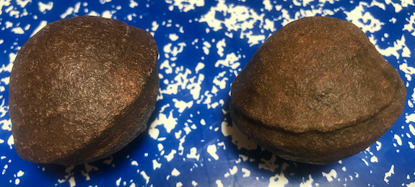
LEVEL 3: Powerful Rocks for Shamanic Divination
Boje’s BOJI-stones – which is Male and Female energy?

Slide 21
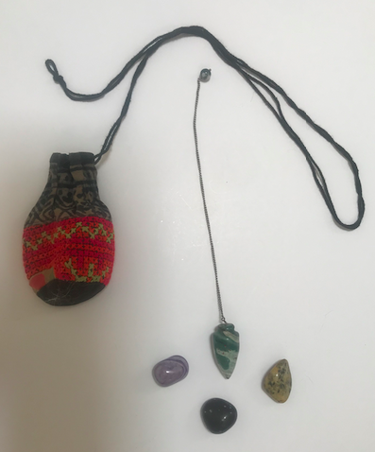
LEVEL 3: Powerful Rocks for Shamanic Divination
How to ask questions with a pendulum?
This one is a jade stone
We are 90% STARDUST & 55 to 85% Water that gives us vibrant energy vibrations of our 37.2 trillion living cells
Notes:
The human body is 90% Stardust it is 55% to 85% water during our life and we are 37.2 trillion living cells.

Slide 22
LEVEL 3: Powerful Rocks for Shamanic Divination
2nd Breakout session
Set and Intention, and write it in your notebook
Journey to Lower or Upper World
Ask rock DIRECTLY about your Intention?
As drumming stops, Come back to Middle World
Write down any signs, wonders, messages, insights, conversation you received

Slide 23
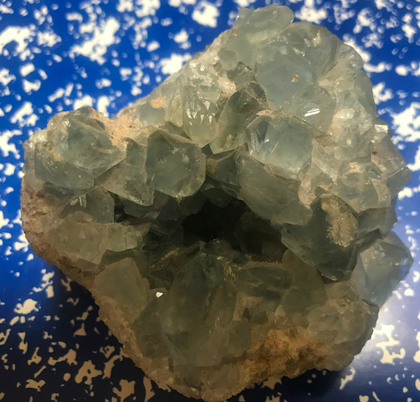
LEVEL 3: Powerful Rocks for Shamanic Divination
Story of Blue Celestite Imbued with Spiritual Divine Energy

Slide 24
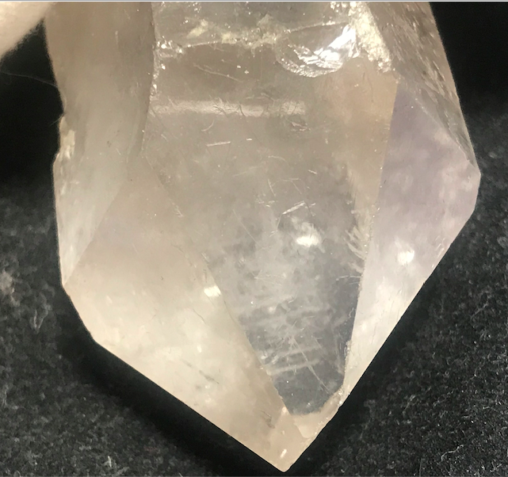
LEVEL 3: Powerful Rocks for Shamanic Divination
The Record Keeper Crystal – Book of Life

Slide 25
More on Rock Divination https://youtu.be/s7kqtJLIB_E

Slide 26
Thank You 575-936-9578 (cell) slides at https://davidboje.com/shamanic contact davidboje@gmail.com

