Slide 1
Business Storytelling Encyclopedia
Main site https://davidboje.com/#encyclopedia
We are making a radical shift in business storytelling by appealing to Ethics and ecology is the new business storytelling paradigm

Slide 2
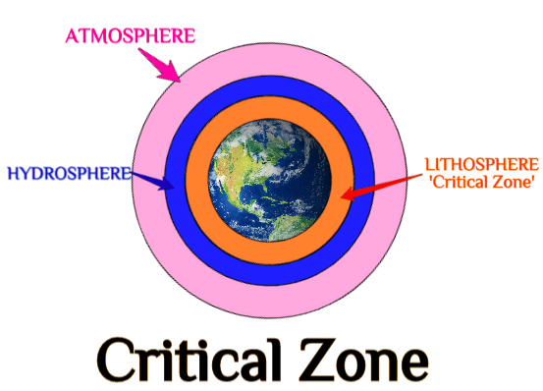
A paradigm shift in Business Storytelling

Slide 3
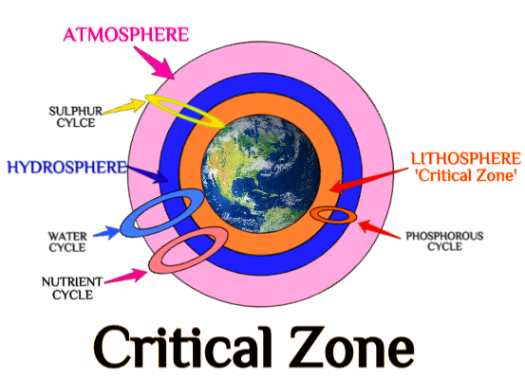
A paradigm shift in Business Storytelling

Slide 4
World Scientific Encyclopedia of Business Storytelling
Set 3: Ethical Practice
11. Business Storytelling and Sustainability - Kenneth Mølbjerg Jørgensen
12. Business Storytelling and Postcolonialism - Ozan Nadir Alakavuklar, Amon Barros. Prasad Jammulamadaka, & Ana Maria Peredo
13. Business Storytelling and Gender-Telling - Alessio Sartore
14. Business Storytelling & Race, Ethnicity - Jean Helms Mills
15. Business Storytelling and Indigenous Wisdom - Professor Tyron Love
16 Business Storytelling and Communication - Jillian Saylors
Set 1: Strategies
1. Business Storytelling Socioeconomics - Amandine Savall
2. Business Storytelling of Entrepreneurship - Duncan Pelly
3. Business Storytelling in Ensemble Leadership - Grace Ann Rosile
4. Business Storytelling and Strategy - Yue Cai Hillon
5. Business Storytelling and Change Management - Mark Hillon
Set 2: Methodologies
6. Business True Storytelling - Jens Larsen
7. Business Storytelling and Big Data Methods - Rohny Saylors
8 Business Storytelling and 4th Wave Grounded Theory Methodology - Marita Svane
9. Business Storytelling, Science, and Statistics - David Trafimow
10. History and Business Storytelling - Prof. Albert Mills
https://www.worldscientific.com

Slide 5
Volume 16 by Boje needs more authors
Treatment of animals e.g., whaling and Japan; SeaWorld, PET
Border security and Trumpâ€™s wall
Treatment of indigenous peoples for profit.
International trade and its effects on the environment.
Treatment of gender storytelling of the global situation
Environmental racism
Mining
Water
Fracking from Clean Air Act and Clean Water Act
Deception in Global Storytelling by business
Complicity of the Business School in Global Storytelling deception
True storytelling methodology from an ethical perspective

Slide 6
New Deadlines
Submissions March 15, 2021
Reviews completed Revisions completedJune 15, 2021
Off to press August 15, 2021 To Danielle Lee zrlee@wspc.com Desk Editor Singapore. World Scientific

Slide 7
Style Guideline
https://www.worldscientific.com/doi/epdf/10.1142/S2345737620500037 Please use this example for the style, where there is an abstract keywords and shows the formatting of references
Abstract for each chapter
Up to 50 word bio sketch or each chapters authors at the end of the chapter location
5 to 7 keywords for each abstract
Introduction to each volume written by one or more of the volume editors
Index to be done by World Scientific and reviewed by age volume editor
Permissions need to happen for each figure photo...
They should be done in black-and-white we don’t have any color images

