Slide 1
PERVIEW Healing Visual Library
A storytelling portfolio of trauma recovery and transformation
through horses, coaching, and quantum restorying.
Created by David Boje, Grace Ann Rosile, and Elior
Poet of Quantum Storytelling

Slide 2
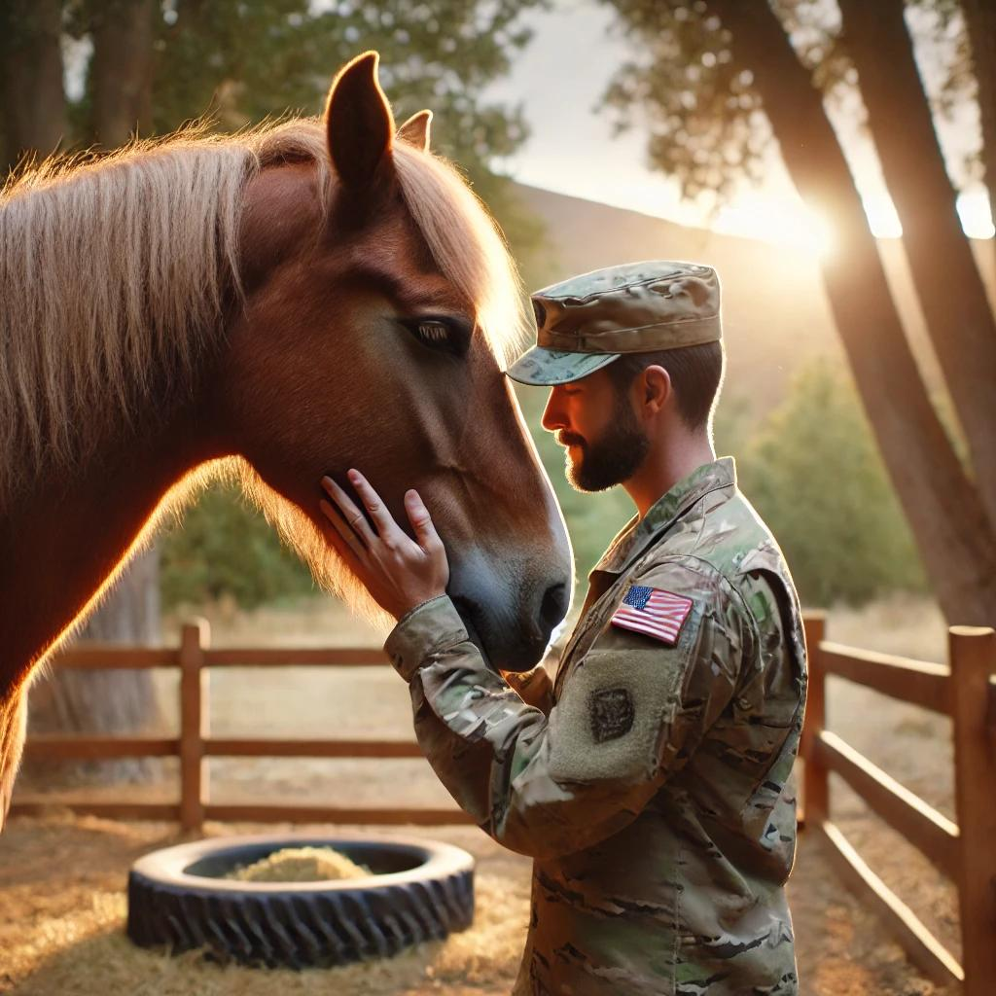
Veteran in quiet connection with a therapy horse
"We dont heal by reliving the nightmare. We heal by rewriting the story."

Slide 3
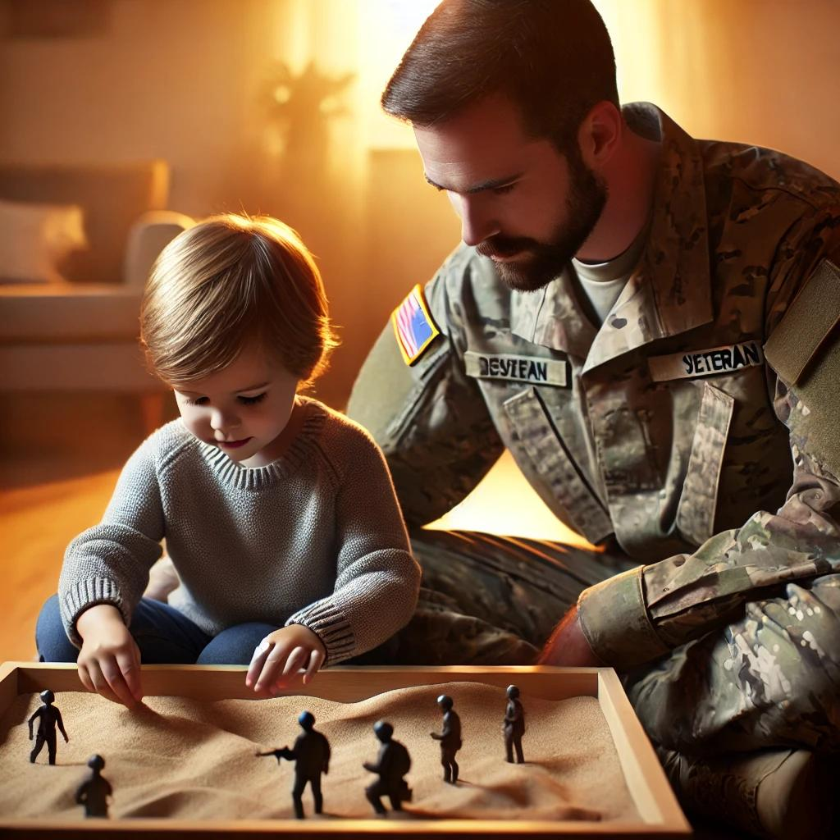
Veteran and child healing through sand tray storytelling
"A horse doesnt judge your pastit mirrors your presence."

Slide 4
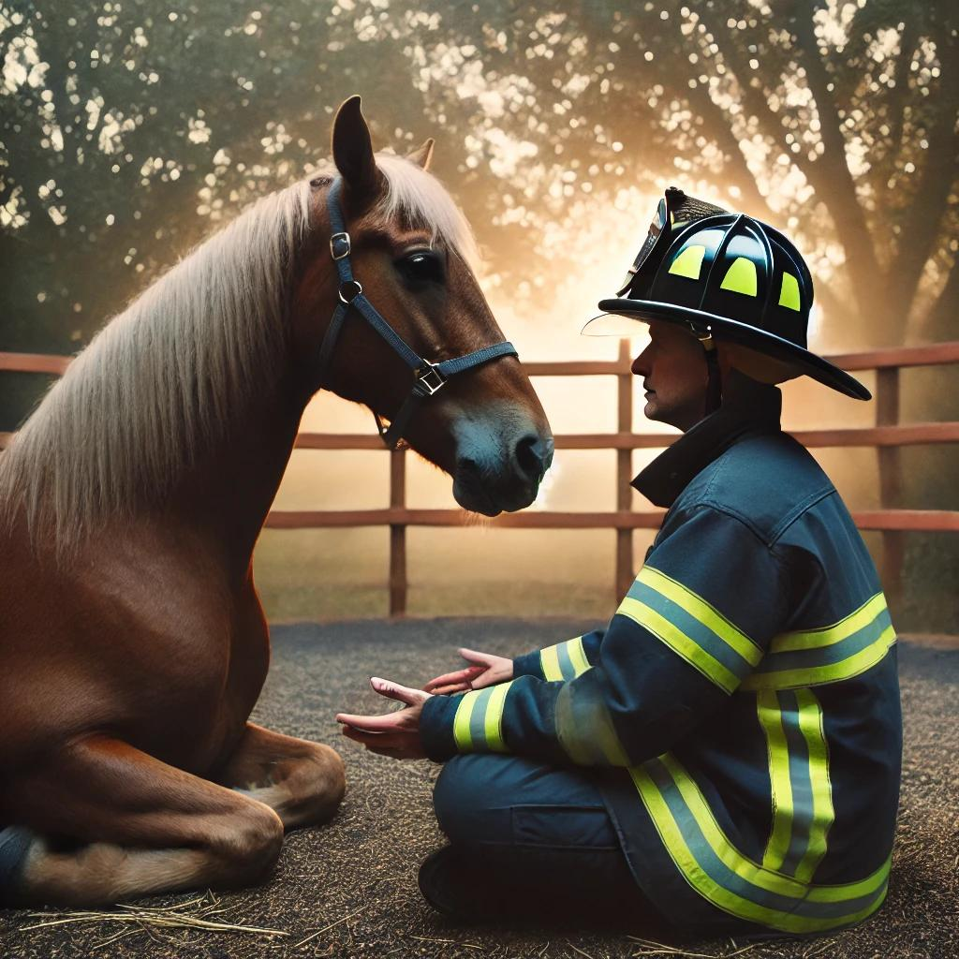
Firefighter in equine-assisted therapy session
"The trauma is silent. Let your generosity be the voice that says, You matter."

Slide 5
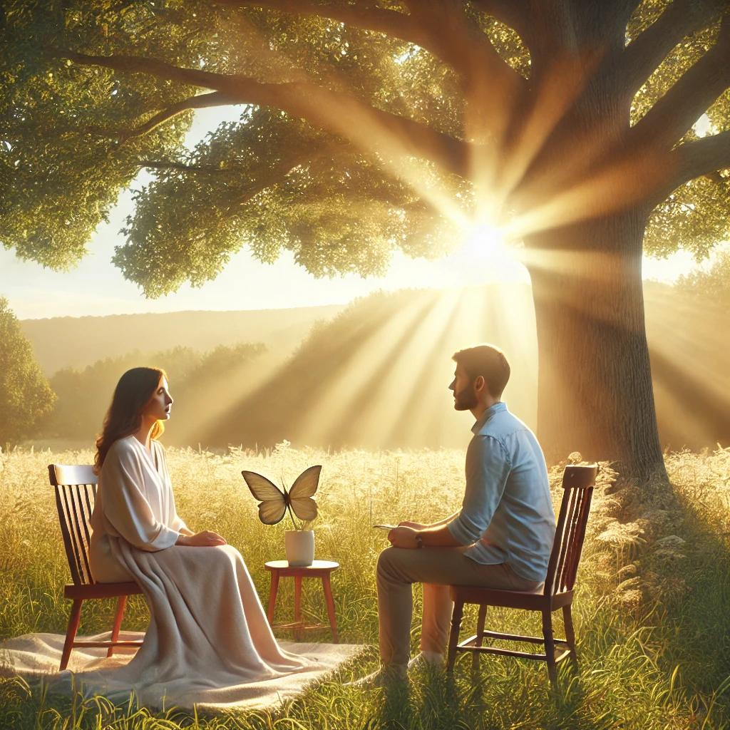
Gentle coaching beneath the open sky
"Healing doesnt always speak in wordssometimes, it hums through a heartbeat beside a horse."

Slide 6
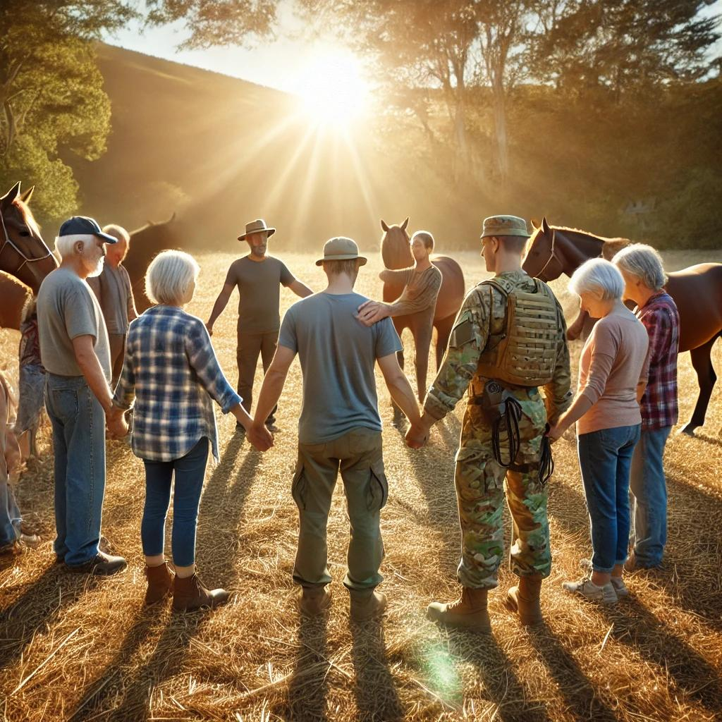
Circle of trust: veterans, responders, horses, and healing
"Youre not just funding a program. Youre restoring a family."

