Slide 1
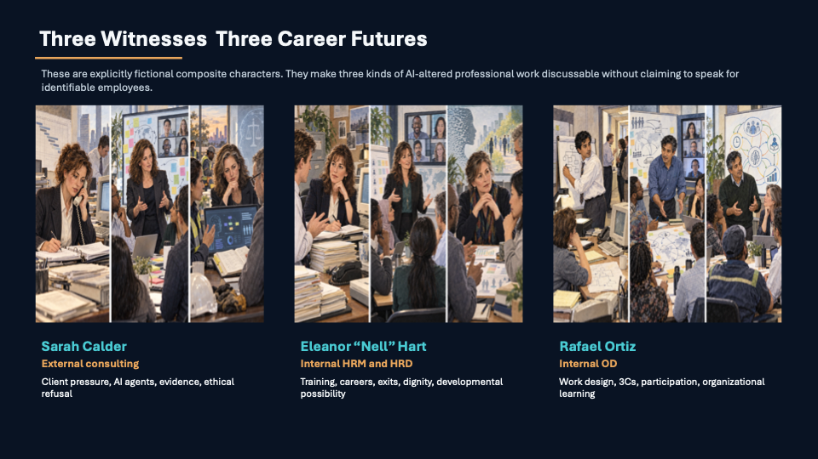
Storytelling - HRD & OD
David Michael Boje
Each Getting Older & Older
https://davidboje.com/luddite/
SLIDES + BOOK+GLOSSSARY
Notes:
Spoken opening
“Thank you for inviting me. I have spent about forty years studying organizational storytelling and ODC, working with the Socio-Economic Approach to Management Consultation. For 20-summers I went to Lyon and learned a stubborn lesson: before a consultant prescribes, a consultant must FIRST listen.
I listened SEAM to the late Henri Savall, his wife Véronique Zardet, and daughter, Amandine Savall, and Operations: Marc Bonnet. Today Three Composite Characters:
Sarah Calder EXTERNAL CONSULTANT, Eleanor 'Nell Hart, HRM/HRD & Rafael Ortiz (Internal OD) to represent pressures, skills, hopes, and contradictions carried by many consultants during the AI transition. Sarah grew up outside Harrisburg, Pennsylvania, in a household where the kitchen table was a map of obligations: bills, homework, her mother’s blue-ink calendar, and the small daily repairs by which a family keeps itself together. Her father repaired municipal equipment; her mother worked in a pharmacy. Sarah learned that systems look orderly from the outside while asking somebody, somewhere, to carry the unrecorded work.
At Penn State she majored in supply chain and information systems, with an English minor. Logistics gave her a way to see the hidden geography inside an ordinary thing: a part, a warehouse scan, a late shipment, an apology to a client.
Core idea: As a Luddite Consultant is pro-human judgment and pro-quality work. The stance challenges speed-driven deskilling rather than technology itself.
Suggested line: “The machine can calculate. The organization must still listen.”
Watch out: Do not begin with definitions or company statistics. Begin with your authority as a listener.
Today with AI, the consulting industry can ingest ten thousand lines of data in nano-seconds.
My question is whether AI-speed has made us better listeners, or whether AI-IN-OUR-CONSULTING, has made the unheard easier to remove from the report. I call my position the Luddite Consultant. The original Luddites were skilled workers defending the quality and dignity of work. I am not here to reject AI. I am here to ask who remains answerable for what it does to work.”
MY MAIN POINT TO remember:

Slide 2

Is Higher Education Is Inside the AI Revolution?
The university is now a workplace, a curriculum, a research setting, a purchaser of AI systems, and sometimes a proposed host for AI infrastructure.
1
Teaching and learning
Assessment, authorship, tutoring, research practice, and AI literacy change together.
2
People and work
Faculty, staff, student workers, HRD, and OD teams face redesign, monitoring, training, and workload transfer.
3
Campus and community
Procurement, cloud contracts, data governance, energy, water, land, and public mission now belong to the same inquiry.
Penn State, NMSU, Fisk, and every institution face different circumstances. The shared question is whether AI transformation enlarges learning and public purpose or transfers its costs out of view.
Notes:
Purpose: make the audience see higher education as a central site of the same transformation, not as an outside observer.
Say: “Many of you will become faculty, administrators, HRD or OD practitioners, researchers, and consultants. You will encounter AI in assessment and learning, in staff work and HR, in procurement and data governance, and sometimes in the physical question of what the university builds on its land.”
Use Fisk cautiously: its proposed technology/data-center project is contested and framed by the university as part of a long-term reinvention. Use NMSU as a different case: AI degree development and education. Do not make either case a simple morality tale.

Slide 3


What is your Future in the AI Revolution?
Sarah, Getting Older & Older
Notes:
Purpose Turn the problem toward the audience.
Story or move: Pause for five seconds and ask participants to choose silently between two imagined futures: consultant as platform operator, or consultant as accountable listener who can use platforms without surrendering judgment.
Core idea: This is the question the rest of the talk will answer.
“When the diagnostic takes ninety seconds, what becomes of the consultant's responsibility?”
Watch out: Let the silence work. Do not answer the question yet.

Slide 4
The Biggest Consulting Companies of the AI Revolution
Organization | Data Point | Note on Role
Accenture | 77,000 AI professionals | Largest deployment of AI Agent Builders.
McKinsey & Co | 10% internal staff cut | Selling AI transformation while cutting their own staff.
BCG | 25% of 2025 revenue | A quarter of all revenue now derived from AI consulting.
Deloitte | "Unhearing" staffing studies | Focus on efficiency metrics over human welfare.
IBM Consulting | Enterprise Layer Architect | Designing the specific tasks AI agents will replace.
PwC | Institutional Cover | Providing the "narrative shield" for radical change.
EY | Billion-dollar influence | Aggressive scaling of AI auditing and transformation.
KPMG | Trust/Usage studies | Shaping the public perception of AI reliability.
Infosys Consulting | Retail/Logistics focus | Redesigning global physical supply chains.
Cognizant Consulting | Gov/Healthcare focus | Moving AI into sensitive public and medical sectors.
Notes:
IBME Enterprise Layer Architect;; Means -
Purpose Show that the transformation is industry-wide.
Story or move: Use a panorama rather than ten mini-lectures. Say that firms are simultaneously sellers, adopters, workforce designers, and narrators of AI transformation.
Core idea: The table is evidence of scale and role differentiation. Name Accenture, McKinsey, and Deloitte as the examples the later slides develop. The central issue is that those implementing AI also author the story of what counts as responsible transformation.
Accenture references its 77,000 AI and Data professionals and its role in the largest deployment of AI implementation labor, it is highlighting a massive operational shift from the traditional, headcount-heavy consulting model to an AI-driven, highly specialized engineering matrix; Machine Learning Operations (MLOps) engineers, data governance experts, clean data estate builders, and specialized AI agent builders.

Slide 5
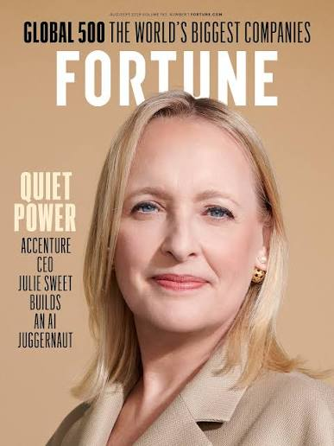

Main Point Today:
Narrative & Storying are Different
Aristotle’s Narrative – has a Plot with a
Beginning, a Middle – and an End (BME).
Julie Sweet CEO -Official consulting plot is a BME Narrative
Beginning: a gap Middle: action End: measured results
Sarh Calder is not one story, She has 4 personas
Sarah as Task leader, Humanistic listener, Becoming leader, and Answerability leader. AI generated editorial illustration of a fictional composite character.
Sarah is antenarrative = Hundreds of fragments are already betting on a future storyline, each fragment having the potential to shape her future story
Notes:
Audience contract
Please refuse BME because it treats living work as if it were already a report.
Storying without a Hidden Costs Ledger leaves the IMPORTANT Storying off the books.
“I will give you a case, Sarah (a composite character) at Accenture, and an eight-step way to audit/Deconstruct the story around her. Then I want to spend the second half with your questions and the stories from your own organizations.”
: Tell the voice-on-the-editing-room-floor story. You dictate an account into an AI system. It returns a polished beginning, middle, and end, but your cadence, uncertainty, and unresolved fragments have disappeared.
Core idea: A BME narrative closes. Storying remains active, unfinished, and populated by conflicting voices. Antenarratives are fragments that bet on possible futures before a dominant plot settles them. Qualimetrics adds a ledger so the human consequences do not remain only anecdotes.
Suggested line: “Narrative tells us the transformation succeeded. Storying asks what is still happening to people while that conclusion is being written.”
Watch out: Explain centripetal and centrifugal forces only if useful. The plain-language distinction should come first.

Slide 6
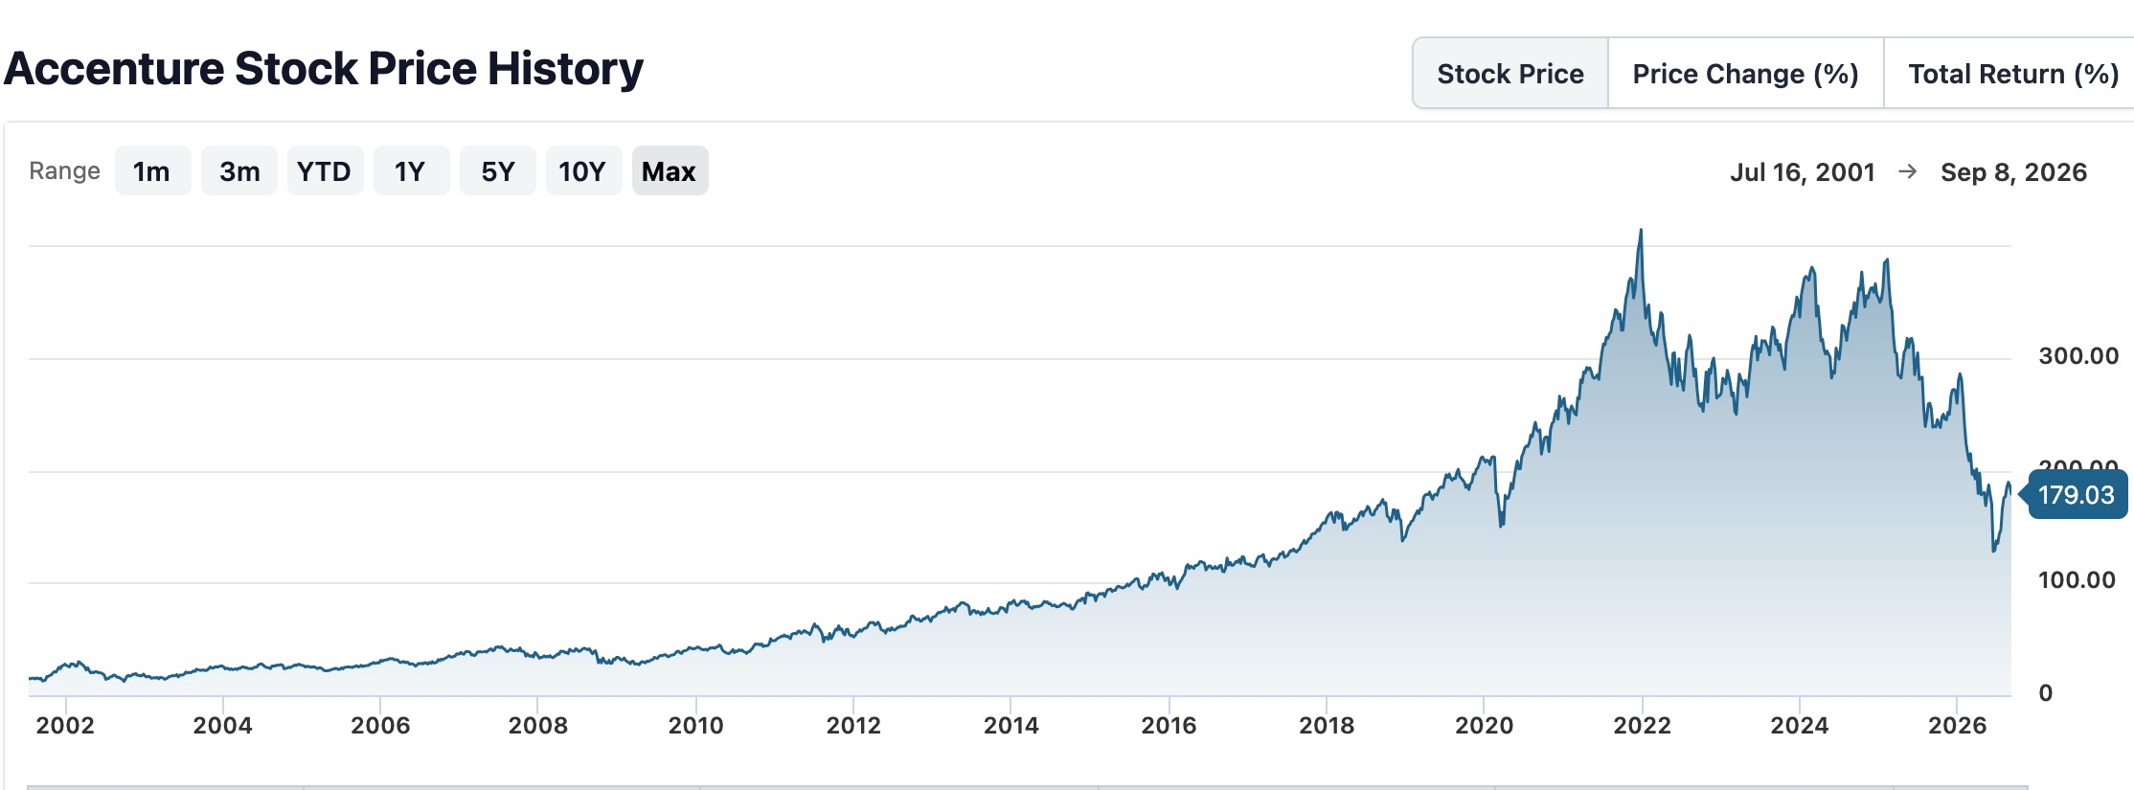
What’s the Accenture Storying?
https://davidboje.com/ws/
https://davidboje.com/aibets/
https://Storying.site
Notes:
stock chart as one Boardroom-room artifact. It tells an important financial story, but it cannot tell Sarah's work story by itself.
Core idea: Introduce Tamaraland: different rooms contain different, simultaneously true accounts. A stock chart, an earnings call, a worker's timesheet, and a client's failed deliverable belong to different rooms.
Punch lind: “A chart can show value moving. It cannot show whose midnight labor made the movement possible.”
Watch out: Avoid implying that a single workforce decision caused a stock move. Use the chart to illustrate partial vision, not causation.

Slide 7
How long would you last at Accenture ?
“What about Sarah Calder the Consultant?”
Clock | What it measures | Honest 2027 range
Official tenure Accenture Narrative | “Vibrant careers”; 97k promotions in FY2025; more entry-level hires | Some will make Analyst → Consultant in 2–3 years if AI utilization + tool use + a live account line up
Sarah’s Living Storying | Joined out of college; planned to leave at one year, but stayed, and has 4 personas at Accenture | Sarah keeps OT off the timesheet; no safe path up the power chain. She has spent 3 decades at Accenture
Accenture’s Official Transformation Narrative | 14% voluntary attrition; compressed window of ~11–12k in one quarter; pyramid still needs juniors | Many will be managed out or self-exit before the competency grid is ever drawn
Notes:
| Purpose Humanize the transformation and disclose the composite method.
Story or move: Introduce Sarah as explicitly fictitious and composite, built from publicly reported workflows and workforce patterns. Walk her through one compressed day: she launches an agentic diagnostic, receives a rapid output, checks anomalies, rebuilds weak evidence, responds to a client, and records fewer hours than she actually worked.
Core idea: The official tenure story, Sarah's living storying, and the firm's transformation narrative run on different clocks. Her risk depends on utilization, tool adoption, available accounts, overtime practices, and whether anyone above her will hear a concern.
Method Point: “Sarah is not a person I am exposing. She is a methodological device for making aggregate statistics answer to a human workday.”
Watch out: Say the composite disclaimer clearly. Do not present projected tenure as a measured prediction.
The agent produces output rapidly, but Sarah inherits verification, deadline, client, and reporting burdens. Disclose that Sarah is composite.

Slide 8
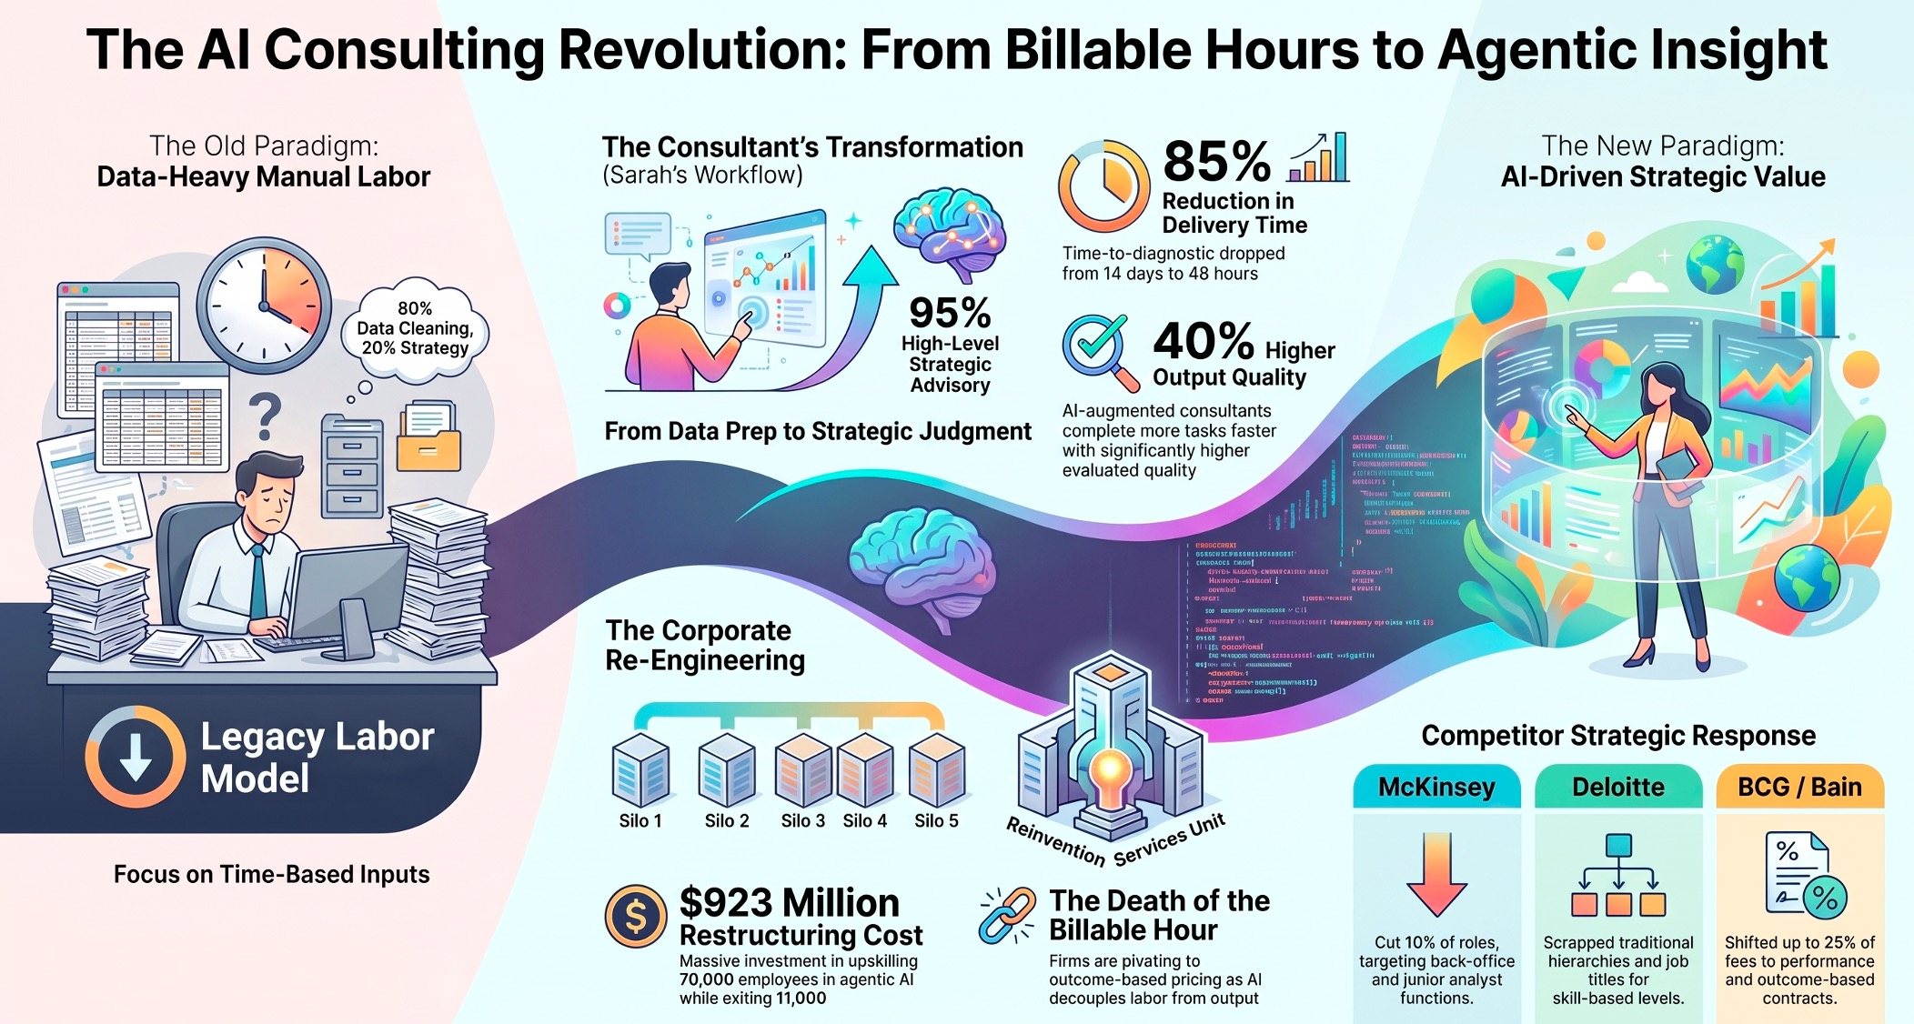
Notes:
| Purpose Present the attractive official case before critiquing it.
Story of Accenture’s $923 million restructuring is a highly calculated, aggressive realignment to phase out human roles that cannot adapt to Artificial Intelligence, rather than a traditional cost-cutting mass layoff; Why the Legacy Model Suffered an AI "Productivity Paradox"
Tasks that once required a six-person team of junior analysts working for three weeks can now be completed by one experienced supervisor utilizing automated AI agent workflows in a matter of hours. Because AI dramatically compresses the time needed for execution, continuing to bill strictly by the hour would result in an immediate collapse of top-line revenue
Story or move: Tell Sarah's before-and-after workflow. In 2024, data preparation dominates and the diagnostic takes roughly fourteen days. In the official 2026 plot, agents process data rapidly and Sarah spends most of her time on strategic judgment.
Core idea: Acknowledge the real benefit. Faster data work can release time. Then pose the distribution question: who receives the released time? The worker, the client, the firm's margin, or the next deadline?
Suggested line: “The productivity gain is real. The organizational question is who owns the time it releases.”
Watch out: Do not ridicule the official narrative. Your critique is stronger after you grant what the technology genuinely improves.

Slide 9
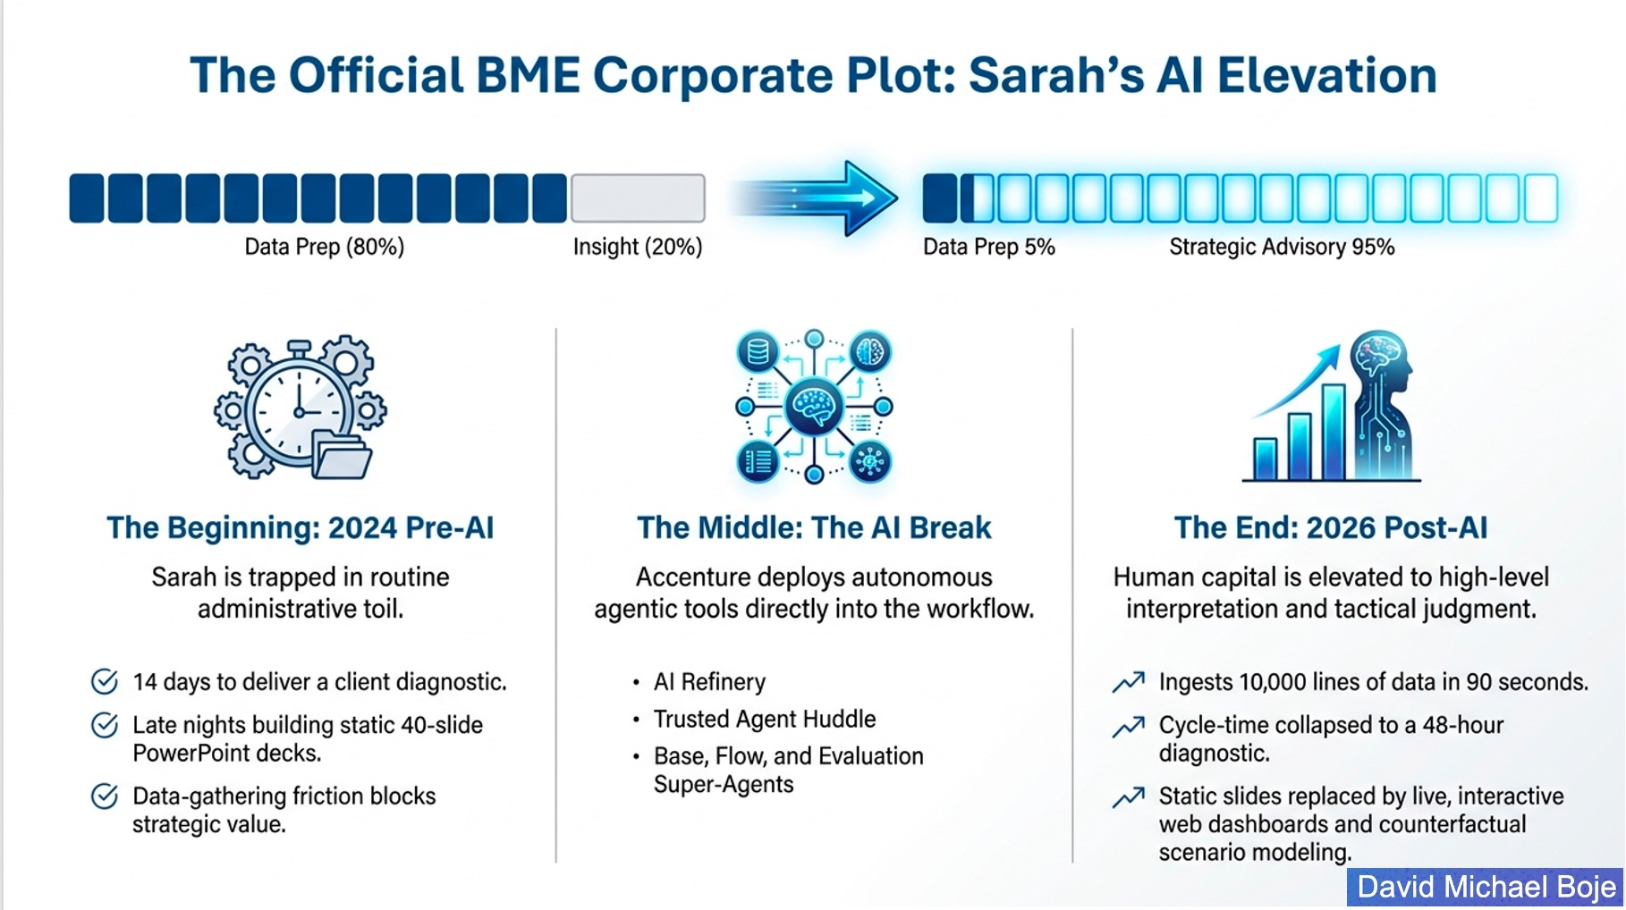
Notes:
| Purpose Make the audience demonstrate that its seeing has changed.
Story or move: Return to Sarah's clean 80/20 to 5/95 progression. Ask: What can you now see below this diagram? Take two or three quick answers in chat if the webinar format allows. Supply possibilities: verification labor, apprenticeship loss, platform dependence, overtime, environmental infrastructure, and missing answerability.
Core idea: The diagram remains partly true. Deconstruction makes it insufficient rather than simply false.
Suggested line: “Twenty minutes ago this looked like a complete transformation story. Now it looks like one room in Tamaraland.”
Watch out: If you move this slide after slide 8, use it there as the official plot and omit the callback exercise.

Slide 10
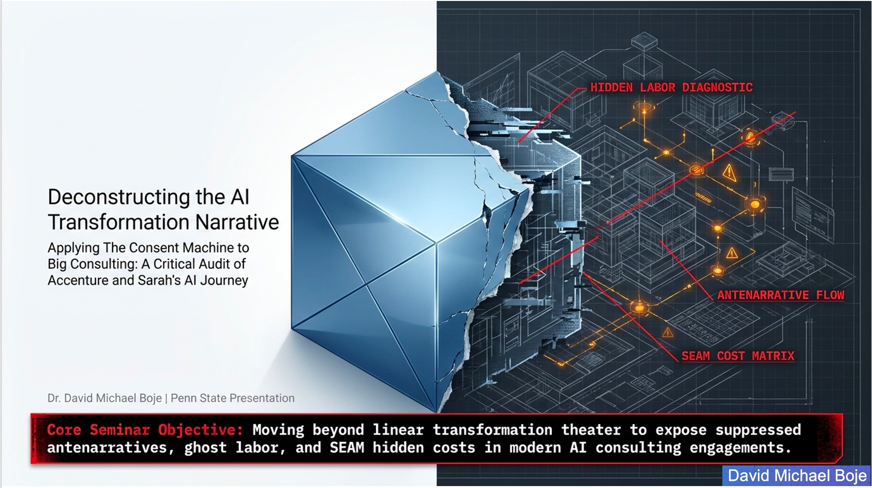
Notes:
Purpose Reset the room and introduce the method.
Story or move: Say that deconstruction does not destroy a story. It opens a finished plot so the excluded stories and hidden costs can re-enter the analysis.
Core idea: Preview the sequence: surface promise, marginalized interpretation, excluded voices, hidden ledger, denied plot, exceptions, between-the-lines architecture, and resituation.
Suggested line: “I am going to open the narrative, not merely oppose it.”
Watch out: Move briskly. This is a map, not a ninth content block.

Slide 11
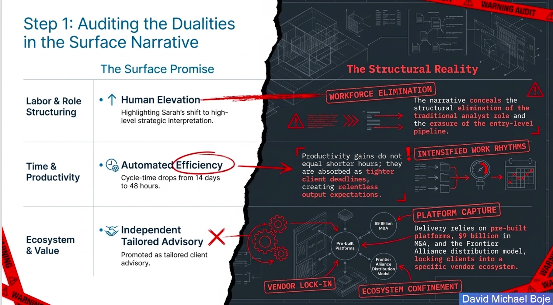
Notes:
| Purpose Show how an official plot makes one side appear inevitable.
Story or move: Use one duality all the way through: human elevation versus elimination of the analyst pathway. Then briefly connect speed versus workload and tailored advice versus platform dependence.
Core idea: Dualities do ideological work. They label AI work as progress and human-intensive work as legacy, so objections sound like resistance to progress rather than evidence about design.
Suggested line: “The first audit question is simple: which side has been named progress, and which side has been made embarrassing to defend?”
Watch out: Do not explain every arrow on the slide.

Slide 12
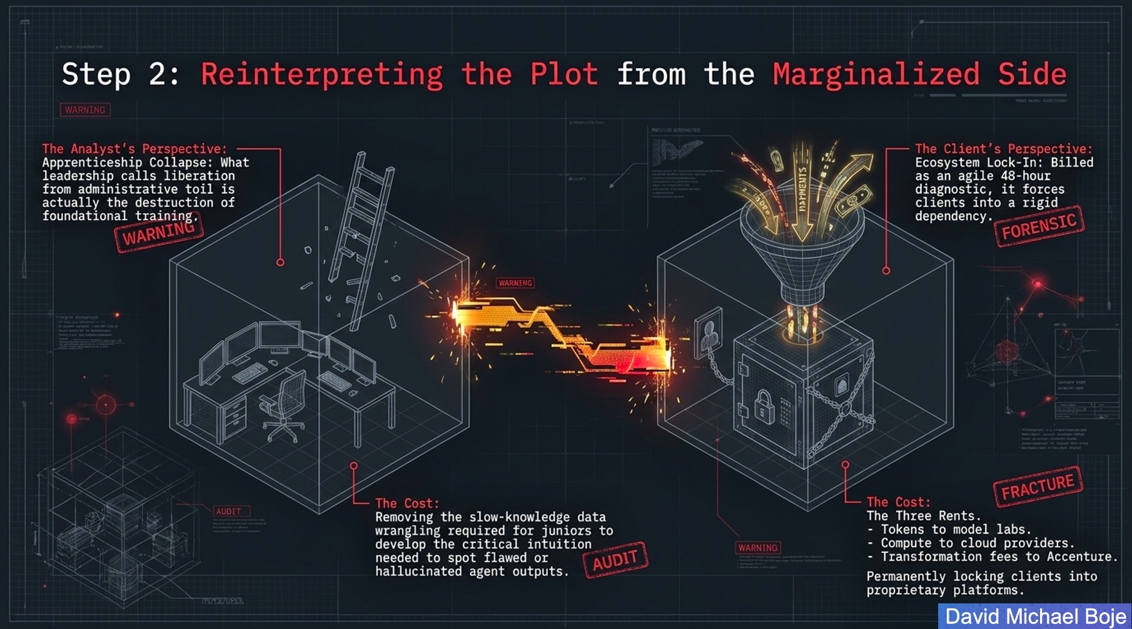
Notes:
| Purpose Reverse the viewpoint.
Story or move: Tell the apprenticeship story. A junior who cleans messy data slowly learns where organizations hide exceptions. Remove the slow work and the firm may also remove the training that later lets a senior consultant detect a beautiful but false AI answer.
Core idea: Reframe liberation from administrative toil as possible apprenticeship collapse. Reframe the agile diagnostic as a stream of rents paid to model, cloud, and transformation platforms.
Suggested line: “Slow work can be drudgery, but some slow work is where judgment is born.”
Watch out: Avoid romanticizing all manual work. The issue is which learning functions must be preserved.

Slide 13
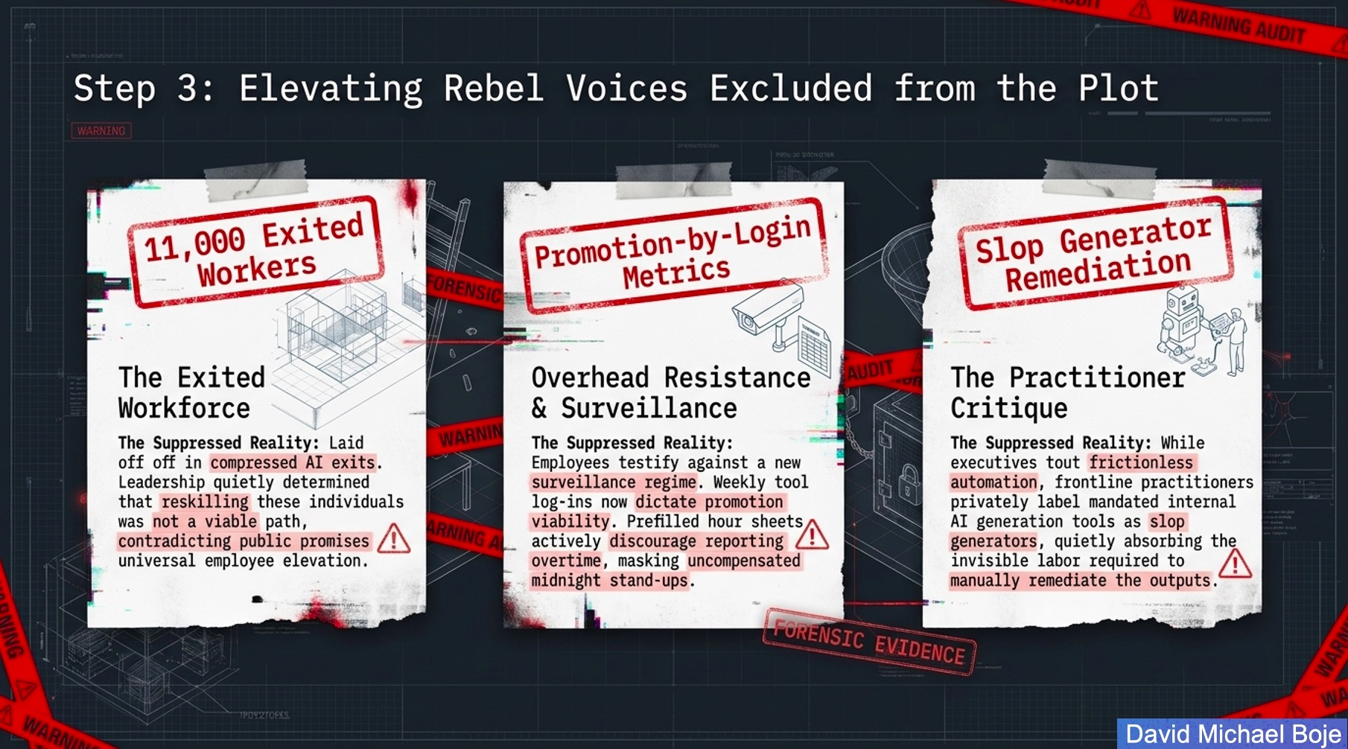
Notes:
Purpose Bring excluded testimony into the case.
Story or move: Speak one sentence in each voice: the exited worker, the employee governed by login metrics and prefilled time sheets, and the practitioner who quietly repairs ‘slop’ before the client sees it.
Core idea: A rebel voice supplies evidence that the official vocabulary suppresses. Qualimetrics does not smooth these statements into survey averages. It preserves verbatim language and connects recurring dysfunction to measurable cost.
11,000 exited workers at Accenture story, represents a major shift in the IT services industry. It marked the first time a global consulting giant openly admitted to executing a mass workforce reduction because a segment of its employees could not be reskilled for the age of Artificial Intelligence fast enough.
At Accenture, "Promotion by Login Metrics" refers to the highly aggressive, mandate-driven policy of directly linking a senior employee’s career advancement to their frequency of logging into internal AI platforms. Introduced under CEO Julie Sweet, the policy shifted AI adoption from a voluntary upskilling initiative into a strict, dashboard-tracked condition for leadership eligibility. In internal talent reviews, consistent weekly interaction with core AI systems serves as a "visible input" for promotion decisions
.
Accenture, "Slop Generator Remediation" refers to the strategic, technical, and operational processes used to eliminate low-quality, generic, or hallucinated AI outputs (known colloquially as "AI Slop") from enterprise workflows. The phrase gained immense prominence after internal leaks revealed that senior Accenture consultants were pushing back against mandatory AI tool rollouts (such as AI Refinery), criticizing poorly calibrated corporate LLMs as "broken slop generators". In response, Accenture established rigid frameworks to clean up AI outputs and ensure enterprise-grade accuracy.

Slide 14
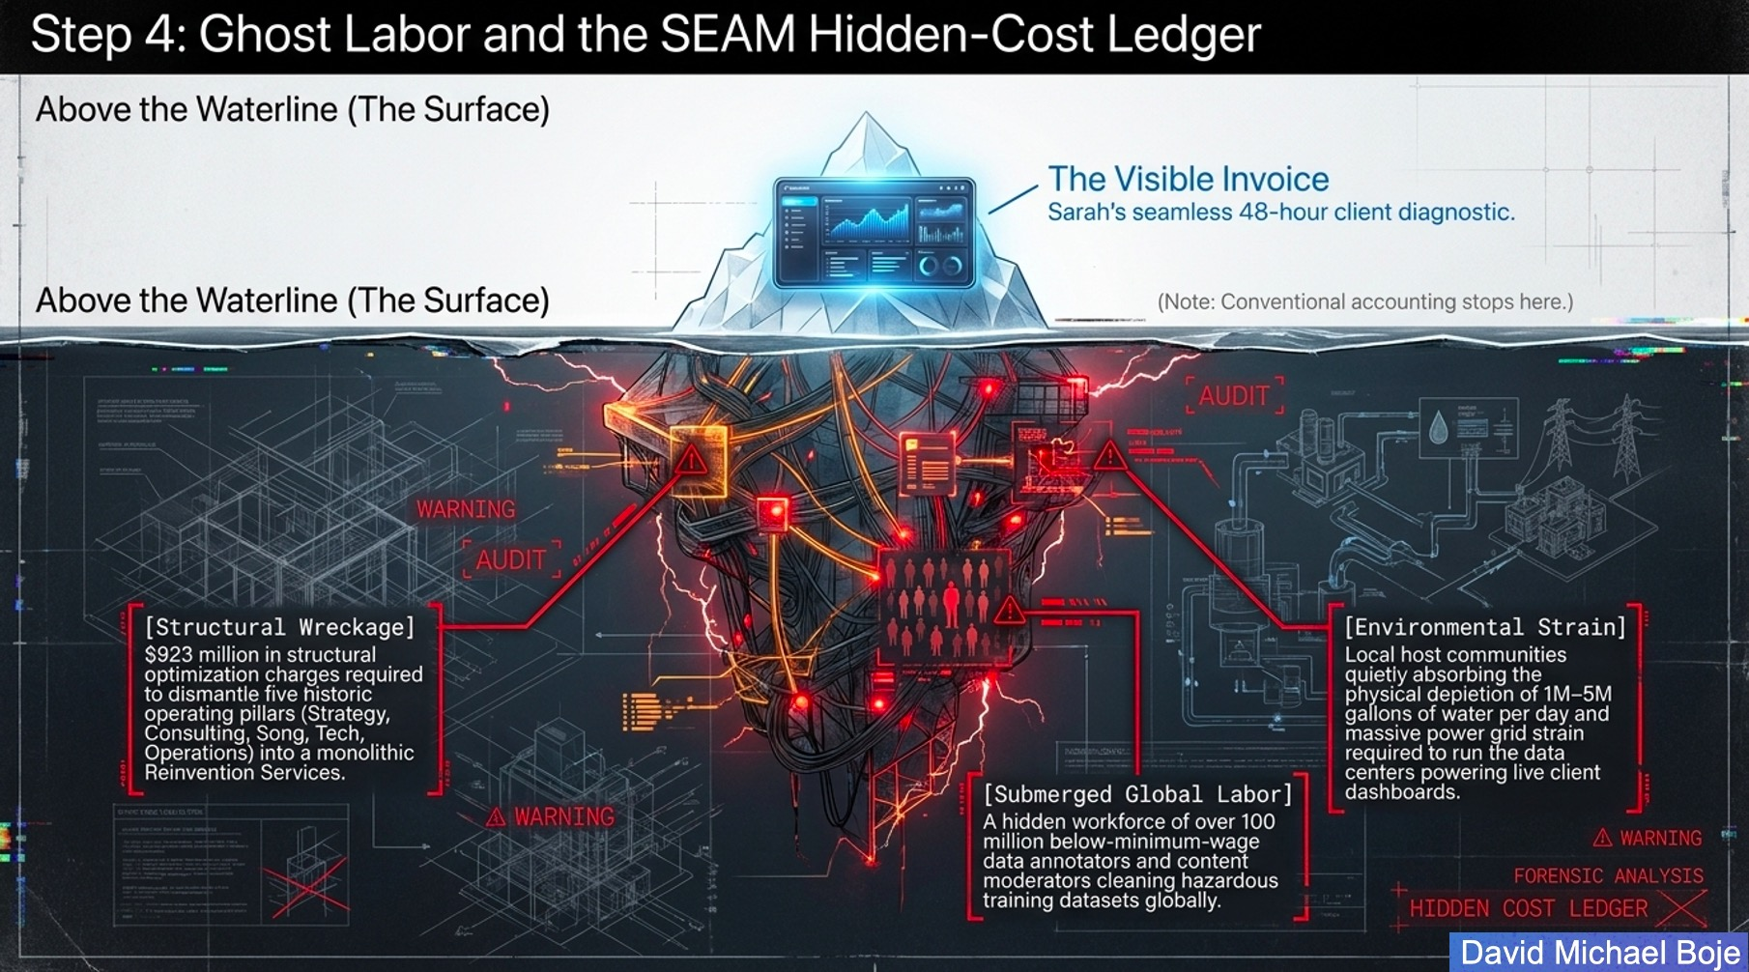
Notes:
| Purpose Make the invisible work and cost structure legible.
Story or move: Use the iceberg story. Above the waterline sits the visible diagnostic and invoice. Below it sit restructuring, verification, displaced labor, data annotation, content moderation, community water use, grid strain, and other transferred costs.
Core idea: Explain the SEAM ledger as an accounting correction. It asks who performs the work after automation claims the work disappeared. If you mention the 167 percent multiplier, describe its use here as an extrapolation from SEAM interventions, not an audited measure of these firms.
The “Structural Wreckage” narrative surrounding Accenture’s $923 million restructuring describes the systematic dismantling of five decades of organizational architecture. Driven by CEO Julie Sweet, the firm wiped out the internal borders separating its five legendary operating pillars—Strategy, Consulting, Song, Technology, and Operations—collapsing them into a monolithic entity named Accenture Reinvention Services. [This was not a superficial rebranding. It was a complete operational rewiring that altered how the world’s largest consulting firm packages human labor and technology.
The "Submerged Global Labor" paradigm refers to the vast, deliberately invisible human workforce that powers modern Artificial Intelligence. Often described by sociologists as "Ghost Work" or the "Invisible Pillars of AI," these workers form the foundational layer of the global tech supply chain; Sociologists and major economic organizations estimate that the hidden data labor force spans between 150 million and 430 million workers globally. Massive digital labor clusters reside in India (aiming for 1 million full-time annotators), the Philippines, Kenya, Uganda, and Venezuela & The Domestic Underclass: A smaller, domestic fraction operates within the United States and Europe, drawing slightly higher hourly wages ($10–$15/hour) but working entirely without health benefits, job security, or legal employee classifications; The Profile: They are often college graduates, displaced professionals, or gig workers who look to online platforms (like the former Remotasks or Amazon Mechanical Turk) because domestic job markets have collapsed; Why Are They Needed? (The "Productivity Paradox") AI algorithms cannot naturally comprehend human context, ethics, or safety. They require continuous human intervention at three critical stages:
Hyperscale AI data centers require 1 million to 5 million gallons of water per day for direct evaporative cooling—a consumption rate equivalent to a city of 10,000 to 50,000 residents; Aquifer Starvation: Unlike agricultural irrigation, which partially trickles back into local watersheds, the majority of data center water evaporates completely into the atmosphere, permanently removing it from the local water table; Contaminant Concentration: The remaining unevaporated water discharged back into municipal systems (known as "blowdown") carries highly concentrated minerals, heavy metals, treatment chemicals, and dangerous secondary contaminants like nitrates or PFAS. For example, an Amazon data center in Oregon agreed to a $20.5 million class-action settlement following allegations that its server-cooling process concentrated nitrate-laden wastewater, contaminating local drinking wells.
Suggested line: “Automation often moves labor across a boundary. The work changes its name, location, contract, and accounting category.”
Watch out: This is the densest conceptual slide. Slow down, choose two submerged costs, and leave the remaining labels for the audience to inspect.

Slide 15
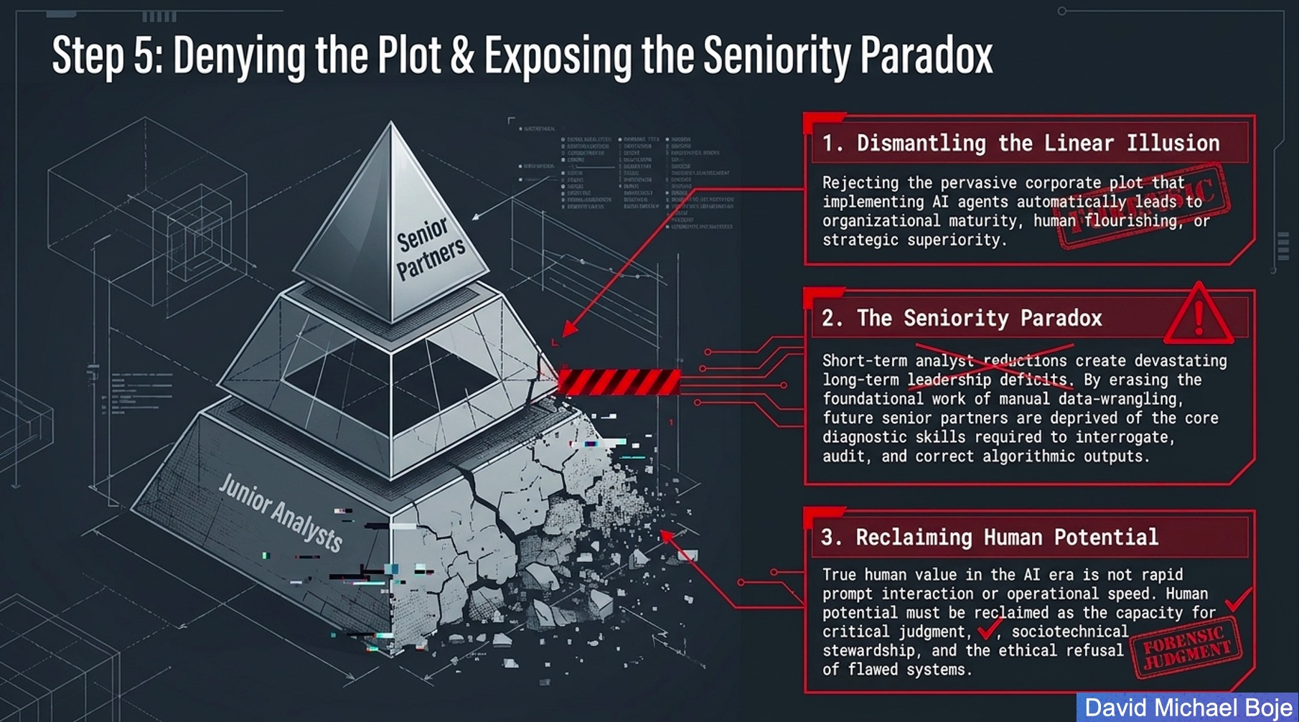
Notes:
Purpose Reject inevitability and name the long-term leadership risk.
Story or move: Tell the future-partner story. Ten years from now a partner receives an authoritative agent output. The partner never learned through junior data work how organizational records become inconsistent. The firm has produced speed today and a judgment deficit tomorrow.
Core idea: The seniority paradox links entry-level reductions to future leadership weakness. Human potential means critical judgment, sociotechnical stewardship, and the capacity to refuse a flawed system.
Suggested line: “If we automate the apprenticeship, where will the expert judgment come from?”
Watch out: Frame this as a researchable risk and design problem, not a certainty about every worker.
The Seniority Paradox describes the structural crisis where automating entry-level "grunt work" destroys the training grounds for future leaders. Historically, junior consultants built their foundational intuition by grinding through manual software testing, basic code generation, data cleaning, and workflow documentation; The strategic plot aims to decouple revenue growth from headcount expansion. The Death of Engineering Intuition: If an AI agent generates all the boilerplate, architecture, and documentation, a junior employee never encounters the friction required to understand why a system fails. They cannot develop the deep system-level intuition required to debug high-stakes enterprise systems when things break.
The "Experience Cliff": Within 3 to 5 years, the industry will experience a severe deficit of senior leaders capable of managing ambiguity, risk, and macro-system design. Organizations will have a glut of low-cost AI tools and highly paid senior partners, but a completely hollowed-out middle tier capable of stepping into executive shoes
To resolve this crisis, organizational theorists point to the work of the late Henri Savall (pioneer of the Socio-Economic Approach to Management - SEAM) and David Boje (expert on Quantum Storytelling). They co-authored extensive frameworks on releasing the "Untapped Human Potential" of enterprises by identifying and capturing "hidden costs". [1]
To apply their principles, Accenture would have to pivot away from its current structure:
Quantifying TFW (Time Fraction Wasted) as a Hidden Cost: Savall's SEAM model proves that treating humans as mere inputs to a tool creates massive "hidden costs" (high turnover, toxic workplace anxiety, and low-quality outputs). Accenture must stop using superficial "login metrics" as a measure of productivity. Reclaiming potential means measuring how effectively humans use cognitive space to solve creative client problems.
Restoring the "Storytelling Organization": David Boje's theories emphasize that organizations thrive on tribal knowledge and shared human narratives. By replacing human teams with cold AI agent swarms, Accenture deletes the narrative context of how problems are solved. To fix this, teams must be restructured around collaborative apprenticeship models where senior leaders deliberately co-pilot ambiguous problems with juniors, restoring human storytelling and mentoring over automated verification.
4. Stewardship and the Ethical Refusal of Flawed AI Systems
In a rigid environment where career advancement is strictly tied to automated metrics, stewardship and ethical refusal become hazardous for employees. If a consultant discovers that a proprietary model or automated system is a "flawed slop generator," the system heavily disincentivizes speaking up:
The Compliance Trap: If an employee refuses to deploy a flawed AI agent because it introduces systemic security vulnerabilities or hallucinations, their dashboard shows a drop in tool usage. In automated talent calibrations, this drop can flag them as an "unadaptable laggard," resulting in deferred promotions or inclusion in workforce exit tranches.

Slide 16
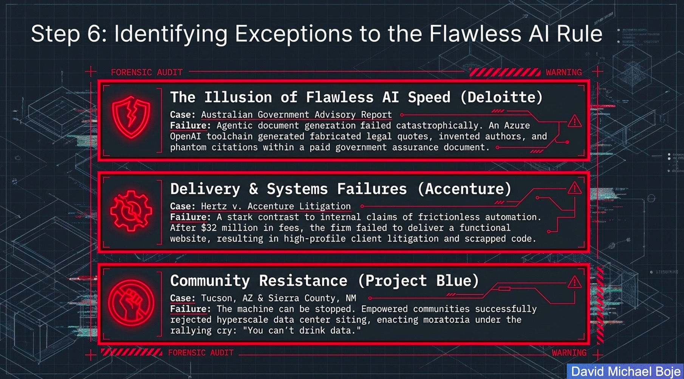
Notes:
Purpose Use anomalies to puncture a universal success story.
Story or move: Choose two examples. The strongest spoken pair is the Deloitte Australia report with fabricated legal material and the community phrase ‘You can't drink data.’ One shows output failure, the other shows that infrastructure decisions remain contestable.
Core idea: An exception does not prove all AI consulting fails. It disproves the stronger claim that speed, scale, or certification makes failure negligible.
Suggested line: “The purpose of the exception is not sensationalism. It restores contingency to a story that has been presented as inevitable.”
Watch out: Do not attempt all three cases in equal detail. Keep Hertz as a backup example for Q&A.

Slide 17
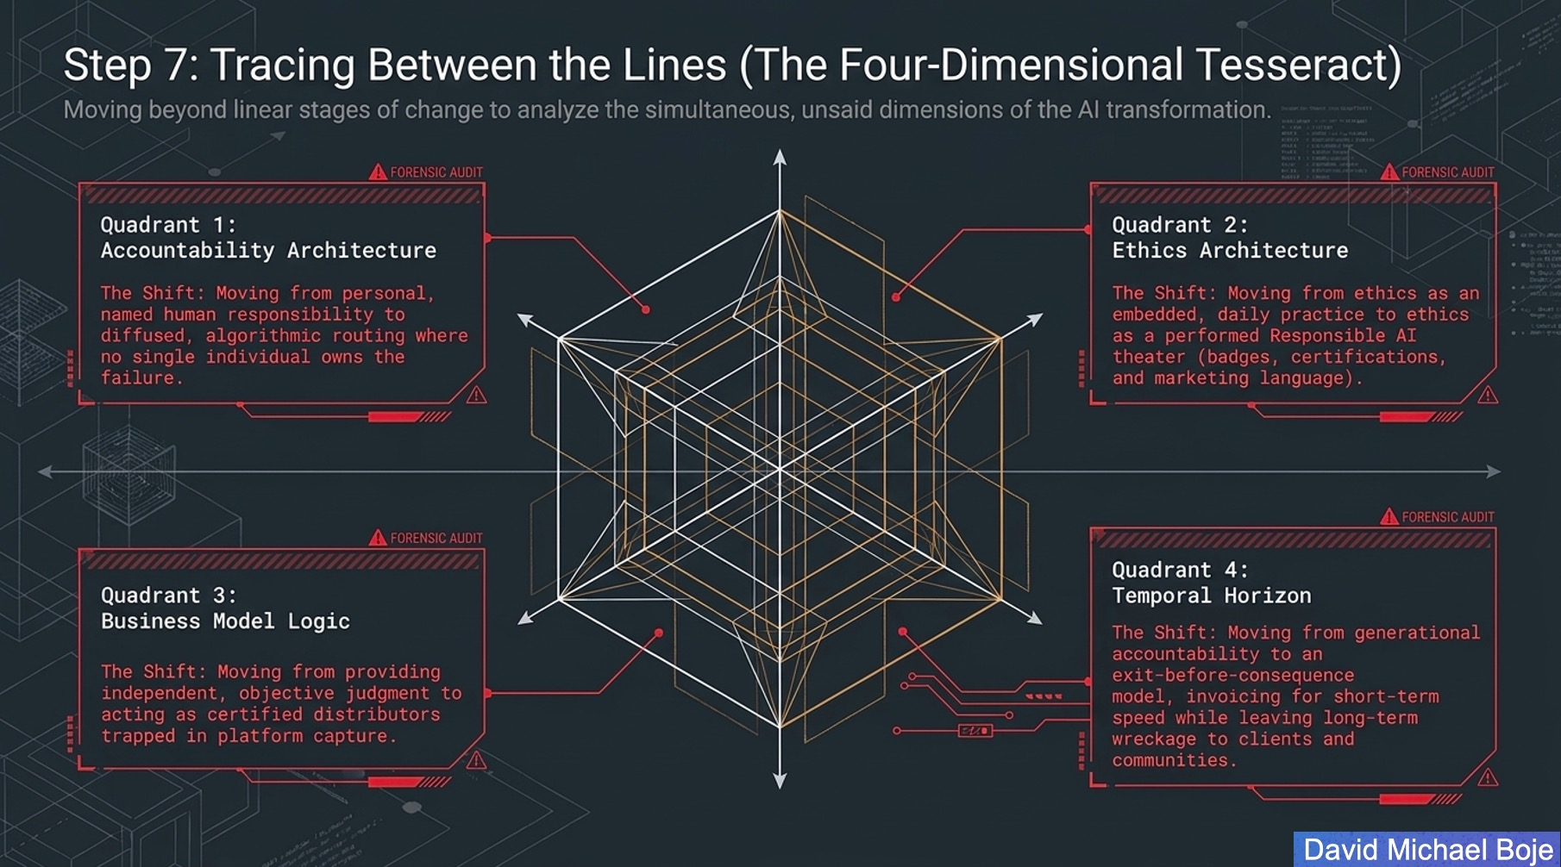
Notes:
Purpose Show that transformation occurs in simultaneous dimensions.
Story or move: Use a four-question walk around the tesseract: Who owns the failure? How does ethics appear in daily practice? Who captures the platform rents? What will this decision do to the next generation of judgment and to communities?
Core idea: The tesseract resists linear stage models. Accountability, ethics, business model, and temporal horizon change together. A firm can improve one dimension while damaging another.
Suggested line: “A transformation is not a line from old to new. It is a simultaneous rearrangement of responsibility, practice, value, and time.”
Watch out: Do not teach the geometry. Teach the four questions.

Slide 18
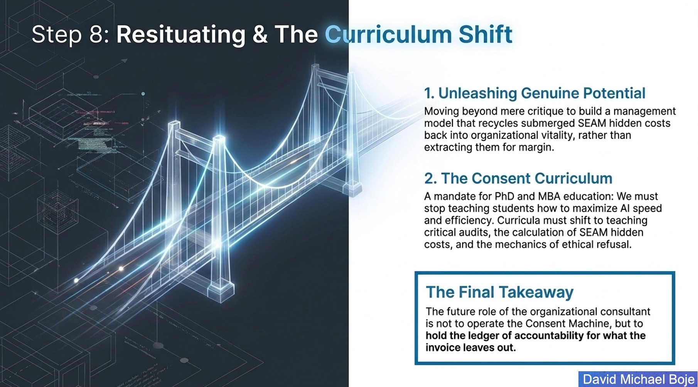
Notes:
Purpose Offer an OD&C alternative and address the PhD audience directly.
Story or move: Return to the Lyon experience: months of listening, verbatim notes, the mirror-effect meeting, and cross-level DPI teams. Explain that faster data processing should create more capacity for listening and joint diagnosis, not justify compressed exits.
Core idea: The curriculum shift is from teaching only AI speed and efficiency toward critical audit, hidden-cost calculation, answerability, and ethical refusal. Resituation means rebuilding the work so people participate in diagnosing dysfunction.
Suggested line: “If AI saves three days of data preparation, SEAM asks us to invest some of those days in the people whose organization the data only partially represents.”
Watch out: This slide is your constructive turn. Give it time. Do not end the talk in critique.

Slide 19

What Will Your Future Be in the AI Revolution?
Notes:
Purpose Close with agency and transfer ownership to the audience.
Story or move: Offer one practical action: in the next AI project, add a second column to the invoice or business case. Name the hidden work, transferred cost, silenced voice, and accountable person before approving the transformation.
Core idea: Re-state the central sentence and invite discussion.
Suggested line: “The future consultant does not have to choose between AI and humanity. The choice is whether we use AI inside a practice of answerable listening. What will you put in the second column?”
Watch out: Stop. Do not add another summary. Let the question open the Q&A.
Questions to ask the audience
Where in your organization has saved time become a tighter deadline rather than released capacity?
Which room in your organization writes the official AI story, and which room bears the hidden work?
What slow work in your field actually produces judgment and should not disappear?
Who can stop an AI transformation when evidence of harm appears?
What would you put in the second column of your current AI business case?

