Slide 1
Socio Economic Interventions David Boje and Grace Ann Rosile Cabrini University Doctoral Seminar

Slide 2
FROM FUTURING TO REHISTORICIZING
Ensemble Leadership can also become Worker-Driven Corporate Social Responsibility
Futuring by prospective sensemaking, making new direction and forecaring in advance for its Becoming,
Then Rehistoricizing by picking out a past (or inventing a past) to legitimate the new direction.

Slide 3
SEAM’s Self-Correcting ‘storytelling science’ competitive advantages
SEAM uses Peirce’s Abduction-Induction-Deduction in Scientific Method of unleashing human potential
Appreciative Inquiry is POSITIVITY of Confirmation without any Refutation
Action Research and Grounded Theory are not doing self-correction refutation method

Slide 4
TRILECTIC
This is a positive dialectics, the interplay of practical findings from application with academic canons in a “conflict-cooperation dialectical system” to sort a zone of convergence (Savall & Zardet, 2008: 80).
Savall and Zardet (2008: 21) cite Peirce’s (1955) logics of induction, deduction, and abduction, but prefers to move from abductive hypothesis selections from many possible ones, to deduction, and finally inductive reasoning.

Slide 5
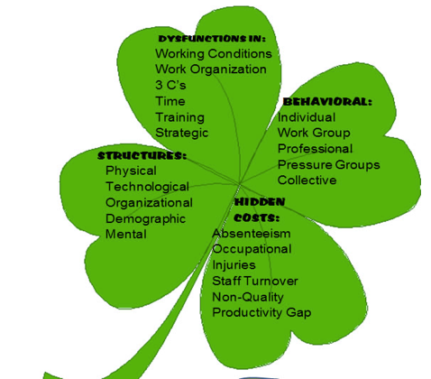
Hidden Costs Diagnostic Analysis
The analysis can include five socio-economic indicators

Slide 6
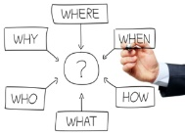
Causes of hidden costs & general characteristics of the socio-economic method of enterprise analysis.(DYSFUNCTION, HIDDEN COST ANALYSIS, JOB-TRAINING)
CAUSES OF HIDDEN COSTS
Structures and behaviors of company actors.

Slide 7
SEAM intervention-research is an Alternative to GT/AR & 10 Consultancy Giants
SEAM-STORYTELLING
TFW VIRUS
STORYTELLING DYSFUNCTIONS
STORYTELLING Behaviors
STORYTELLING Hidden Costs
STORYTELLING Structures
TAYLORISM
FAYOLISM
WEBERISM

Slide 8
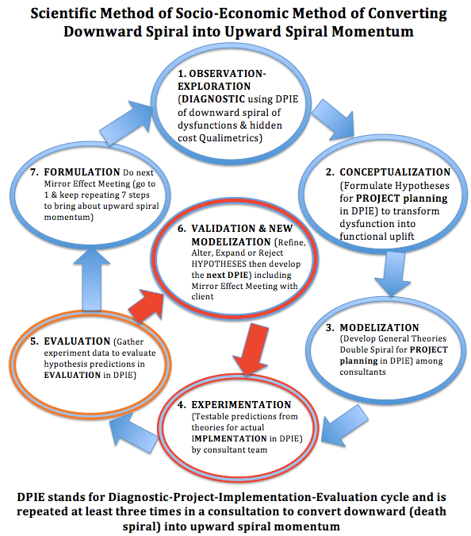
Why SEAM is not AR or GT inductive fallacies
Based upon (Savall & Zardet, 2008: 145, 148) Thank you, Rohny

Slide 9
Behaviors of business actors
Behavior is the observed human action that has an incidence on the physical and social environment.
Employees often can follow five behavior rationales or logics depending on the situation in which he or she is placed and on the nature of the problems that is faced with.
Individual logic ( personality, and family)
Group activity logic ( belongs to dept. – agency - … etc ).
Categorical logic ( job categories, job positions )
Affinity group logic (groups membership as political, religious… etc)
Collective logic ( behaving as expected …. (rare).

Slide 10
Socially Responsible Capitalism
Instead of WESTERN WAYS OF KNOWING (WWOK) of Liquid Modernity (Post-Fordism + Neoliberal Globalization Progress-Narrative = Annihilation of INDIGENOUS WAYS OF KNOWING (IWOK ) languages, their living story webs & ‘Mother Earth’ cultural practices).
I say Try Savall!
Savall, H., Péron, M., Zardet, V., & Bonnet, M. (2018). Socioeconomic Approach to Management. Socially Responsible Capitalism and Management, 73(90), 18.
Notes:
Zygmunt Bauman (2000) call is Liquid Modernity and Liquid Times (2007). His assessment is that globalization morphed from Fordism (phase III) to Post-Fordism and US Globalization (Phase IV), from stability of nation-state control to the instability, uncertainty, and disaster of Phase IV, where we are now stuck, with no way out.

Slide 11
TRILECTIC
This is a positive dialectics, the interplay of practical findings from application with academic canons in a “conflict-cooperation dialectical system” to sort a zone of convergence (Savall & Zardet, 2008: 80).
Savall and Zardet (2008: 21) cite Peirce’s (1955) logics of induction, deduction, and abduction, but prefers to move from abductive hypothesis selections from many possible ones, to deduction, and finally inductive reasoning.

Slide 12
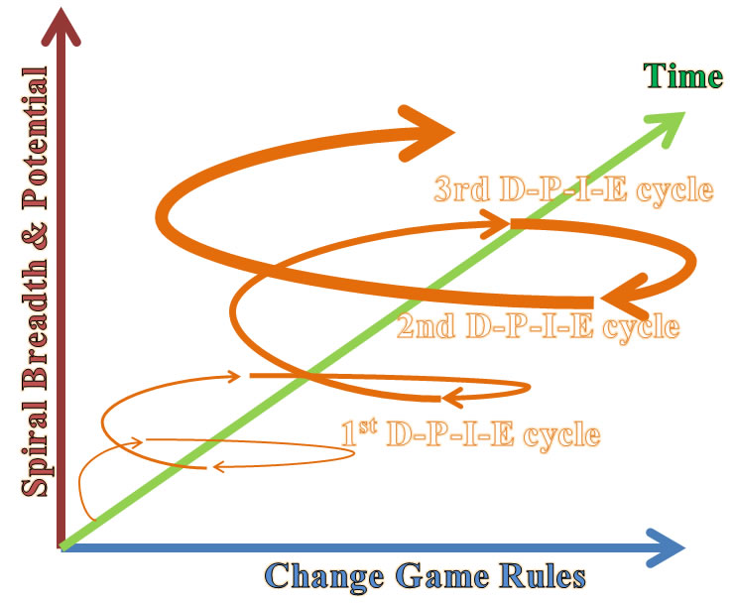

Slide 13
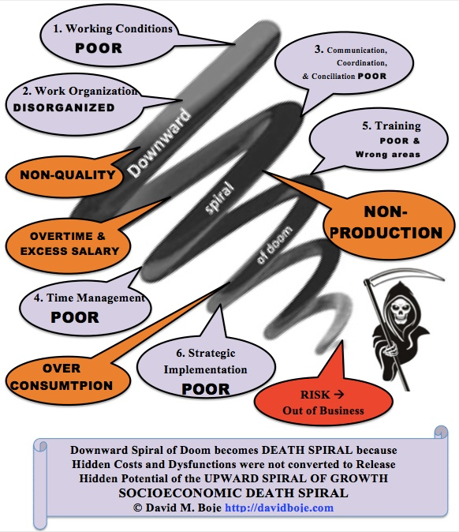

Slide 14
Savall and colleagues (abbreviated) contributions
Savall, Henri. (1975/2010). Work and People: An Economic Evaluation of Job-Enrichment. 1975 book "Enrichir le trail human dans les enterprises et les organizations”.
Savall, H. (1983). Germán Bernácer. La heterodoxia en la economía (No. halshs-00783092).
Savall, H. (2003). An updated presentation of the socio-economic management model. Journal of Organizational Change Management, 16(1), 33-48.
Savall, H. (2001). interview with the SEAM Faculty (Henri Savall, Veronique Zardet, Marc Bonnet and Michel Péron), conducted by Grace Ann Rosile and David M. Boje, taped and transcribed, from, 2.
Savall, H. (Ed.). (2004). Crossing frontiers in quantitative and qualitative research methods: first international co-sponsored conference, Research Methods Divsion, Academy of Management (USA); March 18-20, 2004, Lyon, France. 1 (2004). ISEOR.
Savall, H., & Zardet, V. (2005). Tétranormalisation: défis et dynamiques (No. halshs-00783085).
Savall, H., & Zardet, V. (Eds.). (2013). The dynamics and challenges of tetranormalization. IAP.
Péron, M., & Savall, H. (2007). Raising the Curtain on Business Operation Theatrics. Revue Sciences de Gestion, (58).
Savall, H., & Zardet, V. (Eds.). (2008). Mastering hidden costs and socioeconomic performance. IAP.
Savall, H., Zardet, V., & Bonnet, M. (2008). Releasing the untapped potential of enterprises through socio-economic management (No. halshs-00780720).

Slide 15
Some Savall and Colleagues'’ Contributions
Savall, H., Zardet, V., Bonnet, M., & Péron, M. (2010). contribution of qualimetrics intervention-research methodology to transorganizational development (No. halshs-00749946).
Savall, H., & Zardet, V. (Eds.). (2011). The qualimetrics approach: Observing the complex object. IAP.
Savall, H., Zardet, V., & Péron, M. (2011). 22 The Evolutive and Interactive Actor Polygon in the Theater of Organizations. Storytelling and the future of organizations: An antenarrative handbook, 366.
Savall, H., Zardet, V., Péron, M., & Bonnet, M. (2012). Possible Contributions of Qualimetrics Intervention-Research Methodology to Action Research. International Journal of Action Research, 8(1), 102-130.
Worley, C. G., Zardet, V., Bonnet, M., & Savall, A. (2015). Becoming agile: How the SEAM approach to management builds adaptability. John Wiley & Sons.
Savall, H., Péron, M., & Zardet, V. (2015, September). Human Potential at the Core of Socio-Economic Theory (SEAM). In Decoding the Socio? Economic Approach to Management: Results of the Second SEAM Conference in the United States(p. 1). IAP. Savall, H., & Zardet, V. (2015). Reflecting on SEAM in the 21st Century. The SocioEconomic Approach to Management Revisited: The Evolving Nature of SEAM in the 21st Century, 1.
Savall, H. (2016). TFW virus concept history. In Decoding the socio-economic approach to management: Results of the second SEAM conference in the United States.
Savall, H., Péron, M., Zardet, V., & Bonnet, M. (2018). Socioeconomic Approach to Management. Socially Responsible Capitalism and Management, 73(90), 18.

Slide 16
(Savall & Zardet, 2008: 145, 148)
Exploration in Diagnostic phase of DPIE
Conceptualization from In-Depth Observation
Modelization
Experimentation by implementing co-created projects (horizontally and vertically, in HORIVERT).
Evaluation
Formulation of relevant and knowledge to be disseminated
Validation

Slide 17
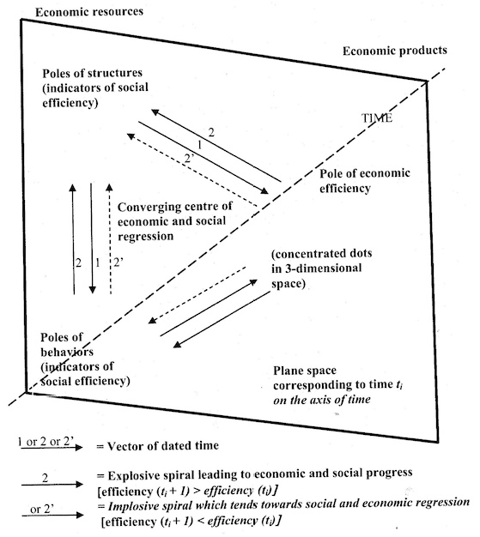
- Savall's depiction of Socioeconomic Dialectics of a Double Spiral (Savall, 1975/2010: 205)

Slide 18
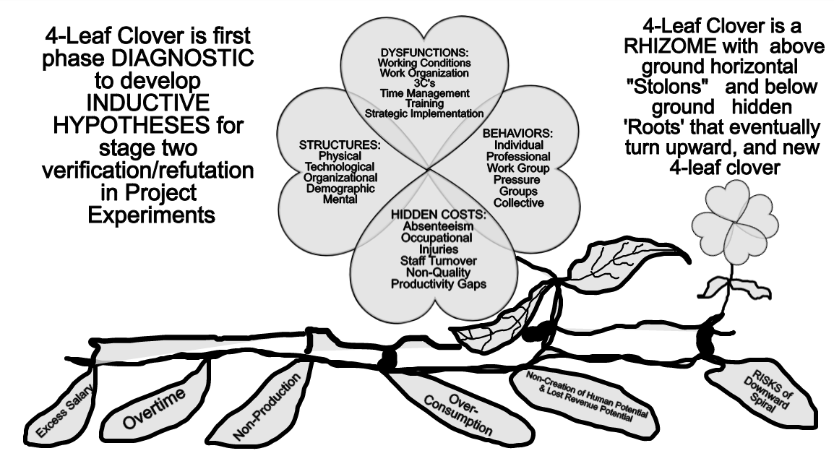

Slide 19
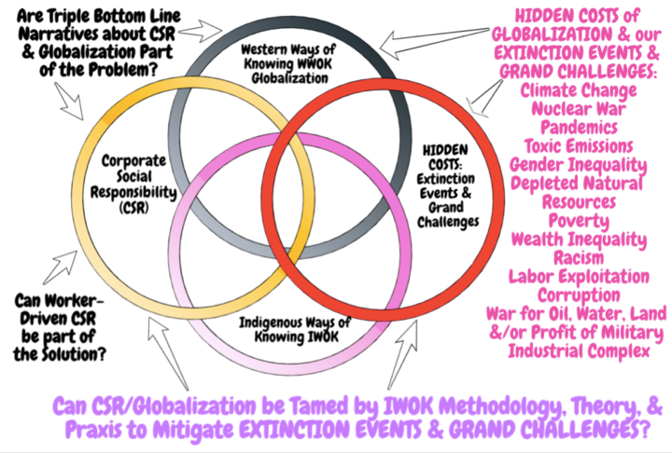

Slide 20
Can SEAM uses self-correcting ‘storytelling science’ to be Eco-Friendly?
Water quality standards are high in France as they must comply with strict EU standards.
62 percent of drinking water supply is from groundwater and 38 percent from surface water.
Veolia and Suez: Water privatization in France goes back to the mid-19th century when cities signed concessions with private water companies for the supply of drinking water.
75% of water and 50% of sanitation services in France are provided by the private sector, primarily by two firms, Veolia Water and Suez Environnement.
Wastewater is a problem; twice EU threatened France with fines if not brought up to EU standards
Agricultural is exempt from the Polluter-pays principle and that it continues to deteriorate the quality of groundwater with impunity.
Notes:
https://en.wikipedia.org/wiki/Water_supply_and_sanitation_in_France
https://en.wikipedia.org/wiki/Water_privatization_in_France

