Slide 1
Self-Correctiong ‘storytelling science’ methods
David Boje and Grace Ann Rosile
Cabrini University Doctoral Seminar

Slide 3
4 Tests of Self-Correcting Method
1. Refutation test of self-reflexivity, self-conversations, or in autoethnography, to question assumptions,
2. Storytelling conversations with others,
3. Understanding the science and processes of Nature, and
4. Doing experiments and practice interventions to get closer to the grounded situation.

Slide 4
PHASE 1: Test by Autoethnographic Reflexivity
What is autoethnography?
What is your living story of your dissertation?
What is reflexivity?

Slide 5
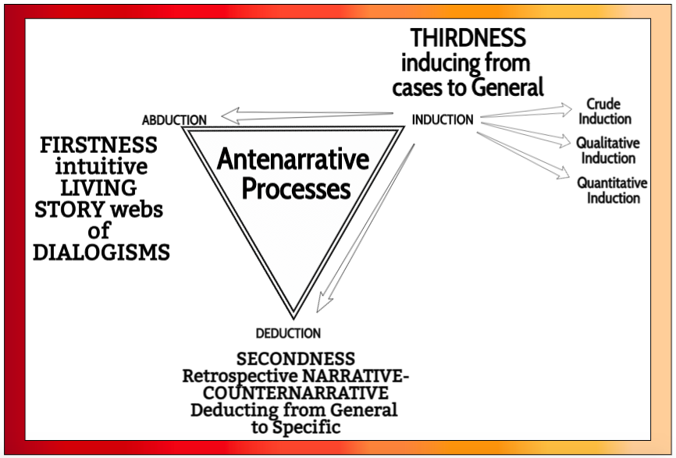

Slide 6
Self-Correcting Induction Methods
For Karl Popper it is Zigzag between intuitive hypotheses and testing theories by disconfirmation, not by confirmation
For C. S. Pierce it is self-correcting induction by four tests to get closer to Truth
For Henri Savall it is self-correcting by ’Agile’ intervention using Peirce’s Abduction-Induction-Deduction in Scientific Method of unleashing human potential

Slide 7
Popper (1972: 243)
Self-Correction Formula
PS₁ ➔ TT₁ ➔ EE₁ ➔PS₂
PS₁ = Problem situation, initial response
TT₁ = Tentative theories (conjectures)
EE₁ = Error elimination by testing
PS₂ = Problem situation, theories surviving refutation process

Slide 8
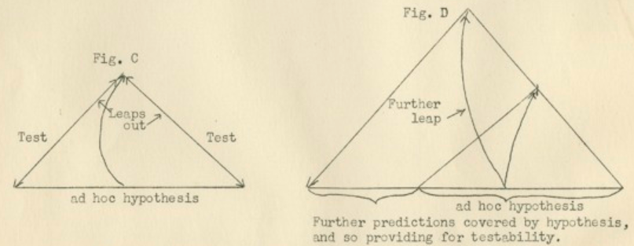
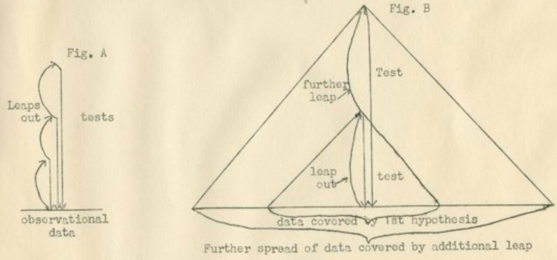

Slide 9
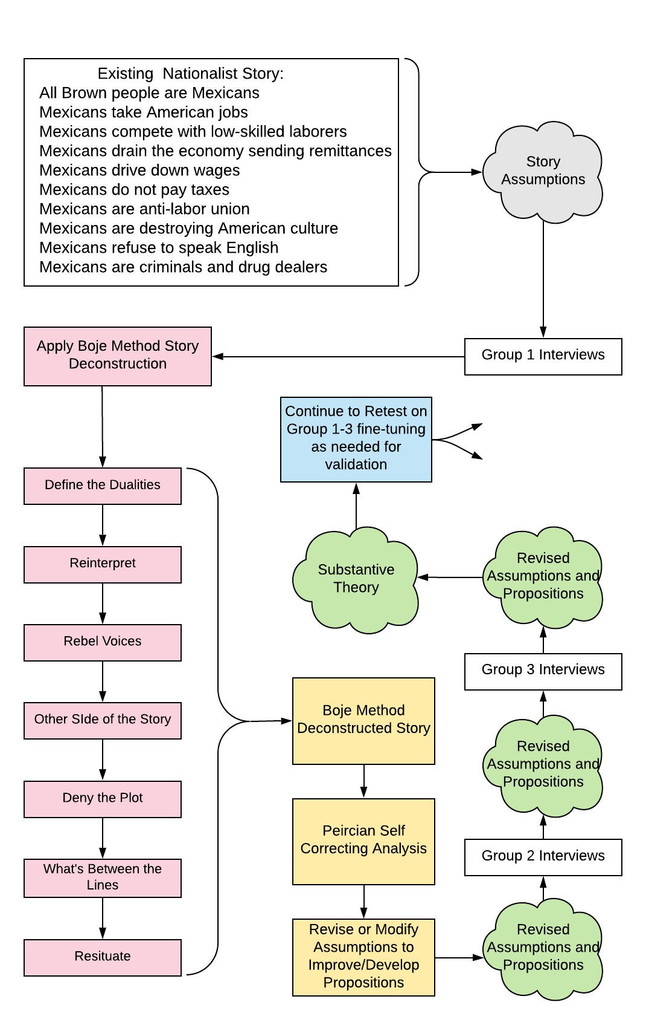
Jim Sibel Dissertation

Slide 10
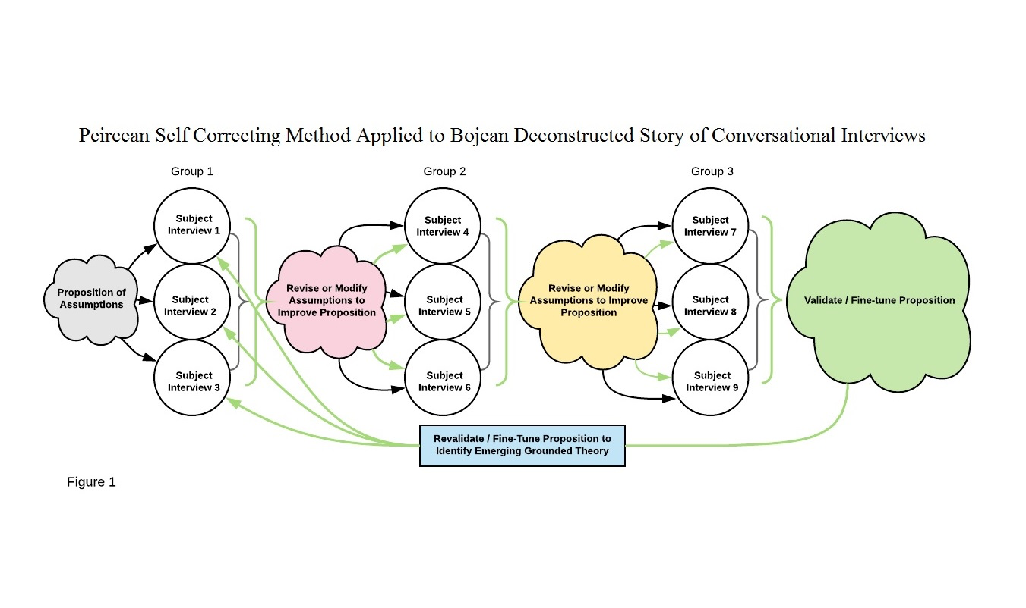
Jim Sibel dissertation example

Slide 11
An Ontology of Industrial Work in the Digital Electronic Age
Thomas E. Kleiner, Jr.

Slide 12
Phase 2: Test by Conversations
Sound of footsteps
David: Ok, how can I help you? (Softly asked)
Grace Ann: I’m going to give him his second. So that’s his (points to one plastic tub)
David: OK
Grace Ann: And there’s a bowl, outside for now [more footsteps; sound of food being poured into the bowl] See that bowl there
David: OK?
Grace Ann: We keep them separate (scuffling sound) that’s all right, let him go, he’s going to go with you.

Slide 13
Sound of footsteps David: Ok, how can I help you? (Softly asked) Grace Ann: I’m going to give him his second. So that’s his (points to one plastic tub) David: OK Grace Ann: And there’s a bowl, outside for now [more footsteps; sound of food being poured into the bowl] See that bowl there David: OK? Grace Ann: We keep them separate (scuffling sound) that’s all right, let him go, he’s going to go with you. | David is in his home office in Las Cruces Grace Ann walks in the office, interrupting David’s usual writing, with Sparkles who usually eats there in that office. The new puppy from the Rescue Shelter is about to get first meal in our home (Before). The new dog gets his food second to reinforce to the old dog that she is now the senior dog, she knows the rules, and the new dog should respect her and follow her lead David agreeing, to show he has heard. There is history here (Before), since it is about how Sparky and Honey had been fed in separate rooms before Sparky died. Then Honey was alone, and then later when Sparkles came, Honey became top dog and was fed first. After Honey was gone, Sparkles was alone until the new male puppy was adopted. Now Sparkles is top dog and gets to eat first, and the new puppy is second in rank. This is (Rehistoricizing) the dog-to-dog relationship. (Futuring) Giving her plan (Foretelling bets on the future) for how the feeding will be done. (Grounding) David is to feed Sparkles in his office. Grace Ann points to Sparkles bowl, in his office.

Slide 14
PHASE 3: Test with Science
Taylor’s (2007) three-year ethnography of animal sanctuaries raises challenges to ‘animal personhood’ in the intersubjectivity between animals and humans (the animal workers).
Pet statistics tell a multispecies-story, one relayed in social media accounts of homelessness and euthanasia (for which the literal meaning of the root words is ‘Good Death’), and part of pet capitalism. “Each year, approximately 1.5 million shelter animals are euthanized (670,000 dogs and 860,000 cats).

Slide 15
PHASE 4: Testing Claims

Slide 16
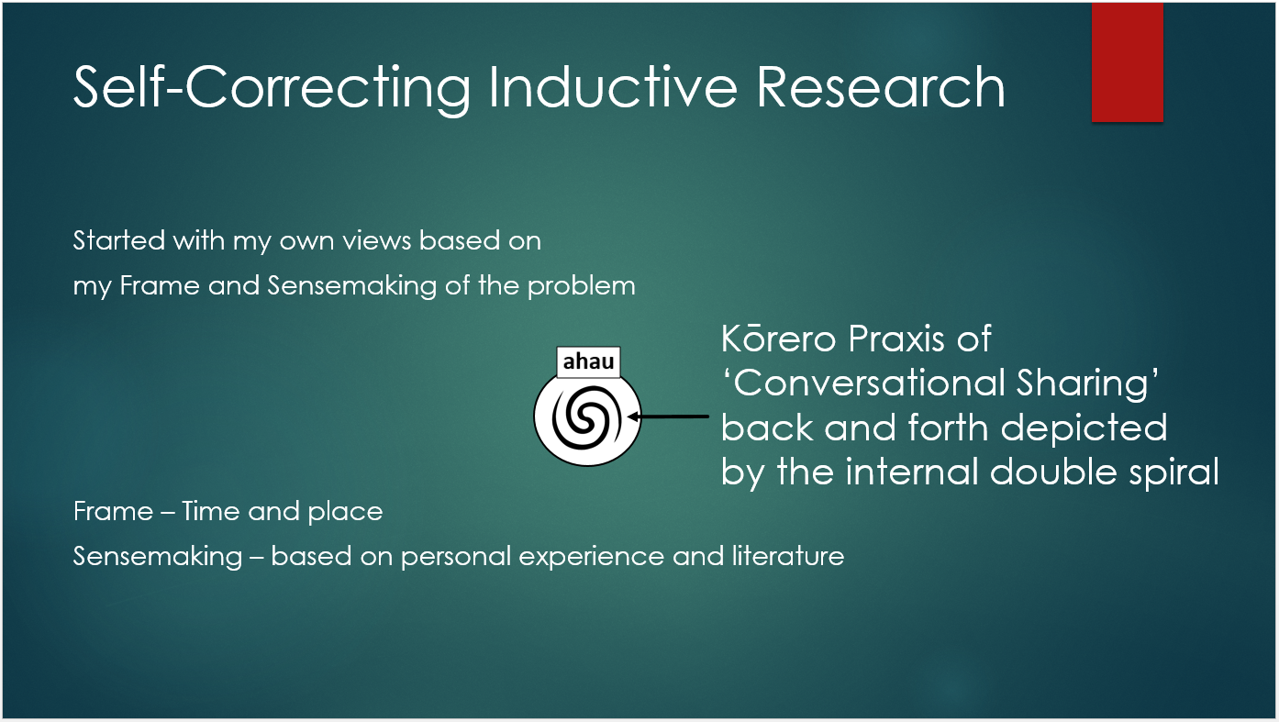
Mark Van der klei

Slide 17
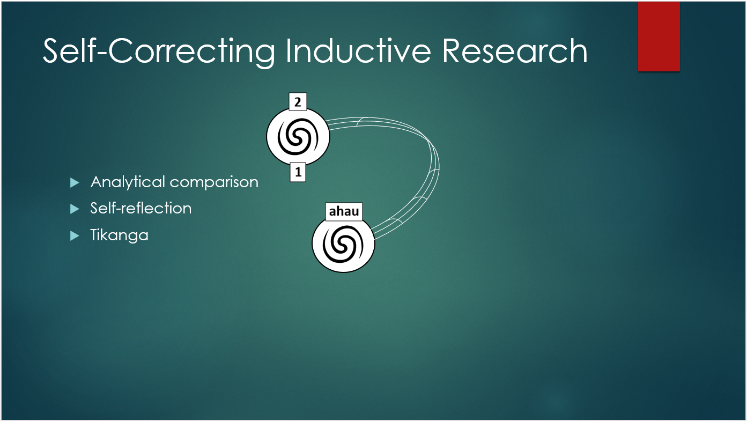

Slide 18
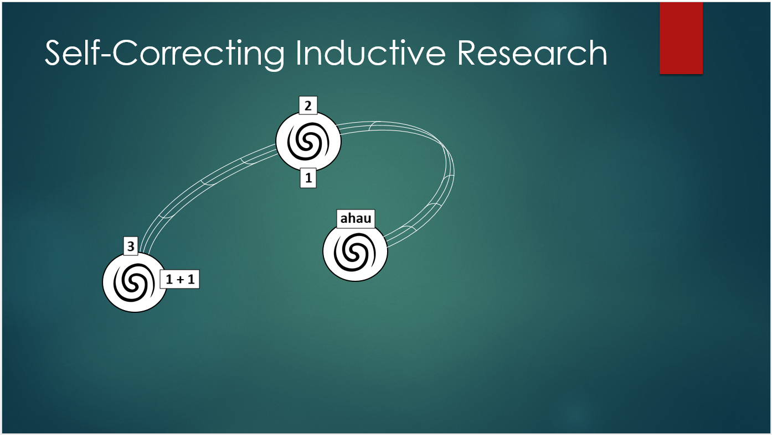

Slide 19
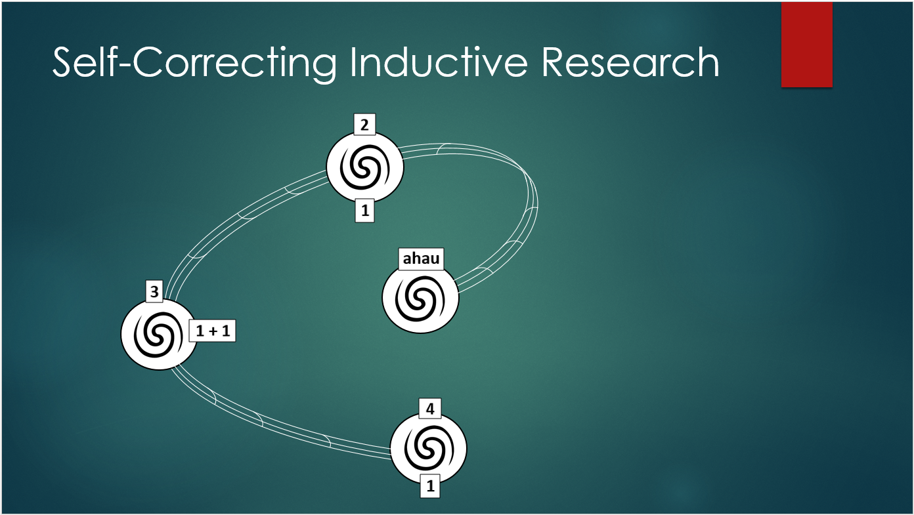

Slide 20
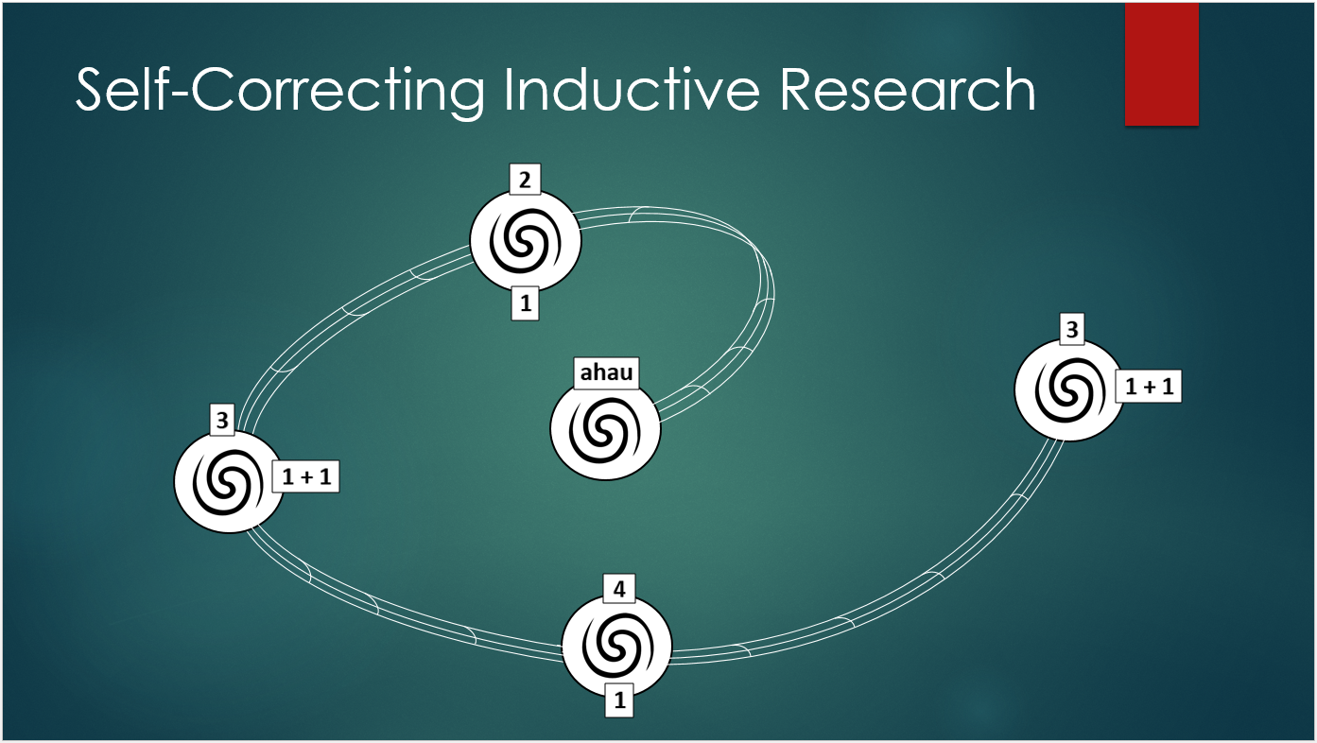

Slide 21
Untold Story of Fashion, Pet Euthanasia, and Global Warming
PICK ONE VIDEO:
Overpopulation
https://www.youtube.com/watch?v=Ye6-8ZCMJIg
Homeless pets
https://www.youtube.com/watch?v=gp5gwioRyGs
Pets and Global Warming
https://www.youtube.com/watch?v=sJGw_rR6RZk (UCLA Study)
It’s a bizarre injustice that this untold story is swept under the carpet due to the power of the pharmaceutical and agricultural industry lobbying
The more this is a story-told, the more awareness raised the better.

