Slide 1
The Storytelling Paradigm
David M. Boje
October 17 2019

Slide 3
The Iceberg of 6 B’s for Spirit and World

Slide 4
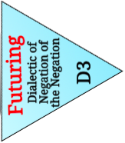

Slide 5
What Research Question would this suggest?
“Barry Estabrook chronicled the Hidden costs of cheap, year-round, industrially farmed tomatoes “Tomatoland: How Modern Industrial Agriculture Destroyed Our Most Alluring Fruit,” which detailed the use of chemicals and the exploitation of workers in Florida”
Tomato workers are exposed to toxic chemicals that have led to health problems, and birth defects (Living stories of workers)
Florida growers use 8 times as many chemicals on their fields as similarly sized fields in California.
Corporate Agriculture Narrative that mono-crops with chemical fertilizers only profitable way; Counternarrative is for penny more per pound, slavery, sex abuse, & toxic work conditions could be transformed
Sociomateriality: The tomatoes are rubbery, capable of bouncing across a kitchen floor without breaking, and completely tasteless
Florida's tomato industry has been under assault by cheap, government-subsidized tomatoes from Mexico since the implementation of the North American Free Trade Agreement in 1994.
S
Notes:
Florida tomato farmers, the nation’s leading producer of fresh tomatoes, allege Mexican growers are running them out of business by low-balling prices in violation of trade agreements adopted periodically over the last two decades. https://www.jacksonville.com/opinion/20190411/editorial-forget-avocados-florida-tomato-farmers-face-real-crisis
https://www.nytimes.com/2019/04/30/dining/tomatoes-climate-change.html
https://opinionator.blogs.nytimes.com/2011/06/14/the-true-cost-of-tomatoes/
https://www.upi.com/Top_News/US/2018/10/25/Floridas-tomato-industry-could-be-wiped-out-under-new-trade-deal/5631540447504/
https://www.jacksonville.com/opinion/20190411/editorial-forget-avocados-florida-tomato-farmers-face-real-crisis

Slide 6
Fodder for Research Questions
In Florida alone, agriculture runoff, laced with fertilizer nutrients, is considered one of the primary fuels feeding blue green algal blooms that plague both coasts, declining water quality across the state and complications to Everglades restoration efforts.
Notes:
https://www.miamiherald.com/news/local/environment/article234030662.html
“report from the United Nations’ Intergovernmental Panel on Climate Change revealed that agriculture, food production and deforestation produce about 23 percent of all human-induced greenhouse gas emissions”
“growers are already changing how they fertilize and spray for pests in response, but the big concern for low-lying South Florida is saltwater inundation for the wells they use to water their crops. Plus, there’s the impact of extreme heat on outdoor workers, who currently have no federal or state legal protections from heat stress.”
EPA report on Florida and Climate Chanbe https://www.epa.gov/sites/production/files/2016-08/documents/climate-change-fl.pdf

Slide 7
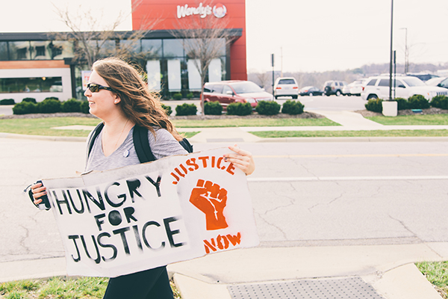
Mabel Sanchez, doing Participant Observation March 2017

Slide 8
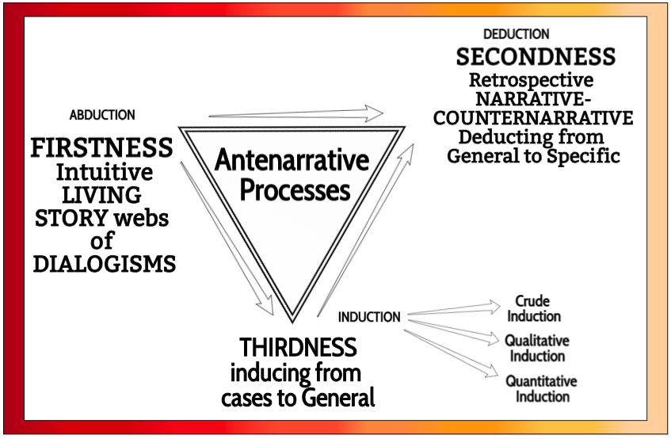

Slide 9
Self-Correcting Induction Methods
For Karl Popper it is zigzag between intuitive hypotheses and testing theories by disconfirmation, not by confirmation
For C. S. Pierce it is self-correcting induction by four tests to get closer to Truth
For Henri Savall it is self-correcting by ’Agile’ intervention using Peirce’s Abduction-Induction-Deduction in Scientific Method of unleashing human potential

Slide 11
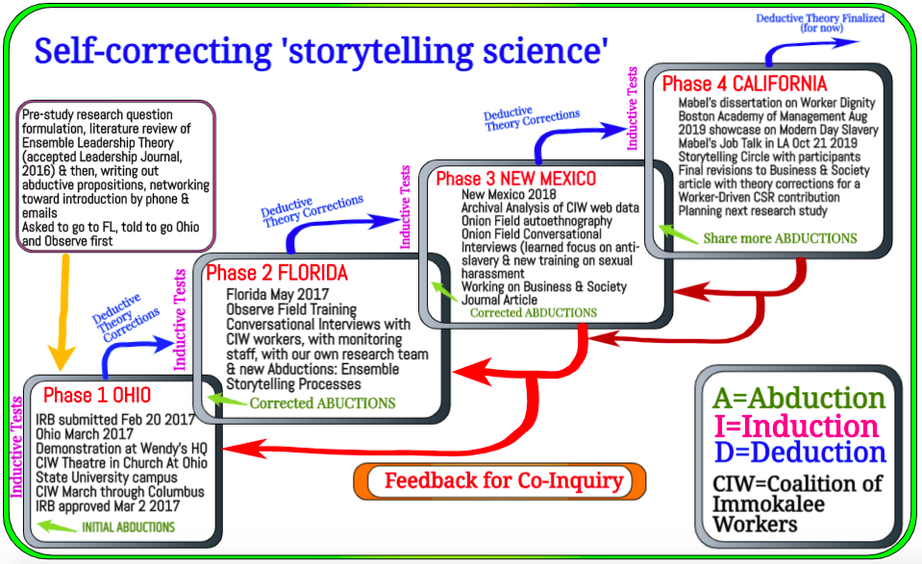

Slide 12
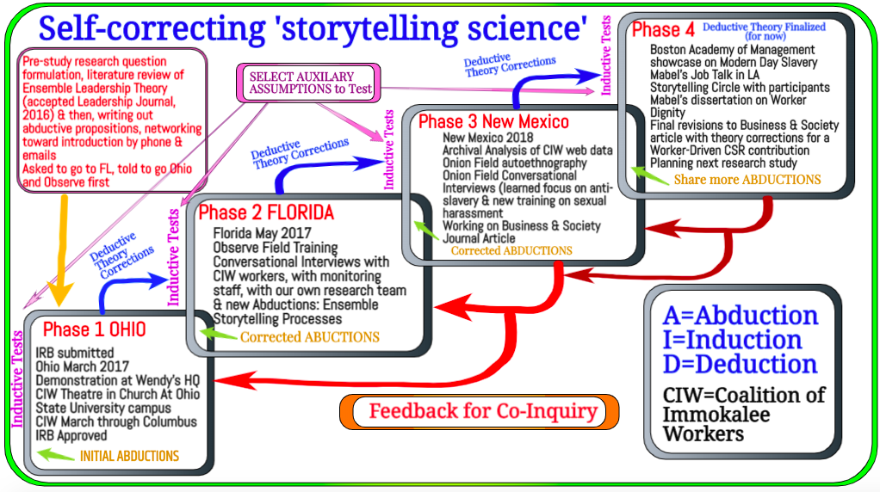

Slide 13
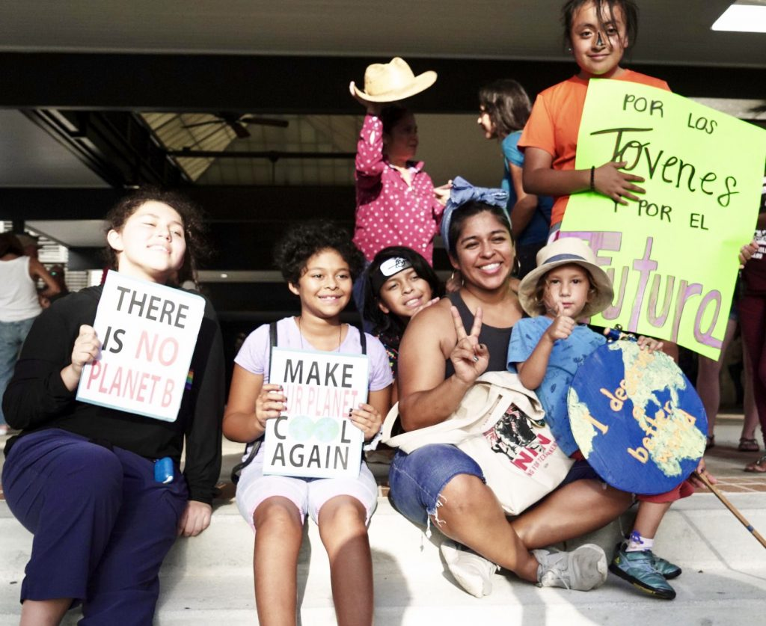
delegation of farmworkers and their families from Immokalee assemble in Naples, Florida, for a group photo following the local Climate March
Notes:
https://ciw-online.org/blog/2019/09/climate-march-2/

Slide 14
4 Tests of Self-Correcting Method
1. Refutation test of self-reflexivity, self-conversations, or in autoethnography, to question assumptions,
2. Storytelling conversations with others,
3. Understanding the science and processes of Nature, and
4. Doing experiments and practice interventions to get closer to the grounded situation.

Slide 15
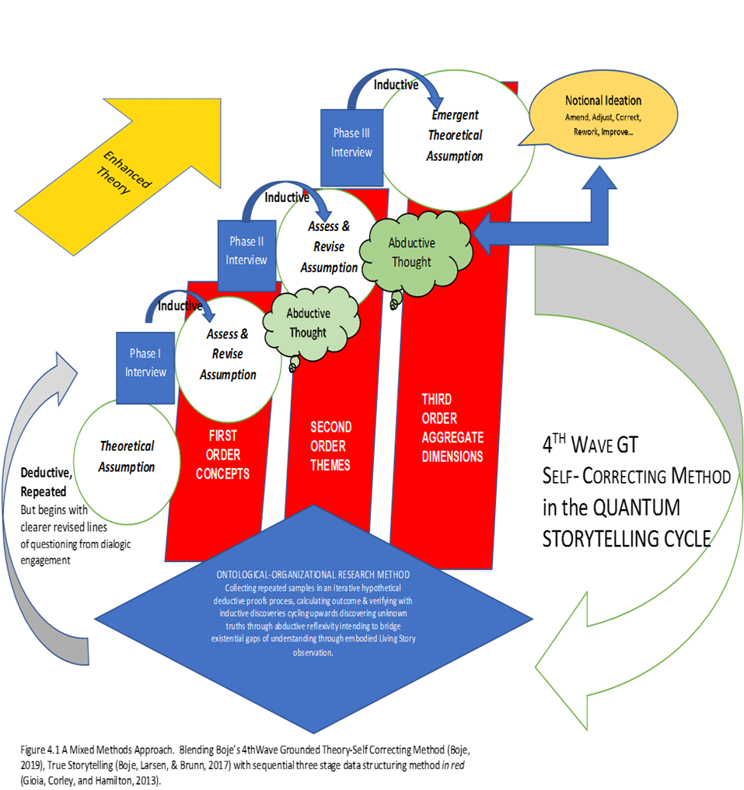
Excerpted from: An Ontology of Industrial Work in the Age of Digital Electronic Technology -Thomas Kleiner, April 2019

Slide 16
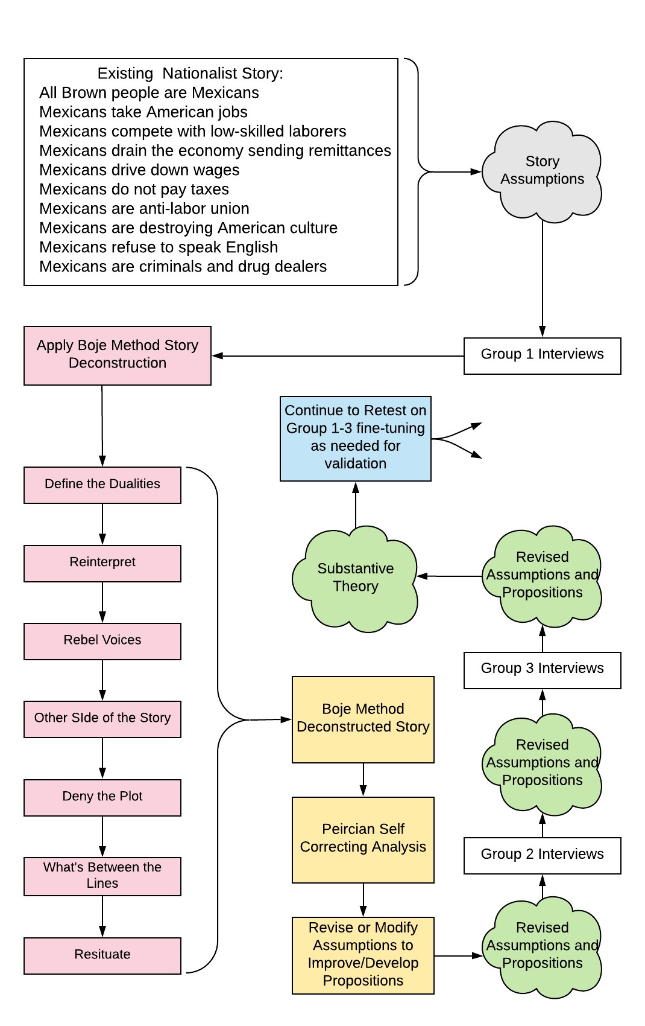
Jim Sibel Dissertation

Slide 17
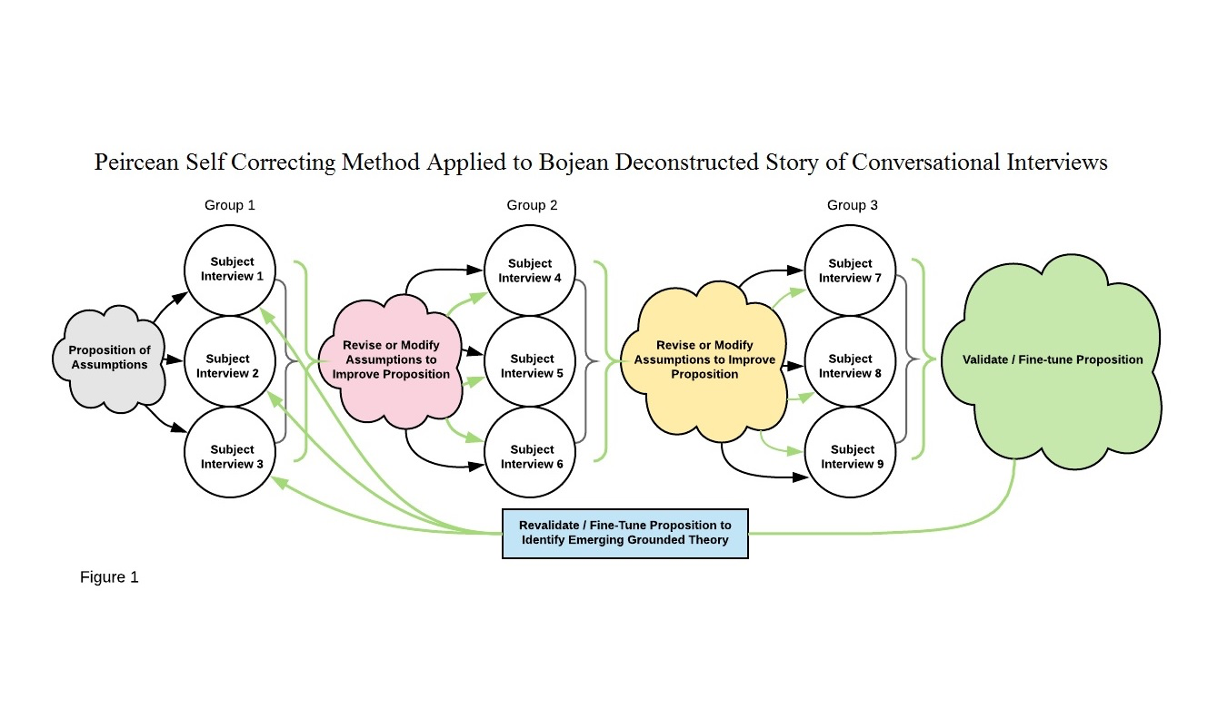
Jim Sibel dissertation example

Slide 18
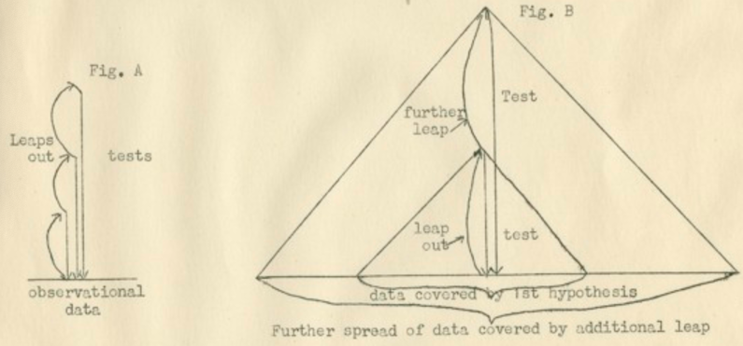
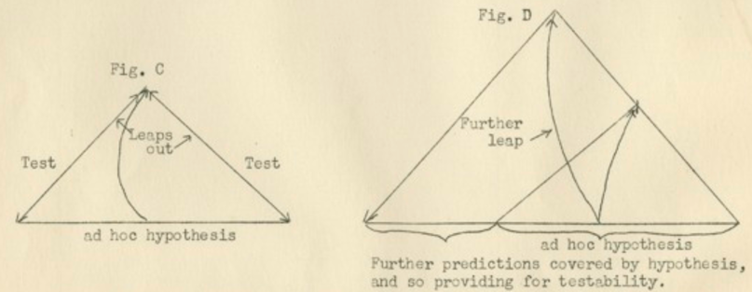

Slide 19
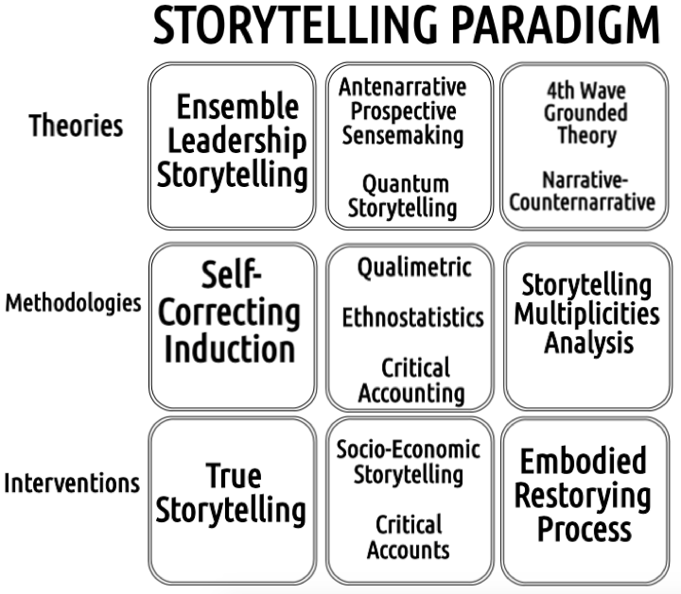

Slide 25
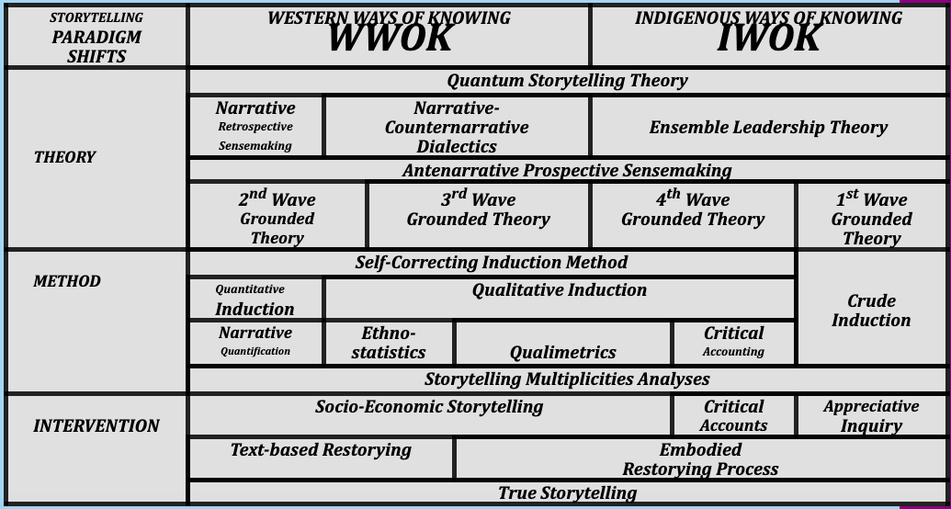

Slide 26
Questions and Discussion
Slides at https://davidboje.com

