Slide 1
What is Storytelling Research?
David M. Boje
Grace Ann Rosile
Slides at https://davidboje.com
For Alana James
DoctoralNet Ltd
Advancing Graduate Support Through Technology and Research

Slide 2
What is Storytelling?
Storytelling includes three facets:
Narratives & Counternarratives
Living Stories Grounding in place & time
Antenarrative Processes
For now Antenarrative means BEFORE (narratives or story) and BETS on the Future
Notes:
Lundholt, M. W., & Boje, D. (2018). Understanding Organizational Narrative-Counter-narratives Dynamics: An overview of Communication Constitutes Organization (CCO) and Storytelling Organization Theory (SOT) approaches. Communication and Language at Work, 5(1), 18-29.

Slide 3
What is Storytelling Research?
It does not start with the BME Story although it may show up later
It does start with 3 concepts:
Storytelling as Tamara-Land
Storytelling as Antenarrative = 6 B’s
Storytelling as ‘science’

Slide 4
Notes:
Lundholt, M. W., & Boje, D. (2018). Understanding Organizational Narrative-Counter-narratives Dynamics: An overview of Communication Constitutes Organization (CCO) and Storytelling Organization Theory (SOT) approaches. Communication and Language at Work, 5(1), 18-29.
Explain:
Multiple simultaneous fragmented stories
That have permutations & combinations (factorial)
Different sides of Personalitie show up with different characters in different rooms
Meaning of story you get depends on sequence of rooms you were in BEFORE
We keep Diffracting the multiple histories coming unraveled and reweaving in Tamara-Land

Slide 5
Notes:
See Boje & Rosile new book How to use storytelling conversation interviewing in your dissertation
Boje, D. M.; Rosile, G. A. (in press). How to Use Conversational Storytelling Interviews for Your Dissertation. UK: Edward Elgar Publishing Ltd. https://www.dropbox.com/sh/bd297r9f6lhgjeh/AAChF7KdZH7hvz3aGIySrTJwa?dl=0

Slide 6
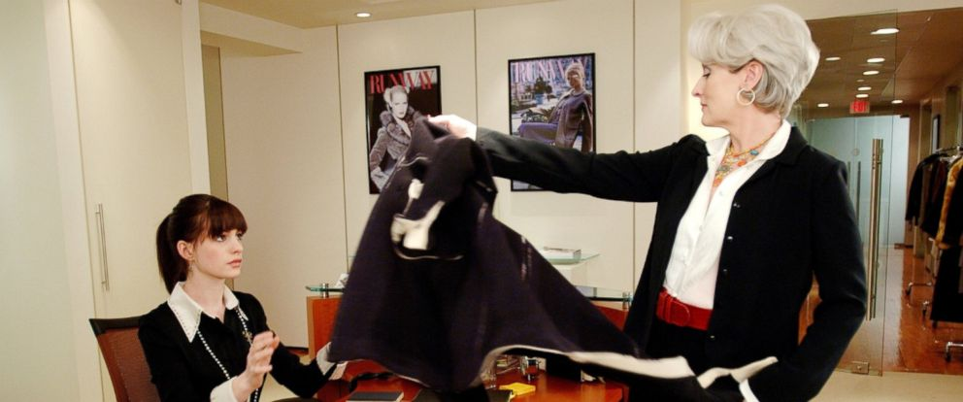
Antenarrative Intersubjectivity
The “untold story” (Hitchin, 2015)
Notes:
Izak, M., Hitchin, L., & Anderson, D. (Eds.). (2015). Untold stories in organizations. Routledge.
See chapter by Hitchin on Tamara-land and fragmented stories

Slide 7
WHAT IS INTERSUBJECTIVITY OF STORYTELLING?
‘Walking the Stairs’ story
Boss’s New Couch
Office Supply Study (Boje 1991)

Slide 8
Narrative tends toward ABSTRACTING
Notes:
This is an example of Abstracting
Aristotle. (2006). Poetics (Vol. 20685). ReadHowYouWant. com.

Slide 9
Notes:
Burke, K. (1945). A Grammar af Motives. Berkeley and Los Angelos: University.

Slide 10
WHAT IS INTERSUBJECTIVITY OF STORYTELLING? Conversational Storytelling
Sound of footsteps
David: Ok, how can I help you? (Softly asked)
Grace Ann: I’m going to give him his second. So that’s his (points to one plastic tub)
David: OK
Grace Ann: And there’s a bowl, outside for now [more footsteps; sound of food being poured into the bowl] See that bowl there
David: OK?
Grace Ann: We keep them separate (scuffling sound) that’s all right, let him go, he’s going to go with you.
Notes:
Boje, David M.; Rosile, Grace Ann. (2019). 'Conversational Storytelling Research Methods: Cats, Dogs, and Humans in Pet Capitalism. Communication Research and Practice journal. Accepted Oct 9, 2019. Click here for pre-publication PDF https://davidboje.com/vita/paper_pdfs/Boje%20Rosile%20Conversational%20Story%20Res%20Methods.docx

Slide 11
Sound of footsteps David: Ok, how can I help you? (Softly asked) Grace Ann: I’m going to give him his second. So that’s his (points to one plastic tub) David: OK Grace Ann: And there’s a bowl, outside for now [more footsteps; sound of food being poured into the bowl] See that bowl there David: OK? Grace Ann: We keep them separate (scuffling sound) that’s all right, let him go, he’s going to go with you. | David is in his home office in Las Cruces Grace Ann walks in the office, interrupting David’s usual writing, with Sparkles who usually eats there in that office. The new puppy from the Rescue Shelter is about to get first meal in our home (Before). The new dog gets his food second to reinforce to the old dog that she is now the senior dog, she knows the rules, and the new dog should respect her and follow her lead David agreeing, to show he has heard. There is history here (Before), since it is about how Sparky and Honey had been fed in separate rooms before Sparky died. Then Honey was alone, and then later when Sparkles came, Honey became top dog and was fed first. After Honey was gone, Sparkles was alone until the new male puppy was adopted. Now Sparkles is top dog and gets to eat first, and the new puppy is second in rank. This is (Rehistoricizing) the dog-to-dog relationship. (Futuring) Giving her plan (Foretelling bets on the future) for how the feeding will be done. (Grounding) David is to feed Sparkles in his office. Grace Ann points to Sparkles bowl, in his office.

Slide 12
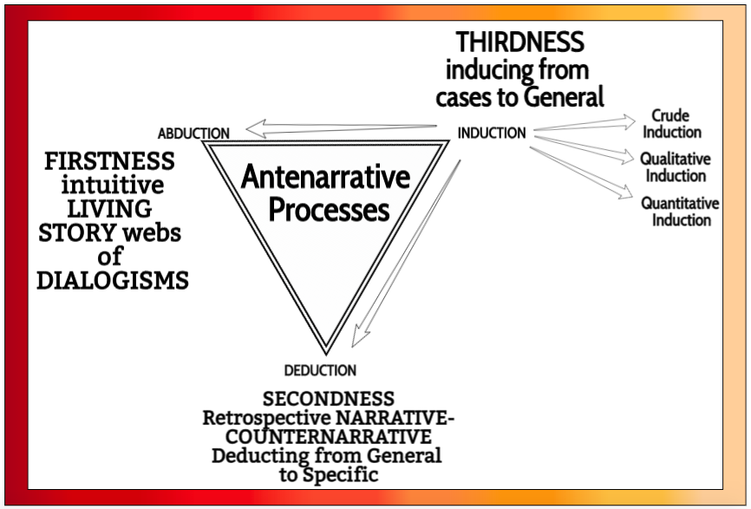

Slide 13
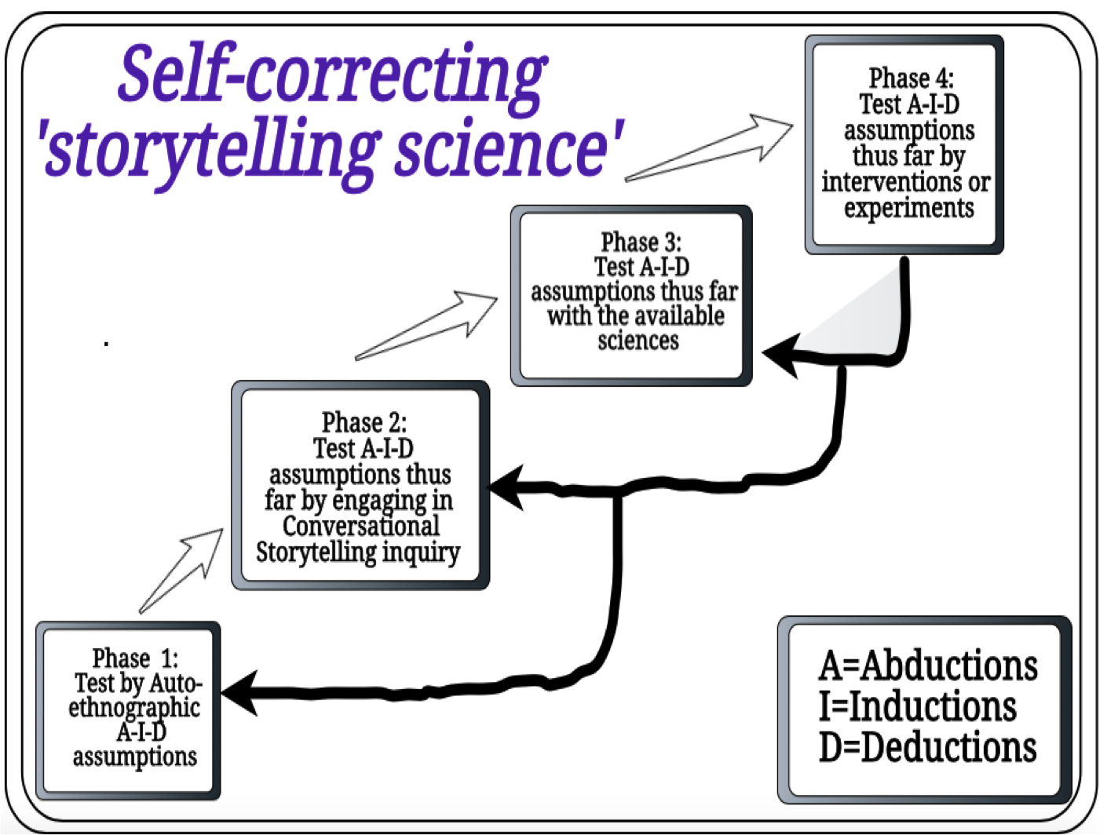

Slide 14
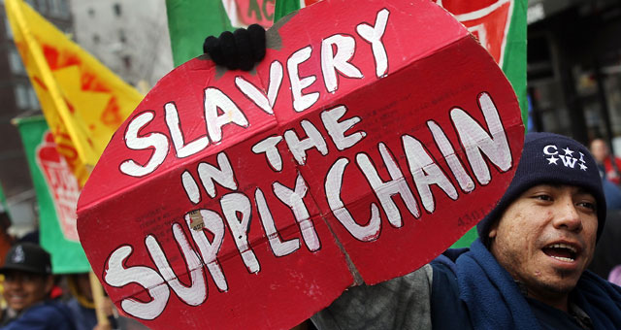
Coalition of Immokalee Workers (CIW) ending Modern Day Slavery with Worker-Driven Corporate Social Responsibility
Notes:
https://ciw-online.org/blog/2019/09/climate-march-2/

Slide 15
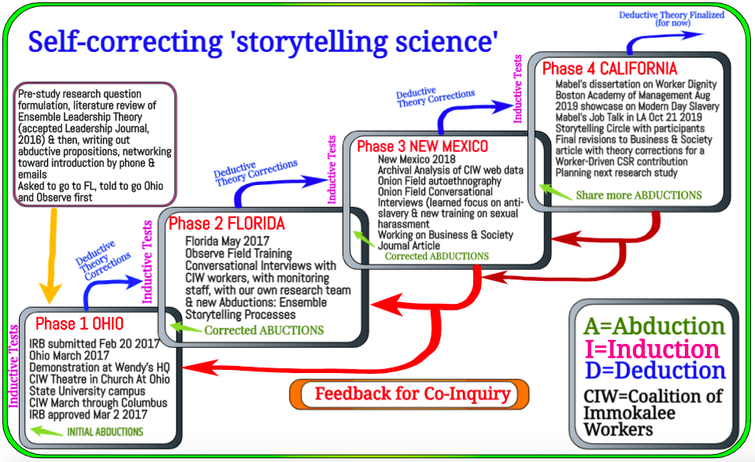
Boje, D
Notes:
Rosile, Grace Ann; Boje, David M.’ Herder, Rick; Sanchez, Rick. (2019, in press). The Coalition of Immokalee Workers uses Ensemble Storytelling Processes to Overcome Enslavement in Corporate Supply Chains. This is earlier draft of article accepted by Business and Society Journal, July 2019. Click here for PDF draft version. https://davidboje.com/vita/paper_pdfs/CIW%20article%20draft%20for%20Business%20and%20Society%202019.pdf

Slide 17
Embodied Restorying Intervention
The Cheating case example

Slide 18
Steps of the Embodied Restorying Process:
Characterize: “Describe you at your “best.” What would a favorite grandparent, parent, teacher, family member, or best friend, say about you? These received narratives constitute a received self-identity. For example, society, films, families, and institutions such as the military or professional training all tell us who we should be and how we should behave.”
Externalize: “Describe your ‘old story,’ and make any problems or struggles into another character in your story (use an object in the sand tray to describe this character/problem).” (Note: some people prefer to talk about their old story before they describe their “best” self.
Sympathize: “How has the problem (the old story) benefitted you or how is it understandable?”
Revise: “Identify negative consequences of the problem.” This helps reaffirm the commitment to change them.
Strategize: “Find the ‘little wow moments’ of exception to the usual ‘same old story.’” For example, “How did you overcome the problem this time?”
Restory: “Re-write history and write a new future story. This time, highlight all the ‘little wow moments’ and make them the “new normal” (instead of the exception) in the future story.”
Publicize: “Identify a support network and write letters to potential supporters to request participation in the new story of the future. It does not matter if the letter recipients respond or not. Consider family and friends who can support and ‘call you on it’ if the old story creeps back in.”
Notes:
Flora, Jeanne & Boje, David & Rosile, Grace & Hacker, Kenneth. (2016). A Theoretical and Applied Review of Embodied Restorying for Post- Deployment Family Reintegration. Journal of Veterans Studies. 1. 10.21061/jvs.41. http://veteransstudies.org/journal/index.php?journal=jvs&page=article&op=view&path%5B%5D=7&path%5B%5D=20

Slide 19
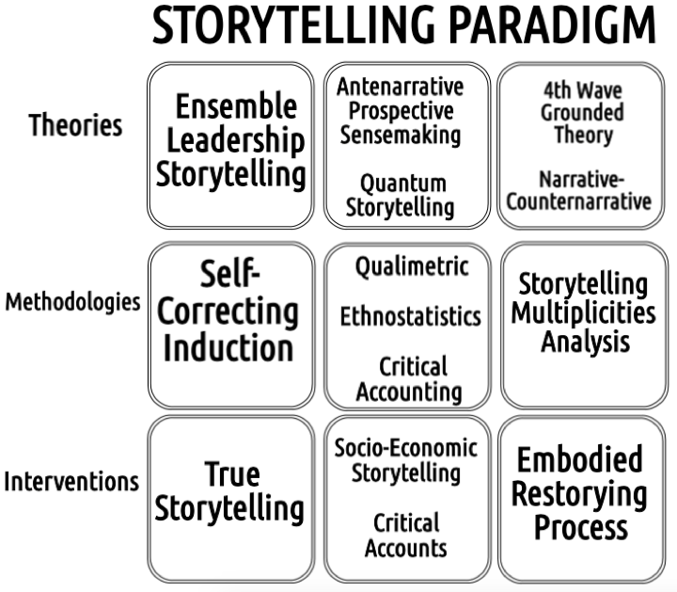

Slide 20
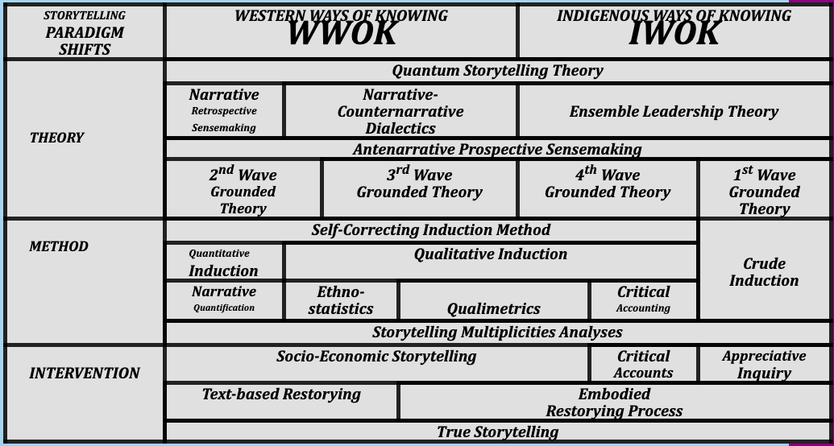

Slide 21
Your Questions
How do you triangulate data when building out a storyline?
Triangulation too often lets quantitative marginalize qualitative, but makes its points with the qualitative excerpts; we recommend self-correcting methods over triangulation (ask GA for hospital maternity ward case)
Use Abduction, and let the story emerge.
Based on what emerges, you can observe something & use Induction to draw a conclusion which can be tested (boss throws coat on secretary’s desk; are all bosses arrogant?).
Deduction: General belief that secretaries/subordinates should help the boss with less-challenging work

Slide 22
Your Questions
2. What are the three things that are most important when bringing my data together to tell a story?
Let people speak in their own voices; it is their story and their data, not yours.
Explain the contexts (6 B’s of Antenarrative)
Identify patterns in both process & content (i.e. process: the boss always speaks first/ Content: the boss assigns the tasks)

Slide 23
Your Questions
3. How does the storyline relate to the publication? Is it like an outline?
A. At least 2 elements of the research process should be addressed in your final article:
Autoethnography: self-reflection on how you as researcher have influenced the process,
Self-reflection with self as subject, how the topic has changed you.
B. Publications need to follow the format required by the particular journal

Slide 24
Your Questions
4. Where do you start?
Something catches your attention ➔Abduction,
You wonder how to test it ➔ Induction, and
You develop a theory of conclusions from premises ➔ Deduction

Slide 25
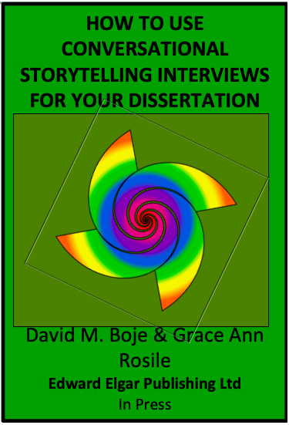
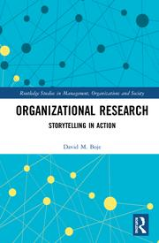
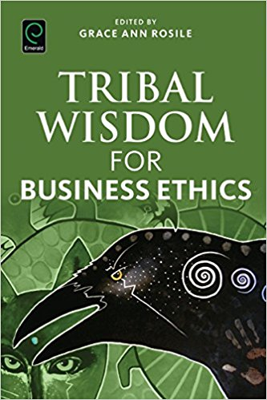
Questions and Discussion
Download for free until published in 2020
Download free till published
Slides at https://davidboje.com
Notes:
Boje, D. M.; Rosile, G. A. (in press). How to Use Conversational Storytelling Interviews for Your Dissertation. UK: Edward Elgar Publishing Ltd. https://www.dropbox.com/sh/bd297r9f6lhgjeh/AAChF7KdZH7hvz3aGIySrTJwa?dl=0

