Slide 1
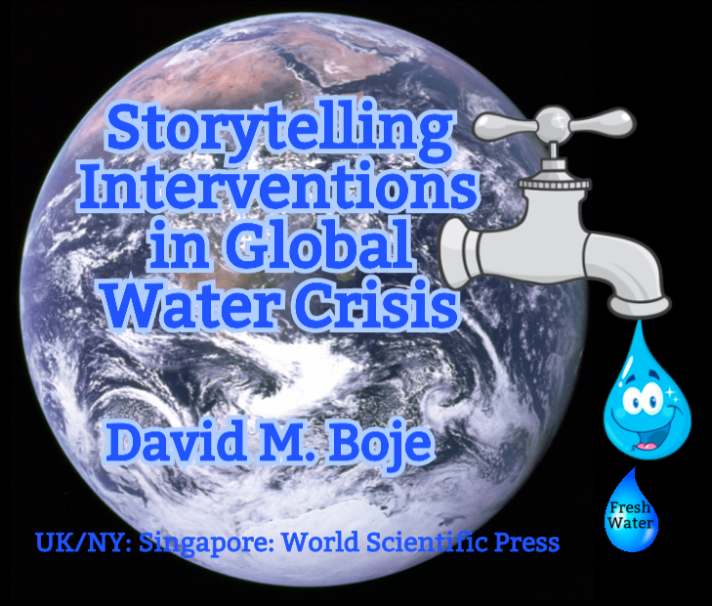
David M. Boje
davidboje@gmail.com
https://davidboje.com/water
Notes:
Image source https://en.wikipedia.org/wiki/Water_distribution_on_Earth#/media/File:Water_drop_001.jpg

Slide 2
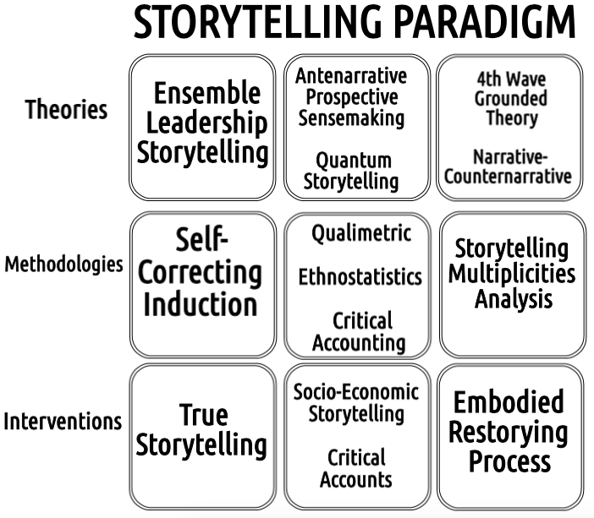

Slide 4
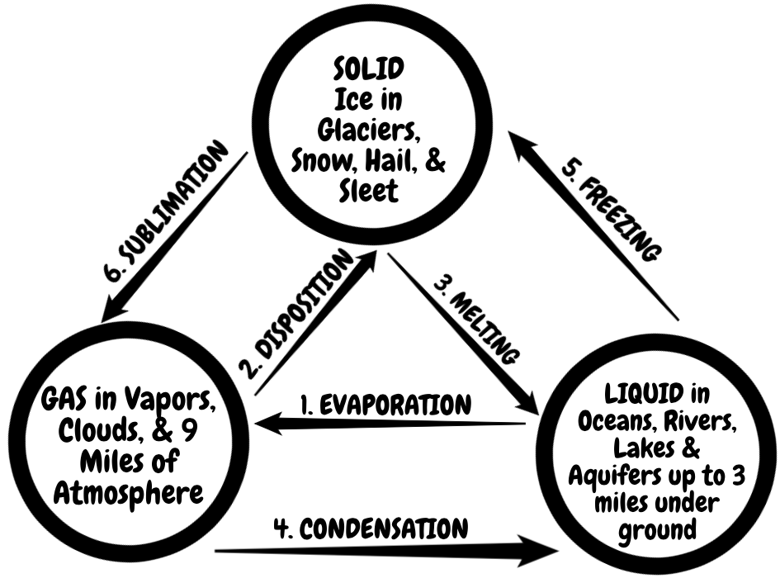

Slide 5
How to Research the Fresh Water Replenishment STORYTELLING Claims of Coca Cola?
Use Coca Cola Annual Sustainability Report for such claims
Then Study the Claims and ‘auxiliary assumptions’ in photos, graphs, numbers, and text
Check out Coke’s collection of stories and those ‘auxiliary assumptions’
Check out the counter-stories of people living around Coke bottling plants and their ‘auxiliary assumptions’
Learn the facts about Fresh Water Scarcity and Water Stress on planet Earth so you can make new ‘auxiliary assumptions’ to test out on the next Coke stories and counter-stories for farmers around the world

Slide 6
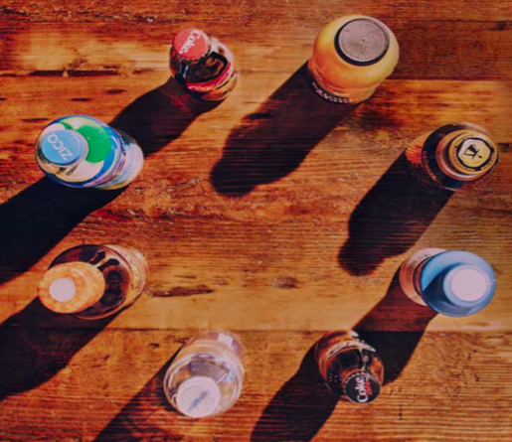
Coca-Cola’s Annual Sustainability Report

Slide 7
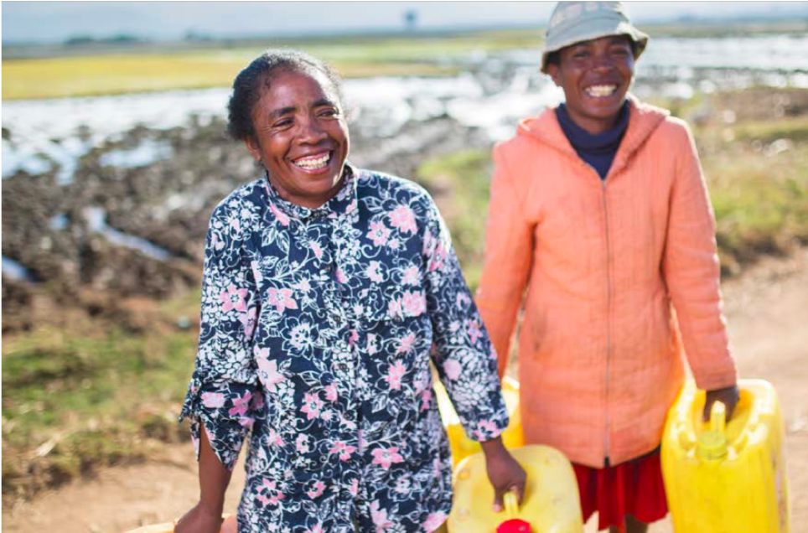
FOR EVERY DROP OF WATER WE USE, WE GIVE ONE BACK
… we take water leadership seriously because it’s the earth’s most valuable finite resource. With our size and local presence, we have the ability to help people and communities get access to the water they need (p. 11)

Slide 8
Storytelling Research Questions
What was center stage on the cover?
Next read carefully the opening story lines of Coca-Cola’s Annual Sustainability Report on p. 1

Slide 9
Coca-Cola’s Annual Sustainability Report
Start with the Cover: Our Sustainability Report tells only part of our story… Our growth and our environmental and social impact stories are interconnected …
Our Annual Review cover features diverse beverages from our consumer-centric brand portfolio.
Our Sustainability Report cover represents the packaging we want to recover, recycle and reuse.
We will continue to do business the right way by following our values and working toward solutions that benefit us all.

Slide 10
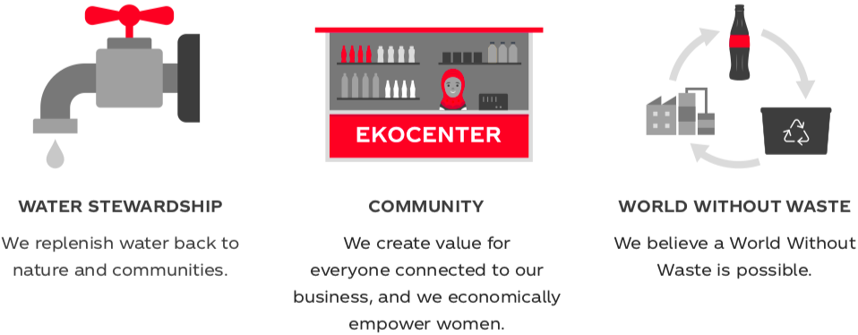
While growth is important, we cannot grow at any cost. We believe in doing business the right way, not just the easy way. For us, that means continuously working to reduce our environmental impact through programs like World Without Waste, providing access to clean drinking water, supporting women’s economic empowerment, and strengthening local communities. This is who we are. Source

Slide 11
Storytelling Research Hints
Coca-Cola has “text-representation” and “abounding illusions” to “invisible elements” and “distant images” that “emerge from all the sides of the scene” depicted in their report (Foucault, 1977: 98).
Trace the “underlying series” of photos, quotes, graphics, and numeric displays for “hallucinations” ‘illusions” (p. 99) and even “the sleep of reason” (p. 94).
Investigate “the power of the impossible” that is “formed in opposition to reality” in the ”infinitesimal fragments” and tersely told episodes find “incongruities of natures (p. 91)

Slide 12
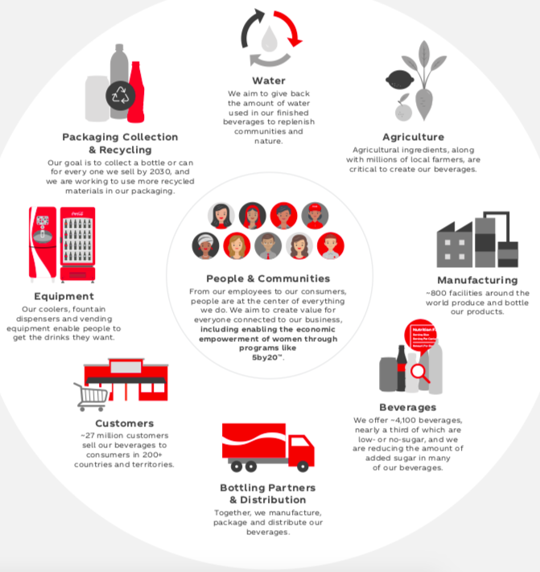
CLICK TO EXPLORE INTERACTIVE VALUE CHAIN
We strive to do the right thing for people and the planet

Slide 13
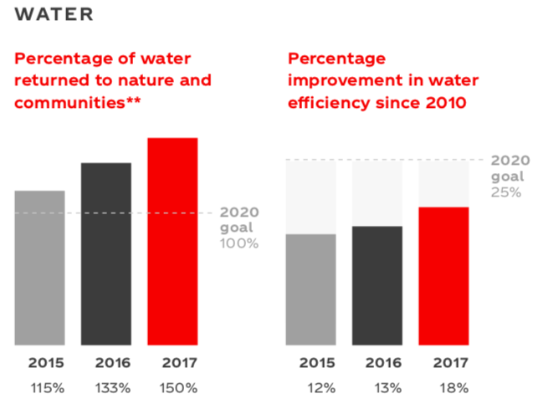
Coca Cola says “Water We aim to give back the amount of water used in our finished beverages to replenish communities and nature” SOURCE
Question: How would you research this?
**As estimated working with our many external partners and using generally accepted, independently peer-reviewed scientific and technical methods. Finished beverages based on global sales volume. (Coke Sustainability Report, p. 9)
Notes:
https://www.coca-colacompany.com/2017-sustainability-report

Slide 14
Coke Storytelling Statements
While water stress and challenges continue to increase in certain regions, we believe the world has enough fresh water to meet growing demands if correctly managed and respected https://www.coca-colacompany.com/stories/2017-water
In 2017, we continued to replenish 100% of the water used in our finished beverages back to communities and nature, a goal we first met in 2015. Projects implemented by the end of 2017 are replenishing an estimated 248 billion liters per year through community and watershed projects globally, as estimated with the help of our many reputable partner organizations using peer-reviewed scientific and technical methods

Slide 15
Coca-Cola Storytelling claims need fact checking for Stupidity
Coke claims: “FOR EVERY DROP OF WATER WE USE, WE GIVE ONE BACK”
If something is too good to be true, it usually is!

Slide 16
Water Facts
326 million trillion gallons total water on Earth
97% is Ocean (salt water), only 3% is Fresh Water source
Ocean ➔320 million cubic miles salt water
2.5% of fresh water is unavailable: locked up in glaciers, polar ice caps, atmosphere, and soil; highly polluted; or lies too far under the earth's surface to be extracted at an affordable cost.
1.63 million trillion gallons (Less than 0.5% of the earth's total water) is accessible Fresh Water
Coca-Cola Water Projects by end of 2017 replenished estimated 248 billion liters of Fresh Water that year
CONVERSION: 1 Liter = 0.26417205 Gallons
65.5 billion gallons of water that Coca-Cola Water Projects Replenish

Slide 17
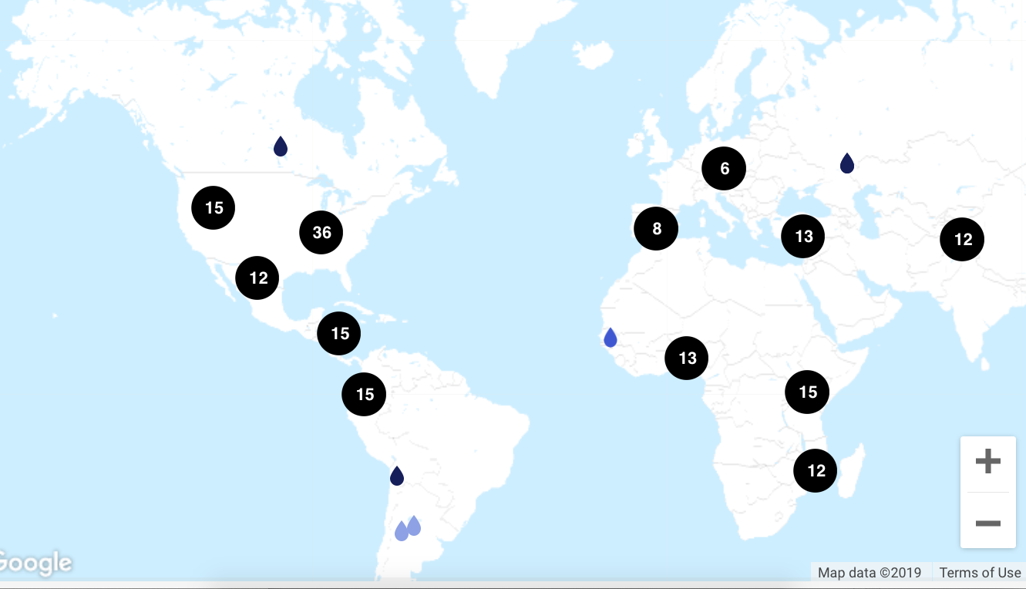
How does Coke Replenish 65.5 billion gallons of Fresh Water?
The numbers on the map represent the amount of projects underway in that area

Slide 18
Storytelling Research Hints
How does Coke Storytelling “maintain a single and exclusive meaning” in the face of the “existence of multiple meanings” of a super wicked complex Global Fresh Water problem? (Foucault, 1977: 99). Source

Slide 19
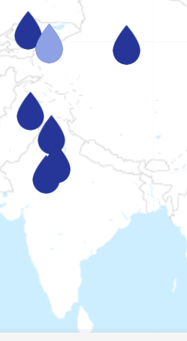
Coke Business ‘Water’-Storytelling
Conserving water usage through improved irrigation techniques
Laser-leveling activities and conversion to drip irrigation is helping improve ground water availability. Read More
In 2011, Sohanlal Khosle geared up to take part in a drip irrigation experiment initiated by The Coca-Cola Company on his half-hectare of farmland near Coke's Kaldhera bottling plant SOURCE
The project has expanded from 26 farmers in 2007, to touching the lives of 523 farmers. The goal is to reach 1,000 farmers within the next three years

Slide 20
Other Side of Business Storytelling
“There was so little rainfall this monsoon that there is no way that Coca-Cola can recharge significant amounts of water through their water-harvesting structures for next year.”

Slide 21
Study all sides of the Storytelling, and go back historically and get the story of the water and land relation
New Delhi: Shrawan Nayak’s journey home from work each day is marked by sadness and frustration. Now a day wage labourer, Nayak’s route back to his house in the town of Kala Dera passes by a mineral powder factory that occupies the land where he and his father once had a 7-hectare farm.
That was 10 years ago, before a Coca-Cola bottling plant opened up nearby and, critics say, exploited the existing water supplies to such an extent that the surrounding farmland dried up.
“The level of groundwater dipped too low and it made farming nearly impossible. Like many other farmers in Kala Dera, we were finally forced to sell the land to a mineral powder maker eight years ago,” said Nayak, 41, whose farm produced wheat, millet and vegetables. He also had to sell his cows and buffaloes.
Not long after Coca-Cola opened its plant in the already semi-arid and Kala Dera, in Rajasthan, in a locale surrounded by farmland, the water table in the area dropped significantly, leaving farmers unable to access it and reducing their land to dust.
Their claims are supported by studies by India’s Central Ground Water Board (CGWB), which found that the water table in Kala Dera has fallen by 22.36 metres since the factory opened, including by six metres between 2007 and 2008 alone. SOURCE

Slide 22
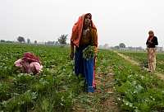
The Farmers Side of The Drip Story
Feb 12, 2016 - Coke Suspends Bottling at Plant at Center of Water Dispute ... Coca-Cola said it runs the Kaladera plant in Rajasthan "as a responsible setward of fresh water
“The people who run the Coca-Cola plant are enormously influential and have the backing of politicians from both the [ruling] Congress party and the Bharatiya Janata Party [main opposition],” said activist and farmer Rameshwar Prasad Kudi in a phone interview with IPS from Kala Dera. “But we have the people on our side and we will continue to press for the closure of the plant.”
Kudi, who is a member of the Kala Dera Sangharsh Samiti, a local group that has been demanding closure of the plant, said it was bad enough that various rules and norms were violated to allow the plant to be set up in a water-stressed area. Worse, it was “positively obscene” that it was functioning as usual in the middle of a severe drought. SOURCE
Sharma said his company has launched initiatives to replenish groundwater through recharge projects within and outside its 56 plants across India.
“In Kala Dera, we have created the potential to recharge 15 times more water into the ground than we use in our plant. Even with less than normal rainfall, these structures can recharge substantially more water than is drawn for our bottling operations.’’

Slide 23
How?
The government data showed water table decline of 1.83 metres in Kala Dera compared with those of other villages: 2.39 m in Chomu, 2.28 m in Jaipur and 2.43 m in Tigariya. Coca- Cola claims this is the result of “water stewardship’’ by a responsible company with “expertise in water management’’.
Coca-Cola is prepared to help farmers make the transition. “Last year, we entered into a public-private partnership with the government agency Krishi Vigyan Kendra [an agricultural extension service] to help farmers install drip irrigation projects in Kala Dera to improve water and energy efficiency,” Sharma said. “So far, we have installed 27 drip irrigation projects and we plan to set up 200 more in the next few months.”
But the farmers have a different take on the issue. Mahesh Yogi, a farmer and campaigner who spoke with IPS, said that while Coca-Cola was giving out subsidies for drip irrigation, the scheme was costly and unsustainable, considering the equipment needed, which would also require maintenance.
“There are 25,000 farmers in Kala Dera, and it is just not possible to cover a significant number in a short period of time. What are we to do in the meantime? And who will take care of future maintenance?”
Yogi claimed that the beneficiaries of the drip irrigation schemes were a handful of better-off, influential people who supported Coca Cola’s activities. “They are following a divide-and-rule policy here,’’ he said.

Slide 24
Take away
“Water shortages are commonplace in India already, and numerous studies point towards an even more difficult water situation with climate change, inefficient farming practices, as well as rampant industrial pollution and extraction,” he said. “Whether they like it or not, Coca-Cola will have to accept that communities, farmers and livestock have precedence over water.” SOURCE

Slide 25
Findings
Coca-Cola has “wasted abundance” retold as “admirable history” of philanthropic deeds (Foucault, 1977: 88)
Coke plays with phantasm, and representational-fantasy in an “ironic and deceptive manner” (Foucault, 1977: 140). Source

