Slide 1
Fourth Wave Grounded Theories
David Boje and Grace Ann Rosile
Cabrini University Doctoral Seminar

Slide 2
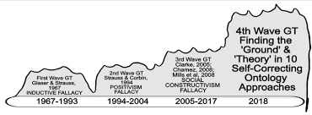

Slide 3
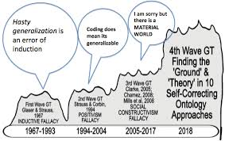

Slide 4
More Resources
What does John Dewey contribute to Grounded Theory – see chapter

