Slide 1
Ethnostatistics
David Boje and Grace Ann Rosile
Cabrini University Doctoral Seminar

Slide 2
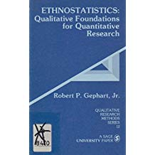

Slide 3
Ethnostatistics Example
Using an ethnostatistical analysis to interpret data: The Nike case.
Article (PDF Available) in Organization Management Journal 5(3):119-131 · December 2008 with 182 Reads
DOI: 10.1057/omj.2008.12
Cite this publication
Nancy E. Landrum
13.47Loyola University Chicago
David M Boje

Slide 4
Enron Ethnostatistics
Using the ethnostatistics methodology to reconcile rhetoric and reality: an examination of the management release of Enron’s year end 2000 results
Article (PDF Available) in Qualitative Research in Accounting & Management 1(September):1-16 · July 2004
Smith, Boje & Gardner

