Slide 1
FUTURING and the Negation of Globalization-Slavery
David M. Boje
http://davidboje.com for link to the SLIDES of David and of Grace Ann

Slide 2
I am an ontologist
An ontologist does storytelling about the social and material situation of global slavery
I do sociomaterial storytelling of the relational processes at a macro-system level
The global problem is that slavery in globalization is an ‘untold story!’
Notes:
Linda Hitchin (2015) chapter in untold storytelling book is essential here

Slide 3
Ensembles have Vertical & Horizontal Dimension
VERTICALLY IN THE SYNCHONICS
D1 ➔Narrative-counternarrative relies on Abstracting in a kind of dialectic called ‘Thesis-Antithesis-Synthesis’
D2➔Living story-counterstory relies on Grounding in dialogism (polyphonic, stylistics, chronotopes, architectonics)
HORIZONTALLY in TEMPORAL HORIZON of DIACHRONICS
D3➔Multiple futures are Futuring in a dialectic called ‘The Negation of the Negation’
D4➔Multiple histories are Rehistoricizing

Slide 4
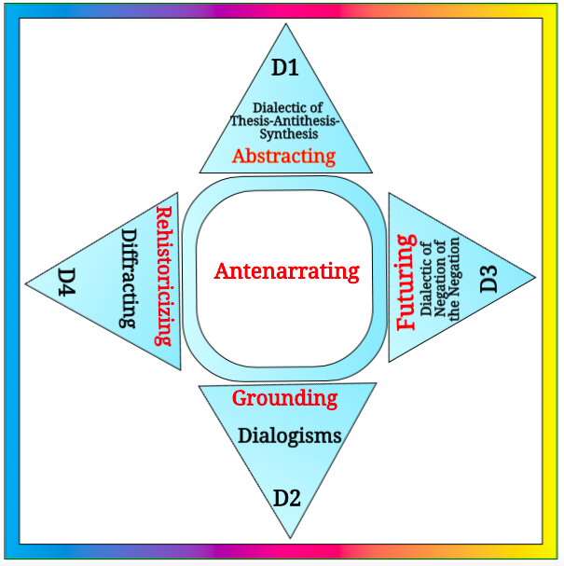
Notes:
VERTICALLY IN THE SYNCHONICS
D1 ➔Narrative-counternarrative relies on Abstracting in a kind of dialectic called ‘Thesis-Antithesis-Synthesis’
D2➔Living story-counterstory relies on Grounding in dialogism (polyphonic, stylistics, chronotopes, architectonics)
HORIZONTALLY in TEMPORAL HORIZON of DIACHRONICS
D3➔Multiple futures are Futuring in a dialectic called ‘The Negation of the Negation’
D4➔Multiple histories are Rehistoricizing

Slide 5
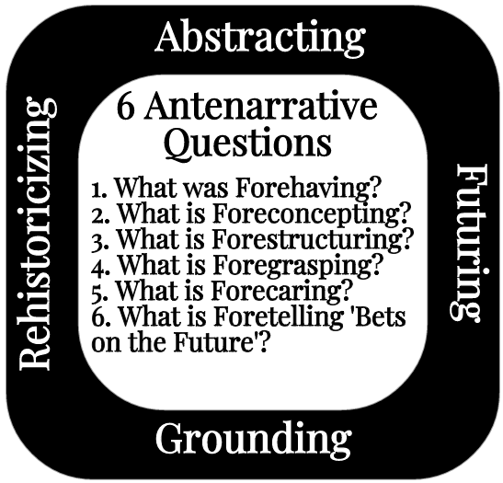

Slide 6
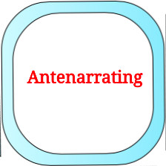
Slavery has too many differences lumped together
Victims are scattered throughout the workforce: the captive migrant tomato picker, the prostitute bonded by a smuggling debt, the domestic servant working around the clock without pay.
https://www.commondreams.org/views/2010/06/19/driven-globalization-todays-slave-trade-thrives-home-and-abroad

Slide 7
58% of those living in slavery in 5 countries
India
China
Pakistan
Bangladesh
Uzbekistan

Slide 8
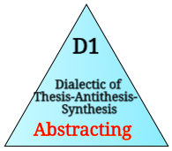
Can we change slavery NARRATIVE Profit bottom-line DEDUCTION?
Profit,
People &
Planet
Notes:
D1 The Abstracting is not empty (Sartre, 1960: 87), it possess a “genuine intelligibility”. the deductive (analytic)

Slide 9
Can we treat people as persons instead of ‘human resources’ to be managed (Fortier & Albert, 2015)?
“They are often managed like purely material resources that can be bought, sold, modified, or discarded after use” (p. 1). Modern-day slavery is a one-dimension conception of human beings as ‘disposable,’ ‘objects,’ ‘factors of production,’ or ‘an instrument’. Fortier and Albert (2015: 4)

Slide 10
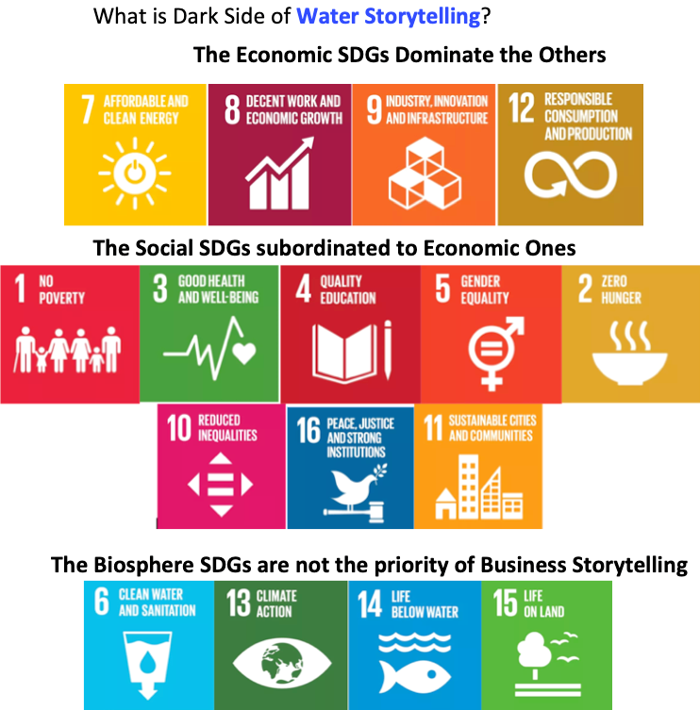

Slide 11
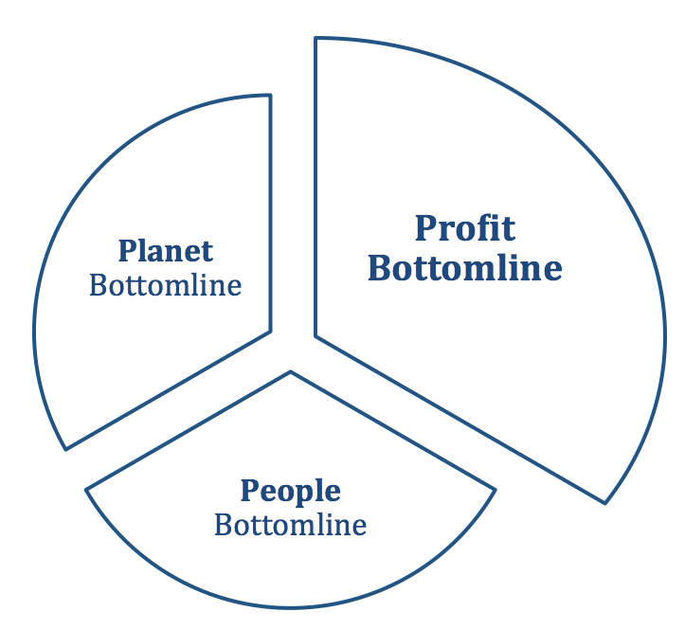
How Globalization P³: Profit, People & Planet are hierarchial in Triple Bottom Line fantasy?
Notes:
http://www.chinauscenter.org/attachments/0000/0001/CradleDesign.pdf
For more CRITIQUE of the Triple Bottom Line 3Bl please see this excellent article
Triple Bottom Line advocates never actually propose how to measure the ADDITION of profit bottom line + People bottom line + Planet bottom line…
Without an agreed methodology, the income statement trumps the people and planet measurement.
CRITICS: “We submit that the only way to make sense of such a claim is by formulating it (roughly) in the way we have with the Aggregation Claim, above. That is, we cannot see how it could make sense to talk about a bottom line analogous to the bottom line of the income statement unless there is an agreed-upon methodology that allows us, at least in principle, to add and subtract various data until we arrive at a net sum.

Slide 12
Why is Slavery is $32 billion a year?
Consumer demand for Bonded labor, debt-related slavery, commercial sexual exploitation, forced labor --- trafficking have become a global industry → TOTAL SITUATION
http://www.huffingtonpost.com/armand-f-pereira/globalization-and-modern-slavery_b_809765.html

Slide 13
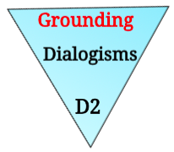
ENSEMBLE LEADERSHIP by the PEOPLE!
Ensemble in French means 'together'.
Rosile, Grace Ann; Boje, David M.; Nez, Carma Claw. (2016). “Ensemble Leadership Theory: Collectivist, Relational, and Heterarchical Roots from Indigenous Contexts.” Leadership journal
CIW motto is 'everyone is a leader'.
Ensemble leadership builds an alliance of self-managing groups as a relational material discursive process

Slide 14
LUPE, CIW worker GROUNDING in BEING
“We are the Earth and our roots being in Florida… We are a strong root, a root not even the corporations that exploit workers will be able to pull from the ground” (March 7, 2016, Ohio fieldwork about fieldwork

Slide 15
Sociomateriality of Modern-Day Slavery In USA
"The bosses carried weapons. They scared me. I never knew where I was. We were transported every fifteen days to different cities. I knew if I tried to escape I would not get far because everything was unfamiliar. The bosses said that if we escaped they would get their money from our families.”
--Congressional testimony of Maria, trafficking survivor from Mexico
https://www.commondreams.org/views/2010/06/19/driven-globalization-todays-slave-trade-thrives-home-and-abroad

Slide 16
Slaver Practices
Slavers typically recruit individuals in economically poor countries by promising them good jobs in richer countries.
If the slave is a young woman (80 percent of slaves on the global market are female; up to 50 percent are under age 18), she is often forced into the prostitution industry. Approximately 43 percent of the known slaves on the global market are used for sex. The rest are funneled into other forms of unpaid manual labor or a combination of sex and manual labor
https://www.thetrumpet.com/3123-eu-to-start-trade-talks-with-central-american-and-andean-nations

Slide 17
Antonio Martinez, who come to the US after his parents took ill in Mexico. He paid a coyote to get him north to a construction job in LA
At border, Martinez handed off to another coyote
crossed the desert for three days, and ran our of food and water after the first day.
was passed to yet another coyote name Chino, who demanded more money from Martinez; sold him to the tomato boss named El Chacal, bought Martinez and other slaves for $350 each.
26 slaves were locked into two trailers, that had cockroaches, rats, lizards, snakes from the surrounding swamps, skittering about.
Water from the shallow well was rank smelling, slept on mattresses on floor, locked in at night, armed guards patrolled during day. Martinez escaped
El Chacal was convicted, and served a light prison term. Upon leaving prison, Chello hired as boss at another farm

Slide 18
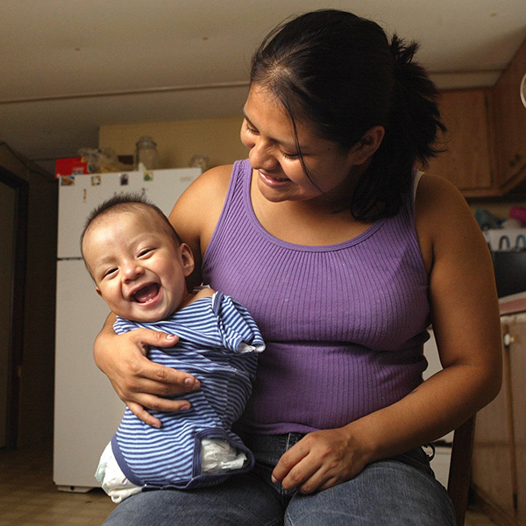
What are the Chemical Working Conditions”
Carlos Candelario, known as Carlitos, was born Dec. 17 without arms or legs.
At the entrance to the field where the mother worked, there is a list of some 30 chemicals used on the crops during the year
This is sociomateriality of storytelling.
Its an embodiment and dismemberment of the next generation
http://www.mypalmbeachpost.com/news/carlitos/

Slide 19
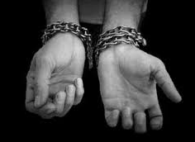
Why are Modern-Day Slavery Practices so brutal?
“…chained the worker's feet to the pole…. beat them, slapped them … multiple victims, multiple acts of violence, multiple injuries to the victims."
Mariano Lucas Diego reported beatings and nighttime imprisonment in a truck, where the family would have to urinate and defecate in the corners.
Diego and another victim pounded on the truck until they made a hole through which they squeezed out, then found a ladder so the others could escape.
https://www.sanders.senate.gov/newsroom/must-read/immokalee-family-sentenced-for-slavery-each-navarrete-boss-gets-12-years-in-prison-ft-myers-news-press

Slide 20
ANIMATED SYSTEMS Grounding in Nature!
Animation = people empower themselves; “We don’t organize… we animate people” – Lucas Benitez (CIW).
power-with, not power-over
AVOIDS hierarchical domination that is top-down system
*NOT ‘Representational'
*embodied practices & animated processes in actions *conversations are dialogical, not “checklists” *implemented in audit-->reports-->corrective action plan
Notes:
Lucas Benitez – we don’t organize. Librarians organize books. “we animate people.”
“The whole as the presencing of the future” (Sartre, 1960: 86).

Slide 21
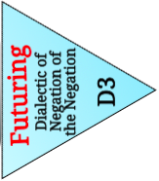

Slide 22
Why TOTAL SITUATION of Slavery in Global Capitalism is expanding?
27 to 40 million people are still trapped in slavery
Population Explosion
Small Farmers displaced by Corporate Mono-crop farming resulting in more slaves
Economic turbulence resulting in greater corruption
The stories remain untellable

Slide 23
We need better measures of slavery?
Almost every country in the world has laws against modern slavery.
But very few governments have sought to hold business to account.
45.8 million enslaved worldwide
FRANCE - ESTIMATED NUMBER LIVING IN MODERN SLAVERY 12,000
USA → 57,000
India →18,354,700
https://www.globalslaveryindex.org/index/

Slide 24
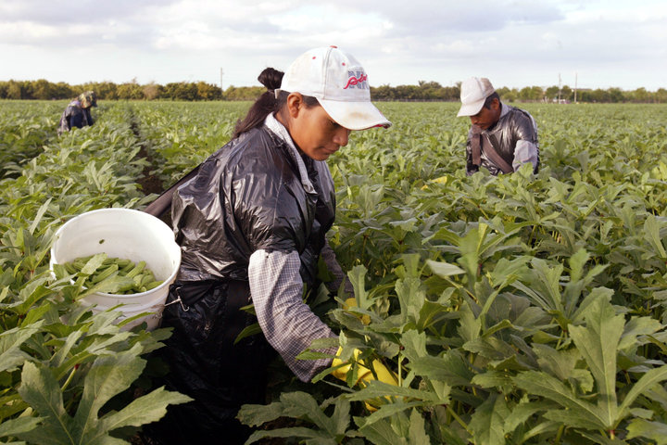
Five Female Migrant Workers Awarded $17 Million In Rape, Harassment Case
The women claim their bosses assaulted them on the job.
By Laura Bassett

Slide 25
Globalization 3BL: Profit, People, & Planet
How can 3BL align with Ensemble Leadership, Animated Systems to change Slavery-Globalization?

Slide 26
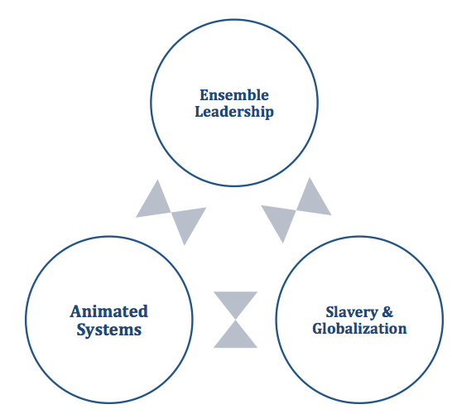
People
Planet
Profit

Slide 27
How to End SLAVERY with GLOBAL FUTURING?
Slavery makes Gang-bosses money, lowers wage for regular workers; does not save money for brands or consumers
Ending slavery practices by promoting Fair Food Program as a win-win because it takes out the middle-man

Slide 28
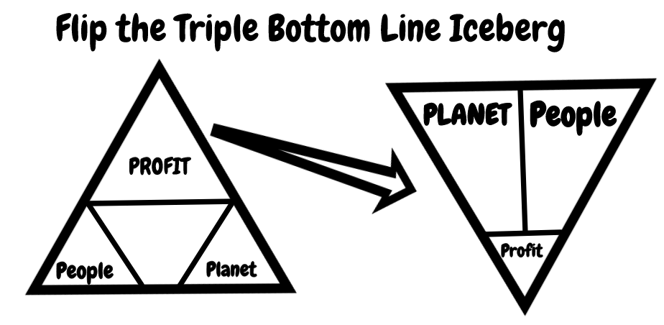
Notes:
A new order of ensemble leadership and ensemble storytelling is being inserted into the old ensemble, differentiating its structures

Slide 29
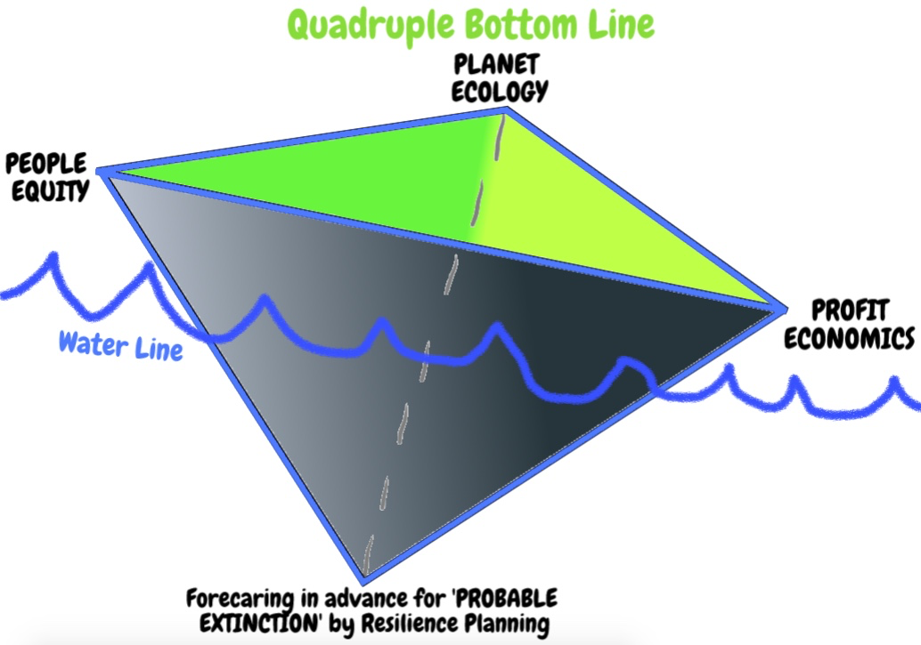
Notes:
A new order of ensemble leadership and ensemble storytelling is being inserted into the old ensemble, differentiating its structures

Slide 30
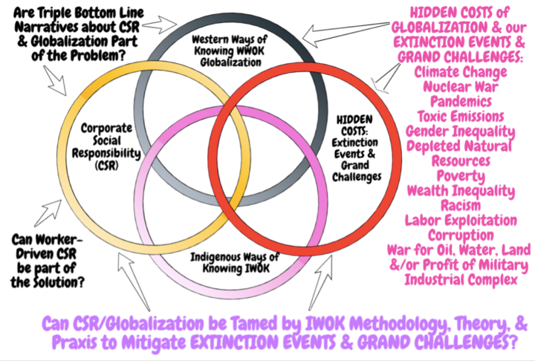

Slide 31
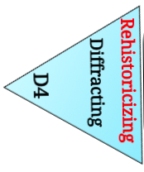
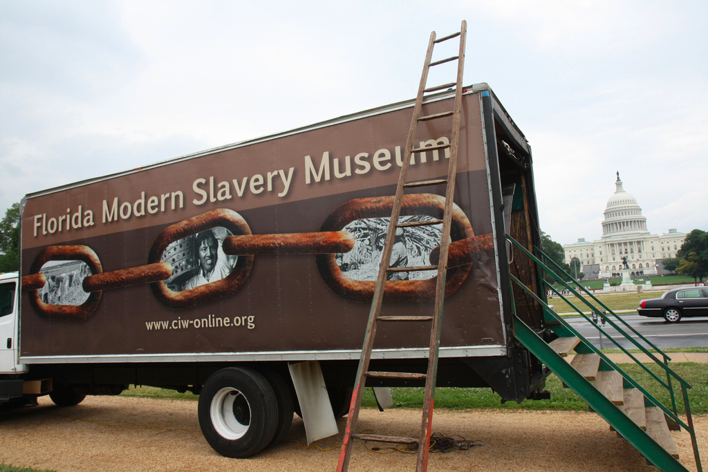
REHISTORICIZING global slavery supply chain?
Worker education,
Worker-driven alliances, &
System of alliance of consumers, brands, growers, and workers
This creates revolutionary changes

Slide 32
Ensemble Alliance Network
CIW's alliances are a network of these five groups:
Coalition of Immokalee Workers(CIW): education, animates workers
Inter-Faith Alliance for Fair Food (AFF)
Student/Farmworker Alliance (SFA) organizing colleges & universities
Fair Food Standards Council (FFSC): auditing and monitoring to certify 'fair food” practices in Florida and 7 other states
Fair Food Program (FFP) = Code of Conduct for an alliance of consumers, 17 growers, and 14 Buyers/brands (including Bon Appetit Management CO., McDonald's, Taco Bell, & Pizza Hut)

Slide 33
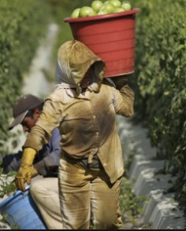
Thank you
Questions?
Contact: davidboje@gmail.com
http://davidboje.com/cabrini for link to the SLIDES of David and of Grace Ann

