Slide 1
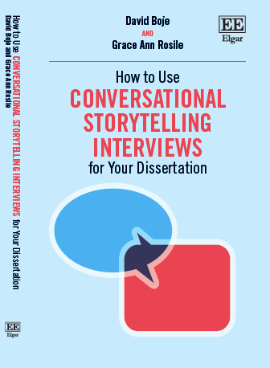
Cabrini Cohort
Feb 20, 2022
Journey led by David M. Boje and Grace Ann Rosile
slides at https://davidboje.com/cabrini

Slide 2
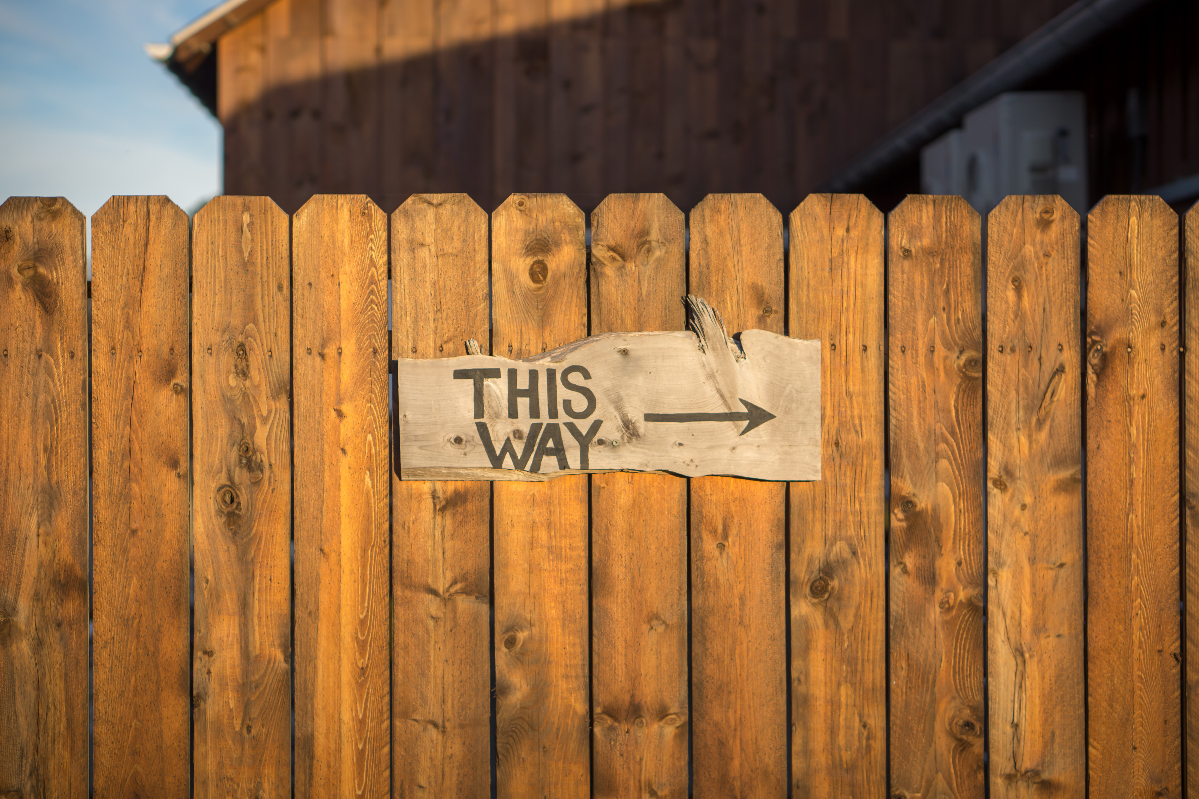
Agenda for Today
PART I Q: How are you living a True Story Life?
PART II Q: How does your ♥ discern what’s true & what’s not?
PART III What Abduction are your exploring?
PART IV How do you Sample in A-I-D?
PART V How to use A-I-D in conversational storytelling interviewing?
PART VI 4th Wave Grounded Theory
PART VII What are the 4 Who’s

Slide 3
Groundrules
Please bring a notebook and pen/pencil to each session.
Use the “Gallery View” so you can see each other while viewing PowerPoint.
Please do not give advice to others or use ‘should’ statements for self or others.
Speak more from the heart than from the head.
Laser in, be concise, and share only one story
instead of several.
CONFIDENTIALITY:
Do not tell someone else’s story. Please DO NOT record any session of the presenters or the participants.
Please use Chat
ONLY when asked to do so. Avoid “side talk.”
Please attend all sessions. If you must miss one, contact us so we can help you to catch up before you return.

Slide 4
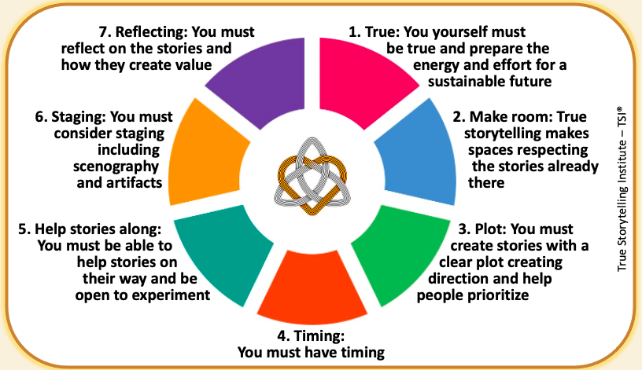
Part I: How are you Living a True Life?

Slide 5
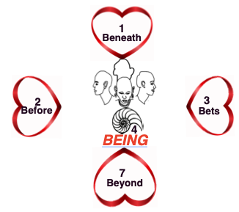
Part II: How does your Heart discern what’s true and what’s not?
Please Draw Your 4 Heart’s
Click Here for one page handout;
Notes:
What direction are you look in-time (past, present, future, or from future present past?), and in-depth (dwell in surface or in grounding)

Slide 6
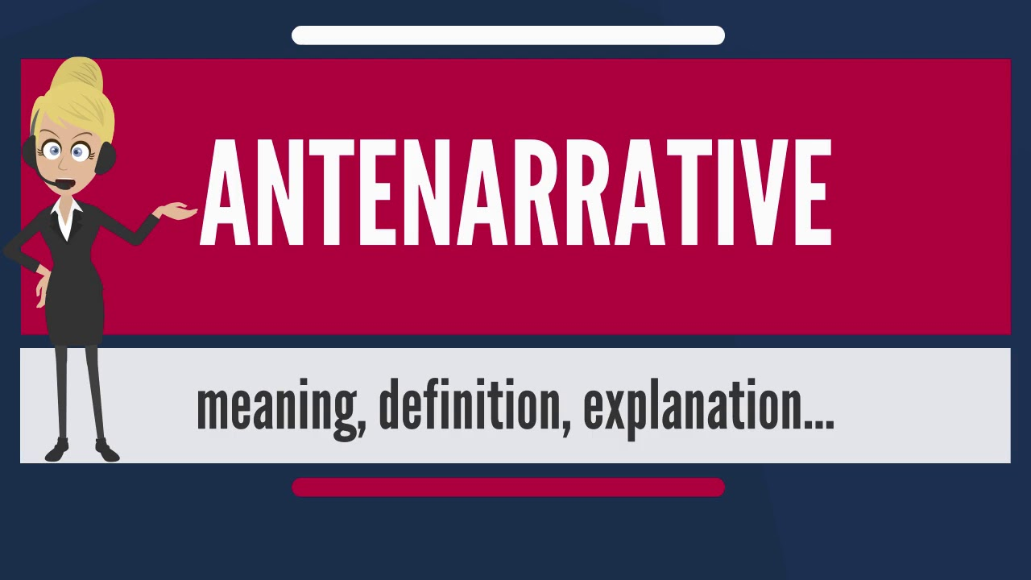
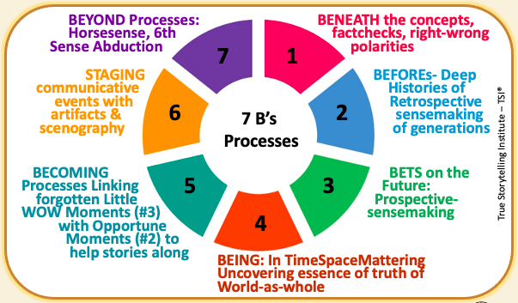
Notes:
Stories & Narratives are composed of pre-conceived SURFACE values, concepts, & motives, so GUIDES go BENEATH to core values…
On the surface is the ‘Domination of the Obvious’
Going BENEATH the words, labels, judgements, and polarities, gets to CORE values & CORE concepts & CORE motives
BENEATH the surface is the changes, movements, the flow, and its what is changeless about the world and universe
Going BENEATH the Narrative-Counternarrative arguing, the polarities, we get to the changes and the changeless
What is the BENEATH?
Stories & Narratives are composed of pre-conceived
SURFACE values, concepts, & motives
→ Guides go BENEATH to core values
On the surface is the ‘Domination of the Obvious’
BENEATH the words, labels, judgements, and polarities is the CORE
→ Guides gets to CORE values & CORE concepts & CORE motives
BENEATH the surface is the changes, movements, the flow, and it’s what is changeless about the world and universe
BENEATH the Narrative-Counternarrative arguing, the polarities
→ Guides get to the changes and the changeless

Slide 7
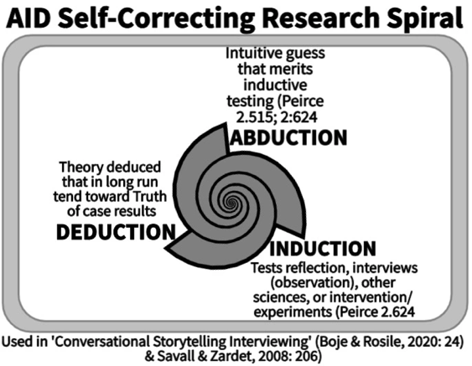
Part III: What ABDUCTION are you exploring?

Slide 8


PART II : BREAKOUT
Write notes on your ABDUCTIONS so far for your dissertation topic (3 min.)
-No theory yet, no tests yet.
Share your story with Breakout Partner, and hear and note their story of Abductions
  TOTAL = 3 min per person
REMEMBER:
NO THEORY YET!
That will happen next week.
Talking Stick
My intuitive hunch is …
My wild guess …
My own idea..
Notes:
When did you foresee a negative outcome
and turn around the plot as it was happening?
INTRO TO BREAKOUT ROOM
15 minutes total in groups of 3 or 4
2 min explains/demonstrates questions to Faith Groups and Consumer Groups aligning to Agricultural Workers to affect growers & corporations
Workers that pressure Corporate Social Responsibility which pressures growers (BUILD VISUAL OF CONNECT THESE DOTS)...
Any extra time:
What we had in common; where we diverged.
2 min silent written prep
BREAKOUT
2 min. per person; Total 8 or 10 minutes
QUESTION:
What stories are already there that you can connect to in your situation?
After you took action (broke up with someone, fired someone, quit your job) and said to yourself:

Slide 9
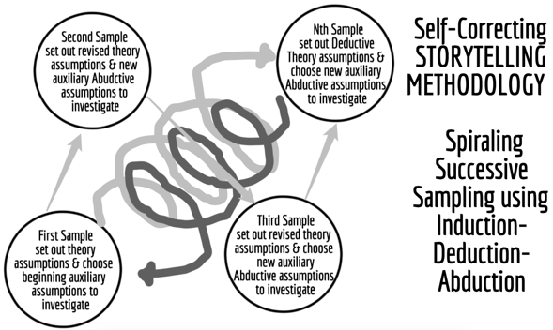
Part IV: How do you sample in A-I-D?
Charles Peirce Sanders
self-correcting method

Slide 10
PART IV : BREAKOUT
Imagine Using Iterative Cycles of Spiraling Sampling in your dissertation (3 min.)
Share your spiraling sample plan with Breakout Partner, and hear and note theirs
  TOTAL = 3 min per person
REMEMBER:
You are having a Storytelling Conversation, back and forth, wandering together.
Talking Stick
My first sample is …
My 2nd sample …
My 3rd sample..
Notes:
When did you foresee a negative outcome
and turn around the plot as it was happening?
INTRO TO BREAKOUT ROOM
15 minutes total in groups of 3 or 4
2 min explains/demonstrates questions to Faith Groups and Consumer Groups aligning to Agricultural Workers to affect growers & corporations
Workers that pressure Corporate Social Responsibility which pressures growers (BUILD VISUAL OF CONNECT THESE DOTS)...
Any extra time:
What we had in common; where we diverged.
2 min silent written prep
BREAKOUT
2 min. per person; Total 8 or 10 minutes
QUESTION:
What stories are already there that you can connect to in your situation?
After you took action (broke up with someone, fired someone, quit your job) and said to yourself:

Slide 11
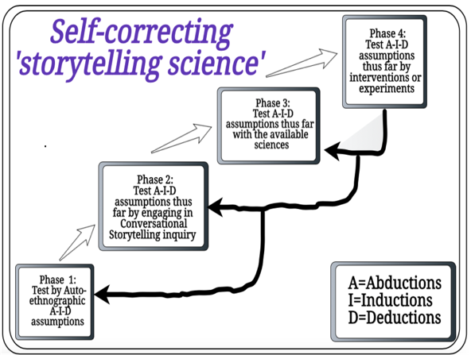
Part V: How to use A-I-D in conversational storytelling interviewing?

Slide 12
PART V : BREAKOUT
Make a few notes: What was your best and your worst ever conversation (3 min.)
Share your BEST conversation experience, please hear your partners, then tell your WORST experience, and then please hear theirs.
  TOTAL BREAKOUT = 3 min per person for Best & 3 min for Worst (total 12 minutes)
REMEMBER:
You are having a Storytelling Conversation, back and forth, wandering together.
Talking Stick
My Best conversation experience …
My Worst ever ..
Notes:
When did you foresee a negative outcome
and turn around the plot as it was happening?
INTRO TO BREAKOUT ROOM
15 minutes total in groups of 3 or 4
2 min explains/demonstrates questions to Faith Groups and Consumer Groups aligning to Agricultural Workers to affect growers & corporations
Workers that pressure Corporate Social Responsibility which pressures growers (BUILD VISUAL OF CONNECT THESE DOTS)...
Any extra time:
What we had in common; where we diverged.
2 min silent written prep
BREAKOUT
2 min. per person; Total 8 or 10 minutes
QUESTION:
What stories are already there that you can connect to in your situation?
After you took action (broke up with someone, fired someone, quit your job) and said to yourself:

Slide 13
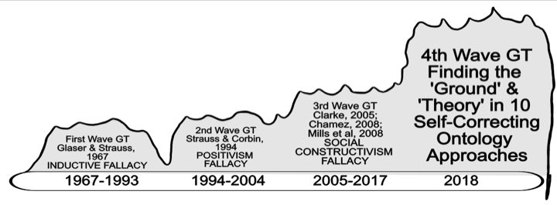
Part VI: Fourth Wave Grounded Theory?
How to overcome Confirmation Bias?

Slide 14
PART VI : BREAKOUT
Make a few notes: Where is the GROUND and the THEORY in your dissertation? (3 min.)
Share your GROUND and your THEORY with partner, and please hear theirs.
  TOTAL BREAKOUT = 3 min per person for Ground & 3 min for Theory (total 12 minutes)
REMEMBER:
You are having a Storytelling Conversation, back and forth, wandering together.
Talking Stick
My Ground in my BEYOND ♥ …
My Theory in my DEDUCTIONS of BENEATH ♥ …
Notes:
When did you foresee a negative outcome
and turn around the plot as it was happening?
INTRO TO BREAKOUT ROOM
15 minutes total in groups of 3 or 4
2 min explains/demonstrates questions to Faith Groups and Consumer Groups aligning to Agricultural Workers to affect growers & corporations
Workers that pressure Corporate Social Responsibility which pressures growers (BUILD VISUAL OF CONNECT THESE DOTS)...
Any extra time:
What we had in common; where we diverged.
2 min silent written prep
BREAKOUT
2 min. per person; Total 8 or 10 minutes
QUESTION:
What stories are already there that you can connect to in your situation?
After you took action (broke up with someone, fired someone, quit your job) and said to yourself:

Slide 15
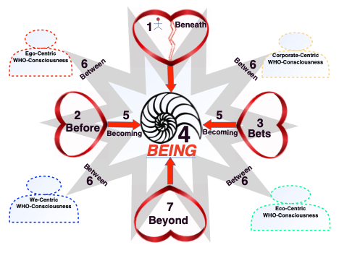
Part VII: What are the 4 Who’s?

Slide 16
PART VII : Your Four Who’s
Make a few notes: Your 4 Who’s are telling you what?
Share you’re your ego-who, corporate-who, we-who (family, colleagues), ecological who (nature). Have a conversation on each and heart your partners…
  TOTAL BREAKOUT = 2 min per person each who & 2 min to hear theirs (total 16 minutes)
REMEMBER:
You are having a Storytelling Conversation, back and forth, wandering together.
Talking Stick
My EGO self…
My CORPORATE…
My We (they-self), looking glass self…
My Ecological self..
Notes:
When did you foresee a negative outcome
and turn around the plot as it was happening?
INTRO TO BREAKOUT ROOM
15 minutes total in groups of 3 or 4
2 min explains/demonstrates questions to Faith Groups and Consumer Groups aligning to Agricultural Workers to affect growers & corporations
Workers that pressure Corporate Social Responsibility which pressures growers (BUILD VISUAL OF CONNECT THESE DOTS)...
Any extra time:
What we had in common; where we diverged.
2 min silent written prep
BREAKOUT
2 min. per person; Total 8 or 10 minutes
QUESTION:
What stories are already there that you can connect to in your situation?
After you took action (broke up with someone, fired someone, quit your job) and said to yourself:

Slide 17
SUMMARY:
7 Processes, 4 Hearts, & 4 Who’s

Slide 18
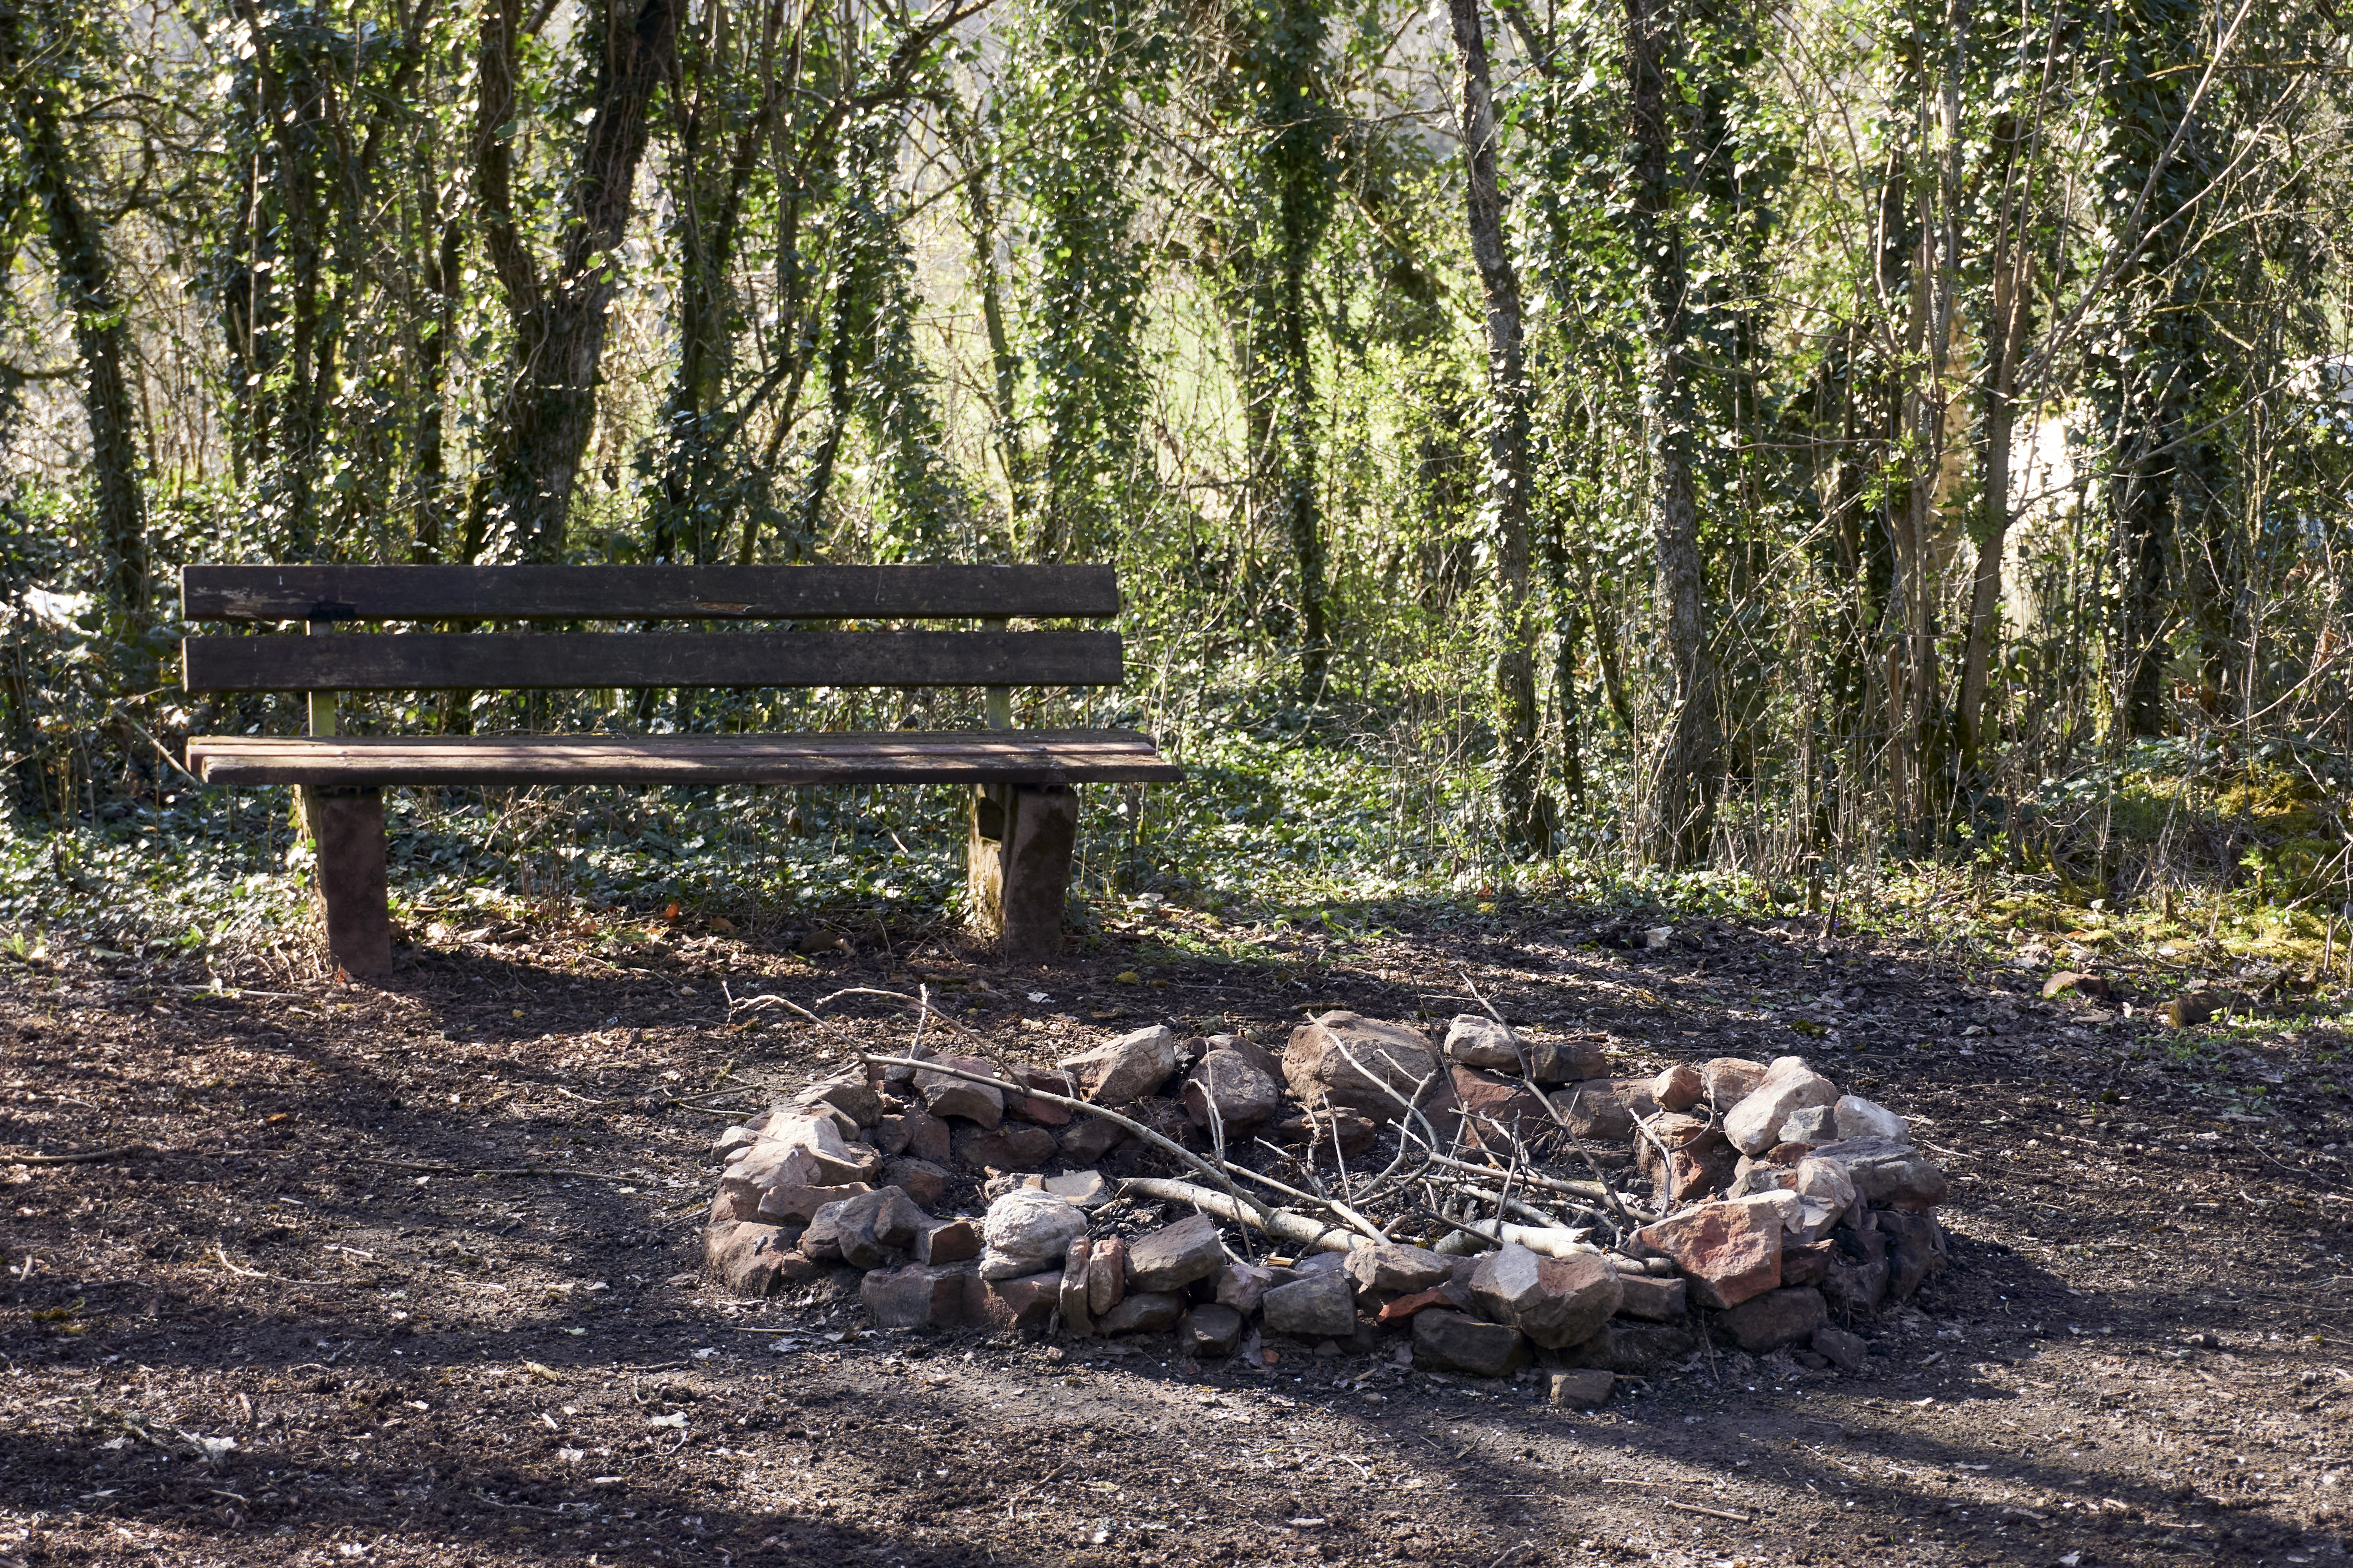
POST-
SESSION
“COFFEE
in the LOBBY”
Go-Around:
Wow Moments?
Slides at davidboje.com/cabrini
Notes:
ROADMAP: Lena
Last Week:
Principle 1 True
This week:
Principle 2 Making Room
and
Nuts and Bolts

