Slide 1
Antenarrative Prospective Sensemaking
David Boje and Grace Ann Rosile
Cabrini University Doctoral Seminar

Slide 2
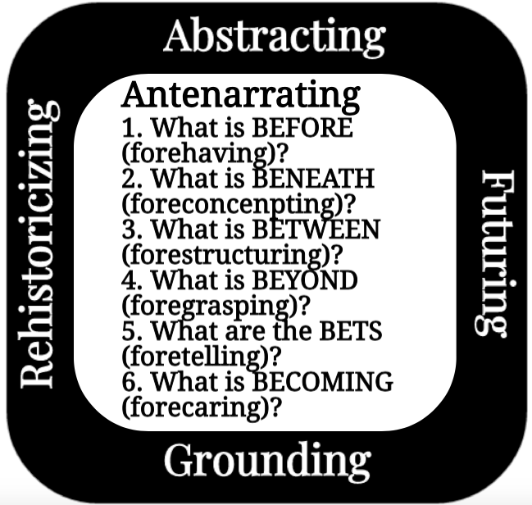

Slide 3
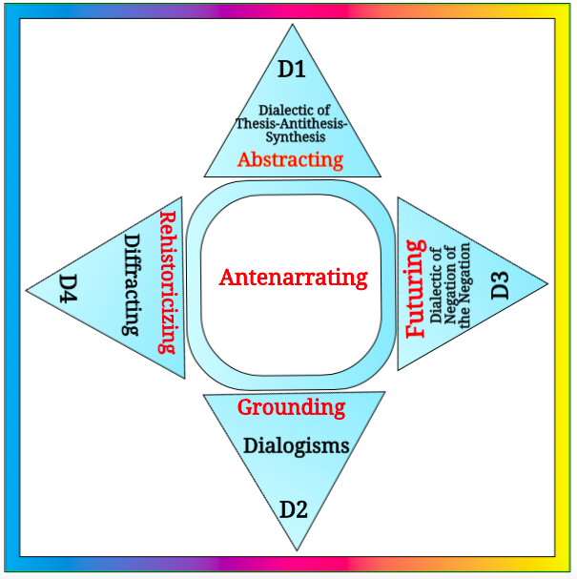
Notes:
VERTICALLY IN THE SYNCHONICS
D1 ➔Narrative-counternarrative relies on Abstracting in a kind of dialectic called ‘Thesis-Antithesis-Synthesis’
D2➔Living story-counterstory relies on Grounding in dialogism (polyphonic, stylistics, chronotopes, architectonics)
HORIZONTALLY in TEMPORAL HORIZON of DIACHRONICS
D3➔Multiple futures are Futuring in a dialectic called ‘The Negation of the Negation’
D4➔Multiple histories are Rehistoricizing

Slide 4
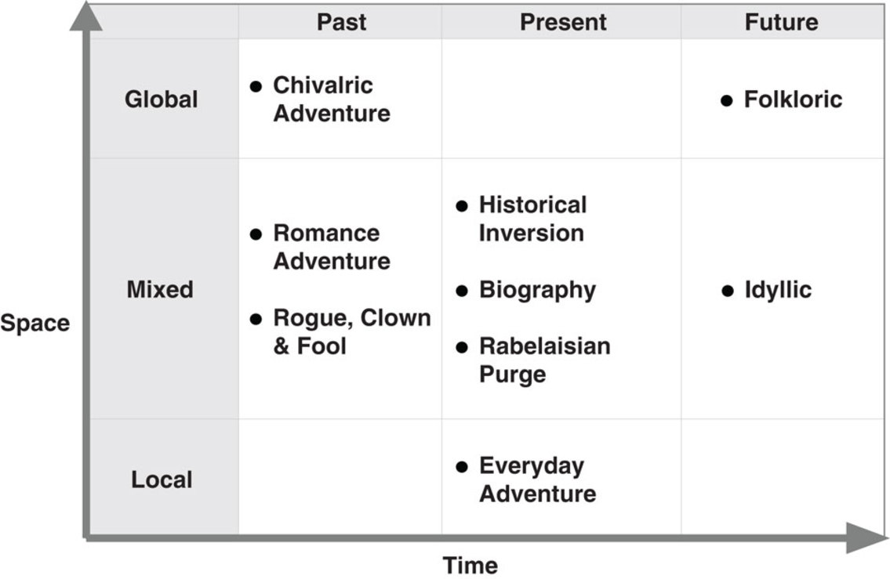
Haley & Boje, 2014; Boje, Haley, Saylors, 2016
Using Mikhail Bakhtin’s typology of nine space–time conceptions and directed observations of McDonald’s Corporation, we show how multinational enterprises (MNEs) create narratives of internationalization to mitigate the risks…
Notes:
DIACHRONIC:
Past (Chivalric Adventure, Romance Adventure & Rogue-Clown-Fool)
Present (Historical inversion, Biography, Rabelaisian Purge, & Everyday Adventure)
Future (Folkloric & Idyllic)
SYNCHRONIC:
Global (Chivalric Adventure, & Folkloric)
Mixed (Romance Adventure, Rogue-Clown-Fool, Historical Inversion, Biography, Rabelaisian Purge, Everyday Adventure)
Local (Everyday Adventure)
Boje, D. M., Haley, U. C., & Saylors, R. (2016). Antenarratives of organizational change: The microstoria of Burger King’s storytelling in space, time and strategic context. Human Relations, 69(2), 391-418.
Haley, U. C., & Boje, D. M. (2014). Storytelling the internationalization of the multinational enterprise. Journal of International Business Studies, 45(9), 1115-1132.

Slide 5
Storytelling Paradigm
The Abstracting Thesis-Antithesis-Synthesis (TAS) dialectic is a synthetic temporality which is not Grounding in the material environment or in elementary praxis or in the Futuring of its own prospective sensemaking Antenarrating possibility directions in Negation of the Negation dialectic (N of N). Rather the retrospective narrative sensemaking is Rehistoricizing by abstracting, reductionism.
Notes:
“The only real difference between primitive synthetic temporality and the time of elementary praxis lies in the material environment which, by not containing what the organism seeks, transforms the totality as future reality into possibility. Need, as a negation of the negation, is the organism itself, living itself in the future, through present disorders, as its own possibility and, consequently, as the possibility of its own impossibility; and praxis, in the first instance, is nothing but the relation of the organism, as exterior and future end, to the present organism as a totality under threat; it is function exteriorized. The real difference is not between function as internal assimilation and the construction of tools with an end in view. Many species of animals, in fact, make tools of themselves” (Sartre, 1960: 83).Critique of Dialectical Reason” Practical Ensembles

Slide 6
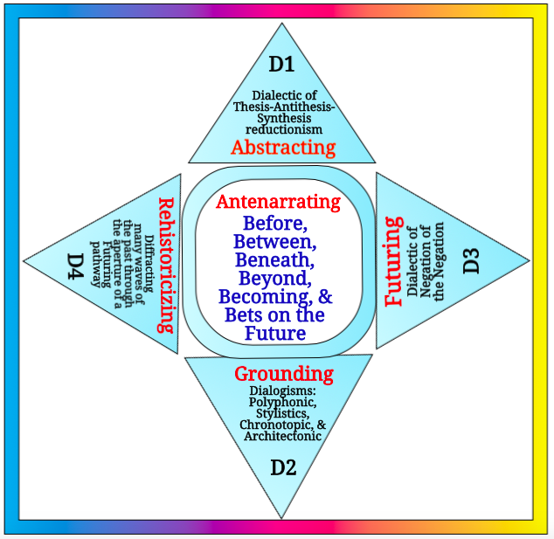

Slide 7
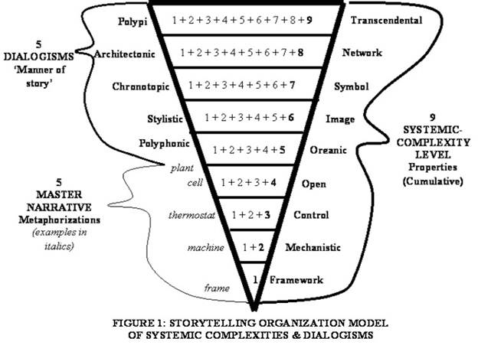

Slide 8
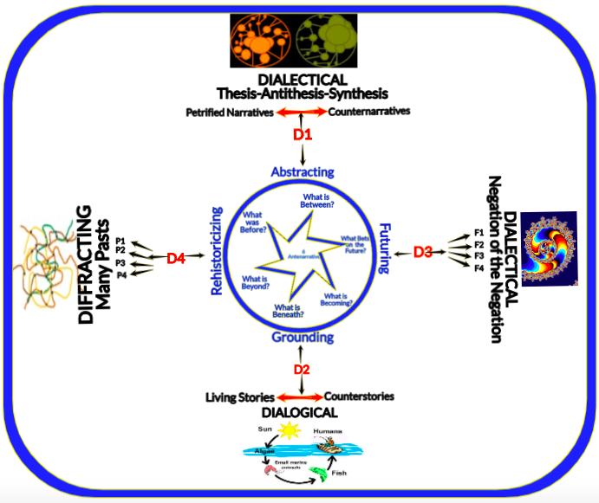

Slide 9
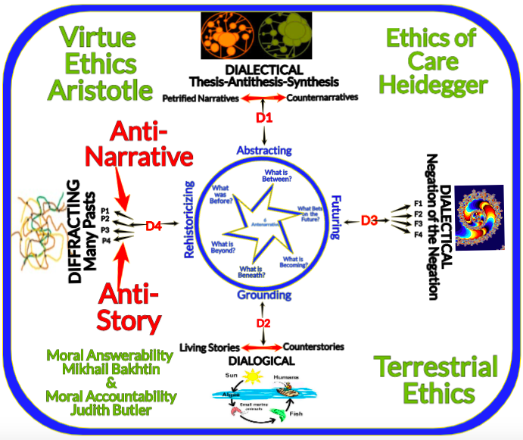

Slide 10
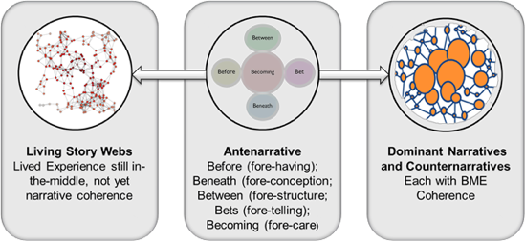
Figure 5: Drawing of Antenarrative relations by Marita Svane (see Boje, Svane, Henderson & Streval, in press; Svane & Boje, 2014; Svane & Boje, 2015; Svane, Boje & Gergerich (2015); Enang & Boje, 2017; Enang, Boje, Rosile & Sminia, 2017)

Slide 11
