Slide 1
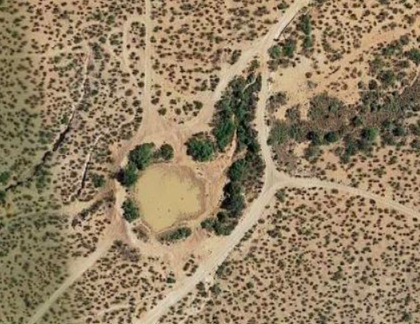
WHAT IS TRUE STORYTELLING of EAST MESA’s EPHEMERAL POND?
David M. Boje, Ph.D.
Davidboje.com
4700 Dunn Drive
Las Cruces, New Mexico 88011
575-936-9578
Zoom Meeting ID: 838 949 9873

Slide 2
Agenda First Session June 19
Introductions & Ground Rules
Sacred Place – opening ceremony
Slide show of Situation of Stated story and actual Untold story
STORY CIRCLES in Breakout Rooms, Principle 1 – Truth Now of uses of Place
STORY CIRCLES in Breakout Rooms, Principle 2 – Make Room for Stories Already There, but Forgotten, Ignored.
Comments & Closing Ceremony

Slide 4
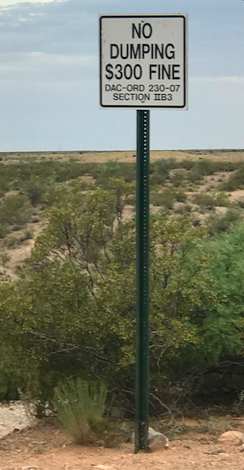
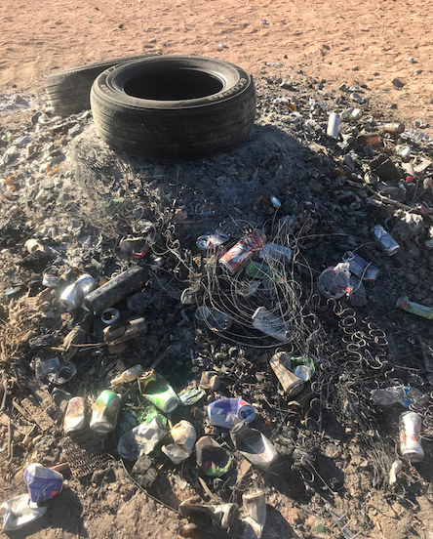
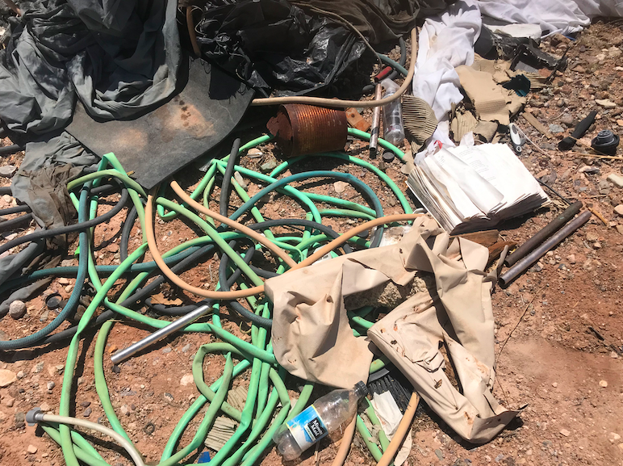
PRINCIPLE 1. What is TRUTH of this?
County Ordinance No. 230-07
Notes:
County Ordinance No. 230-07, Residential and Commercial Solid Waste Collection and
Disposal (see Appendix F), contains a prohibition on discharges of solid waste. Solid
Storm Water Management Program waste is defined in the ordinance as:
“…any garbage, rubbish, or refuse, rejected or
waste food, offal, swill, carrion, ashes, dirt, slop, wastewater, trash, weeds, briars, brush,
automobiles or automobile parts, waste or unwholesome material of any kind…”
Section II.B.3, Prohibited Acts, of the ordinance states: “It shall be unlawful for any
person to sweep, place, throw, or deposit solid waste upon any street, alley, sidewalk,
gutter, storm sewer, parkway, river, stream, lake, pond, arroyo, or other premises within
the County, except in receptacles or containers consistent with the provisions of this
Ordinance.”
Section IV of the same ordinance
June 2009 (Rev. Sep. 2009) pp. 12-13
https://www.donaanacounty.org/sites/default/files/pages/SWMP_2009.pdf

Slide 5
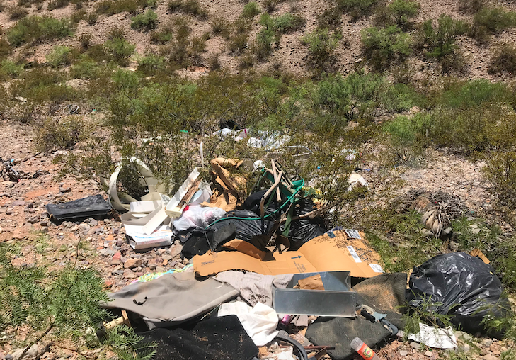
Principle 1: TRUTH: Illegal Dumping Has Increased since pandemic

Slide 6
PRINCIPLE 1: TRUTH
Bureau of Land Management’s MISSION STATEMENT
What is TRUTH of
Wetlands Pond USES?
Kids’ Rave Party’s
taken over ALL USES of Pond
Illegal Dumping since Coronavirus Pandemic Decreases Quality of Life
BLM, County, & City Codes of Stewardship Not Enforceable
Public Lands Being Mis-Used
Resources Being Destroyed
’To enhance the quality of life of all citizens through the balance stewardship of America’s public lands and resources
Notes:
Gun Laws of New Mexico https://en.wikipedia.org/wiki/Gun_laws_in_New_Mexico

Slide 7
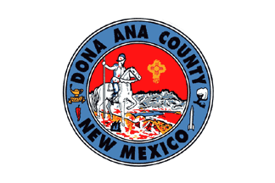
PRINCIPLE 1: WHAT IS TRUTH of Doña Ana County’s Mission?
The Story Being Told:
What is the Reality:
Doña Ana County government enhances the health, safety, and quality of life for all residents as determined by law and community interests
STATED VALUES:
Conservation of the area’s natural environment
Safe place for residents, workers and visitors based on the effective reduction of serious crimes
Notes:
https://www.donaanacounty.org/sites/default/files/pages/DAC_Mission_Statement.pdf

Slide 8
PRINCIPLE 1: WHAT IS TRUTH of City of Las Cruces Mission?
Stated Mission?
Actual Reality?
The Mission of the City of Las Cruces is to provide customer-focused municipal services to residents, businesses, and guests so they can experience a “quality of place” to live, work and play
10 to 20 residents violate dumping laws, firearms laws, while gang of youth trashes the “quality of place” for thousands of residents
Unsafe place for most residents to go
Notes:
https://las-cruces.org/1468/Strategic-Action-Plan#:~:text=City%20Mission,to%20live%2C%20work%20and%20play.

Slide 9
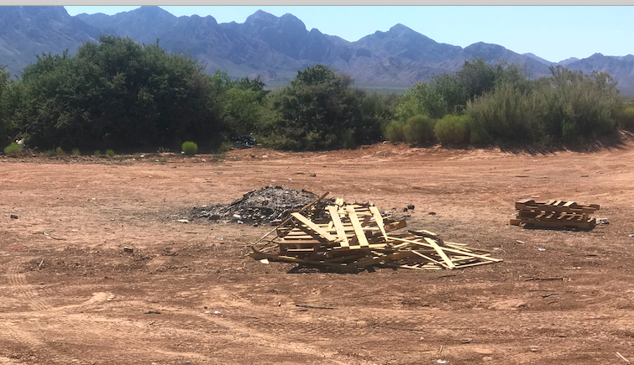
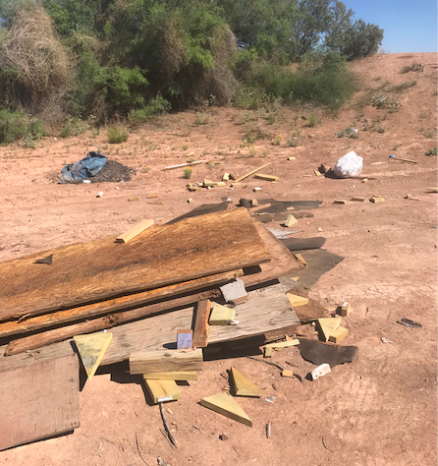
PRINCIPLE 1 TRUTH: Local Kids’ Burn Pile and Pallet burning Happening Most Nights in East Mesa of Las Cruces & Dona Ana County & BLM
Every Day I clean it up, and that night Kids have another Burn Pit Drunk-fest
Failure to contain construction waste is enforceable with the same escalating penalties described for illicit discharges in Section 3.3.4 and THERE CONSTRUCTION DUMPING in POND
Notes:
“… Failure to contain construction waste is enforceable with the same escalating penalties described for illicit
discharges in Section 3.3.4 of the SWMP. P. 17 https://www.donaanacounty.org/sites/default/files/pages/SWMP_2009.pdf
“Where the
permittee lacks legal authority for direct enforcement action, the program must include
notification procedures and if an illicit discharger fails to comply with procedures or
policies established by the permittee, the permittee may rely on EPA and the state
environmental agency for assistance in enforcement of this provision of the permit.””

Slide 10
PRINCIPLE 1: TRUTH
We live in times of changes:
The climate crisis
Black & Brown & Indigenous Lives Matter
Coronavirus pandemic
People struggling with stress & Unemployment
We need people who are ethical strong and dare stand in the arena and fight for ethical and sustainable changes in BLM, City of Las Cruces and Dona Ana County

Slide 11
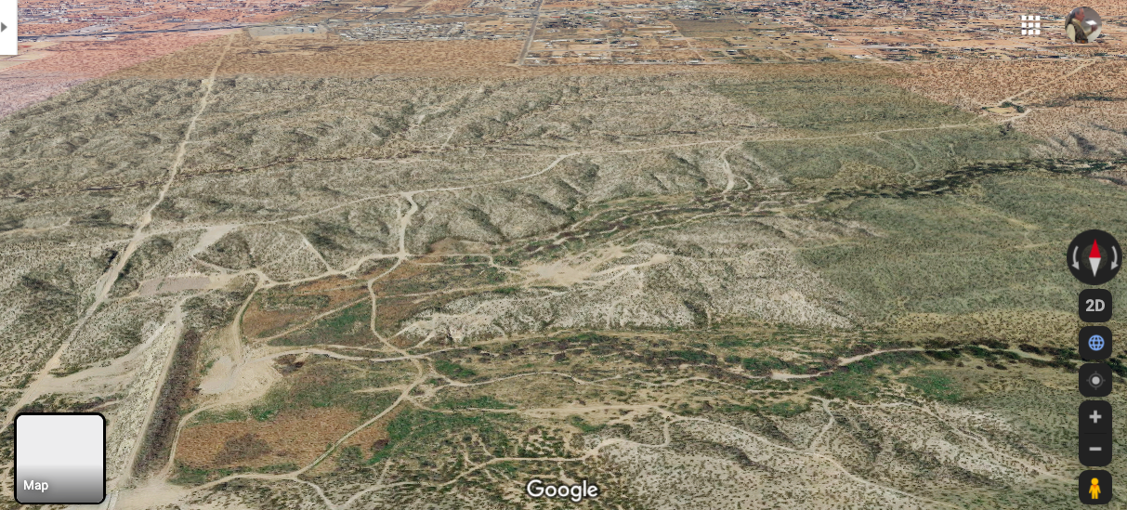
PRINCIPLE 1: WHAT IS THE TRUTH? East Mesa Surface Water & Aquifer Water flows into Las Cruces Mesilla Aquifer and the City’s Water Supply

Slide 12
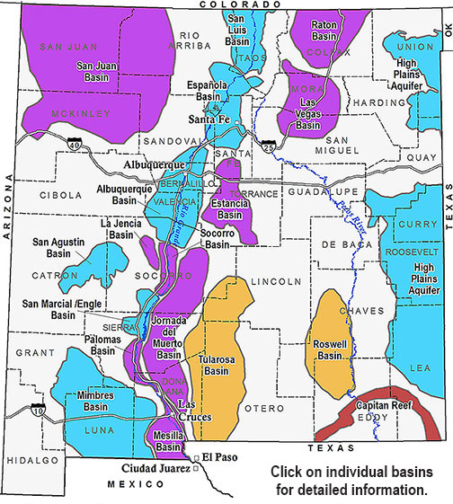
PRINCIPLE 1: WHAT IS THE TRUTH?

Slide 13
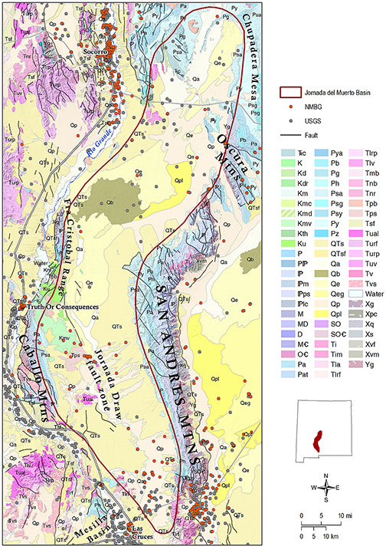
PRINCIPLE 1: WHAT IS THE TRUTH?

Slide 14
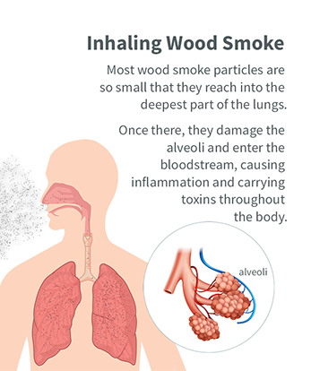
1. What is the Truth of Kids Inhaling Smoke of their Burn Pit Parties?

Slide 15
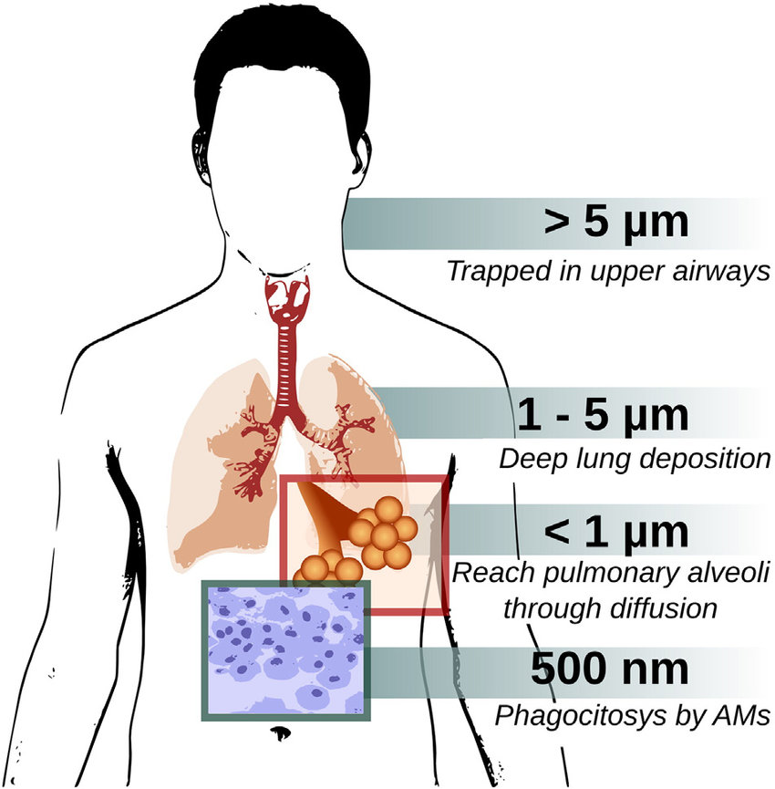
1. WHAT IS TRUTH ABOUT INHALING PLASTIC Nanoparticles in Kid’s Burn Pit Parties?

Slide 16
BREAKOUT ROOM Starter Question for STORY CIRCLE
Q: Each Tell 1 Story of Misuse of East Mesa?
Pass Talking Stick
Person with Talking Stick tells one story, and everyone holds a space of Story-Listening, no interruptions, no questions, wait your turn
After All shared one story, then discuss the connections between the stories
Select a spokesperson for your STORY CIRCLE

Slide 17
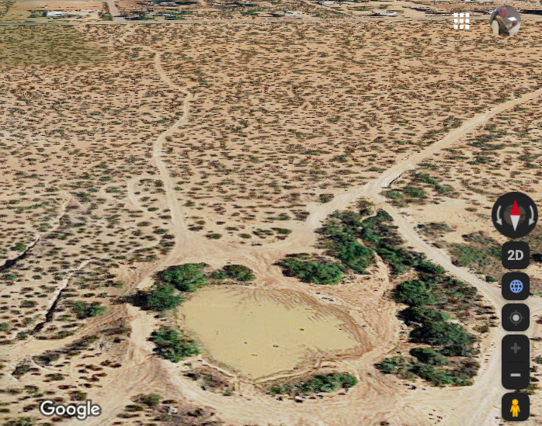
PRINCIPLE 2.
MAKE ROOM for Stories Already There
For Two Centuries East Mesa Wetlands Pond Maintained by Farmers, Ranchers, & Miners-Photo During July 2019

Slide 18
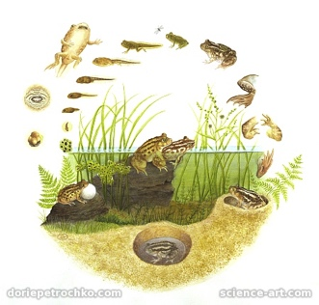
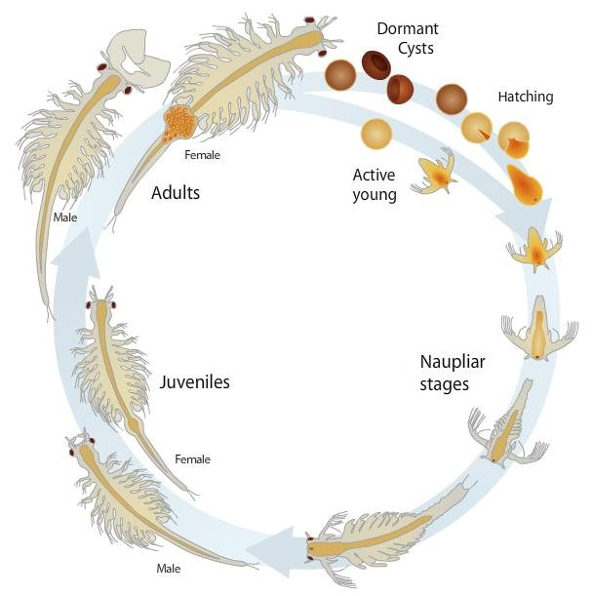
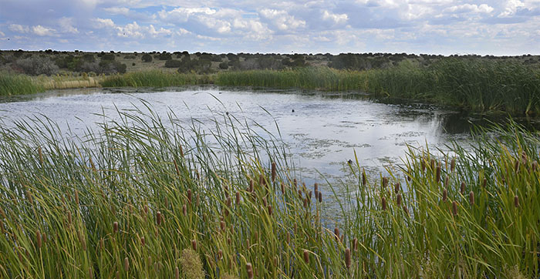
PRINCIPLE 2. MAKE ROOM FOR STORIES ALREADY THERE, FOR CENTURIES?
New Mexico Spadefoot Toad
New Mexico Fairy-Shrimp
Notes:
Cattails border the water’s edge of high desert wetlands pond near Santa Fe. Photo by Dan Williams. http://www.wildlife.state.nm.us/discover-new-mexico-home/aquatic-wildlife/pond-connections/
New Mexico Spadefoot Toad is Official Symbol of Aquatic Life in State of New Mexico

Slide 19
PRINCIPLE 2. MAKE ROOM FOR STORIES ALREADY THERE: Pond’s Primary Produers?
Notes:
Cattails border the water’s edge of high desert wetlands pond near Santa Fe. Photo by Dan Williams. http://www.wildlife.state.nm.us/discover-new-mexico-home/aquatic-wildlife/pond-connections/
New Mexico Spadefoot Toad is Official Symbol of Aquatic Life in State of New Mexico
New Mexico FISH & GAME’s Wildlife cards http://www.wildlife.state.nm.us/download/education/conservation/discover-curriculum/Pond-Life-Card-List.pdf

Slide 20
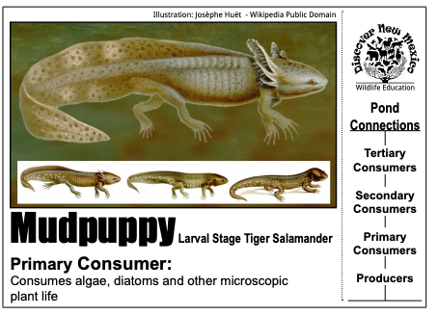
PRINCIPLE 2. MAKE ROOM FOR STORIES ALREADY THERE: Pond’s Primary Consumers?

Slide 21
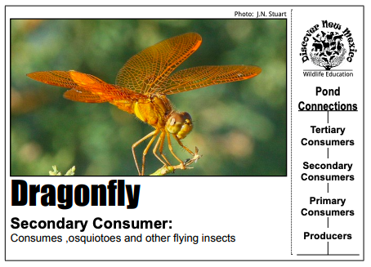
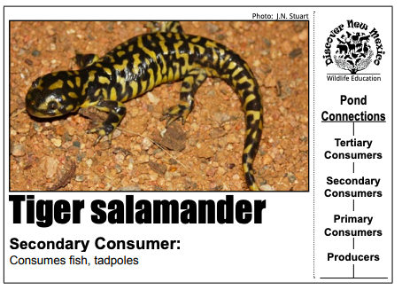
PRINCIPLE 2. MAKE ROOM FOR STORIES ALREADY THERE: Pond’s Secondary Consumers?

Slide 22
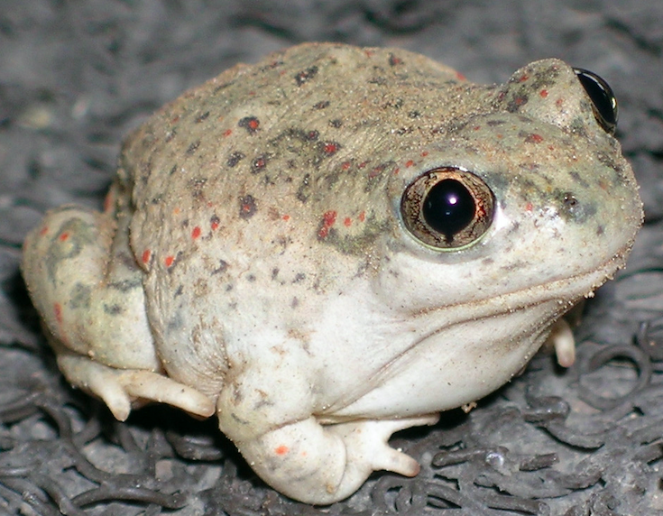
PRINCIPLE 2. MAKE ROOM FOR STORIES ALREADY THERE: Pond’s Tertiary Consumers?

Slide 23
BREAKOUT ROOM Starter Question for STORY CIRCLE
Q: What are Untold Stories of What is Already There?
Pass Talking Stick
Person with Talking Stick tells one story, and everyone holds a space of Story-Listening, no interruptions, no questions, wait your turn
After All shared one story, then discuss the connections between the stories
Select a spokesperson for your STORY CIRCLE

Slide 24
NEXT WEEK SESSION TWO: PRINCIPLE 3: What is NEW plot, NEW Strategy?

Slide 25
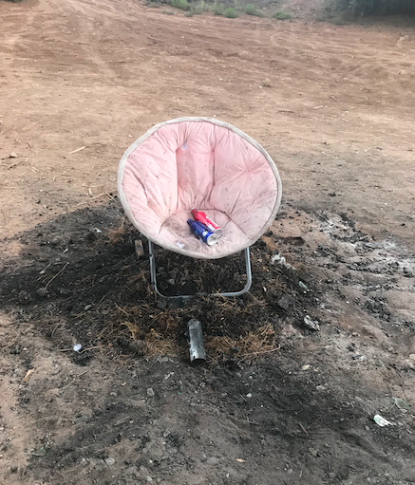
SESSION TWO: PRINCIPLE 3: PLOT – New Story What OLD Story are Kids at Pond Telling Themselves in this Photo?

Slide 26
SESSION TWO: PRINCIPLE 4: What is Timing of Changes we can Choose?
We need timing of opportune moments to shift the storytelling, and get ahead of the story, and tell a NEW story of opportunities for East Mesa uses by its citizens, and by the Natural World

Slide 27
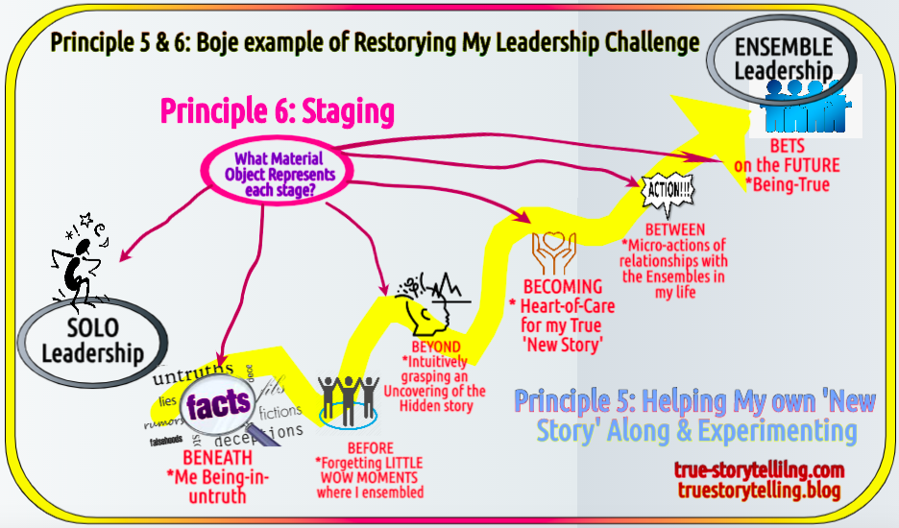
Looking at Session 3

Slide 28
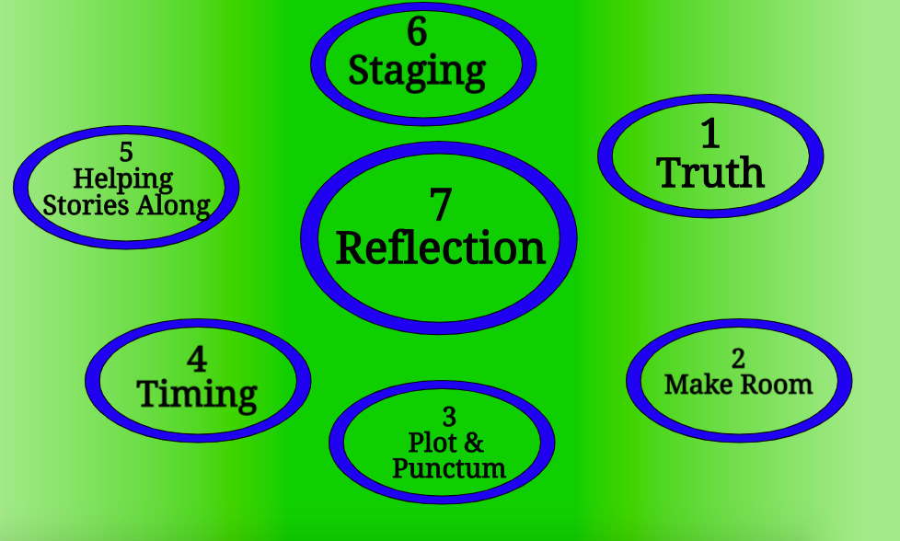

Slide 29
Thank you & Comments
Next week meeting
Join us , June 19th 10AM Friday
Zoom Meeting ID: 838 949 9873
Story Circle Method of Participative Action Research, using True Storytelling Principles? https://true-storytelling.com or https://truestorytelling.blog for more on this if you want to explore.
davidboje@gmail.com if you have someone else to invite
https://davidboje.com for 15 + films about East Mesa illegal uses and damages to quality of life, to health of our youth, and well-being

